Slide 1
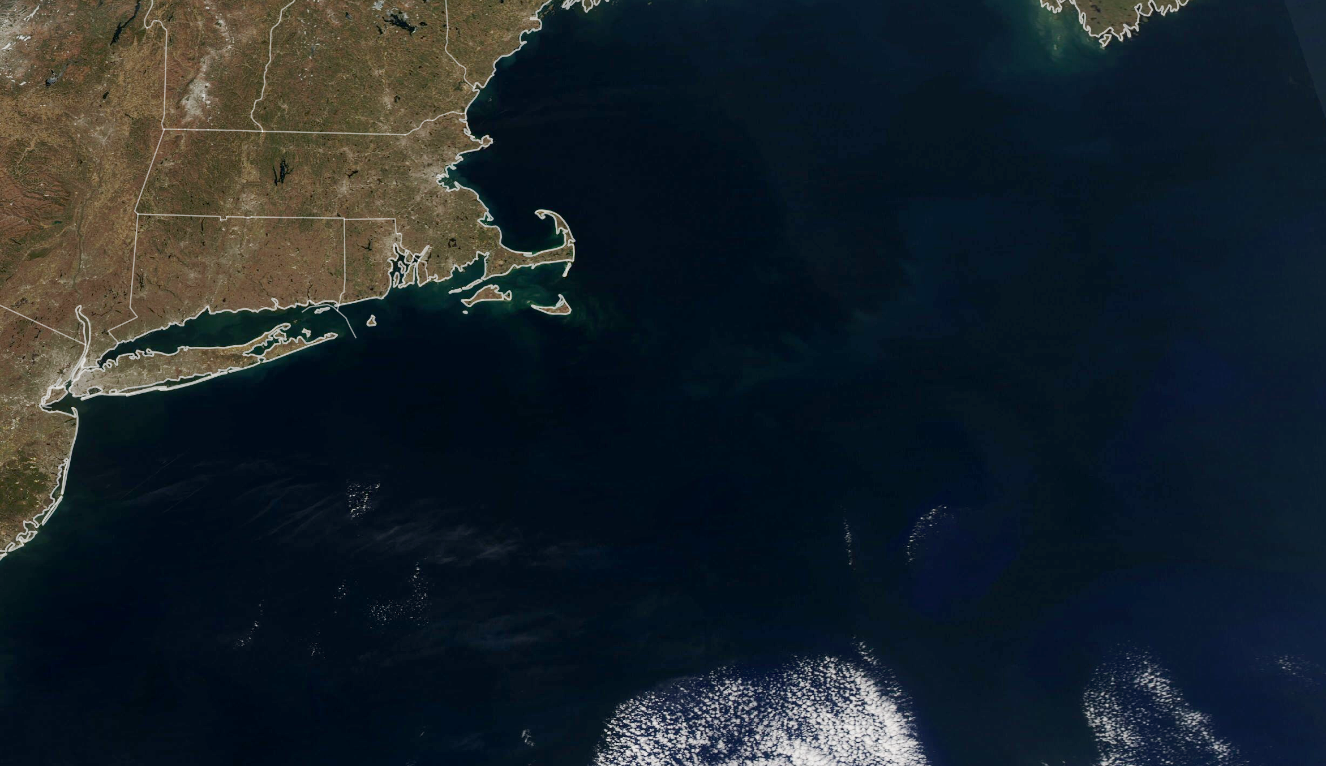
CEOS Plenary
Biarritz, France
Julie A. Robinson, Ph.D.
Deputy Director, Earth Science Division
Science Mission Directorate, NASA
Dec. 1, 2022
Notes:
CEOS Plenary, Agency Reports

Slide 2
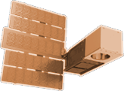
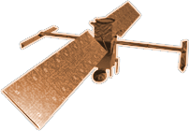
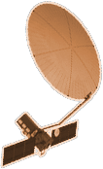
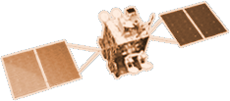
CYGNSS (8)
NISTAR, EPIC
2015
GRACE-FO (2)
SMAP
ICESAT-2
OCO-2
2020
LIS
SAGE III
GPM
SENTINEL-6
MICHAEL FREILICH
TSIS-1
EARTH FLEET
LANDSAT 8
ECOSTRESS
LANDSAT-9
SUOMI NPP
INVEST/CUBESATS
GEDI
CIRIS 2023
NACHOS 2022
CTIM 2022
NACHOS-2 2022
SNOOPI* 2022
MURI-FO* 2022
HYTI* 2023
OCO-3
1995
2010
TROPICS (4)
EMIT
LANDSAT 7
CALIPSO
SWOT
TERRA
CLARREO-PF
AQUA
CLOUDSAT
AURA
JPSS INSTRUMENTS
TEMPO
2000
OMPS-LIMB 2022
LIBERA 2027
OMPS-LIMB 2027
OMPS-LIMB 2032
PREFIRE (2)
2005
NISAR
MAIA*
ISS INSTRUMENTS
KEY
PACE
INTERNATIONAL PARTNERS
U.S. PARTNER
ISS INSTRUMENT
JPSS INSTRUMENT
CUBESAT
LAUNCH DATE TBD
TSIS-2*
(PRE) FORMULATION
IMPLEMENTATION
OPERATING
EXTENDED
GEOCARB*
SENTINEL-6B
GLIMR*
INCUS*
LANDSAT NEXT*
ESO-1, 2, 3, 4*
MISSIONS
10.11.22
2025

Slide 3
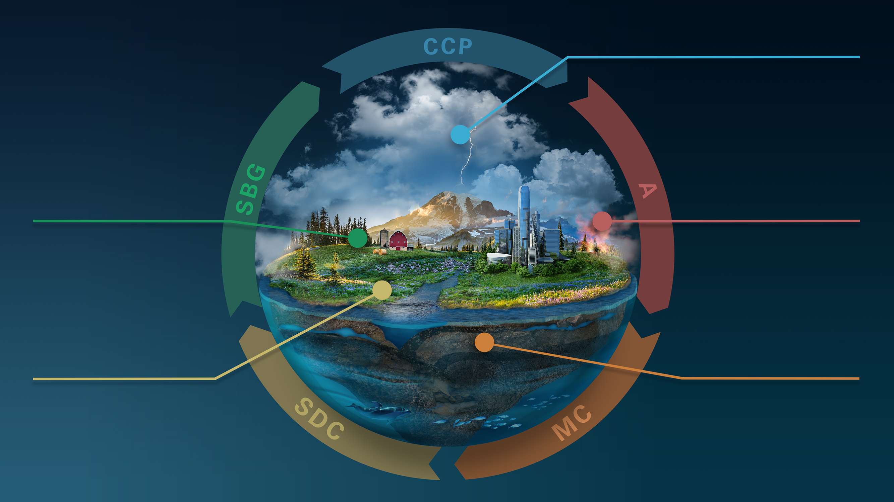
CLOUDS, CONVECTION
AND PRECIPITATION
Water and Energy in the Atmosphere
INTERCONNECTED
CORE MISSIONS
SURFACE BIOLOGY
AND GEOLOGY
AEROSOLS
Particles in the
Atmosphere
Earth Surface & Ecosystems
SURFACE DEFORMATION
AND CHANGE
MASS CHANGE
Large-scale Mass
Redistribution
Earth Surface Dynamics
Notes:
The ESO is the heart of our response to the Decadal Survey.

Slide 4
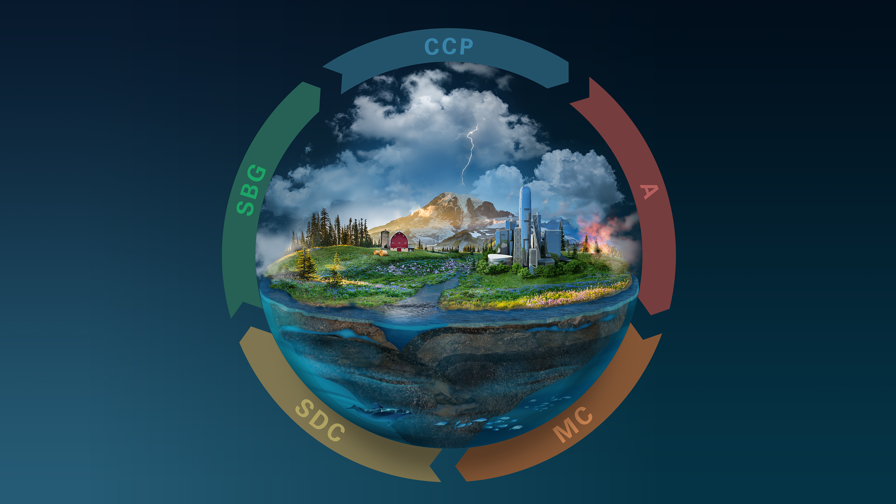
Greenhouse Gases
INNOVATION & COMPETITION
EARTH EXPLORER MISSIONS
Ozone and Trace Gases
Snow Depth and Water Content
Atmospheric Winds
3D Ecosystem
Structure
Ice Elevation
Ocean Surface
Winds and Currents
Notes:
The Decadal recommended Earth System Explorers a new competed mission element in the Earth portfolio.

Slide 5
NASA Earth Action Strategy
Driving impact from $1.5 B in NASA observations and research Delivering impact to meet the needs of Federal agencies, state, local, and tribal governments
New Earth Information Center Physical and Virtual Engagement
Earth Science to Earth Action
Earth Action Solutions
Scaling NASA science and tools for climate response through National and International partnerships
Earth System Science & Tools for Impact
Research, Analysis, Modeling, Applications Incubation
Earth System Observations
Observation of Earth from Space, Air and Ground
Major Applications Themes and Needs (under evaluation)
• GHG Monitoring (new) • Sea level & coastal risk (mature) • Disasters (mature)
• Wildfire risk (developing) • Energy efficiency & infrastructure (new) • Water Resources (developing)
• Health & Air Quality (developing) • Agriculture & crops (developing) • Biodiversity/Ecosystems(developing)
Notes:
Our Earth Action Strategy encompasses a number of Decadal recommendations, and is designed to drive impact of the NASA investment. Talk through layers of pyramid.
Through this Earth Action Strategy, we will be broadening our partnerships across a range of governmental and non-governmental partners, as recommended by the Decadal Survey.
Non-governmental examples: Existing Space Act agreements to leverage EOs for societal benefits with Mercy Corps, Conservation International, Google, Esri, Microsoft. In talks with additional philanthropies for additional collaboration.

Slide 6
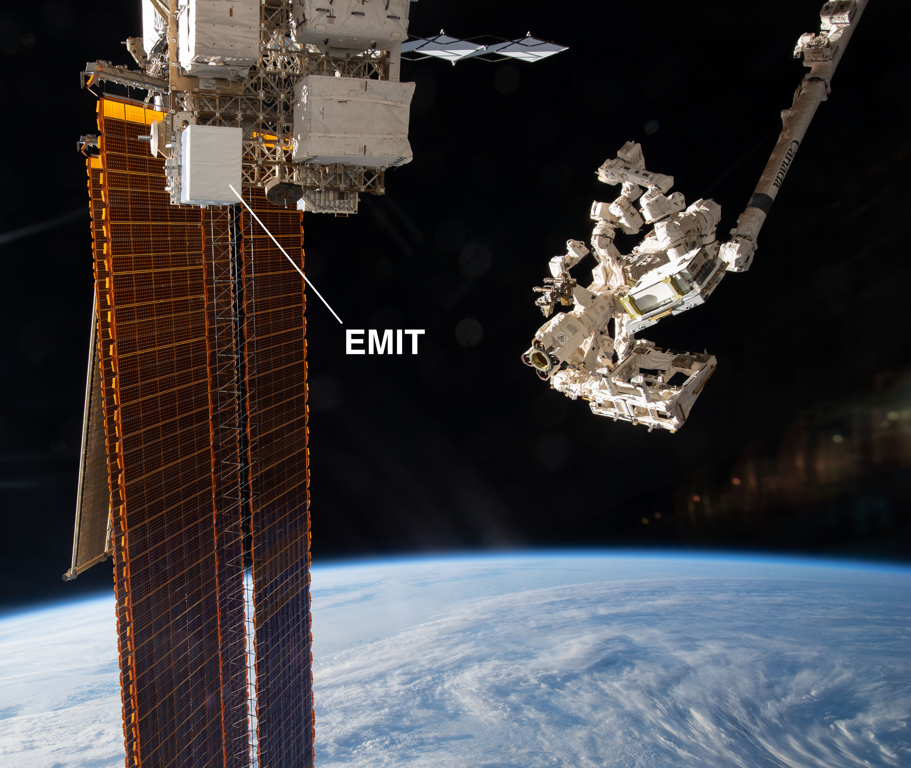

Slide 8
Transform to Open Science (TOPS)
TOPS is a 5-year NASA SMD initiative to foster adoption of Open Science practices across the scientific community.
Strategic Objectives:
Increase understanding & adoption of open science
Accelerate major scientific discoveries
Broaden participation by historically underrepresented communities
Notes:
We are bringing the community with us in transformation.
TOPS activities underway:
NASA has allocated $3 million/year to fund projects related to Open Science Training via the “TOPST” ROSES 22 element.
Develop ScienceCore
OpenCore summer schools
OpenCore virtual cohorts
OpenCore is a community developed introduction to open science
The SMD Chief Science Data Office (part of ESD) is participating in the Office of Science and Technology Policy (OSTP) Subworking group on the Year of Open Science
Maintaining GitHub to share resources and ensure an open and transparent working environment

Slide 9
Notes:
https://images.nasa.gov/details-iss040e081123

