Slide 1
GISTDA
Agency Report
Tanita Suepa, GISTDA
Agenda Item #2.11
2022 CEOS Plenary
Biarritz, France
Nov. 29 – Dec. 1

Slide 2
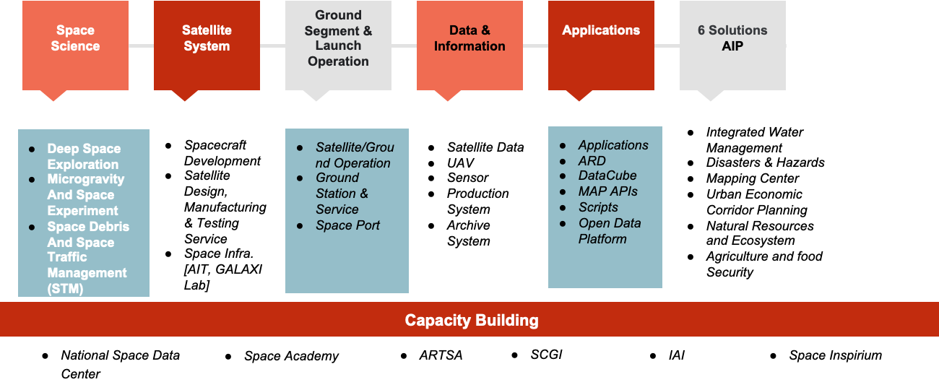
GISTDA New Space Values Chain

Slide 3
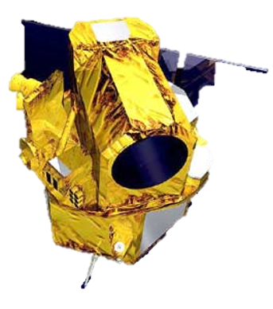
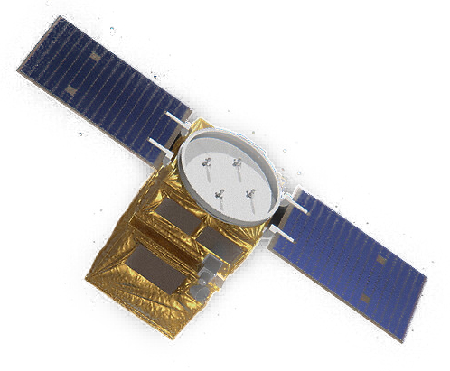
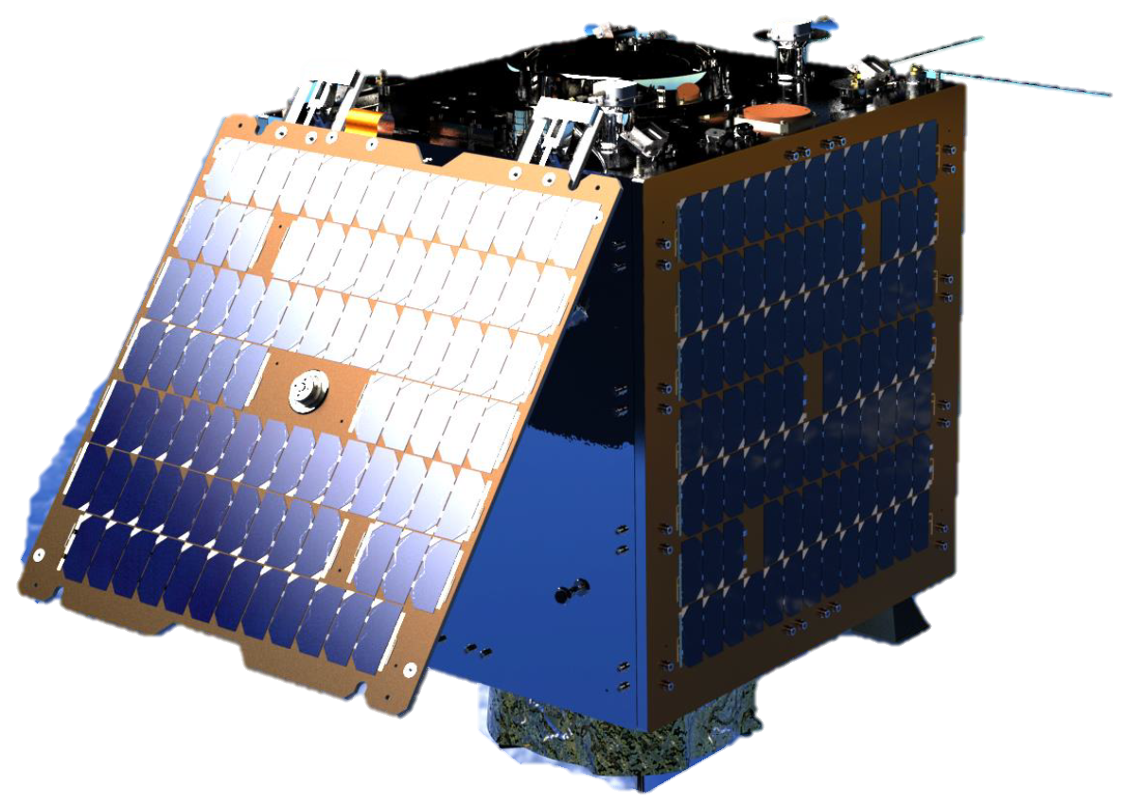
Built by SSTL and GISTDA engineers
THEOS (THAICHOTE)
THEOS-2
THEOS-2A
Launch date : Oct 1st 2008
Payload : Imager Full SiC (Silicon Carbide) telescope 2m (PAN), Refractive telescope 15m (MS)
Mass : ~750 kg
Dimensions : 2.1 m x 2.1 m x 2.4 m
Orbit : ~672 km Sun Synchronous - Low Earth Orbit
Launch date :Q1 2023
Payload : Very high-res imager (KORSCH Type with 3 SiC mirrors) 0.5m (PAN), 2m (MS)
Mass : ~425 kg
Dimensions : 1.4m x 1.2m x 1.8m
Orbit : ~621 km Sun Synchronous - Low Earth Orbit
Launch date :Q1 2023
Main Payload : High-res imager with CMOS; 1.18m (RGB), Video Capture
Mass : ~100 kg
Dimensions : 0.62m x 0.72m x 0.95m
Orbit : ~500 km Sun Synchronous - Low Earth Orbit
GISTDA’s SATELLITES
3

Slide 4
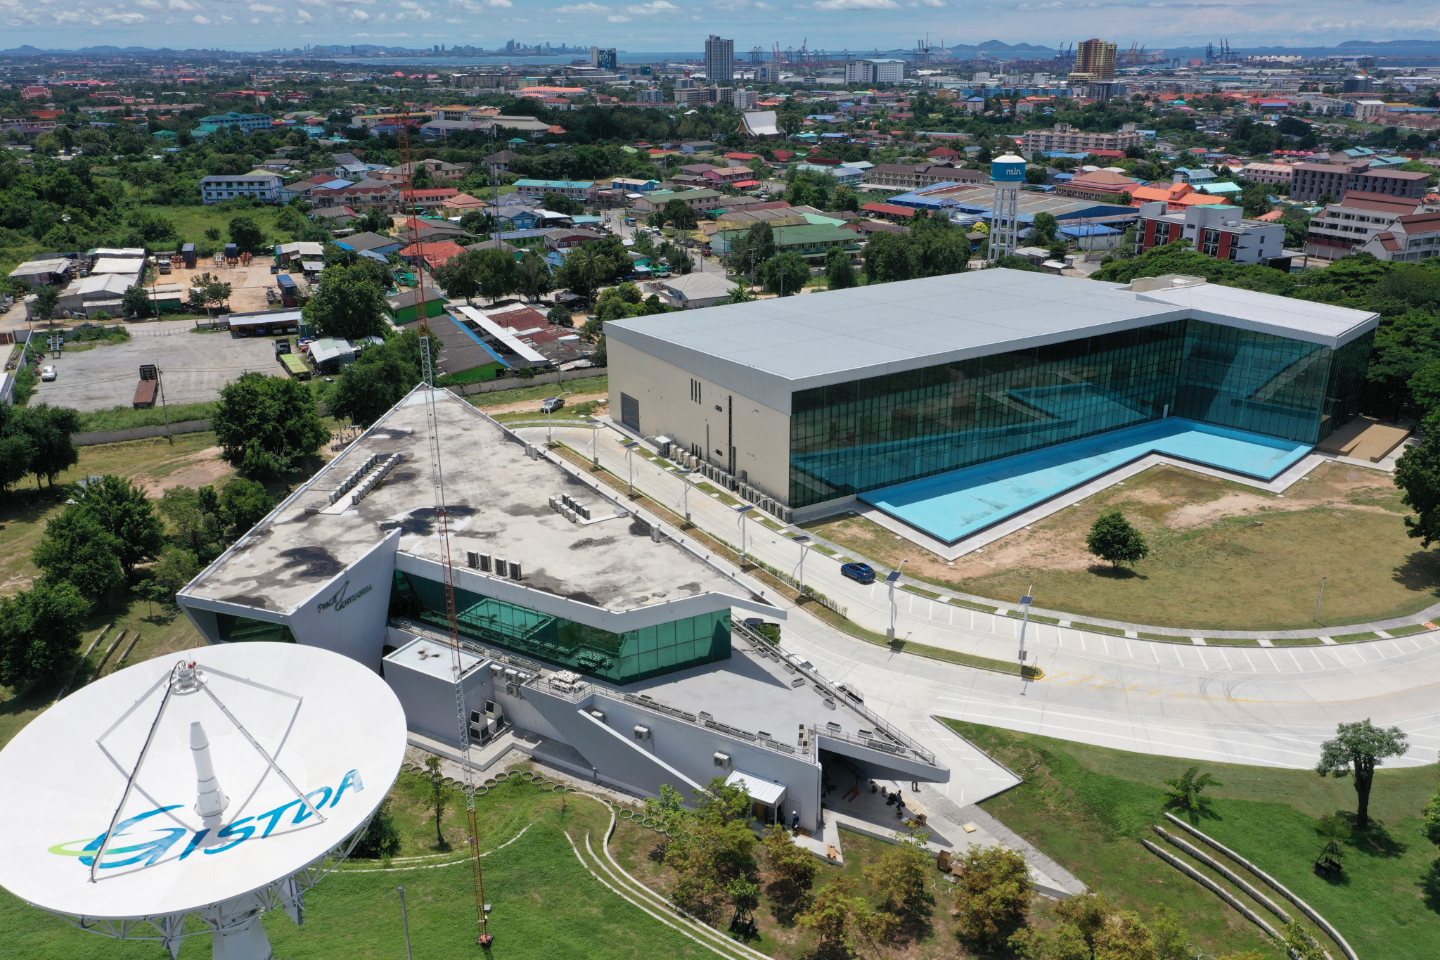
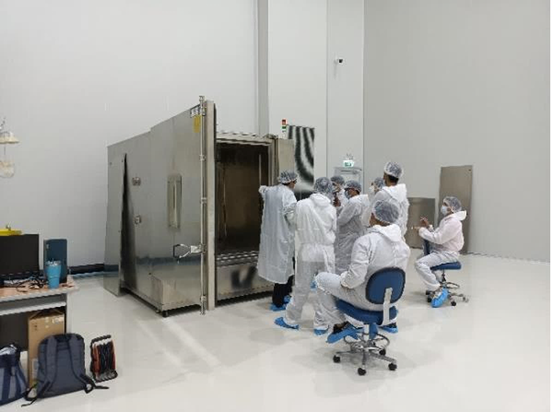
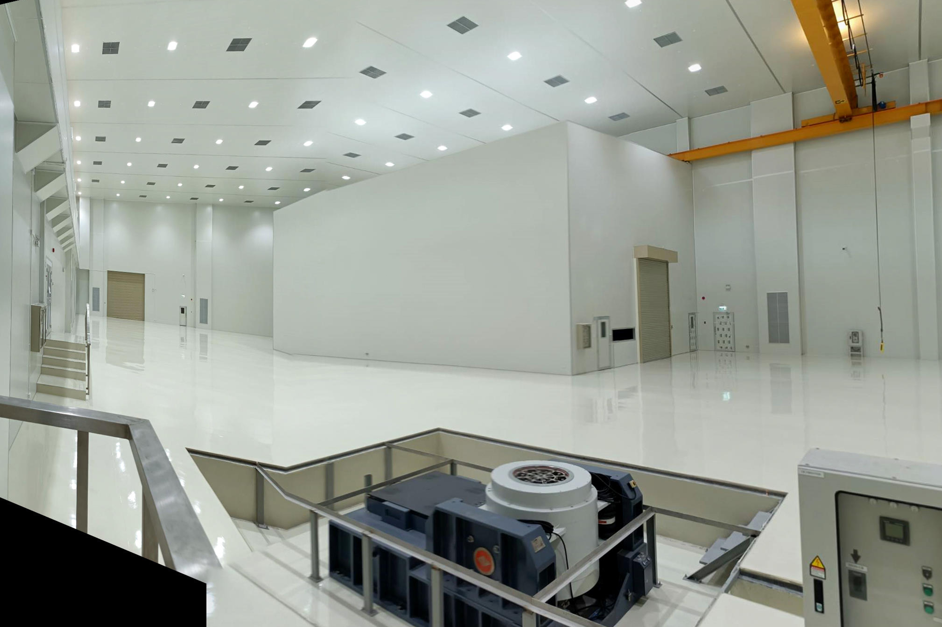
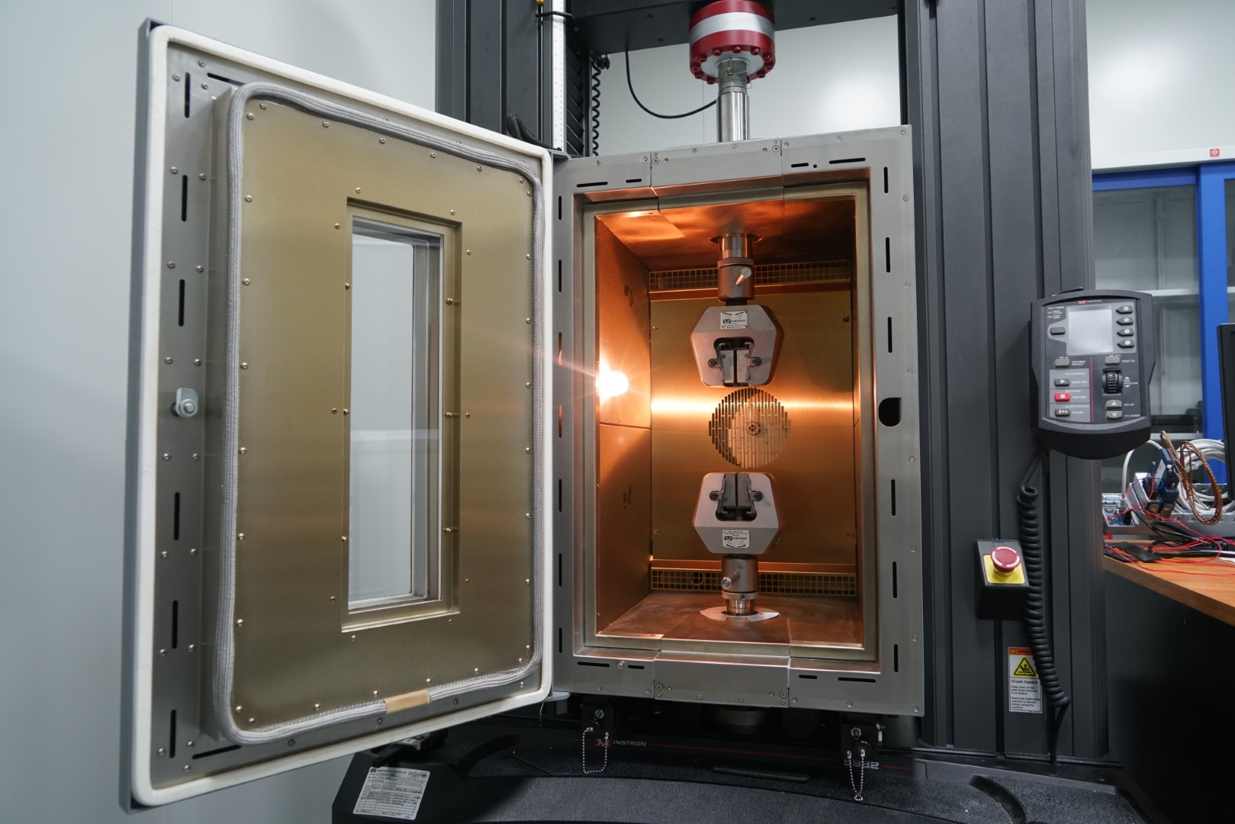
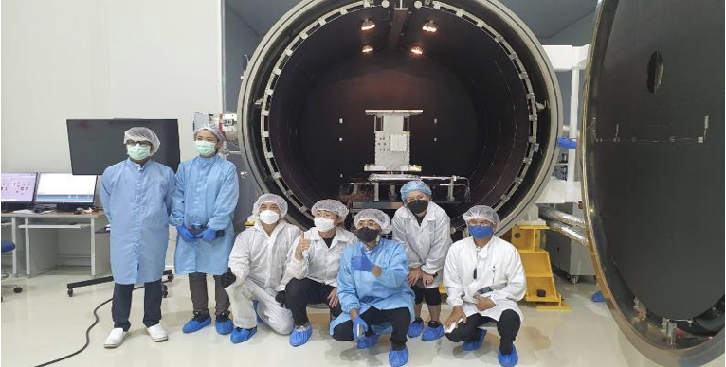
National Assembly Integration and Test: AIT

Slide 5
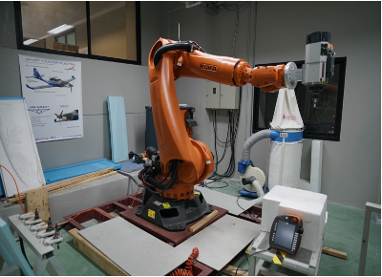
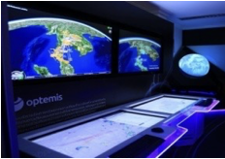
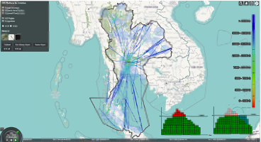
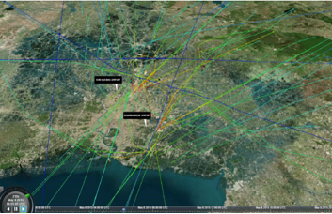
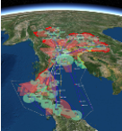
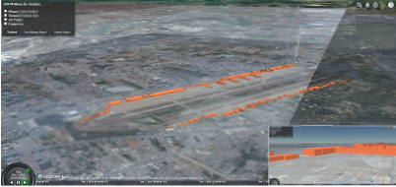
GISTDA Space Lab

Slide 6
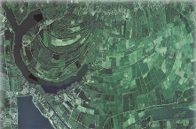
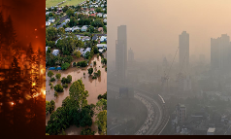
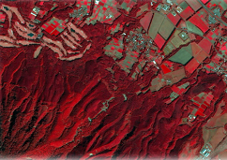
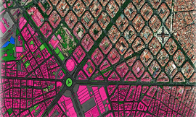
Solutions
Agriculture
Agri value evaluation
Eco chain monitoring
Fast disease detection
Precise crop management
Disaster
Accurately forecast and monitor flood situations
Quickly identify the location of wildfires
Check the air dust value immediately
Water Management
Water management to keep up with demand
Urban water management
Agricultural water management
Make a plan for the water situation
Mapping
Comprehensive survey and mapping services
High resolution map
Unmanned aerial vehicle mapping service
Natural Resource
Track changes in green area
Analysis of land use
Climate Change Impact Assessments
Biodiversity Analysis
Urban
Track changes in green area
Analysis of land use
Climate Change Impact Assessments
Biodiversity Analysis

Slide 7
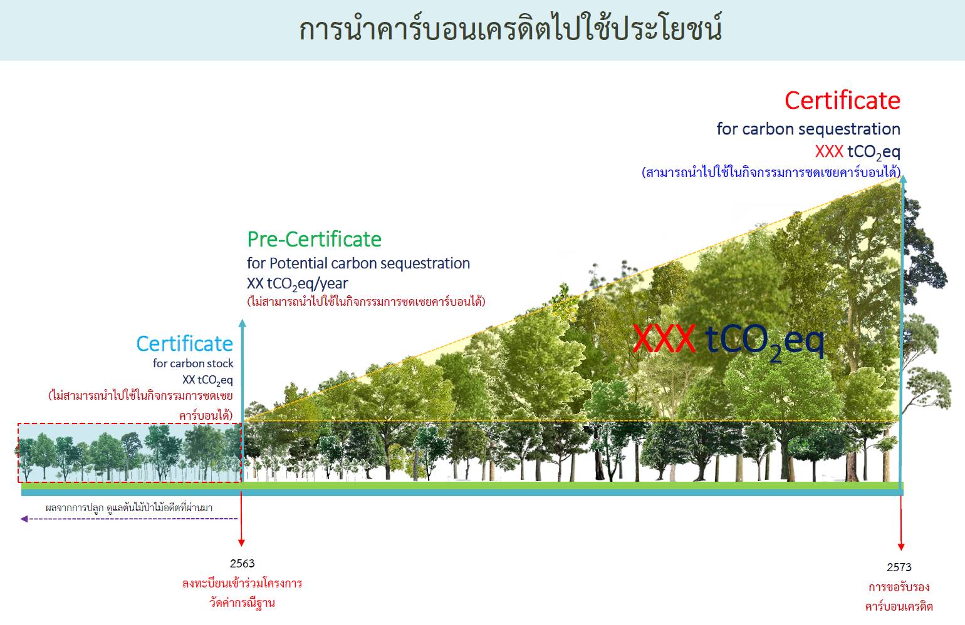
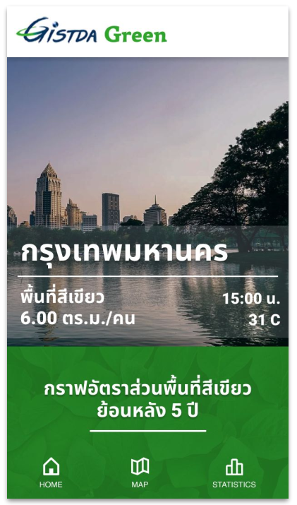
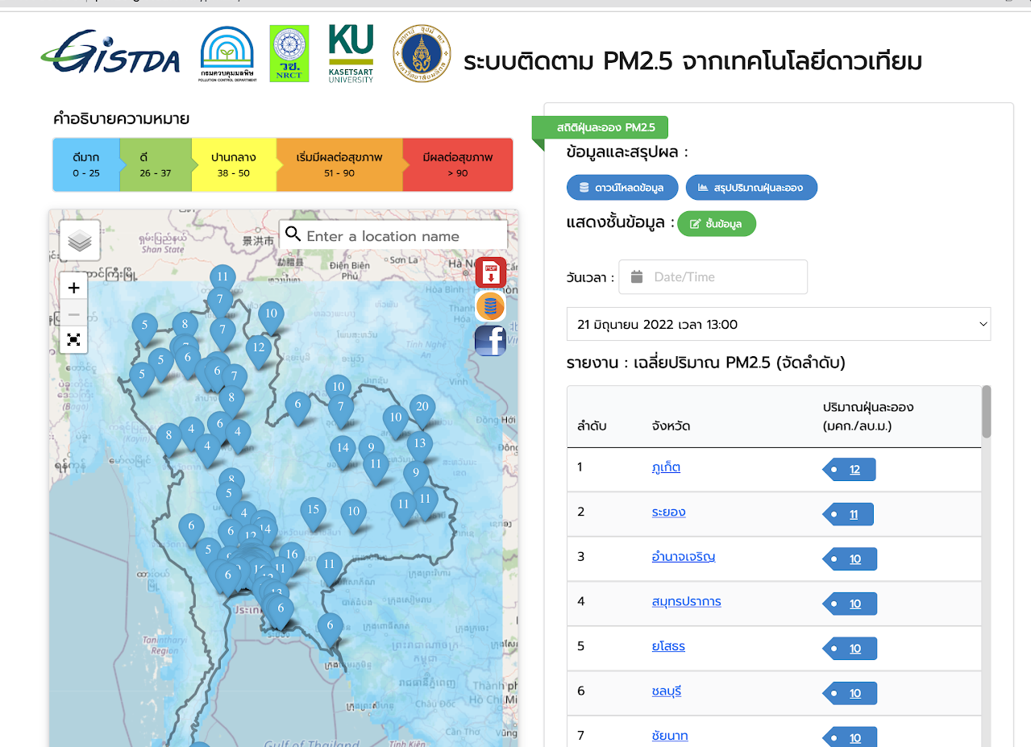
Carbon and Air Pollution Monitoring from Space

Slide 8
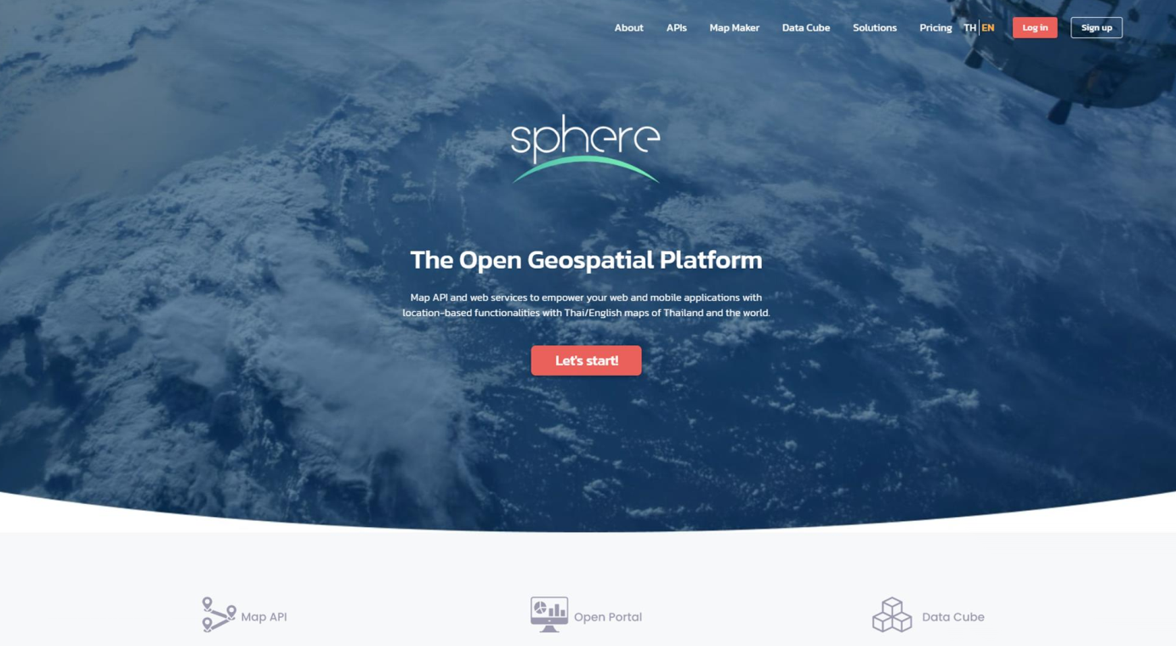
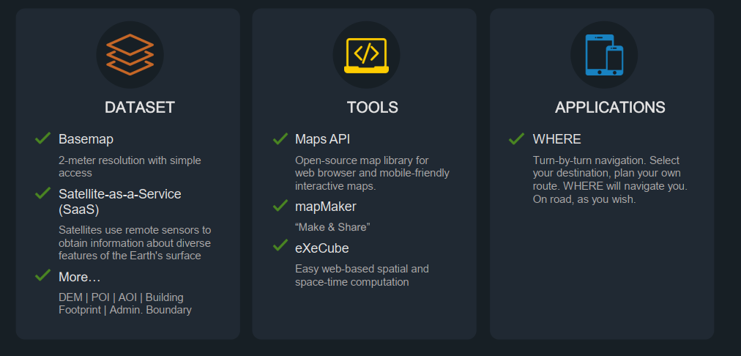
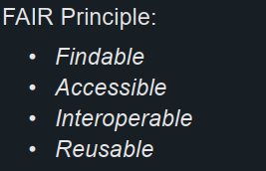
GISTDA Sphere
SPHERE provides fast and reliable access to these products, unifying the interface and facilitating reducing the time to start analyzing the data.

Slide 9
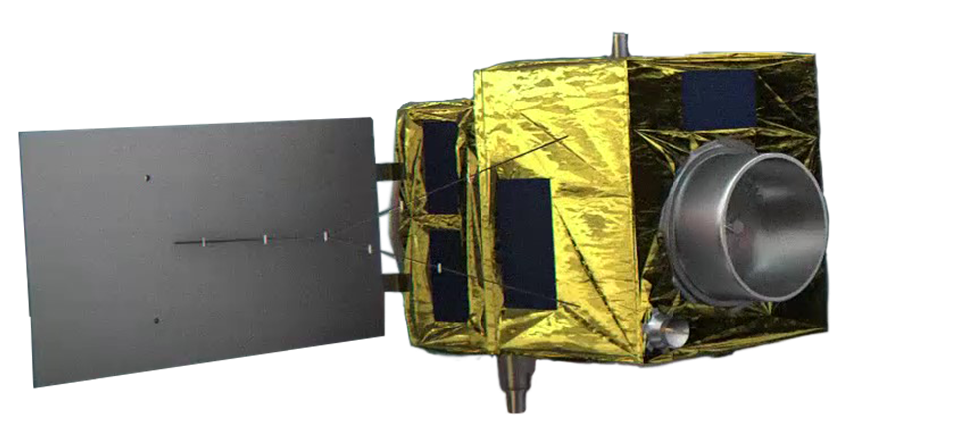
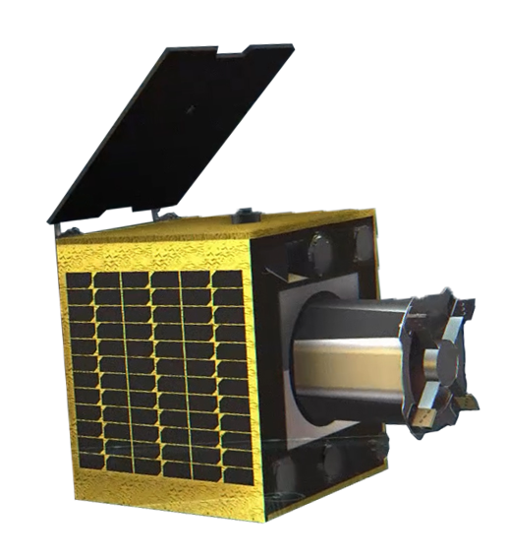
GISTDA PRODUCTS & SERVICES for SHAPING our FUTURE
Space Infra. & Service
Data & Info.
Application/Solution
Capacity Building
1. Imagery from Satellites
2. Sensor
3. Geo-spatial Information
Web App.
Mobile App.
6 Solution+1
Space Academy
Training
ARTSA
SCGI
Galaxi Lab
AIT
Operation Software
Ground Station Service

Slide 10
Thailand-GISTDA New Space Perspective
Traditional Space
New Space
New Business Models with Commercialization Potential
Commercial
Space
To Explore
Business Models
UAV- HAP
Industry
Frontier Research
Traditional EO
Satellites
Components
& Subsystems/
CubeSat
Space debris & asteroid impact
Space Tourism
Space
Habitats
Positioning,
Navigation
& Timing
Meteo Sat
Small Sat
Systems
Space Weather
Satellite
Servicing
Humans
To Mars
Space (Land/Sea/Air) Traffic Management
Small Sat EO
Constellations
Space Situational Awareness
ISS Servicing
Humans
To Moon
THEOS-1
Services: IOT,
Media and
Internet for All
Ground Station Services
Manufacturing in Microgravity
& Space
New Launch
Systems/
SpacePort
Energy from
Space
Geoinformation
Data and Services
THEOS-2
Space Resource
Mining
Cybersecurity in Orbit
1. Digital in Sky
2. Devices in Space
Established Implemented Started Starting Emerging
Established
3. Frontier Research: Earth Space System

Slide 11
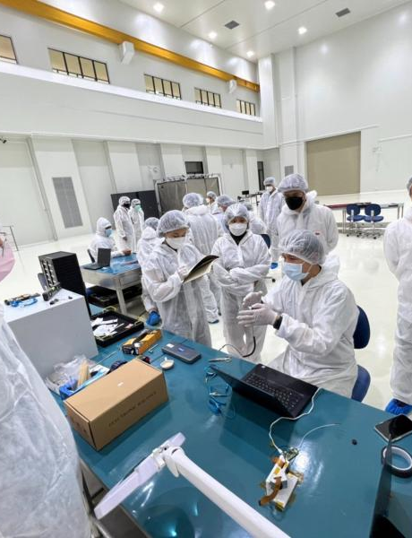
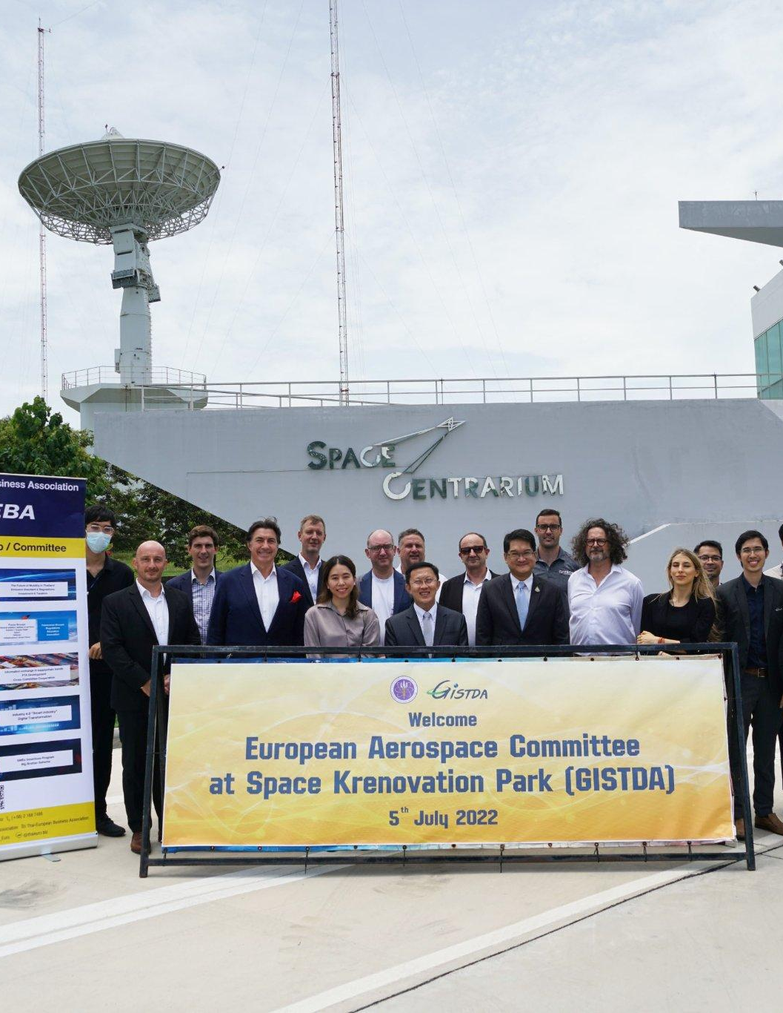
Industry sector khow-how transfer

Slide 12
Application & Solution

Slide 13
Application & Solution

Slide 14
Space Sciences
Earth Space System Frontier Research
Protein Crystallization experiment
Quality of Thai Food in Space
Cassava growth in Space
2D Food mixed in space
Bacterial growth in space for cancer curation
Water meal growth in Space for life support system on planet

Slide 15
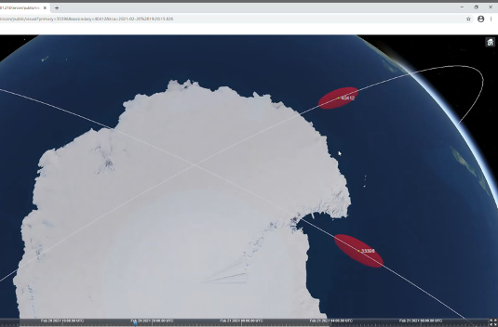
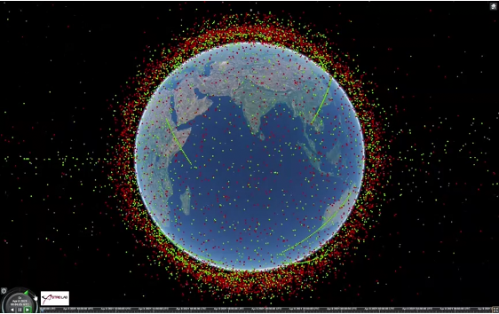
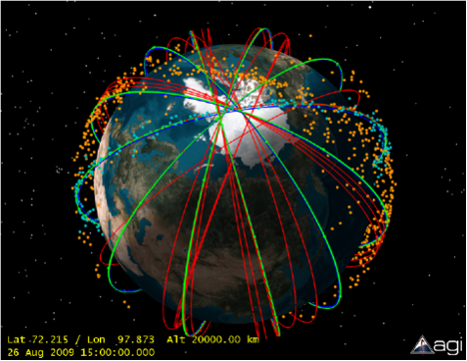
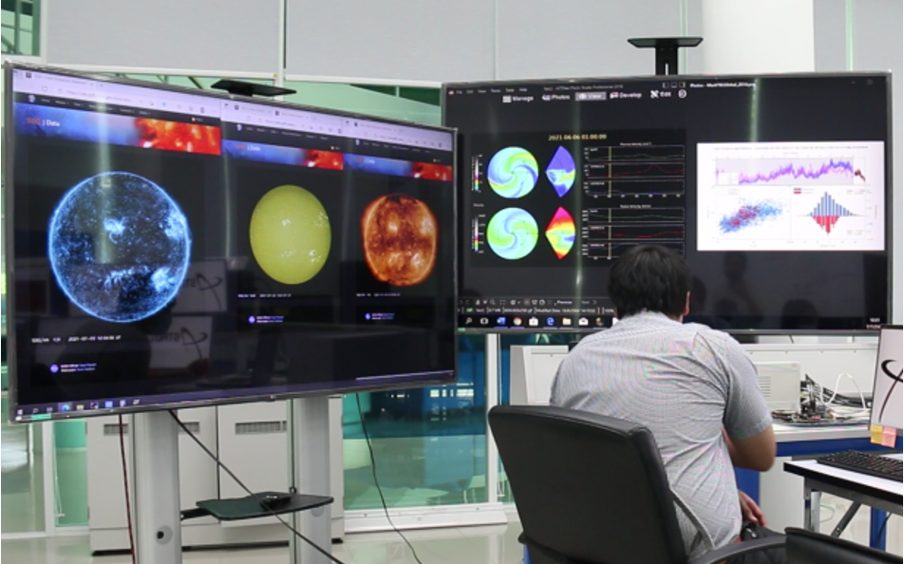
Space Sciences
Space Flight Dynamic
Space traffic Management System
Space debris and asteroid mitigation
Space Weather Forecast

Slide 16
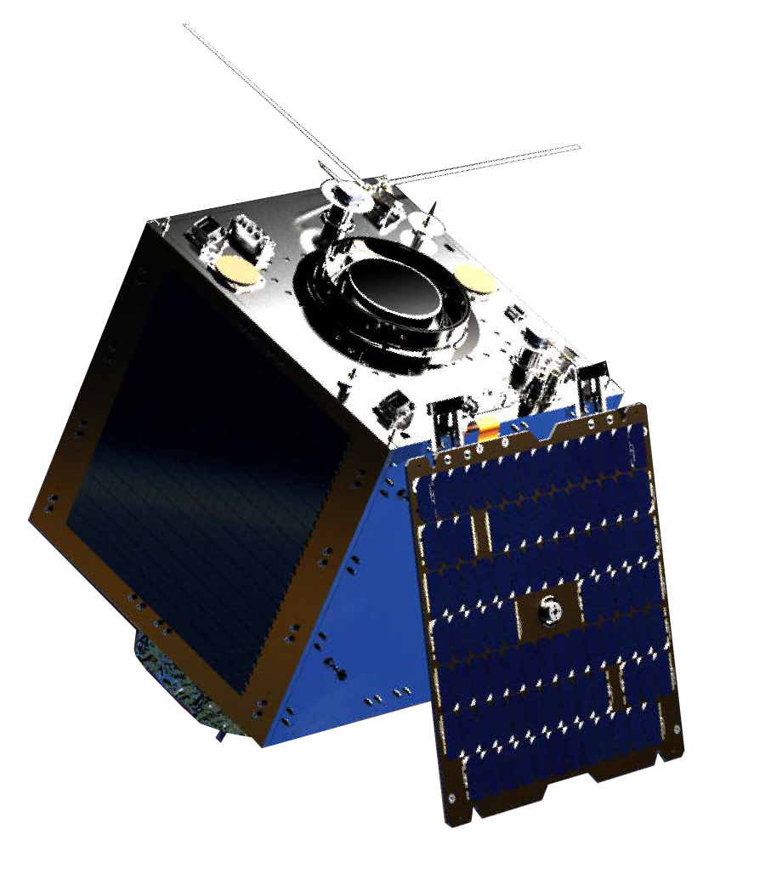
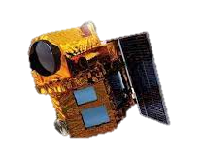
GISTDA Constellation
Built by SSTL and GISTDA engineers
THAICHOTE THEOS-2 THEOS-2A
2m Panchromatic
15m Multispectral
0.5m Panchromatic
2m Multispectral
1m RGB
HD VIDEO

