Slide 1
CEOS Agency Report: NOAA
Dr. Stephen Volz
NOAA Assistant Administrator for Satellite and Information Services
December 1, 2022

Slide 2
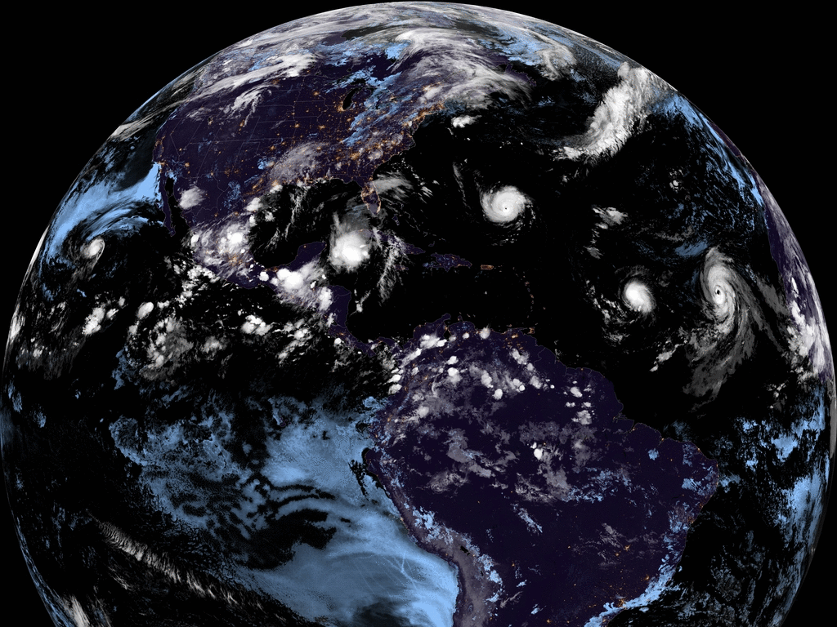
Climate-Ready Nation
2030 Vision Statement
A thriving Nation whose prosperity, health, security, and continued growth benefit from and depend upon a shared understanding of, and collective action to reduce, the impacts of climate change

Slide 3
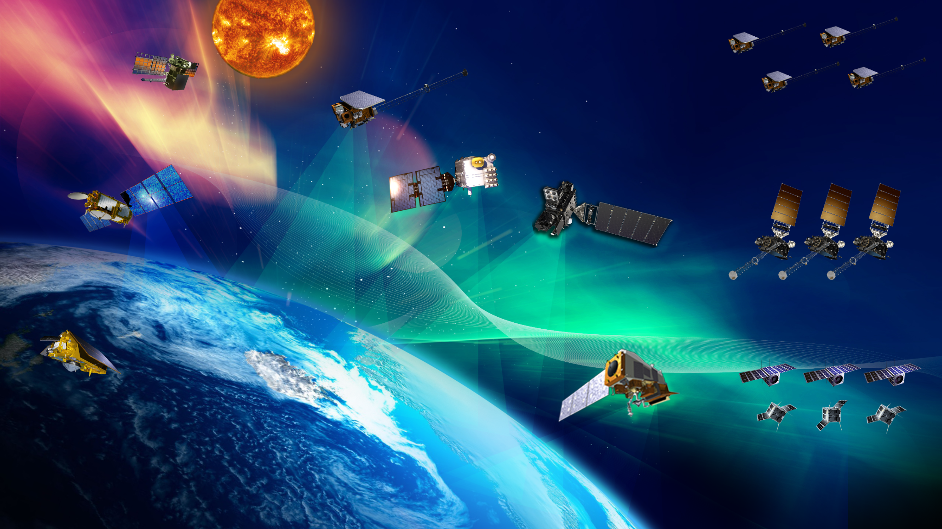
NOAA Has Future
Satellite Missions
SWFO
SWFO-L1 - FY 2025
DSCOVR
Operational - July 27, 2016
COSMIC-2
COSMIC-S - Operational - Feb, 25, 2020
SW NEXT
JASON-3
Operational - July 1, 2016
GOES-R SERIES
GOES-16 - Operational - Dec 18, 2017
GOES-17 - Operational - Feb 12, 2019
GOES-18 - Launched - Mar 1, 2022
GOES-U - FY 2024
GeoXO
SENTINEL-6 Michael Freilich
Sentinel-6 Michael Freilich - Operational - Nov 22, 2021
JPSS SERIES
NOAA-20 - Operational - May 30, 2018
NOAA-21 - Launched Nov 10, 2022
JPSS-3 - FY 2026
JPSS-4 - FY 2031
LEO Satellites

Slide 4
NESDIS Plans for Future Satellites
GOES-T
2022
GOES-U
2024
Geo-Sounder 1
2035*
Geo-Sounder 2
2040*
GOES-R
GeoXO
Legacy Program Launch Dates
Geo-Imager 1
2032*
Geo-Imager 2
2035*
Geo-Imager 3
2039*
JPSS-2
2022
JPSS-3
2027
JPSS-4
2032
PWS
LWS
LEO Weather Satellites
Next Generation Program Launch Dates (dates are notional)
QuickSounder
2025*
LWS-1**
2030
LWS-2**
2033
LWS-3**
2035
LWS-4**
2037
LWS-5**
2039
SWFO-L1
2025
SWFO +
ESA Vigil
2029*
Space Weather Next
SW Next L1A
2029*
SW Next L1B
2030*
SW Next L1C
2035*
SW Next L1D
2037*
2020
2025
2030
2035
2040
** LWS mission sequencing after QuickSounder are subject to change based on the assessment of periodic mission impact assessments

Slide 5
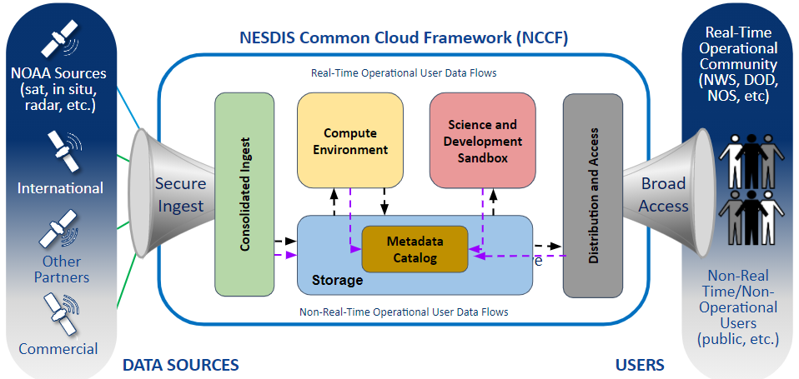
The NESDIS Common Cloud Framework
What is NESDIS Common Cloud Framework (NCCF): A framework of services that can change to meet the organizations mission and science needs. The NCCF is secure, scalable, fault tolerant, data source agnostic solution that is capable of processing near real-time data flows.
Vision of NCCF Implementation: Migrate and consolidate on-premise IT services onto the NCCF to reduce costs, increase IT provisioning speed, and scale seamlessly while ensuring that systems maintain their current high level of security, reliability, and performance.

