Slide 1
2022 CEOS Plenary
Selma Cherchali, CNES
Agenda Item 2.11
2022 CEOS Plenary
Biarritz, France
Nov. 29 – Dec. 1

Slide 2
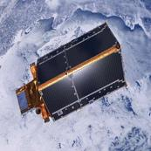
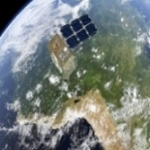
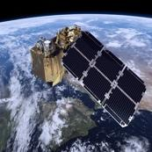
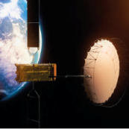
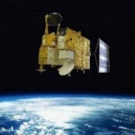
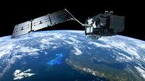
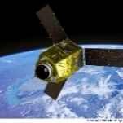
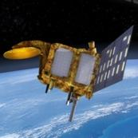
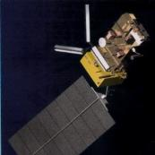
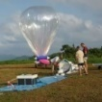
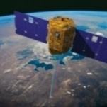
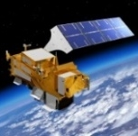
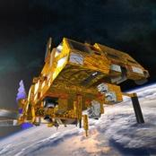
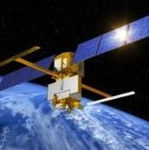
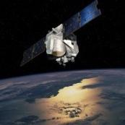
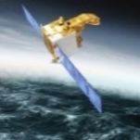
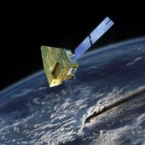
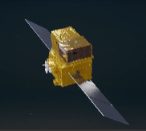
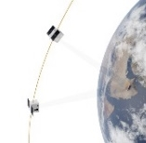
Earth Observation Program
Operational programmes
Programmes under development
Cryosat-2
Sentinel-2B
Sentinel-6 -MF
Swarm
Sentinel-2A
Biomass
Hy-2A
Sentinel-3A
Strateole 2-2
Pleiades
Saral-AltiKa
Hemera 1&2
Hemera 3
IASI-NG1 & 3MI
/Metop SG A1
IASI-NG2 & 3MI/Metop SG A2
Venμs
Iasi 3/MetopC
Iasi2/MetopB
Strateole 2-1
Swot
Calipso (2006) -> 16 years in-orbit
CFOSAT
Merlin
Smos (2009) -> 13 years in orbit
Méghatropiques(2011) -> 10 years in orbit
Microcarb
Trishna
CO3D

Slide 3
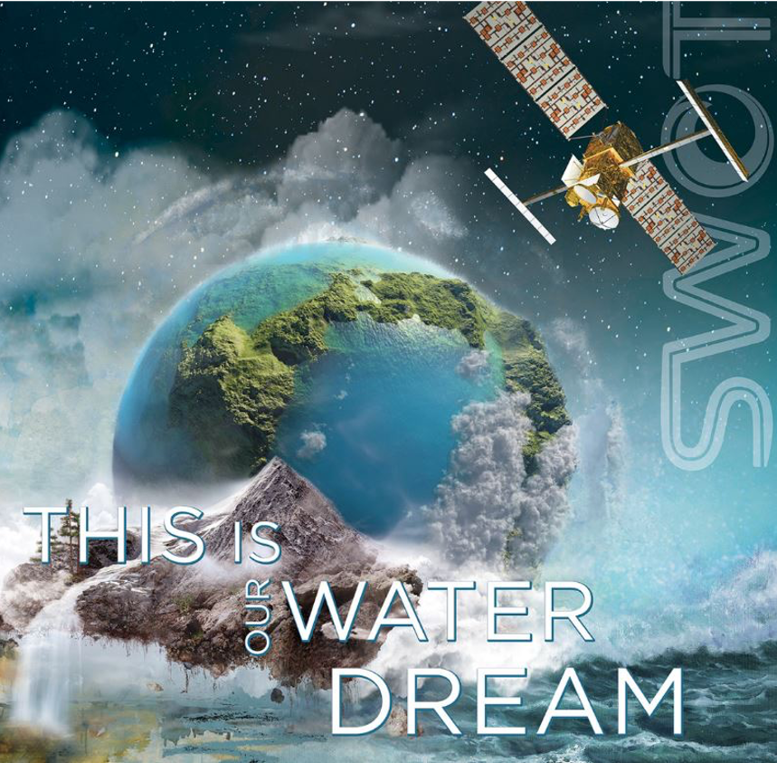
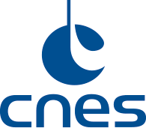
THE NEW GENERATION OF ALTIMETRY MISSION… A BREAKTHROUGH…
Launch: Dec 15, 2022
Ocean,
Fresh water,
Coastal dreams
came true…
‹#›
@ cnes

Slide 4
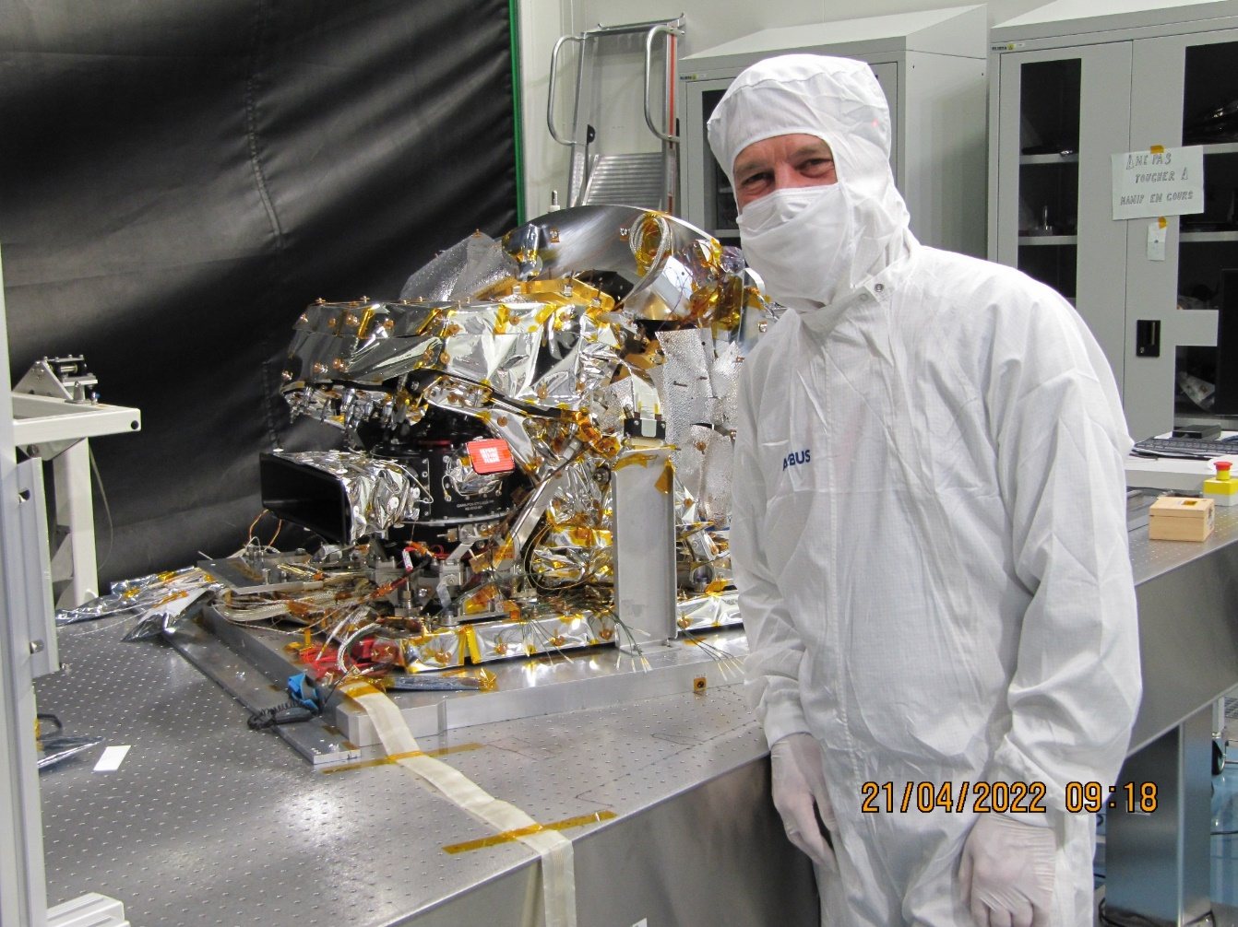
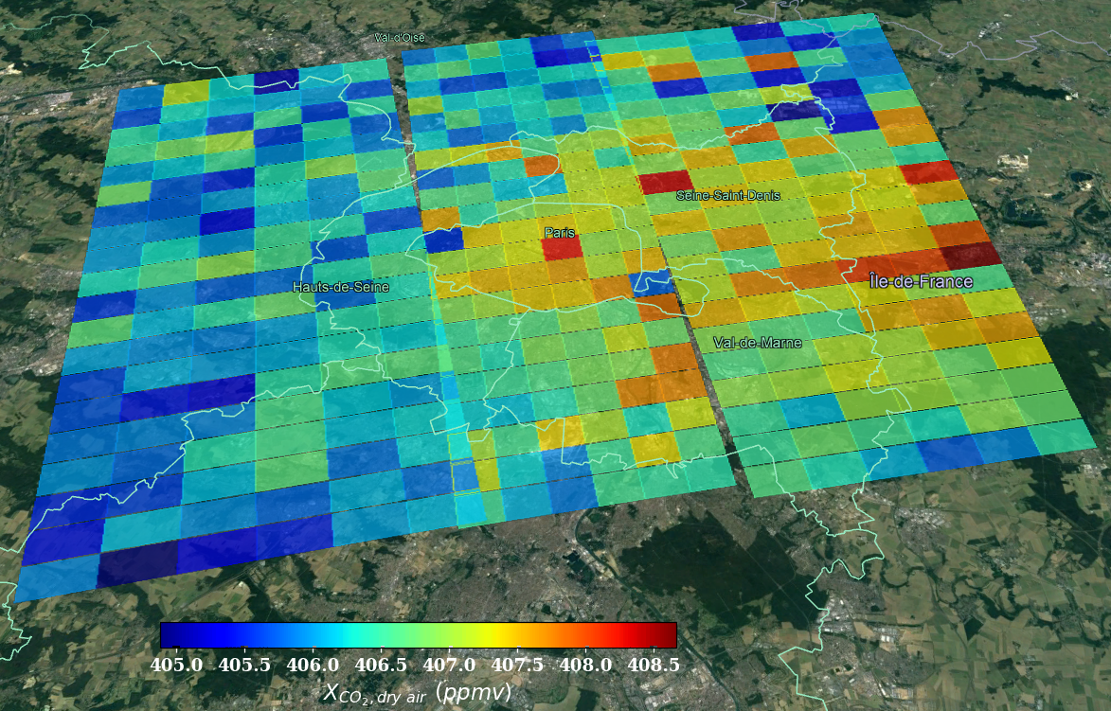
Microcarb, Measuring CO₂ from space
► After OCO2 & 3, GOSAT 1 & 2 and before CO2M, Microcarb will be able to propose a new approach to measure atmospheric CO₂ concentration (better than 1ppm, with bias < 0,1ppm) and to retrieve CO₂ surface fluxes (sources & sinks) and its evolution in the context of global warming.
► Microcarb will demonstrate its capacity over strong emission sites (cities, power plants).
Satellite Myriade (200kg);
Compact Grating spectrometer with 4 bands (O2 at 0,76μm, 2 CO2 at 1,6 & 2 μm, 1,27μm);
2x 6 months for Cal/Val period + 4 years operations.
Possible launch end 2023 (VEGA) or early 2024 (still on discussion with AE)
Data distribution via french data management node AERIS & EUMETSAT
iRDP Instrument 27/04/17
iRCD Instrument 09/10/18
Instrument
Delivery
30/09/22
Earliest launch
01/10/23
2016
2017
2018
2019
2020
2021
2022
2023
2024
Phase B 08/12/15 - 03/04/17
Phase C 04/04/17 –30/04/19
Phase D 01/05/19 – 30/09/23
Phase E1
01/10/23 - 12/09/24
RDP Satellite 03/04/17
RDP
Segment sol 15/02/18
RCD Satellite 25/03/19
PK PQT 21/04/20
Today
Satellite Delivery
30/06/23
In flight acceptance
27/11/23
then 1 year CALVAL

Slide 5
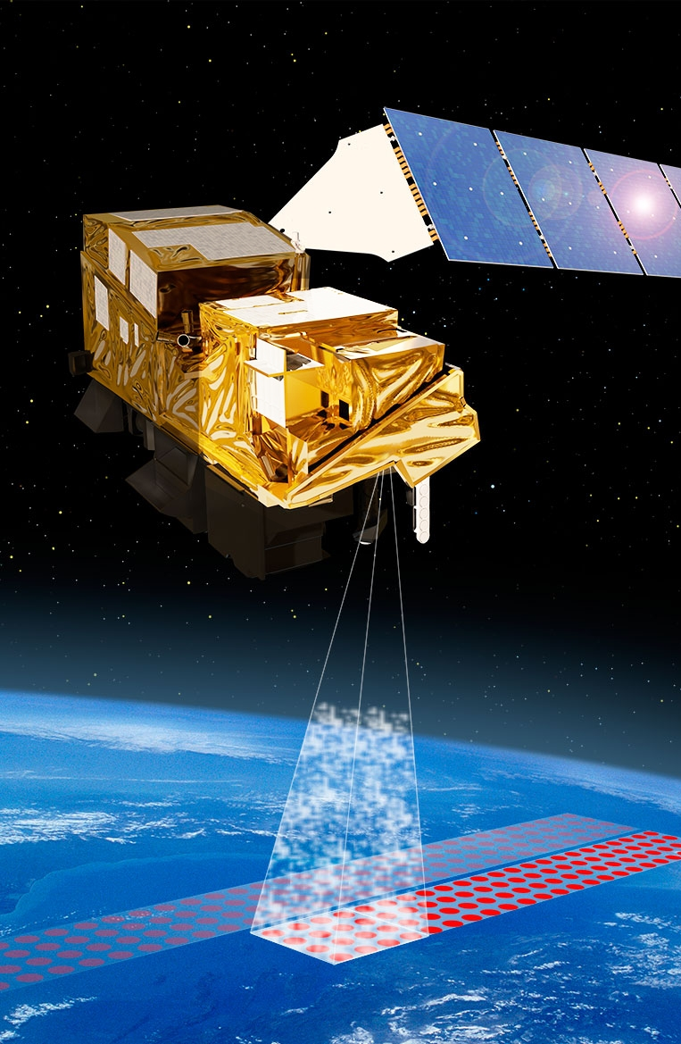
IASI NG, for Climate, operational meteorology and atmospheric chemistry
► Meteorology: Numerical Weather Prediction;
► Climate: for lower atmosphere (GHG, ECV trends, IR Radiative budgets,…)
► Atmospheric composition: aerosols, pollutants, volcanic ashes,…
Thanks to its exceptional spectral and radiometric stability, and the continuous work done by CNES, EUMETSAT and the laboratories, IASI has been selected as the reference instrument for thermal infrared by the WMO-GSICS program 🡺 Expectation is high for IASI-NG
- An operational processing chain (L1CPOP) to generate user products (level 1C) operated by EUMETSAT Expertise Center (IASTEC) for in-flight performance monitoring and parameter updating, operated by CNES Toulouse.
- Concept of operations of the IASI-NG instrument which will be operated by EUMETSAT within the framework of the European meteorological program Polar System Second Generation (EPS-SG)
Metop-SG-A1
IASI-NG PFM
Metop-SG-A2
IASI-NG FM 2
Metop-SG-A3
IASI-NG FM 3
2025
2032
2039
2024
Metop-SG-B
Modèle de vol 1
2031
Metop-SG-B
Modèle de vol 2
2038
Metop-SG-B
Modèle de vol 3

Slide 6
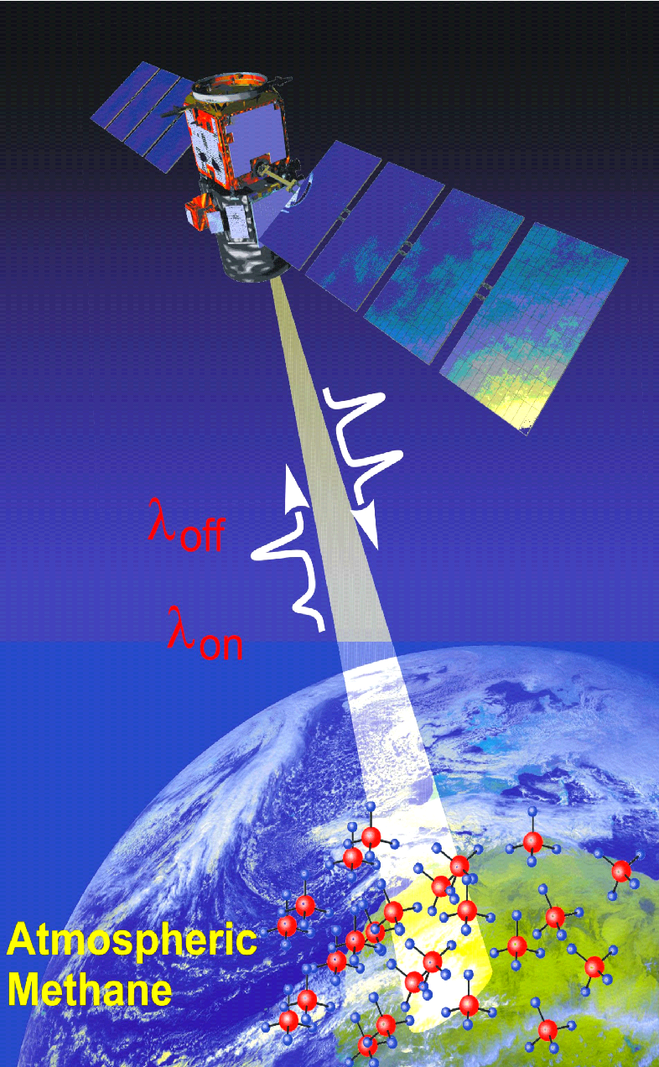
MERLIN, Measuring CH₄ from space
► Measure of the methane atmospheric concentration (better than 22ppb) in integrated column to better quantify surface fluxes.
=> There is no other equivalent!
► Based on the CNES-DLR cooperation since 2016 :
Qualification of the first Myriade Evolution Platform (400 kg) by CNES and,
First measures with the new Integrated Path Differential Absorption (IPDA) lidar for global methane remote sensing by DLR.
French start-up Kayrros will analyze images with AI support from Merlin and Microcarb satellites with the objective to participate to International Methane Emissions Observatory (IMEO), a joint UNEP-European Commission new initiative which aims to drive global action on reducing methane emissions.
Platform integration in 2022;
As soon as the IPDA provision is done, project on the french side will restart again;
In parallel, CH4 validation activities are on-going leb by LMD (ex. MAGIC Campaigns).
Launch horizon 2028 (to be confirmed in June 2023).

Slide 7
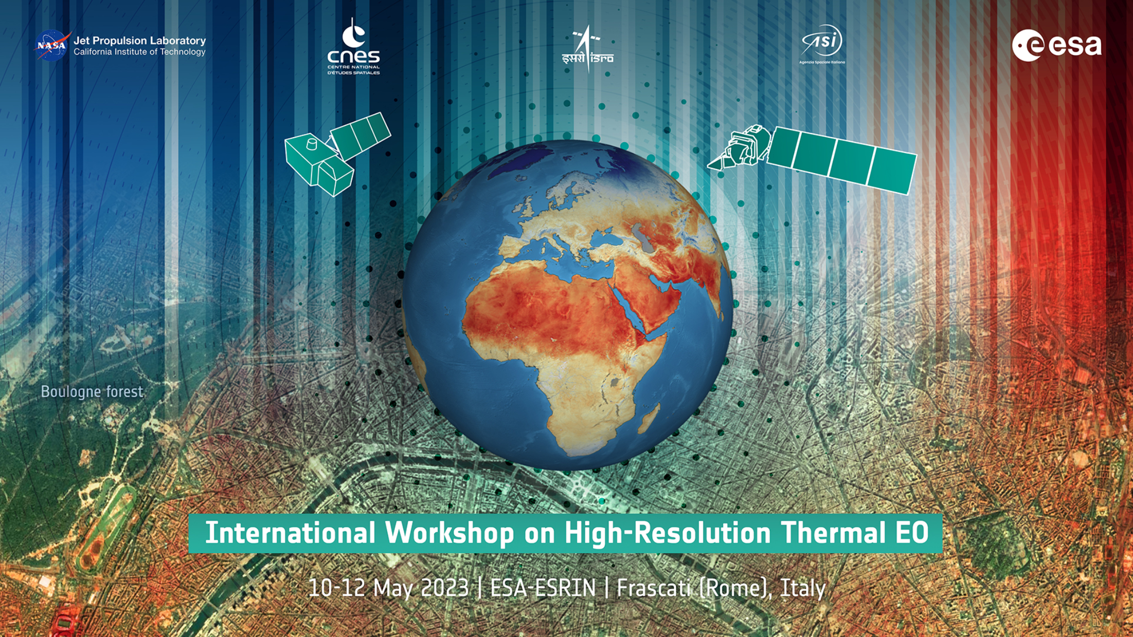
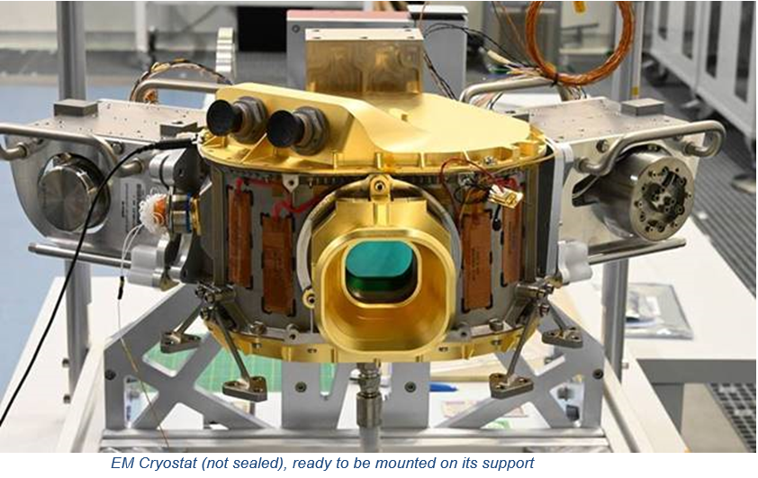
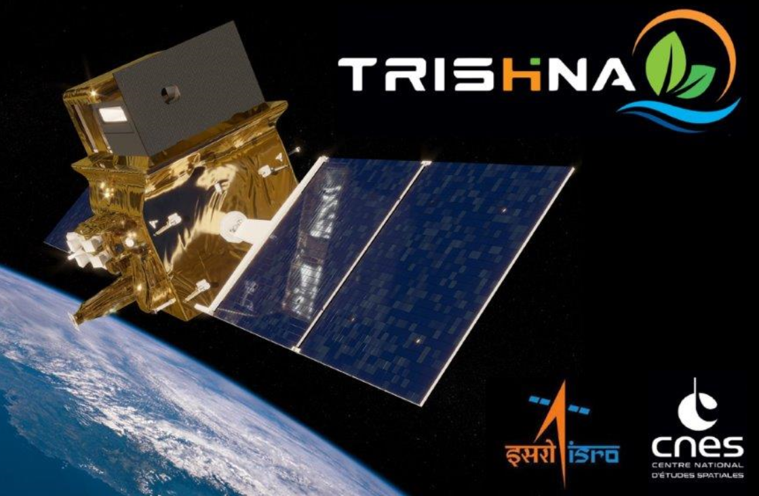
TRISHNA, Thermal infraRed Imaging Satellite for High resolution Natural resource Assessment - A research and downstream program
► Agriculture
► Coastal and inland Hydrology
► Urban, Cryosphere, Solid Earth
Global coverage @ 60m resolution for Continental and Coastal Areas
4 TIR bands (NeDT 0.2K)+ 5 VNIR bands + 2 SWIR bands, 3-Day revisit
Indo-French Science Team,
Strong synergies at Project and Science Team levels with ECOSTRESS, SBG & LSTM science & application teams, + other European contributors
Phase B ongoing Project Activity since March 2020
TRISHNA is the ESA LSTM Precursor
ESA/CNES/ISRO/ASI/NASA International Workshop on HR Thermal EO May 2023
Special Session IGARS 2023
Contribution to CEOS for L1 CAL/VAL (WGCV/IVOS) and L2+ (Land Product Validation WGCV/LPV)
Launch scheduled 2025

Slide 8
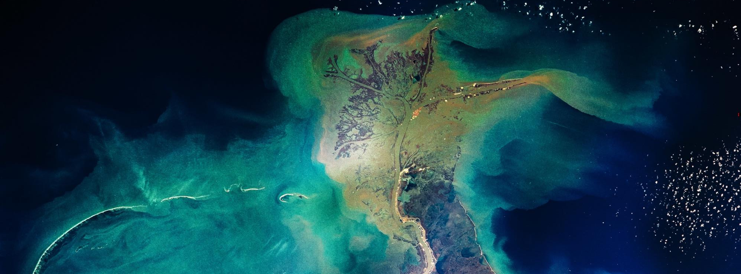
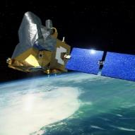
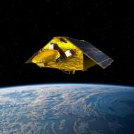
ENGAGE FOR A SUSTAINABLE DEVELOPMENT – 2022-2026 AND BEYOND
SCIENCE : Better understand and monitor the evolution of our Earth in the light of global change
TECHNOLOGY : Innovation to build the sustainable industry of tomorrow
SOCIETAL : Responding to Climate Change Challenges and crisis
SERVICES : Development of new services for the population at regional level
COOPERATION : Pursue the international Partnership
Four Missions Services for Climate in complement to ESA EO Program
= Top Science priorities (Séminaire de Prospective du Havre en 2019)
AOS
C3IEL
DAMONA
ODYSEA
Atmosphere Observating System
Clouds and Precipitations
Water ressources
Ocean winds and currents

Slide 9
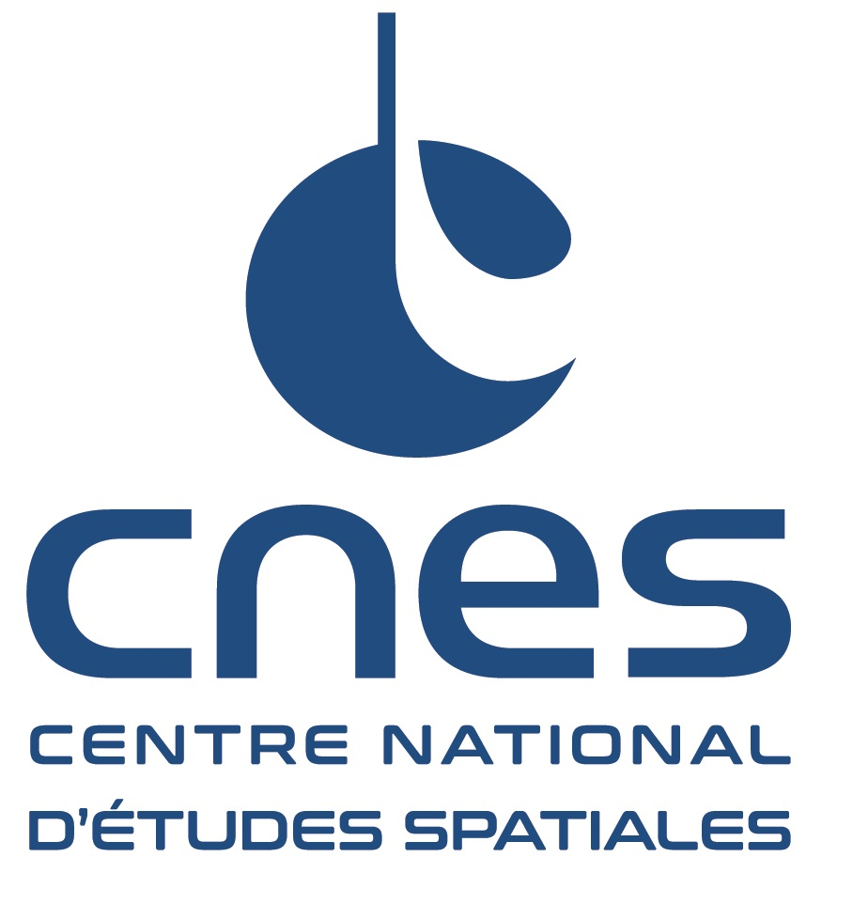
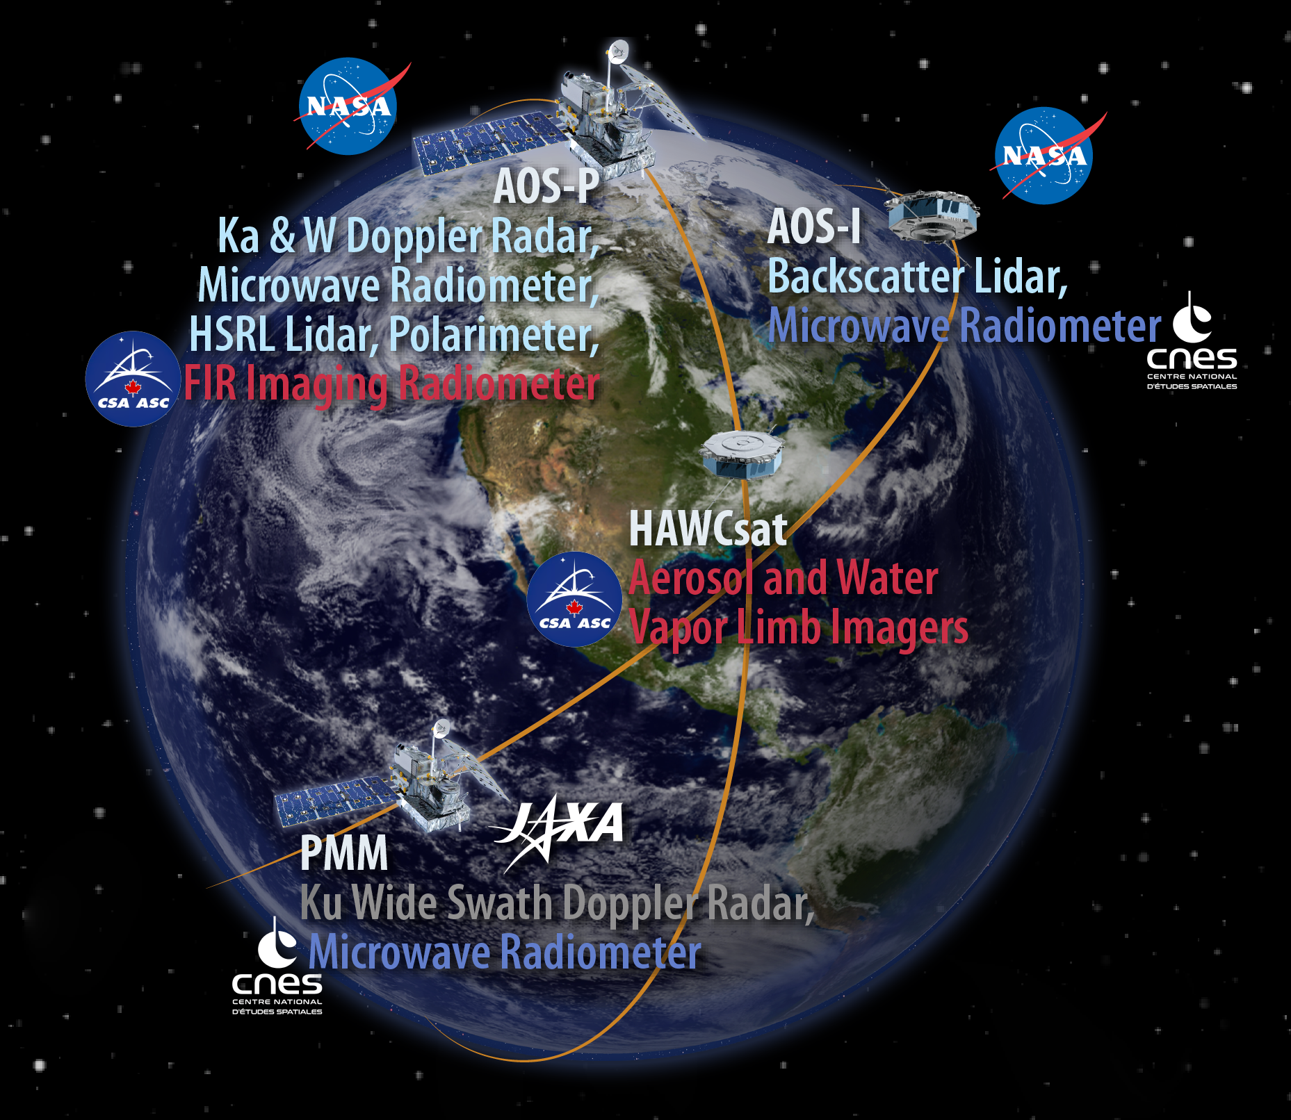
Tomorrow’s CNES missions: AOS & C³IEL SPS follow-up
► Atmospheric Observing System (AOS)
- CNES participation to an international observatory from Space
(lead by NASA, with JAXA and CSA participation)
Ambitious and innovant programme for studying the Earth Atmosphere and
improving climate and meteorological forecasts
French contribution :
tandem of microwave radiometers to study convection systems (heritage
SAPHIR, Megha-Tropiques on GPM)
Aerosols and Clouds retrieval from lidar measurements (heritage of CALIPSO
on A-Train)
Beginning of phase A in December 2022, Phase B is expected to start in 2023
Launches : 2028 (inclined orbit), 2030 (polar orbit)
► C³IEL : Cluster for Cloud evolution, ClimatE, and Lightning
French-Israel collaboration (CNES-ISA)
Innovative mission: 2 small satellites to study clouds in 3D and monitor the electrical activity

Slide 10
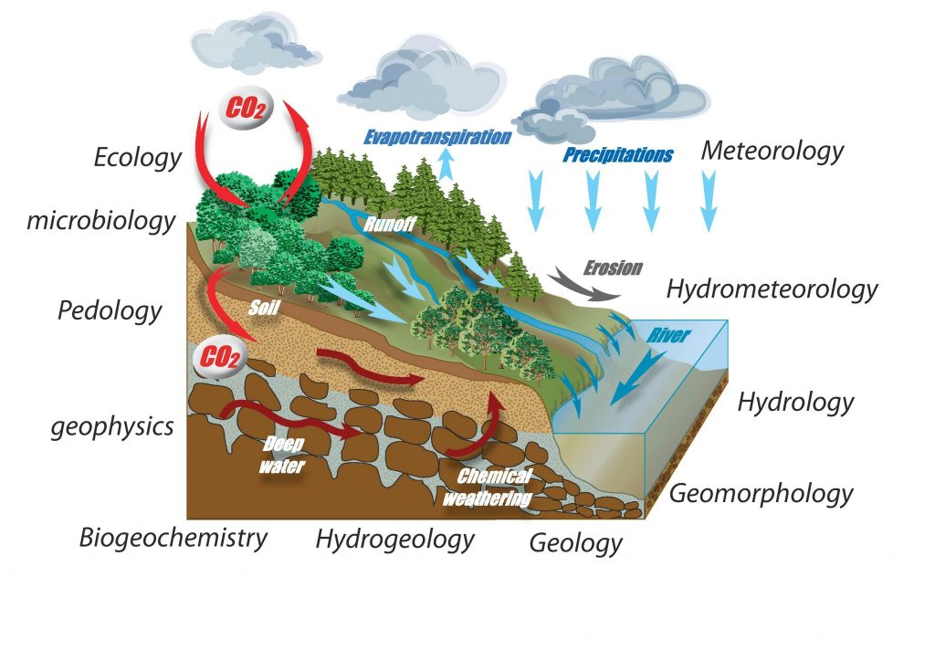
An e-Research Infrastructure to observe and understand
the Earth system and the environment in an integrated way
► Planet Earth, a complex dynamic system: - Geophysical and environmental processes - Diversity of spatial and temporal scales - Permanent interactions between the compartments: solid earth, continental surfaces, ocean, atmosphere and the anthroposphere
Understanding these processes requires access to and analysis of numerous, complex and big data sources (Space AND in situ)
- 26 Research bodies and universities CNRS, CNES, IFREMER, IGN, INRAE, IRD, Météo-France …
- 30 centers (Data & services)
- 32 Scientific Expert Council
- 200 FTE / 450 scientists, engineers and technicians
- 1000+ products, 15000+ users, 100 PB of data
Source: Ozcar - La zone critique, « entre le ciel, la végétation et les roches »
Atmosphere
Oceans
Solid Earth
Land
surfaces
HR images

Slide 11
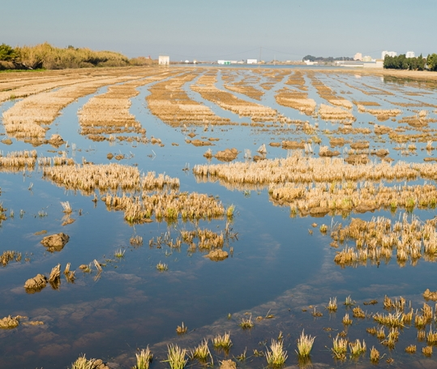
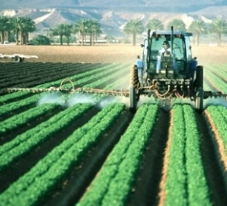
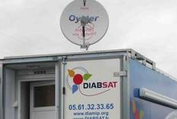
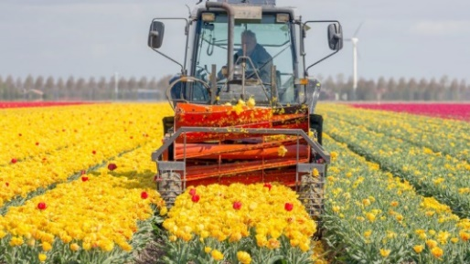
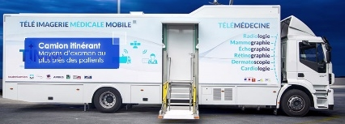
Connect by CNES : Objectifs and priorities
► Develop a new community of users
In order to boost economic, societal and environmental development in France in particular by adding value through the use of satellite data and innovative services for the healthcare, environment and mobility sectors.
Startups
Large
Groups
public
actors
Environment
Mobility
Health
International

Slide 12
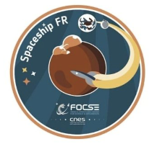
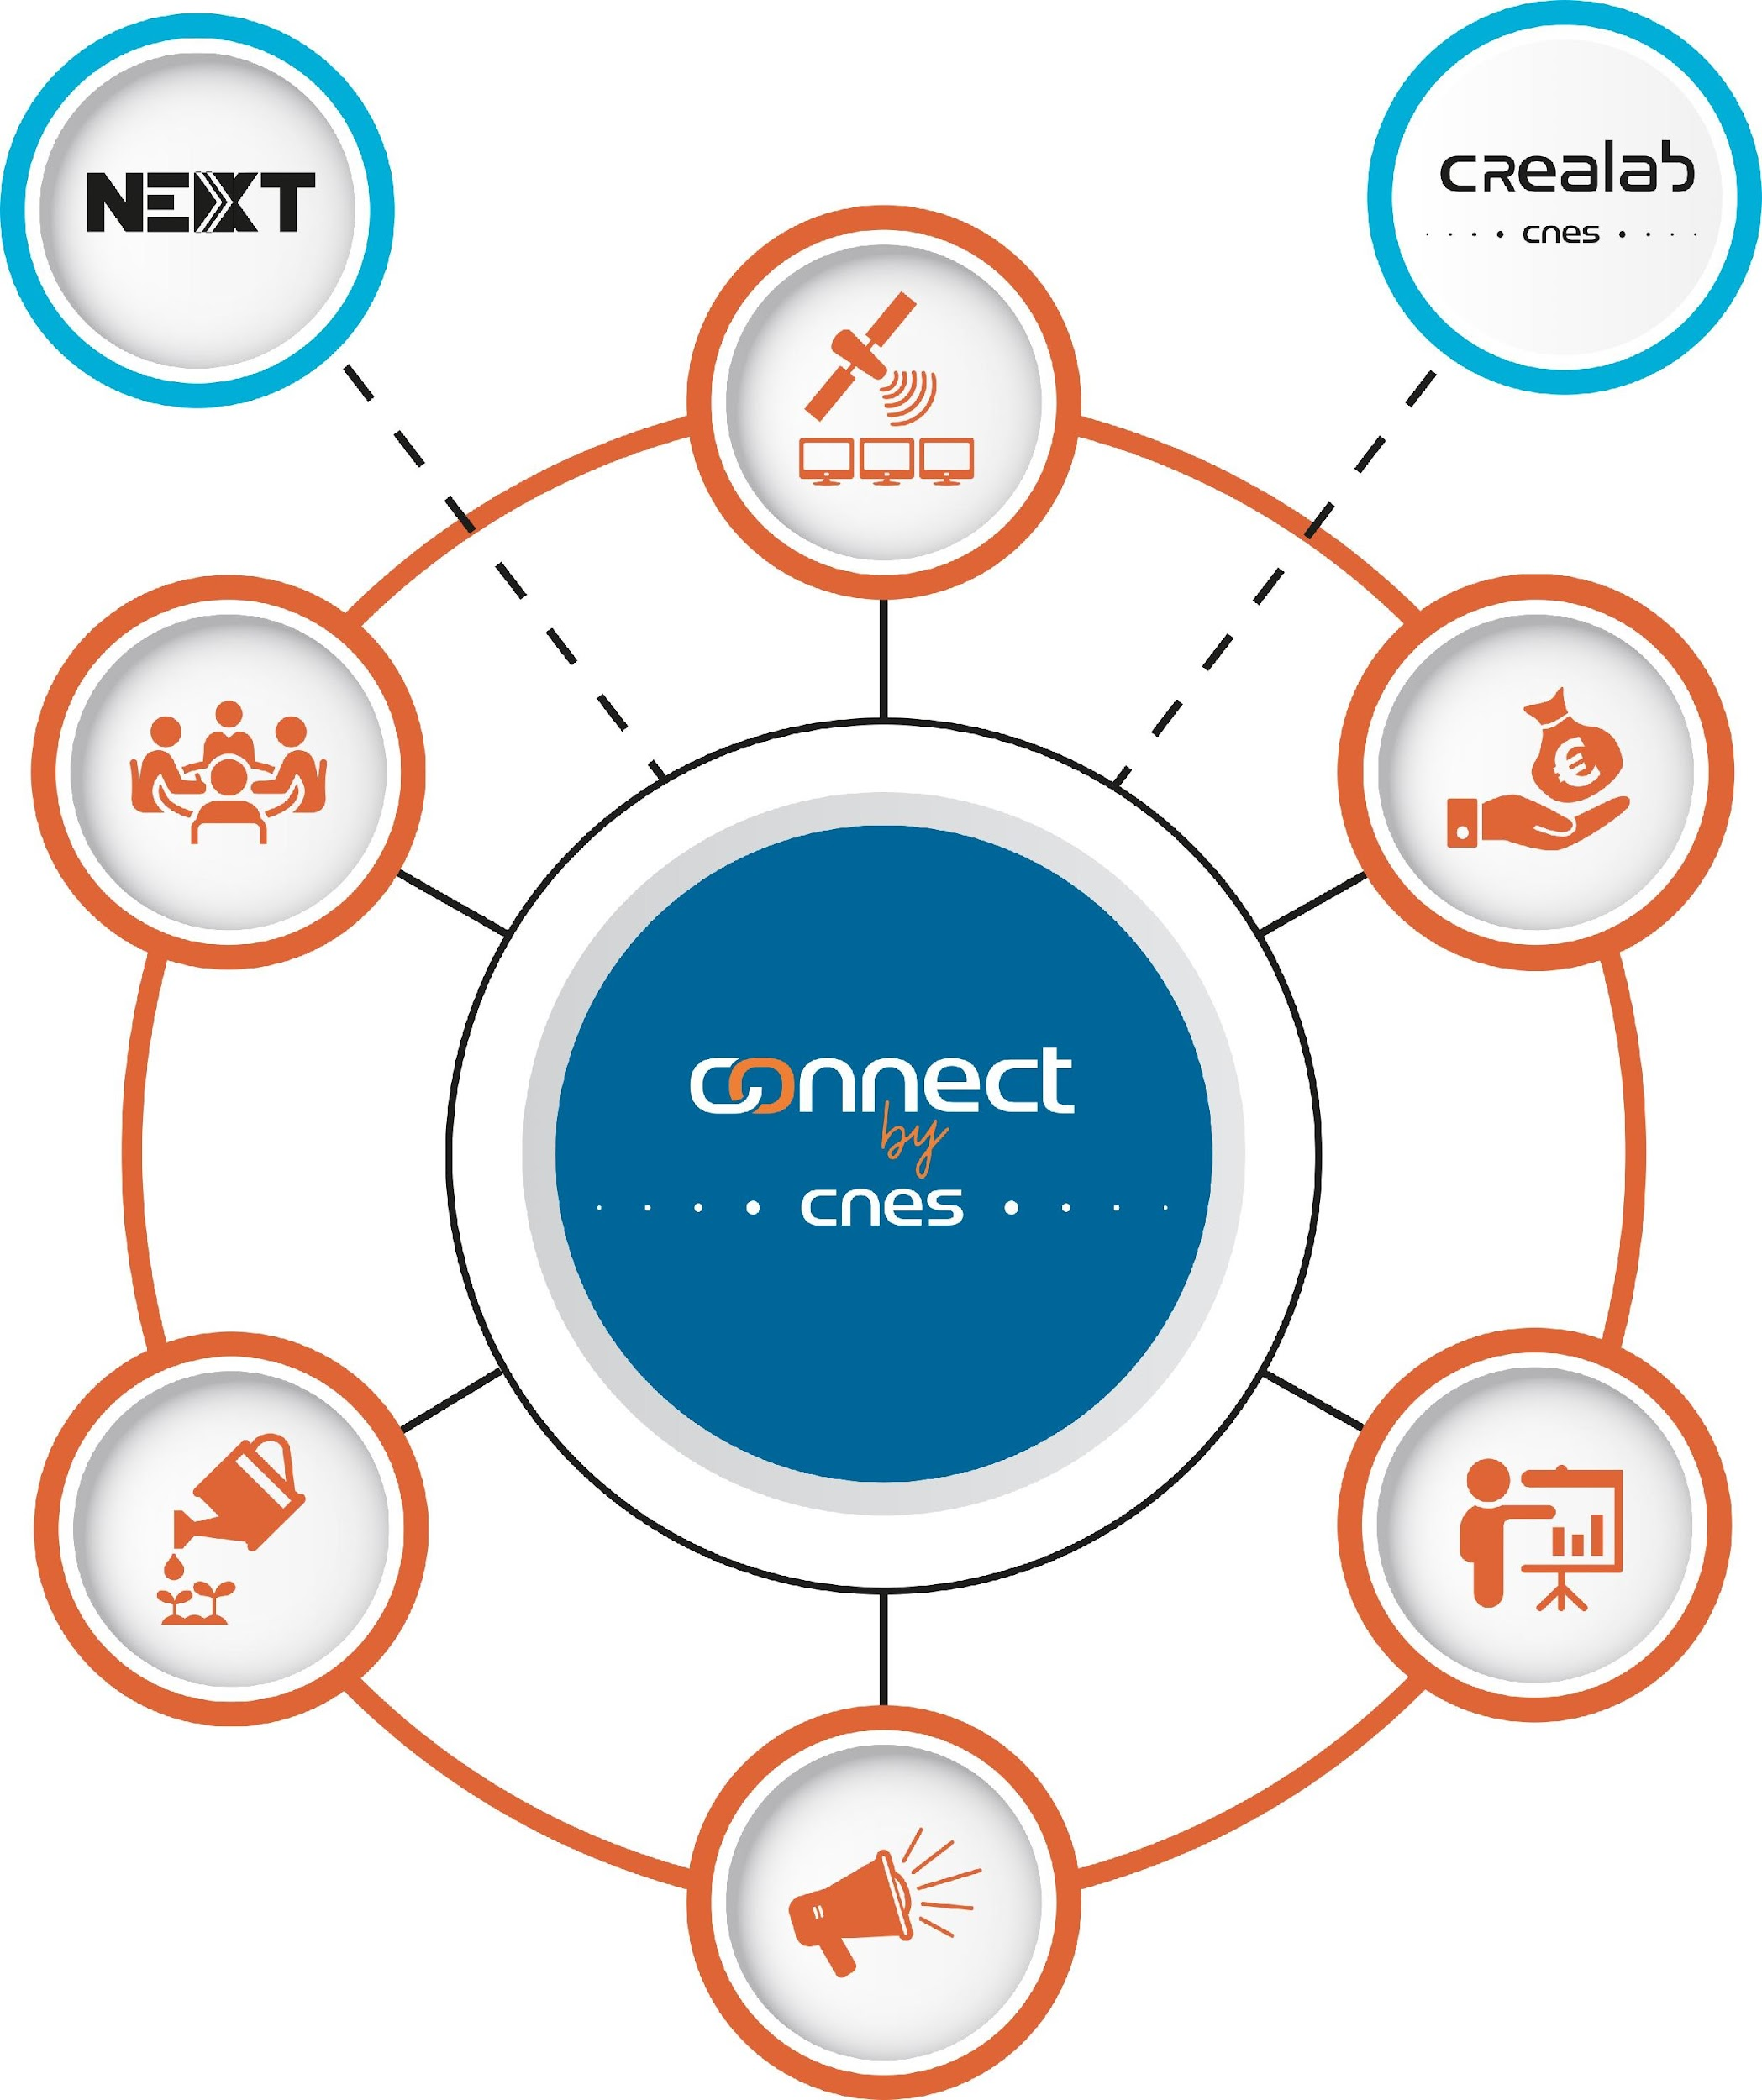
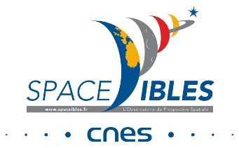
NAVLAB
EXPERTISE
IDEATION
FUNDING
INCUBATION ACCELERATION
EDUCATION
COM/MARKETING

