Slide 1
2022 CEOS Plenary
GEMS Status
Jaehoon Jeong, NIER(s)
Agenda item #2.11
2022 CEOS Plenary
Biarritz, France
Nov. 29 – Dec. 1

Slide 2
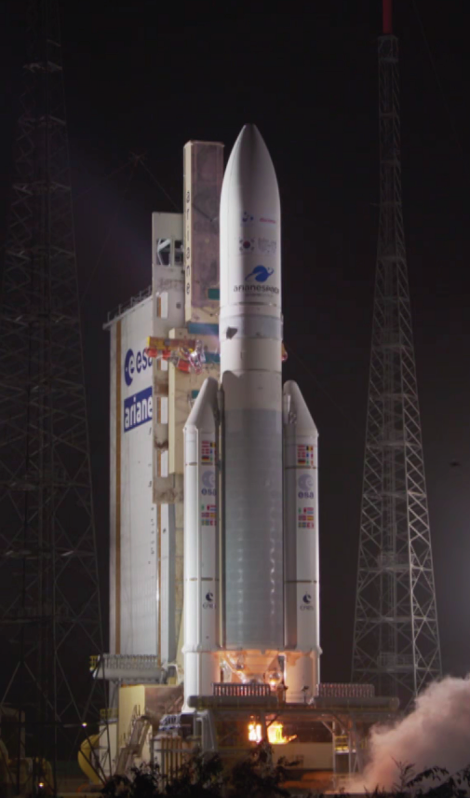
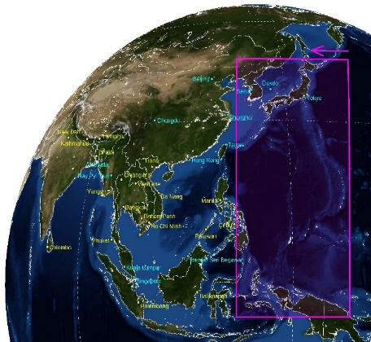
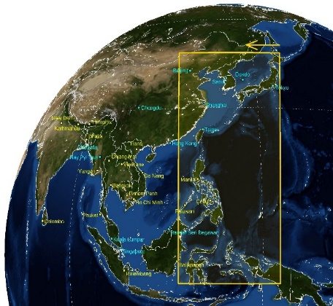
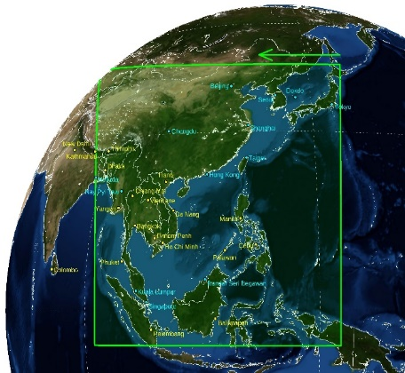
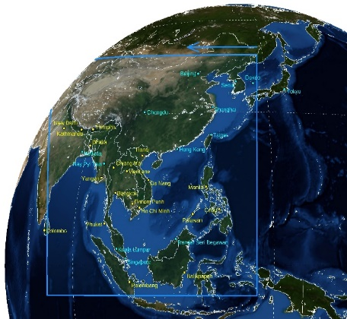
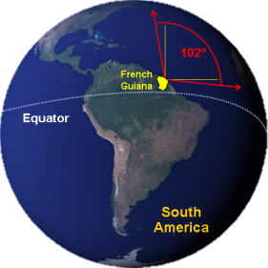
Launch of GEMS and its domain
Launch on 19 February 2020 (the Guiana Space Center)
Scan Area
GK-2B
GEMS
Countries in GEMS domain (20)
Brunei
Bangladesh
Bhutan
Cambodia
China
India
Indonesia
Japan
Laos
Malaysia
Mongolia
Myanmar
Nepal
Palau
Philippines
Singapore
S. Korea
Sri Lanka
Thailand
Vietnam

Slide 3
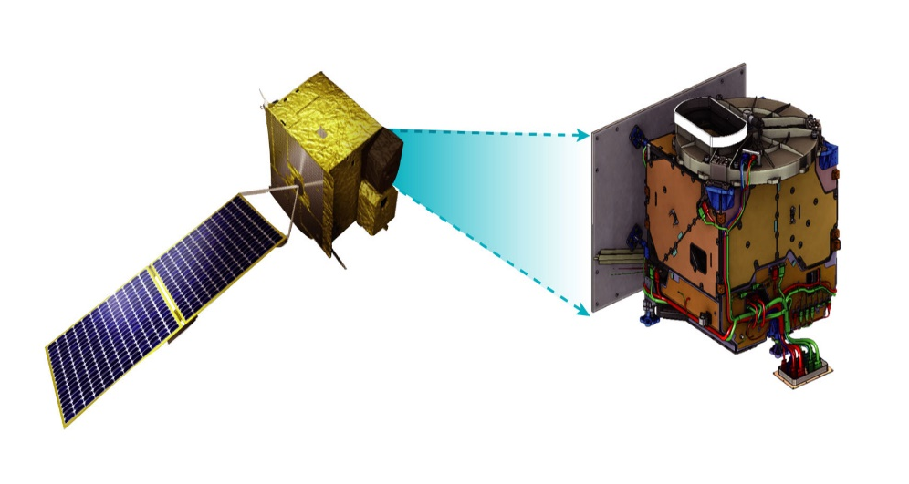
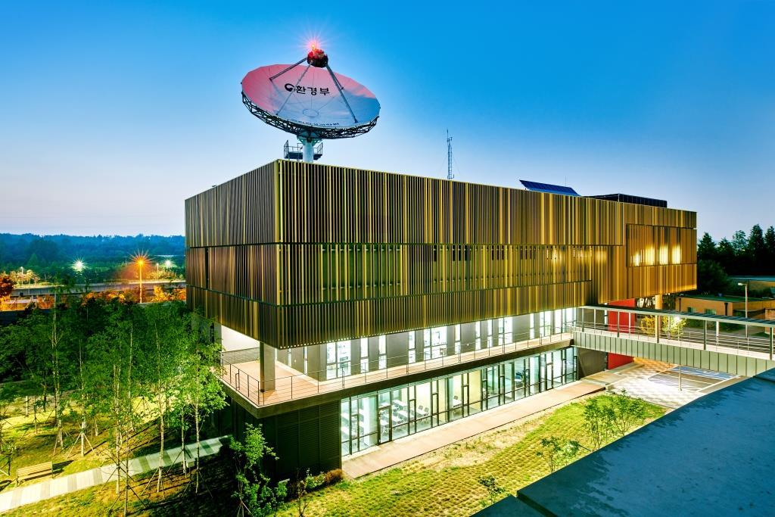
GEMS overview
Satellite & Payload
Environmental Statellite Center
GEMS overview
Main Targets | O₃, SO₂, NO₂, HCHO, Aerosol and so on
Mission Period | 10 years
Scan Area | 5,000km x 5,000km(5°S – 45°N, 75°E – 145°E)
Spatial Resolution | 3.5km x 8km (Ozone Profile & CHOCHO: 14x32km, SO₂: 7x16km)
Time Resolution | 8 times on average (30min scanning, 30min stand-by)
Spectral Resolution | UV-VIS, 300-500nm
Obit/Height/Longitude | Geostationary satellite/36,000km/128°E

Slide 4
GEMS observation plan
Scan Regions and Time
HE
(half East)
HK
(Half Korea)
FC
(Full Central)
FW
(Full West)
Scan
Area
Countries in GEMS domain (20)
Brunei
Bangladesh
Bhutan
Cambodia
China
Korea, Japan and so on | Korea, Japan, East China regions and so on | Korea, Japan, China, Southeast Asia and so on | Korea, Japan, China, Southeast Asia, India and so on
8~10 KST | 9~11 KST | 10~12 KST | 12~17 KST
Scan
Regions
India
Indonesia
Japan
Laos
Malaysia
Mongolia
Myanmar
Nepal
Palau
Philippines
Scan
Time
Singapore
S. Korea
Sri Lanka
Thailand
Vietnam

Slide 5
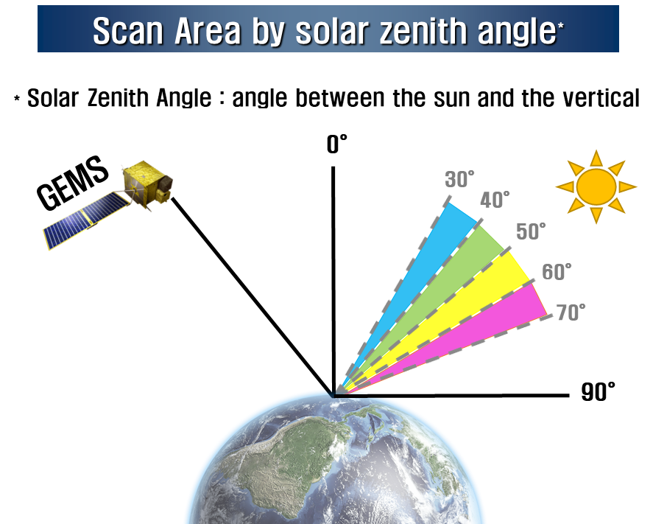
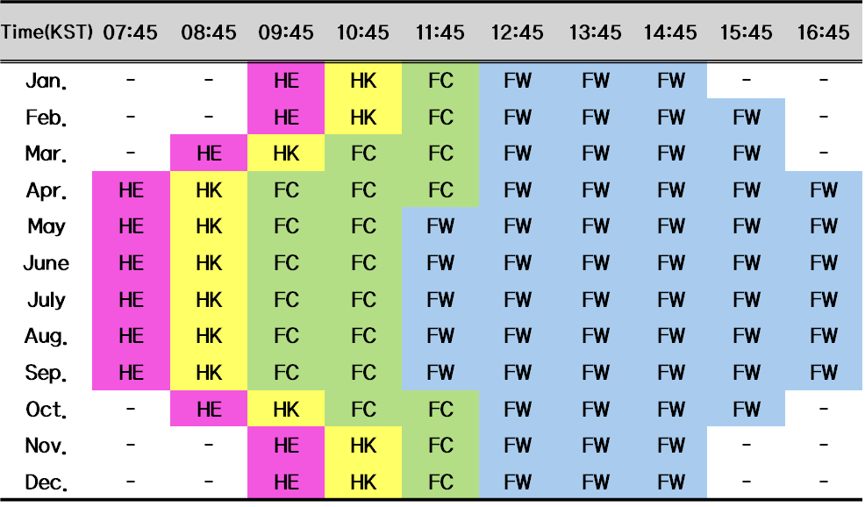
GEMS observation plan
Monthly observation plan

Slide 6
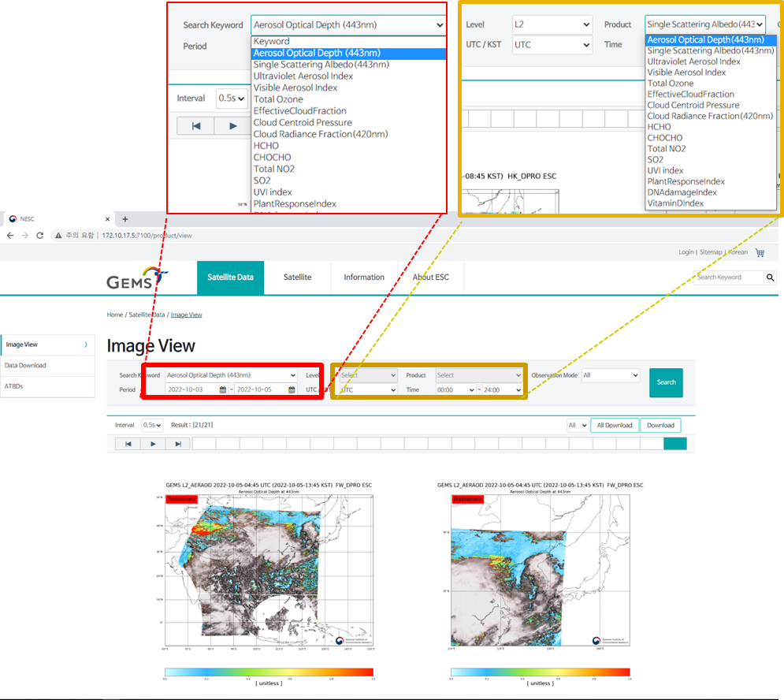
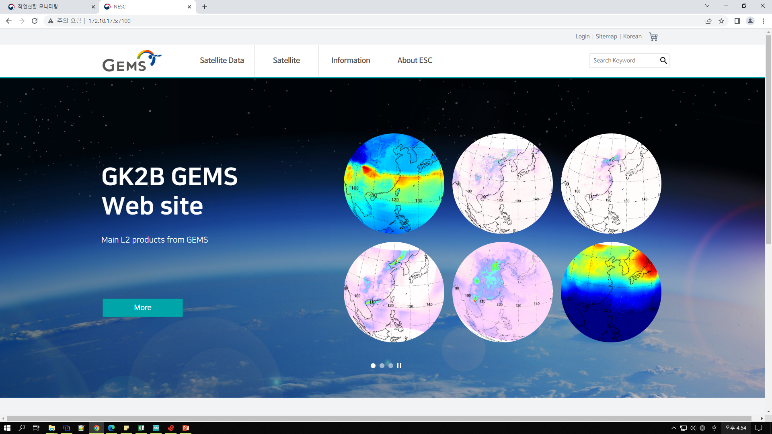
GEMS data release
Data distribution (https://nesc.nier.go.kr)
☯ GEMS data can be easily accessed through Website
☯ Website Address : https://nesc.nier.go.kr
→ Satellite data → Image View
→ Search Keyword or choose level and product

Slide 7
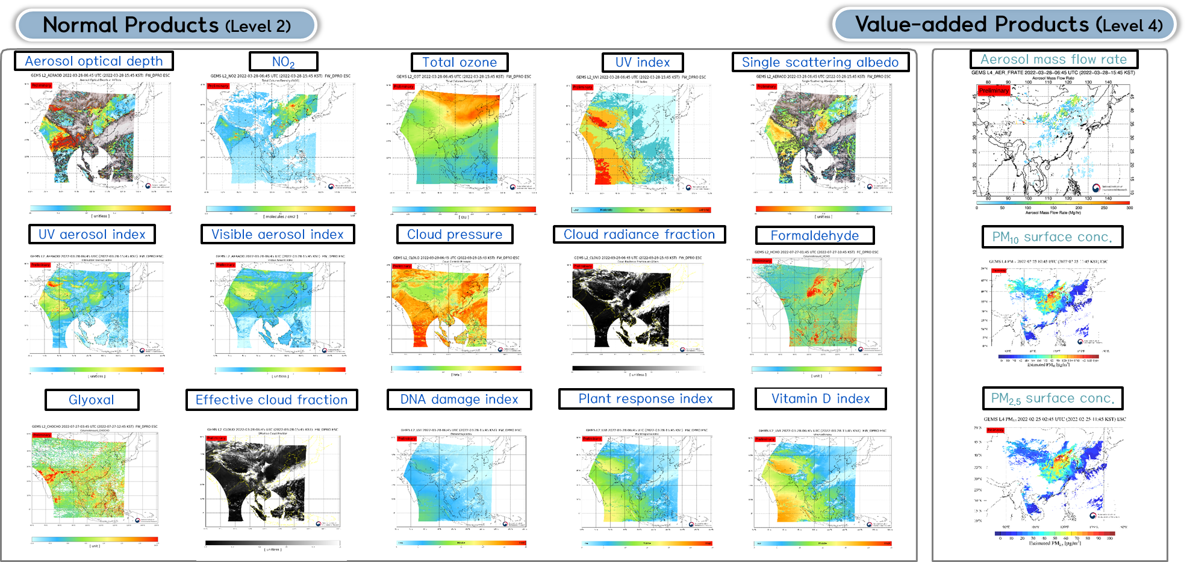
GEMS data release

Slide 8
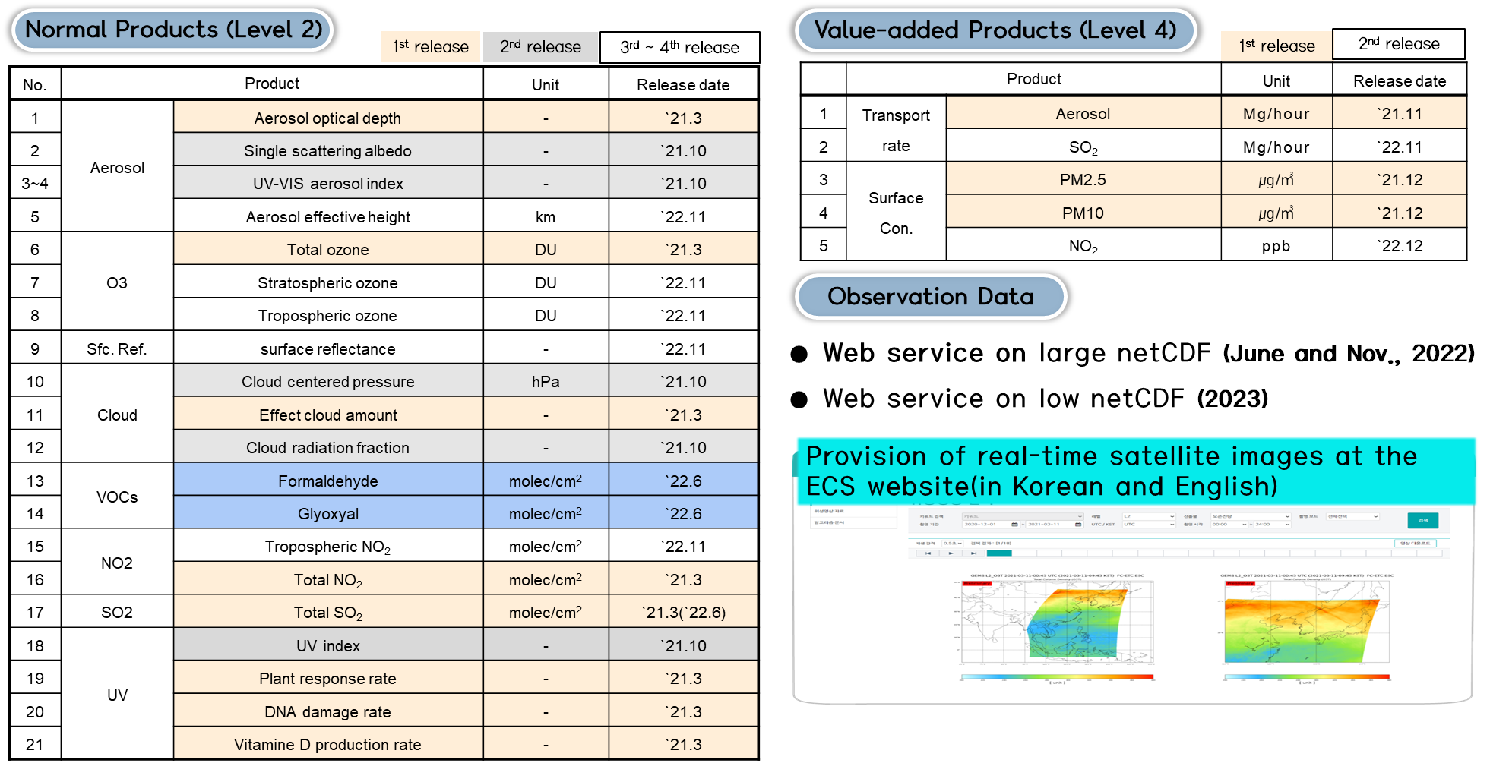
GEMS data release plan

