Slide 1
UKSA update to CEOS Plenary 2022
Beth Greenaway
Head of Earth Observation and Climate at the UK Space Agency
November 2022

Slide 2
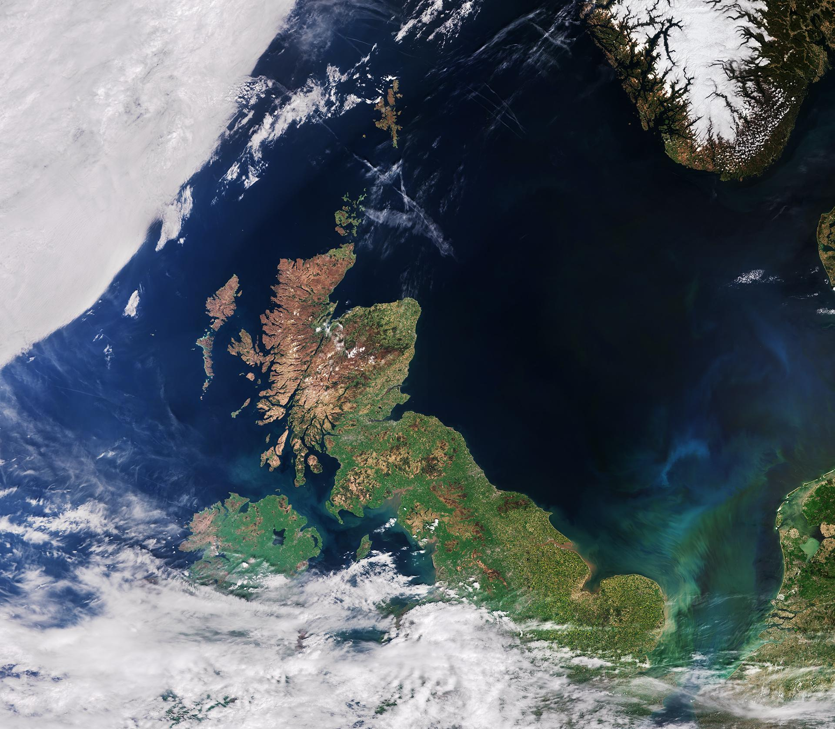
Earth Observation is a UK priority
The UK Space Agency plays a major role in delivering the government’s National Space Strategy and support a thriving space sector in the UK, which generates an annual income of £16.5 billion and employs 47,000 people across the country.
Catalyse investment to support projects that drive investment and generate contracts
Deliver missions and capabilities that meet public needs and advance our understanding
Champion the power of space to inspire people, offer greener, smarter solutions, and support a sustainable future
Eight delivery Priorities :
Launch: supporting satellite launch services from UK spaceports
Sustainability: taking a leading role in keeping space safe and accessible
Discovery: supporting space science and exploration missions
Innovation: investing in bold new technologies
Levelling-up: boosting space investment and jobs across the country
Earth observation: studying our planet to drive discovery and tackle climate change
Low-Earth orbit: delivering vital everyday satellite services
Inspiration: inspiring new space customers, investors and the next generation

Slide 3
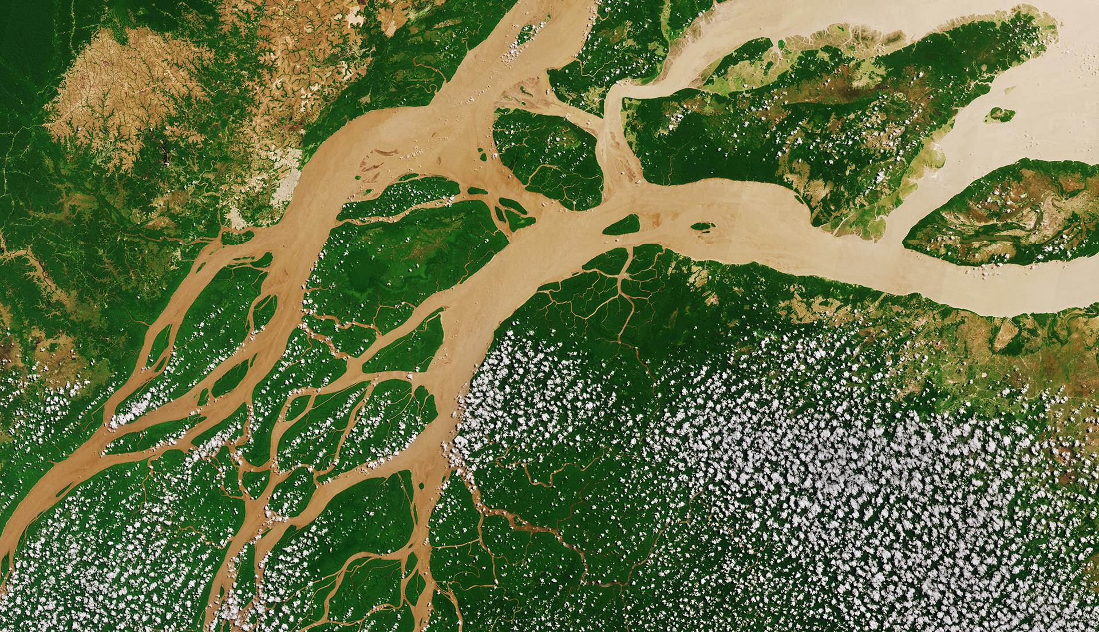
Current UKSA EO and Climate activities
Pre-Technology Development
Upstream Activities
Midstream Activities
Downstream Activities
EO Technology
Missions
UKSA Earth Observation Teams
EO Data and Ground Segment
ESA Programmes
Copernicus lead by Department of Business Energy Industrial Strategy
Climate – Space4Climate, UKEO-CIS (lead by NERC/NCEO), SCO, CEOS etc

Slide 4
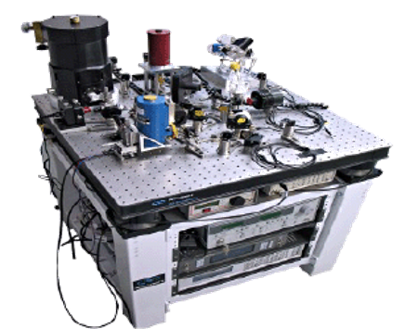
Earth Observation and Climate – EO Technology
The scientific insights, public services and economic benefits enabled by EO are all underpinned by the instruments and technologies which enable satellites to gather data.
EO instruments can take decades to build and mature, often requiring science to be developed in parallel with technology. This discourages private investment in early-stage technologies.
To catalyse the development of new EO technologies in the UK, the UKSA funds an Earth Observation Instrumentation Programme (EOIP), which is delivered by the Centre for Earth Observation Instrumentation (CEOI). Many successes are now seen from this national programme.
To date, CEOI has run 14 themed and open R&D grant funding calls, each securing parallel investment from industry and academia. CEOI also runs events to establish and strengthen networks between academia and Industry, has directly advised UK companies bidding for ESA projects, and provides strategic and technical EO advice to UKSA and wider Government.
Development of the RAL Space Laser Heterodyne Radiometer (LHR) ​

Slide 5
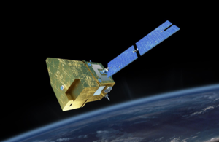
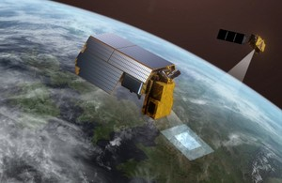
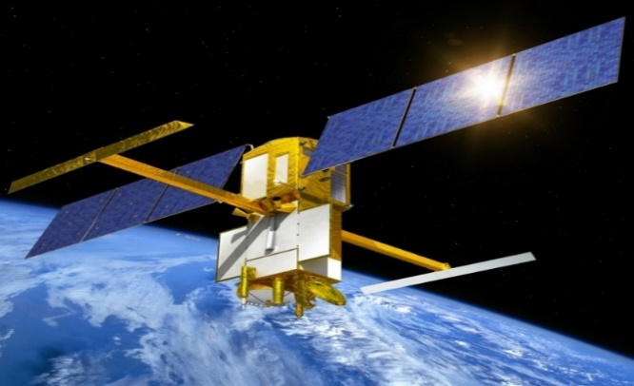
International Partnership Missions
And many others through ESA including Biomass, Aeolus 2, IASI-NG, HydroGNSS, CubeMap etc
MicroCarb
Joint mission with CNES
Designed to map sources and sinks of carbon dioxide (CO2)—the most important greenhouse gas—on a global scale.
Uniquely has a special city-scanning observing mode to map CO2 emissions
TRUTHS
Traceable Radiometry Underpinning Terrestrial- and Helio- Studies
UK led ESA mission
Designed to provide optical climate data ten times more accurately than is currently possible and upgrade the performance and integration of the global Earth Observation system as a whole.
SWOT
Surface Ocean Topography Mission
Jointly developed by NASA and CNES, the French space agency, in partnership with the Canadian Space Agency and UK Space Agency.
Will make the first global survey of Earth's surface water, observe the fine details of the ocean's surface topography, and measure how water bodies change over time.
Instrument due to arrive in
the UK on 5th December
Passed Science and Technology
review and now in Phase B2
Excited for the launch on 15th Dec and calibration over
Bristol Channel

Slide 6
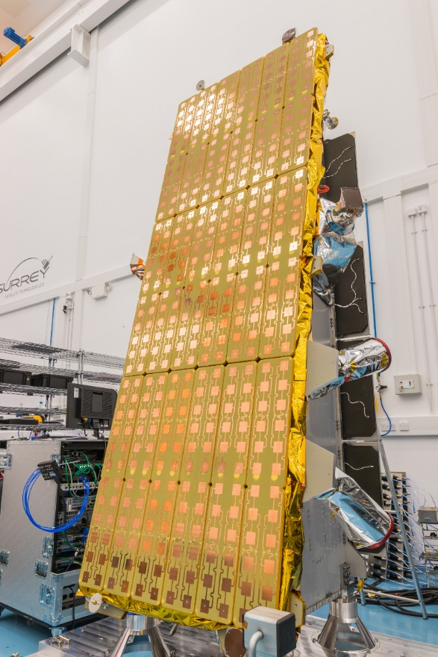
Data
The UK has a 15% share of NovaSAR imagery. There is currently an interim process for accessing archived imagery from this UK share following a change in process. The data remains available upon registration and agreement of the End User Licence Arrangement by contacting uksatelliteops@airbus.com who will process the request on behalf of UKSA.
A concentrated work on how the UK responds to international and technological developments and has a data architecture fit for the future.
Notes:
EO Data Hub (with NERC/NCEO)

Slide 7
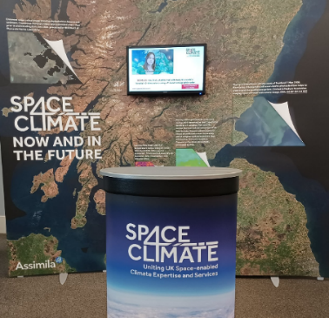
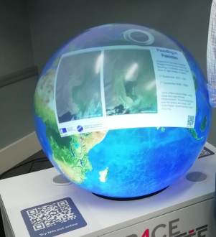
Climate
UKSA funds and chairs the Space 4 Climate (S4C) partnership.
We work with the United Nations Office for Outer Space Affairs (UNOOSA) on mapping existing international efforts using space technologies to support climate action
Joined the Space Climate Observatory Charter in July 2022
Influence the annual COP (Conference of Parties – UN Climate Change Conference).
Major funder of ESA CLIMATE SPACE and TRUTHS programmes.
Supporting the use machine learning to find methane plumes. Starting with Sentinel 2 data can then switch to other data. In addition, NPL are leading the work to develop a framework for quality assurance of methane analysis.
Space 4 Climate stand
Pufferfish interactive globe

Slide 9
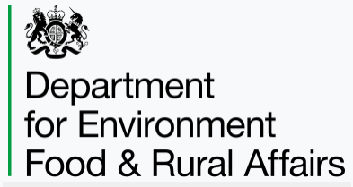
UK CEOS/GEO Office
UK CEOS/GEO office is a collaboration between:
The Joint UK CEOS/GEO office pool resources to improve cost effectiveness and efficiency of coordination in the UK in responding to CEOS/GEO initiatives, engaging with the scientific community and supporting the UK’s EO and data-sharing representatives at international level.
Please contact any of us and we look forward to working with you.

Slide 10
Summary: Earth Observation and Climate Priorities
‘’To deliver a portfolio of Earth Observation focused activities, that ensures long-term value for money and access to the data, we need a series of related programmes’’ - UKSA Corporate Plan 2022
The creation of Earth Observation space assets and missions
Maximise EO data exploitation
Sustaining and enhancing Earth Observation technological capability
National and International Earth Observation Climate Policy Leadership

Slide 11
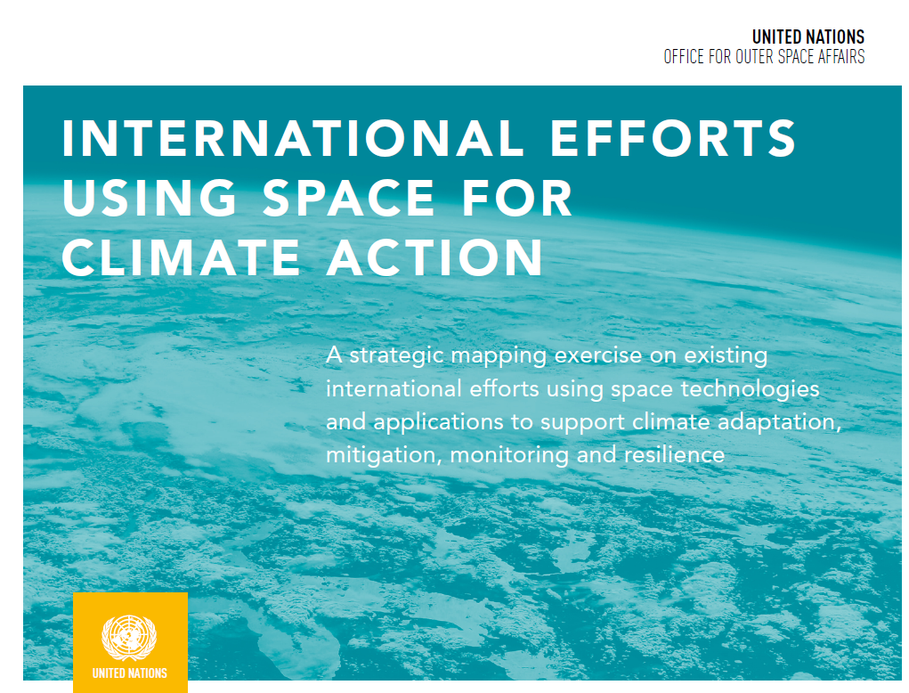
UNOOSA: International Efforts Using Space For Climate Action
Conclusions
The mapping exercise shows that there is a wealth of ongoing and existing initiatives using space technology for climate action. On the other hand, in the area of climate services or capacity-building, a comparable solid coordination and collaboration structure does not currently exist.
Summary of findings
Climate observation, research and science as well as climate policy development is well-established, developed and coordinated
“Climate services” are loosely defined and different actors use different definitions
“Space climate services” and “space for climate actions” are being developed by a vast and increasing number of bodies and stakeholders
There is a lack of platforms or forums that facilitate the sharing of actions and lessons learned
There is currently no international exchange of comprehensive and timely surface and space-based greenhouse gas observations
Limited capacity-building on “Space for Climate Service”
Processes and activities are not as co-ordinated within the United Nations system as might have been expected
The full report can be found here: https://www.unoosa.org/documents/pdf/Space4SDGs/Space_for_Climate_Action_-ebook.pdf

