Slide 1

Status, Contributions & Future Prospects
2022 CEOS Plenary
Vardis Tsontos, NASA
Agenda Item #2.9
2022 CEOS Plenary, Biarritz, France
Nov. 29 – Dec. 1

Slide 2

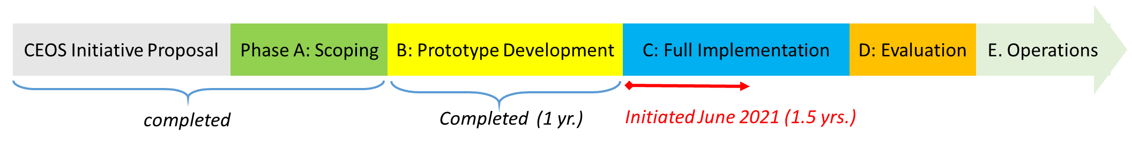
Topics
COVERAGE
?
Initiated June 2020 (1.5 yrs)
Concludes end Dec. 2022
COVERAGE Phase-C activity concluding by year’s end
Summarize status & contributions
Initiate discussion on future co-development within CEOS and possible longer term sustainability

Slide 3
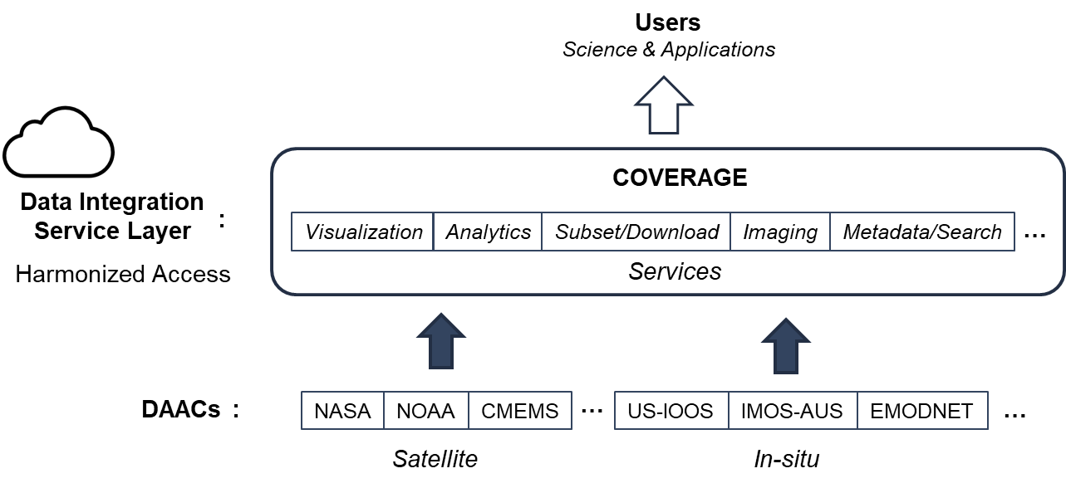
Overview
COVERAGE
CEOS Initiative: Cross-cutting, collaborative effort involving CEOS Ocean Virtual Constellations, GEO-MBON & GEO-Blue Planet
Goals
Implement Cloud-enabled Tech. platform providing harmonized access to complementary satellite & in-situ datasets from distributed sources via value-added data services enabling Open Science and interdisciplinary marine applications
Improved access to a coherent, curated set of global, interagency data products from the 4 Ocean VCs at common resolution as a baseline dataset, with additional support for select higher resolution and in-situ datasets
Demonstrate utility of the system in the context of 2 pilot thematic Marine Ecosystem application for societal benefit in support of UN-SDG14 “Life Below Water” and the UN-Biodiversity Beyond Areas of National Jurisdiction (BBNJ) policy framework:
Sargasso Sea Commission & Inter-American Tropical Tuna Commission partners
Approach
Governance: Advisory Board from contributing stakeholder organizations
Community driven, Stakeholder focused, Open Source, data FAIR

Slide 4
Synergies
COVERAGE
COVERAGE
Unique, cross-cutting CEOS initiative
Touches upon/complements
several CEOS activities
Ocean VCs
Ocean coordination
COAST
Ocean Decade
COVERAGE
Integrated access to Interagency ocean VC data
Product showcase
UN Decade “Ocean Shot”
COVERAGE
Integrative Data system
Data cubes & Cloud services
Data visualization
Satellite-insitu support
WGISS-FDA
SDGs
Ecosystem Application
development (SSC, IATTC)
CMEMS-WEkEO
EUMETSAT
Ecological data
support
Biodiversity

Slide 5
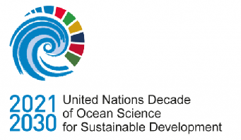


UN Ocean Decade Involvement
COVERAGE
COVERAGE Serving as:
Cumulative CEOS contribution to the UN Decade of the Oceans
Joint CEOS liaison with stakeholders on the UN Decade Process
“Ocean Shot” Concept Advancement
Concept proposal submitted to Ocean Decade U.S. (National Academy of Science committee) in December 2020
“Next Generation Data Service Infrastructure for a Digitally Integrated Ocean Observing System”
Linkage to UN-SDG 14: “life below water”, emphasizing the role of Earth Observations and data infrastructures in supporting ecosystem-based management efforts
COVERAGE highlighted as a focal development area for the Ocean Decade in the recent report by the National Academies of Sciences Decade US committee on Cross-Cutting Themes for U.S. Contributions to the UN Ocean Decade. https://doi.org/10.17226/26363 (April 2022)
Alignment & Coordination with other relevant Ocean Decade efforts
CEOS-COAST, Digital Twins of the Oceans (DITTO), Marine Life 2030, Basin Events to Coastal Impacts (BECI)

Slide 6


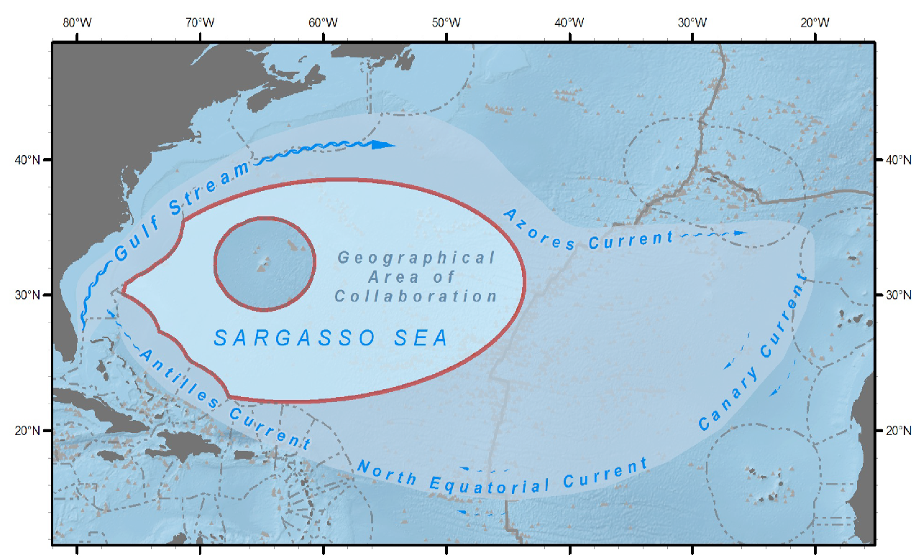
Regional Ecosystem Applications involving
Inter-governmental Agency Partners (1/2)
COVERAGE
Sargasso Sea Commission (SSC)
Promote stewardship of the Sargasso ecosystem via work program & action plan development for this high sea’s area
5 year Global Environmental Facility (GEF) and FFEM funded project (UN IOC & UN FAO oversight) – “SARGADOM” (Sargasso Sea & Costa Rica Dome project)
Ecosystem Diagnostic Analysis (EDA), identifying trends and impacts from available environmental, biological and socio-economic data
Development of an ecosystem-based stewardship approach for the Sargasso Sea, including framework for MPA designation
COVERAGE providing integrative data system and core EO data, satellite-derived Sargassum data, and in-situ data support
SSC and SARGADOM strongly endorses COVERAGE continuity

Slide 7
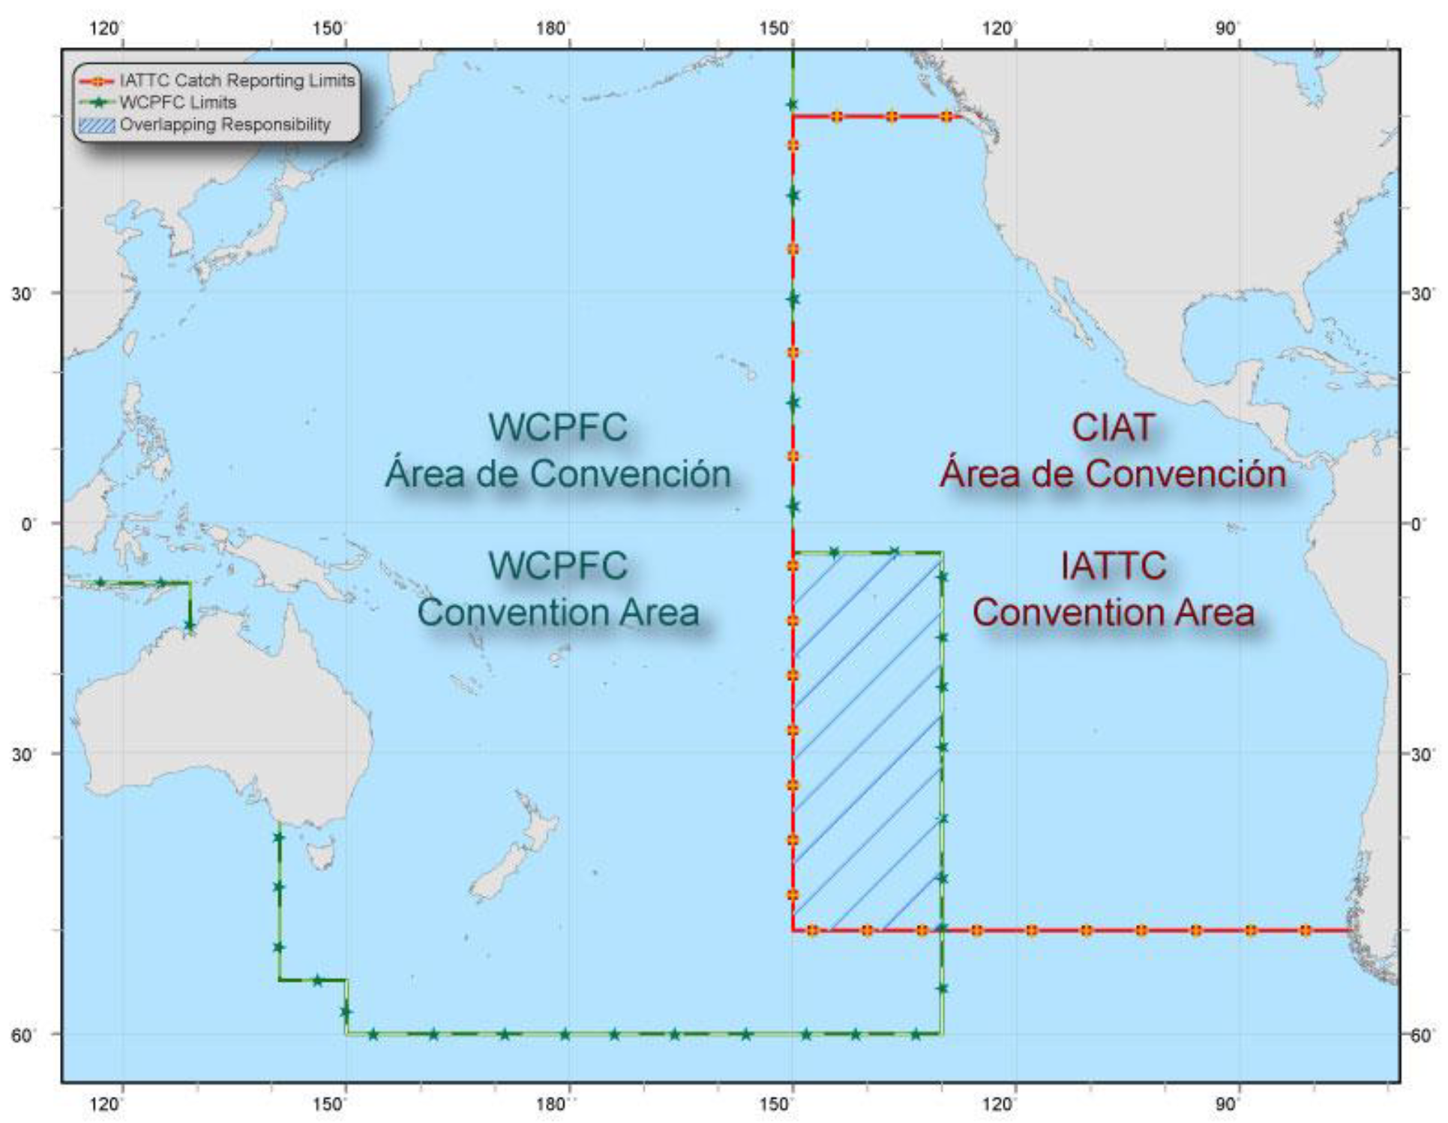
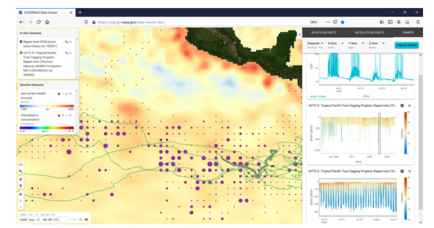
Regional Ecosystem Applications involving
Inter-governmental Agency Partners (2/2)
COVERAGE
Inter-American Tropical Tuna Commission (IATTC)
21 Nation Intergovernmental Regional Fisheries Management Organization (RFMO)
Responsible for the scientific assessment and management of Tuna and large pelagic fisheries in the E. Tropical Pacific (ETP)
Potential applications of remote sensing data to support fisheries Dynamic Ocean Management, habitat analyses, Spatial catch forecast, By-catch mitigation, Fishery closed area designation
IATTC-COVERAGE regional spin-off application
MOU between NASA.JPL and IATTC signed
COVERAGE Viewer dynamic visualization of IATTC Bigeye tuna archival and spatial catch data in relation to AVISO SSH-A

Slide 8
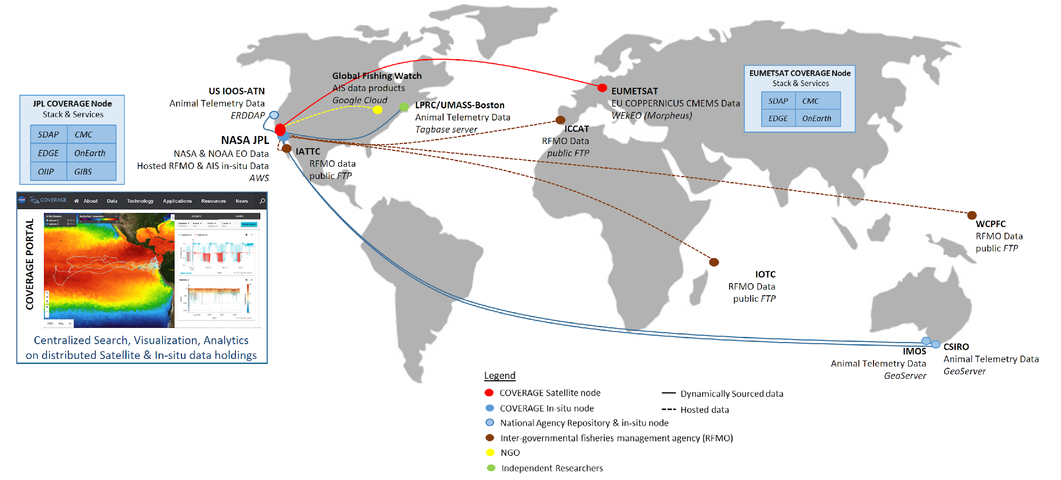
Distributed Data Architecture
Supporting the Fisheries/Ecosystem Thematic Application Pilot
COVERAGE
Cloud nodes on NASA/AWS & EUMETSAT/WEkEO hosting COVERAGE software stack and serving US and European/CMEMS EO datasets respectively
Interfaces to GOOS regional Ocean Observing System elements serving in-situ data (e.g. IMOS-Australia, IOOS-US)
Integration of fisheries-related data (AIS, Animal telemetry, RFMO Catch/Effort series)

Slide 9
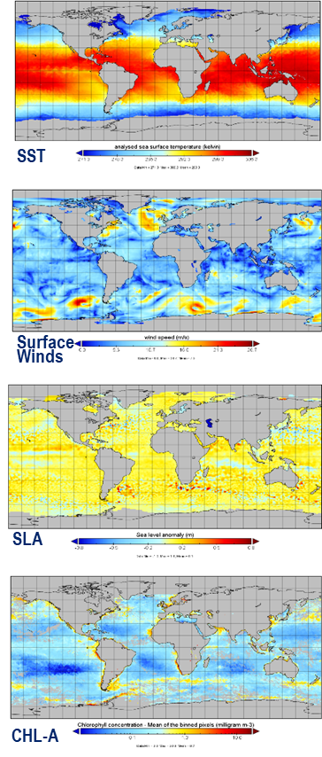
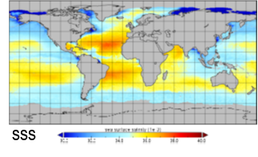
Constituent CEOS Agency Ocean Data
Baseline Dataset: High value, L4 Global Reanalysis & NRT products
COVERAGE
Sea Surface Temperature
- METOFFICE-GLO-SST-L4-NRT-OBS-GMPE-V3 (GHRSST-CMEMS/UK Met.Office)
- MUR25-JPL-L4-GLOB-v4.2 (GHRSST- NASA/Measures)
Ocean Surface Winds
- WIND_GLO_WIND_L4_REP_OBSERVATIONS_012_006 (CERSAT/IFREMER - CMEMS)
- WIND_GLO_WIND_L4_NRT_OBSERVATIONS_012_004 (CERSAT/IFREMER - CMEMS)
- RSS_CCMP_WINDS_V2.1 (NASA/Measures – RSS)
Ocean Surface Topography
- SEALEVEL_GLO_PHY_L4_NRT_OBSERVATIONS_008_046 (AVISO/CLS - CMEMS)
- SEALEVEL_GLO_PHY_L4_MY_008_047 (AVISO/CLS - CMEMS)
SEA_SURFACE_HEIGHT_ALT_GRIDS_L4_2SATS_5DAY_6THDEG_V_JPL1812 (NASA/Measures - JPL)
- NOAA_LSA_SLA_GLOB_L4_NRT and DT (NOAA/LSA)
Ocean Color
- JPL-MRVA25-CHL-L4-GLOB-v3.0 (NASA/COVERAGE -JPL)
- OCEANCOLOUR_GLO_CHL_L4_REP_OBSERVATIONS_009_082 (Globcolour – CMEMS)
- OCEANCOLOUR_GLO_CHL_L4_NRT_OBSERVATIONS_009_033 (Globcolour – CMEMS)
- NOAA_MSL12-NRT-CHL-Daily-L4 and DT (NOAA/Coastwatch)
Sea Surface Salinity
- OISSS_L4_multimission_7day_v1 (NASA/SCP – IPRC-SOEST, RSS)
- OISSS_L4_multimission_Monthly_v1 (incl. SSS-anomaly field) (NASA/SCP – IPRC-SOEST, RSS)
- CCI_OISSS_L4_multimission_Weekly_v3.21 (ESA/CCI – ESA CCI, CEDA-NERC)
- CCI_OISSS_L4_multimission_Monthly_v3.21 (NASA/SCP –ESA CCI, CEDA-NERC)
sss

Slide 10
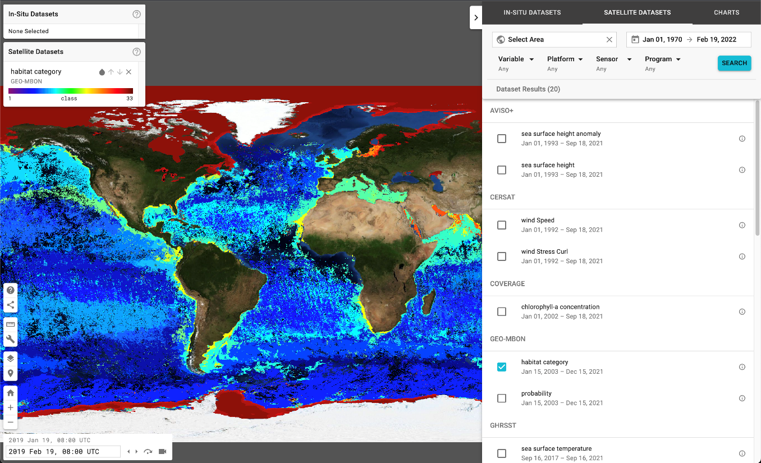
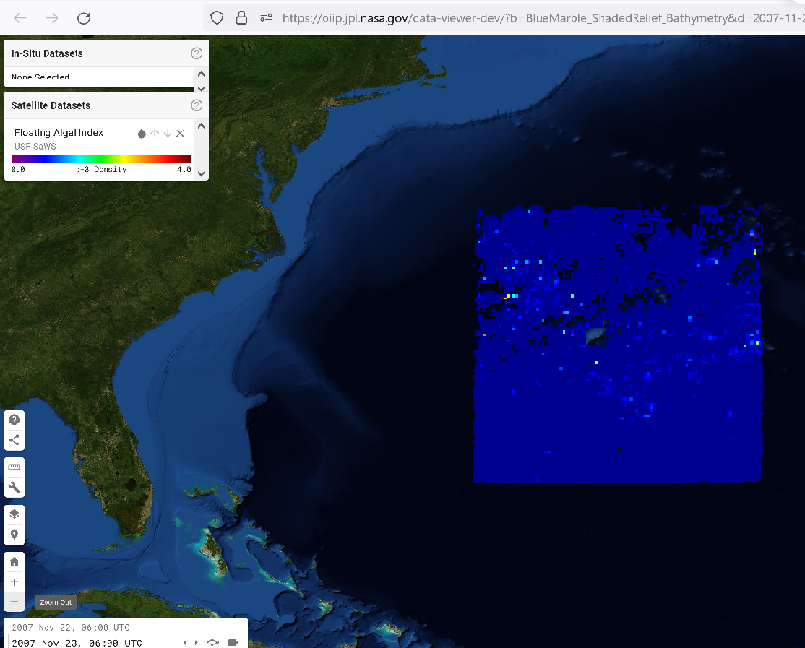
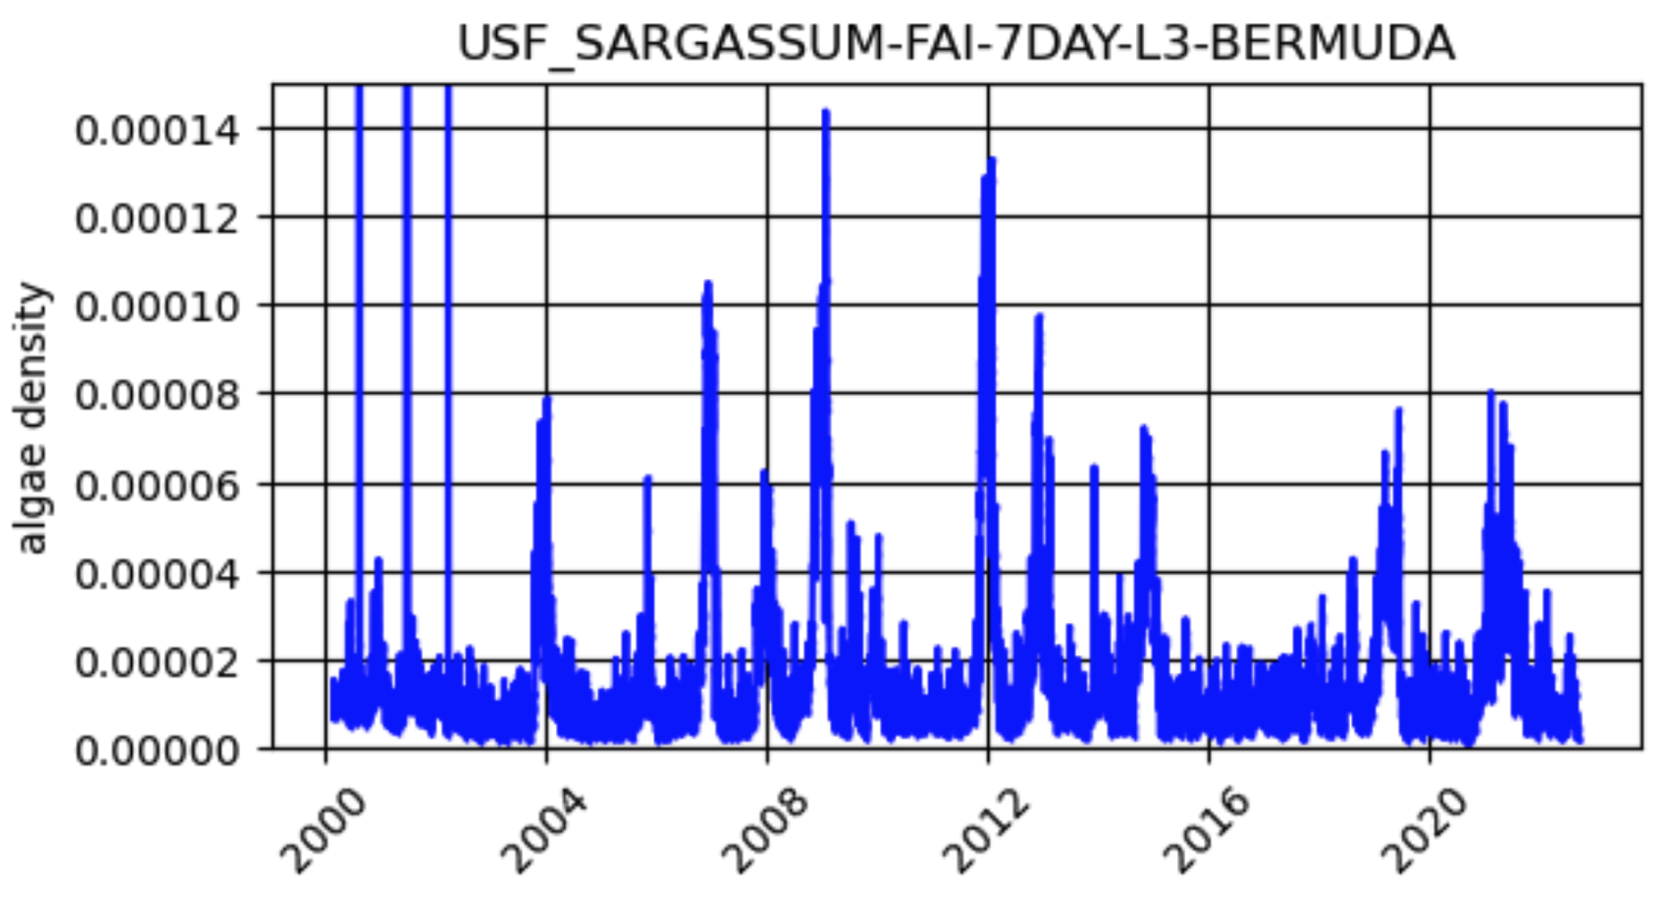
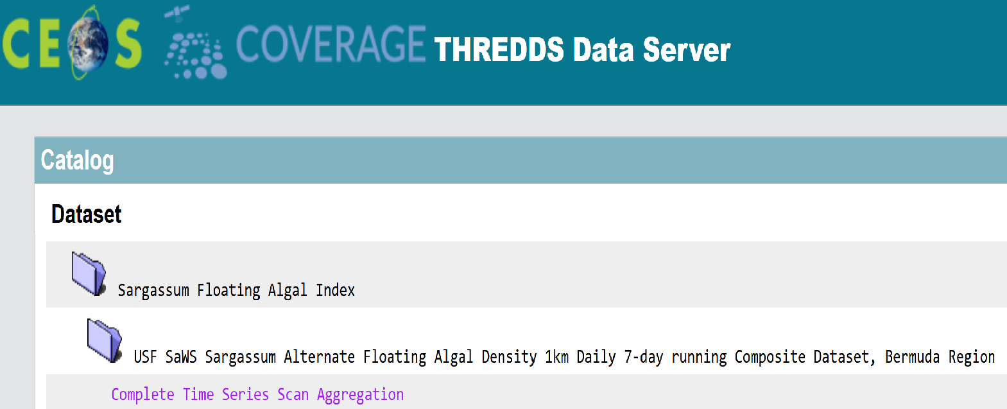
Value-added EO Data Products Included
In Support of COVERAGE’s Regional Ecosystem Applications
COVERAGE
GEO-MBON “SeaScapes” marine habitat classification monthly product integrated in COVERAGE Viewer
Sargassum Floating Algal Index Daily Product integrated in COVERAGE Viewer, THREDDS and SDAP Analytics services
Developed by M. Kavanaugh (OSE)
Developed by Chuanmin Hu (USF, Optical Oceanography Lab)
USF Satellite-based Sargassum Watch System (SaWS)

Slide 11
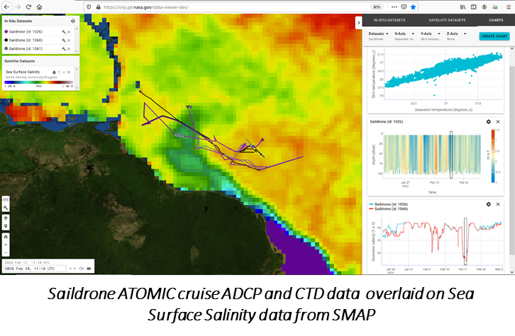
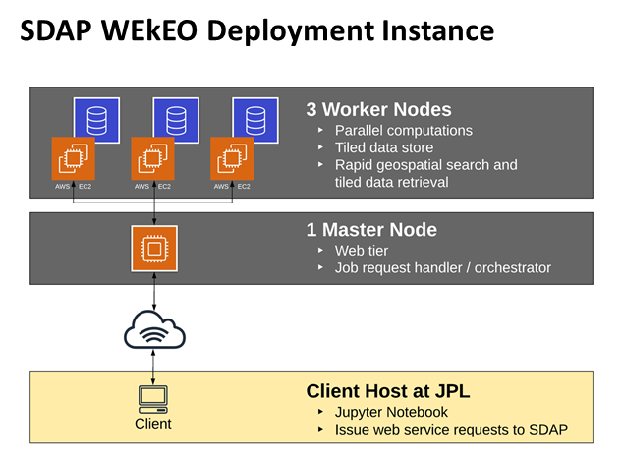
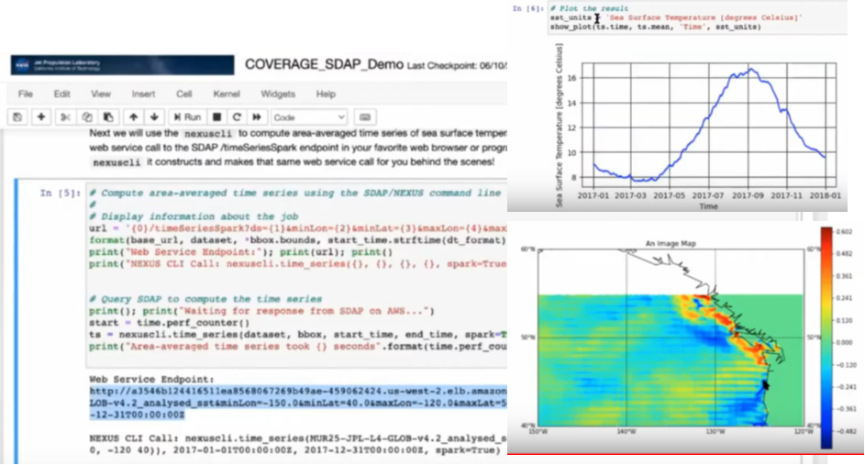
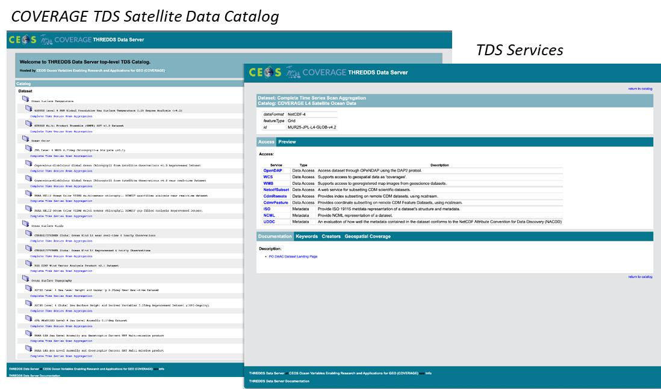
Core Data Services
Accessible via COVERAGE Prototype Portal https://coverage.ceos.org
COVERAGE
Web-based Data Visualization - “COVERAGE Data Viewer”
Integrated visualization of satellite & in-situ data (generalized capability)
Synchronized horizontal and vertical views of data and their evolution over time (custom time step intervals)
Integrated dataset Search & Filtering
Online Help & URL sharing
Analytics
Science Data Analytics Platform (SDAP) – Apache.org open source project
Data cube technology “Enabling Big Data Science Without Download”
Full suite of COVERAGE EO data included
Deployed on both NASA/AWS and EUMETSAT/WEkEO nodes
Interfaces: SDAP-API, Jupyter notebooks, Data Viewer
SDAP Jupyter Notebook Interface
Data Access & Subsetting
Powered by THREDDS v5 in the Cloud
Deployed on both COVERAGE AWS and WEkEO nodes
TDS catalogs accessing COVERAGE dataset granule repositories natively in S3 object stores
Bundled Services/APIs: NCCS (subsetting/download), OPeNDAP, WMS, WCS, ISO metadata

Slide 12
Concluding Remarks
COVERAGE
Accomplishments & Contributions at the conclusion of Phase-C
COVERAGE is a unique, cross-cutting initiative touching upon/supporting several CEOS program areas
A reusable, open source software platform and architecture with core capabilities & data has been assembled, capable of supporting interdisciplinary marine applications and promoting Open Science. This can be extended further to support specific application use cases.
Integrates a range of key interagency satellite Ocean datasets and select value-added EO products with support also for in-situ and ecological data.
Ongoing UN Decade program engagement on behalf of CEOS and successful Ocean Shot concept.
COVERAGE is partnering with 2 Intergovernmental agencies (SSC and IATTC) to support emerging ecosystem-based management approaches that include remotely sensed environmental data in assessment frameworks.
Strong endorsements received for COVERAGE continuation by SSC and community interest in novel technical capabilities.
Initiate discussion on possible future evolution for consideration at next CEOS-SIT meeting
Interest and options for further co-development of COVERAGE within CEOS
Strategy for possible longer-term sustainability of COVERAGE

Slide 13
Backups

Slide 14

Harmonized Data Access & Service Layer Instances
COVERAGE
Users
Science & Applications
COVERAGE
Data Integration
Service Layer
:
Visualization
Analytics
Subset/Download
Imaging
Metadata/Search
…
Harmonized Access
Services
DAACs :
NASA
NOAA
CMEMS
…
US-IOOS
IMOS-AUS
EMODNET
…
Satellite
In-situ

