Slide 1
CEOS & Biodiversity Ecosystem Extent Task Team ToR and Activity Proposal
Gary Geller, NASA
Marie-Josée Bourassa, CSA
Marc Paganini, ESA
Session 5, Item 2.7
2022 CEOS Plenary, Biarritz, France
Nov. 29 – Dec. 1

Slide 2
History
~2012: Biodiversity Activity initiated
~2020: Informal discussions on increasing engagement
Triggered by biodiversity crisis
Goal: Long term engagement
2021 (35th Plenary): “Discussion Group” initiated
2022 (SIT-TW):
Ecosystem Extent focus proposed
Resulted in Action SIT-TW-2022-07 (develop ToR proposal for Plenary)
Notes:
Biodiversity Discussion Group was to begin increased CEOS engagement with biodiversity

Slide 3
Now…
Forming Ecosystem Extent Task Team
Mechanism to enhance CEOS engagement with biodiversity
Long term goal remains
Need for Ecosystem Extent is ubiquitous
EO has a central role
New missions, advancing technology
Wikimedia-Beatriz Moisset

Slide 4
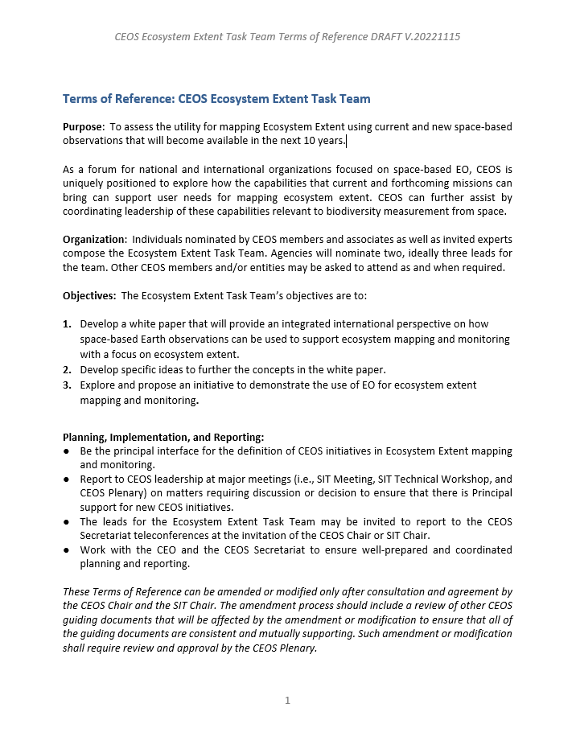
Task Team Terms of Reference
For Endorsement

Slide 5
Task Team Purpose
(From the Terms of Reference)
To assess the utility for mapping Ecosystem Extent using current and new space-based observations that will become available in the next 10 years
Notes:
From draft TOR

Slide 6
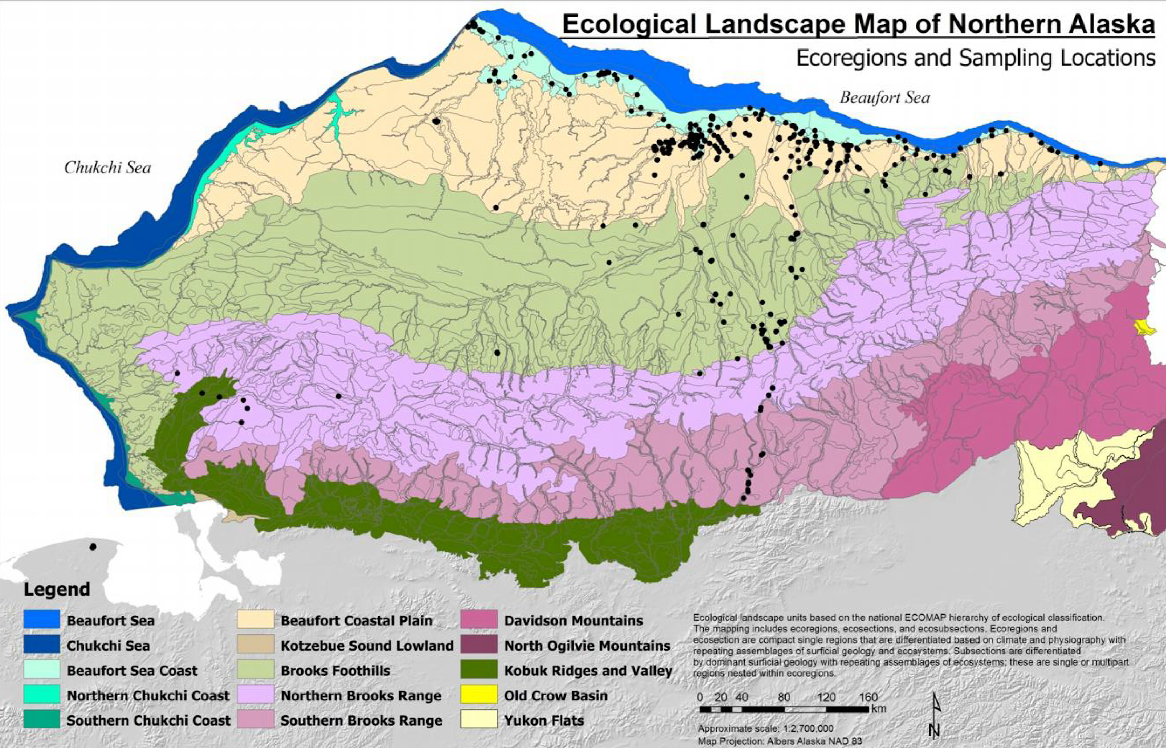
What is Ecosystem Extent?
A dataset that outlines one or more ecosystems of interest
Discrimination based on ecosystem characteristics
ORNL DAAC from Jorgenson and Grunblatt, 2013
Notes:
Rather coarse scale—15 ecosystems (ecoregions)
Perhaps think of ecosystem extent as land cover on steroids, e.g., by using more ecosystem characteristics such as the level of biodiversity

Slide 7
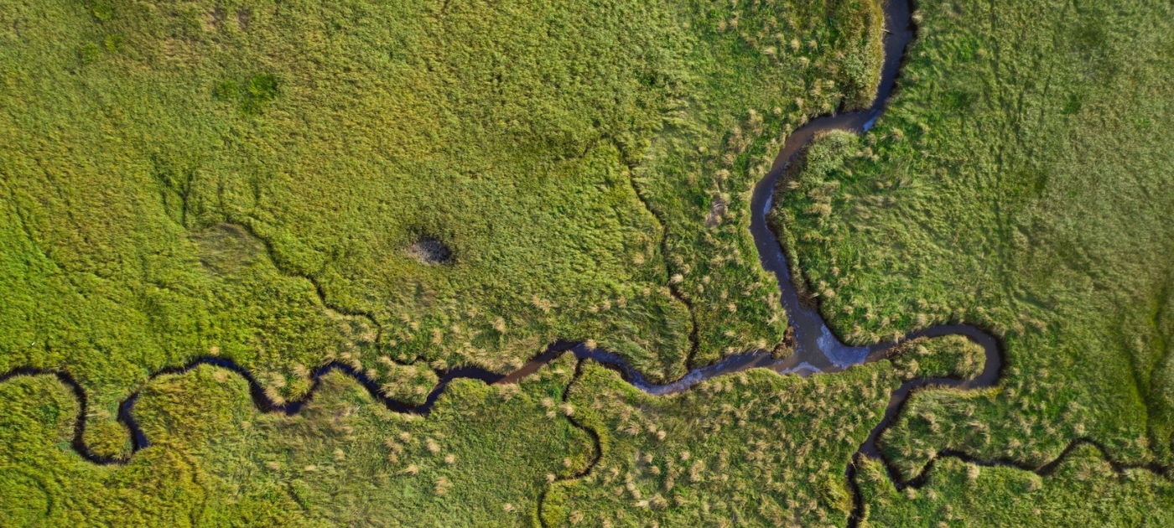
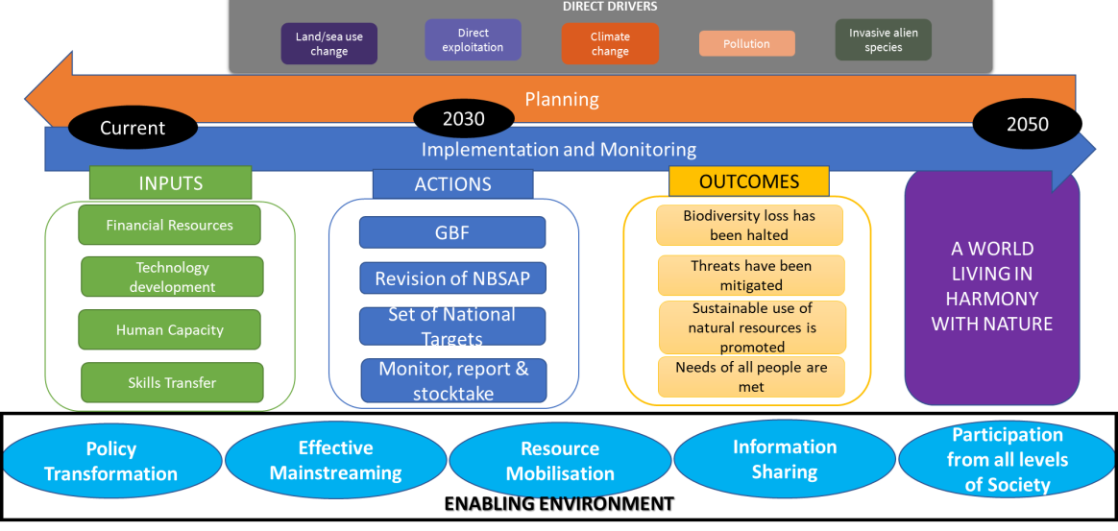
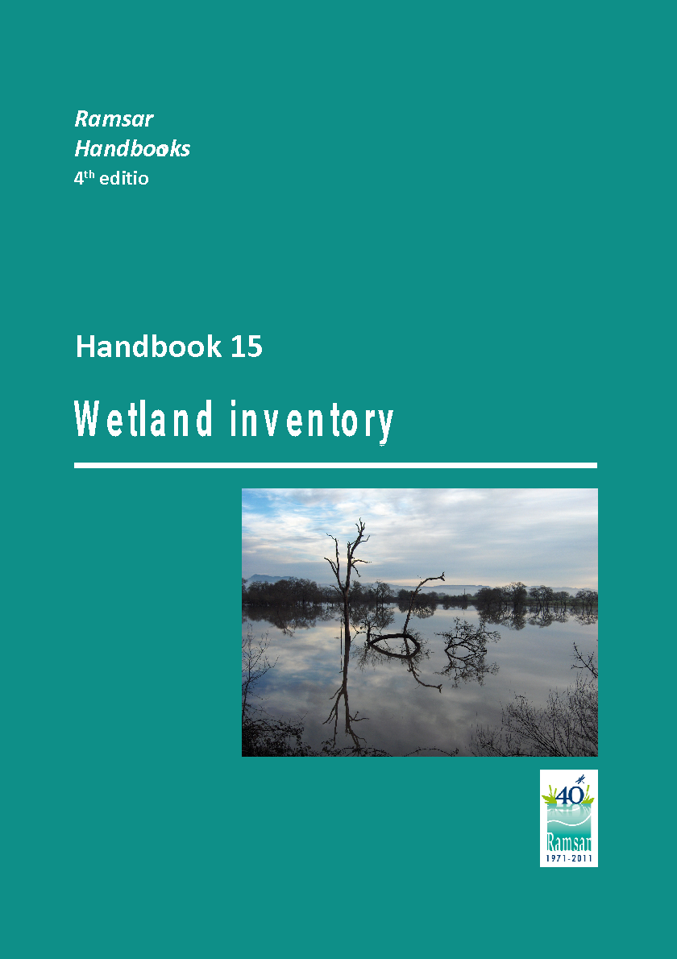
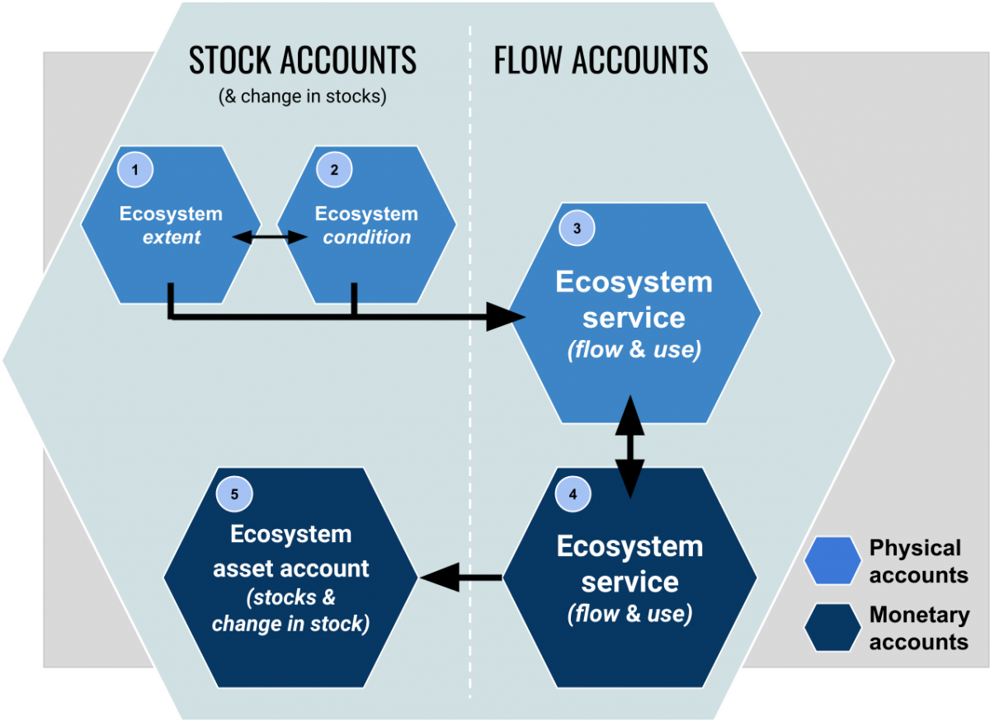
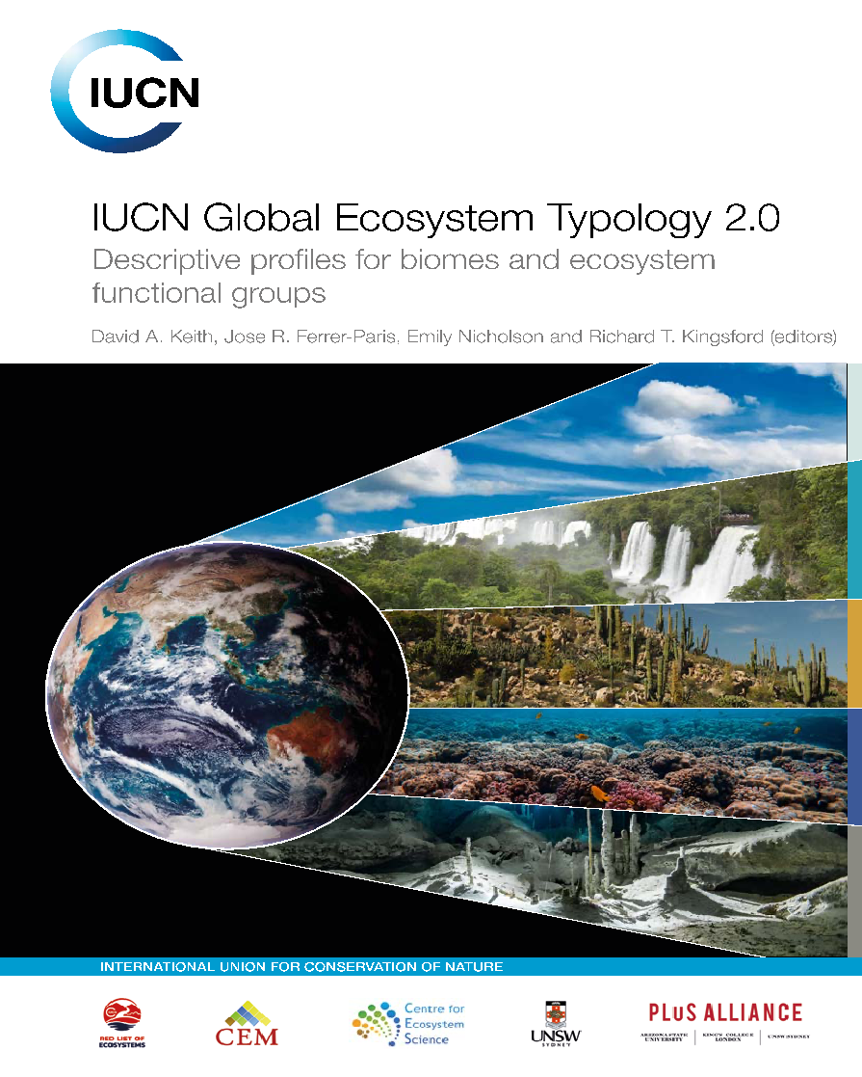
Why Is Ecosystem Extent So Important ?
Convention on Biological Diversity (CBD)
Sustainable Development Goals (SDGs)
Ramsar Convention on Wetlands
Post 2020 Global Biodiversity Framework (GBF)
SDG Target 6.6
Protect and restore water-related ecosystems, including mountains, forests, wetlands, rivers, aquifers and lakes
Ramsar Strategic Plan (2016 – 2024)
Target 8: National wetland inventories are initiated, completed or updated and disseminated and used for promoting the conservation and effective management of all wetlands.
SDG Target 14.2
Sustainably manage and protect marine and coastal ecosystems to avoid significant adverse impacts.
GBF Monitoring Framework
Headline indicator A.0.1 Extent of selected natural ecosystems (forest, savannahs and grasslands, wetlands, mangroves, saltmarshes, coral reef, seagrass, macroalgae and intertidal habitats)
SDG Target 15.1
Ensure the conservation, restoration and sustainable use of terrestrial and inland freshwater ecosystems and their services.
SEEA Ecosystem Accounting
New international standard on Ecosystem Accounting which regulate the production on statistical accounts on ecosystem extent, condition and services.
Measurement framework underpinning the development of monitoring frameworks of other international agreements, such as the CBD post-2020 GBF, the Ramsar Convention on Wetlands, and the 2030 Agenda on Sustainable Development.

Slide 8
Task Team Objectives
From the Terms of Reference
Develop a white paper that will provide an integrated international perspective on how space-based Earth observations can be used to support ecosystem mapping and monitoring with a focus on ecosystem extent.
Explore and propose an initiative to demonstrate the use of EO for ecosystem extent mapping and monitoring.

Slide 9
Task Team Organization
From the Terms of Reference
Individuals nominated by CEOS members and associates as well as invited experts compose the Ecosystem Extent Task Team.
Agencies will nominate two, ideally three leads for the team.
Other CEOS members and/or entities may be asked to attend as and when required.

Slide 10
Summary
Ecosystem Extent is a key product needed by a wide range of organizations
Advancing technology and both current and forthcoming missions have the potential to greatly improve existing products
Proposed Task Team will explore ways to take advantage of these opportunities and demonstrate how
Terms of Reference provide a top-level framing of the proposed team

Slide 11
Thank you
US FWS

Slide 12
Backup

Slide 13
White Paper Content (v. preliminary)
What is ecosystem extent and why is it important?
Who uses it and what for?
How is it currently mapped?
What are the shortcomings?
What is EO’s role?
How do different sensor types map to ecosystem characteristics?
How can forthcoming missions address the shortcomings?
What types of in situ data are needed (and are they available)?
What role can advancing technology play in improving products?
What should be CEOS’s role?
What improvements are possible if shortcomings are eliminated?
Can they enable broadscale IUCN Ecosystem Typology products?
What are the challenges and dependencies to utilizing advances?
What would success look like?

Slide 14
Demonstrator
Purpose
Demonstrate how advances in EO and technology can improve ecosystem extent mapping and monitoring to interested parties such as CBD and SEEA
Wide range of possibilities
Scope and details will be determined by the Task Team
Want to excite potential users
Leverage existing initiatives as much as possible
Enable future work
Dependent on TT level of expertise and of support

Slide 15
Role of EO
Mapping ecosystem extent at scale is impractical from ground
Ecosystems have characteristics that can be measured from space
Classical ecology: Structure, Composition, Function
These map to sensor types
But also need…
Training data
In situ data* (e.g., level of biodiversity)
Models: correlate EO data with site & do the classification
Currently: multi-sensor data fusion is not common
Notes:
Function is a new and developing field

Slide 16
Notional Timeline
Jan-Mar (+) 2023: Enhance TT membership
White Paper:
Jan.-Sept. 2023:
Assemble outline, assign activities and develop initial draft
Sept.-Nov. 2023:
Complete Stream 1 and finalize the White Paper for presentation at the 2023 Plenary
Make recommendations for future CEOS activities under the CEOS Work Plan
Demonstrator
2023: Explore ideas in parallel with White Paper
2023-2024:
Develop concept for demonstrator and begin implementation, in conjunction with stakeholders
Sept 2024: Present initial demonstrator at SIT Technical Workshop
Nov 2024: Present outcome of the two-year Task Team effort at CEOS Plenary

Slide 17
CBD: Widespread Need for Eco Extent
Prioritisation of actions to achieve goals
Assessment &
decision support
Monitoring progress towards goals
Actions
Target 8: Contribution to climate mitigation & adaptation
State of Nature
Societal Benefits
Target 2: 20% of degraded ecosystems are restored
Target 6: Pathways for invasive alien species
Target 10: Sustainable management
Goal A: Ecosystems--area, connectivity
and integrity
Goal A: Species reducing # threatened & maintaining genetic diversity
Goal B: nature’s contributions to people (food security, access to safe water, resilience to natural disaster)
User Goals
& targets
Target 3: 30% of land and sea conserved
Target 12: Urban green space
Extent of Suitable Habitat
Needed Products
Ecosystem Extent (by ecosystem)
Ecosystem Connectivity/ fragmentation
ECV: Land Cover & Land Use
Ecosystem Integrity
Societal
Data Flow
Requirements Flow
EESV: coastal risk reduction
Species
l
Ecosystem Structure EBVs
Model
EBV: Live Cover
EBV: Ecosystem Vertical Profile
EBV: Ecosystem Distribution
EBV: Species Distribution
Key EO Feedstock
Radar
Lidar
Optical MS
Optical HSI
in situ species data; environ data
Ecosystem Level
Species Level
Inspired by: Kim et al. In prep. Essential Biodiversity Variables and Essential Ecosystem Services Variables for Post-2020 Policy Development and Implementation, CBD SBSTTA24 Inf Doc
Notes:
Note that Ecosystem Extent benefits from all types of EO sensors—not just optical
EBV: “Ecosystem Distribution” is identical to Ecosystem Extent
Key point 1: EO is essential for many key products needed by the CBD (e.g., Ecosystem Distribution, Species Distribution)
Key point 2:
EO must be transformed into higher-level products to address CBD needs
But many needed higher level products are not routinely produced by space agencies (eg: Ecosystem Integrity)

