Slide 1
Sustainable Development Goals
Brian Killough, NASA, SEO
Marc Paganini, ESA, SIT Chair Team
Ivan Petiteville, ESA, SIT Chair Team
Flora Kerblat, CSIRO
Agenda Item 2.6
2022 CEOS Plenary
Biarritz, France
Nov 29-Dec 1, 2022

Slide 2
New SDG Coordination Group
Background: CEOS endorsed the transition of the CEOS SDG Ad Hoc Team to a "CEOS SDG Coordination Group" at the 2021 CEOS Plenary.
Group GOAL: The CEOS SDG Coordination Group will communicate our current and planned resources (e.g., analysis ready satellite data, tools, guidance, capacity building) internally across the CEOS community, and externally, and will seek a better understanding of the evolving needs of U.N. Custodian Agencies and country-based users to address the UN Sustainable Development Goals (SDG), including through liaison with GEO.
Strategic Lead: SIT Chair Team (Ivan Petiteville, Marc Paganini)
Implementation Lead: SEO Team (Brian Killough, David Borges)
Former SIT Chair Team (CSIRO): Flora Kerblat, Alex Held
CEO: Marie-Claire Greening
CEOS-GEO liaison: Argyro Kavvada
* Support from Symbios (George Dyke, Matt Steventon, Libby Rose)

Slide 3
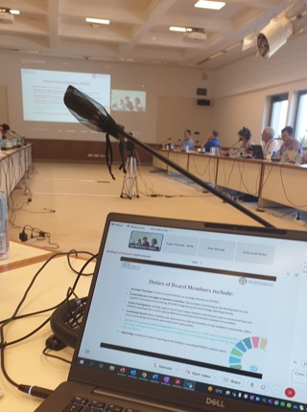
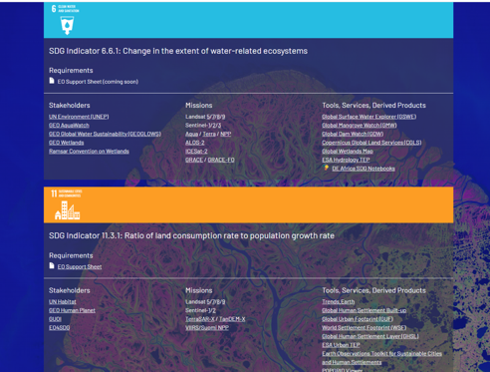
Excellent progress in 2022
Since our endorsement at the CEOS Plenary in late 2021, the SDG Coordination Group has:
been meeting monthly (last on Nov 8),
made excellent progress on the planned deliverables (8 of 9 complete),
reassessed our communications with GEO,
completed two face-to-face side-meetings at SIT-TW and Plenary (yesterday),
agreed on new and impactful deliverables for 2023 and beyond.
All meeting notes here: https://tinyurl.com/yh7af8t8
ceos.org/sdg
SDG side-meeting, SIT-TW, ESRIN Frascati, Sept 13th 2022
Slide ‹#›

Slide 4
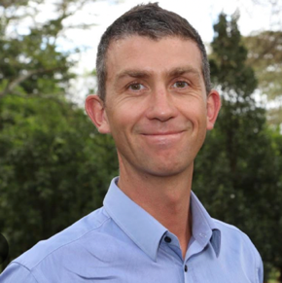
Side-meeting Outcomes
Clear benefits of having a direct interaction with a United Nations SDG Custodian Agency – Stuart Crane (UNEP):
Demonstration of UNEP Freshwater Ecosystem Explorer: www.sdg661.app, used by UN Members Countries,
Followed by Q&A
Review of 2022 deliverables status
GEO provided an update post GEO week – Laurent Durieux (GEO SEC) & Argie Kavvada (EO4SDG)
Discussions and refinement of future deliverables for 2023 and beyond

Slide 5
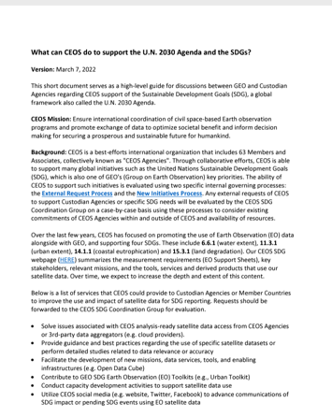
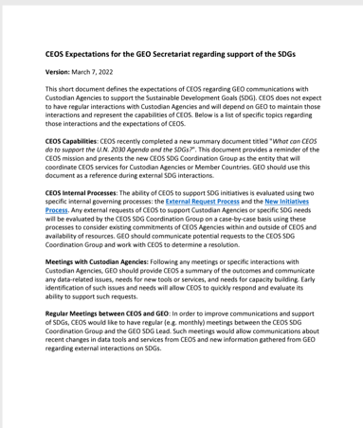
Guiding Documentation
What can CEOS do to support the U.N. 2030 Agenda and SDGs?
A high-level guide for discussions between GEO and Custodian Agencies regarding CEOS support of SDGs
References to the CEOS External Request and New Initiatives Processes
CEOS expectations for GEO regarding support of the SDGs
Defines the expectations of CEOS regarding GEO communications with Custodian Agencies. CEOS depends on GEO to maintain those interactions and represent CEOS’ capabilities.
Reference to CEOS Capabilities, CEOS internal processes, communications
Both documents published on the CEOS website (7th March 2022)

Slide 6
2022 Deliverables
Deliverables # | Name | Status | Comments
SDG-19-02 | Data Cube prototypes | COMPLETE | Posted in GitHub
SDG-20-03 | Water Support Sheet | COMPLETE | Posted online
SDG-20-04 | Urbanization Support Sheet | COMPLETE | Posted online
SDG-20-05 | Eutrophication Support Sheet | COMPLETE | Posted online
SDG-20-06 | Land Degradation Support Sheet | COMPLETE | Posted online
SDG-20-07 | EO Enabling Infrastructures | COMPLETE | Posted online
SDG-20-08 | EO Good Practice Guidance | COMPLETE | Superseded by EO Support Sheets
SDG-20-09 | EO Demonstration Cases | In Progress | Recommend Extension into 2023
SDG-22-01 | SDG webpage (CEOS website) | COMPLETE | https://ceos.org/sdg/
8 of 9 deliverables are complete
SDG-20-09 is proposed for an extension into 2023

Slide 7
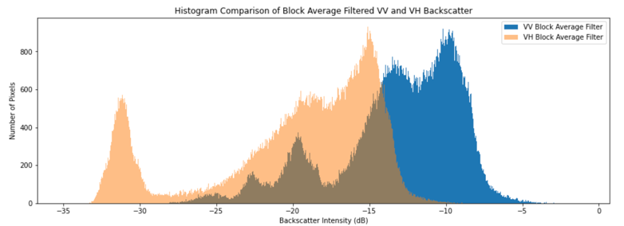
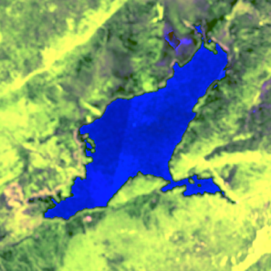
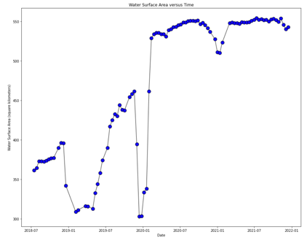
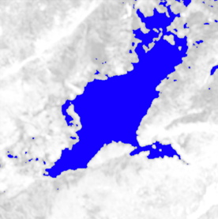
Data Cube Prototypes
SDG-19-02
The SEO completed the development of a water extent (SDG 6.6.1) use-case using the Open Data Cube (ODC) Sandbox.
The Jupyter notebook algorithm uses Sentinel-1 radar data to detect water extent every 12 days which can be used to supplement the annual SDG reporting.
The notebook is available on GitHub and can be run by any global users.
Additional work will be completed in 2023 to develop detailed documentation and training videos.
https://github.com/ceos-seo/odc-colab/tree/master/notebooks
Slide ‹#›

Slide 8
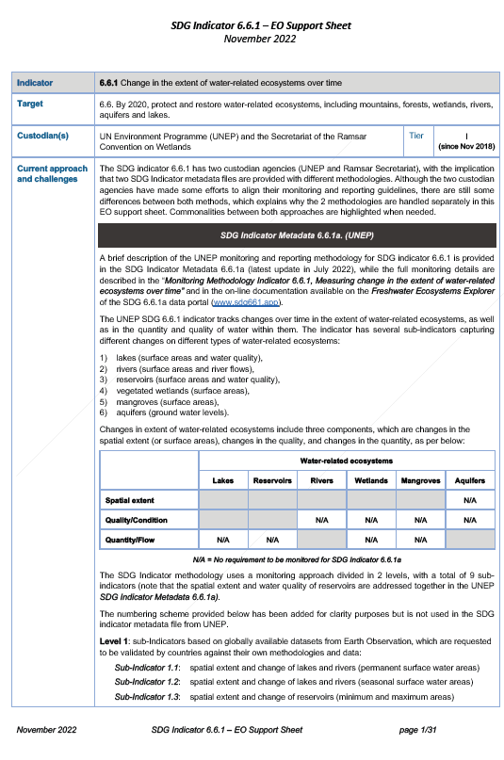
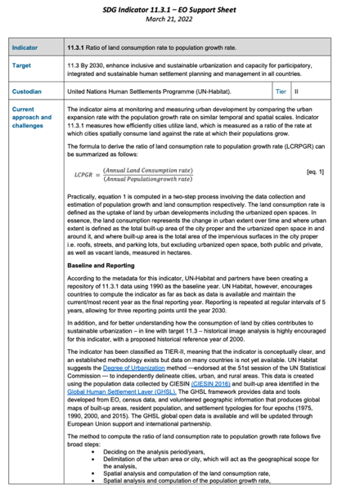
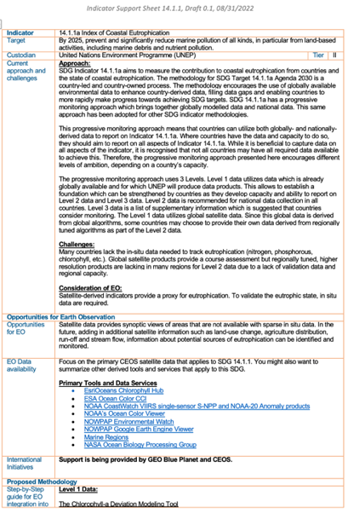
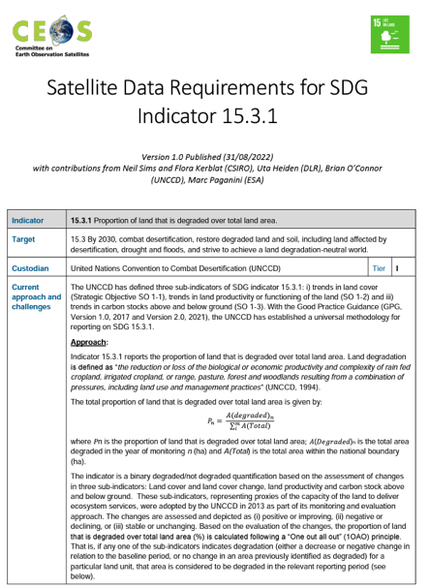
EO Support Sheets
ceos.org/sdg
SDG-20-03
Water
SDG-20-04 Urbanization
SDG-20-05
Coastal Eutrophication
SDG-20-06
Land Degradation
The Earth Observation (EO) Support sheets are a valuable resource for the user community and Custodian Agencies.
Details include current approaches and challenges, data requirements, access and tools, and publication references.

Slide 9
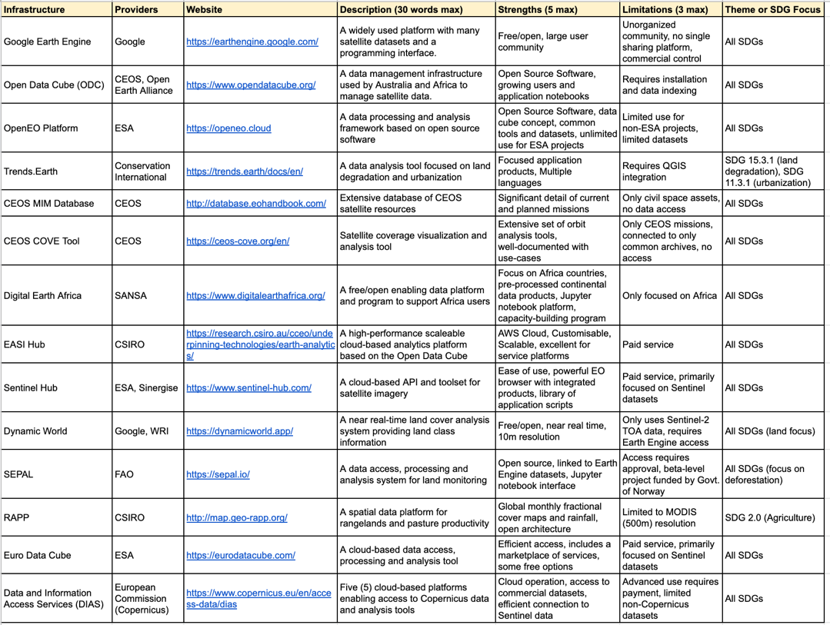
EO Enabling Infrastructures for SDGs
SDG-20-07
CEOS has developed a non-exhaustive list of 14 commonly-used Earth Observation (EO) enabling infrastructures that use free and open EO datasets.
Many of these resources broadly address the SDGs while a few are more focused on a single SDG.
In addition, many of these resources are free and open to all users.

Slide 10
SDG Website
SDG-22-01
A new webpage dedicated to SDGs including:
links to previous resources (AHT),
EO Support sheets (requirements)
And more: stakeholders, primary missions, tools, services and derived data products.
This page is a valuable internal and external resource.
ceos.org/sdg

Slide 11
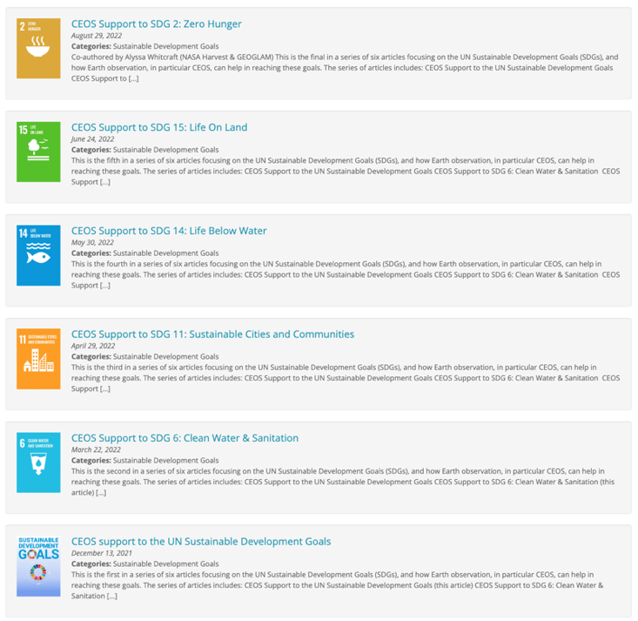
SDG Communications
The CEOS Communications team has worked with SDG team members to complete significant updates to the CEOS SDG webpage: www.ceos.org/sdg
A series of 6 news articles focused on SDGs have been published on the CEOS website. These articles have been released over several months (Mar-Aug) to maintain a steady flow of SDG material.
All workplan deliverables are published on the SDG website
The CEOS Communications Team has created a new SDG video, played at the CEOS booth at the GEO Week in Ghana (attracted visitors)

Slide 12
Connections to GEO
CEOS contributions to GEO activities:
Urban Toolkit with UN Habitat: https://eotoolkit.unhabitat.org/
a New Book: AGU’s Geophysical Monograph Series, Earth Observation Applications and Global Policy Frameworks
GEO week 2022: Brian Killough (SEO) represented CEOS on a panel (EO4SDG side-event) + SDG video at the booth
Today’s joint Special Session with OGS (Oceania Geospatial Symposium) co-organised by GEO : CEOS presentation includes SDGs in the Pacific
Way forward
Plan SDG workshop at the next annual CEOS/GEO bilateral in early 2023 (tentative)
Plan new activities with GEO to continue support countries and help them meet their sustainability targets (e.g., Digital Earth programmes; projects in the Pacific region; small islands; climate; Analysis Ready Data (ARD) … )
GEO to facilitate meetings with CEOS, key United Nations Agencies and Conventions (e.g., UNEP, Ramsar) to better explain what we do and understand the needs of those groups

Slide 13
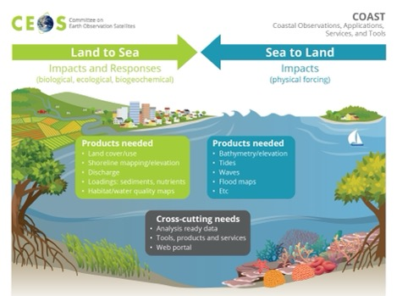
Potential Future Deliverables (1 of 3)
Land Degradation Neutrality (LDN) Project (Sponsor: Neil Sims, CSIRO, and CEOS SEO) – Use the decision tree workflows described in the Good Practice Guidance (GPG) to guide a data and coverage analysis for specific geographies with known issues.
Consider past, current and future missions and include commercial mission opportunities
Focus on small islands (Pacific, Tropical) and mountainous regions.
Benefits to Digital Earth Pacific and a new Mexico project in the Caribbean Islands.
Productivity and Soil Organic Carbon in very arid countries (e.g., Middle East)
COAST Bathymetry Project (Sponsor: Emily Smail, NOAA) - This project, focused on satellite-derived bathymCetry will focus on the Pacific Islands.
Direct connection to SPC and the Digital Earth Pacific initiative.
Potential collaborations for the collection of in-situ validation data and hosting of local products.
Connection to the Oceana Geospatial Symposium (OGS) – Thursday morning interaction
SDG: 15.3.1
SDG: 14

Slide 14
Potential Future Deliverables (2 of 3)
t
Text
Text
Wetland Ecosystem Extent Demonstration (Sponsor: Gary Geller, NASA) – Demonstrate a focused ecosystem extent classification workflow focused on the integration of multiple CEOS datasets with ground and in-situ datasets.
Link to new CEOS Ecosystem Extent Task Team
Potential engagement with ecosystem experts and national governments
Confirmed desire to support SDG 6.6.1 – UNEP (Stuart Crane) report to CEOS suggested improvements in mapping wetland ecosystems is needed.
Open Data Cube Applications (Sponsor: Brian Killough, CEOS SEO)
Develop training documents and tutorials for the existing SDG 6.6.1 (water extent) application released in mid-2022.
Develop and release a new application for urban extent (SDG 11.3.1) focused on short-term variation as a supplement to U.N. 5-year reporting. Include training documents and tutorials.
Advertise these outputs through the GEO EO4SDG team for further impact.
SDG: 6.6.1
SDG: 6.6.1
SDG: 11.3.1

Slide 15
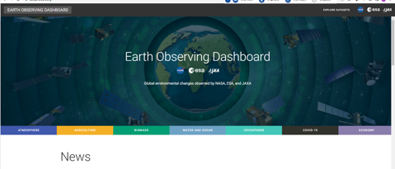
Potential Future Deliverables (3 of 3)
Wetlands’ Inventories (Sponsor: Marc Paganini, ESA) - The task would involve assessing past, current and future mission capabilities regarding the measurement of wetland ecosystem extent. It might also address issues with land classification for these complex land types.
Connection to GEO Wetlands Initiative (Marc-ESA and Laurent-GEOSEC)
Connection to RAMSAR (COP meeting Nov 2022)
Connection to new CEOS Ecosystem Extent Task Team
SDG Dashboard (Sponsor: Marc Paganini, ESA) - Create a new CEOS SDG dashboard (high-level visualization tool) to raise awareness on SDGs and the impact of satellite data.
Consider the ESA/NASA/JAXA COVID-19 dashboard (now EO dashboard – https:://eodashboard.org)
Consider the example climate dashboard: climatedata.imf.org
t
Text
Text
SDG: 6.6.1
Multiple SDGs

Slide 16
Conclusion
New SDG Coordination Group has been working well: monthly meetings (and side-meetings), increased external communications, and 8 of 9 deliverables are now completed -> Clear value for CEOS to have a permanent body coordinating SDG work, including to support the coordination with GEO
The SDG group has been discussing future deliverables: broadening SDG scope (not only Indicators), alignment with CEOS priorities, collaboration with GEO, etc.
Future deliverables with identified Agency and resource commitments to be further refined and added to the CEOS workplan
Planned meetings for 2023:
2022
2023
Feb-March
CEOS Plenary side-meeting
29th Nov
14th Dec
CEOS-GEO annual meeting
Early March
CEOS SIT-38 side-meeting
April-August (monthly)
CEOS SIT TW
Side-meeting

