Slide 1
SEO Perspectives on New Space
Brian Killough, NASA, SEO
David Borges, NASA, SEO
Agenda Item 2.2
2022 CEOS Plenary
Biarritz, France
Nov 29-Dec 1, 2022

Slide 2
Recent Meetings
SatSummit 2022 – Washington, DC, USA
Gathering of satellite industry and global development leaders ... the next generation
High interest in new, interoperable measurements ... radar, hyperspectral, high-resolution optical, drones, Internet of Things (IoT)
Pecora 2022 – Denver, Colorado, USA
Attended by many data providers and users
Mix of workshops and presentations
High CEOS participation
Common topics: ARD, STAC, ODC, SDGs
Notes:
We need to continue to attend meetings where "new space" entities are present
Building relationships with "new space" partners can help support our mission too!

Slide 3
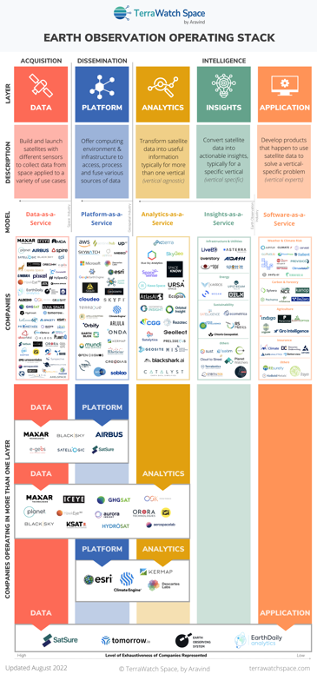
Common "New Space" Themes
Many new “start-ups” are entering the satellite data community ... they are willing to collaborate with CEOS
Public/Private sector EO value propositions remain distinct, but parallel … synergistic opportunities are increasing and can be mutually beneficial
User licenses remain a complex landscape … we must help each other navigate
Analysis-Ready Data (ARD) ... if we don’t lead, they will
Cloud Computing ... they are NOT downloading data
Open Science ... the community is willing to share
Jupyter Notebooks .. this is the most common platform for use
ESGs are just as popular in the commercial community as SDGs are in the government community
Credit: Aravind, Terrawatch Space
Notes:
This is what interests the "new space" community
We need to be aware of their interests and move "with" them
Public/private value propositions remain distinct, but parallel – “both communities are interested in optimizing EO for societal benefit and improve decision making”
Figure .... An example of the number of private sector companies that exist in the full value chain from data to applications. This chart was mostly public sector organizations 20 years ago, but now is mostly private sector.

Slide 4
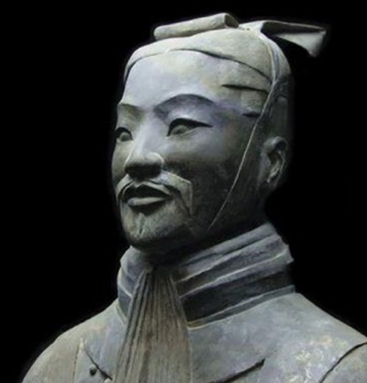
Closing Thoughts
We need to learn more about how our data relates to the data from "new space" missions. “We need to confirm what we see from space” Hamed Alemohammad, Radiant Earth
We need to be part of the ML and AI movement. “The future is forecasting” Joe Morrison, Umbra
We have a flood of new data coming from "new space" and our own missions. “In the midst of chaos, there is also opportunity” Sun Tzu, Chinese Military Strategist
Credit: NACE
Credit: James Clear
Notes:
We need to look for opportunities to engage with the "new space" community.
Interoperability and cal/val opportunities need more focus. Private sector capabilities are usually built on the backbone of (our) highly trusted government data.
CEOS needs to better understand this ecosystem to improve efficiencies.
We need to be cognizant of their world ... cloud computing, ML, AI
We need to embrance the opportunity among the chaos
CEOS is not the first group to address this trend – we need to work closely with partners (GEO, CGMS) and not reinvent the wheel here.

