Slide 1
White Paper: “Monitoring Surface PM2.5: An International Constellation Approach to Enhancing the Role of Satellite Observations”
Atmospheric Composition Virtual Constellation (AC-VC) B. Veihelmann, ESA, AC-VC Co-Chair S. Kondragunta, NOAA, AC-VC Topical Lead AQ Aerosol
Agenda Item # 1.20
2022 CEOS Plenary
Biarritz, France
Nov. 29 – Dec. 1

Slide 2
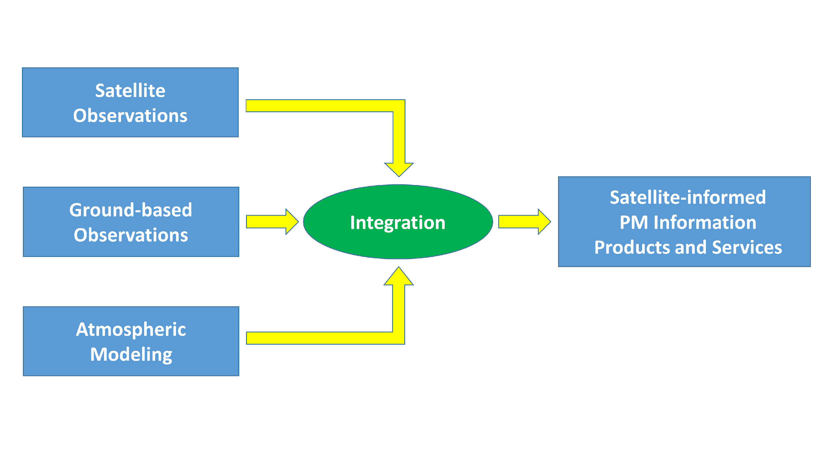
Purpose
Objective: Strengthen the role of satellite missions with aerosol observation capabilities in monitoring particulate pollution of air
Room for improvement
Products
Methods
Validation
Collaborative constellation approach
Whitepaper with actionable recommendations

Slide 3
Content / Structure
Title: “Monitoring Surface PM2.5: An International Constellation Approach to Enhancing the Role of Satellite Observations”
Authors: 46 from academia and space agencies, led by S. Kondragunta (NOAA) and B. Veihelmann (ESA)
Executive Summary (1/2 page)
Recommendations (1 page)
Discussion: status, needs, best practices (42 pages)
Satellite sensors that bring PM information
Satellite products and consistency
Approaches to constrain particulate pollution levels
Validation
Outlook
References
Appendices
Contributing Authors: : R. Chatfield (NASA), M. Chin (NASA), S. Christopher (Uni Alabama Huntsville), A. Clements (EPA), A. Da Silva (NASA), R. Delgado (Uni Maryland), P. Dickerson (EPA), D. Diner (JPL/Caltech), O. Dubovik (LOA), B. Fougnie (EUMETSAT), S. Garrigues (ECMWF), D. Giles (NASA), M. Goldberg (NOAA), P. Gupta (NASA/USRA), M. Hashimoto (JAXA), B. Henderson (EPA), B. Holben (NASA), A. Huff (IM Systems Group), R. Kahn (NASA), J. Kim (Yonsei Uni), K.E. Knowland (NASA/Morgan State Uni), S. Koplitz (EPA), I. Laszlo (NOAA), B. Lefer (NASA), R. Levy (NASA), H. Liu (IM Systems Group), Y. Liu (Emory Uni), D. Loyola (DLR), A. Lyapustin (NASA), R. Martin (Washington Uni), M. Mishra (ISRO), R. Muva (ISRO), V. Natraj (NASA/JPL), M. Newchurch (Uni Alabama Huntsville), B. Pierce (Uni Wisconsin – Madison), J. Price (NOAA), P. Saide (Uni California Los Angeles), J. Szykman (EPA), T. Tanaka (JMA), O. Torres (NASA), A. van Donkelaar (Dalhousie Uni), J. Wang (Uni Iowa), J. Welton (NASA), H. Zhang (IM Systems Group)

Slide 4
Recommendations
Exploit NRT information from meteorological imagers
Exploit vertical information from spectrometers
Exploit information from multi-angle polarimetric imagers
Enhance consistency of aerosol products (🡪 AEROSAT)
Develop synergistic aerosol retrievals from multiple sensors
Enhance radiometric consistency of space-borne sensors (🡪 WGCV/GSICS)
Identify satellite data product requirements and observational needs
Develop statistical PM estimation tools including machine learning
Improve consistency of AOD and PM trends in models and observations
Improve aerosol models in Level-2 assimilation schemes (🡪 AEROCOM)
Improve consistency of aerosol representation in models and satellite products
Improve uncertainty estimates in satellite aerosol products
Develop schemes for assimilation of Level-1 satellite data
Collect comprehensive reference sets to link PM and satellite observables
Validate satellite-informed PM products (🡪 WGCV)
Facilitate validation data access
Satellite Products
Methods
Validation

Slide 5
Evolution and Way Forward
Draft presented at SIT-TW 2022 and Joint AEROSAT & AEROCOM Workshop Oct 2022
Version 1.0 Available on https://ceos.org/meetings/36th-ceos-plenary
Your feedback?
We are reaching out for endorsement!
Trigger and coordinate activities
By satellite remote sensing community
By air quality modelling community
Joint efforts addressing cross-cutting issues
To build and enhance Satellite-informed PM_{2.5} products
Build use cases
Satellite-informed PM_{2.5} products are emerging: operational air quality services (such as CAMS and EPA), scientific community
Demonstrate added value to users (environmental agencies, local authorities, citizens)

