Slide 1
CEOS WG Disasters 2022 Report to Plenary
Hélène de Boissezon, CNES, WG Chair
Laura Frulla, CONAE, WG Vice-Chair
CEOS Plenary November 30th, 2022

Slide 2
Overview
WG Disasters objectives
WG Disasters Lead priorities 2022-2023
Sample of activities :
Geohazards Supersites & Natural Laboratories (GSNL)
Volcano Demonstrator
Landslide Demonstrator
Recovery Observatory Demonstrator
Flood Pilot (GEO/LEO/SAR)
Wildfire Pilot
Demonstrators Sustainability challenges and approaches to address them
Links to other CEOS WGs and to GEO
Slide ‹#›

Slide 3
WGDisasters Objectives
Support the efforts of Disaster Risk Management (DRM) authorities in protecting lives and safeguarding property by means of satellite-based EO and science-based analyses
Support UNDRR Sendai Framework implementation: Understanding Risk; Build Back Better
Foster increased use of EO in support of DRM & DRR, and express related EO needs
Raise the awareness of politicians, decision-makers, and major stakeholders of the benefits of using satellite EO in all phases of DRM
In pursuit of these objectives, the WGD should:
Contribute to the monitoring of the implementation of Sendai Framework;
Support the work of international initiatives such as GEO
Strive to increase the awareness of decision-makers of the critical role of satellite EO;
Reinforce the need for enhanced satellite EO programs to address DRM/DRR needs.
Slide ‹#›
Notes:
UNDRR: UN Office for Disaster Risk Reduction
Pursuit: search Strive: try
mainly Priority1 “Understanding Risk”
more recently Priority4 “Build Back Better”
The CEOS WGDisasters ensures the sustained coordination of disaster-related activities undertaken by the CEOS Agencies and acts as an interface between CEOS and the community of stakeholders and users involved in risk management and disaster reduction.
Who belongs?
Membership is open to all CEOS Agencies (Members and Associates).
Also experts from non-CEOS Agencies who have relevant expertise to contribute to the objectives of the WGDisasters.

Slide 4
WGDisasters Priorities 2022-2023
“Path to sustainability - use cases or the operational uptake of satellite EO at local scale” Focus on Operational Uptake of WG successes to increase resilience
Demonstrators:
Continue to demonstrate potential but begin building path to sustainable operations post Demonstrators – stronger ties to international stakeholders but also local actors
Increase focus on capacity building in all demonstrator activities
Strengthen ties to GEO WGs through increased visibility and impact of WG Disasters activities within GEO
Explore linkages to Climate related activities, especially through the impact of CC relating to extreme weather events, local impacts and links with WG Climate and SCO
Exploit new Technology opportunities, either through new missions, new activities or new data exploitation techniques
Slide ‹#›
Notes:
Current CEOS Presidency : Paths to Sustainability: from CEOS Strategy to practical measures

Slide 5
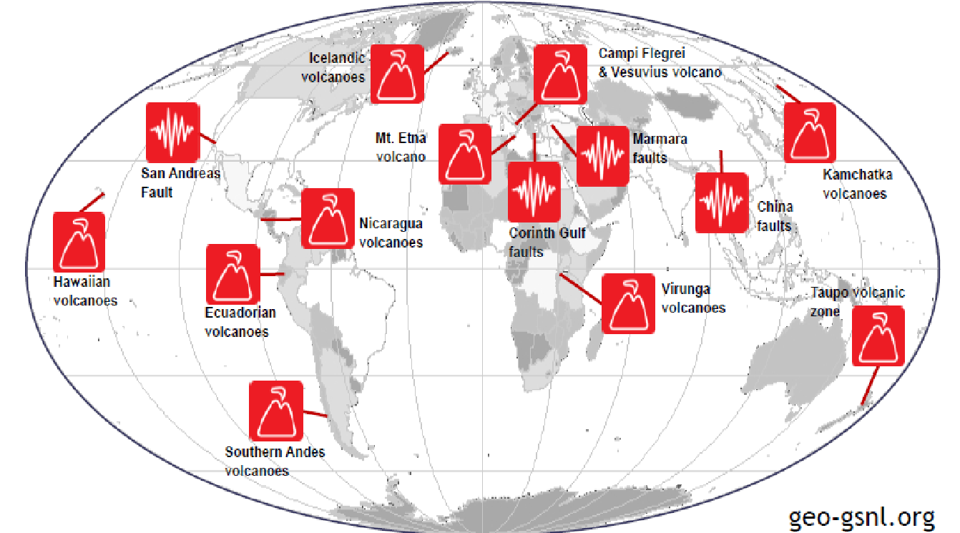
GSNL (Geohazards Supersites & Natural Laboratories)
Aims to improve geophysical scientific studies and geohazard assessment, promoting rapid and effective uptake of new science results for enhanced societal benefits in DRR
Voluntary international partnership supported by CEOS satellite data
14 GSNL Geohazard Supersites
Slide ‹#›
Notes:
The Geohazard Supersites and Natural Laboratory initiative (GSNL) is a voluntary international partnership aiming to improve, through an Open Science approach, geophysical scientific research and geohazard assessment in support of Disaster Risk Reduction.
The goal of GSNL is to promote broad international scientific collaboration and open access to a variety of space- and ground-based data, focusing on geoscience fields with scientific knowledge gaps in locations that are at high risk from geohazards, like earthquakes and volcanic eruptions
GSNL is primarily meant to support: 1) scientific research that will result in a better understanding of forecasting
geohazards and mitigating their impacts at the Supersites, and 2) development of actionable information that is
communicated to risk managers to support prevention of the potential impacts of hazardous geological events,
like volcanic eruptions, earthquakes, and landslides.
How will these decisions benefit from the outputs of this Initiative?
Responses to hazardous geological activity require accurate and reliable information on the likely future course of the hazard. Such information can only be obtained through a thorough scientific understanding of the hazardous process. GSNL aims to facilitate that scientific understanding, by providing access to data and promoting international collaboration.

Slide 6
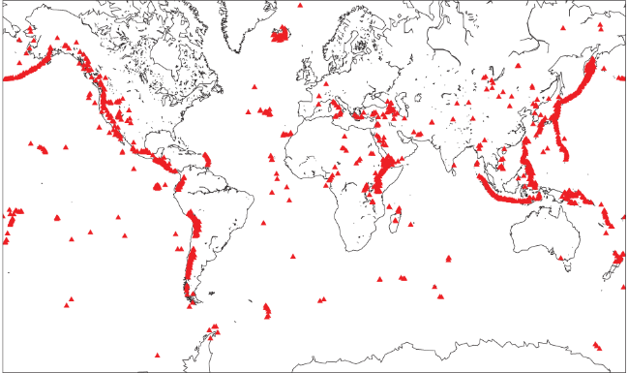
Volcano Demonstrator
Aims to evaluate the utility of remote sensing data for anticipating, detecting, and tracking volcanic eruptions.
Supports EO applications that promote volcanic DRR worldwide.
Current approach would lead to creation of International Virtual Volcano Observatory by 2024.
Response /Monitoring and Research (2019-22)
Slide ‹#›
Notes:
Lead: Univ Leeds, USGS
1) Eruption/Unrest response:
March 2022: Cordón Caulle, La Palma, Hunga Tonga–Hunga Haʻapai, Update from IG
October 2022: Sao Jorge unrest, Karthala unrest 2022, Ambae unrest 2022
2) Research results update

Slide 7
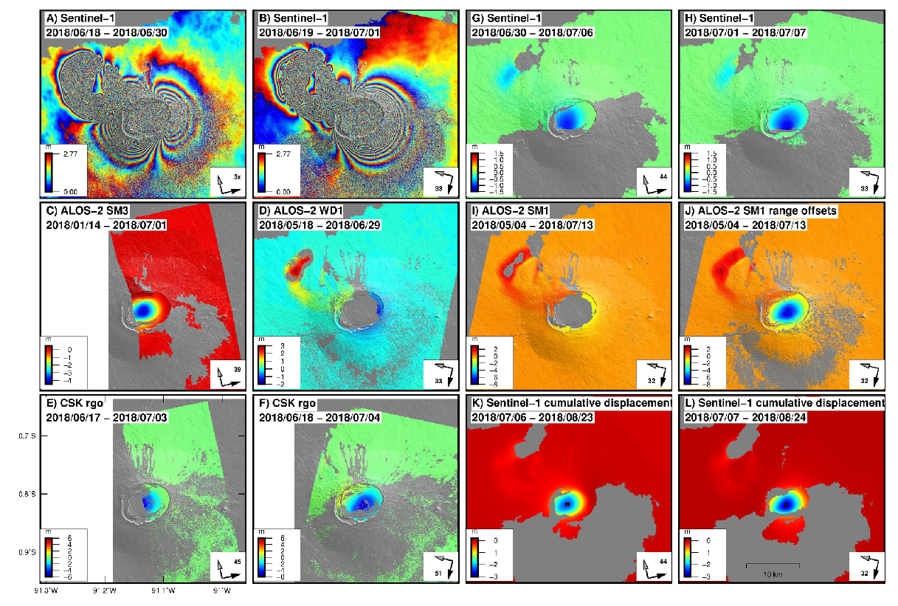
Volcano Demonstrator
Nov 2021
Dec 2021
Dec 2021
Jan 2022
Feb 2022
Event Response
& Monitoring
Ambae unrest, Vanuatu,
Nov 2021- 2022
Contribution to multi-sensor study of Sierra Negra, Galapagos
Research
Notes:
Ambae : from Nov 2021 to Feb 22 Small eruption reported in December 2021 with TerraSAR-X amplitude data revealing growth of new island.
Subsequent images show major re-working of crater floor, removal of crater lake and new ash deposits
Despite large detected changes, the eruption was short lived and small compared with 2018
Growth of island was preceded by a small uplift signal in vicinity of the summit area suggesting injection of fresh material high in the edifice.
Research : Here are the results from time-series analysis. All displacement are relative to the foot of the volcano, chosen to have 0 displacement. And here on the right I show the cumulative line of sight displacements of a 10x10 group of pixels on the SW flank overt time. The two datasets were processed separately and plotted over each other. The vertical black dashed lines show periods of high volcanic activity and the red lines periods of vigorous volcanic activity.

Slide 8
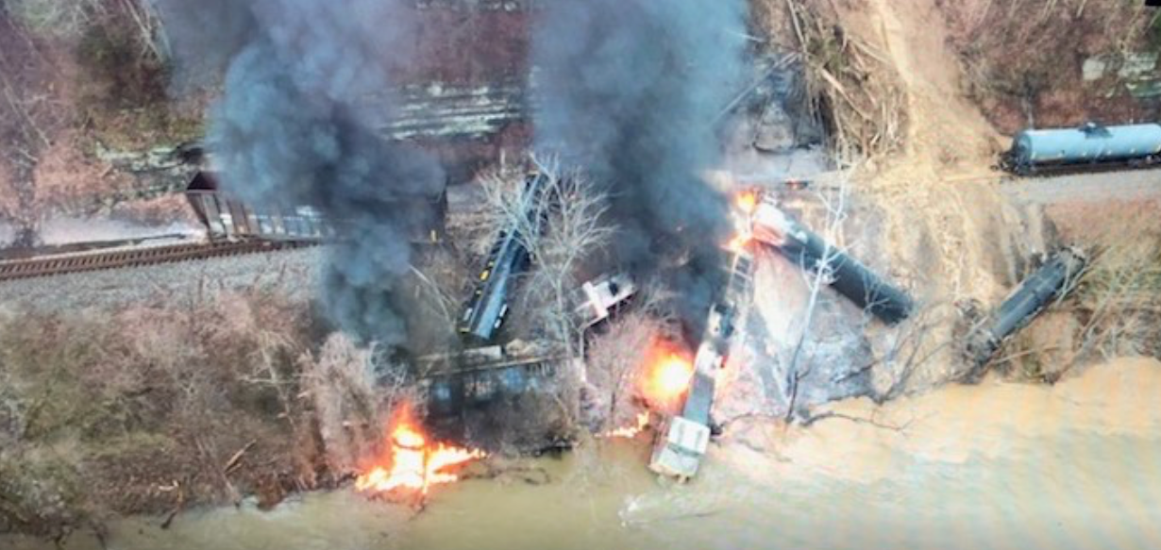
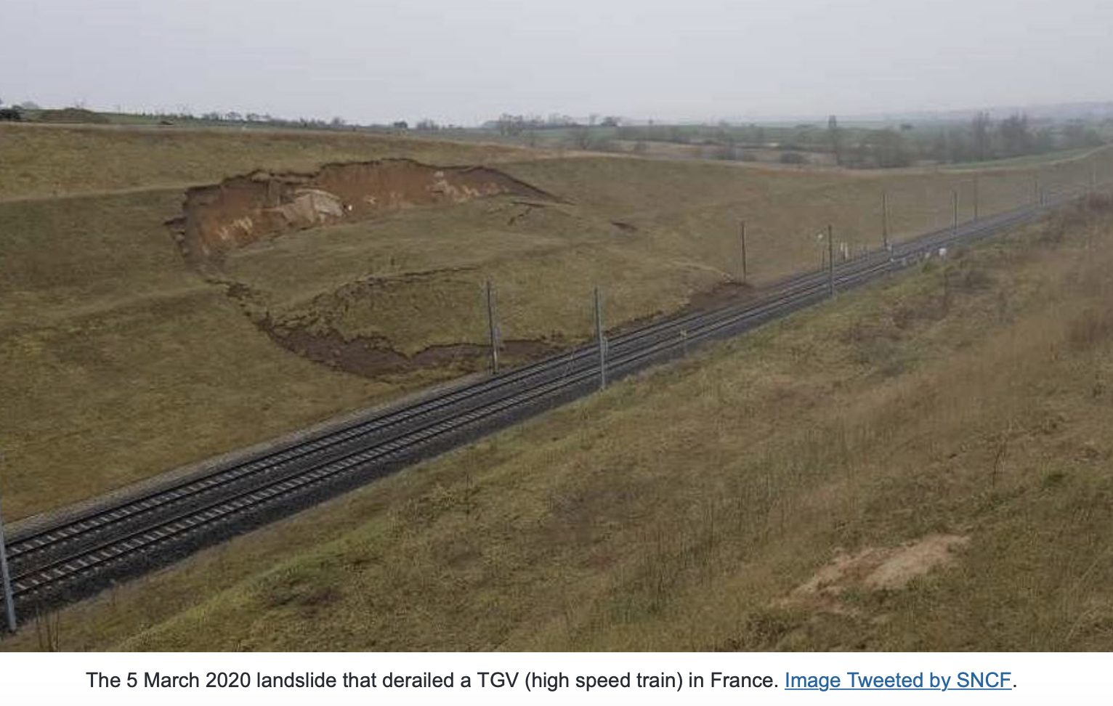
Landslide Demonstrator
Aims to demonstrate the effective exploitation of satellite EO across the cycle of Landslide DRM (i.e. preparedness, response, recovery at global, regional, local scales), including the possibility of multi-hazard focus on cascading impacts and risk.
Current approach would lead to dual path forward: quota to support public good apps and commercial POC in areas where private partners support.
Elkhorn city (Kentucky, US) – February 2020 – shallow landslide / mudflow
Transportation corridors
Landslide Disaster Risk Products
East France – March 2020 – landslide on high speed train TGV
Global Landslide Data
Slide ‹#›
Notes:
LEAD: EOST/Univ Strasbourg & NASA

Slide 9
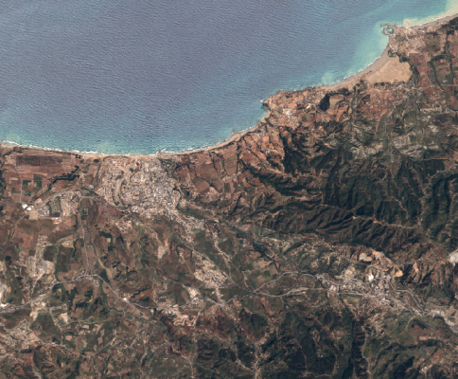
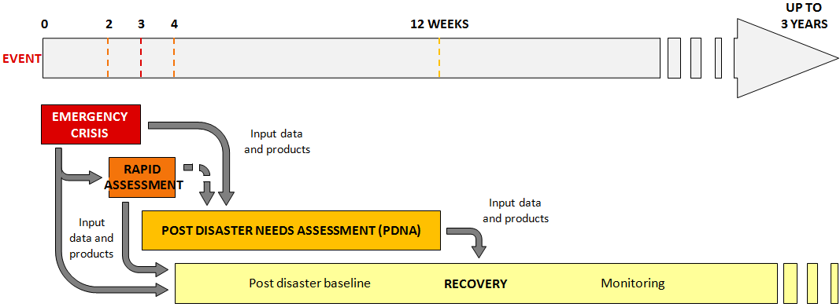
Recovery Observatory Demonstrator
Satellites have become critical for Response to disasters… but what about Recovery?
Collection of satellite images and maps at several scales during ~ 6 months after a major disaster
Iterative links with PDNA partners and government
Overview
AOI
Whole impacted area
Several Hot Spots
Urban
Zoom 1
Hot Spot
Zoom 2
National Recovery Plan
Planning
Evaluation
Ancillary data are indispensable:
terrain validation data, aerial and drone data, statistics, cartography, ….
Notes:
RO Demo establish at Plenary 2020.
After nearly 2 years of activity, an efficient RO Demonstrator community working in best effort mode :
Data providers: ASI, CNES, ESA/Copernicus, DLR, International Charter Space & Major Disasters
Value adder contributors: Copernicus EMS, BGC, NASA, CIMA, LIST, CNIGS, ICube-SERTIT

Slide 10
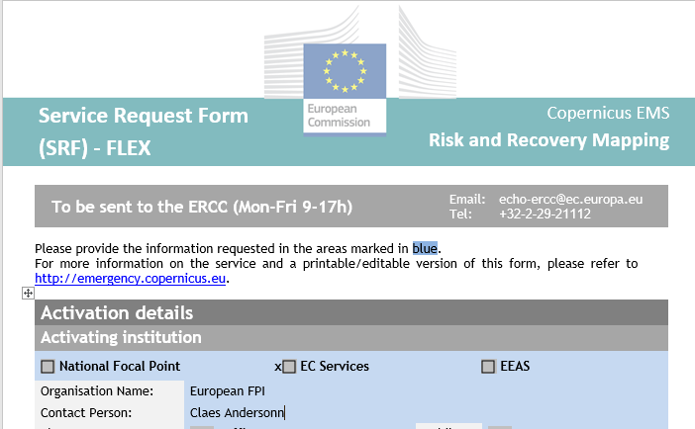
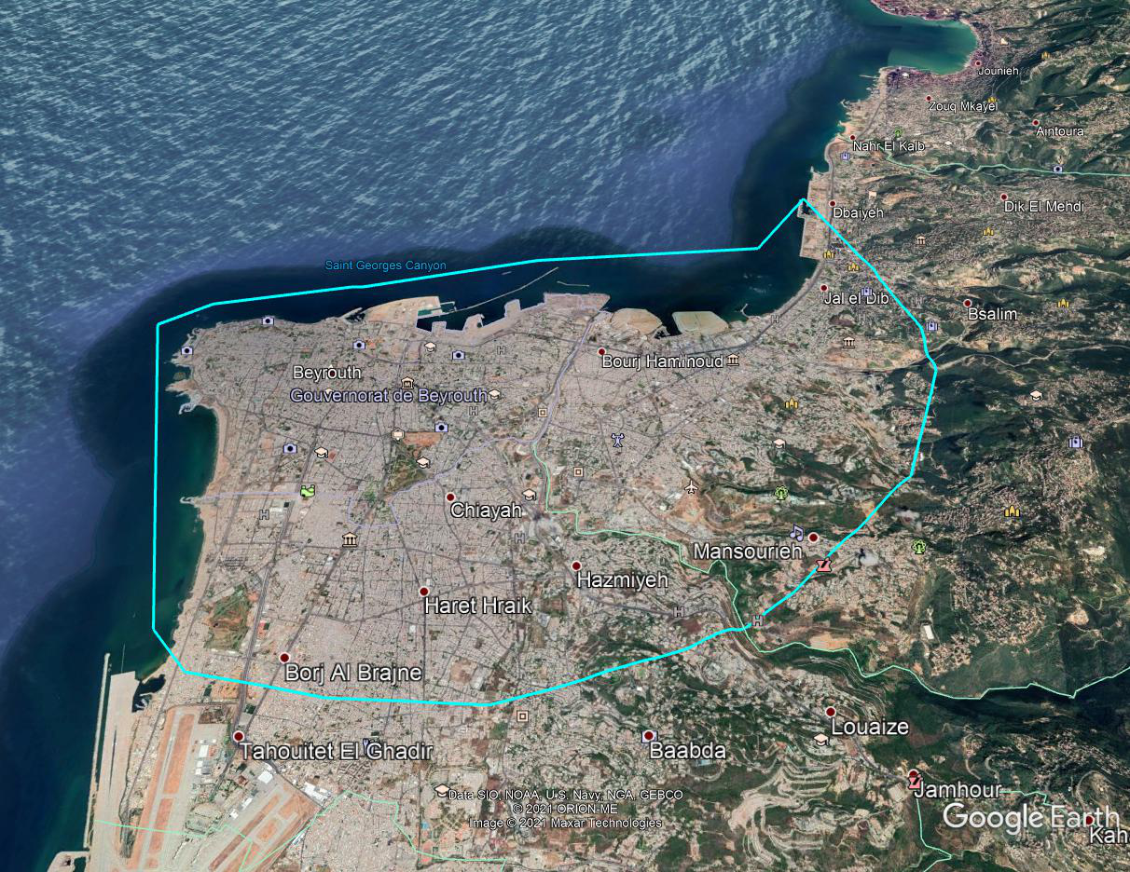
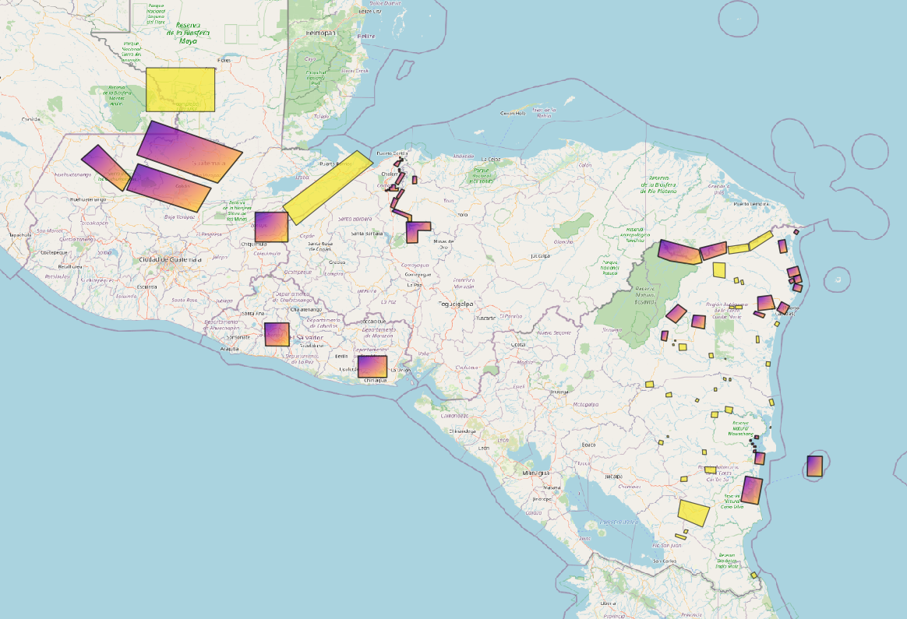
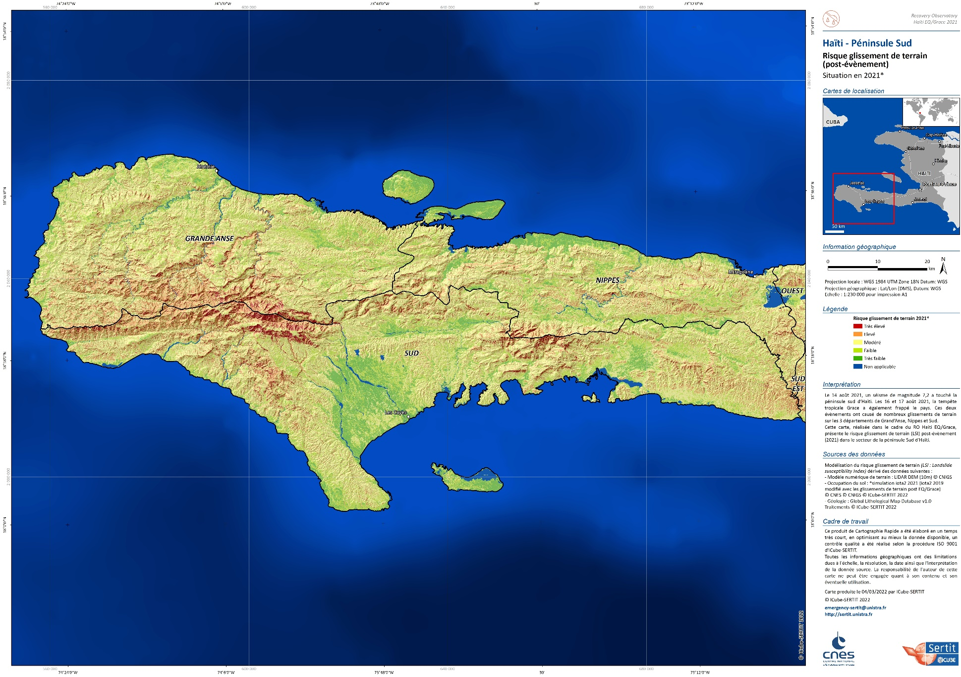
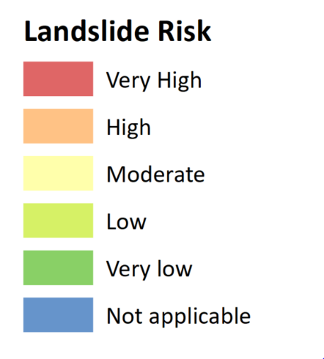
Recovery Observatory Demonstrator
Demonstrator objective :
3-5 ROs activated by UE/WB/UNDP from end2020 to 2023.
To date:
RO Demo1 : Beirut Explosion 2020
RO Demo2 : Eta-Iota hurricanes in Central America 2020-21
RO Demo3 : Haiti Earthquake / Grace tropical storm 2021-22.
RO Demo4 : Pakistan Floods 2022 (ongoing)
2021
Slide ‹#›
Notes:
Operational results :
on Lebanon : monitoring of reconstruction regularly provided to Reform, Recovery and Reconstruction Framework (3RF) (every 3 months during 1 year)
On Eta-Iota: strong new partnership with CEPREDENAC; interferomtric techniques demonstrated in user context; value of integrated solution put forward.
on Haiti : first products delivered in a relative rush mode that directly inform the PDNA with quantitative data (environmental and agricultural damage)
Various products generated and diverse types of satellite made available
Excellent collaboration between the stakeholders and the RO team; RO team responsive to the emergence of new needs. Products welcomed by the recovery community to help reconstruction and better prepare to future events
2 more activation expected between now and late 2023; final report to CEOS Plenary and global stakeholder community in late 2023
HAITI EQ :
1st high-profile example of RO satellite data supplying critical sector data for PDNA – agriculture and environment
3rd RO activation: September 6th, at request of EU on behalf of tripartite team, in support of PDNA and emerging Recovery Framework
Support Haiti Recovery from EQ and Grace through EO-derived products:
to augment and validate PDNA analysis (by end of September 2021) => PHASE 1
to support the Recovery Framework => PHASE 2

Slide 11
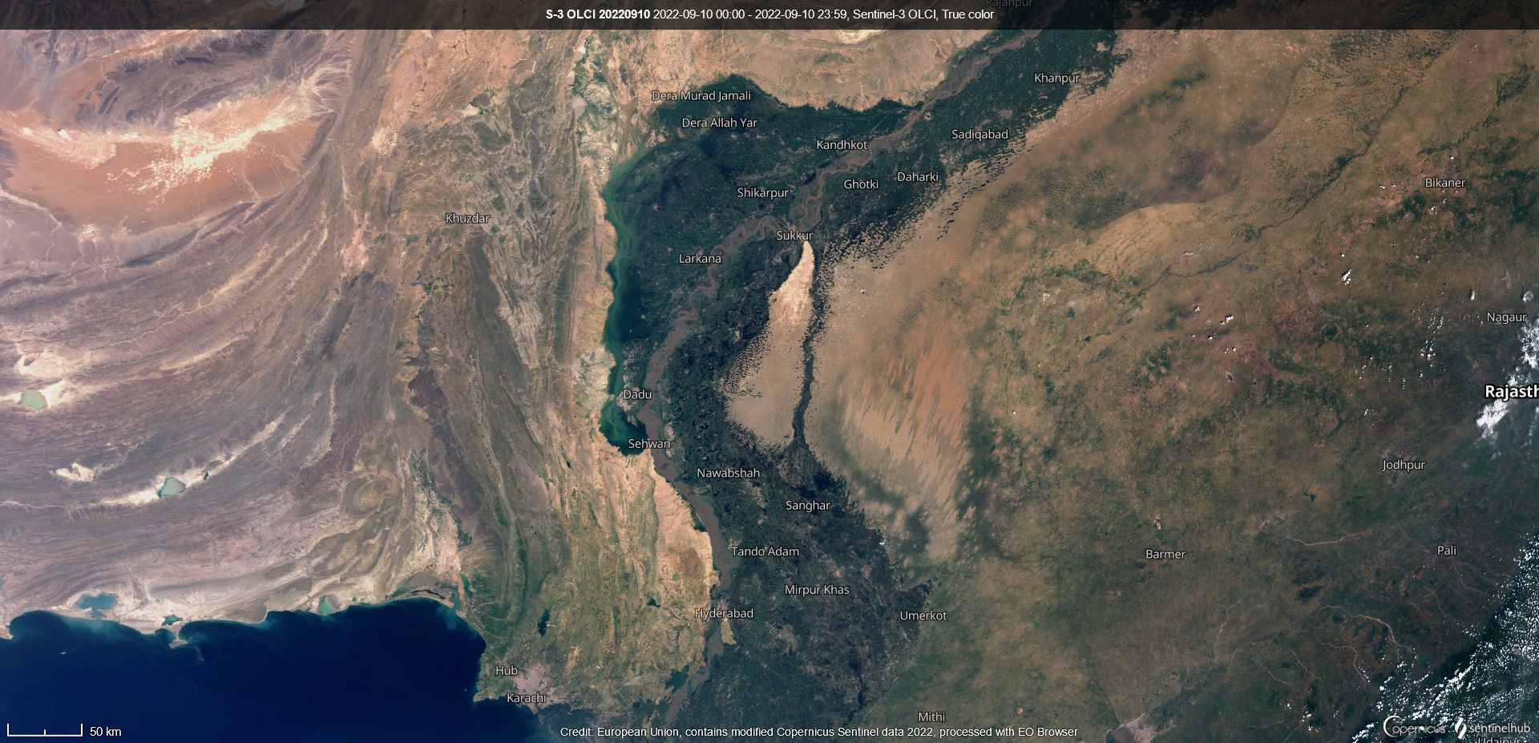
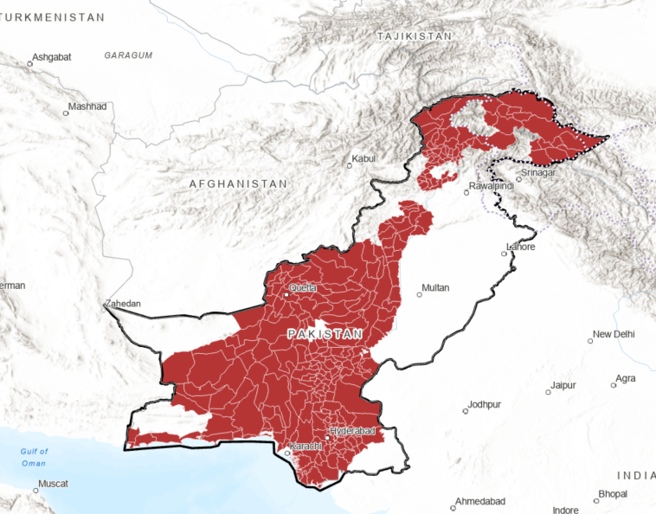
RO Demo4 - Pakistan floods 2022 (ongoing)
4th RO Demonstrator triggered on Sept 20th, at request of EU coordinating PDNA in Pakistan
Support provided to PDNA team:
- Overview of ongoing EO activities worldwide
- PDNA/step A : RO information delivered (Landslides/orchards; Natural Parks & Reserves), complementary to WB/IPSOS, ESA-GDA /CIMA-LIST information
- PDNA/step B : still ongoing
The 84 calamity districts
with a high priority level
Next step : Resilient Recovery Reconstruction and Reform (4RF)
Needs still to be defined by UE/WB/UNDP and Pakistan team
Notes:
on Pakistan: first products delivered in rush mode; some critical areas not addressed; coordination issues with broader recovery effort; better coordination of resources could have provided more comprehensive results.
RO analysis focused on 84 districts identified as « calamity districts »
potential landslides that may have impacted orchards
potential impacted Natural Park and Reserve

Slide 12
RO partners contributions - Perspectives
Openly available response data and products
International Charter Space & major disasters
Copernicus EMS Rapid Mapping
Sentinel-Asia
UNOSAT
Open-source sat data (Landsat, Sentinels, DTM)
Data bases (landcover, population,..)
RO :
integrated dynamic situational awareness
to support Recovery:
Pre and post disaster baselines;
Informed PDNA;
Recovery Framework; Monitoring & Evaluation;
Capacity Building
assessment and plan.
CEOS best efforts
RO coordination,
data and products
RO liaison officer and overall coordination
Dedicated acquisitions of commercial data
Complex satellite products (e.g. SAR interfero, 3D products, …)
Value adding services
Capacity Building
Ad hoc contributions: academia, international org. (e.g. CEMS, UN, FAO..)
Linkages to Copernicus EMS Risk & Recovery, ESA GDA, UN-Spider, …
Value adding services
Expert analysis
Integration of other advanced data sources (e.g. social media, drones, …)

Slide 13
Objective after Demonstrator :
RO integrated in operational Recovery process
National Recovery Plan
Planning
“Sustainable Recovery Observatory” : Process allowing operational use of EO for PDNA, Recovery Planning, then Monitoring & Evaluation, by international stakeholders in charge

Slide 14
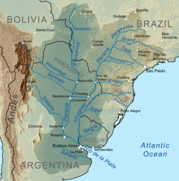
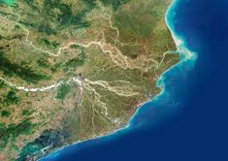
GEO-LEO/SAR Flood Pilot
Explores and demonstrates best practices for combining diverse optical and radar data sources to improve current abilities to map flood extent and depth
Improve understanding of how hazard science can be better integrated with vulnerability and exposure information.
Current approach would lead to more targeted demonstrator focusing on integrated flood solutions in specific geographies
Slide ‹#›
Notes:
Lead: CONAE, NOAA

Slide 15
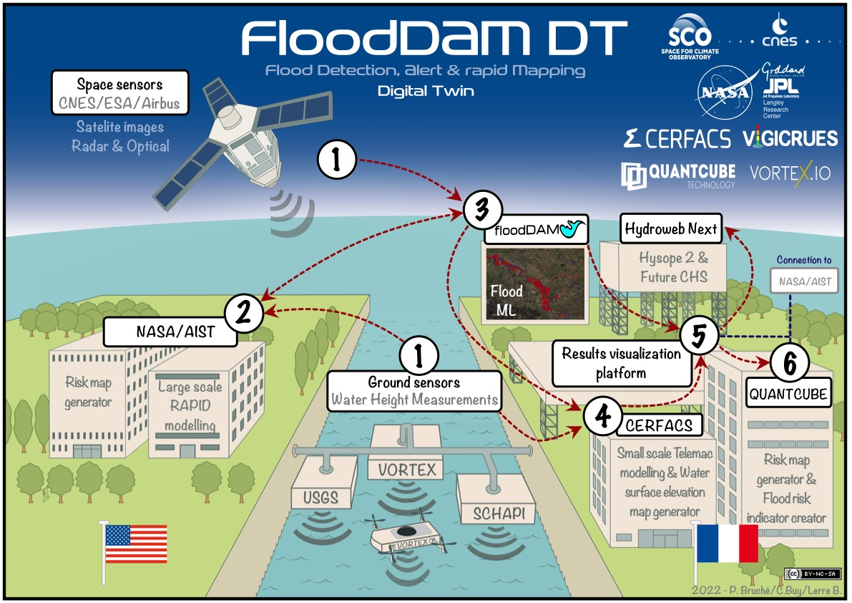
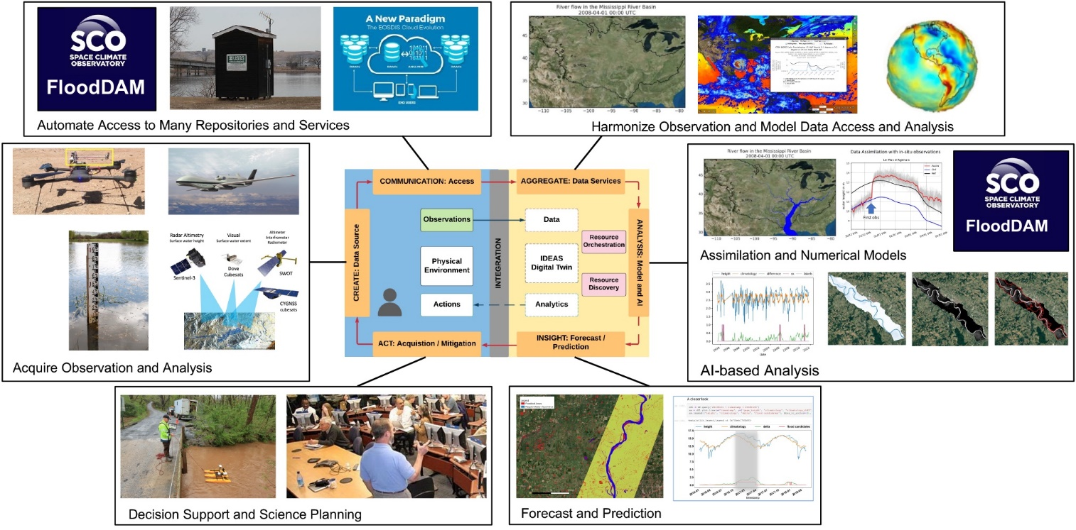
Flood Pilot : FloodDAM & IDEAS DT
NASA ESTO/AIST
IDEAS
SCO/CNES FloodDAM project labelled in 2020
SCO/CNES FloodDAM-Digital Twin with NASA IDEAS w in progress until early 2024
Objective: develop Federated Digital Twins solution between NASA IDEAS and SCO FloodDAM for alert systems and flood risk maps on local and global scales using space technologies.
Partners

Slide 16
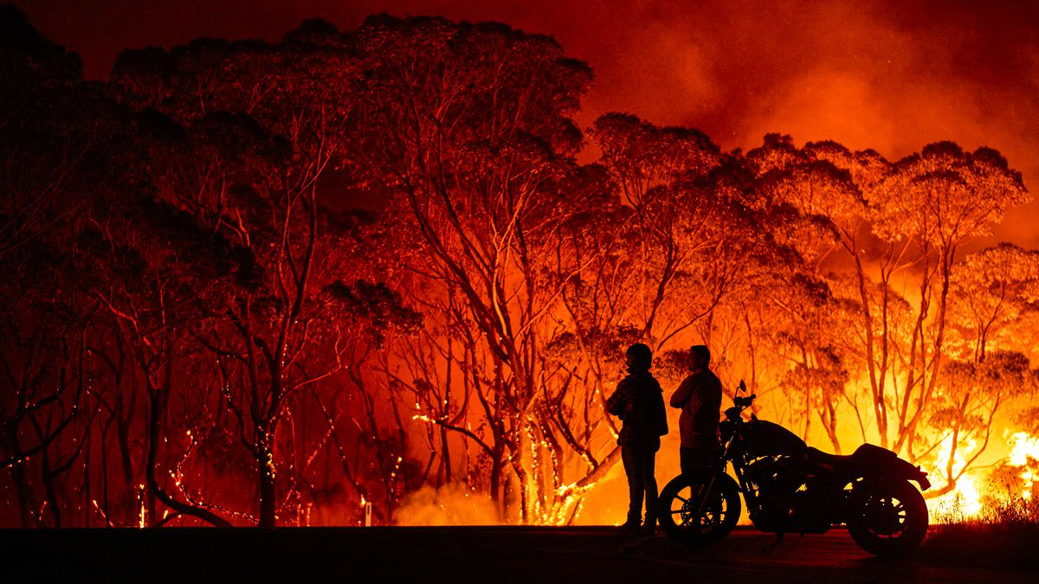
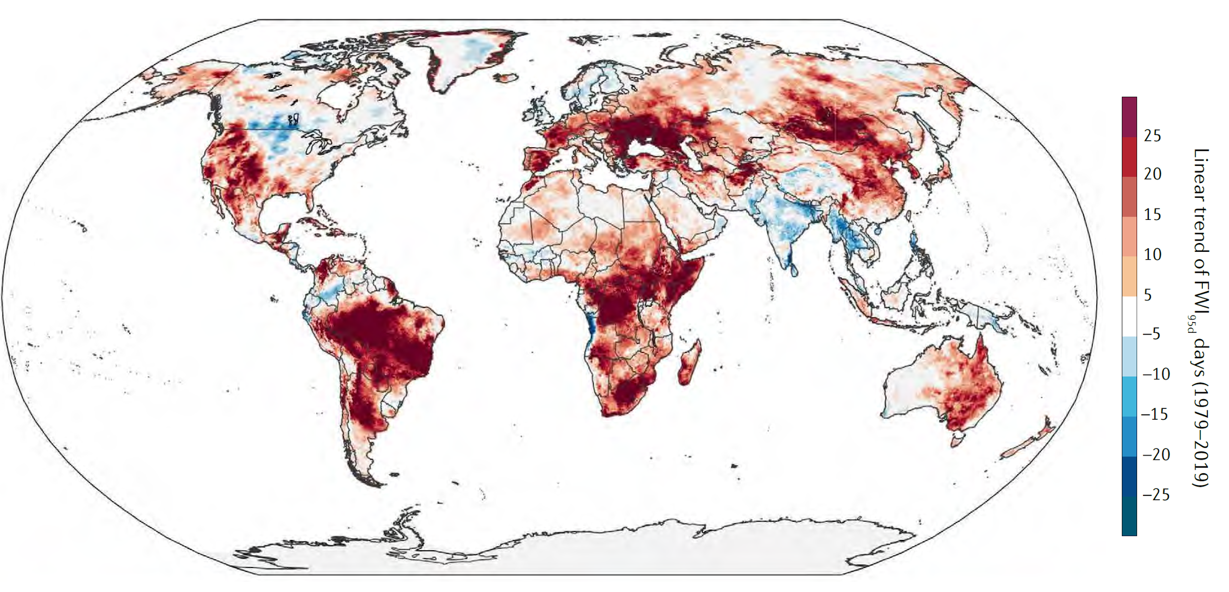
Wildfire Pilot
Provide a fundamental basis for defining global priorities (active-fire monitoring and characterization)
Explore existing gaps in wildfire EO capabilities (existing and proposed)
Articulate global stakeholders and user requirements for active-fire remote sensing
Provide use case for EO and Machine Learning
Current approach does not foresee Demonstrator; Pilot results to inform decisions in global wildfire community (e.g. GOFC/GOLD)
Slide ‹#›
Notes:
Lead: NRCan, FAO

Slide 17
Sustainability Challenges & approaches to address them
Most of valuable solutions rely on marriage of free&open data with commercial data sets, but data cost and value adding remains a hurdle for long-term solutions (especially for DRR)
Work with hotspots to showcase projects more affordable, but scalable in the long-term
Focus on integrated solutions but bring clear cost-benefit to show how using commercial data sets augment overall benefits
Awareness of actual benefit still low
For partners financing DRR : More emphasis on identifying benefits from stakeholder viewpoint
For organizations managing risk : Identify cost savings, cost-benefit wins
Identify and forge partnership with new stakeholders
Continuous effort to be put on Capacity Building (for decision makers too) and on co-construction with users
Maintain and reinforce links WG CapD / WG Disasters, for a synergistic action
Develop “peer awareness” among practitioners and end users
Slide ‹#›
Notes:
Many solutions rely on marriage of free and open data with commercial data sets – data cost and value adding remains a hurdle for long-term solutions, especially for risk reduction (as opposed to response and -to a lesser extent, recovery)
Demonstrators work with hotspots to showcase smaller scale projects that are more affordable, but in the long-term scalable
Awareness of benefit tied to each thematic area or disaster phase still low, especially with partners financing risk reduction
Demonstrators to place more emphasis on identifying benefits from stakeholder viewpoint
Understanding of differences in satellite data solutions still low (e.g. free and open data vs commercial datasets)
Focus on integrated solutions but bring clear cost-benefit to show how using commercial data sets augments overall benefits
In many cases organizations with mandate to manage risk do not have budgets to invest in EO
Identify cost savings; identify cost-benefit wins; identify new stakeholders with more financing and forge partnerships
Continuous effort to be put on Capacity Building (technical, decision makers too) and on co-construction with
Maintain links WG CapD / WG Disasters, for a synergistic action ; Develop “peer awareness”
A subteam has been created within the WG to address sustainability issues. It will produce a final report later this year.
Sustainability questionnaire circulated to activity leads:
Is there a global and/or regional community of practice (CoP) in this area? How is it structured?
Is this CoP engaged in your activity? In what way?
What is the ideal vision for sustainable use of EO in your sector, built on your Pilot/ Demonstrator experience?
Have you estimated the types of data and annual volumes required for a sustainable ongoing use of EO to meet objectives? (at relevant geographical level: global, regional, national…)
In a sustainable perspective, who are the key partners that would exploit EO data / derived products / derived indicators?
What are the main barriers to sustainability? (scientific, technical, cost, human, ….)
What are the cost drivers associated with EO data exploitation that make this challenging?
Beyond the end user community, are there other potential donor communities that have a vested interest in the success of your activity (e.g. foundations, international financial institutions, insurance, etc)? Which ones would you consider most engaged or interested in your activity?
Are there “stepping stones” that would facilitate longer-term achievement of sustainability goals that could be envisaged in a post-demonstrator activity?
Do you know of successful examples of user partnerships where similar barriers have been overcome and how?
Do you have additional comment / feedback ?

Slide 18
Links with other CEOS WGs and GEO
WGCapD: joint RO training for EO decision makers – 1st event 7 December in San Salvador with CEPREDENAC – 300 people in context of DRM regional forum; other 2023 events in Africa & Asia.
WG Climate: Action taken to organize bilateral discussion on joint use case analysis looking at local impacts of climate change and adaptation (WGDisasters 18 in Nice)
WGISS: EAIL/ Flood Pilot; input to be provided for EO & ML White Paper (Disaster Use Cases, e.g. Wild Fires)
Ocean coordination group : ongoing reflections on oceans & climate related disasters, especially climate change impacts in coastal zone
SIT: collaboration on sustainability and implication of new partners including private sector EO players (cf. Volcano Demo, Landslide Demo)
DRR WG: RO one of 1st use cases for EO Risk Toolkit/RiX (UNDRR), Landslides to follow
New GEO thematic Incubators : WG Disasters working to develop use cases
Slide ‹#›
Notes:
GEO / RiX is a living repository of open source global and national risk data, designed to improve risk literacy and strengthen national risk data ecosystems

Slide 19
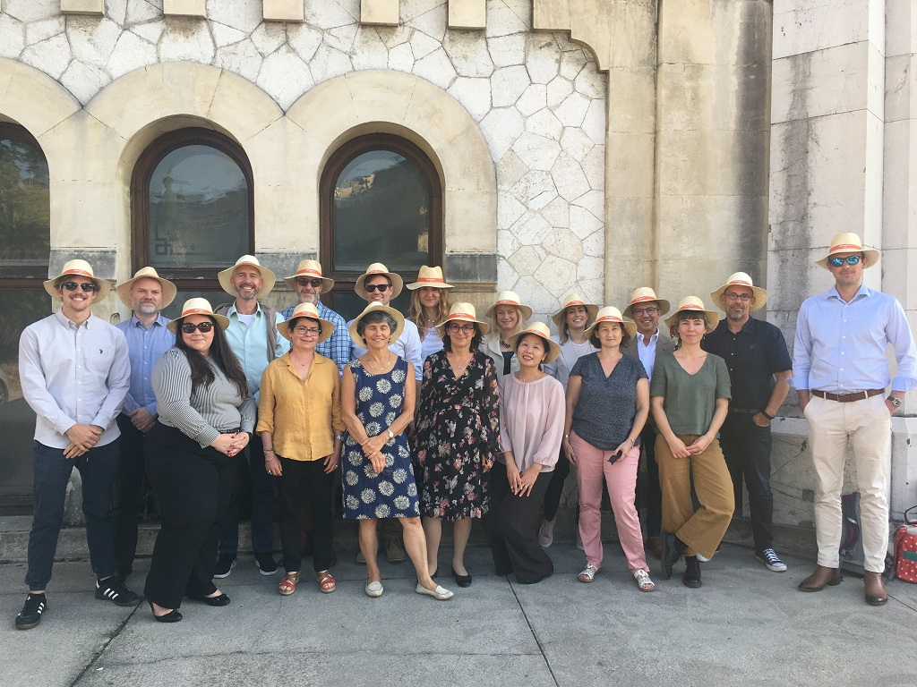
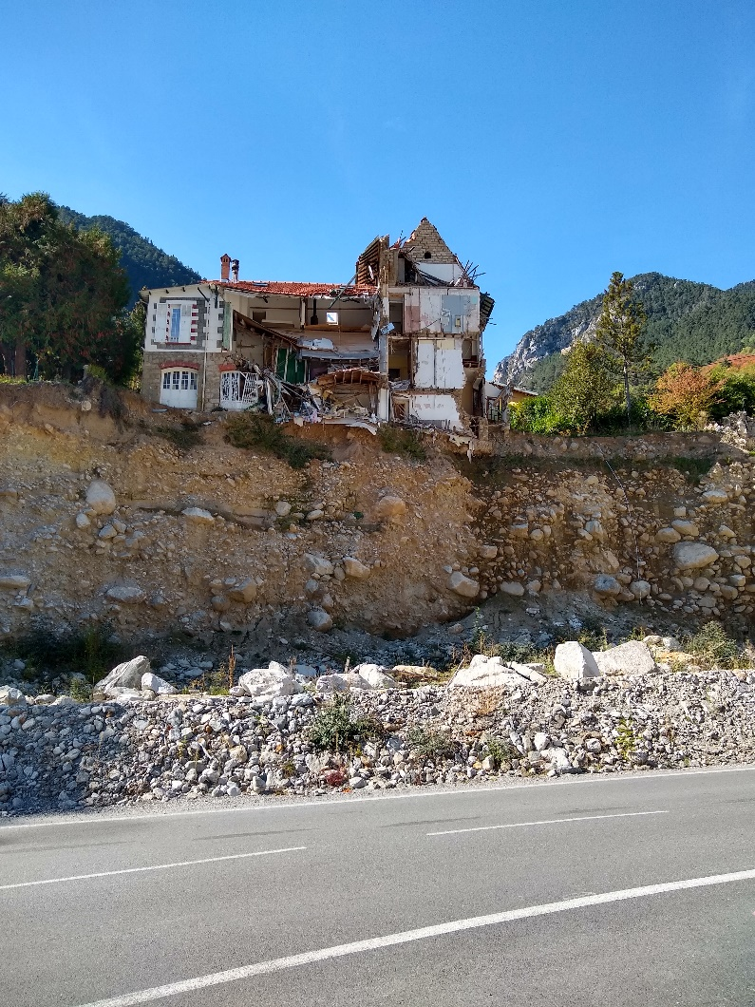
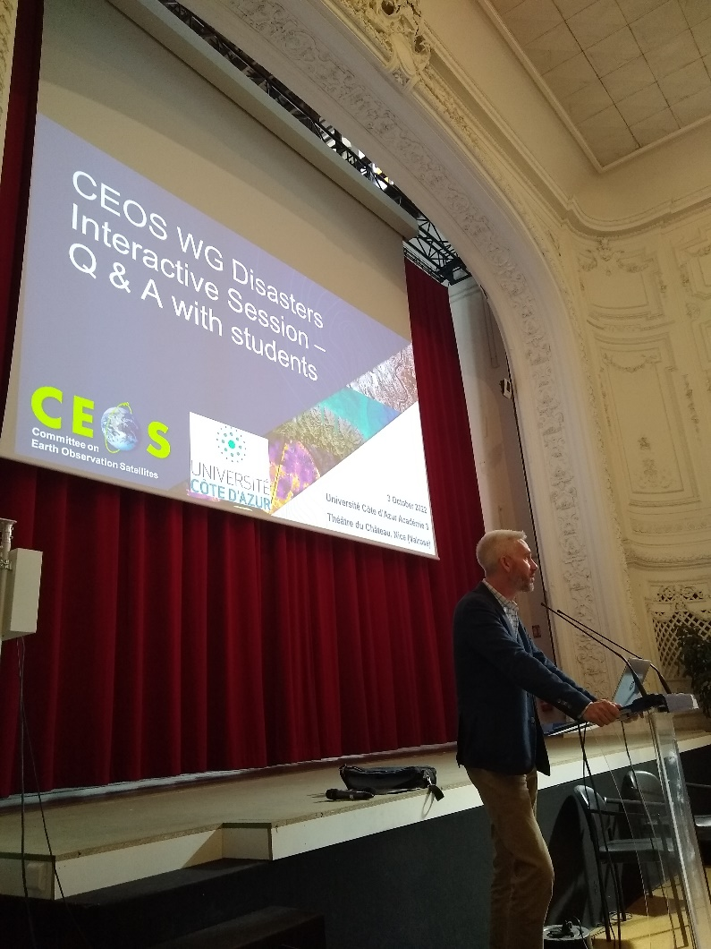
WG Disasters Meetings
Nice October 2022 meeting n°18
Meeting n°19 : invitation by CONAE - Argentina, Cordoba
Possibly at the same time as WGISS ?
Meeting n°20 : invitation by USGS – Yosemite Park, USA
Slide ‹#›
Notes:
GEO / RiX is a living repository of open source global and national risk data, designed to improve risk literacy and strengthen national risk data ecosystems

Slide 20
Thank you !

