Slide 1
EOTEC DevNet
Jorge Del Rio Vera, WGCapD
Erin Martin, Yasha Moz, Martyna Stelmaszczuk-Gorska, Aline Coutinho Souza
Agenda Item #1.17
CEOS Plenary 2022, CNES Biarritz
30th Nov – 1st December 2022

Slide 2
WGCapD
Focus: capacity-building and data democracy
Increase user uptake and raise awareness
Create opportunities for collaboration
Flexible participation
Gather user needs

Slide 3
Deliverables and engagement
High number of deliverables and high success (so far this year 10 completed)
Only possible thanks to very commited members and work with other working groups
Engaging with (emerging) space agencies

Slide 4
What is next?
Annual meeting 1-3 March 2023 - hybrid (Vienna)
Vice-chair position to be filled in by CEOS plenary 2023
SANSA (Dan Matsapola) will become Chair
Vice-Chair (nominations welcome)
EOTEC DevNet way forward for next CEOS SIT

Slide 5
EOTEC DevNet: Connecting Capacity Builders
The Earth Observation Training, Education, and Capacity Development Network (EOTEC DevNet) plays a unique role in fostering collaboration and eliminating duplication among space-based asset providers and others engaged in EO-related capacity building. In particular, EOTEC:
Hosts a diverse community spanning space asset providers and operational global/national met agencies, universities, regional science centers, and EO-related development initiatives
Has a distinct focus on identifying gaps and overlaps
Supports and enhances WGCapD and CEOS work and priorities
Notes:
Zoya → VLAB (Technical)
Lucianne Lu Veeck → Capacity-Building (Education and Training Programme)

Slide 6
A Growing Network of Capacity Builders
Notes:
A sample of organizations participating in the regional CoP meetings and thematic working groups. A lot of interest from Academic Institutions (educators/professors)

Slide 7
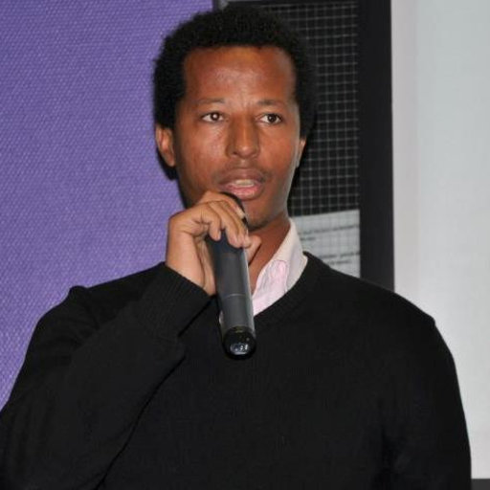
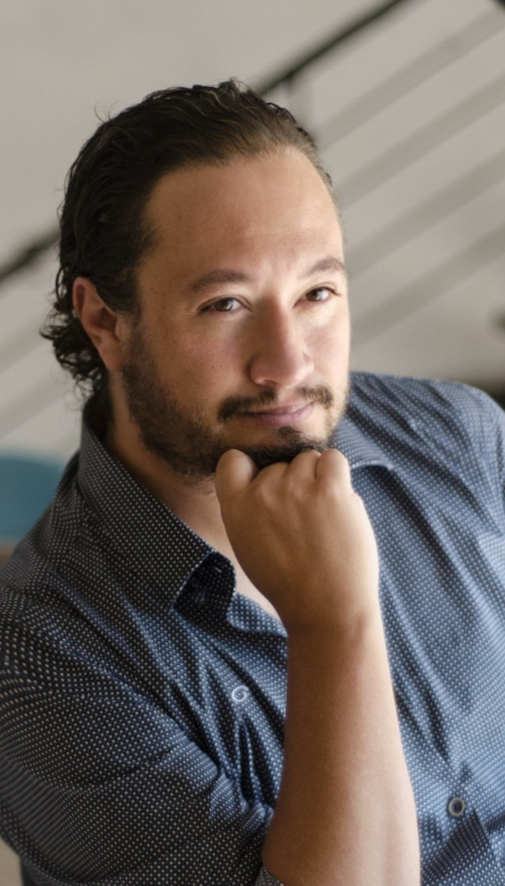
CoP Engagement is Strong
“I am glad to be part of EOTEC because it's an interesting platform to share up-to-date information on innovative GIS/RS ideas/data and services. Currently, there are free and high quality EO products and high capabilities and tools to support sustainable development goals in developing world. However, the use and usability of RS solutions in developing countries, like sub Saharan African countries, is low. Most decision making is impaired by lack of spatial solutions. To that end, experts from GIS and RS or related areas can be part and parcel for mitigation of recurring problems. I encourage GIS/RS experts as well as others from related disciplines to join this network so as to contribute their part for achieving the goals of fostering global development, ensuring food security and mitigation of climate change."
Terefe Hanchiso
Co-lead of EOTEC DevNet Africa Region Community of Practice Task Team,
Wolkite University (Ethiopia), Department of Natural Resource Management
“This “Tracker of Flood Resources and Capacity Tools” is very helpful for Americas region - it serves as an important connection between satellite developers, data providers and end users. It is sometimes difficult to direct students or users to the right resources but now we share this multilingual tracker with them. As a result, we already are seeing people find and participate in relevant trainings and appreciate EOTEC DevNet serving as a useful connection point for academia, research institutions and practitioners.”
Adrian Guzman
Co-lead of the EOTEC DevNet Americas Region thematic working group on floods, Satellite Constellation Manager and International Relations and Space Security Coordinator for the Mexican Space Agency
Notes:
The quote from Adrian was taken from his participation in the flood tracker demo, edited for clarity, we can ask him to confirm

Slide 8
Key Accomplishments
Functional global and regional structures
Global Task Team and Leadership Group coordinating efforts across partner networks
Four regional Communities of Practice (CoPs) meeting regularly, all have co-leads from the region
Preliminary needs identified by CoPs and needs assessment in progress
Co-developed products:
Flood tools tracker - thank you to CEOS SEO for support!
Global flood extent use case in process
Network analysis to assess coordination
Joint work with EO College and EO4GEO Alliance, good engagement with Digital Earth Africa and SELPER
Communication platforms
Independent website under development, content currently hosted at ceos.org/eotec
Twitter account launched at @EOTECDevNet
Slack and ASANA utilized at Secretariat level
WhatsApp group to be trialed for Africa; Slack for Europe
Theory of change, M&E framework and sustainability plan developed
01
Global Coordination
02
Regional CoP Task Teams
03
Floods Working Groups
04
Drought Working Groups
Notes:
WGDisasters involvement? → e.g. Recovery observatory

Slide 9
Key Activities/achievements
01
Representatives of all networks coming together to
Build awareness of each other’s priorities and work programs
Reduce duplication of efforts
Identify joint opportunities for collaboration
Set direction for EOTEC DevNet, i.e. by drafting/approving Theory of Change, M&E Framework, Sustainability Plan
Representing EOTEC DevNet at international forums, i.e. preparing a statement for UN-GGIM or presentation to CEOS Plenary
Explore options to utilize existing mechanisms to assess user needs such as WMO Global Survey on Satellite Data Utilization
Global Coordination
Global Task Team meets quarterly Global Leadership Team meets annually
02
Regional CoP Task Teams
4 Communities of Practice (Africa, Americas, Asia-Oceania, Europe) meet quarterly to
Share capacity-building information and resources
Set regional priorities
Assess regional needs
Spotlight on key capacity building initiatives, organizations, convenings and trainings
Regional CoP Teams meet quarterly Target group: professionals engaged in capacity development
Over 100 colleagues involved so far
20-25 attend Africa & Americas meetings 10-15 attend Europe & Asia/Oceania meetings

Slide 10
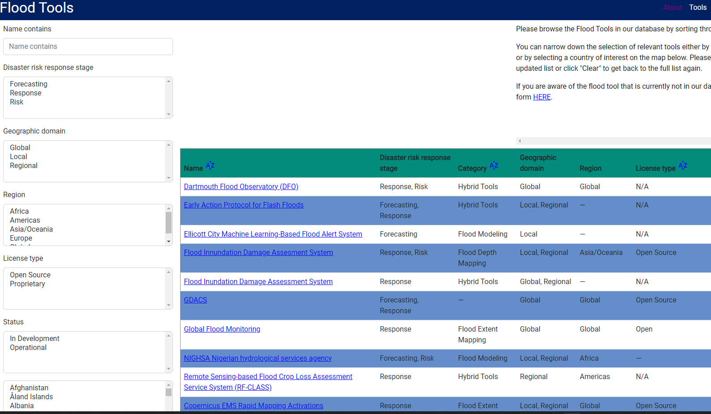
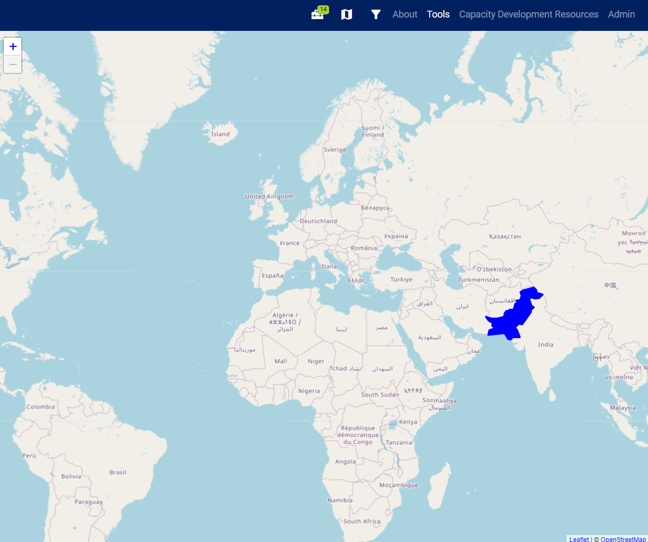
Key Activities/achievements
03
Flood Working Groups
Flood Thematic Working Groups
11 regional meetings took place so far (meeting quarterly)
Groups led by local experts
Collaborated on Flood Tools Tracker (eotec-dev.ceos.org)
9 regional event analyses in development as part of a global use case on flood extent tools
Target group: subject matter experts
More than 50 colleagues involved so far
04
Drought consultation December 1 to identify needs
Share your insights in this collaboration document
Sign up or refer a colleague to the group via this link
Drought Working Groups
Notes:
Drought next area for collaboration. Consultation taking place on December 1.

Slide 11
Current Staffing - A Collaborative Effort
NASA (a member of both CEOS and GEO) - supporting 3 part-time members of the Secretariat for the total of one full-time equivalent (FTE).
NASA’s Capacity Building Program intends to extend its support for EOTEC DevNet Secretariat through March 2024
EO College (with funding from German Federal Ministry of Education and Research via DLR) - supporting 2 part time members of Secretariat for the total of 60% FTE, funding stakeholder mapping analysis and EOTEC DevNet’s standalone website development
EO College commitment is confirmed through September 2023, looking for funding to extend support further
CEOS - SEO personnel supporting the development of flood tools tracker
UNOOSA – supporting part time member of Secretariat at 25% FTE, starting mid-November, engaging subject matter experts on disaster management and emergency response
UNOOSA commitment is confirmed through May 2023
Other networks (GEO, WMO-CGMS VLab, WMO ETR) - regular participation in Global Task Team meetings, ad hoc technical assistance, helping reach members in respective networks, securing enabling environment and encouraging members to engage
Staffing is not all… there are other contributions from Network Partners
Notes:
Staffing is part of the picture, there is more,
SEO has been very helpful.

Slide 12
Sustainability Plan Recommendations
EOTEC DevNet will continue to function as a best-efforts network of networks initiative, with each member network making a specific contribution (monetary or in-kind) towards achieving one or more of the program’s goals and related deliverables. These contributions could include assigning or funding personnel, offering support for development of specific products and/or covering certain program expenses (i.e. marketing materials or costs of travel).
Additional outreach will be conducted to Community of Practice (CoP) members in each of the four regions to support the part-time positions of regional CoP coordinators.
Finally, support will also be sought to staff the Global Coordination team. E.g. funding by the network partners or in-kind support based on a rotating schedule. NASA’s Capacity Building Program and DLR’s support to EO College are funding the current team.
Details available in the Sustainability Plan document
Slide ‹#›

Slide 13
Request for CEOS Members
Help grow the effort through participation in EOTEC DevNet’s regional communities of practice and thematic working groups. Meeting details available at ceos.org/eotec
Review the proposed sustainability plan and consider outlined approaches to staffing, including in-kind support for the part-time positions of regional community of practice coordinators.
Continue letting CEOS SEO support key EOTEC DevNet products that are of greatest benefit to the capacity building community
Pending satisfactory Phase 2 report (will include monitoring and evaluation data, network analysis) endorse EOTEC DevNet initiative at CEOS SIT-38 to continue to Phase 3
Slide ‹#›

Slide 14
Questions for the CEOS Plenary
What other global or regional education, training and capacity development efforts should be incorporated into EOTEC DevNet?
How can we get more space agencies participate in EOTEC DevNet communities of practice?
Any suggestions for potential donors/supporters for EOTEC DevNet Phase 3?
Notes:
The quote from Adrian was taken from his participation in the flood tracker demo, edited for clarity, we can ask him to confirm

