Slide 1
2022 CEOS Plenary
Working Group on Information Systems & Services (WGISS)
Dr. Makoto NATSUISAKA
JAXA
Agenda Item 1.14
2022 CEOS Plenary
Biarritz, France
Nov. 29 – Dec. 1

Slide 2
What is WGISS?
Working Group on Information Systems and Services
WGISS promotes collaboration in the development of systems and services that manage and supply Earth observation data as a working group of CEOS.
The activities and expertise of WGISS span the information life cycle;
data preservation and stewardship,
discovery and access,
interoperability and use,
explore of cutting-edge technology.

Slide 3
WGISS Activities
Survey
Demonstration
Guidelines
Outreach
Open Science in WGISS-52
Data Integrity and Authenticity in WGISS-53
AI/ML session in WGISS-54
Common Implementation of STAC
Service Discovery Best Practice
EAIL Best Practice (TBD)
Jupyter Notebook Best Practice
AI/ML White Paper
EAIL initiative
Jupyter Notebook Webinar
WGISS Webinars
Technologies related to the “Cloud” is getting more important from a viewpoint of “data interoperability and use”.
ref. EO data in the cloud, Analysis in place in the cloud, ARD, STAC, Cloud Optimized Data Format, AI/ML, Knowledge share in the cloud (Jupyter Notebook, Git, etc.)

Slide 4
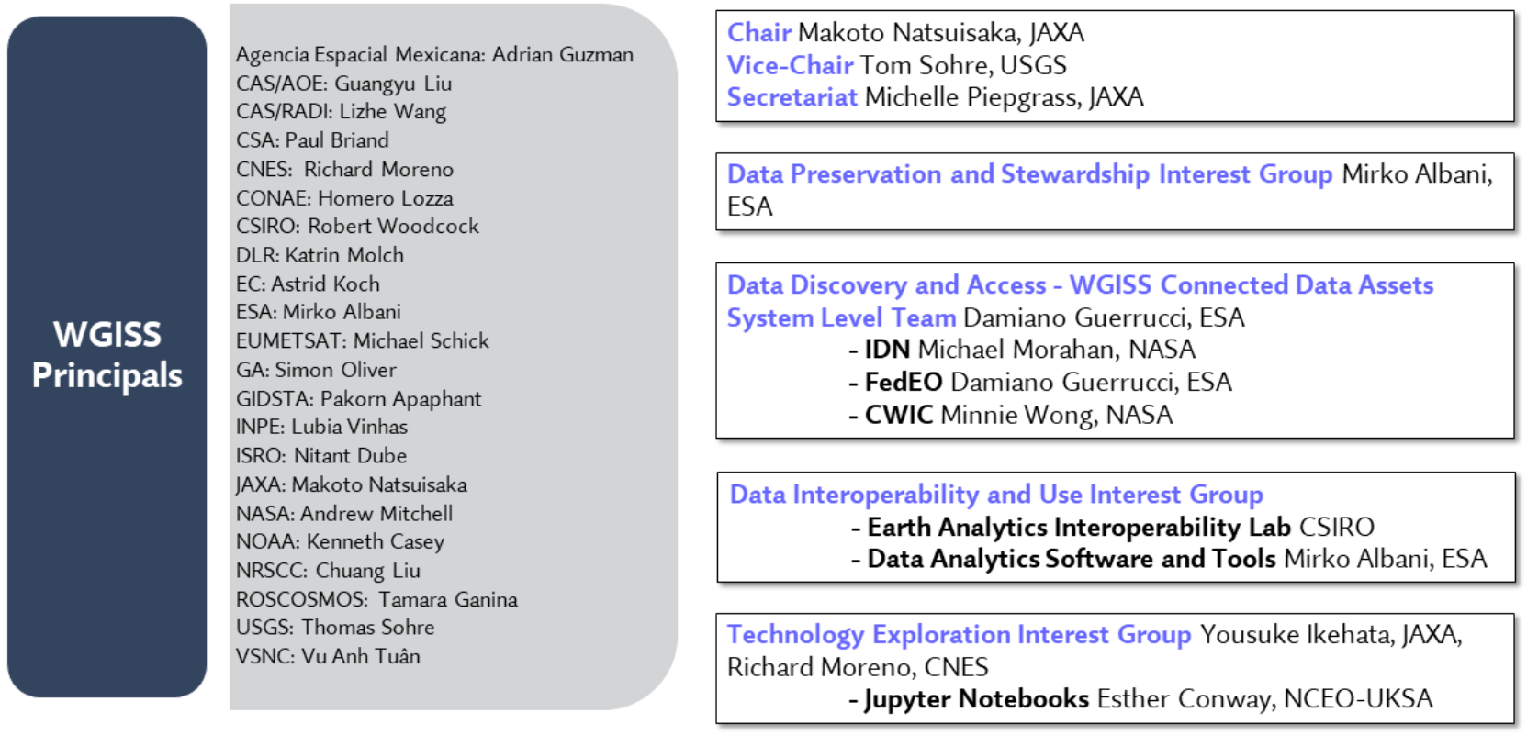
WGISS Structure
https://ceos.org/ourwork/workinggroups/wgiss/

Slide 5
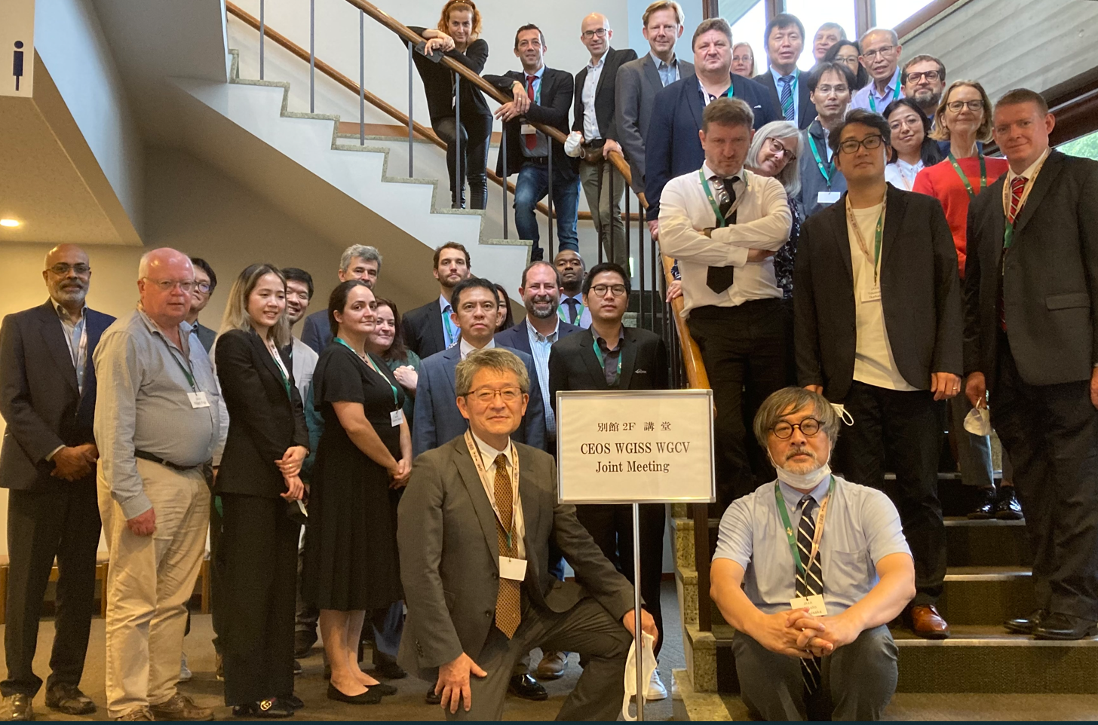
Chair Team Activities
Chair: Makoto Natsuisaka (JAXA), Vice Chair: Tom Sohre (USGS),
Secretary: Michelle Piepgrass (JAXA)
WGISS-53 (22ｰ24 March 2022, Remote)
WGISS-54 (4-7 October 2022, Tokyo JAPAN)
- CEO, SEO, GEO presentations
- ISO TC211/OGC liaison report
- 6th joint symposium with WGISS-WGCV was successfully held.
- LSI VC proposed CEOS interoperability framework and CEOS engagement with Standard Organizations.

Slide 6
Chair Team Activities
CEOS ARD Oversight Group including participation in EUMETSAT “Explore Analysis Ready Data (ARD) with the data cube for atmospheric composition” webinar (16th February 2022)
CEOS Interoperability Framework … Common on-line dictionary initiative led by Katrin Molch (DLR) is considered as one of semantic interoperability.
CEOS Engagement with Standard Organizations
CEOS Ocean Coordination Group
WGISS presentations were input to WGD-17 (March 2022) and WGD-18 (October 2022). The joint session in April 2023 is being planned.

Slide 7
Data Preservation and Stewardship IG
Led by Mirko Albani (ESA).
CGMS (Working Group-1V) requested a short presentation on Best practice on “Long Term Data Preservation” during its Working Group Meeting (April 28th to 29th, 2022) . The both groups identified common interests on data stewardship and are planning to have joint symposium in future.
How to give “Data Integrity and Authenticity in particular on Cloud Archives” was discussed in WGISS-53 and follow-on session was hold in WGISS-54.

Slide 8
Data Preservation and Stewardship IG
Data Quality Assessment and Indicators and DMSMM Maturity Matrix was discussed in the joint session with WGCV at WGISS-54. The information exchange between WGISS and WGCV will be done toward issue of the Best Practice planned in the next year.
Title | Completion Date | Description | Link to GEO Work Programme (if relevant) | External Reference (if relevant) | Responsible User(s) | Responsible CEOS Entity(ies) | Contributing Agency(ies)
Data Management and Stewardship Maturity Matrix | 2023-Q1 | "Data Management and Stewardship Maturity Matrix" respectively defined by WGISS and WGCV will be merged. |  |  |  | WGISS, WGCV | ESA
Archive Technologies White Paper | 2023-Q2 | A white paper for archive technologies enabling proper data preservation will be developed. |  |  |  | WGISS | ESA

Slide 9
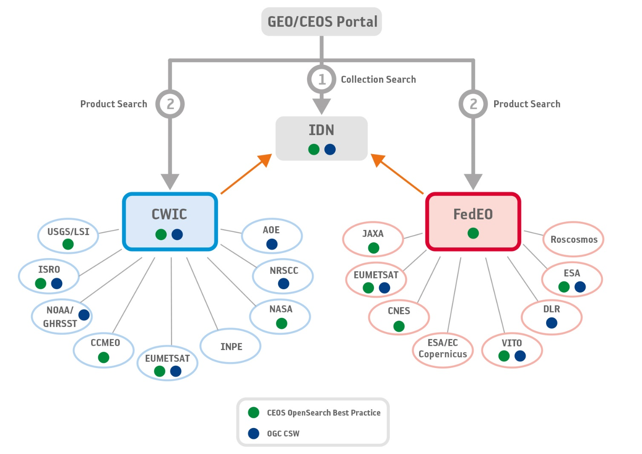
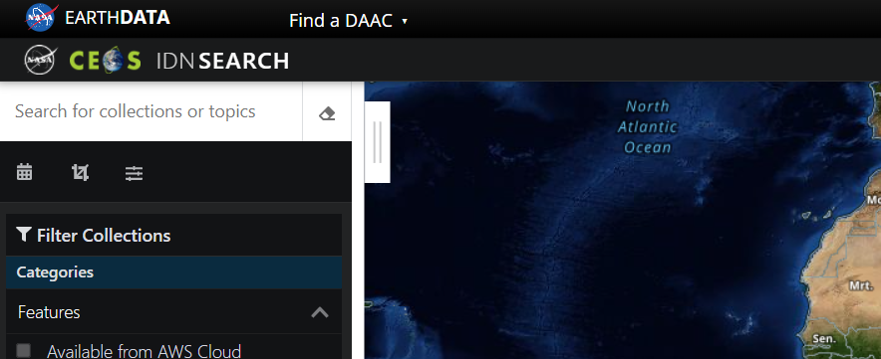
Data DISCOVERY and ACCESS Interest Group
Led by Damiano Guerrucci (ESA).
The interest group makes the CEOS partner’s data to be findable and accessible through “WGISS Data Assets”.
IDN and FedEO are well communicated.
NASA introduced AI/ML as a GCMD keyword.

Slide 10
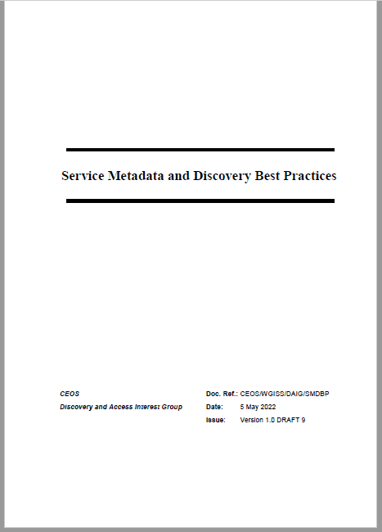
Data DISCOVERY and ACCESS Interest Group
CEOS Service Discovery Best Practice has been developed.
ref. CEOS OpenSearch Best Practice (Discover EO Collection, Granules)
Scenario 1: Online machine to machine interfaces (API)
Scenario 2: Downloadable tools
- Source code, binaries, Jupyter Notebooks, Docker images, …
- Download from repository (GitHub, Zenodo, ..) or registry (e.g. DockerHub, …)
Scenario 3: Web GUI tools
- Software as a Service (SaaS)
- E.g. Jupyter Notebook on Google Colaboratory, Binder
Scenario 4: Application Package
Scenario 5: Coupled Services
Survey of applicable metadata models/elements
ISO19115-1:2014 Annex F.3 “Metadata for discovery of services”
NASA ESDIS UMM-S, UMM-T
INSPIRE Technical Guidance (Metadata),
DataCite Metadata Schema Documentation, …

Slide 11
Data DISCOVERY and ACCESS Interest Group
OGC STAC implementation for CMR was proposed and a volunteer from CWIC provider was solicited. The results will be summarized as STAC implementation Best Practice.

Slide 12
Data DISCOVERY and ACCESS Interest Group
Title | Completion Date | Description | Link to GEO Work Programme (if relevant) | External Reference (if relevant) | Responsible User(s) | Responsible CEOS Entity(ies) | Contributing Agency(ies)
Discovery and Access for Data Analytics and Processing Tools and Services | 2022-Q4 | Facilitate discovery and access for end users to data analytics and processing tools and services through the WGISS Connected Data Assets Infrastructure. |  |  |  | WGISS | ESA
Opensearch Best Practices to include Service Discovery | 2022-Q4 | Extension of Opensearch Best Practices to include service discovery |  |  |  | WGISS | ESA, NASA, JAXA
Feasibility Study for Common Guidlines for the STAC Implementations | 2023-Q2 | Evaluate the possibility of defining a guideline/best practice for the STAC at CEOS level, By that act for an alignment in implementing STAC (in all forms API, static search or metadata modelling) |  |  |  | WGISS | WGISS Member Agencies

Slide 13
Interoperability Data and Use Interest Group
Led by ... (Vacancy)
EAIL (Earth Analytical Interoperability Lab.) is a cloud-based system developed by ex WGISS chair, Robert Woodcock (CISRO) in order to demonstrate “interoperability data and use”. The cloud services enables big data archive and co-use in the cloud, hyper computing in the cloud.
Session on EAIL: Use Cases and Vision was held in WGISS-54 and the status was reported.
- “EAIL Use-cases and vision” by Jonathan Hodge, CSIRO Chile
- “CEOS COAST: A CEOS EAIL Use Case” by Paul M. DiGiacomo, NOAA

Slide 14
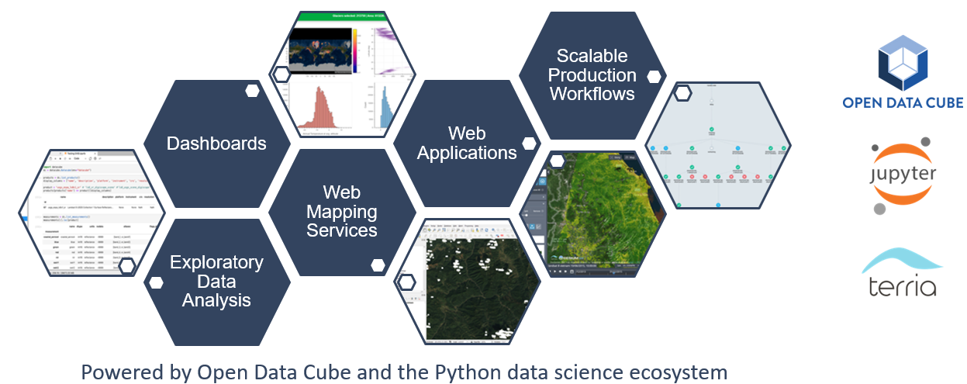
Interoperability Data and Use Interest Group
“EAIL Use-cases and vision” by Jonathan Hodge, CSIRO Chile
https://ceos.org/meetings/wgiss-54/
EAIL is operated by CSIRO Chile with significant support from the Chilean Data Observatory, a public-private-academic partnership founded by the Chilean Government (Ministry of Science, Ministry of Economy), Adolfo Ibáñez University and AWS.
Landsat-5, 7, 8, 9, Sentinel 1, 2, NASA DEM, Copernicus DEM on AWS

Slide 15
Interoperability Data and Use Interest Group
“CEOS COAST: A CEOS EAIL Use Case” by Paul M. DiGiacomo, NOAA
https://ceos.org/meetings/wgiss-54/
WGDisaster Flood pilots is also wishing future use of EAIL.

Slide 16
Updates from the last Plenary
Title | Completion Date | Description | Link to GEO Work Programme (if relevant) | External Reference (if relevant) | Responsible User(s) | Responsible CEOS Entity(ies) | Contributing Agency(ies)

Slide 17
Technology Exploration Interest Group
Led by Yosuke Ikehata (JAXA) and Richard Moreno (CNES)
Jupyter Notebook initiative as a collaboration with SEO and WGCapD has been going on. Jupyter Notebook Day was held on 21st Oct. The white paper will be issued.
AI/ML initiative was proposed at WGISS-54. Use cases, technologies, platforms, etc., related to the Earth observations, will be surveyed. The participation from other entities would be welcomed.
Study on federation between HPC and Archive especially on cloud was also proposed at WGISS-54.

Slide 18
Technology Exploration Interest Group
Title | Completion Date | Description | Link to GEO Work Programme (if relevant) | External Reference (if relevant) | Responsible User(s) | Responsible CEOS Entity(ies) | Contributing Agency(ies)
Jupyter Notebook Best Practice | 2022-Q4 | Knowledge sharing with Jupyter Notebook will be investigated and the best practice will be issued. |  |  |  | WGISS | UKSA, JAXA

Slide 19
AOB
WGISS-55 is to be held in 18th – 20th April 2023 (TBD) hosted by CONAE
- including joint session with WGDisaster
WGISS-56 is to be held in 24th – 26th October 2023 hosted by CNES
A new vice chair (right after 2023 plenary up to 2025 plenary) solicitation has initiated.
Slide ‹#›

