Slide 1
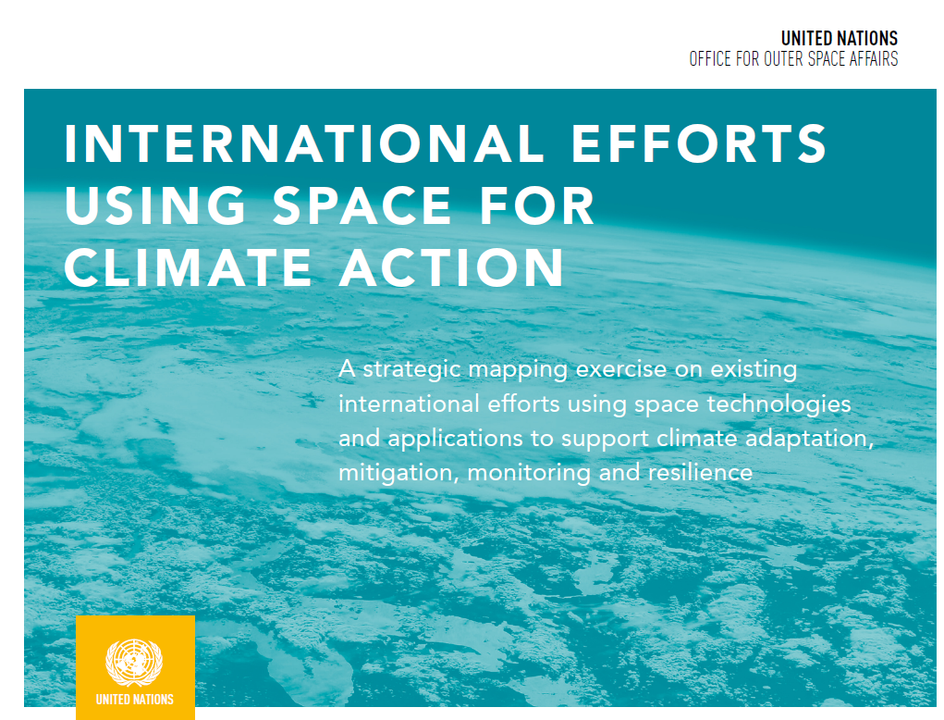
UNOOSA: International Efforts Using Space For Climate Action
Conclusions
The mapping exercise shows that there is a wealth of ongoing and existing initiatives using space technology for climate action. On the other hand, in the area of climate services or capacity-building, a comparable solid coordination and collaboration structure does not currently exist.
Summary of findings
Climate observation, research and science as well as climate policy development is well-established, developed and coordinated
“Climate services” are loosely defined and different actors use different definitions
“Space climate services” and “space for climate actions” are being developed by a vast and increasing number of bodies and stakeholders
There is a lack of platforms or forums that facilitate the sharing of actions and lessons learned
There is currently no international exchange of comprehensive and timely surface and space-based greenhouse gas observations
Limited capacity-building on “Space for Climate Service”
Processes and activities are not as co-ordinated within the United Nations system as might have been expected
The full report can be found here: https://www.unoosa.org/documents/pdf/Space4SDGs/Space_for_Climate_Action_-ebook.pdf

