Slide 1
Joint CEOS/CGMS Working Group on Climate
Agenda item 1.13
Albrecht von Bargen, DLR
Jeffrey A. Privette, NOAA
Agenda Item 1.13
Plenary 2022, Biarritz / France
13th - 15th September 2022

Slide 2
General activity overview
ECV Inventory permanently populated and verified. Version 4.0 (06/07 2021) will have ~1,600 climate data record entries
Gap analysis workshop in May 2022
Action plan
Request to agencies: Please populate ECV inventory continuously!
Unambiguous entry point to UNFCCC
Coordinating SBSTA statements and CEOS contributions to SBSTA/RSO Earth Information Day
Maintain Earth observation role to Global Stocktake
Preparation for COP-27 / SBSTA-57
GHG Task Team see agenda topic 1.11
Guided by AC/VC white paper & roadmap
Members from CGMS major WGs & In-situ community
AFOLU roadmap presentation during WGClimate meetings
Use Cases for CDRs based on ECV inventory
Demonstrates their value in climate applications and services
Request to agencies: Please reach out for Use Cases and advertise in your user communities, commercial or institutional, continuously!
“Space element” in GCOS: support and review implementation plan
GCOS requirements: Regular dialogue with and support to GCOS
Advocating space observations in GEO Climate Change Working Group
See also under http://climatemonitoring.info

Slide 3
COP-27
COP-27 headlines / results / achievements (Egypt presidency)
Clear statements during the world leaders summit by G-77, IPCC, and private initiative representatives: time to act
Focus on financial balance / transfer
Trust fund initiated by European Union & others
Open issue: who exactly pays in, who exactly participate from, what kind of mechanism
Future role of development banks shall be adapted to the incorporation of Paris Agreement goals
No step back behind the Paris Agreement goals

Slide 4
COP-27 / SBSTA-57
Decision topic GCOS IP moved (successfully) forward to a COP acknowledgement
New GCOS Implementation Plan is highly acknowledged and recommended for implementation
Re-calling the role of GCOS
https://newsroom.unfccc.int/sites/default/files/resource/sbsta2022_L20a1E.pdf?download (GCOS IP decision)
Opening session: CEOS / CGMS statement provided by the French delegation
Earth Information Day
Three panels (Panel 2 [mitigation] with representatives from space agencies: CEOS / CGMS WGClimate & Systematic observation community)
Two poster contribution by CEOS / CGMS (additional: ECMWF, ESA, JAXA, ….)
SBSTA cover decision (draft): https://unfccc.int/sites/default/files/resource/cp2022_L19_adv.pdf?download
Conclusions (draft): https://unfccc.int/sites/default/files/resource/sbsta2022_L20E.pdf?download
Webpage: https://unfccc.int/event/earth-information-day-2022
Draft report/conclusion will be provided for review to current WGClimate chair (open) re-calling the role of the Systematic Observation Community

Slide 5
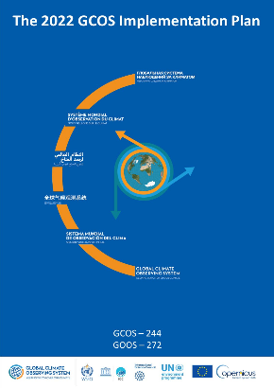
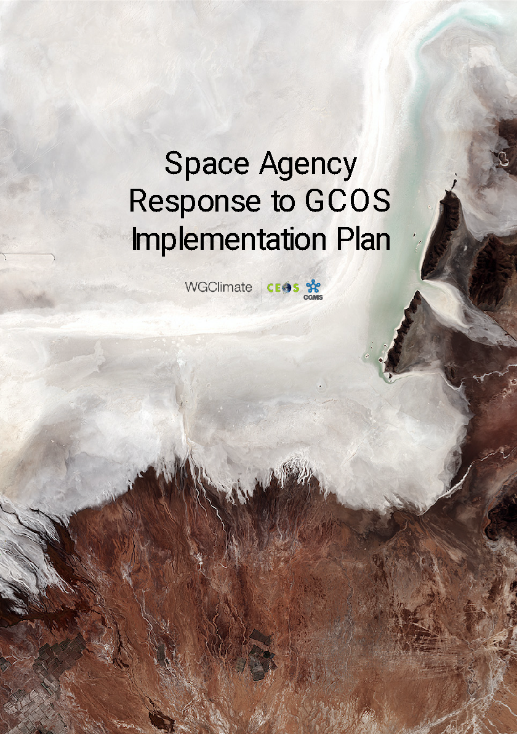
Earth Observation from space: Supporting the Parties in Implementing the Paris Agreement A. von Bargen (DLR), J. Privette (NOAA), M. Dowell (EC), F. M. Seifert (ESA) on behalf of the Joint CEOS/CGMS Working Group on Climate
Space observations support key parts of the Paris Agreement:
State of the climate (Article 2)
Mitigation (Articles 4 & 5)
Mitigation reporting (Article 13)
Adaptation & resilience incl. Early Warning (Articles 7 & 8)
Adaptation reporting (Article 7)
Global Stocktake (Article 14)
Systematic Observations (Article 7)
Space agencies serve the needs with:
The Architecture for Climate Monitoring from Space
Sustained capability for long-term data records
CEOS Carbon and Methane constellation architecture
CEOS / CGMS Carbon and Methane constellation roadmap
Agriculture, Forestry and Other Land Use (AFOLU) roadmap (forthcoming)
The CEOS Global Stocktake Strategy
The Role of Systematic Observations in the Global Stocktake
GCOS Implementation Plan as action-oriented framework
1. To support Parties’s efforts to mitigate and track mitigation of GHGs per the Paris Agreement (Articles 4 and 13), space agencies seek to develop systematic space and Monitoring, Reporting and Verification (MRV) capabilities for sustained emission estimation.
2. Addressing Parties’ needs in support of the Paris Agreement, space agencies seek to integrate Earth Observations into strong value chains in partnership with stakeholders and end-users.
3. The synthesis paper “The Role of Systematic Observations in the Global Stocktake” provides a starting point for Parties and space agencies working together towards the long-term goals of the state of the climate, mitigation and adaptation, but requires strong follow-up.
Information exchange with CEOS & CGMS space agencies:
Needs and Requirements
Reports on Progress
to SBSTA/COP
https://unfccc.int/sites/default/files/resource/202203012343_SO_in_GST_2022_final.pdf
Coordinated Response
Space agencies

Slide 6
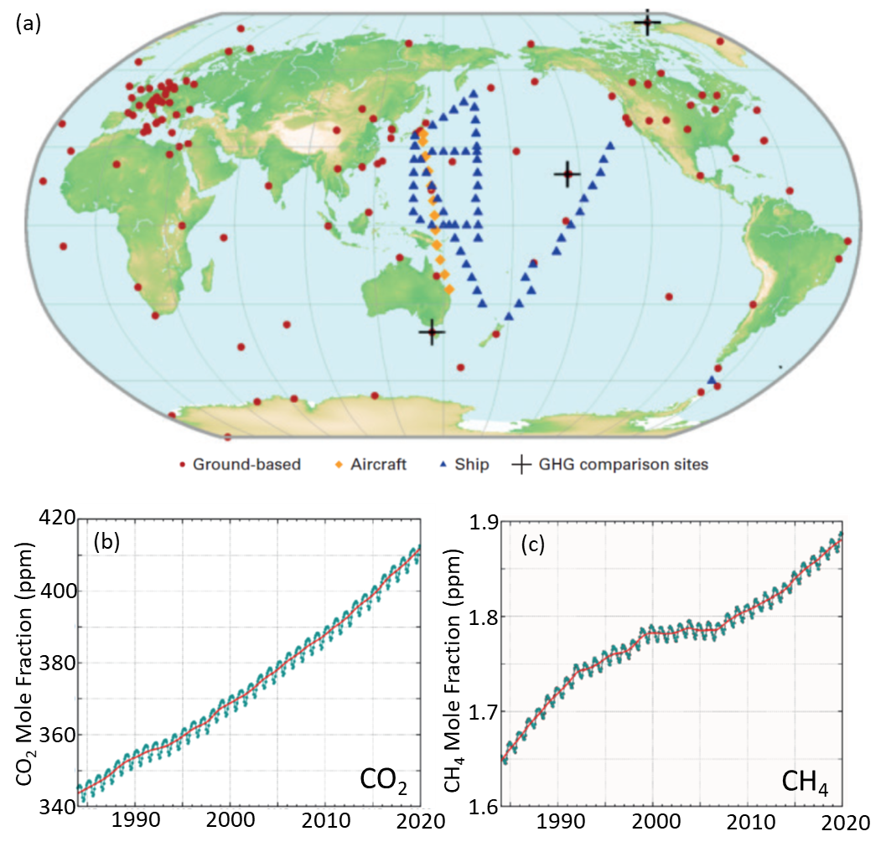
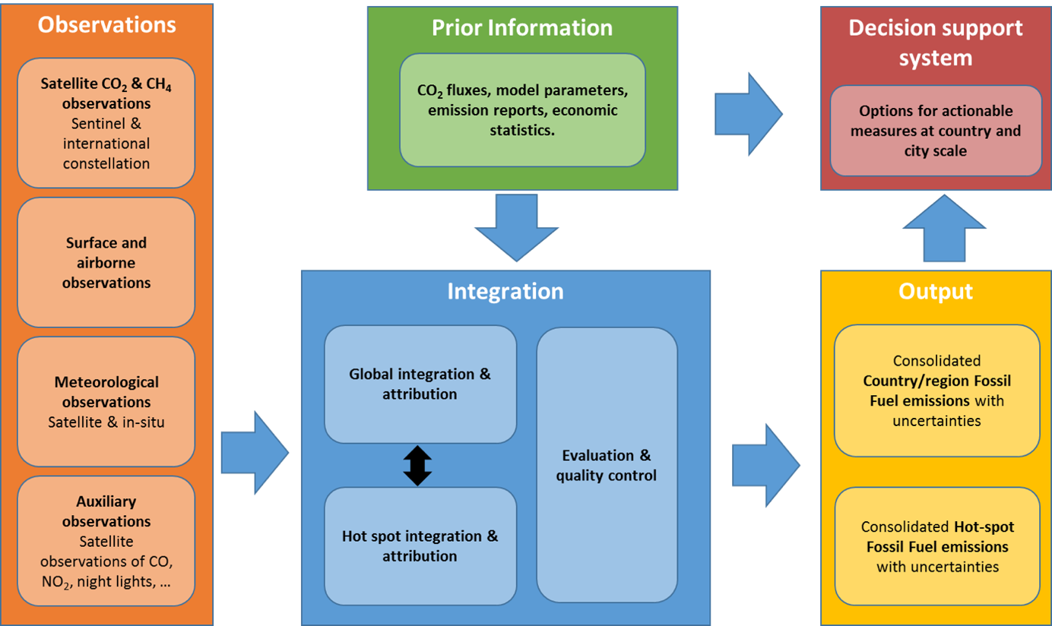
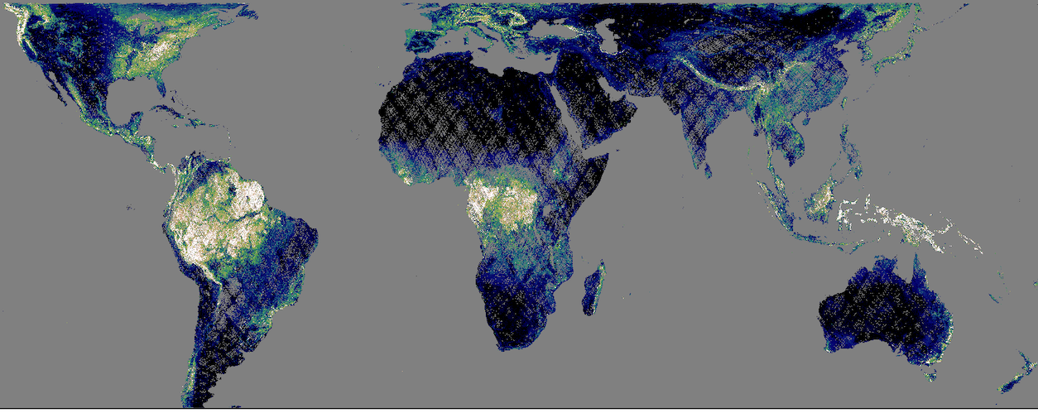
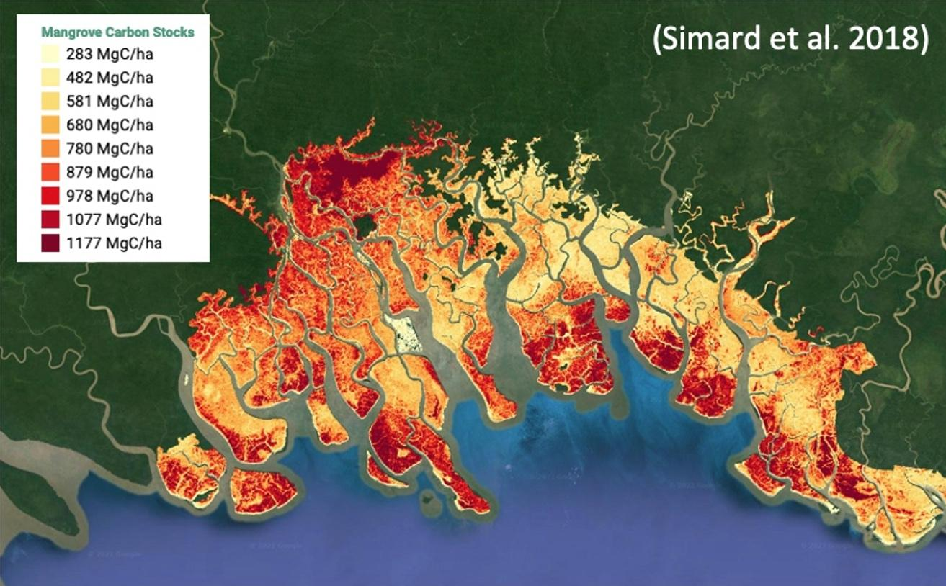
Systematic Observations Required for Mitigation A. von Bargen (DLR), J. Privette (NOAA), M. Dowell (EC), F. M. Seifert (ESA) on behalf of the Systematic Observations Community
Earth Observations
Top-Down GHG Estimates
Space- and ground-based measurements of atmospheric carbon dioxide (CO₂) and methane (CH₄) are analyzed with atmospheric transport models to estimate Greenhouse Gas (GHG) emissions and removals from human activities and the natural land and ocean.
Earth Observation community is supporting the GSTs.
Space observation capabilities must evolve from research to operational (Goal: 2nd GST) and sustained.
A sustained systems approach provides a seamless flow of reliable information to national stakeholders
Agriculture, Forestry and Other Land Use (AFOLU) is the second largest source of emissions (after fossil fuel use) globally, and is the primary source of emissions in many developing nations
Bottom-up GHG National Inventories can be combined with Top-down GHG estimates to produce a more complete and transparent input to the Global Stocktakes (GST).
NASA 2020
JPL
ESA
2020
CCI
NASA 2020
GEDI
Aboveground Biomass Density (Mg/ha)
Global Mangrove Watch
See also at https://ceos.org/gst and https://unfccc.int/sites/default/files/resource/202203012343_SO_in_GST_2022_final.pdf

Slide 7
GCOS interaction
GCOS Implementation Plan had been drafted in 2022
WGClimate had been requested for review:
Review summary forwarded during June to GCOS secretariat
Individual comments in parallel because of the lack of time
GCOS IP is divided into two documents (Implementation Plan and Requirements) and - in addition - there is a new satellite supplement (excerpt from GCOS IP)
Need to prepare a comprehensive response for CEOS / CGMS based on the satellite supplement, but also on the full IP
WGClimate decision to align the response with the gap analysis workshop outcome in order to be consistent and complete
After reorganisation in WMO, new PoCs at GCOS secretariat are identified and will now continuously interact with WGClimate

Slide 8
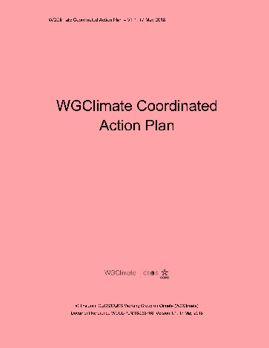
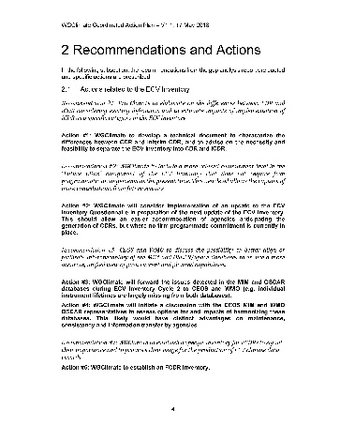
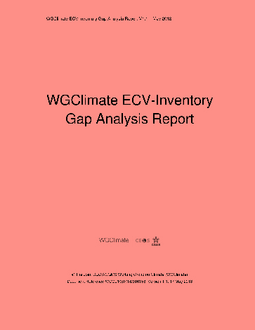
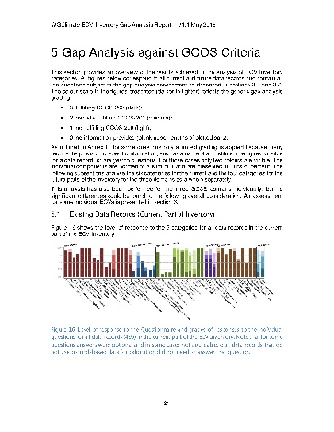
Sustaining Space Capabilities for Climate
Actions
Creation of conditions to deliver climate data records
The ECV Inventory fully describes current and planned provision of ECVs
WG Climate gap analysis used to address actions
Basis for recommendations for CEOS and CGMS agencies
Data access is free and open for more than 98% of the data records
Basis for GCOS Status Report contribution
Analysis of Global Stocktake CDR-related needs may extend the variable set beyond current GCOS-listed ECVs (examples: mangroves, agriculture, a.o.)
Feedback to GCOS, hence to UNFCCC
Version 4.1 recently announced (29 Nov 2022)!
Recommendations to mitigate gaps
ECV Inventory
Population
Content Verification
Gap Analysis
Completeness of ECV Products
Sustainability of space segment
Missed data usage opportunities

Slide 9
Gap analysis workshop (I)
Action items CMRS-22-01, CMRS-22-02, CMRS-22-03, CMRS-22-04
ECV inventory consolidated to interim version based on 4.0
Gap analysis workshop organized with focus on ECVs driving the Earth’s climate Carbon cycle
Workshop in hybrid format with excellent expert attendance
Some of the ECVs had been target of the gap analysis two years before
ECVs in focus: GHGs, Anthropogenic GHG fluxes, Above Ground Biomass, Land cover, Leaf Area Index, FAPAR, Fire, Permafrost, Ocean color

Slide 10
Gap analysis workshop (II)
Guiding questions for the workshop
GCOS ECV definition adequacy
ECV coverage in ECV Inventory (existing/planned) identifying gaps in the inventory
Situation of the space segment for the ECV products
Situation of the ground segment for the ECV products
Situation of the science to exploit the measurements
Everything that is important in addition
Recommendations if needed
A report with findings related to GCOS IP draft had been submitted to GCOS secretariat Mid-June 2022 (CMRS-22-04)
Report of gap analysis containing the report of gap analysis carried out in 2019 / 2020 is under draft and will be combined with the CEOS response to GCOS IP (CMRS-22-02)
Feedback to GST strategy action #1 (and in parts to action #2)

Slide 11
Action item status (Gap analysis)
CMRS-22-01: Gap analysis workshop (closed)
CMRS-22-02: Output wrt GHG had been generated but a dedicated interaction with GHG Task Team must be organized
CMRS-22-03: Wrong expiry date in database -> Q2/2024 (Ocean-related ECVs @ Carbon cycle)
CMRS-22-04: Response to GCOS secretariat sent on June 17th, 2022 (closed)

Slide 12
Use cases
Led by NASA (W. Su) and WMO (Z. Andreeva); NOAA/NCEI supports with tremendous effort wrt publication
Collecting use cases for climate data records
Use case gathering tool at the climatemonitoring.info webpage
Strict review process
More than 20 use cases reviewed, continuous publication process
Discussion linking of the activity with similar activities @ ESA/CCI and @ ECMWF
Activity becomes now a routine activity of WGClimate
See http://climatemonitoring.info

Slide 13
Interaction within CEOS et al.
Interaction with AFOLU team via GHG task team WGClimate chairs are included in AFOLU discussions
WGClimate starts again to intensify their interaction with other Working Groups
Introduction recently at the WG plenaries of WGDisaster and WGCV
Vice versa, both WGs come back to recent WGClimate meeting in October 2022
Topics for interaction identified, but will elaborated in 2023
Inclusion in the Ocean team discussion
Et al.: Scientific Committee and abstract review @ 2nd Climate Observation Conference (GCOS, hosted by EUMETSAT)
GEO WGCC paper for COP-27/SBSTA => preparation under support of WGClimate (W. Su)

Slide 14
Endorsements by CEOS principals
Endorsements items
Vice-chair nomination
“Statement Reporting on Progress by the Committee on Earth Observation Satellites (CEOS) and the Coordination Group for Meteorological Satellites (CGMS) on Coordinated Response to UNFCCC Needs for Global Observations” submitted to the 57th Session of the Subsidiary Body for Science and Technology Advice.
Information item
WGClimate confirmed on October 13th, 2022, Yasjka Meijer (ESA) as chair of the Greenhouse Gas Task Team. Deputy Chair is the vice-chair of WGClimate (ex officio)

Slide 15
Endorsement: Vice-chair nomination
Extra meeting of WGClimate on May 19th, 2022
Only topic: nomination of vice-chair candidate
Dr. Wenying Su (NASA/Langley) had been nominated in full consent
Approval of CGMS during CGMS-50 (June 17, 2022)
To be endorsed during CEOS plenary 2022
Vice-chair term begins with the end of CEOS plenary 2022
Chair term begins with the end of CEOS plenary 2024 (terminates in 2026 with the end of CEOS plenary)

Slide 16
Endorsements by CEOS principals
The CEOS principals endorse the nomination of Dr Wenying Su (NASA) as Vice-chair of the Joint CEOS / CGMS Working Group on Climate. Her vice-chair term will begin with the end of the CEOS plenary 36 (2022). She will succeed as Chair of the Joint Working Group on Climate at the end of the CEOS plenary in 2024 with a chair term terminating at the end of the CEOS plenary in 2026.
The CEOS principals endorse the “Statement Reporting on Progress by the Committee on Earth Observation Satellites (CEOS) and the Coordination Group for Meteorological Satellites (CGMS) on Coordinated Response to UNFCCC Needs for Global Observations” submitted to the 57th Session of the Subsidiary Body for Science and Technology Advice.” The statement had been given during the opening session of SBTSA 57 on November 6th, 2022, and was circulated in advance for comments and decision to CEOS and CGMS members. Due to the consent between CEOS and CGMS that the statement will be given by the CEOS chair (CNES) or its National delegation, the statement had been provided by the France delegation.

Slide 17
Many thanks
To my vice-chair who will now take over the driver-seat
To the CEOS Chair team and CEOS SIT team
To the CEO who was always very supportive and helpful
for your attention!

Slide 18
Appendix

Slide 19
Meeting record 2022
March 2022 16th WGClimate Meeting (virtual)
May 2022 Gap Analysis Workshop (hybrid, EUMETSAT)
May 2022 Interim WGClimate Meeting (Nomination)
May 2022 CGMS Working Group II Meeting
June 2022 50th CGMS Plenary
June 2022 SBSTA 56 meeting
October 2022 2nd Climate Observation Conference organized by GCOS
October 2022 GHG Task Team Meeting
October 2022 17th WGClimate Meeting (EUMETSAT)
November 2022 COP-27 / SBSTA 57

