Slide 1
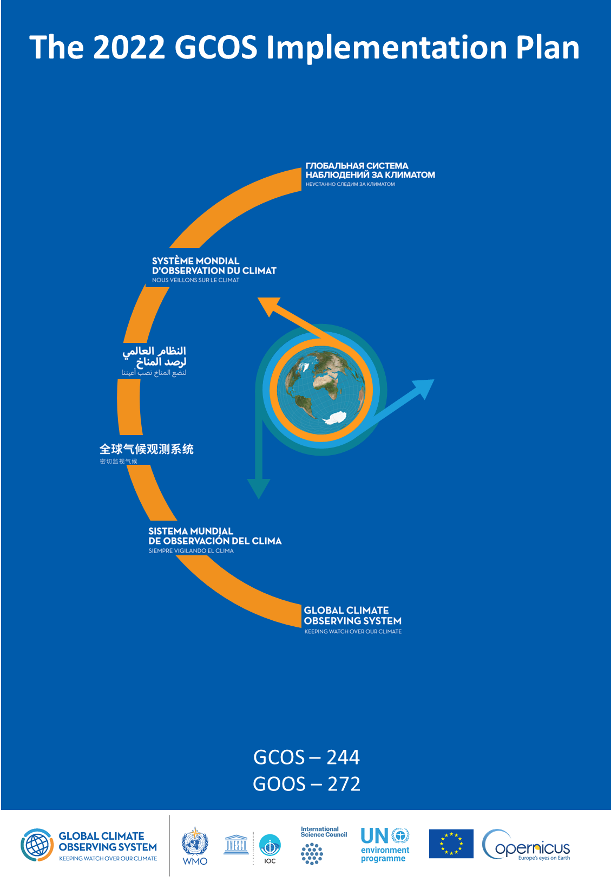
The GCOS Implementation Plan
2022

Slide 2
GCOS Implementation Plan
Produced every 5-6 years, GCOS Implementation Plans:
  Are submitted to UNFCCC and the GCOS sponsors.
  Provide recommendations for a sustained and fit for purpose Global Climate Observing System.
  Cover climate monitoring needs over the entire Earth system from the atmosphere to the oceans, from the cryosphere to the biosphere.
  Encompass the water, energy and carbon cycles.
This 2022 GCOS Implementation Plan has a different form to earlier plans, it has:
  Fewer, more focused, and integrated actions.
  Clearer means of assessment.
  Clearer identification of the stakeholders who need to respond to the actions.
  The updated ECVs requirements are presented in a separate document - The 2022 GCOS ECVs Requirements (GCOS 245).

Slide 3
Producing the plan
GCOS has a cycle or monitoring the climate observing system → status reports → implementation plans
based on extensive consultation and public review
drafted by expert panels and drafting team, overseen by editorial board and GCOS Steering Committee
GCOS Status Report
2021
Consultations
  GCOS expert Panels get inputs from their communities
Preparation of supplements for specific communities.
Drafting
  Led by a writing team
  Panels identify main actions needed in next 5-10 years
2022 GCOS Implementation Plan
2021 Status report
GCOS monitors performance of global climate observing system
2016 Implementation Plan
2015 Status Report
Publication
  Published by GCOS
  Submitted to Sponsors and UNFCCC
Revision
  all comments addressed
  final checks by panels, writing team, and GCOS Steering Committee
Review
  Public review as broad as possible
Earlier Status Reports and plans

Slide 4
Wide range of views and inputs condensed into 6 themes
Ensuring Sustainability
Addressing in situ and satellite observations that are currently at risk.
Consultations with observing community
Filling Data Gaps
Observations are consistently deficient in parts of Africa, South America, Southeast Asia, the deep oceans and polar regions.
The GCOS 2021 Status Report
The UNFCCC Paris Agreement
Improving data quality, availability and utility, including reprocessing
Improvements in transforming observations into user-relevant information
Drafting by GCOS
Managing Data
Ensuring data is well-curated, discoverable, open and freely available and permanently archived
Implications of the IPCC 6th Assessment Report and Special Reports
Scientific studies of the climate cycles of carbon, water and energy
Engaging with Countries
Coordinating national efforts with global systems and support, understanding national needs.
Public Review
Other Emerging Needs
Some new needs can already be identified and adressed (e.g. for adaptation and mitigation)
Main Inputs → Broad Engagement → Themes for Action

Slide 5
Themes
A: ENSURING SUSTAINABILITY
  Ensure long-term support for in situ networks
  Address gaps is satellite observations likely to occur in near future – prepare follow-on plans
B: FILLING DATA GAPS
  Development of reference networks: in situ and satellite
  Implement GBON
  Global reporting of hydrological observations,
  Implement trace gas and aerosol, ocean biological, biogeochemical, CO₂ and N₂O observations
  Improve estimates of latent and sensible heat fluxes and wind
  Identify gaps in monitoring of climate cycles
C: IMPROVING DATA QUALITY, AVAILABILITY AND UTILITY, INCLUDING REPROCESSING
  Develop standards and best practices
  Improvements to satellite and in situ products
  New and improved reanalysis products
D: MANAGING DATA
  Define governance and requirements of data centre
  Ensure in situ data centres exist for all ECV
  Improve discovery and access
  Data rescue
E: ENGAGING WITH COUNTRIES
  Improve regional and national engagement in GCOS
  Enhance support for national climate observations
F: OTHER EMERGING NEEDS
  Higher resolution real time data
  Improvements in urban, polar, coastal regions and EEZ
  Develop operational Global GHG Monitoring System

Slide 6
Next Steps
Who has to act?
GCOS will
  WMO
  NMHS
  Space agencies
  GOOS
  Reanalysis Centres
  Global Data Centres
  Research organizations
  National Agencies
  Parties to UNFCCC
  Academia
  Funding Agencies
  GCOS
Prepare supplements for several of these groups summarising the important relevant actions.
Address actions allocated to it in Implementation Plan.
Identify additional needs arising from Paris Agreement (i.e. adaptation & mitigation).
Continue to monitor performance of global climate observing system.
Facilitate reviews of observations of climate cycles.
Review adequacy of ECV requirements.
Promote national engagement in GCOS.

Slide 7
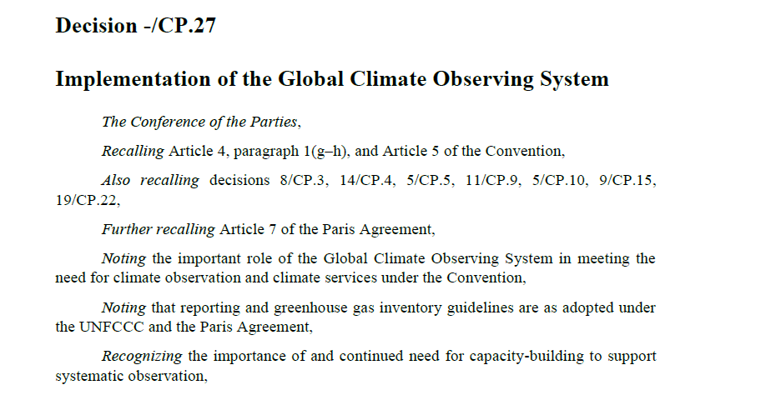
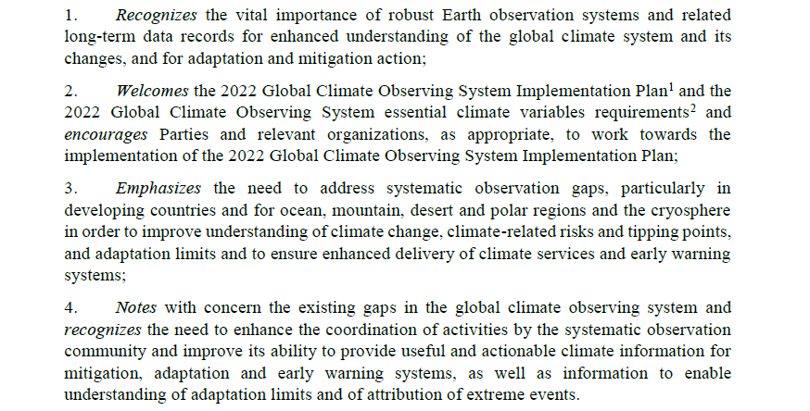

Slide 8

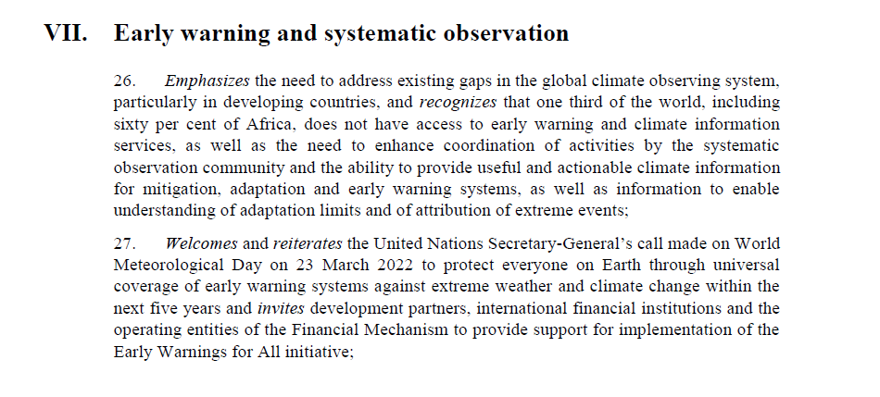

Slide 9
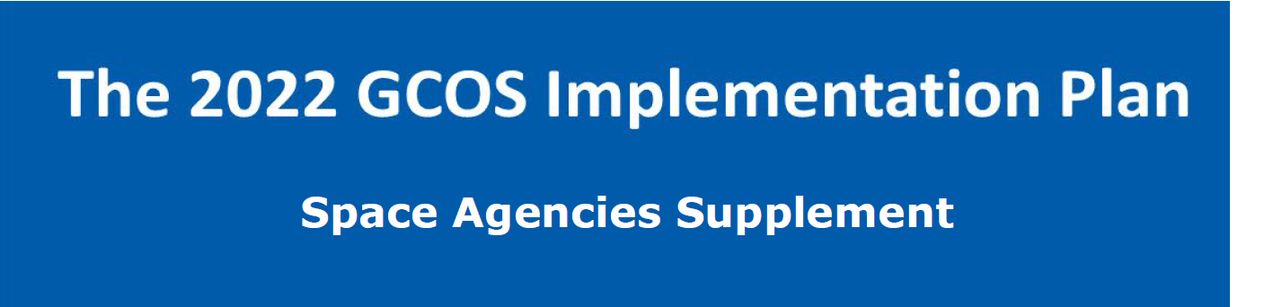
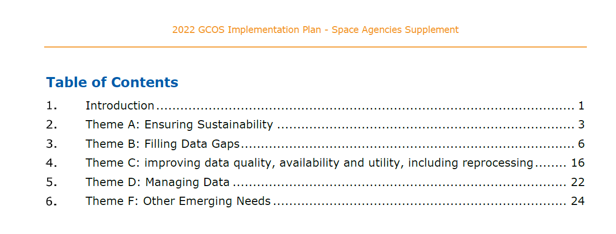

Slide 10
  Theme A: Ensuring Sustainability
IP Actions with relevance for Space Agencies
Action A2: Address gaps in satellite observations likely to occur in the near future
Action B3: New Earth observing satellite missions to fill gaps in the observing systems
Action B7: Augmenting ship-based hydrography and fixed-point observations with biological and biogeochemical parameters
Action A3: Prepare follow-on plans for critical satellite missions
Action B5: Implementing global hydrological networks
Action B9: Improve estimates of latent and sensible heat fluxes and wind stress
  Theme B: Filling Data Gaps
Action B10: Identify gaps in the climate observing system to monitor the global energy, water and carbon cycles
Action B10: Identify gaps in the climat observing system to monitor the global energy, water and carbon cycles
Action B1: Development of reference networks (in situ and satellite Fiducial Reference Measurement (FRM) programs)
Action B6: Expand and build a fully integrated global ocean observing system
Notes:
Space agencies are involved in actions for most of the themes (except in Country engagement, theme E). In several cases, they are the only implementers (e.g. A2, A3. B3…)

Slide 11
Theme D: Magaging Data
IP Actions with relevance for Space Agencies
Action C1: Develop monitoring standards, guidance and best practices for each ECV
Action D4: Create a database of co-located in situ cal/val observations and satellite data for quality assurance of satellite products
Action F1: Responding to user needs for higher resolution, near real time data
Action F2: Improved ECV satellite observations in polar regions
Action C2: General Improvements to Satellite Data Processing Methods
  Theme C: Improving Data Utiliy
  Theme F: Emerging needs
Action F3: Improve monitoring of coastal and Exclusive Economic Zones
Action F5: Develop an Integrated Operational Global GHG Monitoring System
Action C5: ECV-specific Satellite Data Processing Method Improvements

Slide 12
Thank you

