Slide 1
CEOS-IMEO
Cooperation
Stephen Briggs ESA SIT Chair
Agenda Item 1.11
2022 CEOS Plenary, Biarritz
29 Nov - 1 Dec 2022

Slide 2
Heritage
Australian SIT Chair Team first reached out to International Methane Emissions Observatory (IMEO) for a report on their work to SIT TW 2021, recognising:
the central role of satellite EO in their work
the potential high impact of EO on emissions reduction
IMEO is a data-driven, action-focused initiative by the UN Environment Programme (UNEP) with support from the European Commission - both CEOS agencies
ESA SIT Chair agreed the importance of CEOS-IMEO cooperation and undertook to provide continuity
IMEO team has since participated in a number of CEOS groups and meetings, including:
SIT-36
AC-VC
WGClimate
SIT TW 2022
Slide ‹#›

Slide 3
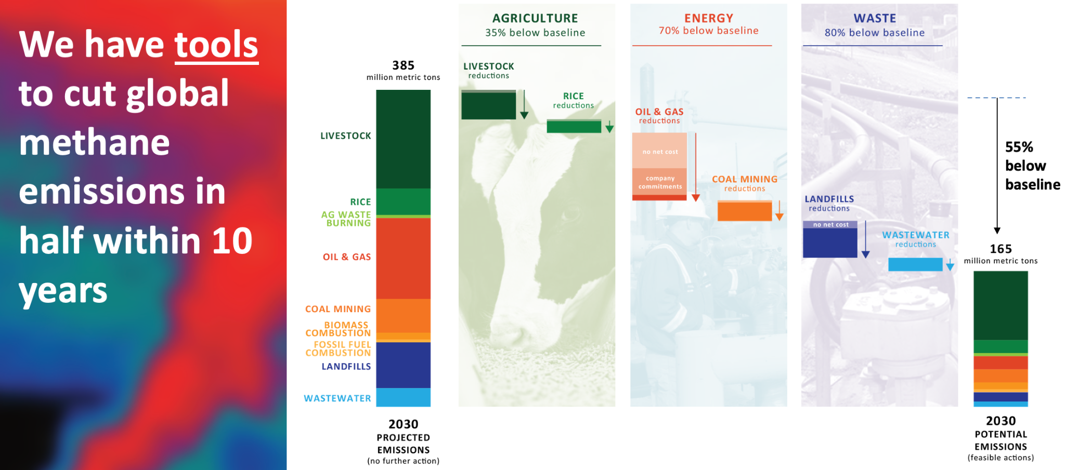
What is IMEO?
Launched at the G20 Summit (Oct 21), the International Methane Emissions Observatory (IMEO) is a data-driven, action-focused initiative by the UN Environment Programme (UNEP) with support from the European Commission to catalyse dramatic reduction of methane emissions, starting with the energy sector.
IMEO aims to revolutionize methane reduction by interconnecting data with action on research, reporting, and implementation. IMEO will collect & integrate diverse methane emissions data streams to establish a global public record of empirically verified methane emissions at an unprecedented level of accuracy and granularity.
By providing near-real time, reliable, and granular data on the locations and quantity of methane emissions that targets strategic mitigation action, IMEO will catalyse strategic mitigation actions that are urgently needed to achieve the Paris agreement goals.
Slide ‹#›

Slide 4
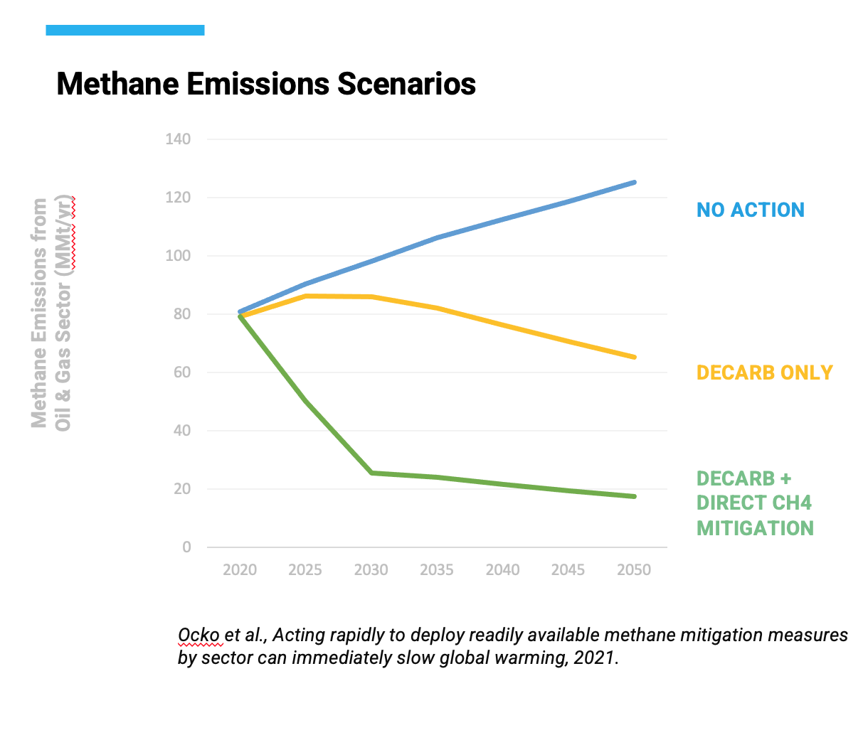
Methane reduction

Slide 5
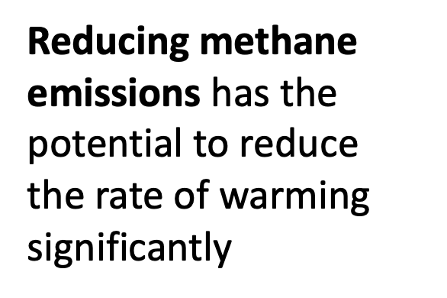
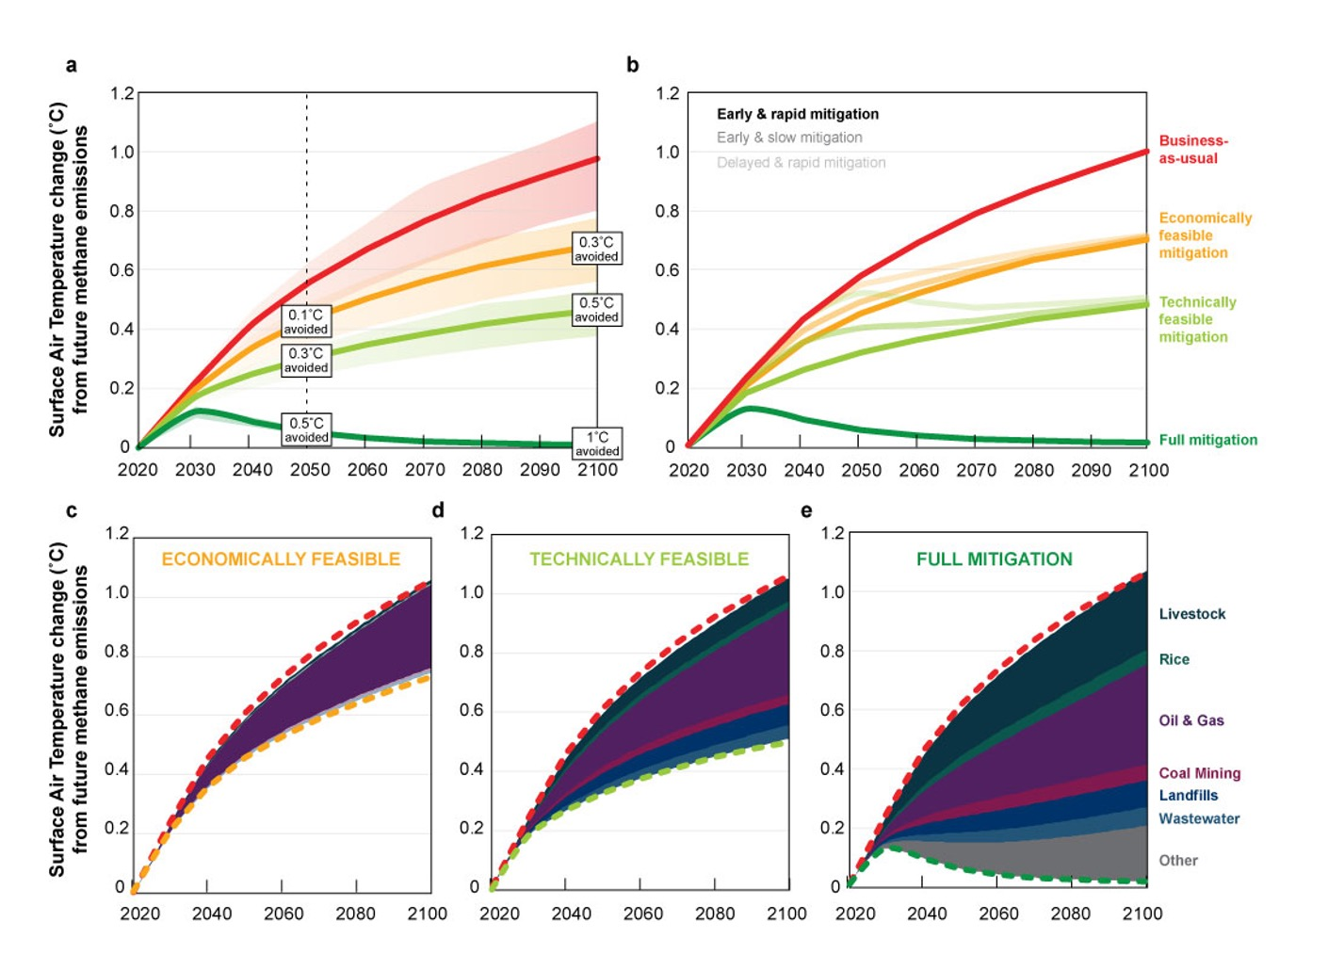
Methane reduction
US & EU launched the Global Methane Pledge at COP-21 and 125 countries have since joined - agreeing to take voluntary actions to contribute to a collective effort to reduce global methane emissions at least 30 percent from 2020 levels by 2030, which could eliminate over 0.2˚C warming by 2050.

Slide 6
IMEO MARS launch at COP-27
Slide ‹#›

Slide 7
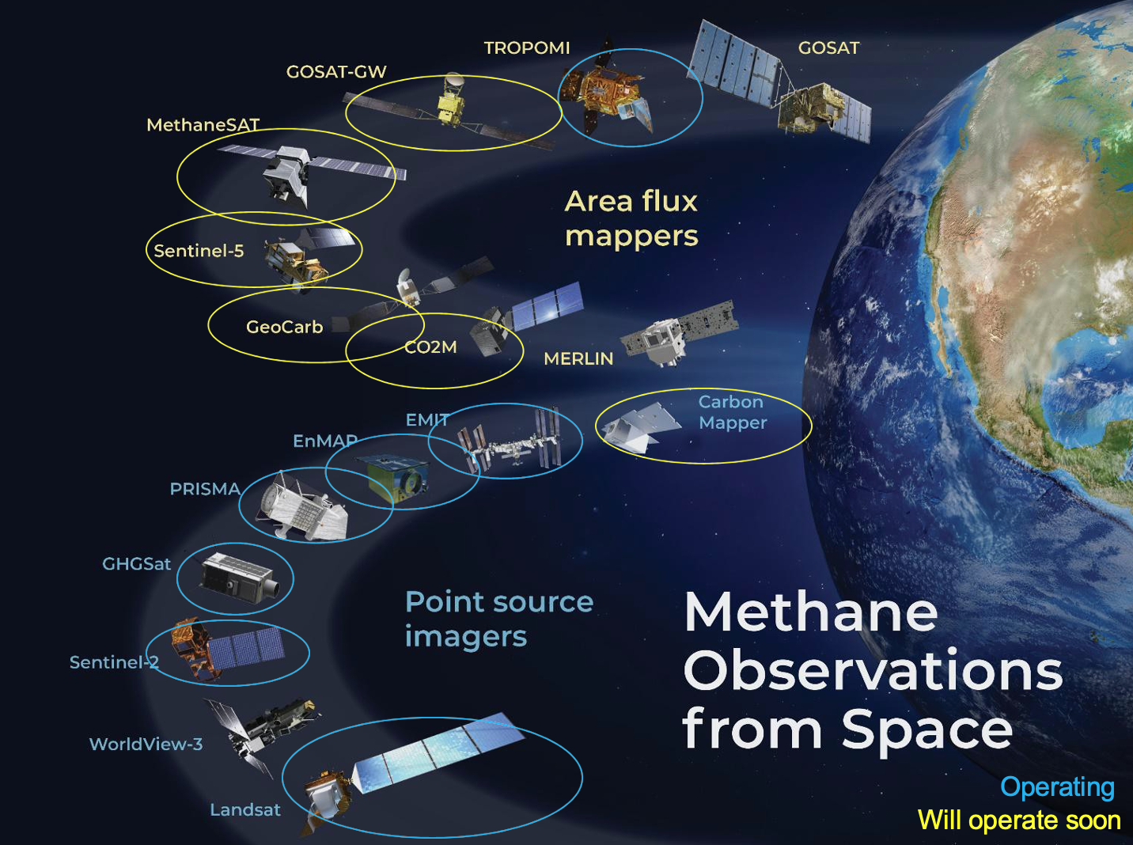
IMEO MARS
Methane Alert and Response System (MARS) – IMEO’s data product
The first phase of MARS system will use satellite remote sensing for detection and attribution of methane plumes from point-sources (energy sector) AND will also include notification and mitigation-tracking workflows.
Component 1: Detection, localization, and – where possible – attribution
Component 2: Notification to OGMP 2.0 companies and governments
Component 3: Mitigation and Tracking
MARS-Detection, objectives:
First phase: use satellites to identify large point-source emissions from the energy sector
Next phases (~2023-2024): improve detection limits and include area sources
Results will be made public through a data portal and used to guide mitigation efforts
Satellite Data:
Ecosystem of methane-sensitive satellite missions is very heterogeneous in terms of: Detection limits; Spatial and temporal sampling; Availability of analysis-ready methane data products
Slide ‹#›

Slide 8
IMEO MARS - Current Satellites
Area flux mappers:
TROPOMI: 7 km/pixel, global daily coverage, >10 t/h emissions, no attribution to sources
A number of other missions coming up in the next 2-3 years
Point Source Imagers:
Hyperspectral missions:
GHGSat (private): 25/50 m resolution, high sensitivity, sporadic acquisitions,12 km coverage
Imaging spectrometers (PRISMA, EnMAP, EMIT, AHSI): 30 m
resolution, medium sensitivity, 30- 60 km coverage, require tasking
Multispectral missions:
S-2/Landsat: 20-30 m resolution, low sensitivity, but “monitoring” with frequent and global coverage
Slide ‹#›

Slide 9
IMEO Requests to CEOS Agencies
Access to hyperspectral imaging missions to explore their plume measurement capabilities
PRISMA (ASI), EnMAP (DLR), EMIT (NASA), Gaofen 5-2 AHSI (China, MEE), GHGSat (via CSA)
Discussion ongoing between DLR and IMEO, to assess how EnMAP could address IMEO’s data needs. DLR request clarification on their requirements.
Dialogue with ESA/EC regarding expediting a TROPOMI Near Real Time Methane product to support the rapid timescales involved in MARS.
SWIR band selection for global imaging multispectral missions (eg Landsat Next and Sentinel-2 series) - take into consideration the potential for methane detection and measurement
SIT Chair Letter 22 July 2022

Slide 10
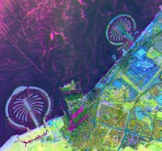
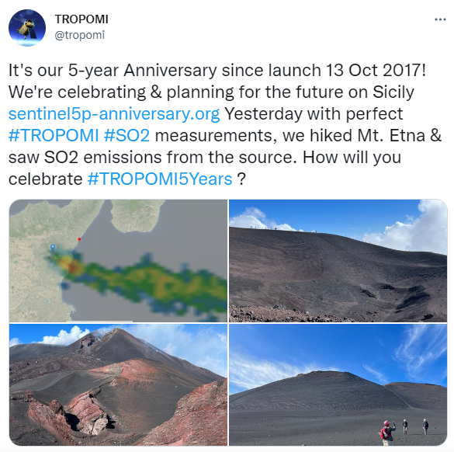
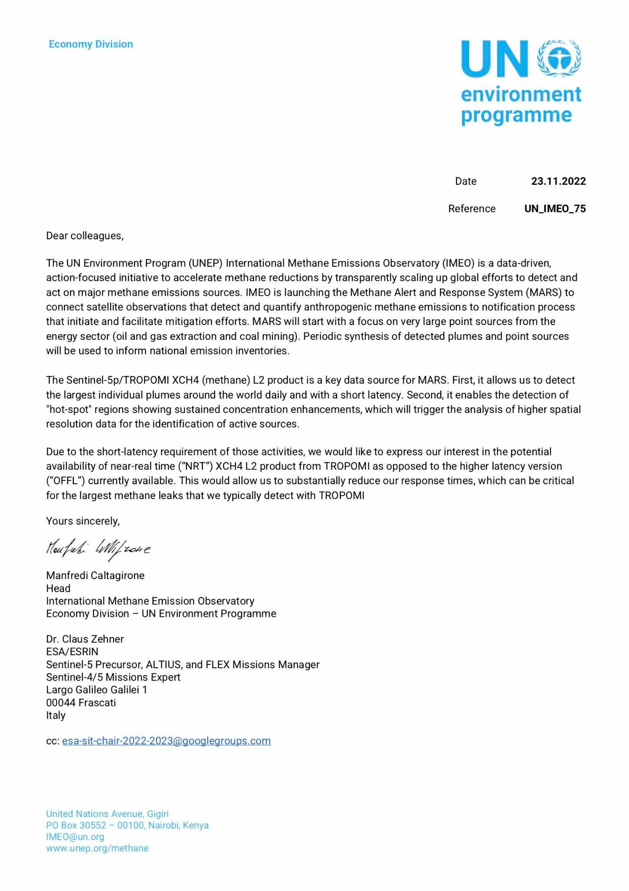
IMEO Requests - progress
DLR and IMEO in constructive discussion around EnMAP data access for MARS support - “open to discuss an optimal provision of EnMAP data supporting IMEO, e.g. the MARS activity”. DLR positive and seeking clarification of IMEO requirements. Dialogue continues as MARS enters operational phase
EnMAP image acquired over Dubai, the Palm on July 1st, 2022. Principle Component Analysis (RGB: PC1, PC2, PC3)
ESA has invited & received a formal letter from IMEO requesting TROPOMI NRT product

