Slide 1
CEOS AFOLU Roadmap
Update
Ben Poulter (Lead Author, NASA)
Osamu Ochiai (JAXA, Co-Lead) Frank Martin Seifert (ESA, Co-Lead)
Agenda Item 1.10
2022 CEOS Plenary
Biarritz, France
Nov. 29 – Dec. 1

Slide 2
Contents
Reminder of heritage & objectives
Progress update - outcomes from CEOS SIT TW-2022
Emerging Grand Vision
Summary of AFOLU engagement (COP27, Carbon from Space)
Next steps & schedule
Request for support
Slide ‹#›

Slide 3
Heritage & objectives
2020 CEOS Plenary 34 agreed to a CEOS AFOLU Roadmap, as an initiative to support UNFCCC Global Stocktake Process
Based on Discussion Paper prepared by LSI-VC Forest & Biomass Team following SIT 35
Recognising need for an AFOLU equivalent to the CEOS GHG Roadmap (with CGMS)
“...if Land Use, Land Use Change and Forestry targets involved in the initial NDCs were implemented in full, this would represent approximately a quarter of pledged mitigation efforts up to 2030“
2021 CEOS Plenary 36, AFOLU Roadmap to be co-led by NASA, ESA, JAXA
2021 / 2022 accomplishments
Assessment of latest AFOLU products (land cover, agriculture & biomass) that could be readied for 2021 COP-26
Biomass Harmonisation Exercise on ESA/NASA MAAP
Coordination with SIT Chair and GHG Team on new CEOS GST Portal – as a unified point of entry to explain & offer our data
New engagement axis with national inventory users, building on our GFOI experience and in the spirit of the ambition cycle of the Paris Agreement to learn together and grow together
Significant input to the synthesis report on “The Role of Systematic Earth Observations in the Global Stocktake” for UNFCCC
Joint Workshop of CEOS AFOLU and GCOS Terrestrial Observation Panel for Climate at SIT-TW 2022
Contributions to COP27 and Earth Information Day

Slide 4
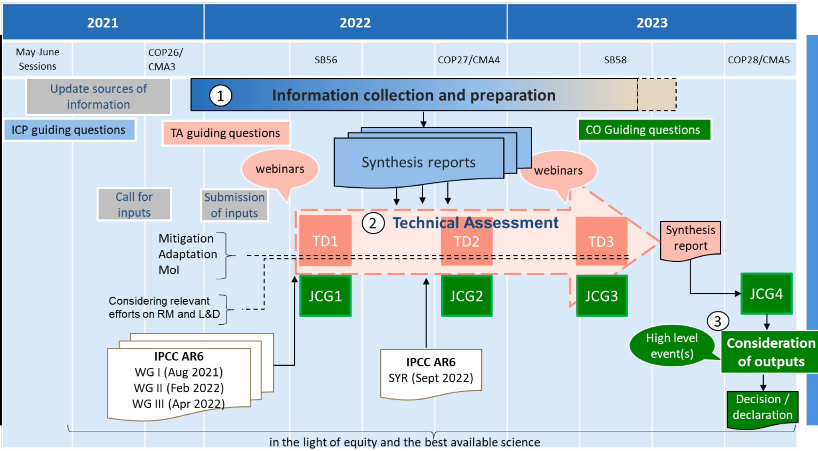
Heritage & objectives
Global Stocktake

Slide 5
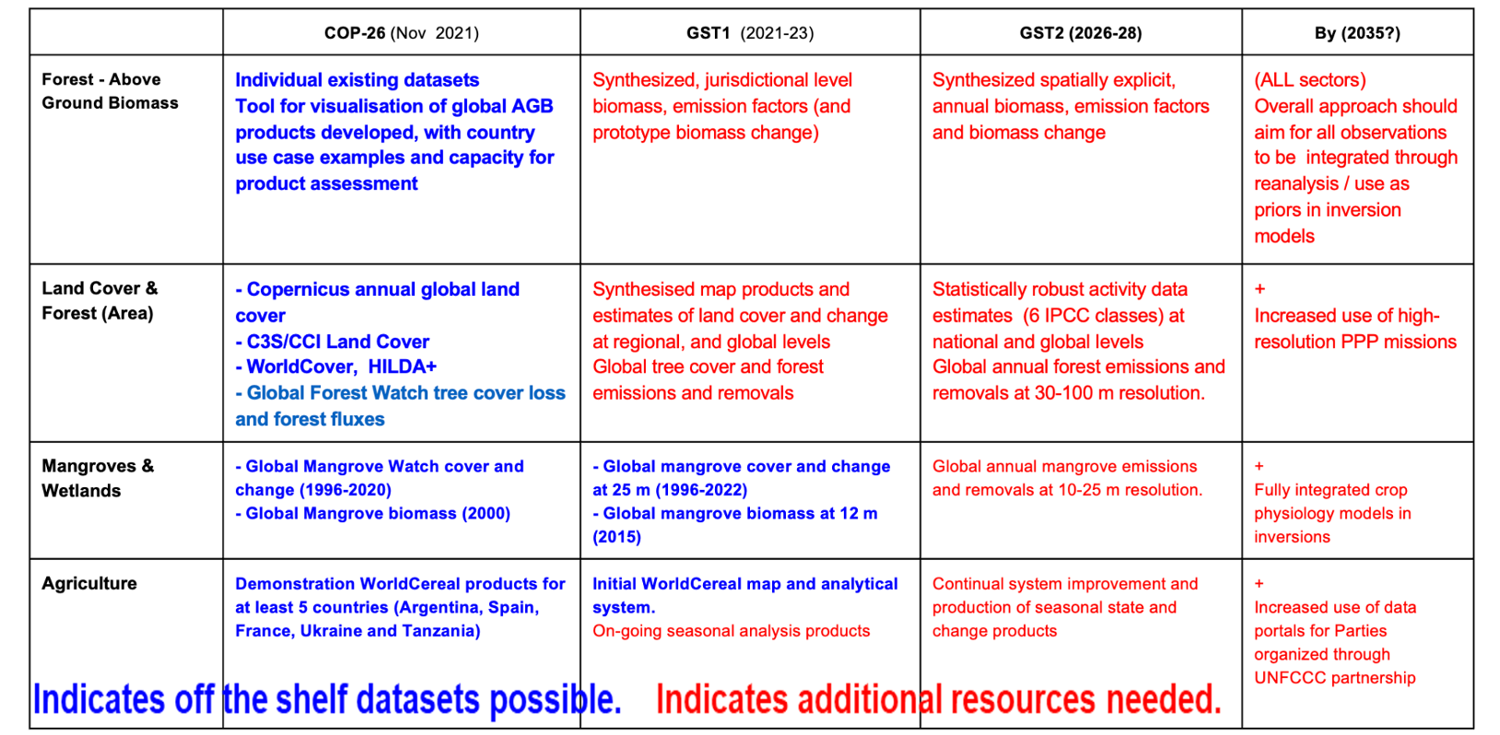
Progress update

Slide 6
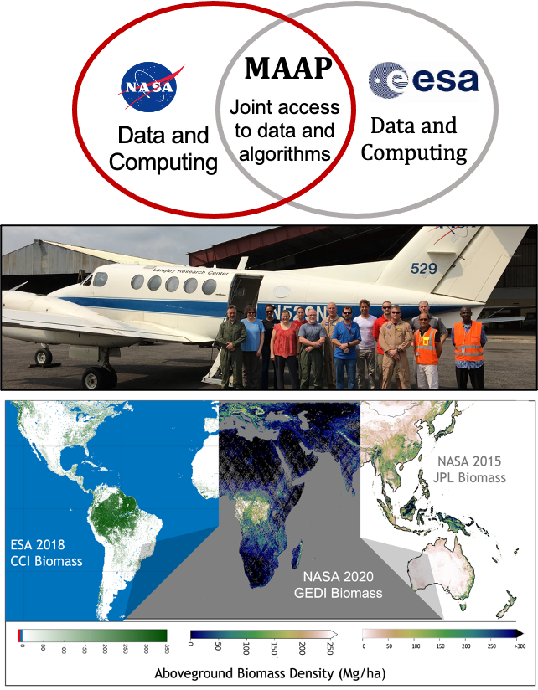
Progress update: biomass
NASA and ESA researchers are collaborating on several activities related to the generation and validation of forest aboveground biomass products.
1.Implementing the CEOS biomass protocol, a guiding document for biomass product validation (uptake by GEO-TREES and biomass harmonization)
2.Supporting GEO-TREES, a new ESA-led GEO activity aimed at coordinating new forest reference data, including field, TLS, and airborne lidar over a set of >100 globally distributed research sites Hosted by Evolution et Diversité Biologique Lab at CNRS and Executive Officer funded by CNES for 2 y
3.Conducting a biomass product harmonization activity, with inputs from NASA GEDI, ICESat-2, and ESA CCI biomass. This CEOS AFOLU activity was presented at COP27 and will help increase product transparency and uptake for policy-relevant applications such as the UNFCCC’s Global Stocktake
The ESA-NASA bilateral Multi-Mission Algorithm and Analysis Platform (MAAP) provides a new tool for open science biomass product development, and cross-agency collaboration.
1.MAAP houses satellite and reference data relevant to biomass mapping (GEDI, ICESat-2, CCI Biomass, field and airborne lidar data)
2.Cloud compute allows big data processing and reproducibility of biomass products
3.MAAP provides tools for collaborating across agencies (and during COVID19); the biomass harmonization activity is being conducted as an Open Science activity on the MAAP

Slide 7
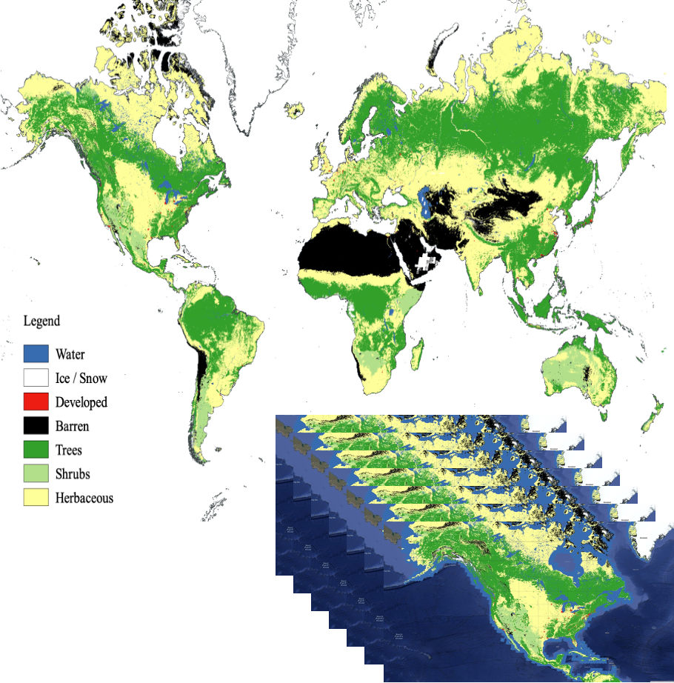
Progress update: land cover
Identifying forest, land cover and wetland cover and change essential for national GHG inventories as ‘activity’ data inputs for global AFOLU modeling and assessments
Copernicus Land Cover
NASA Global Land Cover Estimation (GLANCE)
ESA CCi and C3S
WorldCover 2020 and just released 2021
Hilda+
Dynamic World
Global Forest Watch forest gain/loss
Support national GHG inventories for activity data estimation by show-casing experiences of countries using satellite derived activity data
Improved global land change data for AFOLU and modeling for harmonized global land cover change data and novel next generation global land cover/change products with higher spatial, thematic and temporal delta
Enhance consistency and comparability of national GHG inventories and global GHG estimates

Slide 8
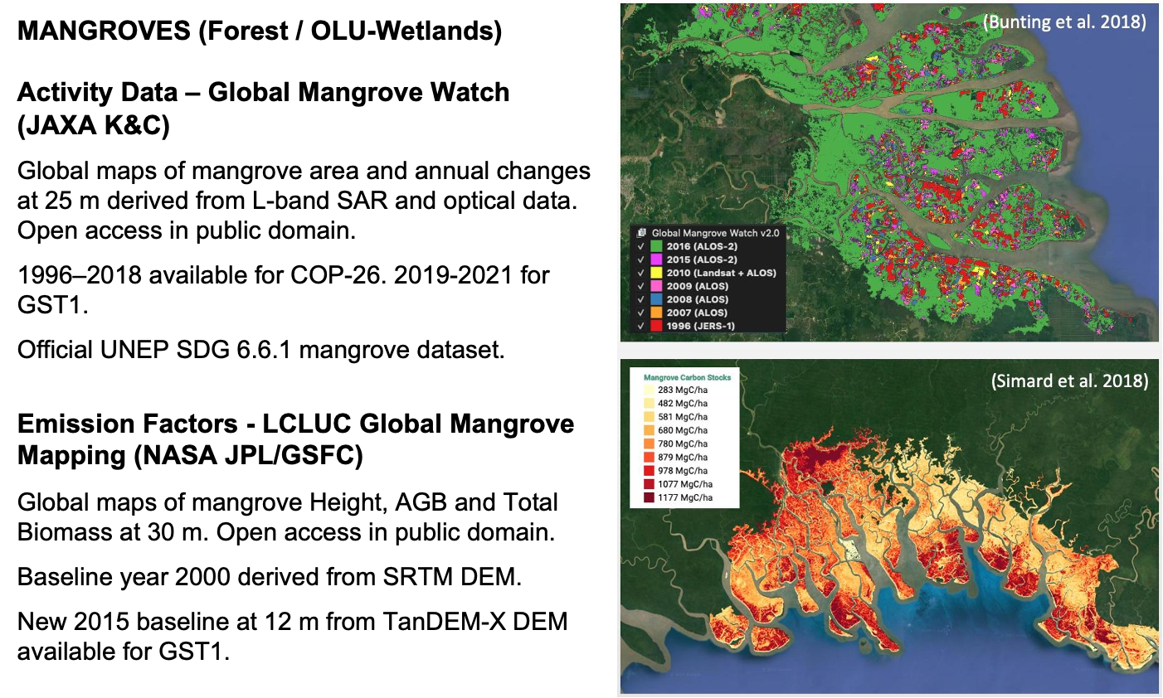
Progress update: Mangroves

Slide 9
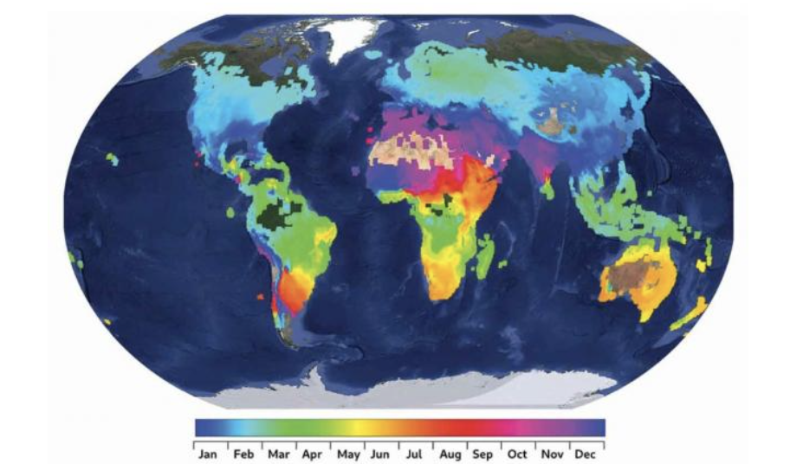
Progress update: Agriculture
GEOGLAM is a coordinated global effort, encompassing major producers and food insecure Least Developed Countries (LDCs)
● Considerable effort directed at the development of global land cover products in recent decades
● Existing products are not suitable for assessments under the Global Stocktake, or NDC’s in LDCs
● Open science is transforming the monitoring landscape and enabling new solutions and the WorldCereal initiative capitalizes on this
ESA WorldCereal project, A Major Step Forward
● WorldCereal is a consortium effort, funded by ESA, led by VITO and
supported by the GEOGLAM community
● Most important, it is building a system, not just one-off products
● WorldCereal system will:
● Produce Global cropland maps at 10 m resolution,
accuracies 80% +, on a seasonal basis (2022)
● Focus on maize and wheat
● Produce a Global in situ reference dataset for agriculture
● Develop and test state-of-the-art classification algorithms
WorldCereal, A two year project: A major step forward but just a first step…

Slide 10
Progress update: CEOS-TOPC AFOLU Workshop
Brought together AFOLU Roadmap Team & Terrestrial Observation Panel for Climate (TOPC) of GCOS.
Objectives:
make a start on defining how society’s needs for information related to AFOLU and its reporting for GST can be expected to evolve in the coming years
consider the policy needs and assumed AFOLU information needs in the 2035 timeframe on the assumption that this foundation can inspire and drive the generation of the CEOS AFOLU Roadmap
Structured along the lines of existing AFOLU thematic expert teams:
Forests & Biomass, Agriculture, OLU (mangroves, wetlands..)
And the dimensions of: global assessments and syntheses; national climate policy and actions; GHG inventories
Key outcome
Identified a workflow for integrating the GHG and AFOLU roadmaps and activities of CEOS, IPCC and WMO for an operational GHG monitoring, reporting and verification (MRV) system

Slide 11
Emerging Grand Vision for Roadmap
Focus in 2022 & 2023 is the development of a CEOS AFOLU Roadmap document
Objectives:
Provide a framework for long-term (~ 15+ years) coordination of CEOS agency observing programmes in support of the needs of society for AFOLU-related information, with a focus on the needs and ambition cycle of the Global Stocktake of the Paris Climate Agreement.
A guiding vision for long-term space agency coordination around AFOLU. Characterises the needs, the services and applications required, the products and observing systems that can support. Explain the need to plan for ground segment, space segment and services.
An effective means for communicating our intentions to society, UNFCCC, national inventory community etc
Addresses basic observation continuity and the necessary agency coordination

Slide 12
Emerging Grand Vision for Roadmap
Revised contents:
Define the 2035 observing system required to address the AFOLU information needs of society
Consider the technologies and systems needed to realise this observing system
Identify the stakeholders required at different stages of the value chain to ensure it can be sustained in the long-term (i.e. users- service providers, - data product producers-observation providers)
The technology development programmes and investments needed by space agencies to achieve them
The programmatic commitments that will be needed to get there
Addressing three different dimensions of GHG emissions and removals accounting:
Global assessments and syntheses
National climate policy and actions
GHG inventories

Slide 13
Emerging Grand Vision for Roadmap
Affirmed that an AFOLU Roadmap is a generational challenge that CEOS and public EO programmes must rise to!
Provide a framework for long-term (~ 15+ years) coordination of CEOS agency observing programmes in support of the needs of society for AFOLU-related information, with a focus on (but not limited to) the needs and ambition cycle of the Global Stocktake of the Paris Agreement.
A guiding vision for long term space agency coordination around AFOLU. Characterises the needs, the services and applications required, the products and observing systems that can support. Explain the need to plan for ground segment, space segment and services.
Confirmed horizon of 2035 and interim milestones of GST1, GST2 and GST3.
Seeking to re-engage the key agencies and individuals using increased intensity process and individual assignments - ideally under a lead author.

Slide 14
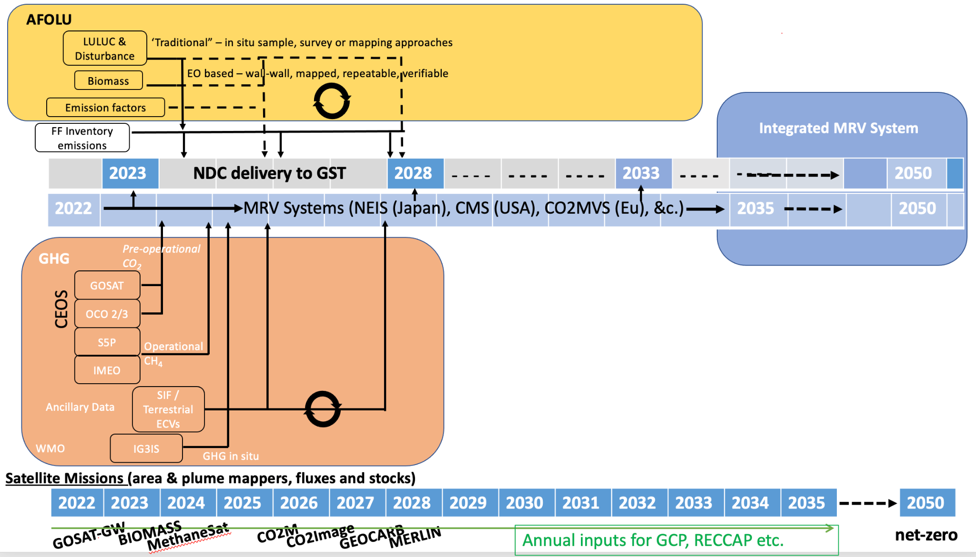
Emerging Grand Vision
Integration of existing and planned satellite missions
Synergies with ground-based and space-based networks
Informing UNFCCC/IPCC reporting guidelines
Inclusion on climate-carbon feedbacks

Slide 15
COP-27 Summary of AFOLU engagement
Earth Information Day (Nov 9, 2022)
AFOLU roadmap reported in the CEOS/CGMS WGClimate Poster
IPCC TFI Eduardo Calvo Buendia presented and well noted as below

Slide 16
COP-27 Earth Information Day
Notes:
❖ Participation on Mitigation Panel (ESA, DLR)
❖ Four poster related to GHG, AFOLU, and modelling for climate action

Slide 17
COP-27 Summary of AFOLU engagement
Earth Information Day (Nov 9, 2022)
AFOLU roadmap reported in the CEOS/CGMS WGClimate Poster
IPCC TFI Eduardo Calvo Buendia presented and well noted as below

Slide 18
Carbon From Space Workshop
See S Briggs GST Strategy Update

Slide 19
ESA Field Campaign
See S Briggs GST Strategy Update

Slide 20
Next steps & schedule
Thematic teams are already doing important relevant work (eg GEOGLAM for Ag) that we must harness for efficiency
Timing of Roadmap delivery to meet 2023 (GST1)
Primarily an internal document but also communicates our intent for public EO to serve society and these policy processes
A step up in capacity needed to realise the ambition now. We welcome support from:
DLR/HR (new team members added since Oct., 2022)
NASA
USGS
EC/JRC
ESA
JAXA
GEOGLAM team, GFOI team, Geotrees, SilvaCarbon, LPV - Biomass, LSI-VC
and more …

Slide 21
Thanks..
Thanks to the many experts across CEOS structure and agencies who are supporting.
Thanks to SIT Chair Team for guidance and support

