Slide 1
2022 CEOS Plenary
GHG Task Team Update
Mark Dowell,
European Commission
Agenda Item # 1.9
2022 CEOS Plenary
Biarritz, France
Nov. 29 – Dec. 1

Slide 2
GHG Task Team role
Develop and maintain the roadmap defining the overall distributed work plan;
Coordinate all CEOS and CGMS efforts needed to execute all the necessary actions…;
Exploit the complementary viewpoints of CEOS and CGMS to advance the implementation of a system
Ensure the critical link to the diverse user communities, …
Actively ensure representation of CEOS and CGMS bodies by identifying Points of Contact (PoCs) for tasks to be executed by these bodies (AC-VC, WGCV/ACSG, GSICS/UVWG, etc.)
Encourage additional CEOS and CGMS agencies representation on the GHG Task Team to ensure that the main Agencies GHG missions are represented and that technical expertise is provided to facilitate the System level competence and linkages to the modelling and Inventory communities;
Support the WGClimate in embedding the user requirements into the respective gathering process of GCOS and IPCC TFI and facilitate the development of system requirements for the operational system;

Slide 3
New GCOS IP (GCOS-244)
The 2022 GCOS Implementation Plan (GCOS-244) | E-Library (wmo.int)

Slide 4
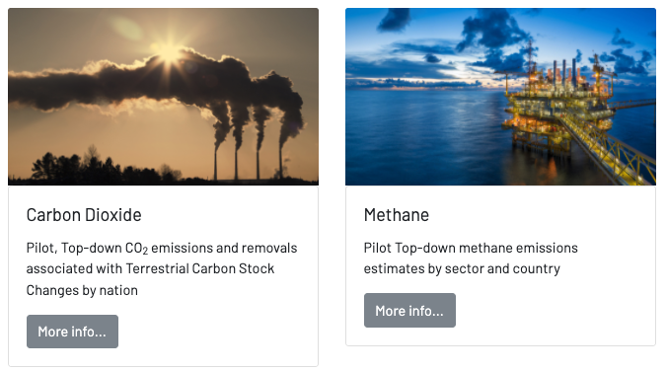
Input to Global Stocktake 1
https://ceos.org/gst/ghg.html

Slide 5
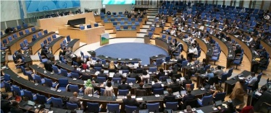
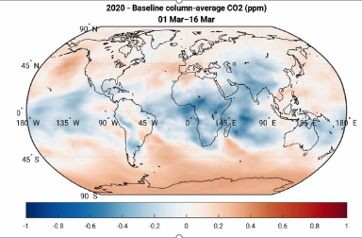
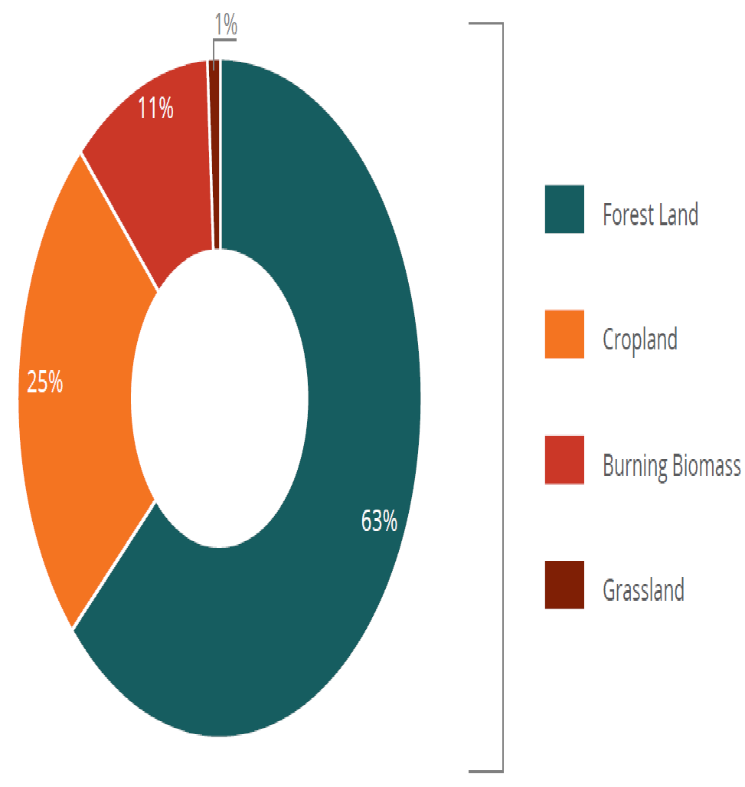
CEOS facilitated and endorsed contributions to stocktake for CO₂ and CH₄ based on satellite total column data sets
These pilot GHG products are intended to start a conversation with stakeholders and users to establish the utility and best practices for combining bottom-up and top-down products to enable a more complete Global Stocktake (Available at https://ceos.org/gst/ghg.html)
Presenter Guidelines 1
Fuel Combustion
Fugitive Emissions
CO₂ Transport & Storage
Energy
Mineral
Chemical
Metal
Non-Energy fuel/solvent
Electronics
Other Products
Global Stocktake
Industry
National GHG Inventory
Livestock
Land
Aggregate
Other
Nationally Determined Contributions
Transparency Framework
(Biennial Reports)
AFOLU
Solid
Biological
Wastewater
Other
Forest
Waste
Crop
National Implementation
Burning
Slide ‹#›
Grassland

Slide 6
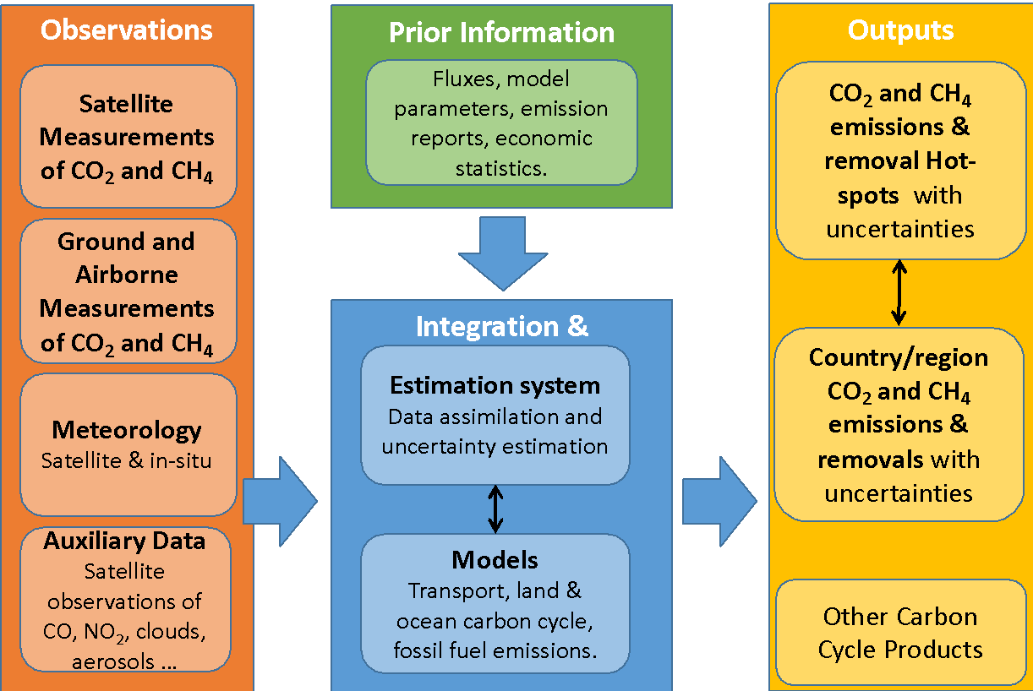
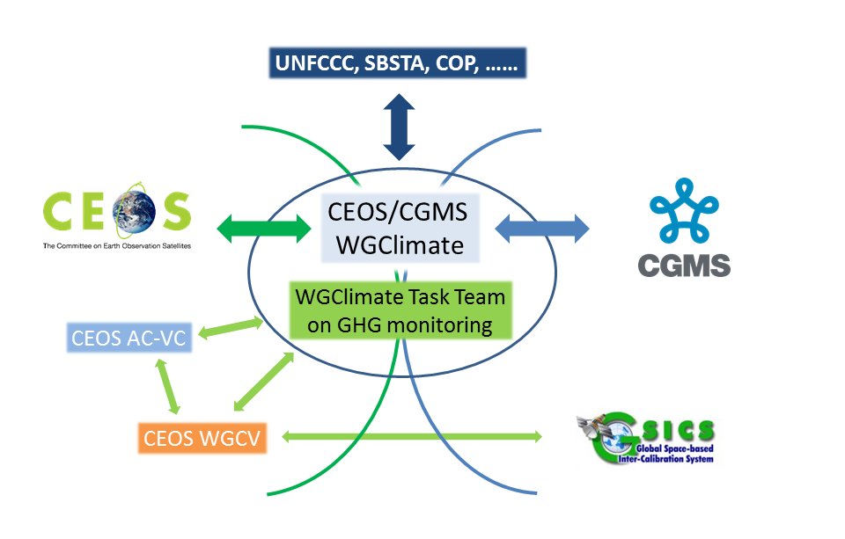
Looking Forward 2nd GST & beyond
Roadmap
System
Stakeholders
space agency engagement in proposed WMO framework

Slide 7
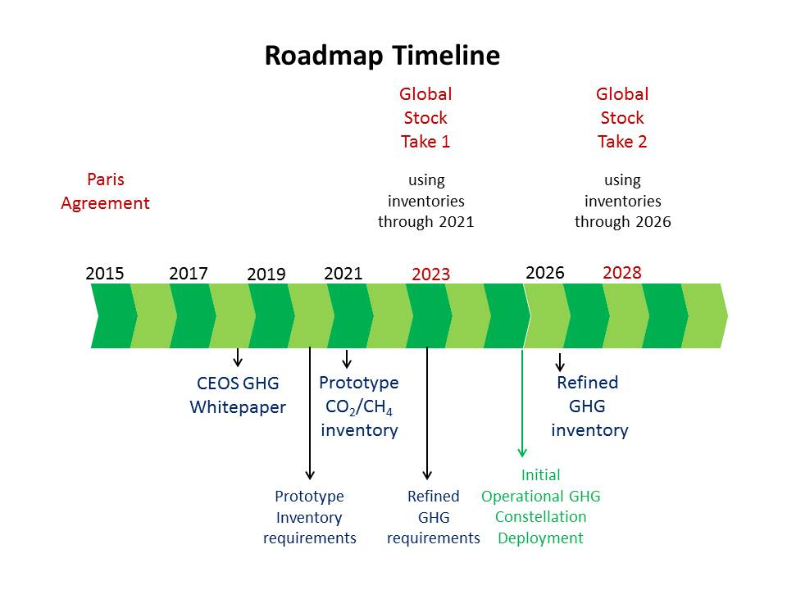
GST1 to GST2
Critical actions in transition to operations:
space segment towards WIGOS vision,
standards for operational products,
QC and Cal/Val framework.
identify continuity issues and make proposals for contingency planning
training and end user support,

Slide 8
From AC-VC
Support efforts to integrate CO₂ and CH₄ based inventories using fluxes from total column data and fossil emissions from high-resolution plume mappers (e.g. GHGSAT and Carbon mapper, Methane-Sat)
EM-27’s uplooking spectrometers are about as accurate as a TCCON site but much cheaper. To what extent can these be used to characterize and adjust XCO2 and XCH4 biases in challenging areas?
Support efforts to develop greenhouse gas information systems (e.g. COCO2, IMEO, NASA)
Intercomparison between CEOS AFOLU estimates and top-down forestry net carbon exchange using atmospheric GHG measurements
Host a workshop on evaluating and attributing uncertainties in top-down CO₂ and CH₄ emissions.
Work with Working Group on Climate to define GHG essential climate variables based on May 2022 gap workshop

Slide 9
Updating GHG Roadmap
Low latency product demand
Commercial sector data and products
Standards
New Cal/Val opportunities
…

Slide 10
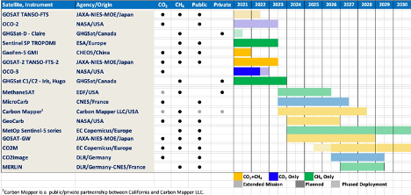
Growing GHG Diversity

Slide 11
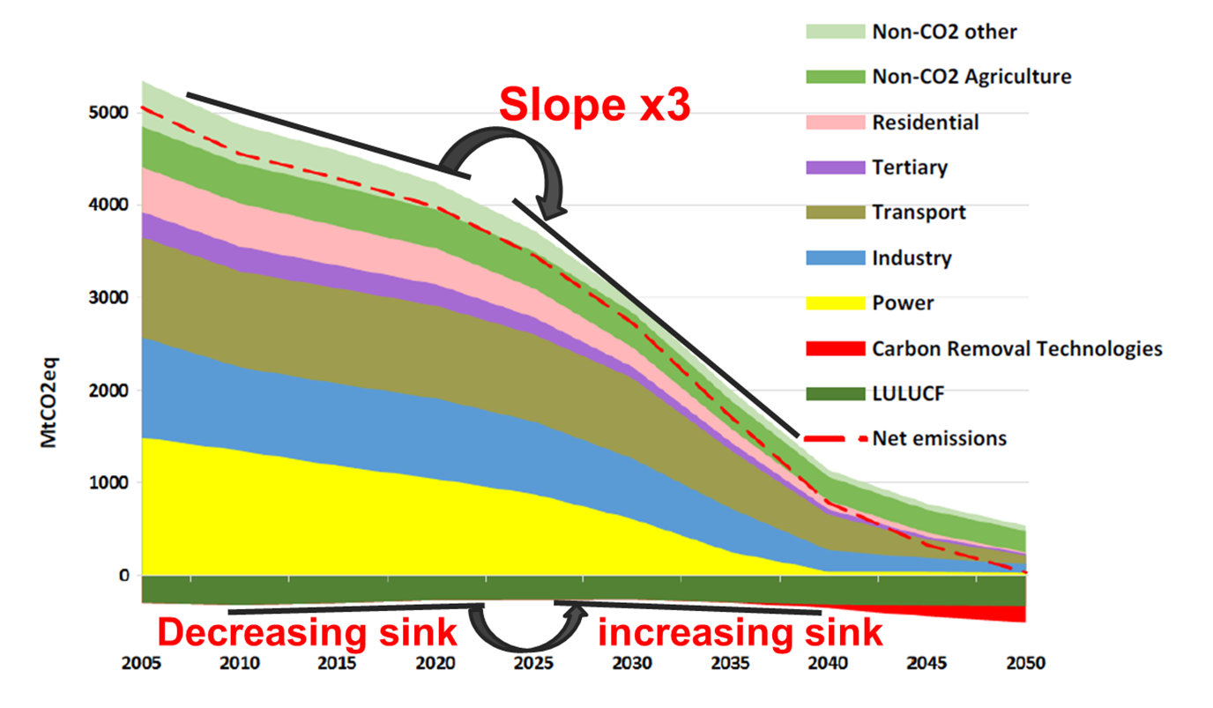
Our future monitoring system, policy implications

Slide 12
Link GHG – AFOLU (1/2)
Data and Standards:
Consistency of products over time back to 1990 (at least)
New Products (land management disturbance)
Additional emphasis on Agriculture (incl. livestock) and OLU
Harmonisation e.g. biomass and more
Improved Emission Factors
Engaging Carbon Cycle Community
(Internal) consistency of products (GHG & AFOLU) and within AFOLU
Cooperation with DGVM community
Lateral flow issues
Model developments e.g. CO2 fertilization / photosynthesis
IMBIE type experiments (Eastern Amazonia, Siberia, West Africa, and Southeast Asia…)

Slide 13
Link GHG – AFOLU (2/2)
Prioritizing Research Needs:
forward-looking research towards an independent “verification” systems
EO involvement in lateral flow studies
CO2 Fertilization
Harmonisation of data records (e.g. biomass, land cover)
Additional AFOLU products e.g. Soil Carbon, Peatlands
Towards common System
Ultimate ambition should be a fully integrated system -> 2035
Need to ensure internal consistency, avoid double accounting and ensure seamless interface to user
… but need stepwise approach, near to mid-term parallel activities but with periodic joint discussions to check interfaces

Slide 14
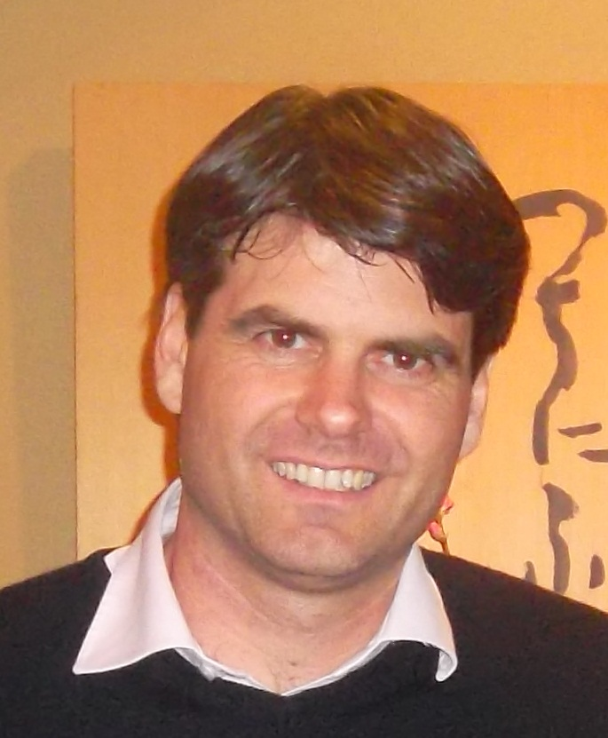
Leadership Transition
GHG Leadership setup
Already 3 years since initial implementation
WGClimate approved new TT lead from ESA (Yasjka Mejier)

Slide 15
Summary
Final contributions to GST1 – Technical Assessment
Start Addressing Roadmap Actions looking forward towards GST2 and beyond
Update roadmap and address additional Actions that have emerged in recent years, low latency product demand, commercial sector data and products, standards, new cal/val opportunities
Links with AFOLU fundamental (future common Roadmap)
Engage in new WMO international GHG monitoring framework
1 day CEOS –CGMS GHG Task Team meeting plan in Geneva 2nd Feb 2023 (follow WMO GHG Conference 30th Jan-1st Feb)

