Slide 1
SIT Chair Priority Synthesis Report
Climate & Carbon
Simonetta Cheli SIT Chair
Agenda Item 1.8
2022 CEOS Plenary, Biarritz
29 Nov - 1 Dec 2022

Slide 2
SIT Chair Themes & Priorities

Slide 3
Climate & Carbon activities 2022
In cooperation with, and complementary to, the good work of CEOS-CGMS WGClimate (Agenda item 1.12)
Supporting and escalating a number of important activities across the CEOS Structure
CEOS Global Stocktake Strategy Action Status
CEOS GST Data Portal Updates
Ocean Carbon Special Report (in GST strategy update & VC synthesis)
AFOLU Roadmap (Agenda item 1.10)
GEO-TREES (Forest Biomass Reference System from Tree-by-Tree Inventory Data)
IMEO relationship (Agenda item 1.11)
Slide ‹#›

Slide 4
CEOS GST Strategy Update
Stephen Briggs,
SIT Chair Team

Slide 5
GST Status
GST Strategy Document V3.1 approved at CEOS Plenary Nov 2021
Document contains 9 Recommendations for specific actions on CEOS Agencies and CEOS bodies to support the GST
Actions derived from the recommendations are included in the overall CEOS Work Plan and are complementary to those already carried out by CEOS bodies in support of the GST. Ongoing work contributes significantly in areas such as adaptation.
Many different elements of CEOS (WGs, VCs and others) contribute under SIT Chair leadership.
Recommendations addressed in agenda items as below.

Slide 6
GST Actions - update
GST Recommendations 1,2: Update WG Climate GHG Task Force Report Annex C: Contributions to updates include those from:
WGClimate Workshop on Gap Analysis 18-20 May 2022 – report pending. Item 1.13
WMO/GCOS workshop 10-12 May 2022 (tbc, Geneva) on Carbon Cycle in Earth System Science (report available from WMO) + Follow-up meeting 30 Jan 2023
AFOLU/GHG Workshop Nov 2021, JRC/virtual + AFOLU Workshop 12 Sept 22 Item 1.8
Ocean Carbon Workshop Feb 14-18 2022 (virtual) led by ESA/NASA, Report submitted for publication (Brewin et al, Earth Science Reviews, Special Issue) (Item 1.19)
Carbon from Space IV October 2022, ESRIN - CEOS GST Presentation, wide discussion between space agencies and global terrestrial carbon science community. Report pending.
Increased involvement from Copernicus CO₂ programme in WGClimate GHG Task Force

Slide 7
https://4thcarbonfromspace.esa.int/

Slide 9
https://oceancarbonfromspace2022.esa.int/

Slide 10
GST Actions - update
Recommendation 3: Inform the report of CEOS to UNFCCC/RSO discussion on observations to support the implementation of the Paris Agreement and should pro-actively flow into the consultancy process of the UNFCCC / Ad hoc group for the Synthesis Report on Observations for the GST. CEOS should also report on this at the Earth Information Day at COP. Actions undertaken include:
Multiple contributions to Earth Information Day at COP 26, 27, Glasgow & Sharm El-Sheikh
Representation from WG Climate, GHG Task Force and AFOLU Task Team at RSO discussion at COP 27
Contributions from all these to the Synthesis Report on Systematic Observations fto COP27: substantial document (140 pp., see Item 1.13)

Slide 11
GST Actions - update
Recommendation 4: CEOS should consider, in conjunction with modellers, setting up one or more focussed observational campaigns as a major contribution to the understanding of trends in natural GHG emissions and removals in key areas.
NASA/ESA/CNES/DLR conducted AMPAC Campaign aimed at understanding methane emissions from tundra under warming conditions. AMPAC Training Course on Arctic Methane and Permafrost held Sept 2022, Norway. Possible extension of AMPAC to 2023 season.
Discussions on campaigns with both public sector and private sector in oil and gas extraction locations eg Permian Basin (see Item 1.11).
Ongoing discussion re possible 2023 Amazon airborne /in situ/ satellite campaign on Carbon cycle - INPE/NASA/ESA etc al. held with science community at CFS4 workshop, October 2022

Slide 12
GST Actions - update
Recommendation 5: The AFOLU Roadmap Team and WGClimate GHG Task Team should work together to ensure consistency between data for emissions reported via AFOLU and for prior biogenic terrestrial emissions, and those due to changing land use, in implementing monitoring and verification systems.
Joint AFOLU – GHG Workshop held at JRC/virtual in Nov 2021 (Item 1.9)
Outcomes inform WG Climate discussion on GHG TF Annex C requirements
Continued cooperation between groups including on development of Systematic Observations paper for UNFCCC
Work of both groups contributes to overall approach to developing satellite - based emissions estimates

Slide 13
GST Actions - update
Recommendation 6: It is recommended that to help in ensuring the take-up of satellite-based methods for AFOLU (and indeed in the context of MVS) CEOS should work with a few selected demonstrator countries to assist them in their national reporting under AFOLU (the model of GFOI can be compared).
Silvacarbon has led action in this area with local training courses in 2022
Recommendation 7: CEOS should work with various partners set out above to identify data requirements and actions for CEOS in relation to adaptation.
Ongoing work in e,g, WG Disasters, LSI-VC, SDGs etc.
WG Climate Use Cases for climate services provide examples of adaptation
Collaboration on adaptation with GEO through its Climate Change Working Group sub-group on Adaptation. Reported to COP27.
3.4)

Slide 14
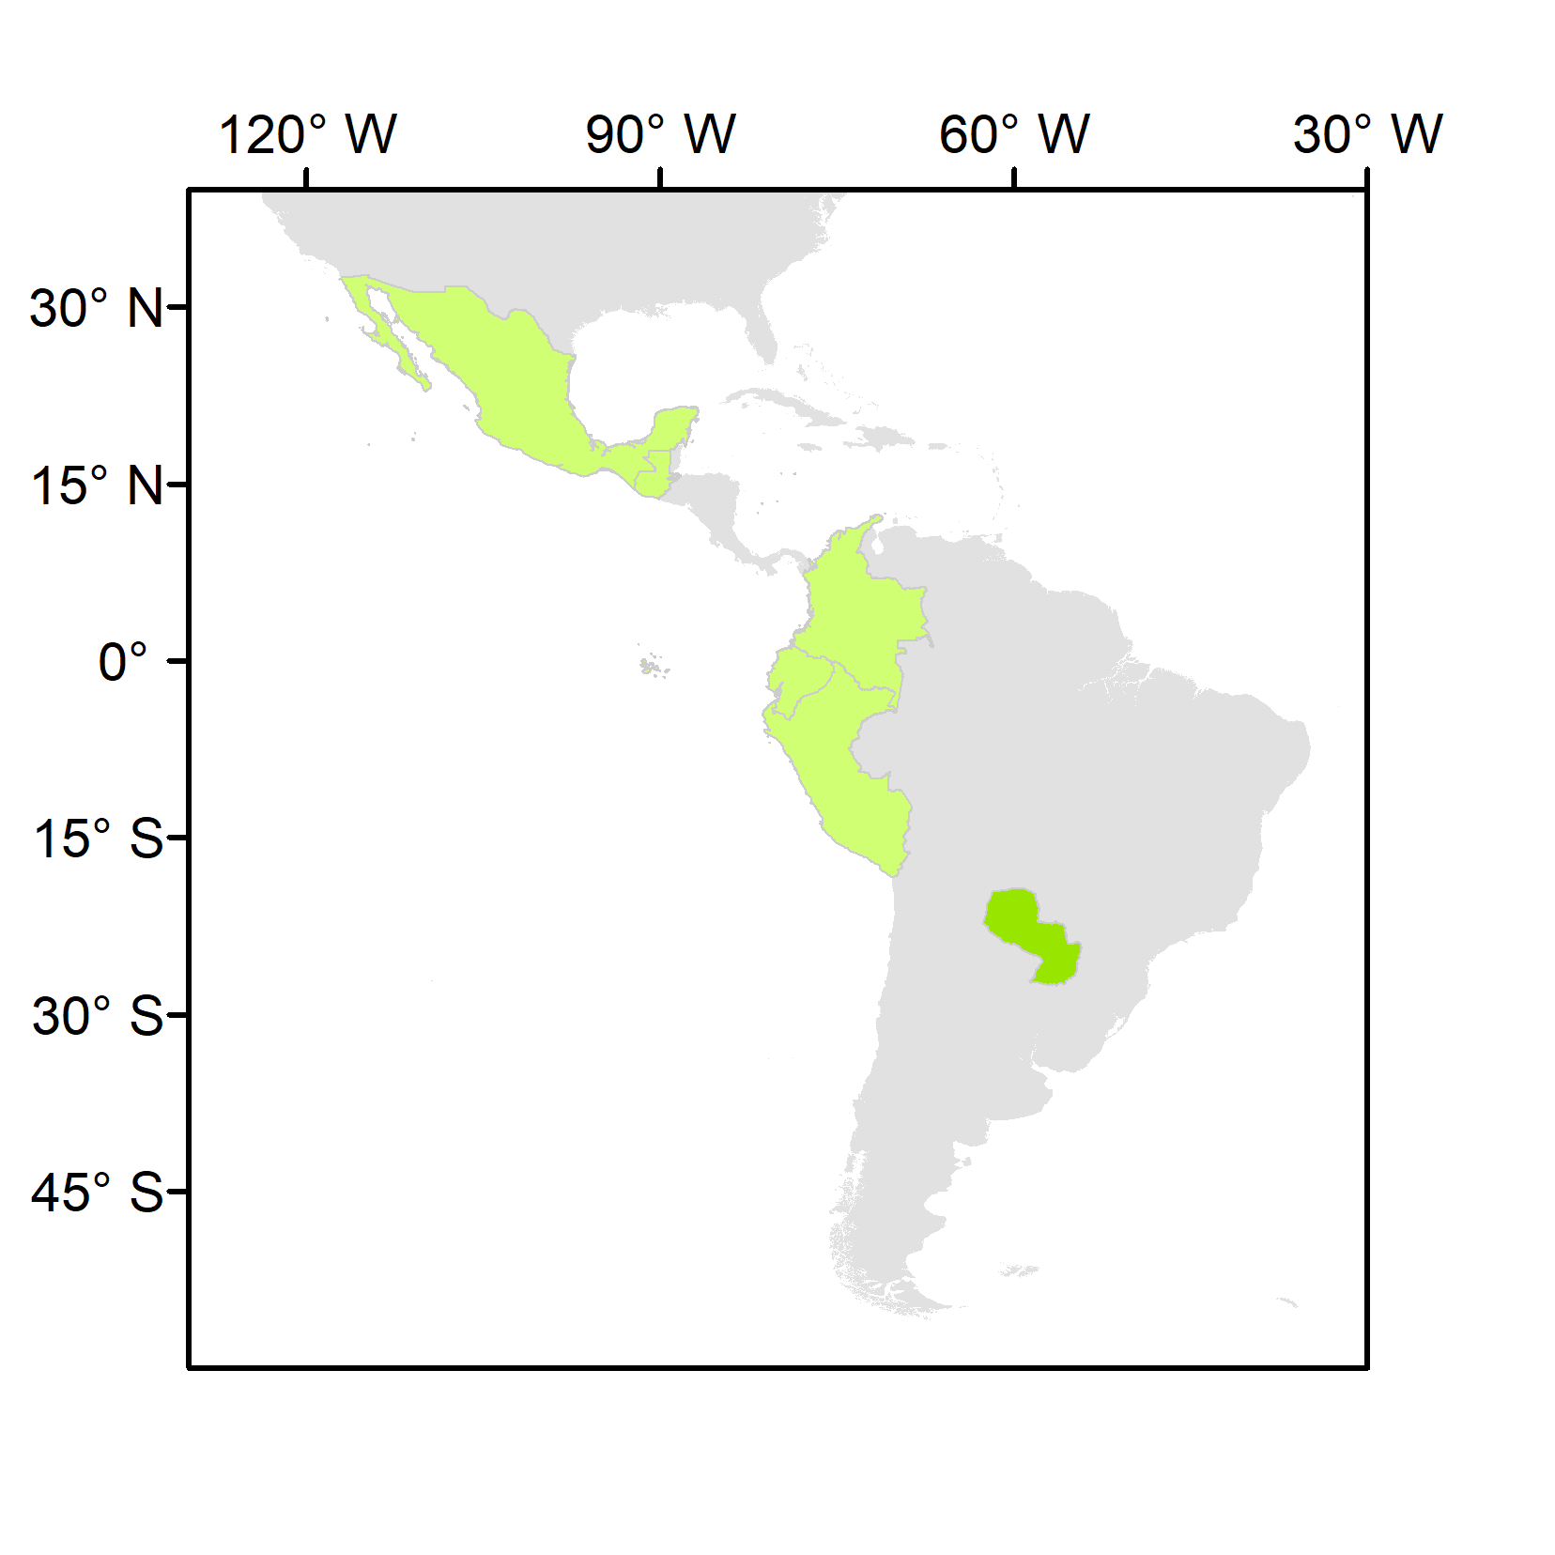
National Inventory User Engagement
1st SilvaCarbon/CEOS Regional Workshop – Biomass measurements
Paraguay, June 2022
 | Country | REDD+ FRL latest submission | REDD+ FRL previous submissions | BUR REDD+ Annex | BUR | NIR | NFI
Latin America and the Caribbean | Colombia | 2020 | 2015 | 2016, 2019 | 2015, 2018, 2022 | 2019 | Yes
 | Ecuador | 2020 | 2015 | 2016 | 2016 | 2017 | Yes
 | Guatemala | 2022 | n.a. | n.a. | n.a. | n.a. | partial
 | Mexico | 2020 | 2015 | n.a. | 2015, 2019 | 2019 | Yes
 | Paraguay | 2022 | 2016 | 2019 | 2015, 2018, 2021 | n.a. | Yes
 | Peru | 2021 | 2016 | n.a. | 2014, 2019 | 2019 | Yes
National teams to present their NFIs, and the data and methods currently used in reporting and domestic MRV
JAXA, ESA, NASA to present:
the available datasets and methodologies to measure land use GHG fluxes
demonstrations of opportunities for their uptake
a clear plan for sharing of NFI data and collaborating in the calibration/validation of products
LULUCF experts in IPCC guidance (nominated in the UNFCCC roster by their Governments or contributors to the 2019 refinement of the IPCC guidelines)
Colombia Ecuador Guatemala Mexico Paraguay Peru

Slide 15
GST Actions - update
Recommendation 8: CEOS should maintain a watch over the implementation of projects funded through climate fund mechanisms to ensure that all appropriate assistance is given by agencies in their implementation and governance.
Joint work on climate finance with GEO proposed at GEO-CEOS annual briefing,
Loss and damage finance an important issue at COP 27; similar needs to adaptation
Private finance issue becoming increasingly important: economic basis for climate action stressed in some countries
Recommendation 9: CEOS must continue all efforts to provide the necessary baseline
climate data records which support the long term modelling of the Earth system, its response to changing GHG emissions and other drivers, and impacts of climate change.
Supported through WGClimate gap analysis (see item 1.13)
Cooperation with GCOS on GCOS IP 2022 satellite elements, satellite supplement upcoming
Further discussion with GCOS and WMO through WMO GHG Workshops (May 2022, Jan 2023) and GCOS Science Conference (Oct 2022).

Slide 16
CEOS GST Data Portal Updates

Slide 17
GST Data Portal
ceos.org/gst updated and expanded in 2022
English/French/Spanish
Single point of entry for multiple GHG & AFOLU datasets for countries
Slide ‹#›

Slide 18
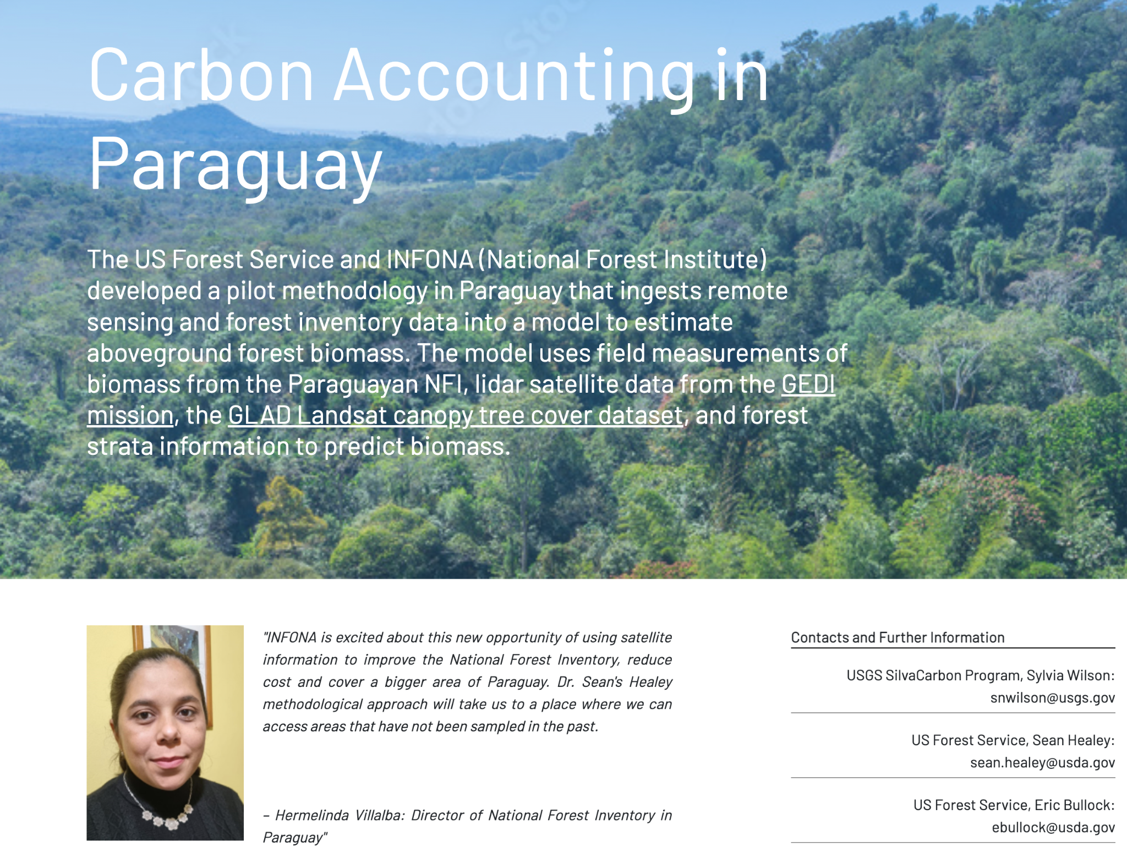
GST Data Portal
Existing dataset profiles and guidance updated in 3 languages
CO2 (Brendan, JPL)
CH4 (John, JPL)
WorldCover (Ruben, VITO)
Mangroves (Richard/Pete, U Aberystwyth)
New section on ‘User Stories & Inspiration’
Examples of how countries & agencies are using the data
Lessons learned and pointers to follow
Carbon Accounting in Paraguay (AGB datasets)
Disaster Risk Financing in Uganda (GEOGLAM datasets)
GLAD land cover map uptake in Peru, Paraguay, and Guatemala
Thanks to Sylvia (SilvaCarbon), Ian (GEOGLAM) and their contacts for all the hard work on the inputs
Slide ‹#›

Slide 19
GEO-TREES

Slide 20
The Global Forest Biomass Reference System
Iris-Amata Dion took up duty as GEO-TREES executive as of 15th June.
The position is funded for two years by CNES.
Hosted by Jérôme Chave’s Evolution et Diversité Biologique Lab at CNRS.
GEO-TREES Governance and Implementation Plan
Draft documents ready
Due for revision and acceptance by the GEO-TREES steering board.
GEO-TREES Trust Fund
The process to set up has been started with the GEO secretariat.
TOR have been drafted and discussed with GEO.
The trust fund will be managed by GEO and audited by WMO.
Funding situation
Engagement of a first private funding partner is in the starting blocks and is pending the setup of the Trust Fund.
But in general the funding situation and especially the engagement of national Agencies is still arduous.
www.Geotrees.cnrs.fr

Slide 21
IMEO relationship

Slide 22
IMEO relationship
IMEO invited to participate in both SIT-37 (virtual) and SIT TW 2022 meetings
SIT Chair Team sees significant potential in effective working relationship with IMEO
High profile MARS (Methane Alert and Response System) launch at COP-27
Full discussion in agenda item 1.11

Slide 23
Ocean Carbon Special Report

Slide 24
Ocean Carbon Special Report
TBA

Slide 25
WMO GHGIS

Slide 26
WMO GHGIS
GHG Roadmap Report is next on the agenda
SIT Chair Team invited WMO to report on their GHGIS developments at SIT TW
Greenhouse gas monitoring would benefit from an integrated, internationally coordinated approach to network design, operation and use of observations to support GHG flux estimation
Workshop organized by WMO, May 2022 - “The case for a coordinated GHG Monitoring Infrastructure” - more than 20 experts in person; 80 online participants, including representatives from NASA, NOAA, NIST, JAXA, NIES, JMA, CMA, European Commission, UNFCCC
WMO Study Group
to develop the concept, including identifying the future vision for WMO-coordinated GHG-related activities
a final proposal to 19th World Met Congress 2023

