Slide 1
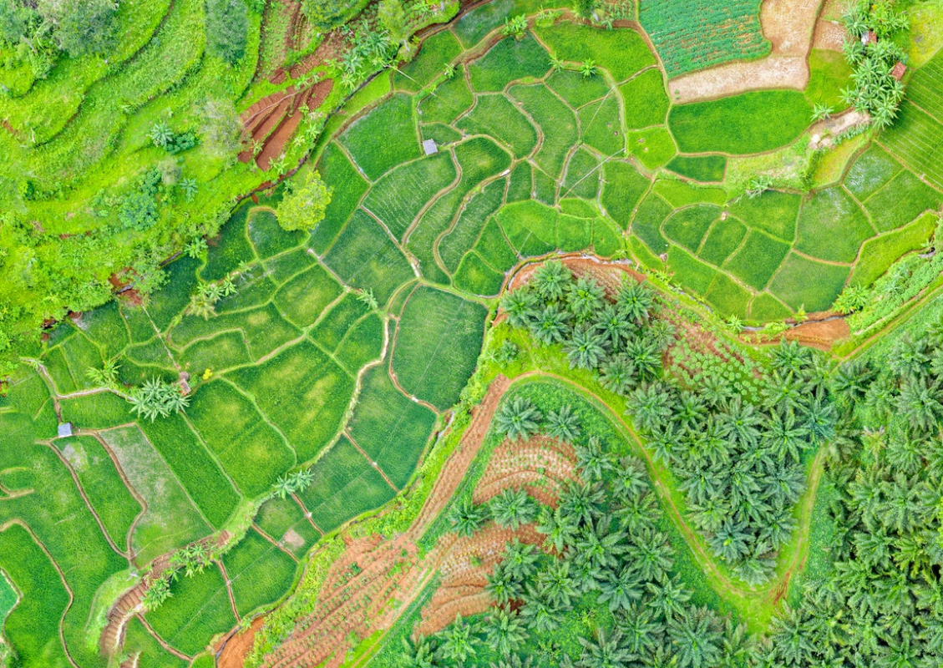
GEO’s Partnership with CEOS
on Global Action
for Local Impact
Laurent Durieux (GEO SEC SDG Coordinator)
CEOS Plenary, Biarritz - 30 November 2022 - Agenda Item 1.7 GEO Sec Report
1

Slide 2
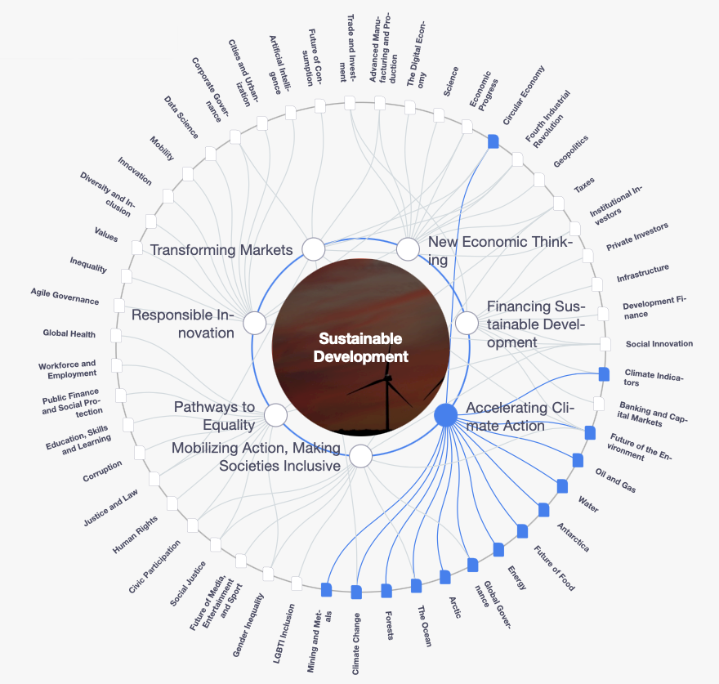
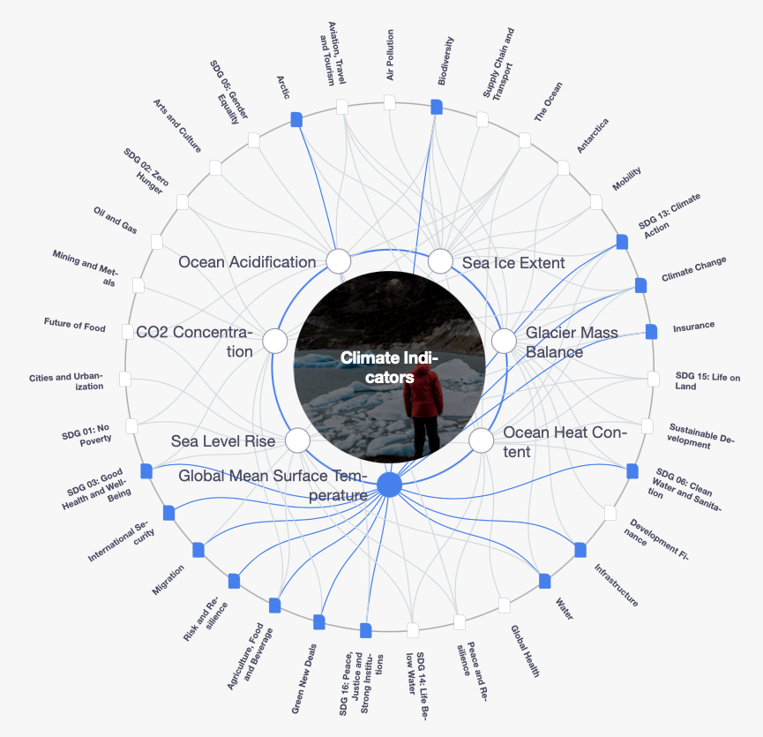
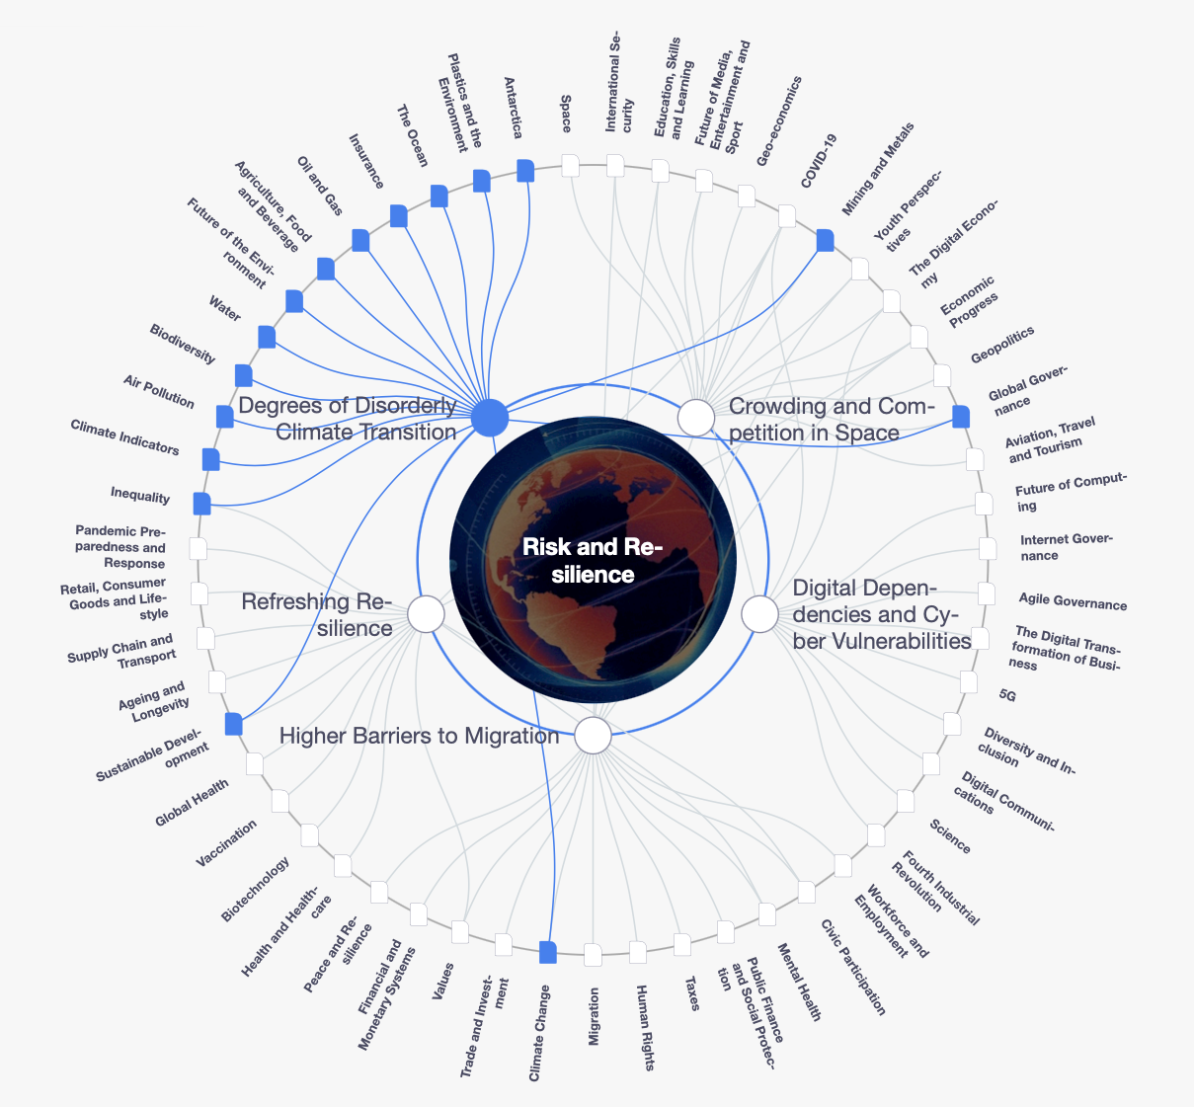
GEO-CEOS 2022
Collaboration Orientations
Continue to support GEO engagement priorities of the 2030 Agenda for
Sustainable Development, the Paris Agreement and the Sendai Framework for DRR
Support the new engagement priority on Urban Resilience
Improve integration of CEOS projects and GEO WP activities
Extend impacts of CEOS-GEO collaboration to identified synergy opportunities
Move from R&D and demonstration activities to applications and services
Capacity development for the use of EO data to solve identified needs by stakeholders
Participation of CEOS to the GEO post-2025 strategy and incubators
CEOS
GEO
Custodian
Agencies
CEOS Plenary, Biarritz - 30 November 2022 - Agenda Item 1.7 GEO Sec Report
1

Slide 3
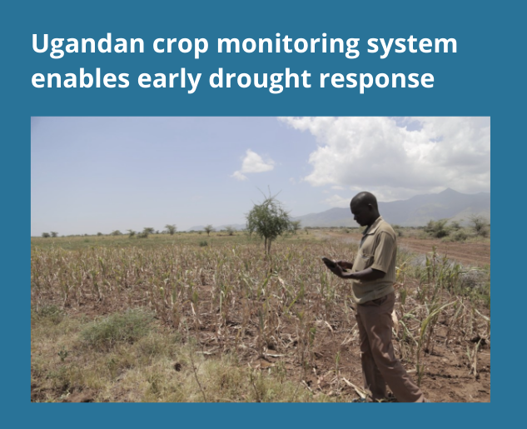
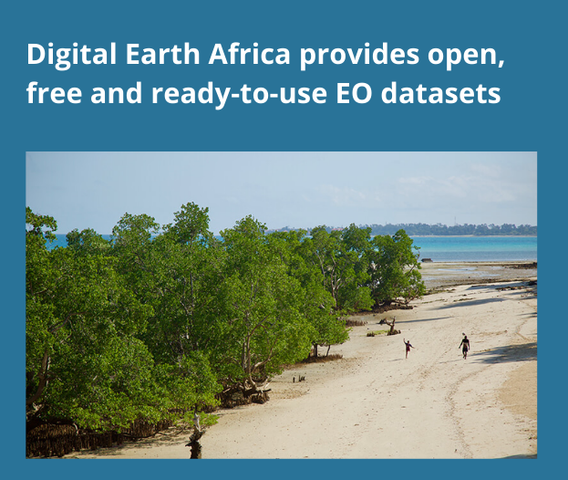
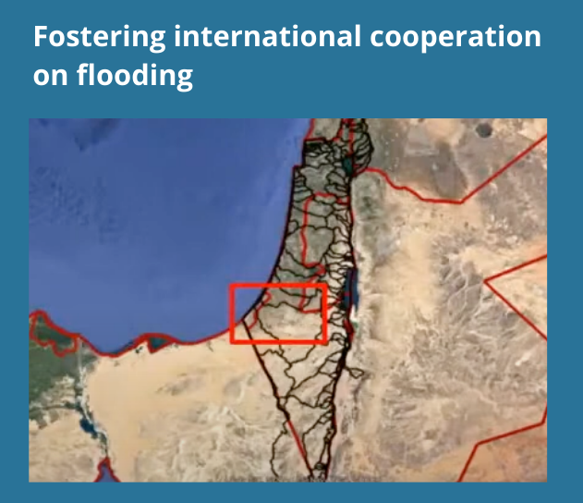
portfolio
GEO is making an impact
We have driven access to open knowledge, and our best partnerships are bringing together global science, technology and research to provide trusted information for decision making
What is GEO doing now?
Notes:
GEOGLAM has successfully co-designed national crop monitoring systems that trigger early warning and disaster risk financing mechanisms. In Uganda the Global Agriculture Monitoring System (GLAM) provided objective indicators of crop damage and helped 90,405 households benefit under a Disaster Risk Financing Programme. Between 2017 and 2020, early financing release saved the government US $11 million in reactive food aid costs.
Digital Earth Africa allows policy makers and industry to access the data needed to detect changes in water supply, crop coverage or coastline, land cover changes, and make informed decisions on mitigation and adaptation.
The initiative also provides a cloud computing platform, open-source algorithms, and online training, making it an ideal platform to build capacity.
When watersheds cross boundaries, the GEO Global Water Sustainability (GEOGloWS) initiative serves as a neutral trusted information source for multisectoral collaboration. In Autumn 2020, data from the GEOGloWS ECMWF streamflow service allowed local authorities in both Israel and Gaza to take anticipatory action ahead of a major flood.
Wetlands are biodiversity hotspots, mitigate against flooding and store more carbon than the world’s forests. They provide ecosystem services including fresh water and food worth an estimated US $47 trillion a year.However wetlands are our most threatened ecosystem, disappearing three times faster than forests.
Protecting the 53.2 million hectares of coastal wetlands globally would secure an estimated 10.6–12.1 gigatons of carbon – a massive contribution to global climate change mitigation efforts. However, the data sources needed to realize these benefits, such as wetlands inventories, are often difficult to find and hard to use. The GEO Wetlands initiative is therefore seeking to develop integrated EO tools and services that will provide countries with the information they need, and at the same time support nature-based solutions, unlock financing and feed into the post-2020 global biodiversity framework.

Slide 4
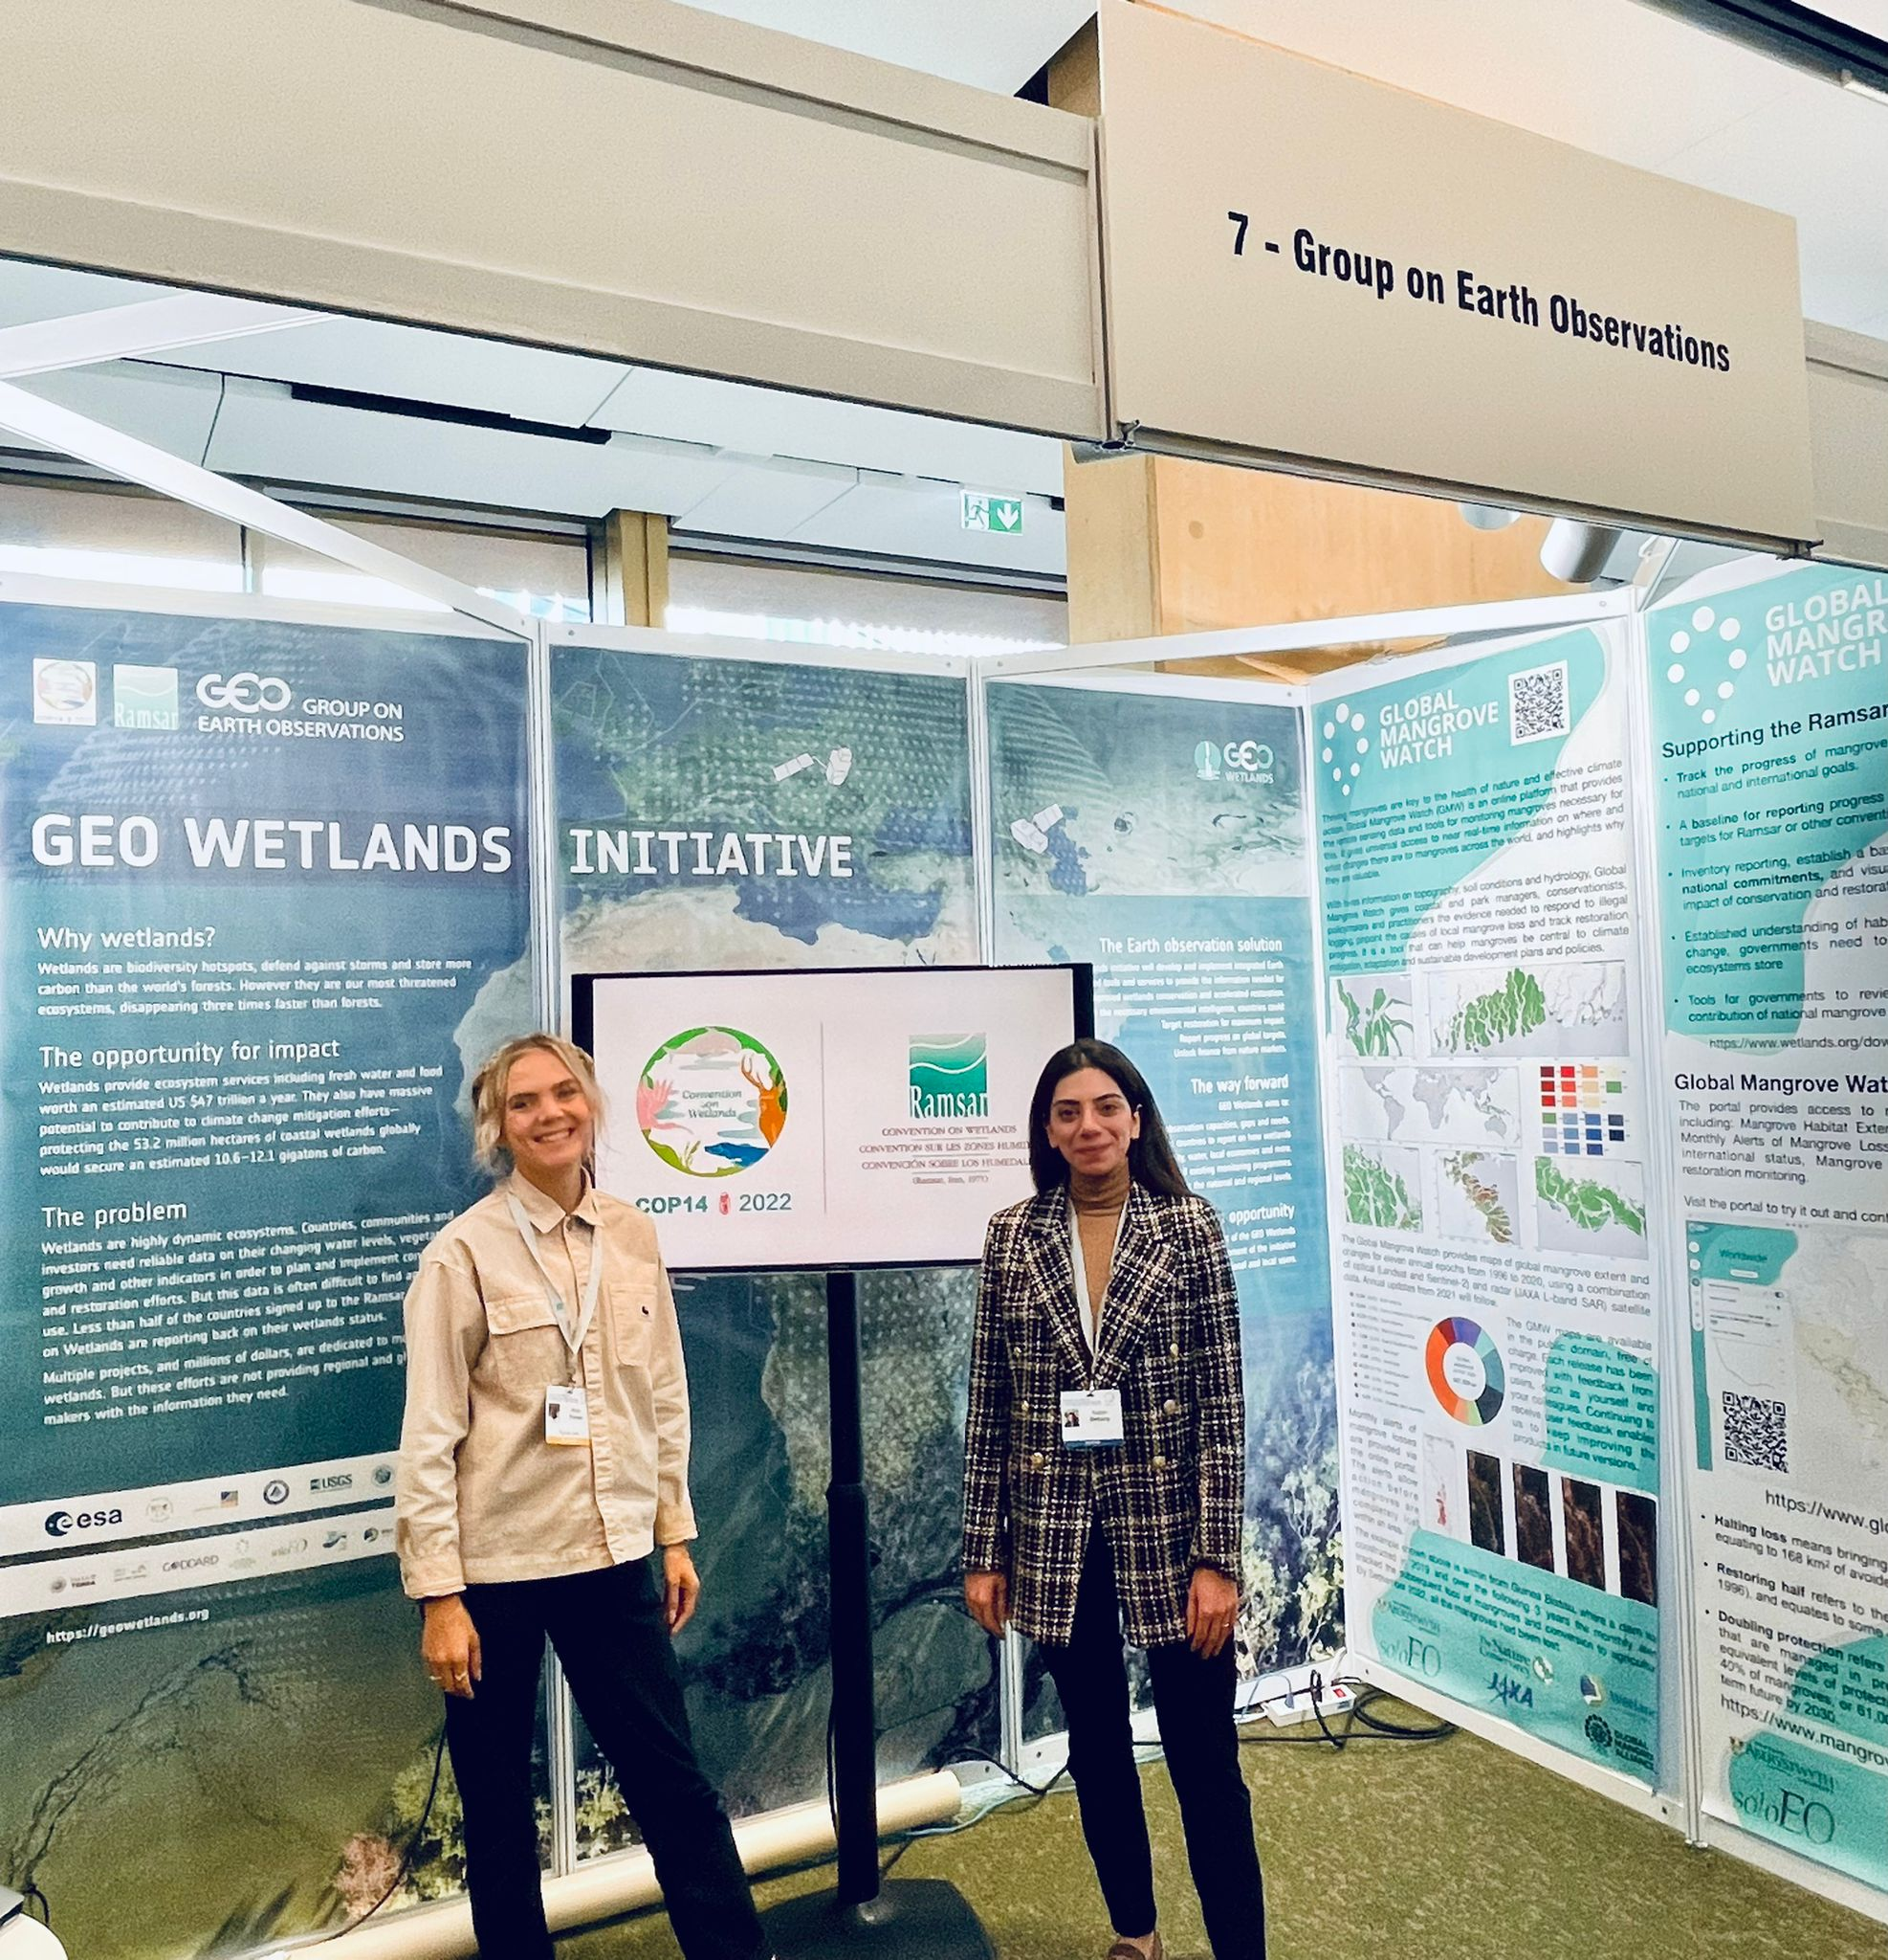
GEO Wetlands Initiative : A model of Collaboration success beetween
GEO and CEOS Space Agencies
CEOS Plenary, Biarritz - 30 November 2022 - Agenda Item 1.7 GEO Sec Report
1

Slide 5
The revival of GEO WETLANDS
Dialogue engaged with Ramsar Secretariat and STRP
Very Successful Workshop to co-design the revival of GEO Wetlands
More than 35 wetlands monitoring programs invited to contribute
Three pillars : Wetlands inventories, wetland-based solutions and capacity development
6 side-events (3 in Geneva and 3 in Wuhan) at Ramsar COP14 linked to GEO WETLANDS
On-going submission project proposals by GEOSEC to traditional and non-traditional donors to finance the first phase on wetlands inventories

Slide 6
Work Programme 2023-25
GEO BON
GEO GLAM
GFOI
GOS4M
GEO-LDN
5 Flagships
AQUAWATCH
DE-AFRICA
DIAS
EO4DRM
EO4EA
19 Initiatives
EO4HEALTH
EO4SDG
GDIS
GEO-BLUE-PLANET
GEO-CRADLE
GEOGLOWS
GEO-MOUNTAINS
GEO-VENER
GEO-WETLANDS
GOS4POPS
GSNL
GUOI
GWIS
HUMAN-PLANET
20 Pilot Initiatives
AIS-MONITORING
ARCTIC-GEOSS
CHEMICAL-EARTH
DE-PACIFIC
EO4KARST
EO4MIN
EO4WEF
GEOARC
GEO-CITSCI
GEOCRI
GEODESY4SENDAI
GEO-EV
GEO-EV-PRODUCTS
GEO-PDRS
GEO-TREES
IN-SITU-ESC
NIGHT-LIGHT
OEA
SPACE-SECURITY
UHCO
AFRIGEO
AMERIGEO
AOGEO
EUROGEO
4 Regional GEOs

Slide 7
Potential Incubators
Nature-based Solutions
Global Ecosystem Atlas
Ocean-Pollution
Global Land and Marine Debris Monitoring System
Cryosphere
Pan-Arctic Earth Observation Initiative
Systemic Risk/DRR
Integrated Floods Forecasting
Global Wildfire Information System
Open Software
Climate-Urban-Health
Global Integrated Heat and Health Information Service

Slide 8
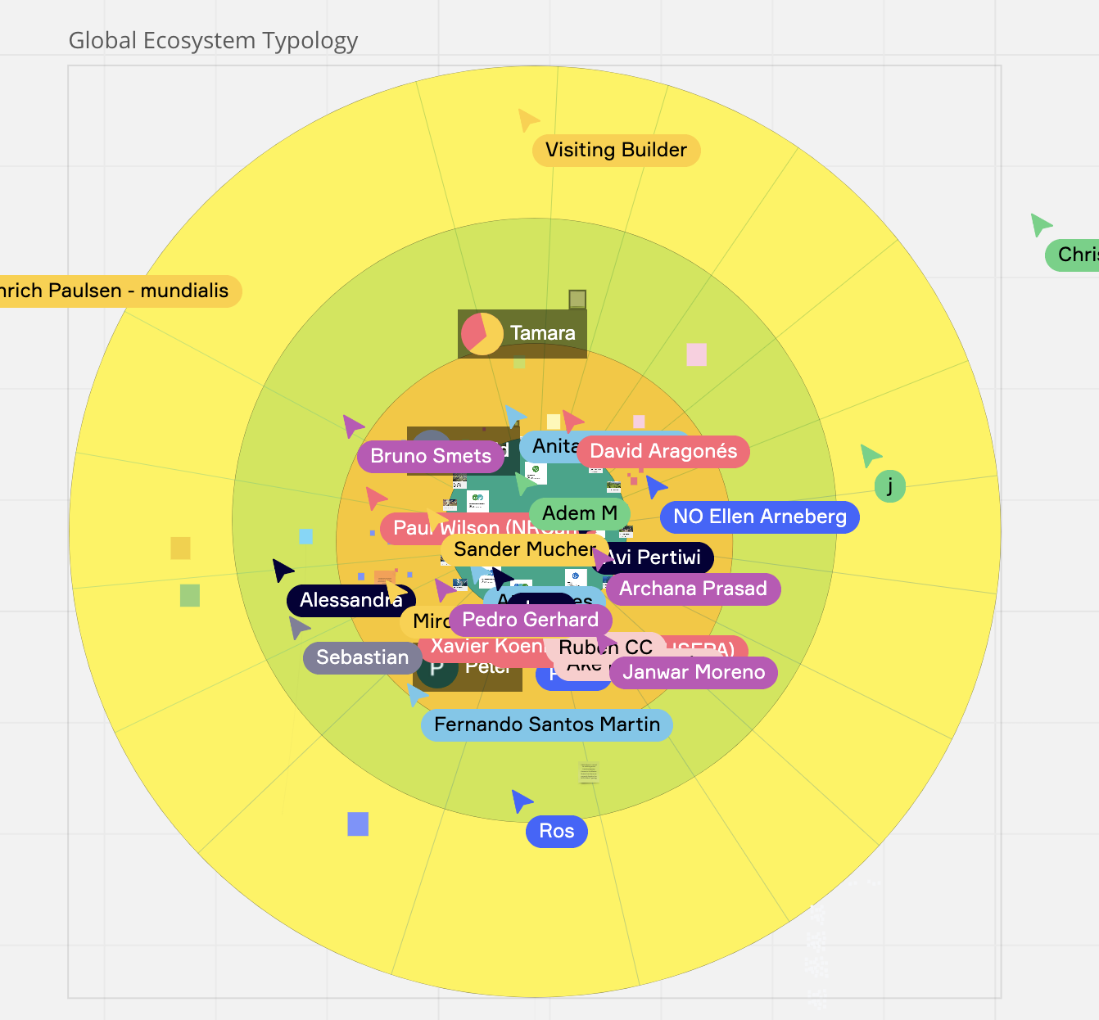
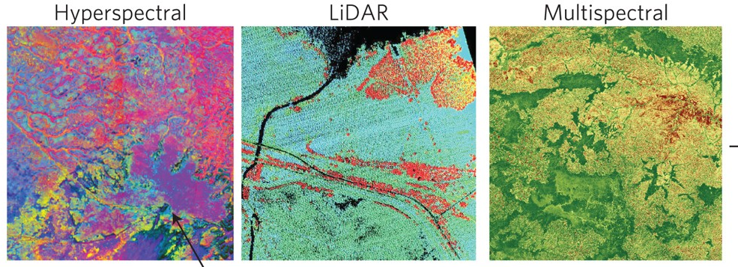
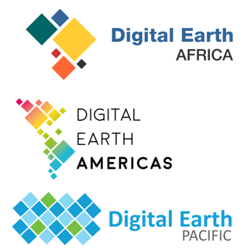
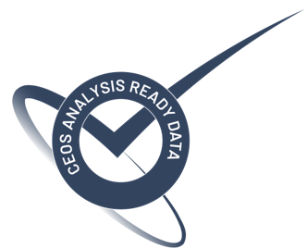
GEO Global Ecosystem Atlas
And
Proposed CEOS Ecosystem Extent Task Team
Supporting a 3 phases programme proposal:
Phase I: Mapping Global Ecosystems (2023-2024)
Phase II: Developing and Accessing the Atlas (2024-2025)
Phase III: Increasing Uptake and Developing Capacity (2025-2027)
CEOS Plenary, Biarritz - 30 November 2022 - Agenda Item 1.7 GEO Sec Report
1

Slide 9
The challenge is evolving
Despite an increase in demand for Earth observation information, and an abundance of information sources, access and use of Earth observations have not accelerated at the same pace.
Towards a new GEO direction
A GEO that is more attuned to users’ needs…. a GEO that provides integrated solutions to integrated problems… and a GEO that attracts new partnerships and funding for a more sustainable future.
Towards Post-2025 GEO Strategy
Building on 17 years of success, ideas behind the vision still valid
Making GEO fit for purpose
Accompanying factors to propel GEO towards the vision (GEO as “Catalyst”)
Responding to user needs: e.g. facilitating access to high-res data
How does GEO harness the opportunities in a changing world?

Slide 10
Increase Equitable Access to Earth Observations
Post-2025 GEO Strategy
Multi-user licenses brokering
Optimize the GEO Work Programme
Integrated activities
Strengthen GEO Governance
public-private partnerships
Equitable representation
Mobilize New Donors, Private Sector and Innovative Financing
Stronger role of Stakeholders
Strengthen Communications and Advocacy
Flagship event and report

Slide 11
Thank you
www.earthobservations.org

