Slide 1
CEOS Executive Officer report
Marie-Claire Greening
CEOS Executive Officer
Agenda Item 1.5
2022 CEOS Plenary, Biarritz, France
29th November – 1st December 2022

Slide 2




CEO Roles and Responsibilities
Serves the entire CEOS organisation and acts with neutrality
Internal Stakeholders
  Focal point on governance, resourcing and processes
  Custodian of CEOS Governing Documents, including CEOS Work Plan
  Ensures information flow across all CEOS entities and advises CEOS leadership
  Handles membership and works with the SEO on comms and outreach
  Contact point for all enquiries, responsible for CEOS membership, listservs, website and events calendar … and general housekeeping!
External Stakeholders
Point of Contact for all external stakeholders, both existing and new
CEOS interface to the Group on Earth Observations (GEO); supports coordination meetings sits on the GEO Programme Board and Executive Committee
External interface to all CEOS contacts and represents CEOS at relevant partner and stakeholder meetings

Slide 3
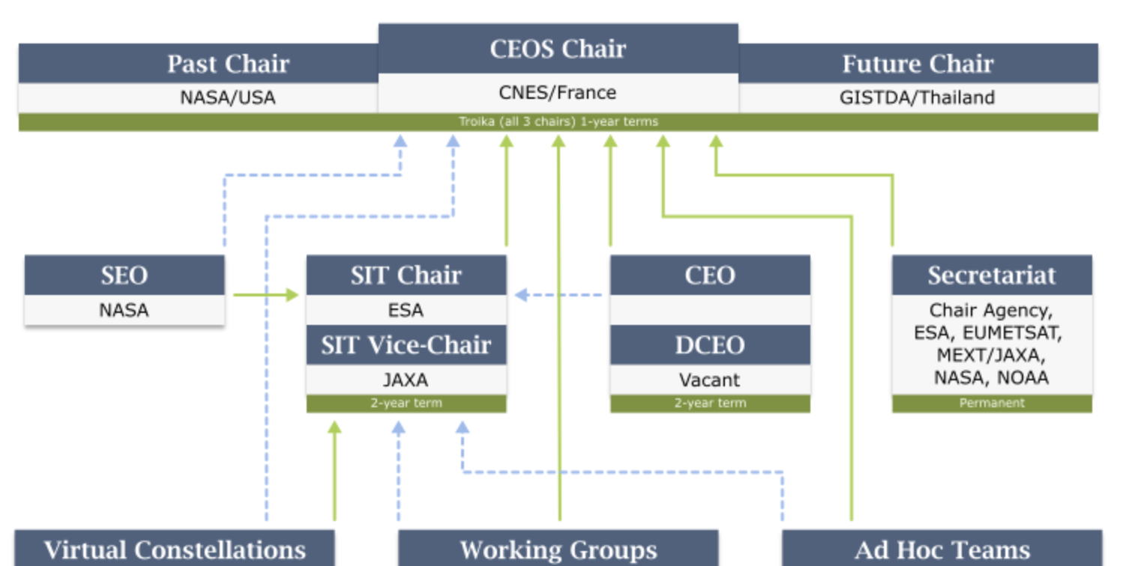
Internal Information Flow
The CEO:
is the internal liaison between CEOS leadership roles (CEOS Chair, SIT Chair, SEC and SEO) and across all CEOS entities (Working Groups, Virtual Constellations, ad hoc Teams and other CEOS Initiatives)
attends all major Principal-level CEOS meetings, is a standing member of the CEOS SEC and contributes to many meetings hosted by CEOS entities
provides guidance on internal and external collaboration to ensure cross-flow of information, priority and objective goal-setting, and resource and scheduling implications

Slide 4
CEOS Organisation
CEO
Troika
SIT Chair
CEOS Secretariat
CEOS Chair
SIT Vice-Chair
Working Groups
Past Chair
ARD Oversight Group
WGCapD
WGClimate
Future Chair
Ocean Coordination Group
WGDisasters
GHG Task Team
New Space Task Team
SEO
WGCV
WGISS
SDG Coordination Group
Subgroups
Data Discovery & Access Team
ACSG
Virtual Constellations
Interest Groups
IVOS
Technology Exploration
AC-VC
P-VC
LPV
COAST AHT
Data Preservation & Stewardship
OCR-VC
SST-VC
MSSG
SAR
Ecosystem Extent Task Team
OST-VC
LSI-VC
Data Interoperability & Use
TMSG
OSVW-VC

Slide 5

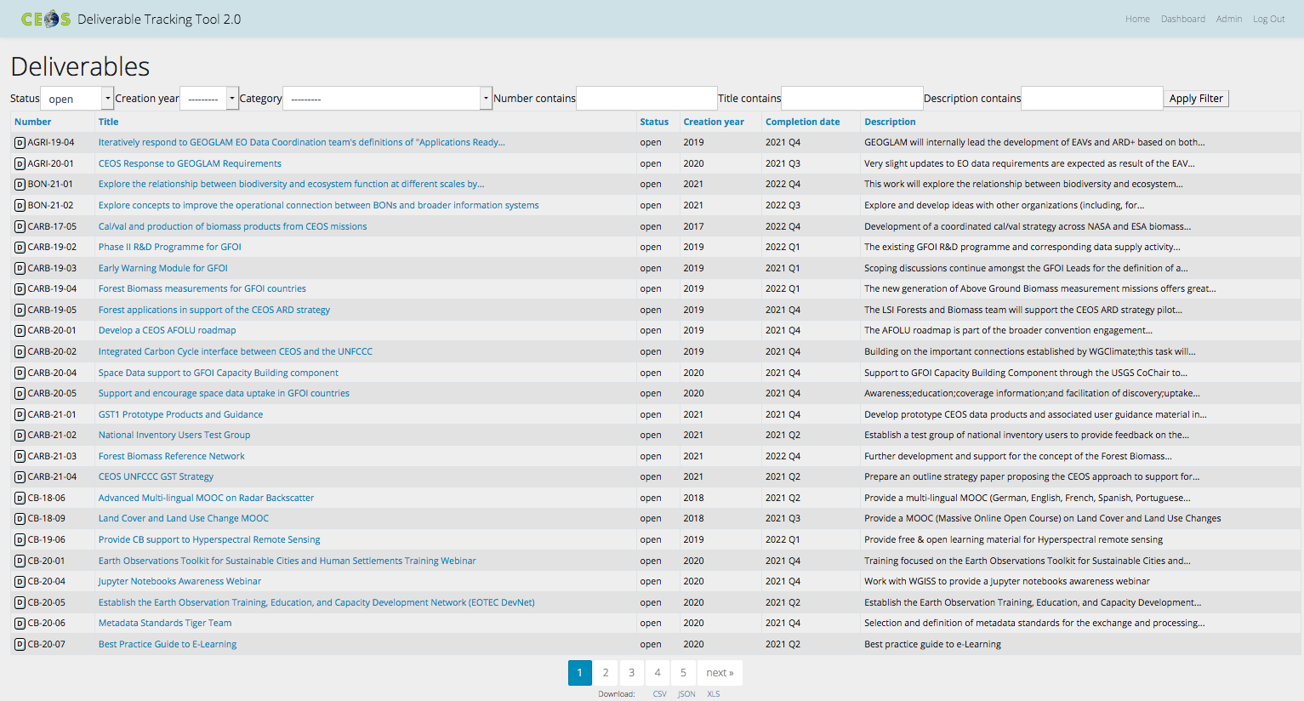
CEOS Work Plan 2022-24
3-year plan updated by all CEOS entities every year and put forward for formal endorsement at SIT. Rigorous work planning, execution and monitoring is critical to CEOS’s credibility.
Jan
Dec
Feb
SIT
Nov
Mar
Plenary
Oct
Apr
Sep
May
SIT TW
Aug
Jun
Jul
Detailed work defined as deliverables: outlined in the WP, reconciled and tracked in CEOS deliverable tracking tool

Slide 6
2022-24 Work Plan deliverables
Chapter |  | Closed | Overdue | Due by end 2022 | Due in 2023 | Due in 2024 & beyond
1 | Climate Monitoring, Research, and Services | 2 |  |  | 4 | 1
2 | Carbon Observations in Support of Climate Science and Policy |  | 1 | 2 | 8
3 | Observations in Support of the Global Stocktake of the UNFCCC |  | 3 |  | 7
4 | Observations for Agriculture |  | 2 | 1 | 1
5 | Observations for Disasters | 3 | 1 | 1 | 4 | 4
6 | Observations for Water | - | - | - | - | -
7 | Data Quality |  |  | 2 | 5 | 1
8 | Capacity Building and Data Democracy | 7 | 1 | 9 | 9 | 1
9 | Data Discovery, Access, Preservation, Usability and Exploitation: approaches, systems, tools and technologies | 1 |  | 3 | 3
10 | Advancement of the CEOS Virtual Constellations | 8 | 1 | 7 | 7 | 6
11 | Support to Other Key Stakeholder Initiatives | 7 |  | 6 | 1
 | Totals | 28 | 9 | 31 | 49 | 13

Slide 7
2022 Key Meetings
 | Jan | Feb | Mar | Apr | May | Jun | Jul | Aug | Sep | Oct | Nov | Dec
CEOS Leadership | SEC¹ | SEC | SIT²-37 SEC | SEC | SEC | UNCOPUOS³-65 SEC | SEC |  | IAC⁴-73 SIT TW⁵ SEC | SEC | CEOS-36 SEC | SEC
Working Groups |  | WGCapD⁶-11 | WGDisasters⁷-17 WGClimate⁸-16 WGCV⁹-50 WGISS¹⁰-53 |  |  |  |  |  | SIT TW side meetings | WGDisasters-18 WGClimate-17 WGCV-51 WGISS-54
Virtual Constellations |  |  | AC-VC¹¹-18 |  | LSI-VC¹²-11 |  |  |  | LSI-VC-12 SIT TW side meetings | OST¹³-VC
ad hoc Teams |  |  |  |  |  |  |  |  | COAST¹⁴ product showcase
GEO |  | CEOS-GEO coordination PB¹⁵-22 | ExCom¹⁶-57 |  | GEO symposium | PB-23 | EXCom-58 |  | PB-24 | GEO-18 EXCom-59
Other External |  |  |  |  |  | CGMS¹⁷ | IGARSS¹⁸ |  |  |  | COP¹⁹-27
¹ CEOS Secretariat
² CEOS Strategic Implementation Team
³ UN Committee on the Peaceful Uses of Outer Space
⁴ International Aeronautical Congress
⁵ SIT Technical Workshop
⁶ CEOS Working Group on Capacity Building and Data Democracy
⁷ CEOS Working Group on Disasters
⁸ Joint CEOS/CGMS Working Group on Climate
⁹ CEOS Working Group on Calibration and Validation
¹⁰ CEOS Working Group on Information Systems and Services
¹¹ CEOS Atmospheric Composition Virtual Constellation
¹² CEOS Land Surface Imaging Virtual Constellation
¹³ CEOS Ocean Surface Topography Virtual Constellation
¹⁴ CEOS Coastal Observations, Applications, Services and Tools ad hoc Team
¹⁵ GEO Programme Board
¹⁶ GEO Executive Committee
¹⁷ Coordination Group for Meteorological Satellites
¹⁸ International Geoscience and Remote Sensing Symposium
¹⁹ UNFCCC Conference of the Parties

Slide 8
Thank you!
Marie-Claire Greening
CEOS Executive Officer
Agenda Item 1.5
CEOS Plenary, Biarritz, France
29th November – 1st December 2022

