Slide 1
Surface Water & Ocean Topography (SWOT) Mission Pre-Launch Update Program scientist/manager : Nadya Vinogradova-Shiffer (NASA) Annick Sylvestre-Baron (CNES) Project Scientist : Lee-Lueng Fu (JPL/NASA), Hydrology Leads : Tamlin Pavelsky (UNC), Jean-Francois Ctrétaux (LEGOS/CNES) Ocean Leads : Tom Farrar (WHOI), Rosemary Morrow (LEGOS/UT3)
Rosemary Morrow,
LEGOS/University Toulouse III
1.2 # 2022 CEOS Plenary
Biarritz, France
Nov. 29 – Dec. 1

Slide 2
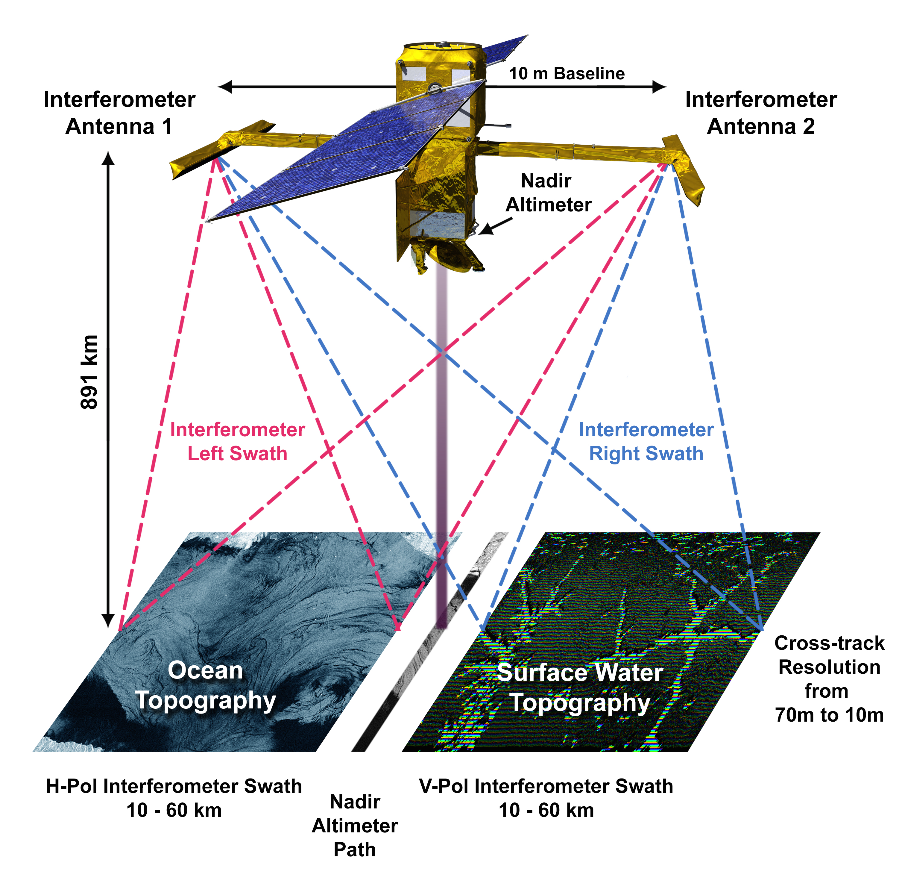
SWOT is a pathfinder mission addressing fundamental questions on the Earth’s water cycle and ocean energy and heat transport
SWOT will use SAR interferometry to make global measurements of water elevation over ocean & hydrology surfaces
SWOT will cover the world between 78N and 78S every 21 days
SWOT follows 30 years of nadir altimetry cooperation between NASA and CNES.
Image Credit : K. Wiedman

Slide 3
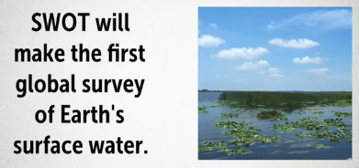
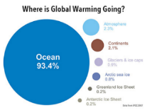
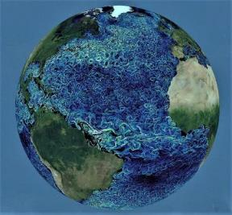
SWOT Science & Societal Objectives
SWOT will provide valuable data and information that will benefit society in two critical areas; freshwater on land, and the oceans’ role in a changing climate.
Surface Water : observations of the amount and variability of water stored in global lakes, reservoirs, wetlands, and derived estimates of river discharge. SWOT will also provide critical information necessary for water management, particularly in international hydrological basins.
Ocean Topography : measure sea surface height at improved resolution to better understand the ocean energy & its transport of heat, carbon and nutrients, for improved understanding of the ocean’s response to climate variations.
Coastal/estuarine regions : SWOT will improve coastal observations for societal impacts in coastal regions, such as navigation, erosion and pollutant dispersion

Slide 4
SWOT -2D data : A technological revolution
Mission Architecture
Ka-band SAR interferometric (KaRIn) system with 2 swaths, 50 km wide
Produces all-weather heights & co-registered imagery
Conventional Jason-class altimeter for nadir coverage, 2-horn radiometer, and GPS/DORIS/LRA for POD
Daily data downlink volume : 8 Tb/day
Over Land : Full resolution within land mask
Over Oceans : Onboard Processor performs initial SAR-Interferometry processing : reduces data download volume (resolution 250x250m )
2 orbit phases :
Calibration orbit 857 km, 77.7° incl, 1 day repeat : 6 months
Science orbit : 891 km, 77.6° incl, 21-day repeat : 3 years
Flight system : 2400 kg; 2100 W
Launch Vehicule : SpaceX Falcon 9
Image Credit : K. Wiedman
Launch Date : Mid December 2022
Notes:
15 Tb/day transferred between CNES & JPL

Slide 5
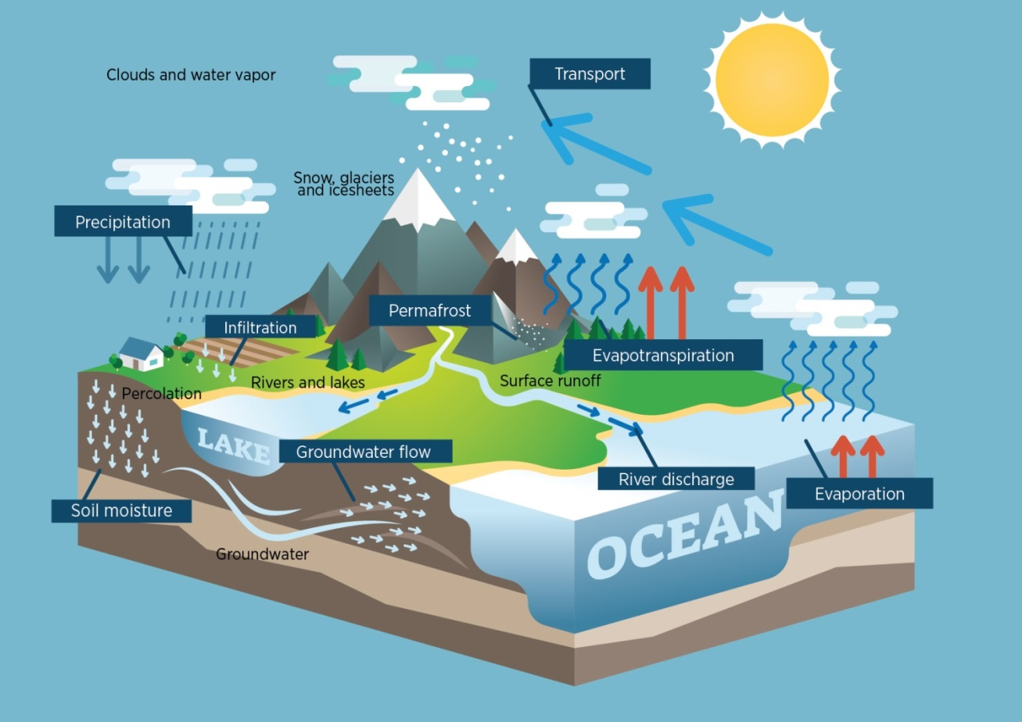
SWOT & hydrology
SWOT will mesure
Water levels and extent in lakes, reservoirs and floodplains > 250 x 250 m
River Levels, slopes and width > 100 m wide
21-day cycle
SWOT will produce
Water storage changes in lakes and reservoirs
River discharge
SWOT will allow
Studies of the global water cycle
Data assimilation in models
Freshwater Inputs to oceans, groundwater
Water Catchment hydrodynamics
New applications
Demonstrator of an operational downstream service for river monitoring
Improvement of flood prediction models
Flood probability mapping
Notes:
Planche assez facile à commenter car bcp de texte. L’idée c’est de dire qu’il y a des mesures, hauteurs étendues tous les 21 jours, que ca va servir à générer des produits avancés (débits rivieres et stocks lacs et plaines inondées) et que grâce à cela on va améliorer la connaissance du cycle de l’eau à travers plusieurs aspects: (‘SWOT va permettre’).
Dire que dans le cycle de l’eau les lacs et les rivières jouent un rôle qui est essentiel: stock l’eau, et écoulement vers l’aval. SWOT va donner les informations sur les stocks et sur les débits, mais aussi indirectement sur l’evapo-transpiration via la cartographie des plans d’eau.
Dire enfin qu’il y a aussi des applications non scientifiques et les citer (dernier bloc de la planche)
C’est la première fois qu’avec une seule mission on aura accès à ces informations et donc qu’on avancera sur la connaissance du cycle de l’eau, qui est fortement impacté par ailleurs par les changements climatiques mais aussi les usages

Slide 6
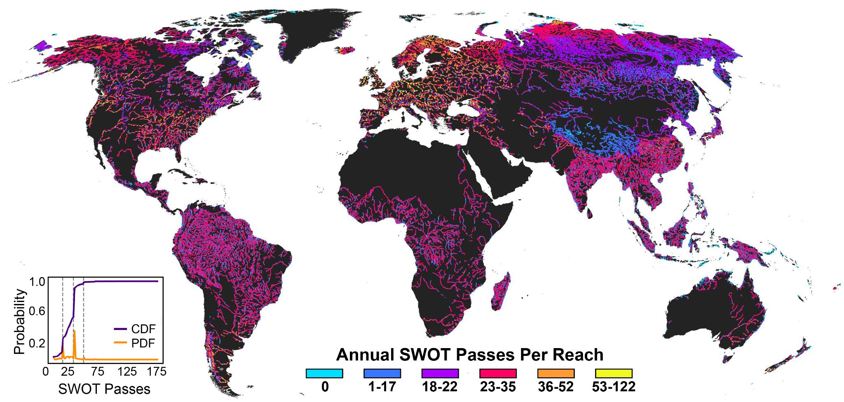
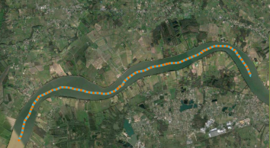
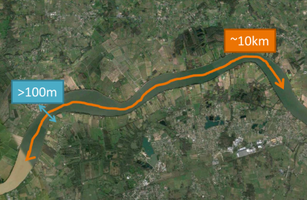
SWOT Ice-Free River Observations Per Year
River Levels, slopes and width > 100 m wide
H & W every 200 m
H, slope, et mean discharge over 10 km sections
Altenau et al., WRR, 2021
120,000 sections >100m wide over 10 km
Notes:
Rivers – also going from 2D to 3D. Going from a patchwork of some coverage in some regions, but most of the world has no data available. With SWOT we are going to a universal baseline

Slide 7
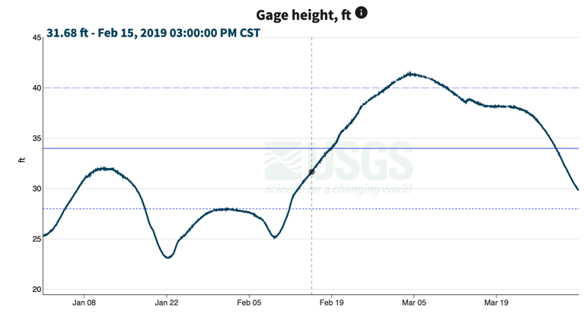
February 15, 2019
?
?
?
?
?
SWOT will give us the first 3-D images of floods, which will help us better predict and track damages
?
Notes:
Flood monitoring … image of EXTENT from a Landsat image … SWOT allows us to go from 2D (extent) to 3D (including depth)

Slide 8
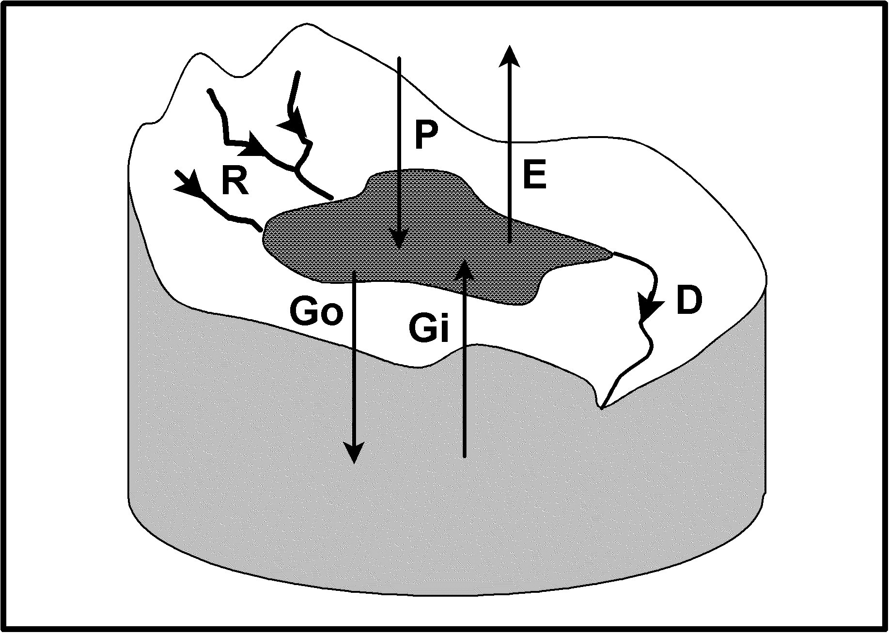
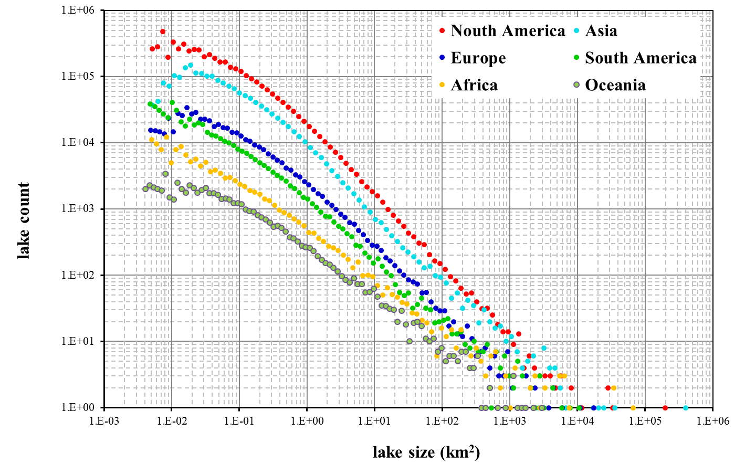
Lakes observed by SWOT
“Lakes are sentinels, regulators and integrator of climate change” and contribute to global water cycle
SWOT : Water levels and extent in lakes, reservoirs & floodplains > 250 x 250 m²
SWOT > 250 x 250 m²
Today > 10 km²
Today we can piece together 10000 lakes > 10 km².
SWOT will observe millions – 2 orders of magnitude in terms of coverage

Slide 9
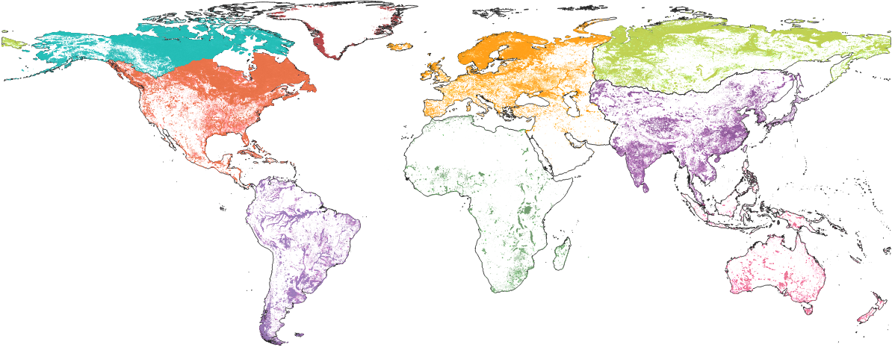
Distribution of Lakes Observed from SWOT
AR
1,924,503 lakes
GR
41,220 lakes
SI
1,126,371 lakes
EU
509,449 lakes
NA
1,544,599 lakes
AS
450,911 lakes
AF
76,714 lakes
SA
250,161 lakes
AU
58,615 lakes
Based on work from Yongwei Sheng’s group at UCLA based on Landsat, compiled and validated by CNES scientists.
Total: 5,982,543 Lakes >0.01 km²
Notes:
Lakes : if we could download water levels from all sources – today we can piece together 10000 lakes. SWOT will observe millions – 2 orders of magnitude in terms of coverage
Canada : partenaire : un des pays où il y a le plus de lacs non suivis
Requirement : 250x250m ; goal : 100x100m
With SWOT, we don’t need the extent from imagery, we can use the surface roughness images from the interferometry calculation

Slide 10
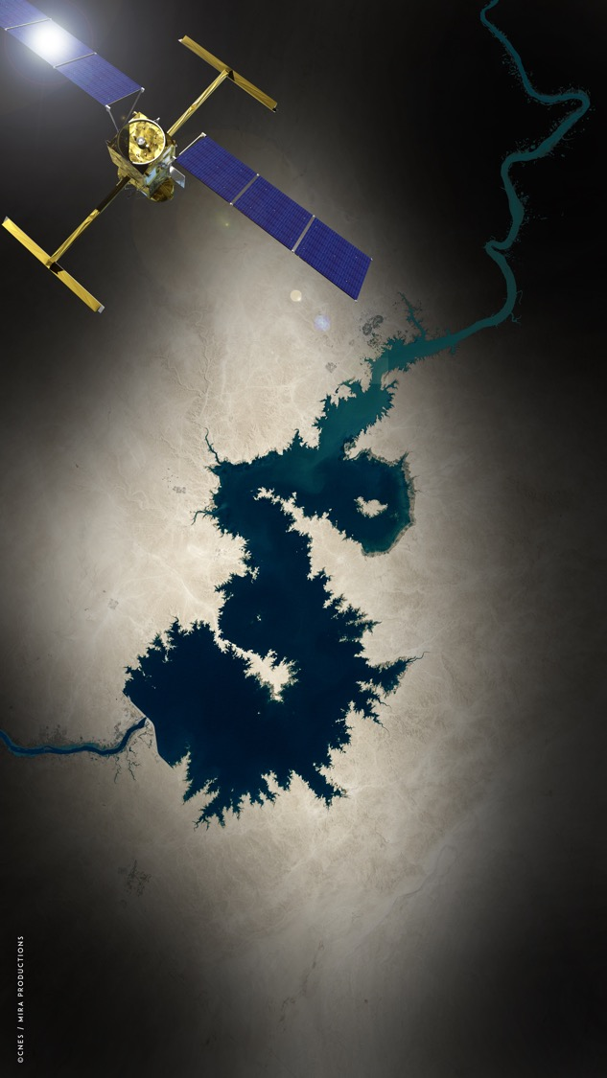
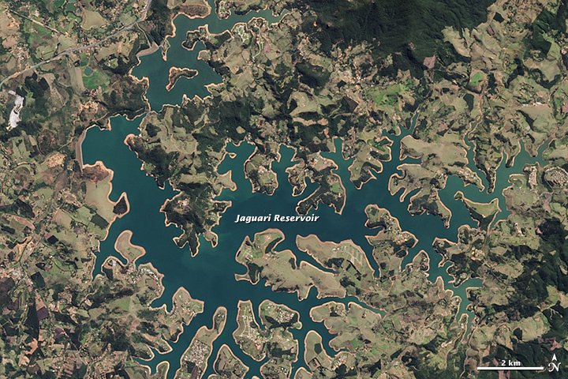
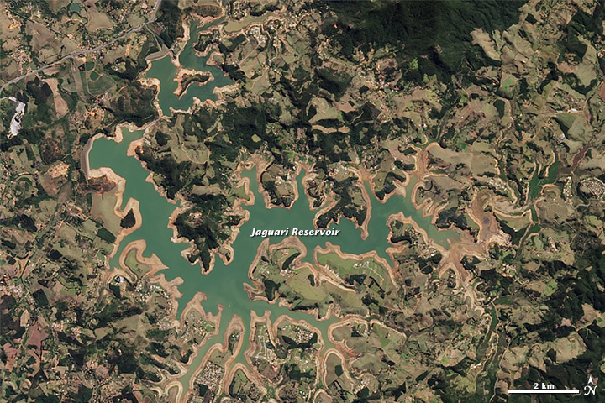
Current imaging satellites can track the area of all of the world’s reservoirs, which is useful for science but not directly useful for management.
SWOT will measure changes in water volume over time for tens of thousands of reservoirs, which water managers can use to understand available resources.

Slide 11
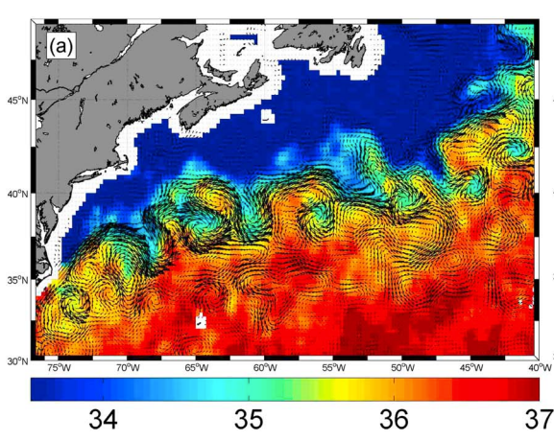
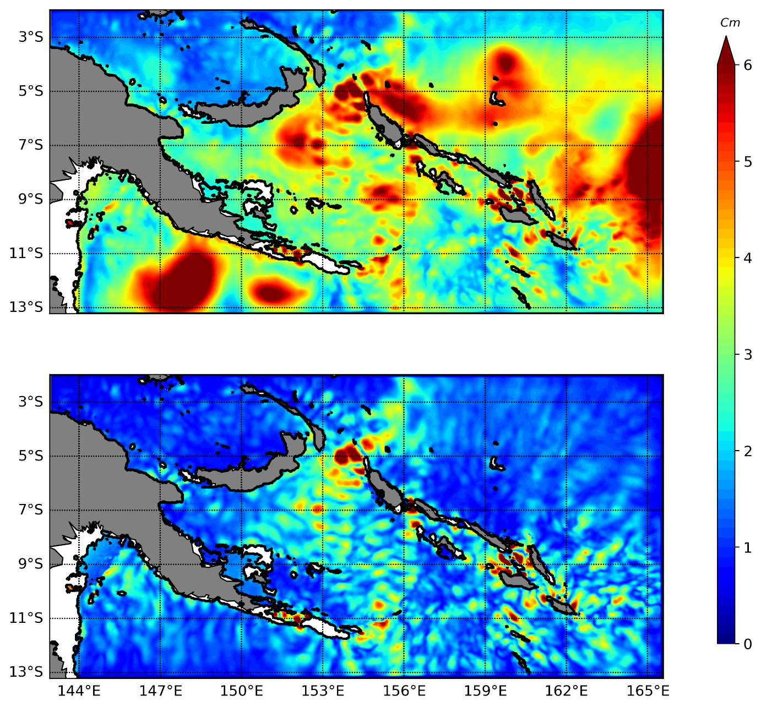
SWOT Ocean Objectives
Today’s 2D gridded nadir altimetry maps resolve mesoscale eddies to 100 km in diameter
SWOT will measure :
Smaller ocean eddies > 10 km diameter to enhance ocean currents & fill the gap 10-100 km.
Orbit chosen to measure ocean tides, and internal tides - > mixing and energy dissipation
Global ocean observations at 250m x 250m or 2x2 km posting, up to the coast and high latitudes (78°)
10-100 km eddies
Why scales < 100 km ?
Most of the ocean’s energy is transported and mixed at scales < 100 km
These scales dominate in coastal and regional seas and at high latitudes
Eddy interaction along ocean fronts drives vertical pumping of heat, carbon, nutrients
Impact on air-sea interactions and biomass transport
Internal tides

Slide 12
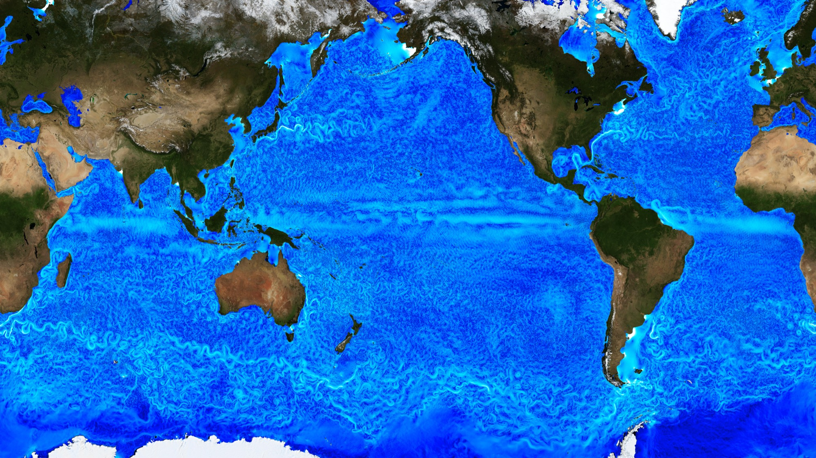
Most of the kinetic energy in the oceans is in the “mesoscale eddy” field
Today we observe eddies > 100 km, we want to observe > 10 km
(Ocean current speed from a high-resolution global simulation)
Notes:
Global 1/48° ocean + sea ice MITgcm simulation
.75–2.3 km horizontal grid spacing, 90 z levels
Forced by .14° ECMWF analysis + tidal potential
14 months of hourly output has been saved

Slide 13
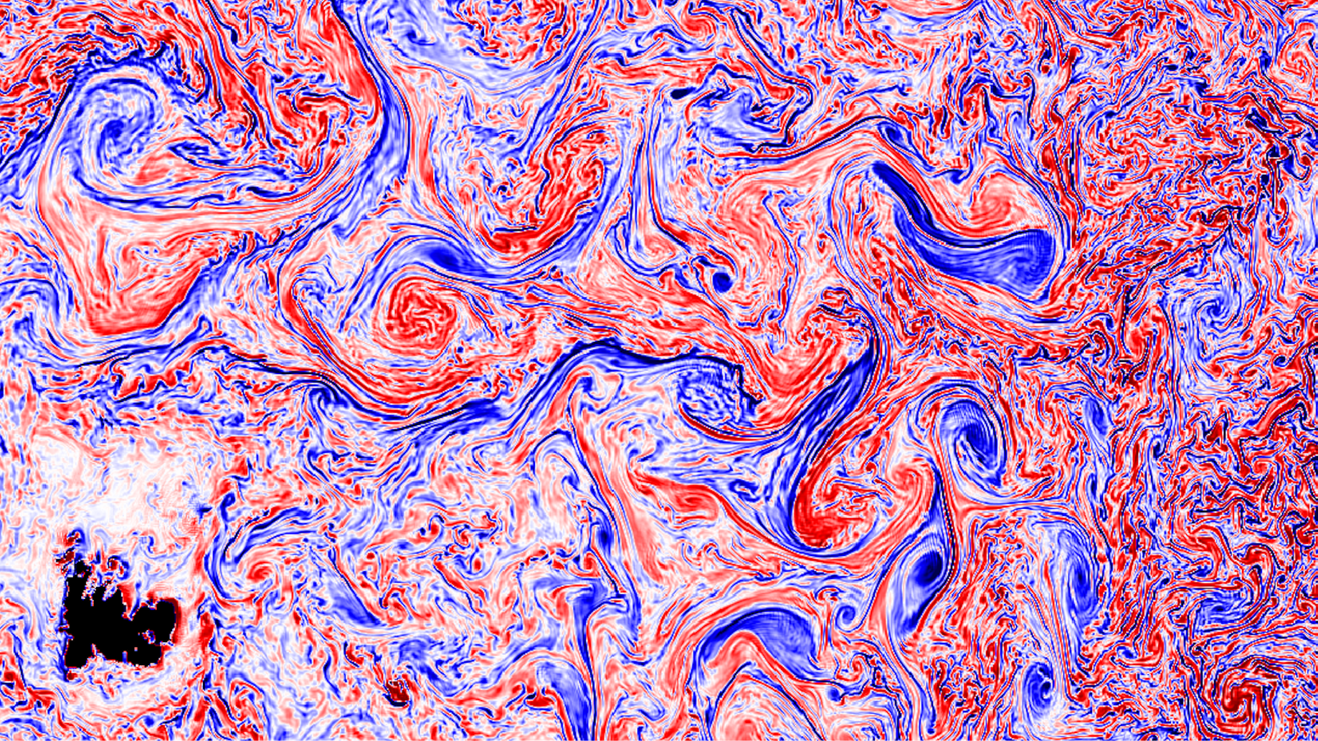
Most of the vertical fluxes in the ocean come from the smaller scale dynamics
(Gradients of ocean currents - Ocean vorticity from a high-resolution global simulation)
10 km eddy & front
100 km eddy
Zoom shows turbulent structures downstream of Kerguelen Island.
To observe these requires 2D observations of sea surface height & slope/gradients
Notes:
We can continue to zoom in to see more structures in these turbulent field. The level of turbulence continuum is not a surprise in theory, but the features we see are beyond the conventional picture painted by the wavenumber spectrum in the context of energy cascade. These are coherent structures, that will benefit from a two dimensional view from satellite measurements

Slide 14
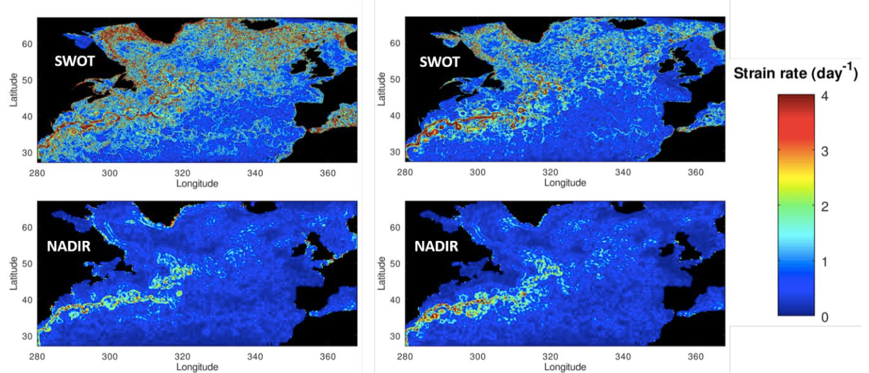
Current gradients driving vertical velocities vary seasonally
Winter
Summer
Model reconstruction of ocean strain rate observed by mapped nadir altimetry today, and nadir + SWOT swath coverage

Slide 15
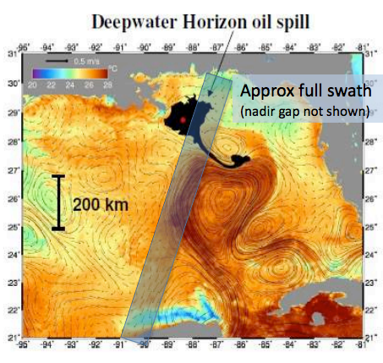
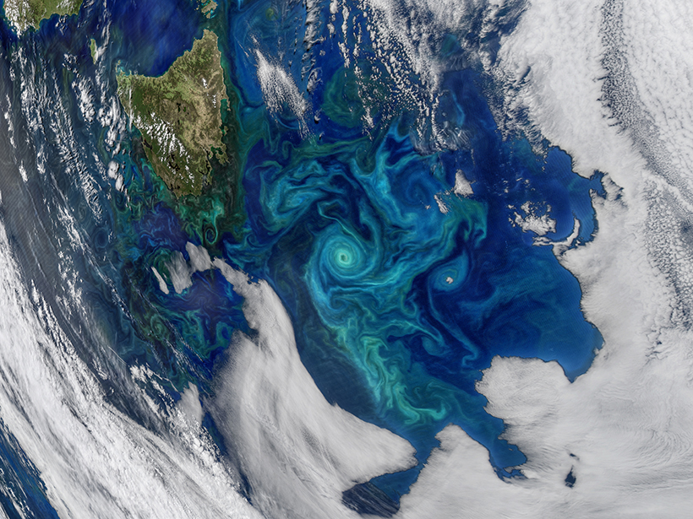
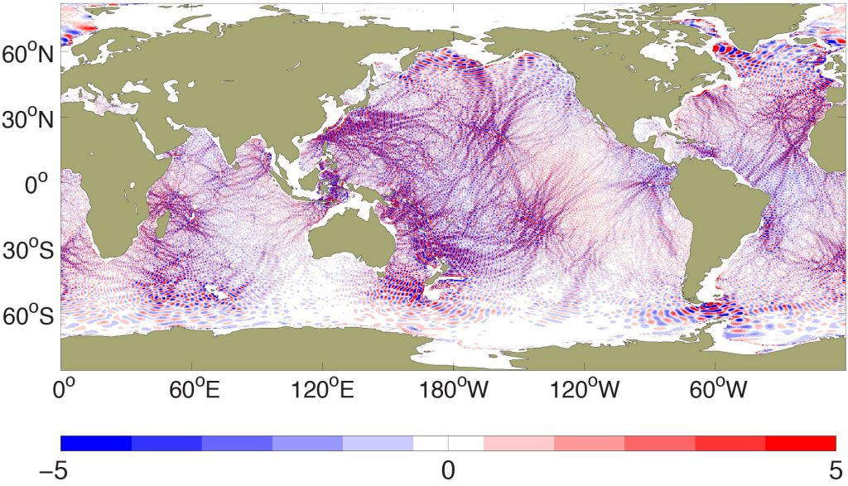
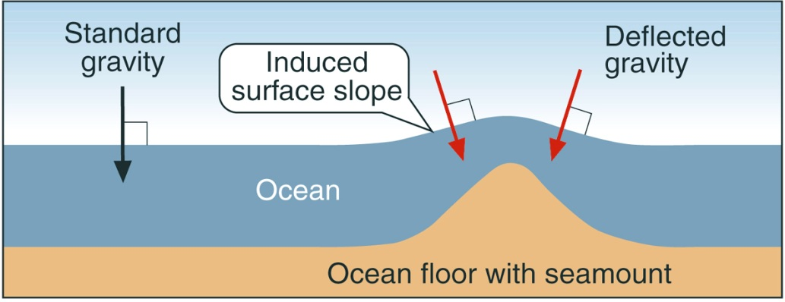
Ocean Applications
Finer-scale 2D currents & derived vertical currents
High-latitude SSH/Currents in leads & Sea Ice Freeboard & snow thickness (Ka/Ku)
Biodiversity structure
Ocean tides & internal tides
2D open ocean geoid & Bathymetry at 250 m
Notes:
Deep-ocean floor has more than 90% of active volcanoes, and millions of sea-mounts. The swath mapping capabilities of SWOT will improve our mapping of the marine geoid by a factor of 5 compared to todays marine geoid maps

Slide 16
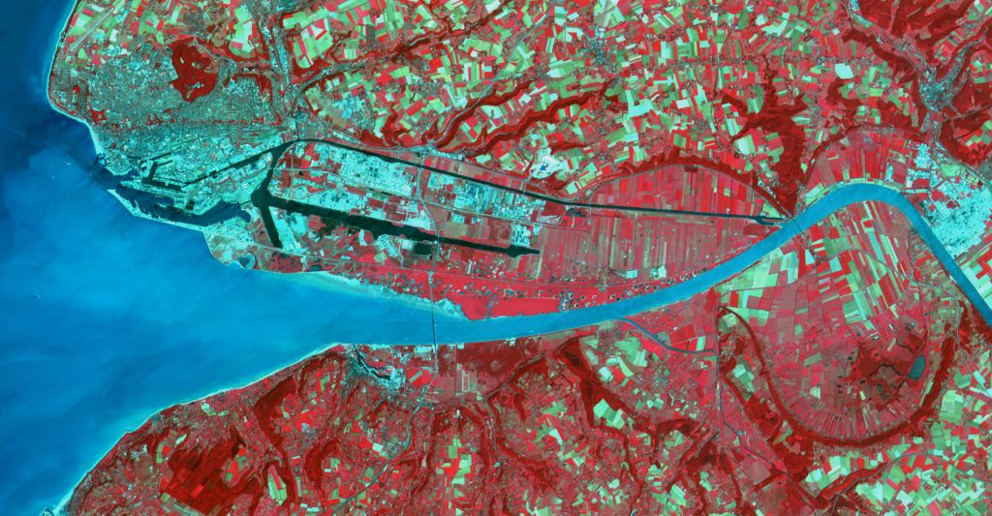
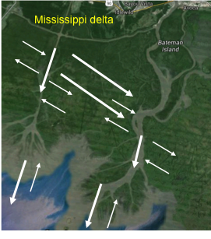
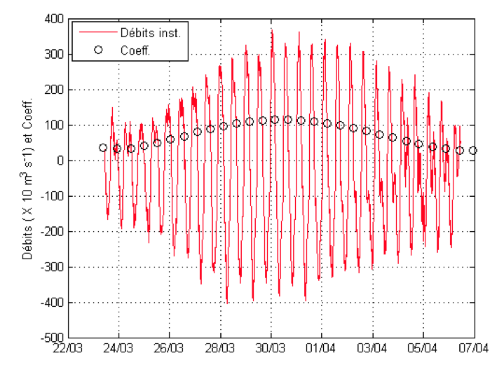
SWOT coastal/ estuaries/deltas/wetlands
Diverse & complex environments ➔
large variations of water level connected to hydro-meteo-marine phenomena:
offshore currents, tides, waves, storm surges, river flow, sea level rise
Flow reversals due to tides – non-harmonic tides
Multi-hazard zones : Flooding (sea level, storm surge, river flood), erosion, pollution
SWOT objectives:
quantify the water exchanges
between the different compartments
wetlands
river
estuary
ocean

Slide 17
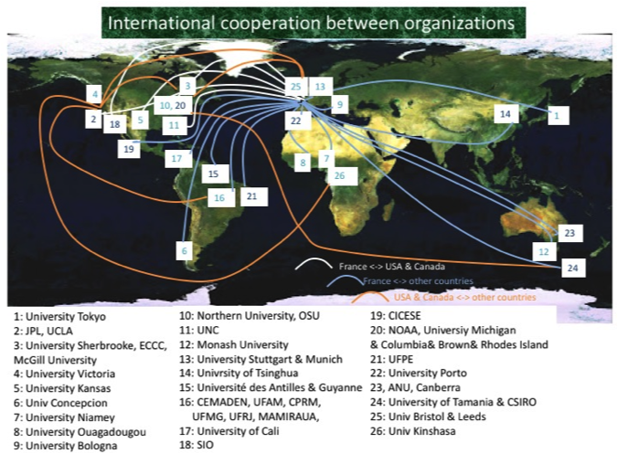
SWOT science teams since 2008
Current Science Team : 2020-2024
 | US | France | International | All
Open Ocean | 9 | 12 | 9 | 30
Coastal | 1 | 3 | 4 | 8
Hydrology | 7 | 7 | 6 | 20
Total | 17 | 22 | 19 | 58
Selection by a joint NASA/ROSES & CNES/TOSCA call. NASA selects & funds US projects, CNES/TOSCA selects international projects & selects and funds French projects
Multiple international partners & co-operation for global observations
Since 2020 (Covid) SWOT Science Team conducts monthly working group meetings.

Slide 18
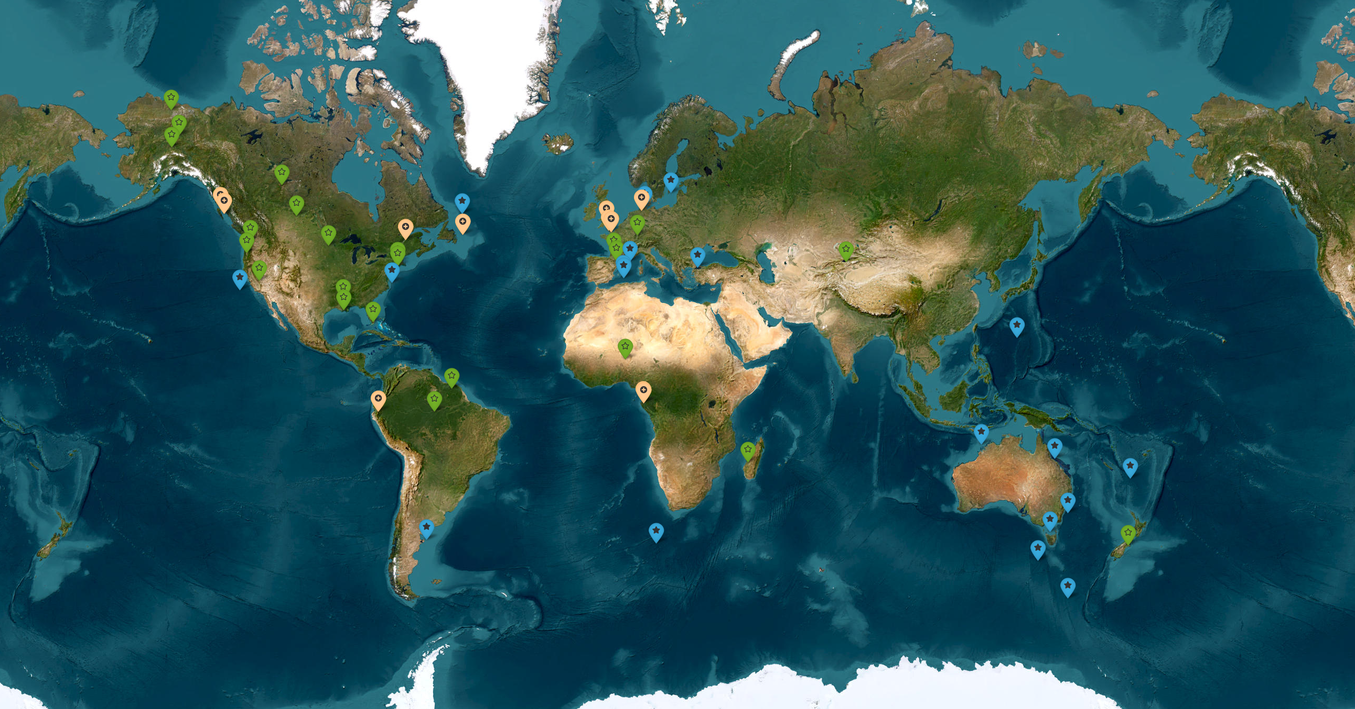
Strong ST implication in in-situ & airborne CalVal in 2023 (ocean research campaigns, river and lake validation, … )
18 open-ocean
11 coastal
23 hydro

Slide 19
Conclusions
SWOT represents a scientific and technical breakthrough in
oceanography & hydrology
First global observations of Earth’s water ressources in SAR-interferometry
First estimate of the flows of all rivers > 50-100 m
Complete inventory of lakes, reservoirs and floodplains > 250m ^{x} 250 m and their spatio-temporal dynamics
First observations of the 2D ocean circulation at fine scale (10 km), and their interactions with the tides
2D observations of coastal / estuarine/ wetland regions : their water storage, discharge & connectivity

Slide 20
Perspectives
Perspectives
SWOT will contribute to OST Virtual Constellation
Development of high resolution databases => ocean and hydrology
Applications and Early SWOT Adopters in the 3 domains: oceanic, hydrological, coastal
Improvement of dynamic and climate models for reanalysis of long series and ocean and hydrological forecasting
Launch 15 Dec 2022
Go SWOT !

