Slide 1
2022 CEOS Plenary
Welcome &
Opening Remarks
Selma Cherchali
CNES, 2022 CEOS Chair
Agenda Item 1.1
2022 CEOS Plenary
Biarritz, France
Nov. 29 – Dec. 1

Slide 2
Week at a Glance
Tuesday 29th | Wednesday 30th | Thursday 1st
Side Meetings: CEOS SEC-300 (closed) Biodiversity Activity – Ecosystem Extent Proposal GISTDA: New Space SDG Coordination COVERAGE | Welcome & Core Business SWOT CEOS Chair team review 2024 CEOS Chair CEO Report CEO Continuity GEO report Climate & Carbon Synthesis Report by SIT Chair GHG & AFOLU Roadmaps CEOS – IMEO Cooperation WG Climate report Working Groups WGCV, WGISS, WGCapD, WGDisasters Virtual Constellations Synthesis Report by SIT Chair AC-VC white paper “PM2.5 Monitoring White Paper” | New Space Synthesis Report by SIT Chair SatSummit 2022 by SEO “New Space” Task team CEOS Standards Organisation Engagement CEOS Interoperability Framework Sustainable Development Goals Biodiversity Oceans CEOS coordination of ocean activities CEOS Agency Reports CNES, ESA, EUMETSAT (as of 9 Nov.) SEO Annual Report MIM Database Report CEOS Leadership Transitions CEOS 2022 Year in Review Closing

Slide 3
Plenary Objectives
CEOS Organisation
Review the outcomes of the CNES 2022 CEOS Chair theme: “Paths to Sustainability: From Strategy to Practical Measures”.
Reach an agreement on a long-term and equitable plan for CEOS Executive Officer continuity.
Welcome the Geo-Informatics and Space Technology Development Agency (GISTDA, Thailand) as CEOS Chair for 2023 and discuss GISTDA’s priorities for the coming year.

Slide 4
Plenary Objectives
New Teams & Extensions
New Space: Consider endorsement of Terms of Reference for a CEOS ‘New Space’ Task Team.
Biodiversity: Consider the proposal for an Ecosystem Extent Task Team. If endorsed, identify contributors for the activity.
Sustainable Development Goals (SDGs): Review the way forward for the CEOS SDG team and its 2023+ deliverables, activities, and resources.
Consider the proposal for a further one-year extension of the CEOS Coastal Observations Applications Services and Tools (COAST) Ad Hoc Team.
Review the Ocean Coordination Group’s recommendations regarding the coordination of CEOS ocean-related activities and consider endorsement of an extension of the Ocean Coordination Group for another 6-12 months.

Slide 5
Plenary Objectives
Working Team Business
Consider endorsement of nominees for the Vice Chair roles of WGCV and WGClimate (and the subsequent Chair terms).
Provide an opportunity for CEOS Principals to hear updates from CEOS Working Groups (WGs) and Virtual Constellations (VCs). Evaluate the following specific items:
a. Consider endorsement of the Atmospheric Composition Virtual Constellation (AC-VC) whitepaper: “Monitoring Surface PM2.5: An International Constellation Approach to Enhancing the Role of Satellite Observations”.
b. Consider an action for LSI-VC to lead further development of the concept of a CEOS Interoperability Framework.
c. Consider endorsement of the updated WGCV Terms of Reference.
d. EOTEC DevNet Sustainability Plan: Sustainability Plan Draft

Slide 6
Plenary Objectives
Consider an action to prepare a way forward for increased coordination on CEOS engagement with standards organisations.
Review the latest developments on ARD standards based on CEOS-ARD specifications.
Climate & Carbon: Review the significant amount of work being undertaken by a number of CEOS Agencies and entities in support of climate and the UNFCCC Paris Agreement, including the GHG & AFOLU Roadmaps, and CEOS cooperation with IMEO:
Consider the request for the additional resources needed to advance the development of the AFOLU Roadmap.

Slide 7
Meeting Protocols
If you want to intervene, please, send a message in the chat or if you are in the room please rise your nameplate
The presentations are now centralised on a computer at the plenary, make sure that the latest issue is available on the CEOS plenary drive.
Remote presenters should join the WebEx and share their screen to present, presenters on site will not share their presentation from WebEx and will be given a clicker to advance their slides.
Please do not activate your webcam unless you are presenting
If your bandwidth is slow while presenting, please turn off your webcam
Please mute if you are not presenting or making an intervention and if you are in the room please make sure to mute the microphones after your intervention
Please rise your nameplate if you wish to make intervention

Slide 8
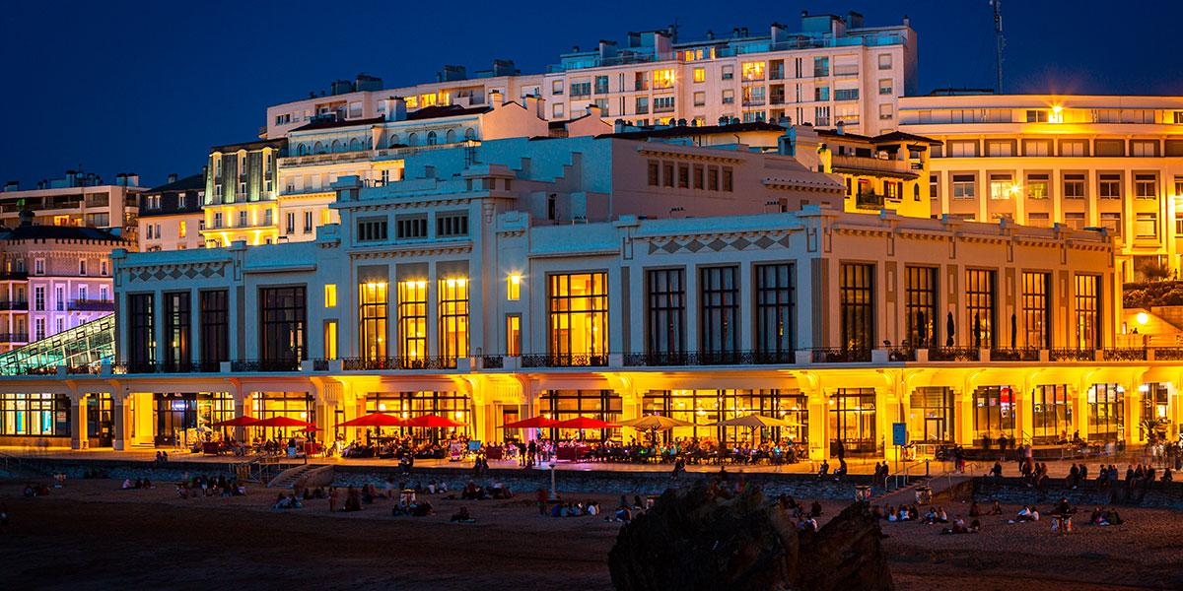
Gala Diner reminder
You are invited to the Gala Diner at the Casino !
The cocktail and traditional basque singing starts at 7 pm
The diner will start at 7:30 pm

