Slide 1
CNES CEOS Chair Priorities 2022
Paths to Sustainability: From Strategy to Practical Measures
Selma Cherchali, CNES
Agenda Item #42
2021 CEOS Plenary
Virtual Meeting
1-4 November 2021

Slide 2
CNES CEOS Chair Priorities 2022 Paths to Sustainability: from strategy to practical measures
Emphasis on evolution of R&D & demo activities to applications and services.
Pursuing and reinforcing the work with GEO to engage stakeholders necessary for such evolution.
Develop application case studies with the CEOS WGs, VCs, and AHTs for stakeholder benefit
Support GST and more specifically AFOLU Roadmap development inc. CEOS Biomass Protocol uptake & GEO-TREES
New and complementary activities, including cooperation on thermal IR cross-collaboration.

Slide 3
CNES CEOS Chair Priorities 2022 Paths to Sustainability: from strategy to practical measures
The 2022 Chair priorities drivers are to:
Ensure continuity of the open science theme introduced by NASA
Support and complement ESA SIT Chair priorities - such as creating new opportunities for EO space agencies and fostering the development and use of innovative digital services
Ensure attention to the Paris Agreement, our established policy drivers and frameworks, UNFCCC/GST, SDGs 2030, Sendai Framework
Continue the work of previous Chairs to secure a long-term solution for CEO and Deputy CEO continuity
Connections between the CEOS Chair and SIT Chair Themes indicated by the coloured icons in the following slides

Slide 4
CNES CEOS Chair Priorities 2022 Paths to Sustainability: from strategy to practical measures
The 2022 Chair priorities are :
Priority 1: Disaster Risk Reduction and Response, & Capacity Building to ensure long-term sustainability of CEOS strategies
Priority 2: CEOS Support to the UNFCCC Global Stocktake to ensure a strong and unified CEOS support to the UNFCCC Global Stocktake
Priority 3: Support to CEOS Cal-Val Initiatives to increase CEOS Agency Cal-Val Collaboration

Slide 5
CEOS and SIT Chair Team Coordination
CNES and ESA Teams have conferred carefully in deriving their respective plans and ensured synergy between them. Both prospectuses apply common nomenclature for ease of understanding
CNES CEOS Chair Priorities 2022
1. Disaster Risk Reduction and
Response, & Capacity Building
ESA SIT
Chair Team
Priorities
2. CEOS Support to the UNFCCC
Global Stocktake
5
3. Support to CEOS Cal-Val Initiatives

Slide 6
Priority #1: Disaster Risk Reduction and Response, & Capacity Building Ensuring Long-term Sustainability of CEOS Strategies
Key Outcomes | Component Tasks | CEOS Contributions
Sustained Operation and Application of CEOS Demonstrators | Highlight activities of CEOS community in GEO projects like GEODARMA, GEOGLOWS Develop synergies between CEOS projects Work with GEO, CEOS Associates, UN entities and WMO, to identify support mechanisms and key external stakeholders Use of CEOS data base to develop bias correction for the GEOGloWS ECMWF streamflow forecast | CEOS Agencies and working teams provide use cases Developing synergies, for example between WGDisasters and WGCapD Work with GEO & CEOS Associates, for example WGDisasters with GEO WG DRR From Global to Local: Strengthen the articulation between CEOS and GEOGLOWS
 | Identify demonstrators / R&D stage activities across CEOS suitable to evolve to next level Engage key stakeholder agencies through GEO mechanisms, with ultimate goal of establishing operational services | WGDisasters Recovery Observatory SDG Indicator CEOS Work Plan Deliverables (requirements)

Slide 7
Priority #2: CEOS Support to the UNFCCC Global Stocktake
Ensure Strong and Unified CEOS Support to the UNFCCC Global Stocktake
Key Outcomes | Component Tasks | CEOS Contributions
Implementation of the CEOS Strategy to Support the Global Stocktake of the UNFCCC Paris Agreement and adaptation objectives | Support Global Stocktake data requirements Support in-situ sites specified necessary for the CEOS Biomass Protocol Support the GEO-TREES GEO Community Activity Provide use cases through Space Climate Observatory (SCO) initiative with WG Climate and others WG (e.g. WG CapD) | COP-27 inputs and Synthesis Report updates AFOLU & GHG Roadmaps CEOS Agencies to ensure missions are providing practical support to the Global Stocktake data requirements CNES will ensure planned missions, such as MicroCARB & MERLIN, provide practical support CNES will support in-situ sites specified as necessary for CEOS Biomass Protocol and GEO-TREES GEO Community Activity

Slide 8
Priority #3: Support to CEOS Cal-Val Initiatives
Increased CEOS Agency Cal-Val Collaboration
Key Outcomes | Component Tasks | CEOS Contributions
CEOS Protocol for Cross-calibration of Thermal Infrared Measurements | Development of protocol document Establishment of a network of sites for Land Surface Temperature (LST) measurements based on thermal IR sensors | WGCV coordination of the protocol document Contributions to the protocol from CEOS Agencies with Surface Biology and Geology (SBG) relevant missions, in particular Trishna, Copernicus LSTM, Aquawatch, etc.
Joint Multi-thematic Cal-Val Sites to Develop CEOS Agency Synergies and Support Future Applications | Development of multi-thematic cal-val sites | CNES, ISRO, ESA, NASA/JPL, NPL (UK), CSIRO, and others

Slide 9
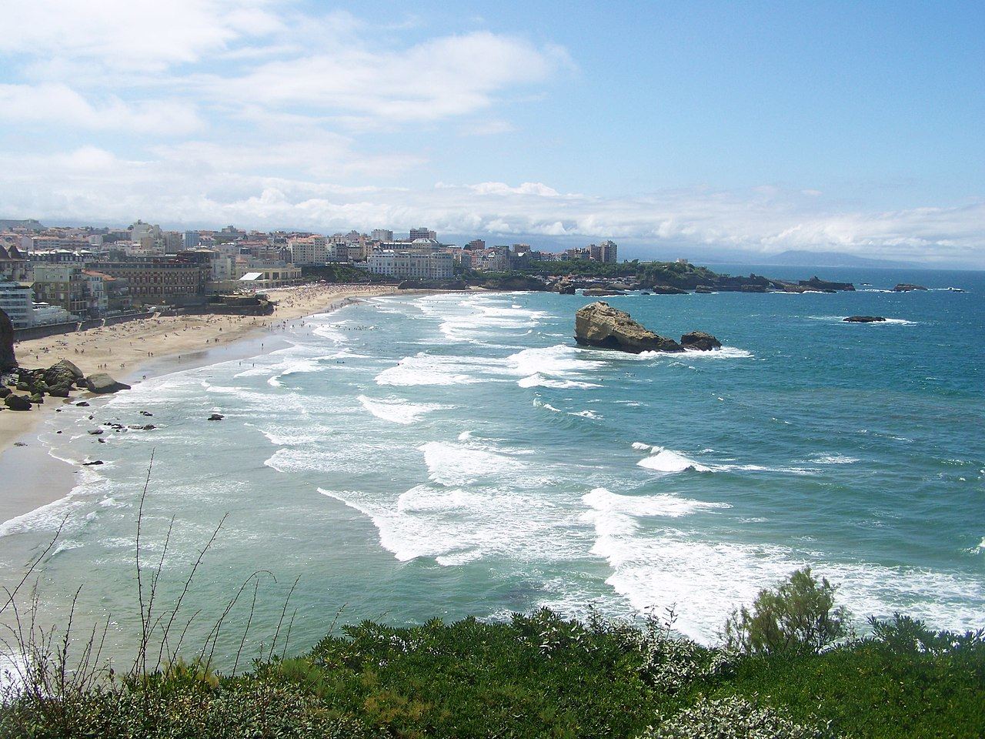
36th CEOS Plenary
The CNES team looks forward to welcoming you to Biarritz, France!
Photo: Florian Pépellin, CC-BY-SA 3.0

Slide 10
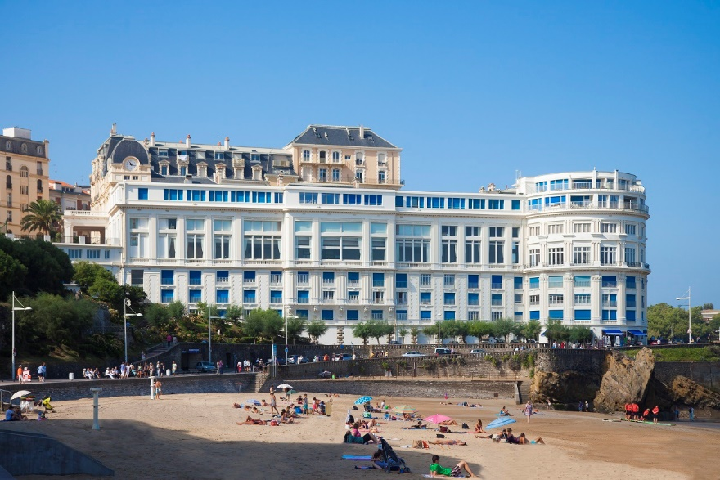
36th CEOS Plenary
The plenary will be held at the Bellevue congress centre.
The dates are 26, 27, 28 October 2022.

