Slide 1
SIT Chair 2021 Report
Alex Held & Adam Lewis SIT Co-Chairs
Agenda Item 39
2021 CEOS Plenary
Virtual Meeting
1-4 November 2021

Slide 2
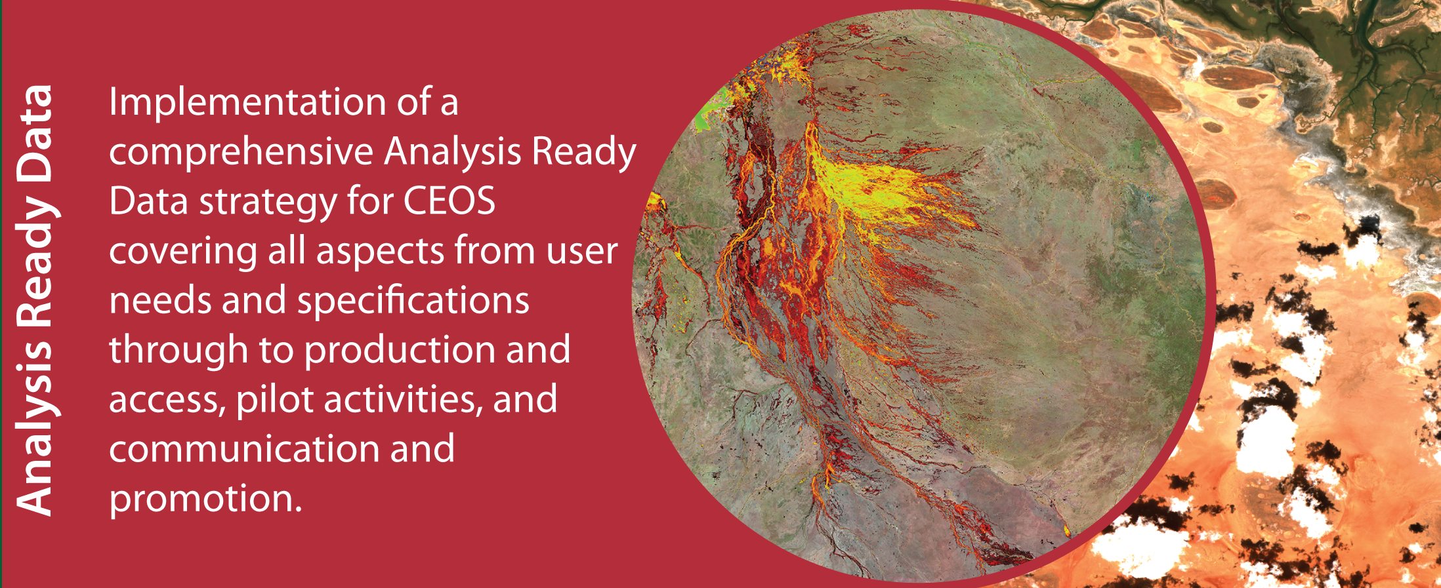
SIT Chair Term Priorities
Slide ‹#›

Slide 3
Working Teams Support
New Processes for Our Term, building on efforts of past SIT Chairs:
All-Hands calls with WGs, VCs and AHTs - agenda set by Teams
Continuity of individual calls with VC Leads - informal & frank
CEOS SEC telcon slots for VCs to report
Thank you CEOS Chairs ISRO and NASA!
Slide ‹#›

Slide 4
Working Teams Issues to Note
New thematic observations page to get a quick overview of the key observing strategies in place or development by all CEOS Working Teams: ceos.org/observations
Substantial increase in VC representation in CEOS WP deliverables - via informal calls with Leads
42 VC-xx or VC-led deliverables in Work Plan
9 CARB, 2 AG, 31 VC
28 of them created in 2020-21
Leadership and representation support provided to: AC-VC, P-VC, AFOLU team
Slide ‹#›

Slide 5
Analysis Ready Data Priority: Term Outcomes
Guided by the CEOS ARD Strategy v1.0
Great CARD4L Product Family Specification progress:
Surface Reflectance (SR)
Surface Temperature (ST)
Normalised Radar Backscatter (NRB)
Polarimetric Radar (POL)
Aquatic Reflectance PFS nearing finalisation
Interferometric and Geocoded SLC SAR in development
Nighttime Lights Surface Radiance in development
LIDAR terrain and canopy height PFS under discussion
First CARD4L Datasets: USGS Landsat Collection 2 SR & ST and ESA Sentinel-2 SR (in final assessment)
Cooperative processes established (LSI-VC & WGCV) to assess and peer-review CARD4L datasets
CEOS ARD Beyond Land: CEOS-COAST uptake of ARD, SST-VC involvement, interest for other domains
➤➤ CEOS ARD Governance Framework (Oct. 2021) & Template Generalised PFS
ceos.org/ard
Slide ‹#›

Slide 6
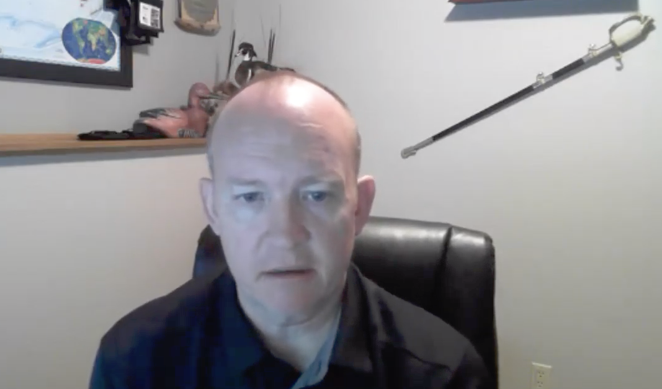
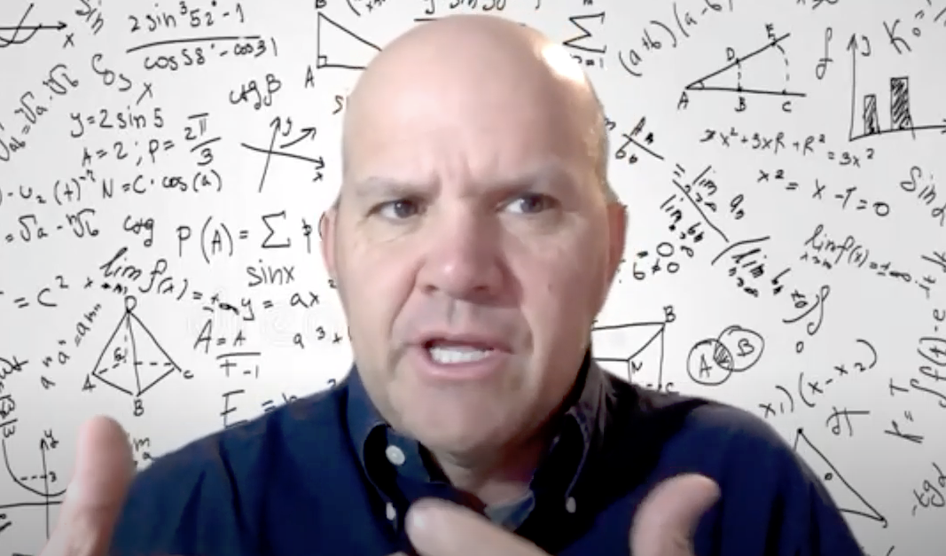
Analysis Ready Data Priority: Term Outcomes
Uptake, Utilisation, Outreach – Some Highlights
CEOS ARD Website – covering all things CEOS ARD
LSI-VC Webinars – Hundreds of live participants and viewers (#1, #2)
CEOS Analysis Ready Data: Involving the Private Sector paper
IGARSS papers and ARD sessions
Engagement on ARD Standards
Participation in OGC’s TESTBED16 ARD activity
ARD2x conferences; CARD4L representation at VH-RODA and JACIE
Planned (but postponed) commercial sector + CEOS ARD workshop
DE Africa data flows (Sentinel-2, Landsat, Sentinel-1): continental coverage of CEOS ARD (CARD4L compliant where possible), Industry is playing key roles in production (Sinergise, Element-84)
Closing term with two additional items to maintain momentum in a coordinated and unified manner:
CEOS ARD Strategy 2021
CEOS ARD Oversight Group
CEOS ARD Webinar #2 (SAR) February 1 & 2, 2021
Slide ‹#›

Slide 7
Analysis Ready Data Priority: Term Outcomes
< Link to CEOS ARD Plenary Video (to be viewed offline) >
Slide ‹#›

Slide 8
Carbon & Biomass Priority: Term Outcomes
Deepened engagement with UNFCCC SEC:
participation of UNFCCC SEC in TW 2020 and TW 2021
focal points established for the Systematic Observations group for the Global Stocktake
leadership on synthesis report for Systematic Observations for GST
New engagement with national inventory users
Country outreach and feedback through AFOLU Roadmap
Building on GFOI experience, thanks to USGS/SilvaCarbon
SIT-led Study Team explored the need for a CEOS-wide strategy for CEOS support to the GST Process for the UNFCCC Paris Climate Agreement
SIT Vice-Chair led development of a Strategy Paper for CEOS to guide and track our activity
Productive engagement at TW 2020 and TW 2021 with GCOS on their requirements process and key document updates
Slide ‹#›

Slide 9
Carbon & Biomass Priority: Term Outcomes
March 2020 CEOS Biomass Workshop in Canberra (face to face!)
progressed the CEOS Biomass Protocol
challenged the LPV team to develop the Forest Biomass Reference Network proposal
which led to the GEO-TREES initiative
Publication of the CEOS Biomass Protocol by WGCV LPV
endorsement at SIT-36
GHG & AFOLU Roadmaps progressed during 2020 & 2021
Prototype GHG inventory products published ahead of COP-26
Available AFOLU datasets published ahead of COP-26 (harmonised products were attempted but insufficient time)
CEOS GST Portal developed as a collaboration between SIT & CEOS Chair Teams and the GHG & AFOLU dataset teams (thanks!)
GHG-AFOLU integration discussion started
Full AFOLU Roadmap development in planning
Slide ‹#›

Slide 10
Carbon & Biomass Priority: Term Outcomes
ceos.org/gst
English/French/Spanish
Single point of entry for multiple GHG & AFOLU datasets for countries
Will be maintained as new & harmonised datasets emerge
Slide ‹#›

Slide 11
Carbon & Biomass Priority: Continuity!
GHG & AFOLU Roadmaps
GHG-AFOLU integration discussion started: JRC Workshop
Full AFOLU Roadmap development in planning - NASA (Ben Poulter) stepping up to support as co-lead of team with ESA & JAXA
New geometries with New Space
International Methane Emissions Observatory (IMEO) invited to TW 2021
Excellent presentation by UNEP & GHGSat highlighted opportunities for CEOS to engage in new geometries
Baton passed to ESA to follow up - identified priority for their term
GEO-TREES & Biomass Protocol
Identified priority for CNES as CEOS Chair
CEOS GST Strategy
SIT Chair identified as having oversight
Identified priority for ESA
David Crisp (GHG) retires at end 2021 - a huge thank you!
Slide ‹#›

Slide 12
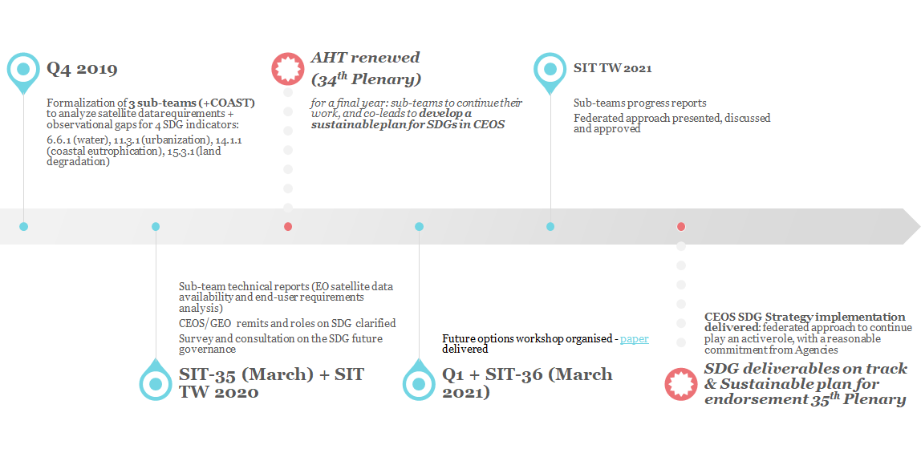
SDGs Priority: Term Outcomes - Summary
Updates on the SDG AHT work: https://ceos.org/ourwork/ad-hoc-teams/sustainable-development-goals/meetings-events/
Slide ‹#›

Slide 13
SDGs Priority: Term Outcomes - Summary
Sub-Team model was exercised with three sub-teams (plus COAST) completing or progressing 11 deliverables - reported under Item 23
Sustainable governance approach developed through the meetings since SIT-35, culminating in the decisions taken at this Plenary:
SDG AHT to be dismantled
Approval of the Federated Approach to continue SDG work
Federated Approach allows CEOS to continue play an active and visible role in the 2030 Agenda on Sustainable Development, including supporting GEO, while taking account current CEOS resources
CEOS SDG Strategy to be led by the SIT Chair
CEOS SDG Implementation to be led by the SEO with a small core SDG Coordination group focused on ensuring SDG deliverables are completed by deliverable teams
Strategy Implementation to be endorsed for the federated approach to be implemented
Slide ‹#›

Slide 14
Strategy Implementation overview

Slide 15
SIT Meetings & Workshops
SIT-35, March 2020: Hobart, Australia => late change to GTM, 3 days
SIT-TW-2020, Sep 2020: Zagreb, Croatia => GTM, 6 days
SIT-36, March 2021: Sydney, Australia => GTM, 3 days
SIT-TW-2021, Sep 2021: Tokyo, Japan => GTM, 3 days plus side meetings prior
Slide ‹#›

Slide 16
Thank you to the entire community!
… over to ESA!
Slide ‹#›

