Slide 1
SST-VC
Christo Whittle and
Ed Armstrong, SST-VC
Conference Agenda Item 36
2021 CEOS Plenary Virtual Meeting
1-4 November 2021

Slide 2











SST-VC Members

Slide 3
SST-VC Highlights…
Collaboration on the development of the ARD Product Family Specification Template and the CEOS ARD Framework Governance with CEOS-SIT and other CEOS VC members.
ESA and SANSA has collaborated to provide an ISAR for deployment during the BENFLEX cruise in the southern Benguela during December 2021
ESA extended FRM4SST funding and support to conduct CEOS shipborne radiometer intercalibration workshop and maintain FRM activities.
EUMETSAT indicated a planned release of a demonstration SLSTR sea-IST product for 2021 and expanding the release of TRUSTED drifting buoys to 150 by end 2021.
KMA developed a new air-sea temperature difference product.
Production of gap-free high-frequency model SST data (with assimilated satellite SST) around Japan with 3km/1hr resolution operationally by JAXA.
ISRO produced a new algorithm for SST retrieval from INSAT-3D/3DR based on the 1DVAR technique.
Slide 3

Slide 4
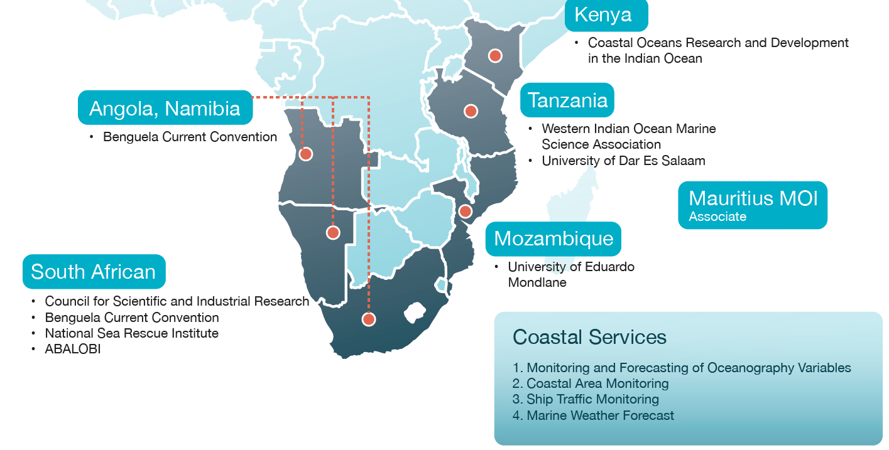
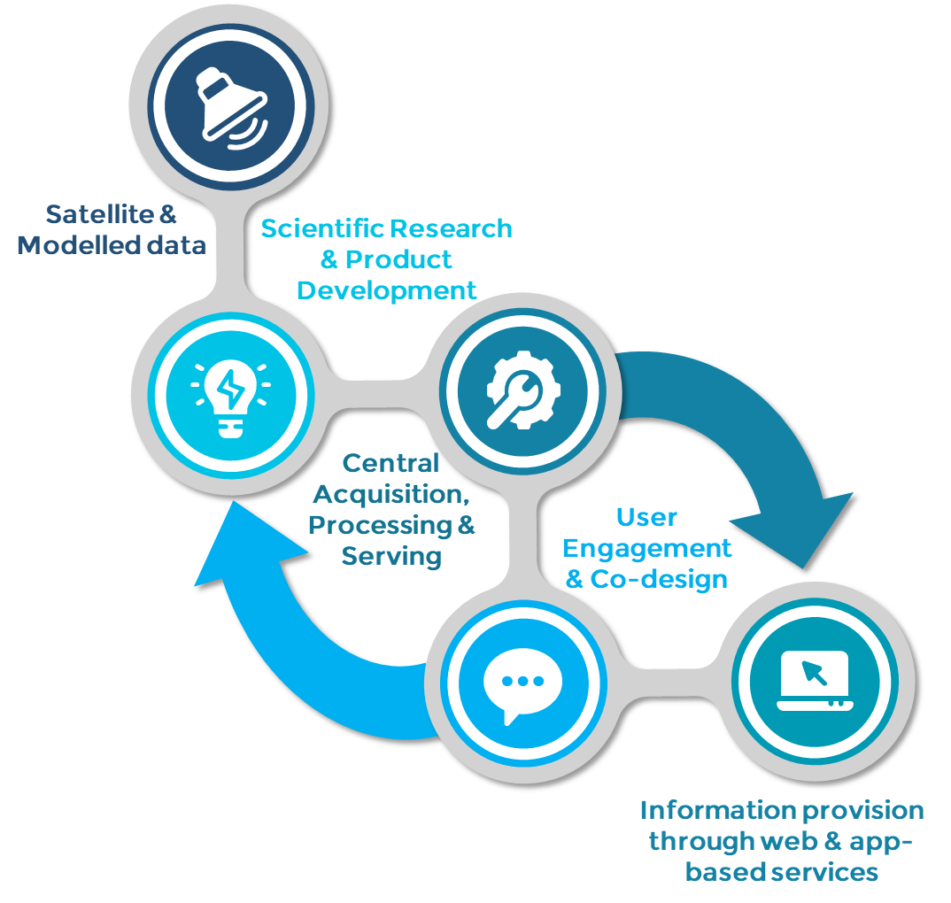



EO for decision support…
Earth observation, model and reanalysis data used to develop decision support tools…
Distributed via South Africa’s National Oceans and Coastal Information Management System…
Regional expansion of services in GMES & Africa Initiative: “Africa Marine and Coastal Operations for Southern Africa” - MarCOSouth

Slide 5
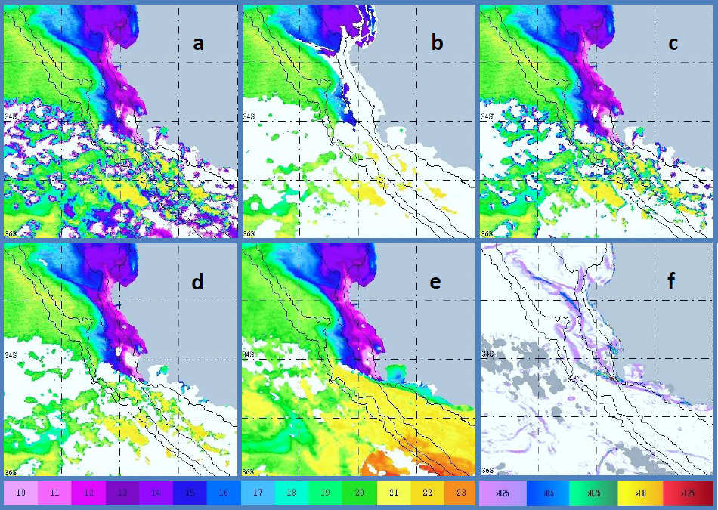
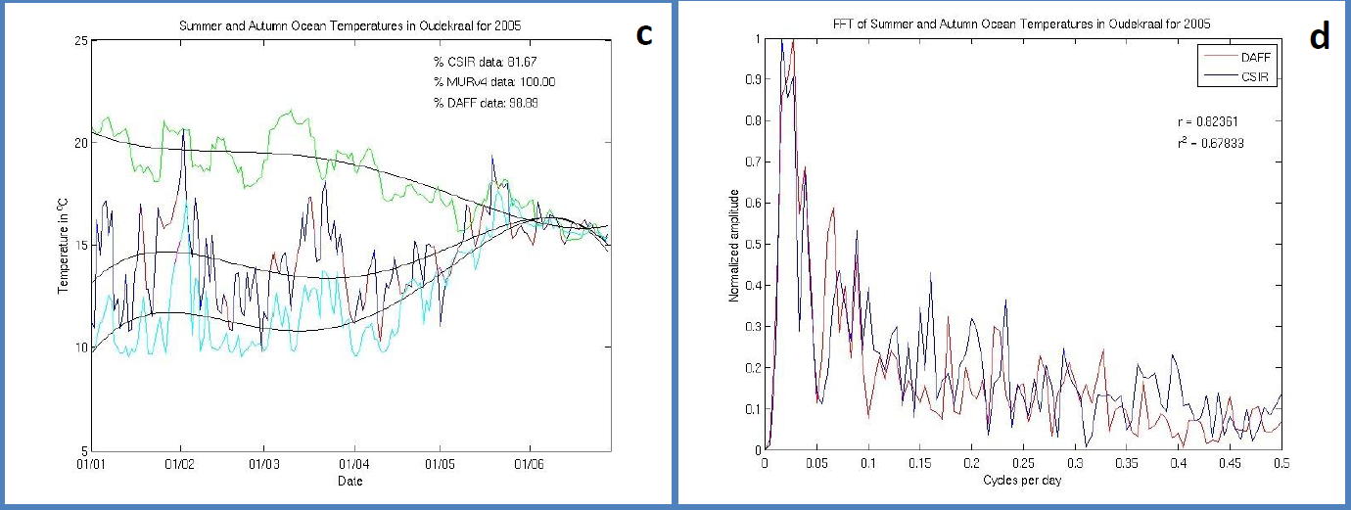
Product R&D: MODIS SST
L4 SST products are compromised by erroneous flagging of suspected cloud pixels on IR observations…
And a reliance upon interpolation schemes to fill missing values near the coast in the presence of strong gradients…
Standard cloud flagging options inadequate…
Develop regional cloud flagging algorithm and create daiy averages from both MODIS sensors…
Validate regional product against GHRSST MUR and in situ data…
SLSTR SST to be included to improve product and extend time-series continuity…

Slide 6
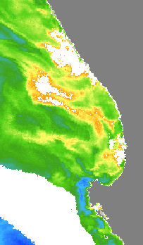
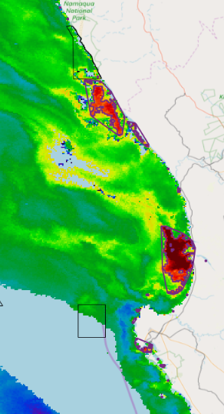
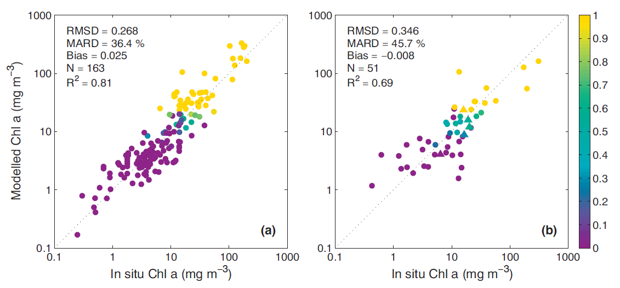
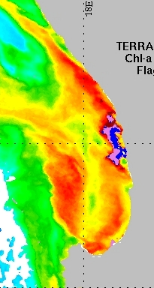
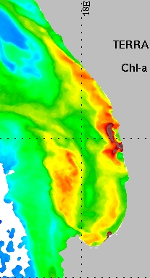
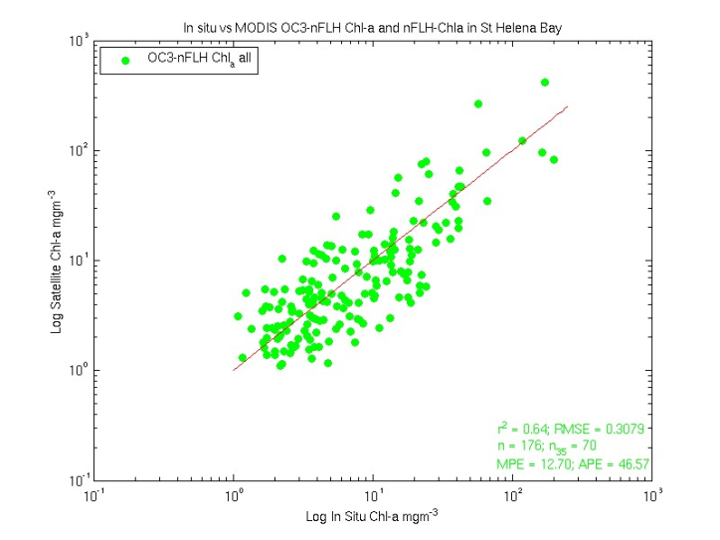
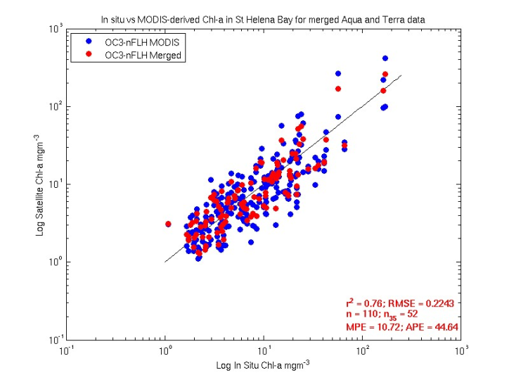
Product R&D: MODIS & OLCI Chla
Standard Chl-a product
Regional Chl-a product
OLCI
OLCI
MERIS/OLCI/MODIS empirical blue-green algorithm fails at high biomass…
For MERIS/OLCI red-nir band-ratio algorithm works best for high biomass…
Developed regional MERIS/OLCI Chla switching algorithm…
For MODIS nFLH correlated with Chla through power function…
Developed regional MODIS Chla-nFLH switching algorithm…
Validate regional Chla products against in situ data…
MODIS
MODIS

Slide 7
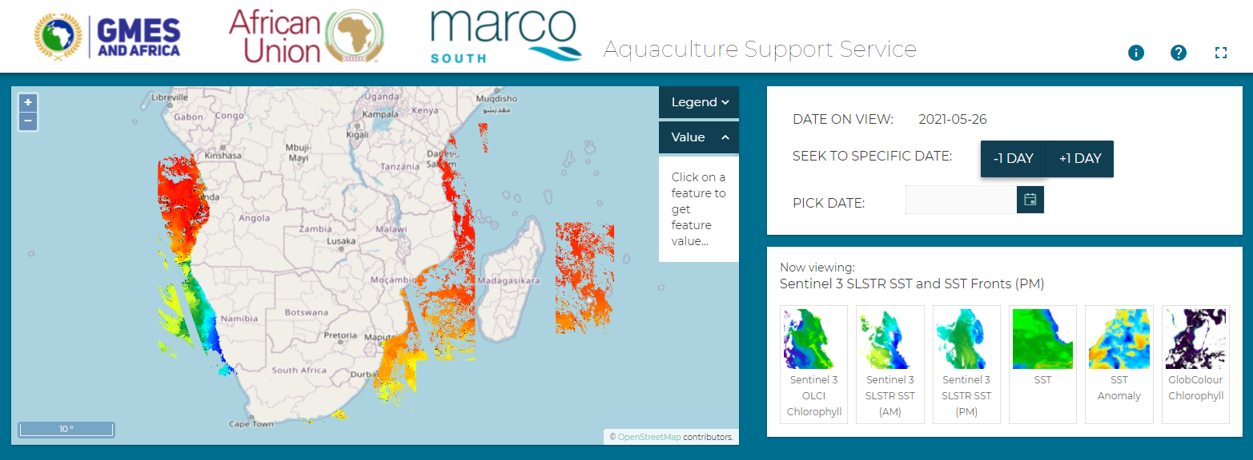
Support service dissemination…
Date selector
Product selector
Product viewer

Slide 8
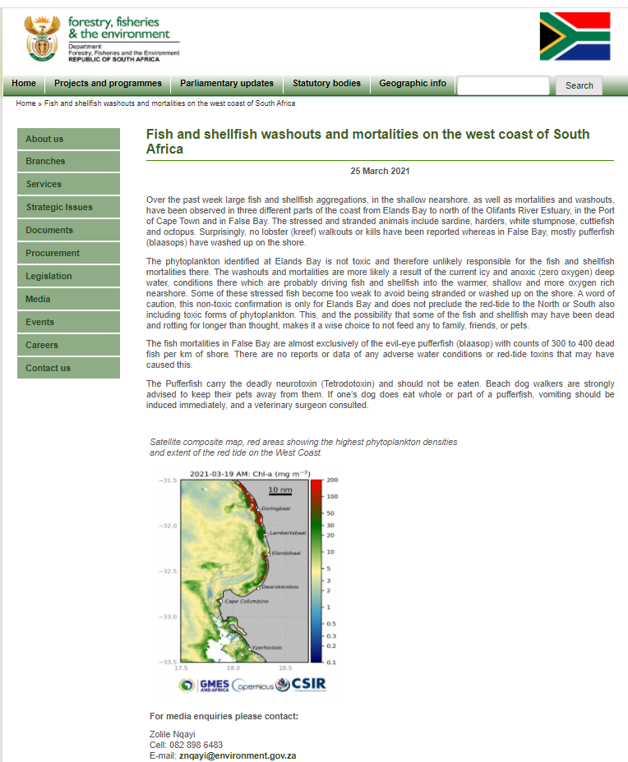
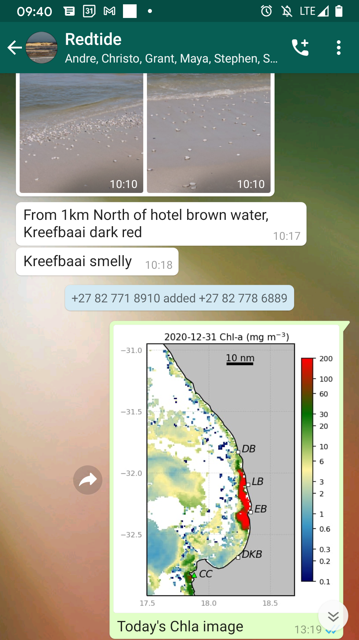
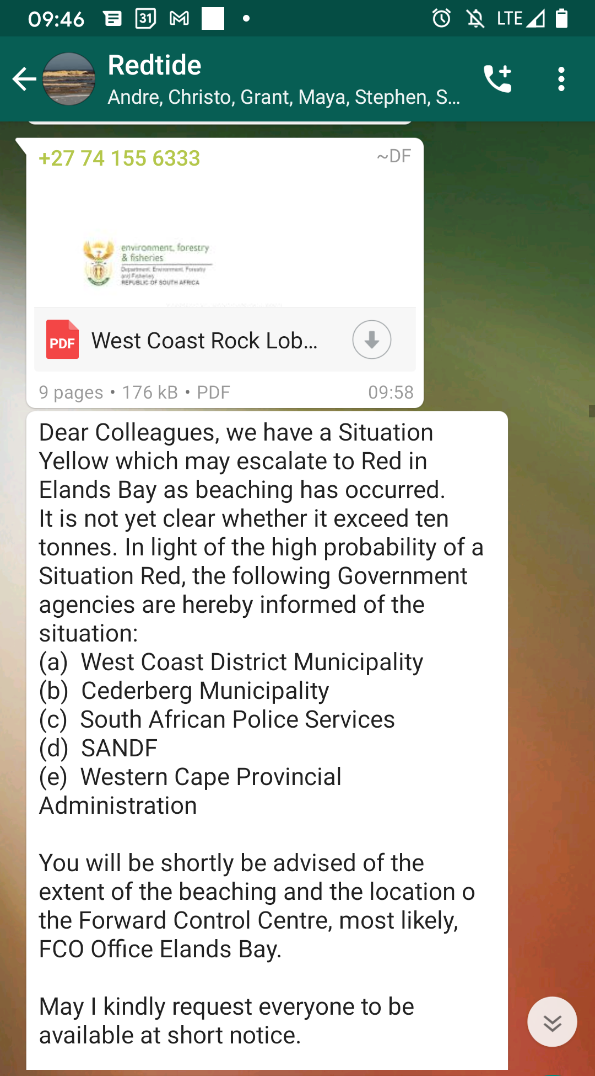
Decision support service impact…
These satellite products are frequently used to guide government, municipal and industry response to potential HABs in South Africa
Municipalities, DFFE, Police and defense force had a 2 week lead time to prepare for an impending Rock Lobster Walk-out event
Quick response: half a ton of live lobster were picked up and relocated to a redtide-free area

Slide 9
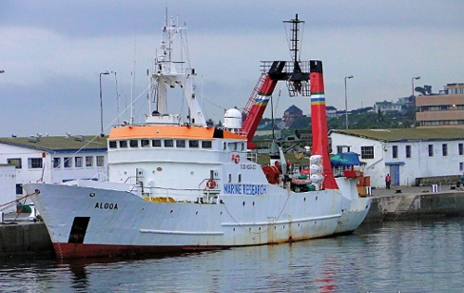
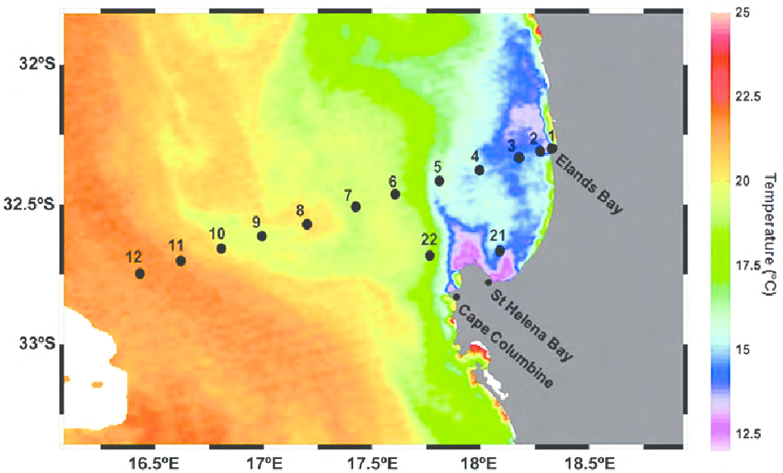
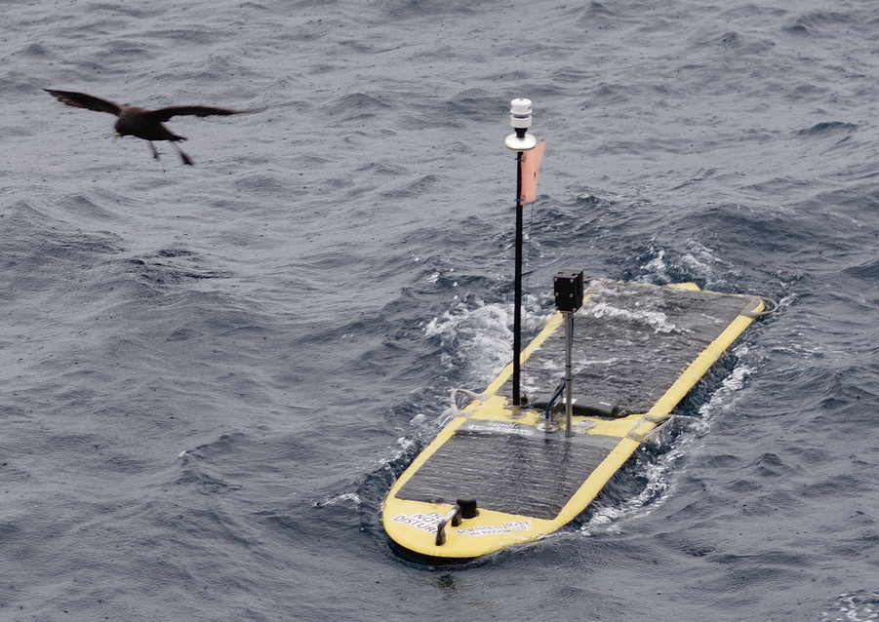
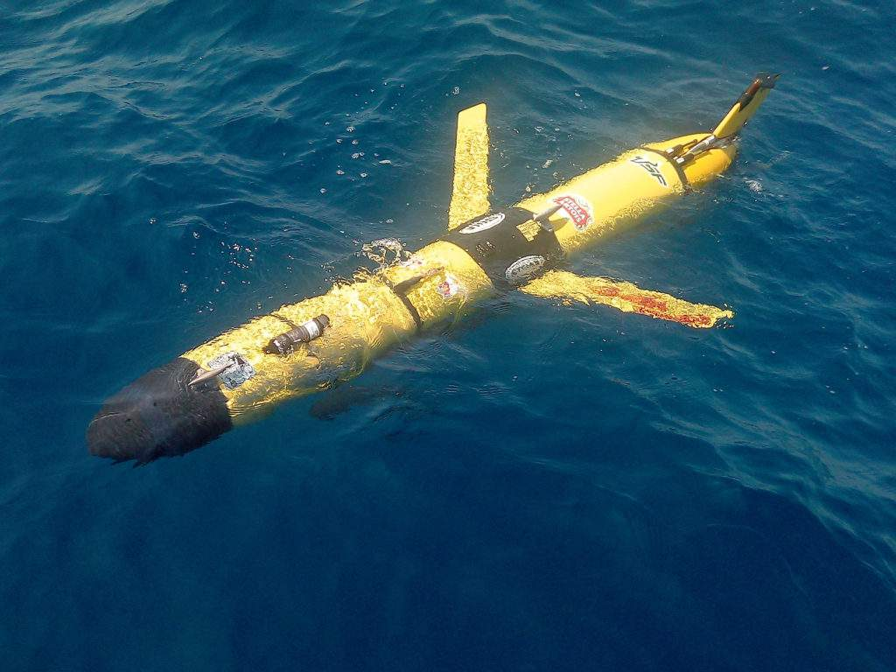
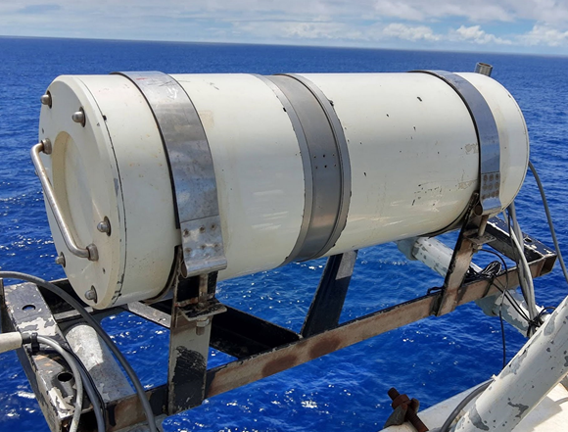

Inter-agency collaboration… BENFLEX
Benguela Flux Experiment – BENFLEX scheduled for December 2021
Hypothesis: Small differences between the skin, foundation and bulk temperatures are causing an underestimation of the air-sea flux of CO2
ESA and SANSA collaborated to secure an ISAR instrument to contribute skin SST measurements for BENFLEX
Southern Ocean Carbon and Climate Observatory (SOCCO) Research Group of CSIR is science lead
Examine the role of the ocean “cool skin” on the air-sea flux of CO2 through top-down Eddy Co-Variance and bottom-up in situ observations
Integrated ship-glider experimental approach

Slide 10
Current and future activities…
Extend regional MODIS EO products to the present.
Ingestion of regional EO products into a marine data cube to facilitate time-series metrics for decision support.
Validate SST on Benguela shelf from 3 hydrodynamic models (BRAN, GLORYS and NGHYCOM)
Participate in BENFLEX during December 2021.
Collaborate with COVERAGE to include regional Benguela EO products as a test case.

Slide 11
A Note On Timing
We are aware that the agenda puts tight time limits on presentation slots.
These limits are in large part due to the limitations of the virtual format and vast time zone differentials across CEOS
As with past CEOS meetings, we ask presenters to keep their messaging focused; to consider what decisions or critical information needs to be communicated to Principals; and to make use of pre-reading, parallel ‘slide browsing’, backup slides, reference documents and other materials (like video for pre- or post-watch) to the extent possible
We’re all learning how to make the most of this virtual environment!
Slide 11

Slide 12
Presenter Guidelines 1
Presenters should name their file using the following convention:
  AgendaItemNumber_LastName_Subject_Version (e.g., 1.1_Ross_Protocols_v2)
Please send all documents and presentations to: matthew@symbioscomms.com
  Documents for endorsement should be submitted by 18 October
  Documents for information should be submitted by 25 October
  Presentations should be submitted by 25 October
Reporting to engage discussion or decision is encouraged, but detailed reporting should be provided as pre-meeting reading material or in background slides.
Slide 12

Slide 13
Presenter Guidelines 2
Please explicitly highlight the decisions, outcomes, or actions you are seeking. The more explicit you are, the better. i.e., feel free to provide text for a proposed action – it may be revised later, but this approach will help with the efficient preparation of the actions record of the CEOS Plenary.
Where relevant and possible, presenters are invited to highlight for the CEOS community, and especially for CEOS Principals and stakeholders, significant milestones and key accomplishments. Please speak to linkages between the Implementation Plan that the 2021 CEOS Chair, NASA, developed with input from the CEOS community on the theme, “Space-based Earth Observation Data for Open Science and Decision Support”, and its elements of data accessibility, transparency, and reproducibility.
Slide 13

