Slide 1
Ocean Surface Topography Virtual Constellation OST-VC
Annick Sylvestre-Baron, CNES
Estelle Obligis, EUMETSAT
Conference Agenda Item 34
2021 CEOS Plenary
Virtual Meeting
1-4 November 2021s

Slide 2
OVERVIEW
The Ocean Surface Topography Virtual Constellation (OST-VC) main goal is to implement a sustained, systematic capability to observe the surface topography of global oceans from the basin scale to the mesoscale
Co-chairs
Annick Sylvestre-Baron (CNES)
Estelle Obligis (EUMETSAT)
Other members
Craig Donlon (ESA) also OSTST project scientist
Eric Leuliette (NOAA) also OSTST project scientist
Gregg Jacobs (US Navy)
Kai Matsui (JAXA)
Nadya Vinogradova (NASA)
Rashmi Sharma (ISRO)
CNSA – A new CNSA representative to be nominated

Slide 3
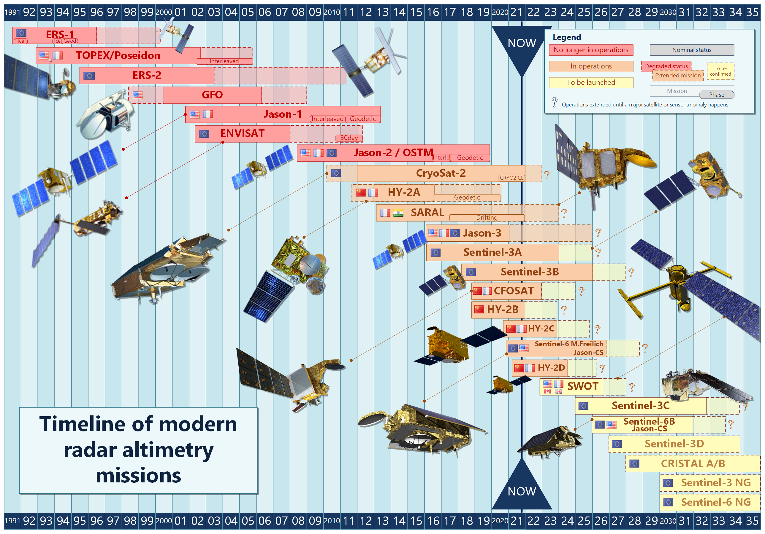
OST-VC missions timeline
2021 updates
SARAL: Extension for 2 more years
in drifting phase
data still useful for oceanographic (operational wave modeling, mesoscale studies) and geodetic applications
Jason-3: Extension for 5 more years
HY2-D: Launched in May 2020
SWOT Launch date: Nov 2022

Slide 4
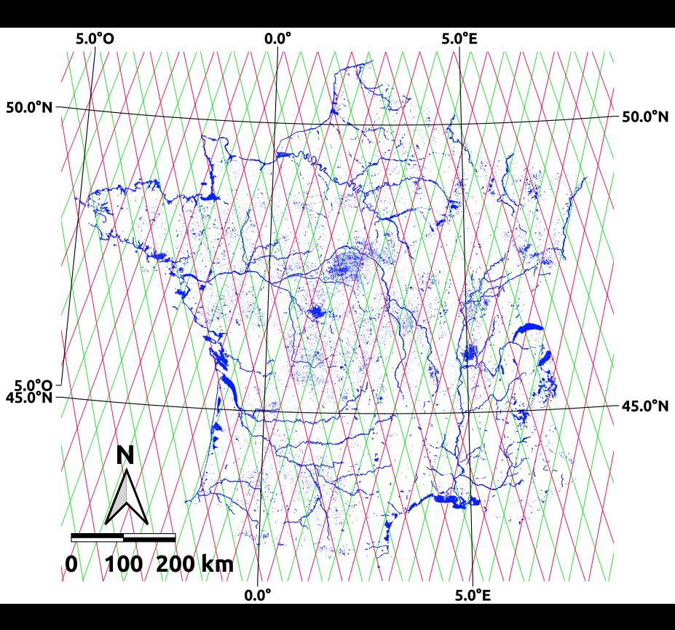
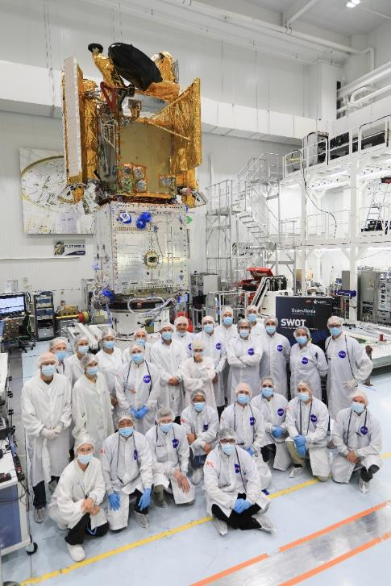
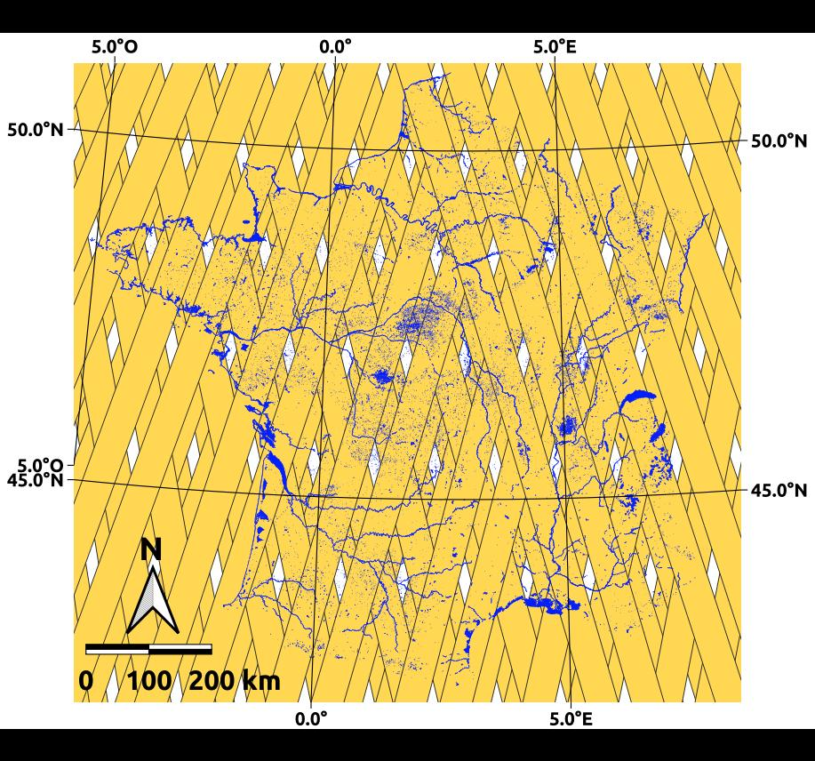
SWOT NASA/CNES/CSA/UKSA
S3-A & S3B (27 days)
Launch: Nov 2022
1st wide swath altimeter (Karin)
Highly expected by ocean, hydrology and coastal scientists and users
International Science Team
56 projects – 137 ST members from 26 international organizations based in 17 countries involved
Despite worldwide sanitary crisis, major critical milestones were reached
SWOT mission is on track to be launched in Nov 2022
©JPL
SWOT (21 days)
©JPL

Slide 5
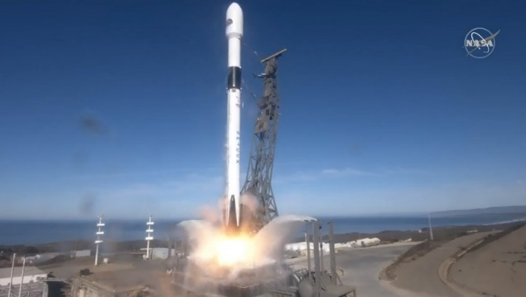
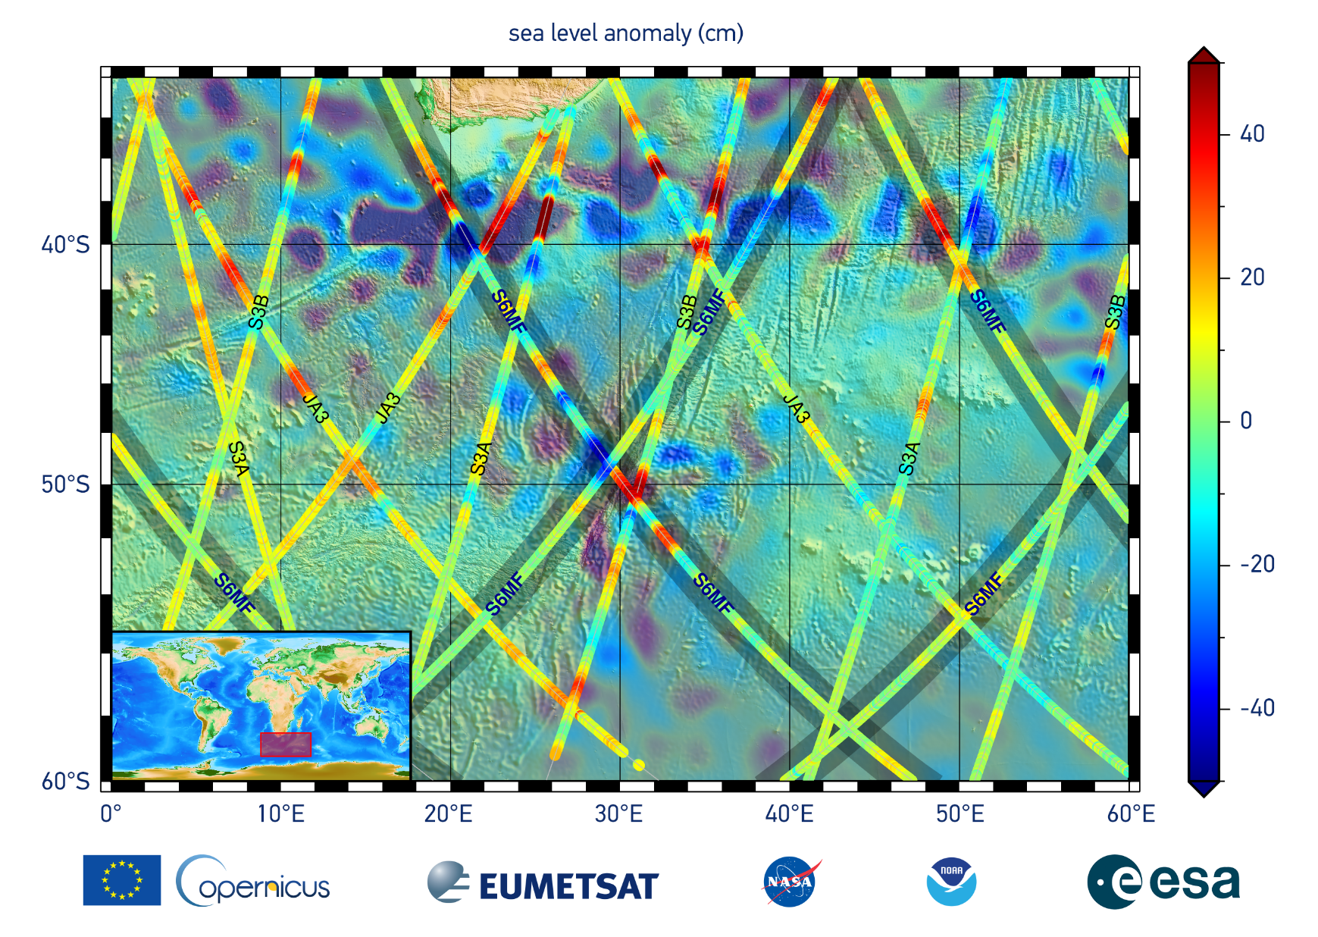
Sentinel-6 Michael Freilich EUM/ESA/NASA/NOAA/CNES
Launch
21 Nov 2020 from Vandenberg, California
SpaceX Falcon 9 (same as Jason-3 on 17 Jan 2016)
Current status
The satellite platform is performing nominally
The instruments (POS-4, AMR, HRMR, DORIS) are performing nominally
Detection of persistent High Power Amplifier (HPA) output power decrease (present in all altimeters but more severe in S6A) → Switch to POS-4 side B to maintain the long-term continuity of the GMSL record
Operational release of all L2 products – early December 2021
Estimated completion of POS-4 Side B commissioning activities – February 2022
JSG meeting to establish Sentinel-6 as reference mission – March 2022
Recurrent S-6 B satellite ready for environmental testing, planned launch in November 2025

Slide 6
Copernicus Altimetry Constellation
Mission Requirements developed at ESA (endorsed by Mission Advisory Group) based on EC user needs
Primary Mission Objective to Guarantee Continuity of Sentinel-3 and Sentinel-6 topography variables (SSH, Hs, σ0, Wind)
Primary Mission Objective to enhance both time and space sampling
Primary Mission Objective to measure hydrology targets
Foresee potential enhancements for other aspects depending on mission design concepts
S3 Topography Next Generation elements
Will provide enhanced continuity of the Sentinel-3 topography component in +2030
ESA Phase 0 complete and ESA Phase A/B1 study has started
Requests early concept down-selection between a constellation of small satellite nadir altimeters, swath altimetry or hybrid of both approaches.
S6 NG Next Generation elements
Will provide enhanced continuity of the Sentinel-6 reference mission in +2030
ESA study in progress to assess End-to-End Sentinel-6 sea level stability uncertainty budget
CRISTAL elements
Will satisfy user needs in the polar sea ice, ice sheets and oceans (better understanding of climate processes and support to climate applications and maritime operations)

Slide 7
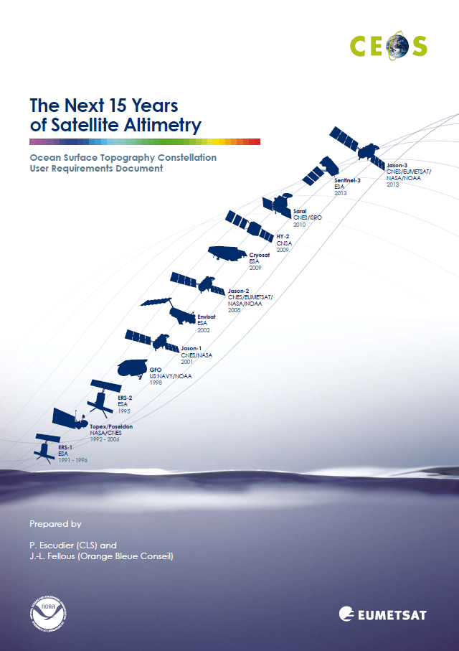
OST-VC white paper status
Action from 2019 SIT meeting to update of the “Next 15 years of altimetry – OST Constellation User Requirement Document”, 2009.
Integrate new user needs from recent books and white papers from the community
Delivery of the white paper was expected Q1 2022
BUT many constraints (new missions, OSTST renewal, covid impacts…) overloaded altimetry community during last two years
New schedule
OST-VC members meeting during OSTST (next March)
Final Delivery in Q1 2023

