Slide 1
LSI-VC
Steve Labahn, USGS
LSI-VC Co-Lead
Agenda Item #31
2021 CEOS Plenary
1-4 November 2021

Slide 2
Some updates...
Leadership changes
Welcome Peter Strobl (European Commission) and Jonathon Ross (GA) as Co-Leads
Andreia Siqueira will take on the Co-Lead role for GA soon
Farewell to Adam Lewis (GA) as a Co-Lead
Farewell to Zolti Szantoi (European Commission) as a Co-Lead

Slide 3
CARD4L
CEOS ARD for Land (CARD4L) remains a core focus for LSI-VC (https://ceos.org/ard/)
CARD4L is clearly aligned with the “Space-based Earth Observation Data for Open Science and Decision Support” theme of the CEOS Chair
Data accessibility, transparency, and reproducibility
Examples in action: Digital Earth Africa – a GEO Initiative, COAST/EAIL, OGC Disasters Pilot
Great progress on CARD4L PFS and assessments (thanks to WGCV and Medhavy Thankappan)
Recently refreshed two SAR CARD4L Product Family Specifications (PFSs)
Developing Aquatic Reflectance, Nighttime Light Surface Radiance, additional radar, and LiDAR PFSs
Agency reach increasing: KARI, DLR, CSIRO, ISRO, and SANSA all undertaking / planning product assessments – in addition to JAXA, ESA, USGS
Various private sector assessments against CARD4L ongoing: LSI-VC involved in ARD21, JACIE, VH-RODA
EO ARD gaining traction globally – CEOS has been a leader in this space and is influencing broadly
Request for CEOS Principals: we encourage all CEOS Agencies to be involved!

Slide 4
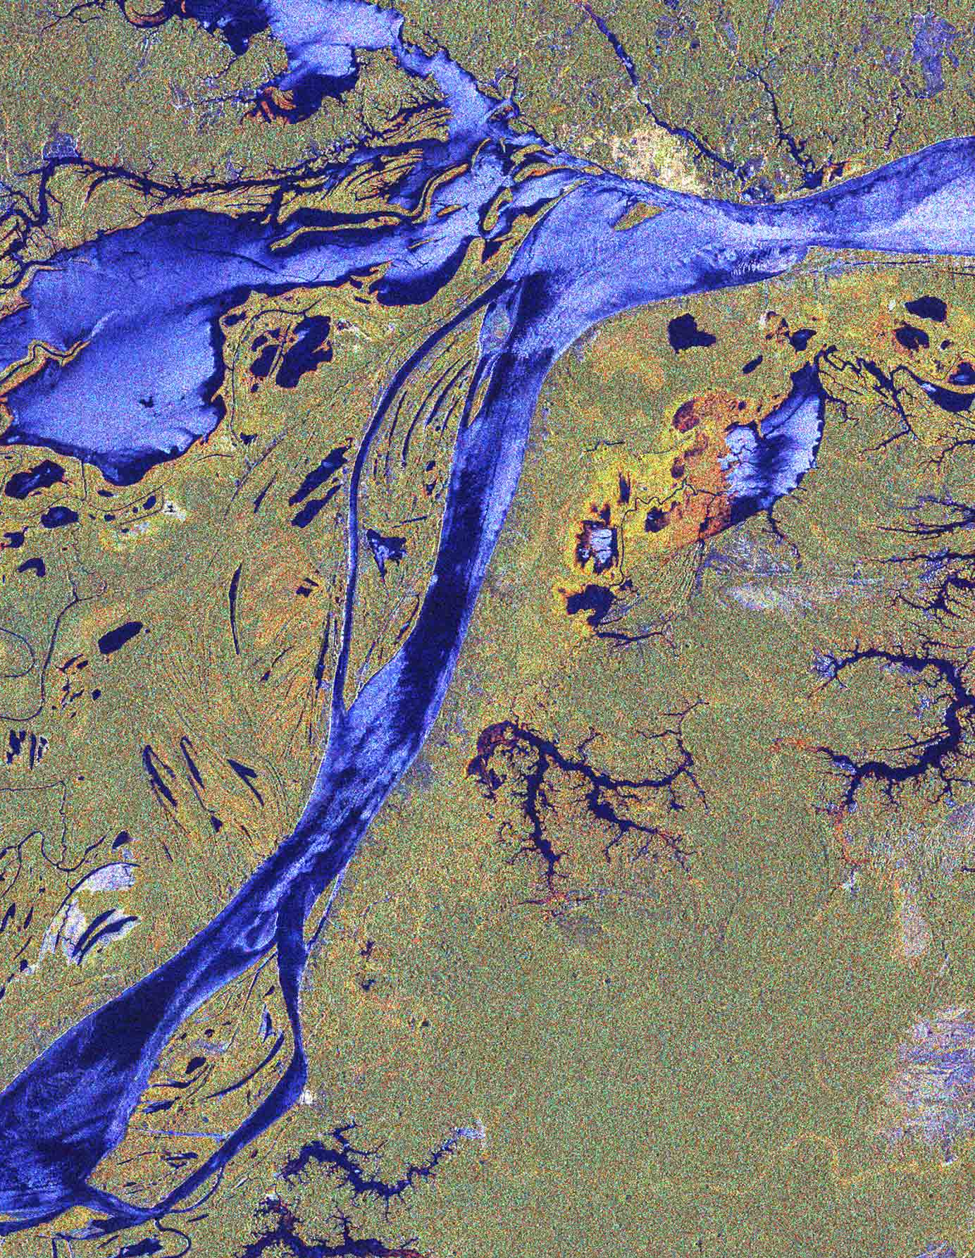
CEOS ARD
LSI-VC welcomes and encourages CEOS endorsement of the:
CEOS ARD Governance Framework – to formalise processes and expand effort on ARD Beyond Land.
CEOS ARD Strategy 2021 – to provide the strategic guidance needed to move us forward together.
LSI-VC supports the:
Template PFS – which will serve as a great basis for our future land-focused PFS, as well as for other domains / VCs.
CEOS ARD Oversight Group – which will provide a forum for the VCs to come together and discuss topics around CEOS ARD, and provide the coordination needed to ensure CEOS ARD is coherently represented in the broader (rapidly moving!) community.

Slide 5
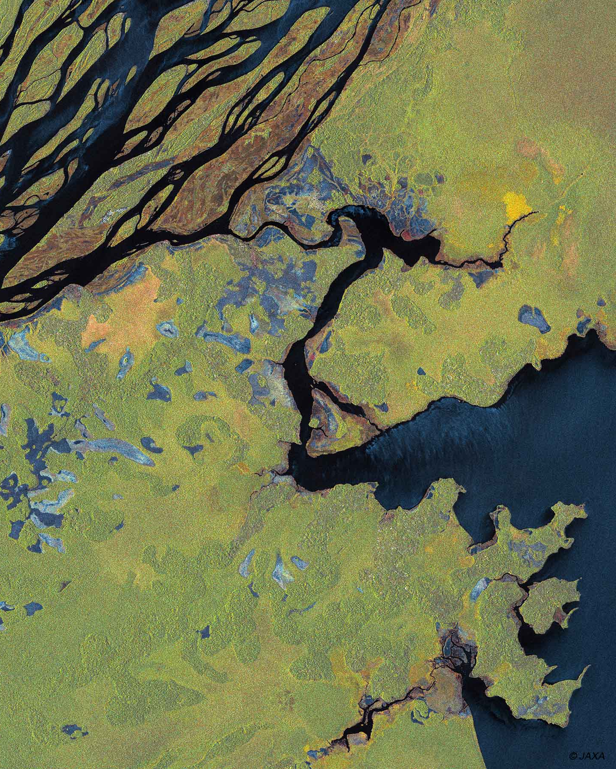
Other updates
Continue assessment of land observation gaps and requirements, application and development of CEOS tools (MIM, COVE)
Pursue interoperability topics, including data formats (COG, STAC, metadata), related standards, and liaise with other VCs
Explore global grid solutions (such as DGGS) with the goal to reach convergence and community acceptance
LSI-VC Subgroups: Forests & Biomass and GEOGLAM – updates to follow...

Slide 6
LSI-VC Forests & Biomass Subgroup
AFOLU Roadmap strong focus for 2021 – targeting initial products for COP26/GST1
CEOS GST Strategy development and the GST Portal
Exploring national pilot with DE Africa to bring together all the land-related datasets that CEOS is compiling for the first UNFCCC Global Stocktake in 2023
2022 focus on AFOLU Roadmap development
Harmonised biomass and land cover products
GHG-AFOLU integration
NASA/Ben Poulter joining as Co-Lead with ESA and JAXA

Slide 7
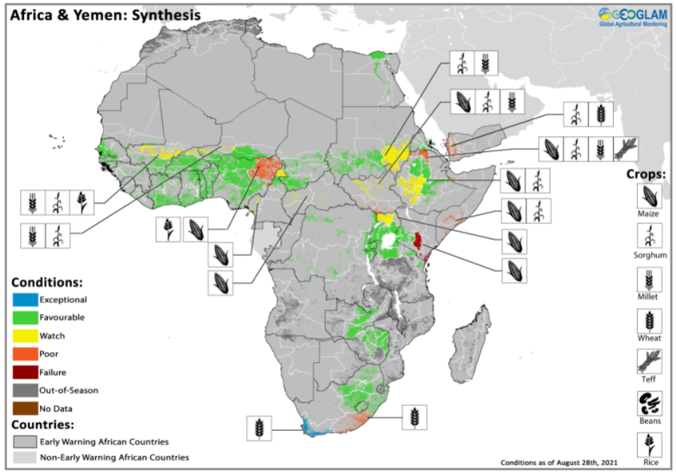
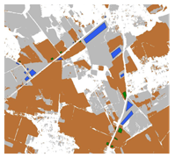
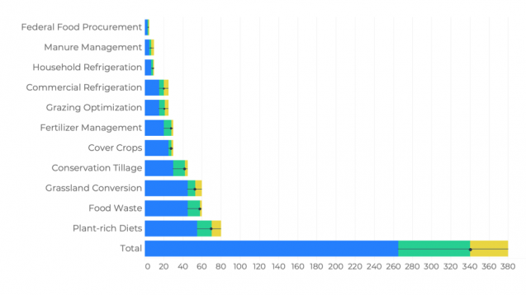
LSI-VC GEOGLAM Subgroup
CEOS Priorities
Societal Impact
GEOGLAM Priorities
Open Science and
Decision Support
Analysis Ready Data
Land Product Validation
CEOS & Global Agendas
AFOLU
GST
NDC’s
SDG’s
Capacity (co)Development
Policy and Program Decision Support
In Situ Data
Cal/Val
Product Intercomparison
Essential Agriculture Variables
Nationally Determined
Contributions
EAV Support
Notes:
GEOGLAM and CEOS priorities are closely aligned
Open science and co-development of agricultural monitoring systems that derive essential variables at the national level support early warning, NDC’s and helps to address the SDG’s
GEOGLAM has a new initiative to better coordinate in situ data and develop product intercomparison best practices, building on work of CEOS LPV.
Improved in situ data supports the development of priority datasets that address the EAV’s
Essential variables are supported by ARD, LPV and open data access
Our communities are working together to address several major policy drivers

Slide 8
Analysis Ready Data Priority: Term Outcomes
CEOS ARD Plenary Video: https://youtu.be/PsIHHMq-1Gk
Slide ‹#›

