Slide 1
CEOS Analysis Ready Data
SIT Chair Team,
LSI-VC, SST-VC
Agenda Item #30
2021 CEOS Plenary
1-4 November 2021

Slide 2
Agenda
Background
CEOS ARD Governance Framework
Template for PFS
CEOS Analysis Ready Data Strategy 2021
AOB and Actions

Slide 3
CEOS ARD Story So Far...
Initially (2016-2019) lead by LSI-VC
CARD4L Definition
Product Family Specifications
Assessment Procedure
WGCV Peer Assessment
Product assessments
Advisory Notes
‘Framework’ was never formally defined end-to-end
ceos.org/ard
Branding
Various outreach activities, conferences, meetings
Webinars
Interoperability considerations

Slide 4
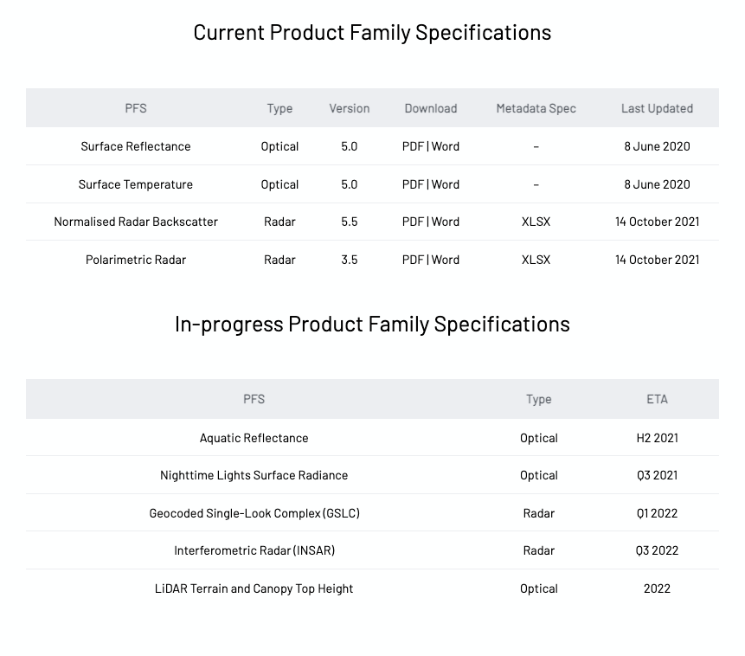

Slide 5
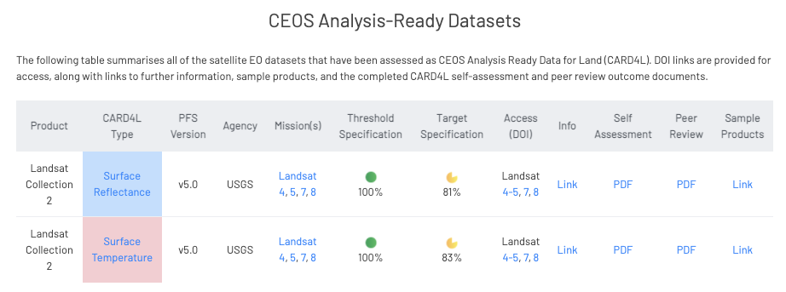
CARD4L – Current and Under Review

Slide 6
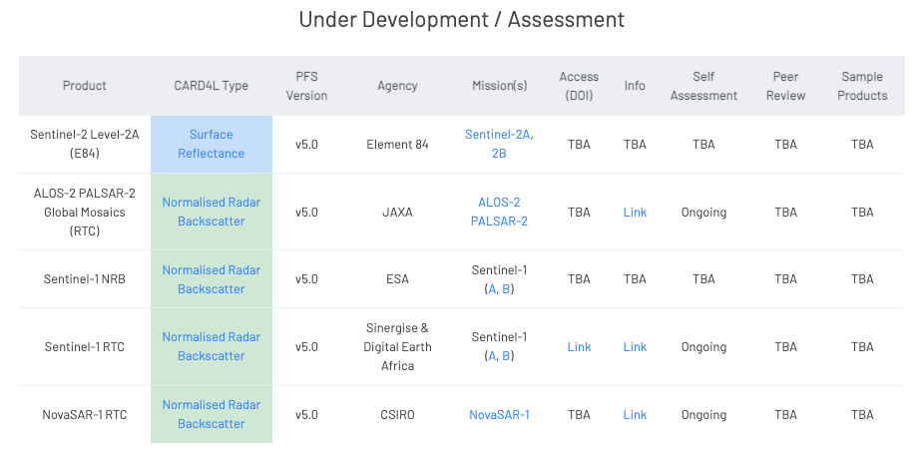
CARD4L – Under Development / Self-Assessment

Slide 7
Now...
CEOS Analysis Ready Data Framework is now broadened to be ‘beyond land’.
Governance framework for CEOS Analysis Ready Data (ARD)
formalise the process LSI-VC has used for CARD4L and exploring the specifics of this broadened CEOS ARD concept.
Framework accompanied by a generalised template for Product Family Specifications that is designed for a broader audience and to minimise confusion as new groups seek to develop specifications.

Slide 8
CEOS Analysis Ready Data Governance Framework
From SIT Technical Workshop:
SIT-TW-2021-01 | Feedback from CEOS Agencies was invited on the Draft Governance Framework for CEOS Analysis Ready Data (ARD) and the accompanying template PFS via email before both documents are finalised and presented for potential endorsement by the 2021 CEOS Plenary.
Thanks to various contributors for their input, including AC-VC, COAST, P-VC, LSI-VC, SST-VC, and many others!
8-9 telecons since Jan 2021 on CEOS ARD framework or PFS barebones subjects
The framework document is presented for endorsement.
The template PFS is presented for information.

Slide 9
CEOS ARD Oversight Group
SIT-TW-2021-02: Nominations were requested to ensure robust support for a CEOS ARD Oversight Group
Identified as a core component of the future CEOS ARD Governance Framework.
Act as a forum for all matters related to CEOS ARD.
Representatives from the CEOS Virtual Constellations are integral to the effort going forward, as these are the CEOS entities with the technical expertise to recommend, develop and maintain Product Family Specifications.
The SIT Chair Team and CEOS Executive Officer have also been identified as key participants.
Also provide:
Strong coordination across CEOS
Promote CEOS ARD in a unified way
Nominations to the CEOS ARD Oversight Group are welcomed today as well as at any point following the meeting

Slide 10
Framework/Template PFS: Some Key Points...
CEOS Virtual Constellations (VC) will serve as the forums in which new PFS are proposed and developed, and in which products are assessed.
PFS will be developed when producers, experts and users perceive that there is a benefit and are prepared to invest in the effort to develop PFS, manage the process, and undertake to produce the data.
A template “bare bones” PFS has been developed to provide a starting point for future PFS, to ensure commonality in layout, general structure, interpretation and approach.
Provides a foundation and common suite of assessment factors for all PFS (optical, Radar etc.) and well as stipulations for additional required factors. Composed of ~20 assessment factors.
About ½ to ⅓ the size of a typical full existing PFS
Most of the proposed terms in the General Metadata category
Per Pixel and Corrections sections have specific guidance and recommendations for for organization for PFS authors to follow.
Highly adaptable to other disciplines areas.
No limitations on additional assessment factors
(Nearly) backwards compatible with existing PFSs

Slide 11
CEOS ARD
Strategy 2021

Slide 12
Context
The CEOS ARD Strategy was developed in 2019/20 and was designed around the CSIRO/GA term as SIT Chair
Addressed the transition from CARD4L through to CEOS ARD in general
Was linked to the SIT Chair priorities, action-oriented
Covered four main areas: User Needs & Specifications; Assured Production & Access; Pilots & Feedback; Communication & Promotion
The revised Strategy needs to support the ongoing ‘business as usual’ of CEOS ARD
Maintain the current specifications
Support new CARD-compliant datasets, land and non-land
Engagement and outreach
& etc.
Process:
Draft circulated
Presentation at SIT WS
Additional input - Revised and final draft
Plenary for endorsement

Slide 13
CEOS ARD Strategy 2021: Some Key Points...
CEOS ARD Strategy 2021 provides direction for the next stage of CEOS activity on ARD.
The focus for the Strategy is to ensure that CEOS data is as impactful as possible, and that such impact is sustained, including via an increased scope of the CEOS ARD concept beyond the land domain.
Leadership, Governance and Accessibility and utilisation of CEOS ARD emerge as pillars of the strategy
Emerging, new objectives to be supported by the 2021 Strategy:
Continued oversight and maintenance of CEOS ARD ensuring that CEOS’ ARD work continues to be coordinated and guided by an appropriate governance framework.
Ensure the suitability of CEOS ARD for the machine-to-machine processes employed for the application of remote sensing data.
Continued evolution of the concept of CEOS ARD, to consider products that are further along the production chain (‘ARD+’).
Continue investigating further opportunities for the CEOS ARD concept to streamline user uptake of satellite Earth observation data, including new thematic domains and applications.
The CEOS ARD Strategy 2021 is presented for endorsement.

