Slide 1
CEOS Support of the 2021 Chair Theme Space-based Earth Observation Data for Open Science and Decision Support
Karen M. St. Germain, PhD
Director, NASA Earth Science
Agenda Item #29
2021 CEOS Plenary
Virtual Meeting
1-4 November 2021

Slide 2
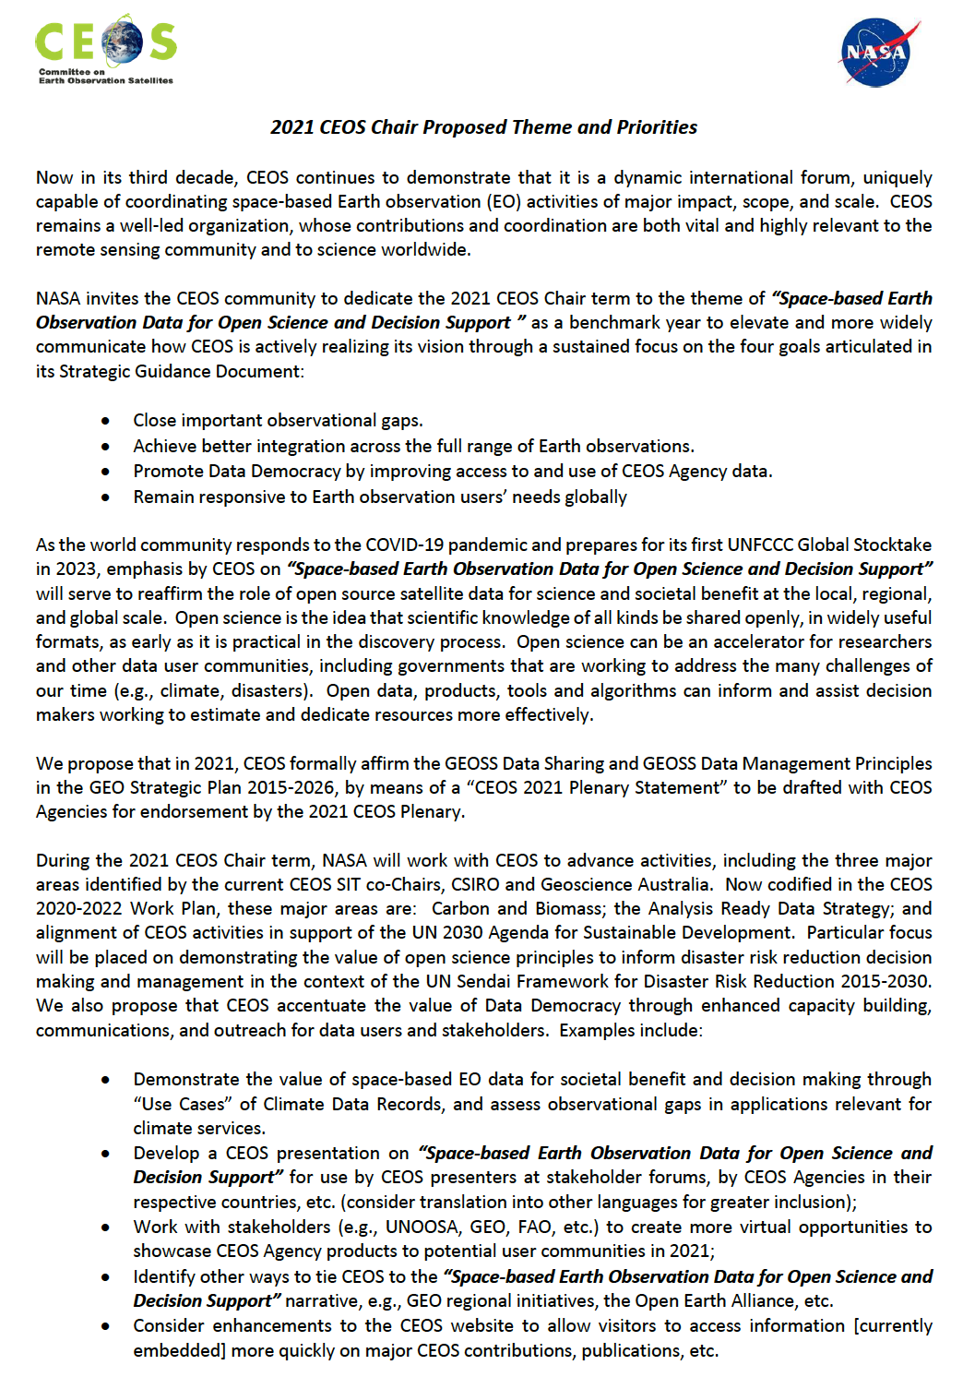
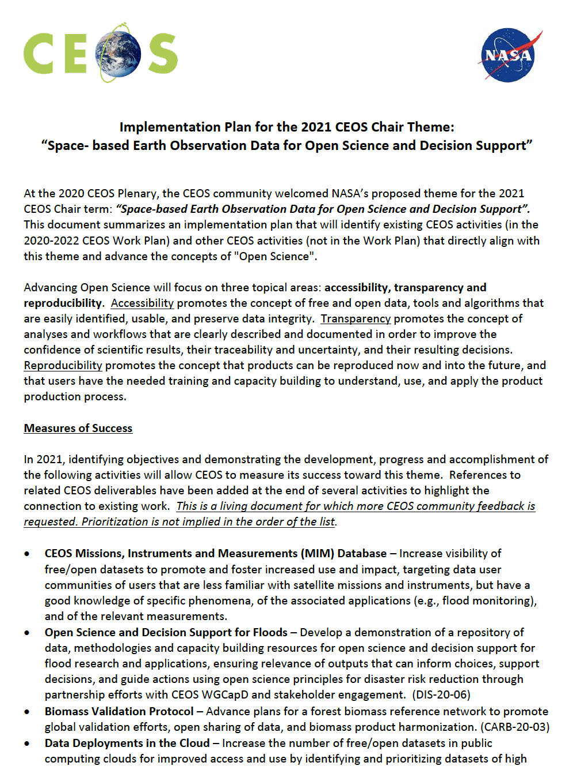
2021 CEOS Chair Theme
Our 2021 theme ... Space-based Earth Observation Data for Open Science and Decision Support
The CEOS community embraced the open science theme, provided valuable inputs to the implementation plan, and established CEOS as a world leader in promoting open science.
Our 2021 Implementation Plan ... Identified 17 objectives that demonstrated the value of our international cooperation for data users – those that know us and those that we invite to know CEOS.
Slide 2

Slide 3
CEOS further elevated its role in 2021!
Our Plan Supports Open Science ... The CEOS Chair implementation plan included 17 objectives, linked to 12 CEOS deliverables. Progress was made on all of those objectives.
CEOS is demonstrating that it is a world leader for open science in global remote sensing ... Here are some highlights of recent progress and accomplishments in the area of open datasets and tools for open science and decision/policy-making.
Slide 3

Slide 4
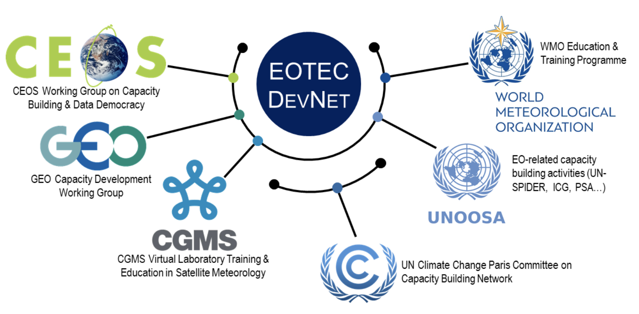
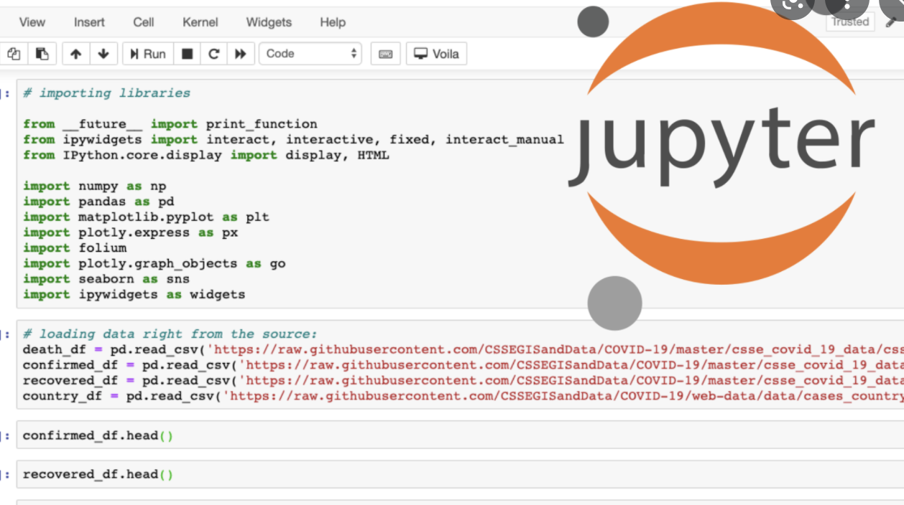
CEOS Accomplishments (1 of 3)
CEOS released the Earth Analytics Interoperability Lab (EAIL), which is now supporting several flood pilot projects.
CEOS endorsed the WGCapD Earth Observation Training, Education, and Capacity Development Network (EOTEC DevNet) Implementation Plan, which includes a database of resources for global users.
A WGCapD Webinar Series on Image Restoration and Processing of SAR Data was completed by 1,569 participants, with 195 participants completing Image and Processing training.
WGCapD hosted a Jupyter Notebook training webinar in July 2021 with over 300 global participants.
WGClimate identified 18 specific use-cases where climate data is being used for decision-making. To date, 5 use-cases are published virtually on this link: https://climatemonitoring.info/use-cases/
Slide 4

Slide 5
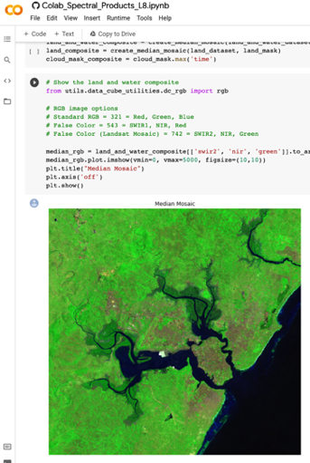
CEOS Accomplishments (2 of 3)
WGClimate has just published the Essential Climate Variable (ECV) Inventory v4.0 – on this link: https://climatemonitoring.info/ecvinventory/
SEO released the Open Data Cube Sandbox through the Open Earth Alliance as a tool for open science.
The CEOS Communications team drafted a series of articles for the website to demonstrate open data and science.
Through the SDG ad hoc Team, CEOS contributed data and tools to the UN Habitat Urban Toolkit (11.3.1) and is developing new tools for water and land change.
LSI-VC developed new ARD specifications that will improve the use of our data for open science.
CEOS released a new Global Stocktake website in English, French, and Spanish (ceos.org/gst) to support access to datasets and provide guidance to users.
Slide 5

Slide 6
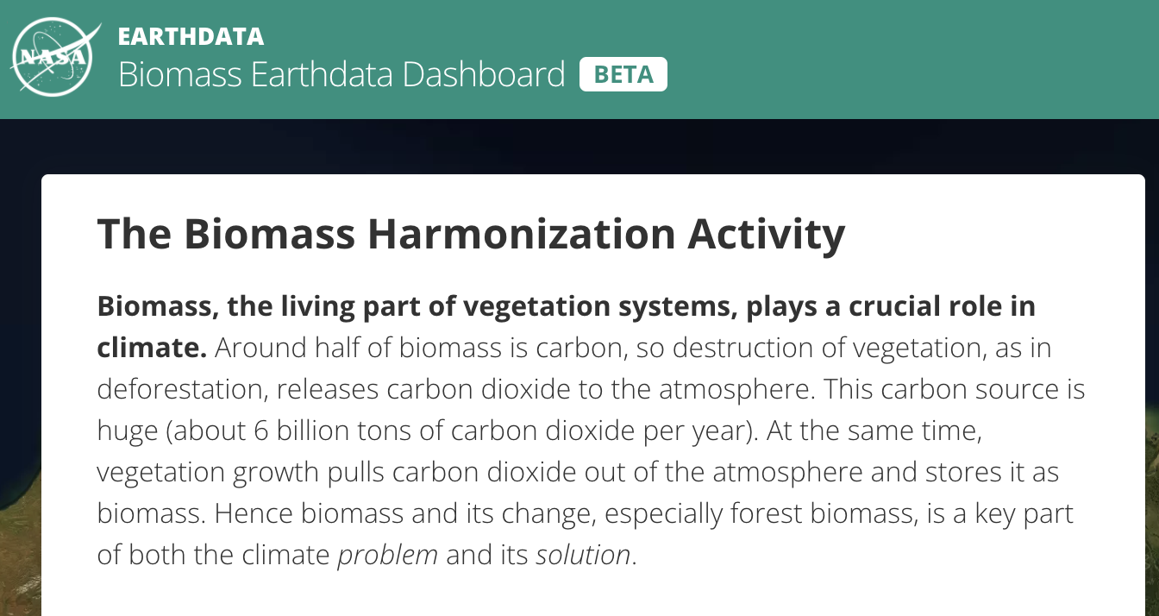
CEOS Accomplishments (3 of 3)
WGCV Land Product Validation Subgroup delivered the “Aboveground Woody Biomass Product Validation Good Practice Protocol”, providing standardized approaches to global product validation of biomass and related products, available at: https://lpvs.gsfc.nasa.gov/documents.html
CEOS released a Biomass Dashboard for mapping aboveground biomass, now available at: https://earthdata.nasa.gov/maap-biomass/ and it is supporting the GEO-TREES global initiative to establish in situ biomass reference measurement sites to validate space-based forest biomass observation instruments.
WGDisasters obtained “observer status” on the Board of the International Charter - Space and Major Disasters Cooperation. This status allows WGDisasters to officially share advanced science products on a case-by-case basis from several thematic CEOS Working Group teams during Charter emergency activations.
AC-VC is undertaking a new coordination activity for aerosol observations from space with application to air quality, an important topic for which no other international coordination activity currently exists.
A WGCV vicarious calibration (VCAL) portal for spaceborne GHG sensors is now available at: https://www.eorc.jaxa.jp/GOSAT/GHGs_Vical/index.html
Slide 6

Slide 7
CEOS is a Leader
CEOS should continue to support Open Science and accessibility to open data as a core objective ... Much of our data is open to the world and we need to continue to develop and promote approaches to share space-based EO data and products to address global concerns.
CEOS should continue to uphold its responsibility as a world leader for Open Science… We are committed to transparency as a core objective and we must continue to calibrate, validate, and release satellite datasets and associated open tools and services.
CEOS should continue to be a known vector for capacity building in remote sensing data utilization and open data outreach ... We should continue to participate in and present at critical global meetings and offer trainings to communicate how our work, our data, and tools strongly support open science and inform decision-making worldwide.
Slide 7

Slide 8
NASA expresses its sincere thanks and appreciation to the CEOS community for your support during NASA’s 2021 CEOS Chair term and your solid support for the Open Science and Decision Support theme.
Slide 8

