Slide 1
Open Source Science
Expanding participation, improving reproducibility, and accelerating scientific discovery for societal benefit.
Kevin Murphy
NASA CEOS Chair Team
Agenda Item #28
2021 CEOS Plenary
Virtual Meeting
1-4 November 2021

Slide 2
Defining Open Science
“We define open science as a collaborative culture enabled by technology that empowers the open sharing of data, information, and knowledge within the scientific community and the wider public to accelerate scientific research and understanding.”
Ramachandran, R., Bugbee, K., & Murphy, K. J. Moving from Open Data to Open Science. Earth and Space Science, Wiley Publication. https://doi.org/10.1029/2020EA001562
Notes:
Let’s define open science before we address open source science!

Slide 3
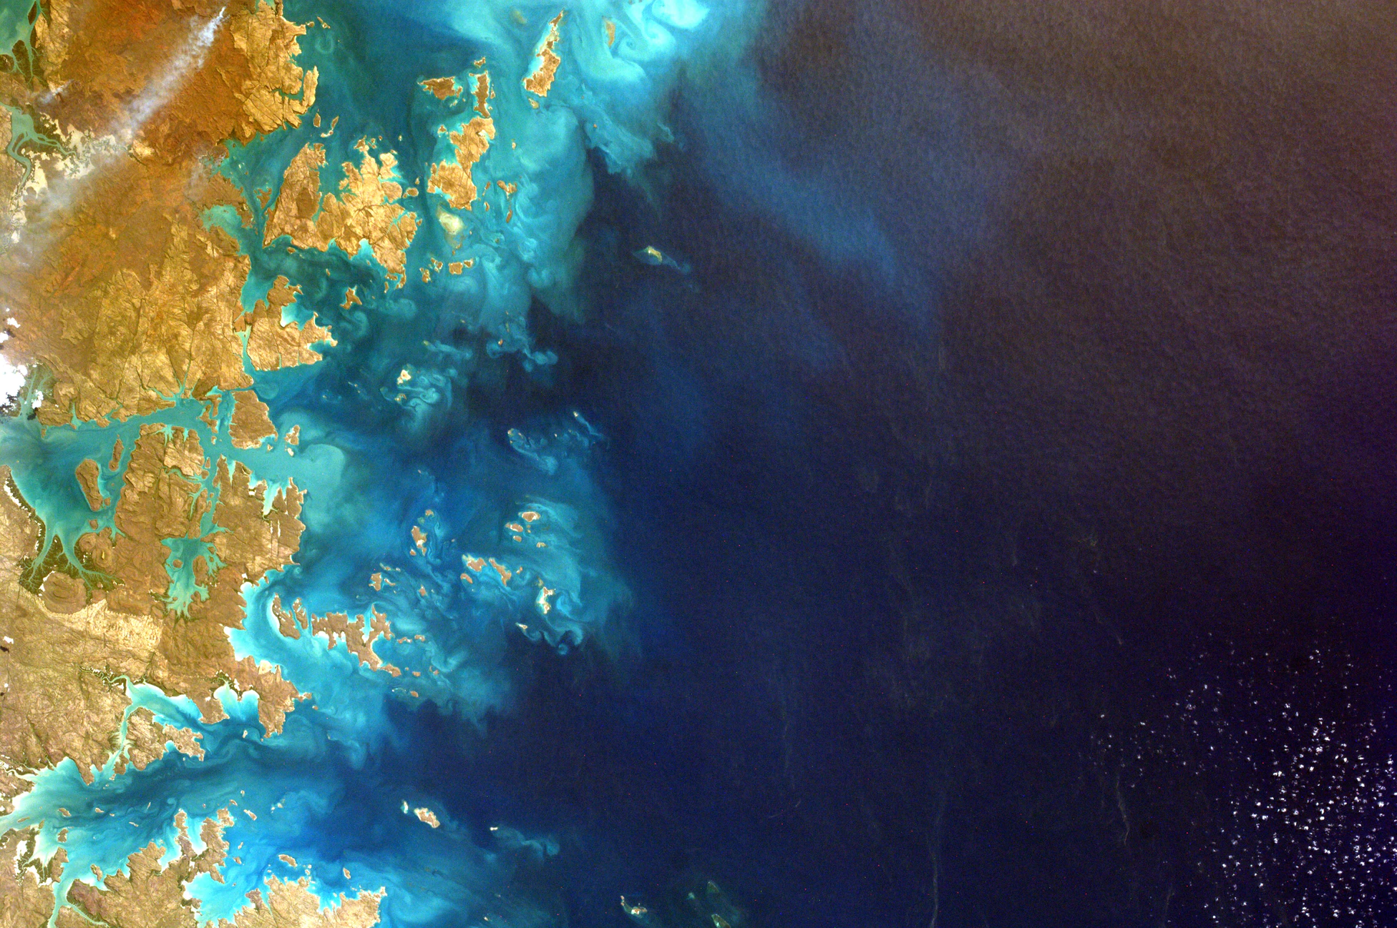
Why “Open-Source” Science?
Builds on concepts from Open Source Software revolution that expanded participation in developing code and applies it to the scientific process to accelerate discovery by openly conducting science from project initiation through implementation.
Notes:
Open-source Science - Open-source software fundamentally changed how software was shared, radically accelerating AI, impacting science, business, policy, and has an immense societal benefit. We are applying this transformation to all of science (data, software, documentation and knowledge) to allow for expanded participation in science and accelerate discovery.
Missions scientific development will be open earlier in their lifecycle, starting in Phase B - Allows broader participation earlier to science meetings and applications.
Open Science is complete access to the entire scientific knowledge process, which includes access to open data, open methodologies, as well as FOSS.
https://unsplash.com/photos/6-jTZysYY_U

Slide 4
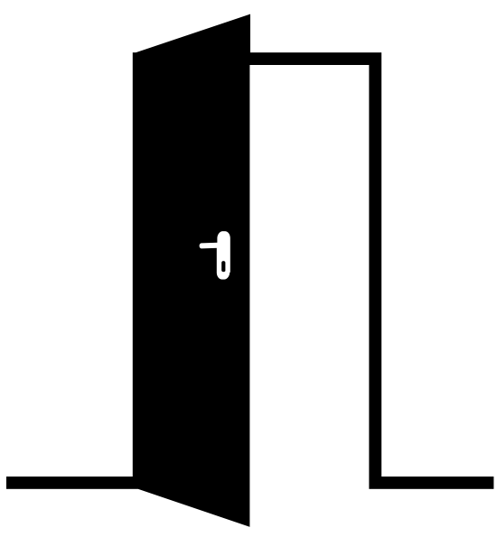
What is Open-Source Science?
OPEN (TRANSPARENT) SCIENCE scientific results and process should be visible, accessible, and reproducible
OPEN (INCLUSIVE) SCIENCE process and participants should welcome participation by and collaboration with diverse people and organizations
OPEN (ACCESSIBLE) SCIENCE data, tools, software, documentation, publications should be accessible to all (FAIR)
OPEN (REPRODUCIBLE) SCIENCE scientific processes and results should be open such that they are reproducible by members of the community
Notes:
Within the definition of open-source science, there's really two meanings to the word Open. Transparent: both the scientific results and process should be visible, accessible and understandable
Inclusive: the process and participants should welcome participation by and collaboration with diverse people and organizations
Take these two definitions together, that's where we excel.

Slide 5
Benefits of Open-Source Science
BROADENS PARTICIPATION and FOSTERS GREATER COLLABORATION in scientific investigations by lowering the barriers to entry
INCREASES THE DIVERSITY of those undertaking these investigations
PROMOTES TRANSPARENCY and reproducibility
SHORTENS THE TIME it takes for a new user to find and learn how to use data
INCREASES CITATIONS, media attention, and funding opportunities
ENABLES SCALING of large datasets for societal benefit and improves data systems efficiency
Notes:
Benefits:
Lowers the threshold for entry into scientific exploration;
Broadens participation in scientific investigations and increases the diversity of those undertaking these investigations; and
Increases opportunities for collaboration while promoting scientific innovation, transparency, and reproducibility.
McKiernan, E. C., et al (2016). Point of view: How open science helps researchers succeed. elife, 5, e16800. DOI: 10.7554/eLife.16800

Slide 6
Open Source Science: Expanded Use and Trust in the Scientific Process
Enable data access, compute, and analysis to happen side-by-side
Facilitates broad, collaborative use of Big Data collections
Increase opportunities to use Big Data to address climate change for local issues
Notes:
This is especially important given new missions set to launch in the coming years as part of NASA's Earth System Observatory.

Slide 7
A Continuum of Open-Source Science
“Teaching” culture
Free unlimited data access
Fully documented open software and algorithms
Transparent processes, meetings, workshops
Fully linked data and publications
Open Access Journal publications
Reproducible across platforms
“Closed-Tent” culture
Data access ($$)
Accessible Publications ($$)
Siloed systems
Limited communication
Proprietary Software
FULLY CLOSED
FULLY OPEN
“Black Box” culture
No public access data
No publications
No insight into processes
No reproducibility
“Open-Tent” culture
Free data access
Open software and algorithms
“Green” Journal publication
Documented processes
Reproducible in specific environments
Notes:
Where are we going: A Continuum of open-source science.
ESO will move the ball to the right.
Kevin: do not specifically mention where NASA is, just show the continuum

Slide 8
NASA Transform to OPen Science (TOPS)
Transform to OPen Science (TOPS) is a 5-year effort focused on capacity building, partner engagement, and incentives to help accelerate scientific discovery through open science.
We are inviting CEOS partner engagement in this effort.

Slide 9
NASA Transform to OPen Science (TOPS)
TOPS Focus Areas
Public Engagement | Designate 2023 as NASA Year of Open Science Partnering with professional orgs., publishing TOPS articles in high-impact journals Engage early with historically excluded communities TOPS GitHub
Capacity Building | Create FAIR - Analysis-Ready Cloud-Optimized (ARCO) data Develop learning resources TOPS JupyterHub Host and sponsor events (summer schools, multi-day trainings, massive open online courses)
Incentives | Develop NASA Open Source Science Awards program Leverage prizes and challenges and cross-division science use cases Increased citizen science activities

Slide 10
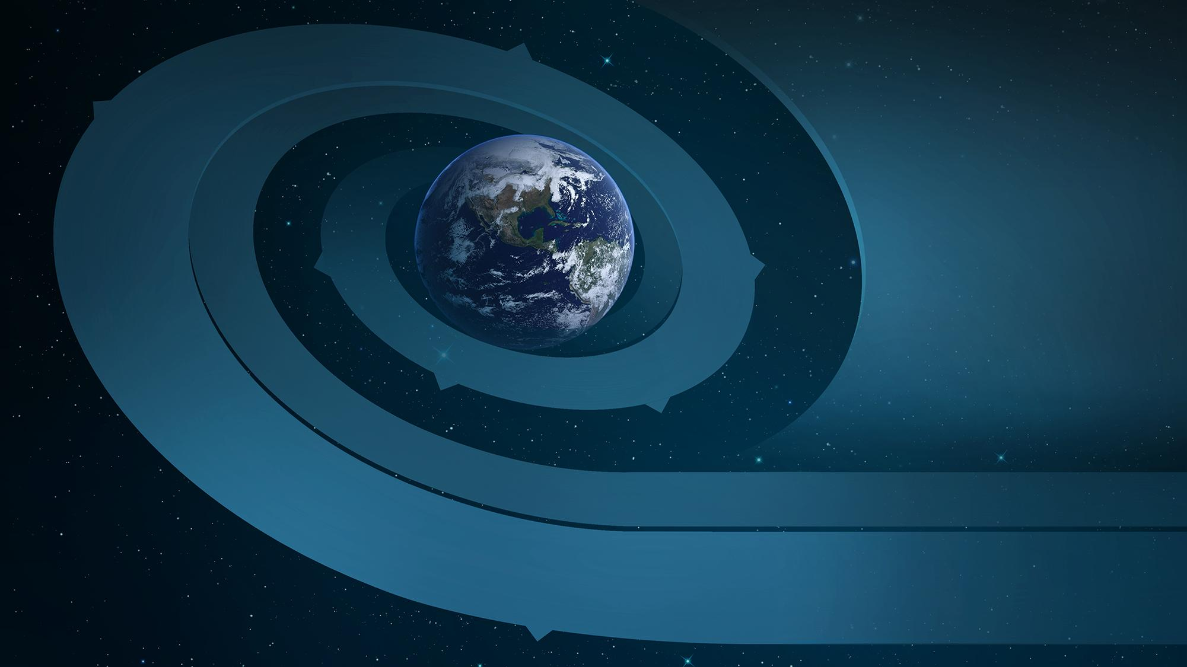
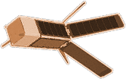
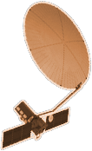
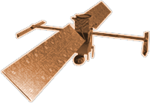
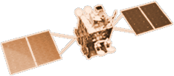
CYGNSS (8)
NISTAR, EPIC
2015
GRACE-FO (2)
SMAP
ICESAT-2
OCO-2
2020
GPM
SENTINEL-6
MICHAEL FREILICH
EARTH FLEET
GEDI
LANDSAT 8
TROPICS (6)
EMIT
SUOMI NPP
INVEST/CUBESATS
ECOSTRESS
CSIM-FD 2023
HARP 2022
CIRIS 2023
CTIM* 2022
HYTI* 2022
SNOOPI* 2022
NACHOS* 2022
NACHOS2* 2022
NISAR
1995
2010
OCO-3
LANDSAT 7
CALIPSO
LANDSAT-9
TERRA
AQUA
CLOUDSAT
SWOT
CLARREO-PF
AURA
2000
JPSS INSTRUMENTS
TSIS-1
2005
GEOCARB
LIS
OMPS-LIMB 2022
LIBERA 2027
TEMPO
SAGE III
PREFIRE (2)
MAIA
ISS INSTRUMENTS
KEY
PACE
INTERNATIONAL PARTNERS
U.S. PARTNER
ISS INSTRUMENT
JPSS INSTRUMENT
CUBESAT
LAUNCH DATE TBD
TSIS-2
GLIMR
ESO-1, 2, 3, 4
PREFORMULATION
FORMULATION
OPERATING
EXTENDED
SENTINEL-6B
MISSIONS
06.23.21
2025
Notes:
*****Kevin: Mention that many of these missions have international CEOS partners, such as JAXA, ISRO, CNES, DLR*****
For example, new missions set to launch in the coming years will have incredibly high data volumes.
NISAR which is will generate about 85 terabytes of data a day
The ESO...

Slide 11
Draft Requirements for Open Source Science Missions
All mission data, metadata, software, databases, publications, and documentation shall be available on a full, free, open, and unrestricted basis starting in Phase B with no period of exclusive access. Science workshops and meetings shall be open to broad participation and documented in public repositories.
1 | Software shall be developed openly in a publicly accessible, version-controlled platform using a permissive software license allowing for community use and contributions. | 4 | Scientific data, metadata, software, publications and documentation shall be archived and made available by NASA and/or [Partner] starting in Phase B.
2 | Manuscripts shall be published with open access licenses; versions of as-accepted manuscripts shall be made available as open preprints and deposited in a NASA or [Partner] repository upon publication. | 5 | NASA and [Partner] software, documentation and data shall be properly marked, cited, and/or attributed. Metrics to measure and acknowledge open-source science contributions will be developed.
3 | All mission data, calibration information, and simulated products supporting development and validation of algorithms shall be made available without any conditions to use. | 6 | NASA and [Partner] will mutually develop an Open-Source Science Plan that specifies details of collaboration.
* Projects should release all information with open licenses unless exceptions are granted based on laws or regulations, including classified, ITAR, EAR and CUI restrictions. CSDO evaluates and approves or declines deviation requests by projects for NASA.
Notes:
Open-Source Science Plan will include at a minimum - Data Management Plan, Open Source Software Development Plan, Licenses, Open Scientific Collaboration Plan, Documentation Plans, Attribution Requirements and FAIR plan.

Slide 12
Open Source Science Data Integration
Multi-Mission Algorithm And Analysis Platform (MAAP)
MAAP
JOINT ACCESS TO DATA AND ALGORITHMS
DATA AND COMPUTING
DATA AND COMPUTING
Notes:
When data comes down from ESO, scientists use the data for analysis globally. MAAP integrates data from multiple missions operated by different agencies into a consistent data record that can be used by global stakeholders.

Slide 13
THANK YOU CEOS
QUESTIONS?

Slide 14
Backup Slides

Slide 15
PROGRAM PRE-FORMULATION
PROGRAM FORMULATION
PROGRAM IMPLEMENTATION
PHASE A: Concept and Technology Development
PHASE B: Preliminary Design and Technology Completion
PHASE C: Final Design and Fabrication
PHASE D: System Assembly, Integration and Test, Launch
PHASE E: Operations and Sustainment
PHASE F: Closeout
PRE-PHASE A: Concept Studies
Open Source Science Starts Here
Notes:
Mission phases slide see: https://www.nasa.gov/seh/3-project-life-cycle
Making things open earlier in the life cycle of the missions. Getting decision-makers involved at the design phase Earlier stages are critical to scientific process
So when the mission launches there's more community

