Slide 1
CEOS Biodiversity Activity:
Opportunities for More Robust CEOS Engagement
Gary GELLER
NASA Jet Propulsion Laboratory
California Institute of Technology
Agenda Item 27
2021 CEOS Plenary
Virtual Meeting
1-4 November 2021
gary.n.geller@jpl.nasa.gov

Slide 2
Biodiversity in the CEOS Context
Biodiversity: Variety of genes, species, and ecosystems
GEO Societal Benefit Area
GEO Biodiversity Observation Network (GEO BON—a flagship)
International Treaties
  UN Convention on Biological Diversity
  UN Sustainable Development Goals
  UN Convention to Combat Desertification
  Ramsar Convention on Wetlands
  Others…
Intergovernmental Panel on Biodiversity and Ecosystem Services
National government needs & obligations
Notes:
Biodiversity is the variety of life in all its forms and scales—so it includes the variety of ecosystems. This is particularly important WRT to space agencies since space-based observations are particularly relevant to ecosystems—there is no better way to monitor ecosystems.
All these organizations have some very clearly identified needs that are not yet being met and to which space-based EO—and CEOS--can contribute. Indicators for the conventions are a good example—many are not yet available, or only for limited areas or timeframes.
Intergovernmental Panel on Biodiversity and Ecosystem Services (IPBES) is the biodiversity equivalent of IPCC.

Slide 3
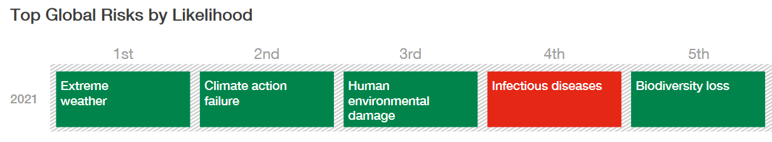
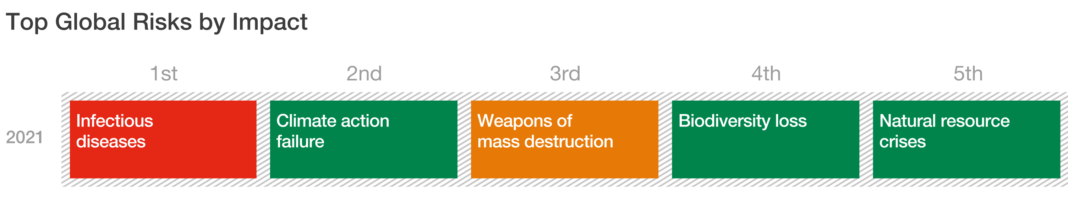
Biodiversity & Climate Commonalities
Both under threat…
Systemically intertwined
Many adaptations to climate are nature-based
World Economic Forum Global Risks Report 2021
Notes:
One thing biodiversity and climate have in common: They are both under threat, with huge implications for society
They are also physically and systemically intimately intertwined
And many climate change adaptations are nature-based
Note also: Strong connection between Biodiversity loss and infectious disease…and consequences of extreme weather and climate change
In 2020, before COVID, was 4th by Risk and 3rd by Impact
When a critical resource is threatened, it needs to be monitored

Slide 4
Considerations for CEOS Members
CEOS already plays key role in space-based EO and measurements for Biodiversity
But: CEOS can be even more pivotal to the overall Biodiversity effort
Challenges for CEOS to address:
  Strengthening awareness of its activities relevant to Biodiversity community
  Optimizing the value of EO for biodiversity science and monitoring
  Growing agency support dedicated to CEOS Biodiversity Activity
Many opportunities for engagement and action
Notes:
CEOS’s key role for Biodiversity: Providing a wide variety of observations and products. These are an essential and core element of biodiversity and conservation activities globally. Many of these are focused on ecosystems. e.g., ecosystem extent, which is an absolutely key parameter to monitor.
But space-based EO observations and products, usually in combination with other data sources, are also a critical input to identify habitats, where species are likely to live, and how many there are likely to be. And space-based EO is now starting to be used to spot plant disease before it can be seen by people on the ground, to provide insights into genetics (essential to adapt to climate change), and to discriminate between the types of fungus that live below ground but are essential for ecosystem health.
Despite the value, the biodiversity community is unfamiliar with CEOS and its work; as a result, it is not engaged. But engagement would benefit CEOS, its members, and the biodiversity community. A good way to enhance engagement is to facilitate activities that they and CEOS have a role in. All of these would support UN CBD, SDGs, other IEA, GEO and GEO BON, and society overall.

Slide 5
Activities for You to Consider
Assessing how to fill gaps in important indicators
Leveraging CEOS & agency connections to identify new collaborations (public, private, NGOs…)
Facilitating utilization of EBVs & derived products
Instigating ideas to connect EO to biodiversity applications
All of these double as engagement activities
And, thinking Big…
  New systems (not just sensors or measurements)
  Explore pathways towards a Global Biodiversity Monitoring System
Notes:
All of the existing International Environmental Agreements have gaps in the indicators they rely on to assess progress and guide activities. Space-based Earth observations (EO) can fill some of those.
Thinking Big: (see also Backup slides)
New systems/approaches: new sensors, multi-sensor measurements…or new systems: cf ICARUS for animal tracking https://www.icarus.mpg.de/en; EO-guided in situ or drone data collection; automation; fusing EO with “camera trap” data…
As a major component of the Earth System that is under threat, biodiversity needs a global monitoring system. This has been discussed in various forms for several years but results have not reached critical mass. The systems and operational expertise within CEOS agencies would significantly help concept development and further a realistic pathway forward. The broad experience base that resides in the various CEOS WGs and Virtual Constellations could also provide key insights.
A concept for something like Biodiversity Data Records…roughly analogous to Climate Data Records…for monitoring change

Slide 6
How to Support the Biodiversity Activity
Host a meeting (we can come to you)
Support experts’ time
Provide another co-lead (1/10th time)
Activities: Many to choose from…
Good starter: Develop CEOS Strategic Plan for Biodiversity
  Build on previous work and plans (including WGClimate)
  Complement GEO BON Strategic Plan
  Identify Goals (maximize impact and ROI)
  Key value: in the process, not the product….
Notes:
A Strategic Plan would take the Biodiversity Activity to the next level—make it a true entity with a specific concept behind it. That would be an important advance over the “facilitator” role it has had so far.

Slide 7
Backup Material

Slide 8
Additional Resources
GEO BON website, and overview (slides and video)
Ecosystem Extent and Integrity (slides and video): key variables for which satellite EO is essential
UN SEEA: ecosystem accounting variables (extent, condition, services…)
Workshop linking EO and in situ for a global system
Example dashboard highlighting products ASEAN Biodiversity Dashboard
World Economic Forum Global Risks Report 2021

Slide 9
Biodiversity & Climate Commonalities
Threats…and societal dependency
Many measurements in common
  Land Cover, ecosystem type
  Environmental variables
Biodiversity & climare are intertwined
  Changes in one affect the other
Potential collaboration activities include
  In situ data sites, data coordination & collection
  Cal/Val sites
  Adaptation, nature-based solutions….
  Modeling
World Economic Forum Global Risks Report 2021
Notes:
One thing they have in common: They are both under threat, with huge implications for society
They are also physically and systemically intimately intertwined
And many climate change adaptations are nature-based
Note also: Strong connection between Biodiversity loss and infectious disease…and consequences of extreme weather and climate change
In 2020, before COVID, was 4th by Risk and 3rd by Impact
When a critical resource is threatened, it needs to be monitored

Slide 10
Some Thoughts on Thinking Big…

Slide 11
New Systems or Approaches
New sensors or measurements
  For example…multi-sensor/multi-model data products
Space-based EO-guided in situ or drone data collection
  Improved application of EO to guide where/when to collect ground data
  Automated drone operation in remote areas
  More fusion of camera trap and space-based EO data
Biodiversity Data Records
  Is a concept very roughly analogous to Climate Data Records needed?
  How else can we identify change?
ICARUS (operational now)
  For tracking animals using tiny transmitters, an ISS-based receiver, and ground components
Notes:
These are just some examples of the kinds of “new thinking” that CEOS and its agencies can help with and should have a role in. Many of these involve existing agency systems and cross-agency collaborations. There is lots of room for increased automation, more networking across within and across ground- and space-based observation components, and (of course) AI and machine learning. Biodiversity applications aren’t the only ones that could benefit from these, indicating the need for and value of cross-discipline/cross community collaboration.

Slide 12
Global Monitoring Systems
Systems exist for other critical areas of global concern
  Weather and Climate (WMO)
    Global Observing System (weather)
    Global Framework for Climate Services
  Various systems for health, agriculture, mercury, other areas…
Biodiversity: lacks such a system
  GEO BON’s BONs are good start, but very limited
  National systems still very limited, ad hoc
  But risks and impacts similar to climate
World Economic Forum 2021
Notes:
Some other examples of existing systems:
CDC, e.g., Division of Global Health Protection (many partners); Global Diseases Protection….
WHO e.g., Global monitoring for Substandard and Falsified Medical Products (contributions by members)
WMO Integrated Global Observing System: Facilitates OS enhancements

Slide 13
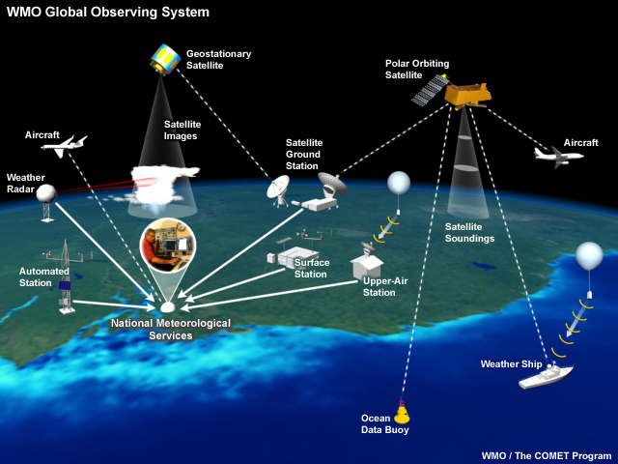
Global Monitoring Systems
Weather
Ideal systems
  Collaborative
  Coordinated data collection
  Multi-source acquisition
  Multi-source data products
  Data collection & format standards
  Data product generation
  Data & information services
  User-driven
  User-oriented products & services
  Fully operational
  Open data, open science…
Notes:
WMO Global Observing System:
Globally integrated system with many components
Many partners
Developed and grown over time
Acquires data, processes it, shares it with others in the network, delivers it to users

Slide 14
Global Biodiversity Monitoring System
CBD & IPBES have indicated the need
Many pieces already exist
Strong ties to GEO & GEO BON
Space-based EO is essential: Global, periodic, perfect for monitoring…
Highly collaborative
Significant interest
  GEO-sponsored workshop (Feb 2020)
  JPL/CalTech workshops 2019
  Many ad hoc discussions
  Planned workshop: World Biodiversity Forum, 2022
  Unified, concrete concept still emerging
Notes:
Thinking broadly a GBMS would have two basic thrust areas: Observations and Processing (the latter including storage and delivery).

Slide 15
Global Biodiversity Monitoring System
Not a traditional “project”: too big to just “build”
  Long-term activity
  Guided by shared vision among many stakeholders
  Approach: Grow a System of Systems for monitoring, largely from existing components
“Federated” approach may be appropriate
Key stakeholders include
  CEOS & member agencies
  GEO BON & biodiversity community
  CBD, SDGs, other IEAs, national governments, NGOs, private sector…
  Data product producers and distributors

Slide 16
GEO BON https://geobon.org/

Slide 17
GEO BON Overview
Indicators and other information
Navarro et al. 2017

Slide 18
Essential Biodiversity Variables
Set of measurements to capture the major dimensions
of biodiversity and how it is changing
Criteria:
Biological
State variables
Sensitive to change
Scalable
Feasible
Ecosystem agnostic
Genetic Composition
Species Populations
EO: Important data source
Species Traits
Community Composition
Ecosystem Structure
EO: Core data source
Ecosystem Functions

Slide 19
Biodiversity Observation Networks
National, Regional, Thematic
Thematic
  Marine
  Freshwater
  Soil
In situ data
  What to monitor
  Standards: collection protocols & data formats
  Coordination and knowledge sharing
Remote sensing data
  Capacity building: where to find, how to use

Slide 20
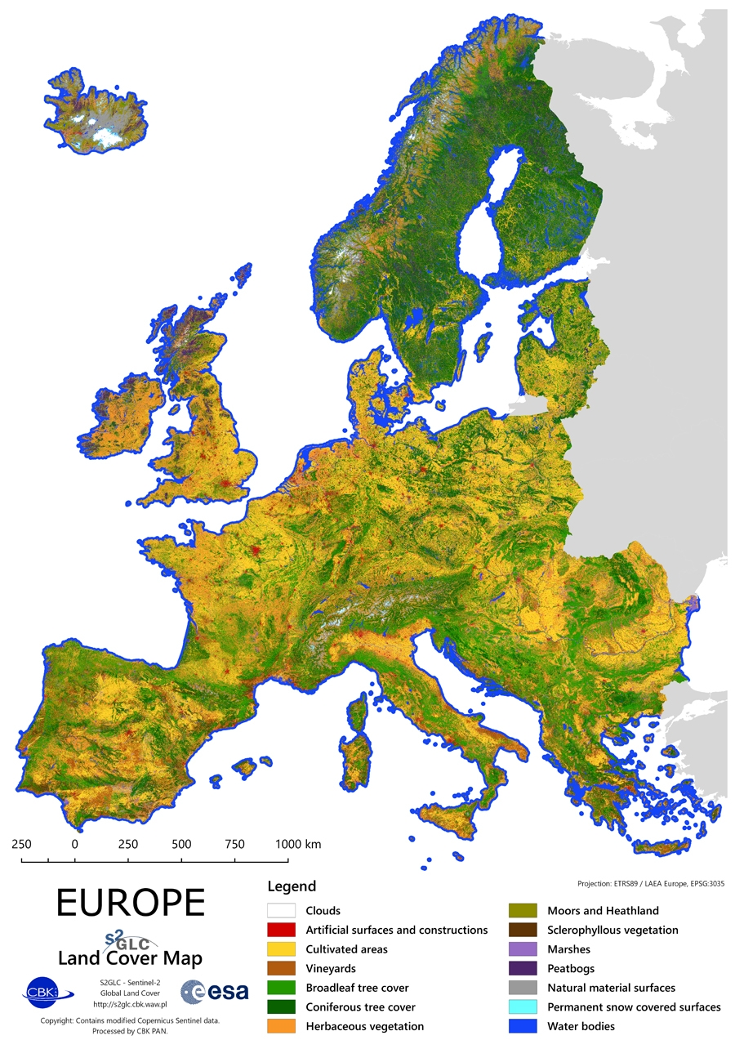
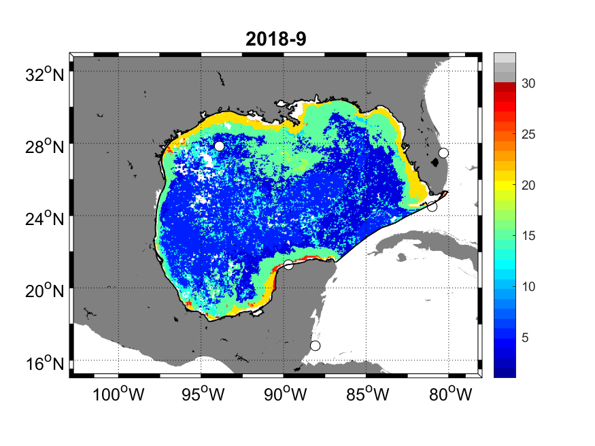
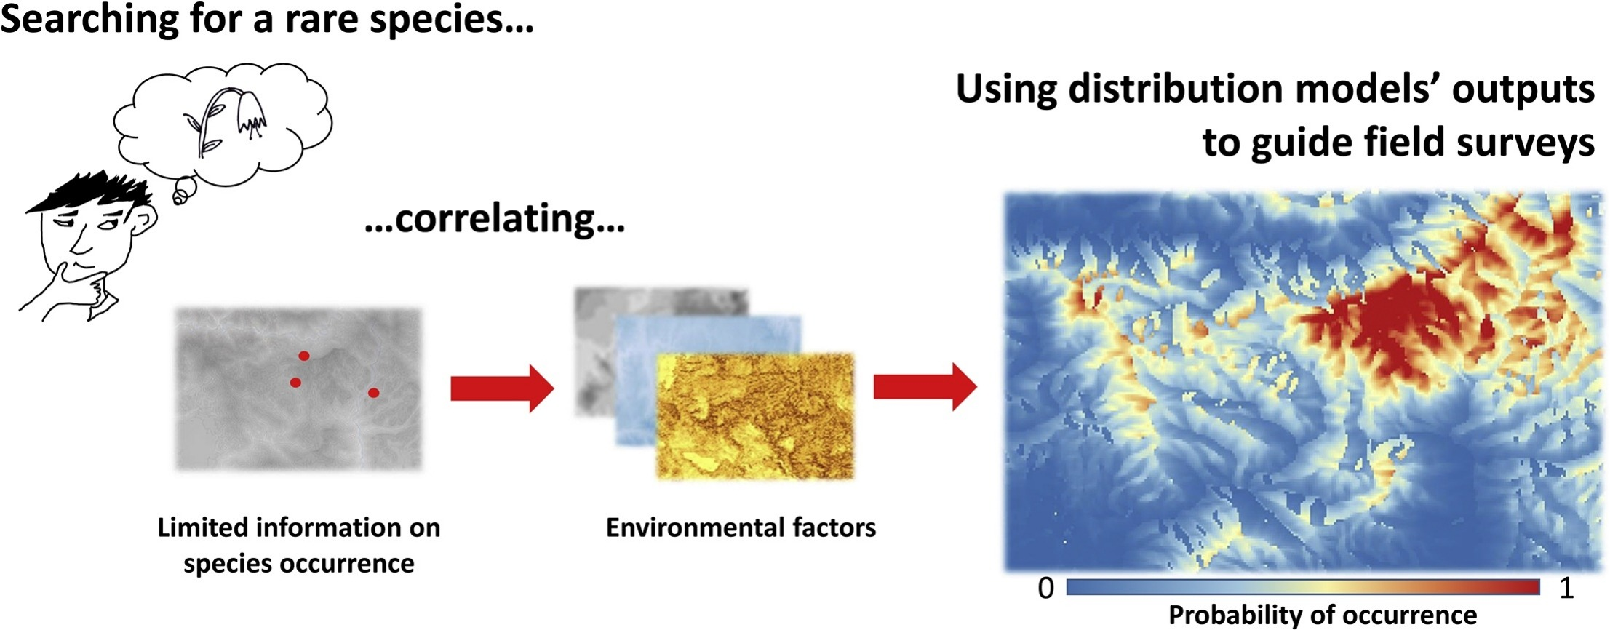
EO Is Essential
Ex: Ecosystem mapping & monitoring… and its applications…
Ecosystem class
Terrestrial
Ecosystems
Marine
Ecosystems
Species level information
Seascapes, NOAA CoastWatch
Including Land Cover
Fois et al 2010, Ecol Mod
Notes:
Applications
National Accounting (SEEA)
Land use planning
Resource assessments & response
Fisheries management
Species level: Habitats are where species live, threatened/endangered species management

Slide 21
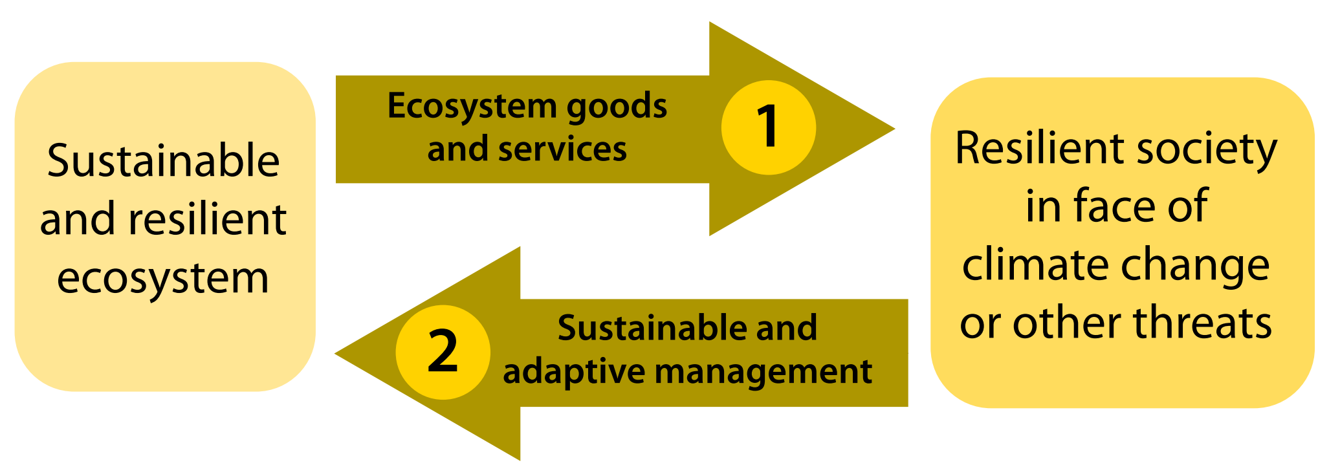
Climate Change Adaptation
Adaptation for biodiversity…or biodiversity for societal adaptation?
Locatelli et al 2010

