Slide 1
CEOS Biodiversity Activity:
Opportunities for More Robust CEOS Engagement
Gary GELLER, NASA
Agenda Item 27
2021 CEOS Plenary
Virtual Meeting
1-4 November 2021

Slide 2
Key Messages
Biodiversity, ecosystems and their services are under threat
Biodiversity and climate are intertwined
EO is essential for understanding, monitoring, and responding
CEOS can play a key role
Notes:
Here are the Key messages, up front….

Slide 3
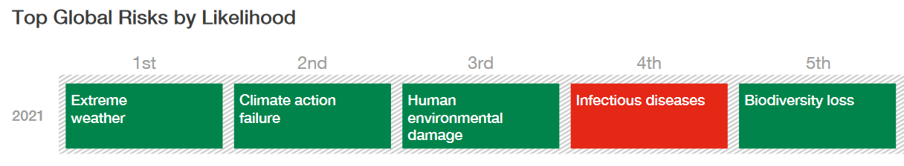
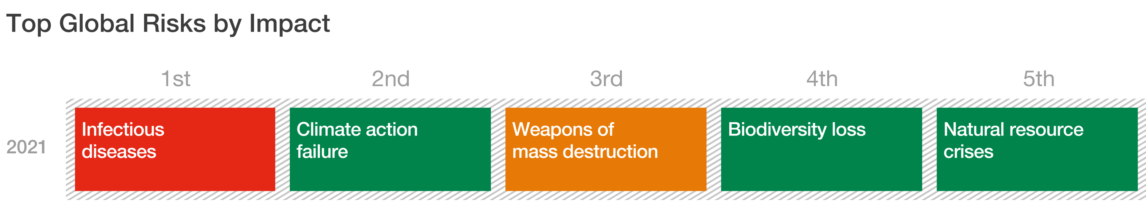
Biodiversity & Climate Commonalities
World Economic Forum Global Risks Report 2021
Notes:
One thing they have in common: They are both under threat, with huge implications for society
They are also physically and systemically intimately intertwined
And many climate change adaptations are nature-based
Note also: Strong connection between Biodiversity loss and infectious disease…and consequences of extreme weather and climate change
In 2020, before COVID, was 4th by Risk and 3rd by Impact
When a critical resource is threatened, it needs to be monitored

Slide 4
Biodiversity and Ecosystem Services
Biodiversity
  Variety of life on Earth, including genes, species, and ecosystems
Ecosystem Services
  Food, Pollination, Carbon Sequestration, Water..., Fiber…., Erosion/Sediment Control, Climate Change adaptation….
Earth Observation: Essential for understanding and monitoring
  Global and periodic
Notes:
Biodiversity: very broad term—includes ecosystems from deserts to tropical forests to coral reefs and open oceans and freshwater…
EO is essential for monitoring ecosystems…but also key input to monitoring at other levels such as species but even genes…

Slide 5
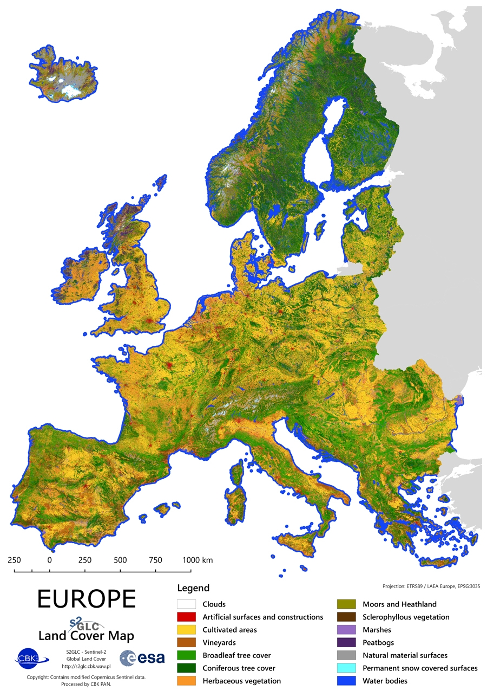
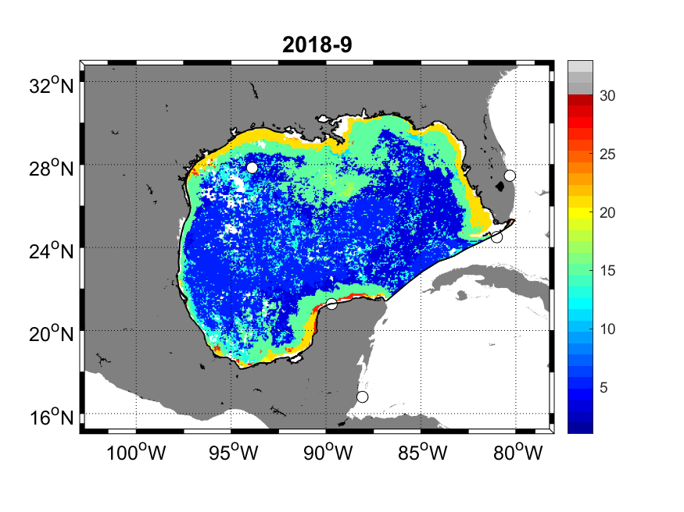
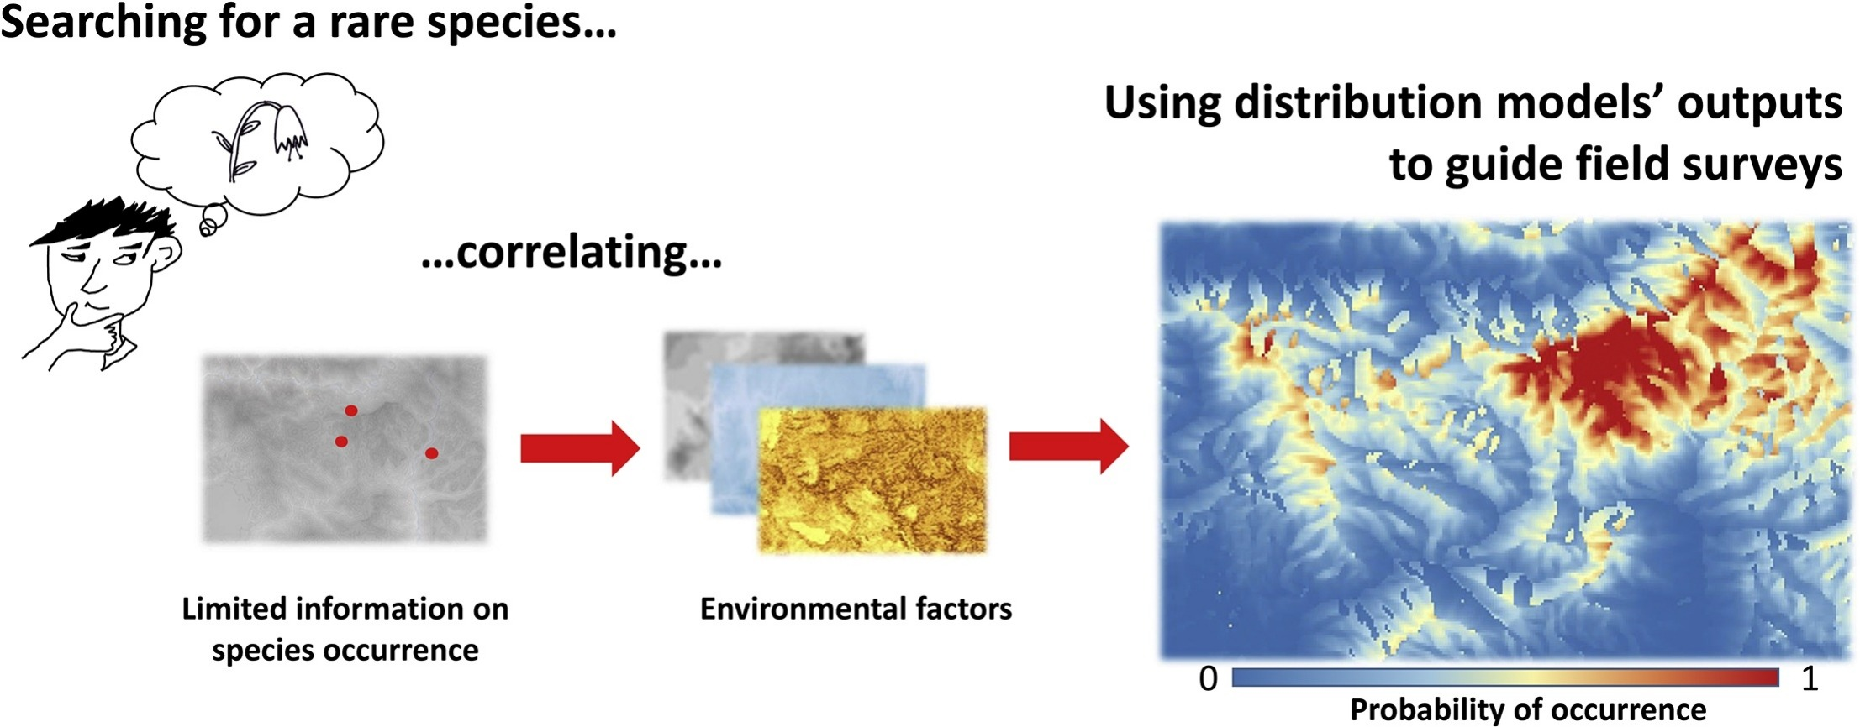
EO Is Essential
Ex: Ecosystem mapping & monitoring… and its applications…
Ecosystem class
Terrestrial
Ecosystems
Marine
Ecosystems
Species level information
Seascapes, NOAA CoastWatch
Including Land Cover
Fois et al 2010, Ecol Mod
Notes:
These are some examples of why EO is essential for monitoring….ecosystem and land cover maps cannot not be made without it.
But EO is also is needed for other products—because it characterizes habitat, it’s a key input for predicting and mapping where species live
Applications
National Accounting (SEEA)
Land use planning
Resource assessments & response
Fisheries management
Species level: Habitats are where species live, threatened/endangered species management

Slide 6
Considerations for CEOS Members
How to support Biodiversity Activity
  Experts’ time
  Provide another co-lead (1/10th time)
  Host a meeting
Possible activities
  Develop a CEOS Strategic Plan for Biodiversity
  Identify practical activities for engagement & collaboration
  Explore pathways towards a Global Biodiversity Monitoring System

Slide 7
Backup Material

Slide 8
Additional Resources
GEO BON website, and overview (slides and video)
Ecosystem Extent and Integrity (slides and video): key variables for which satellite EO is essential
UN SEEA: ecosystem accounting variables (extent, condition, services…)
Workshop linking EO and in situ for a global system
Example dashboard highlighting products ASEAN Biodiversity Dashboard
World Economic Forum Global Risks Report 2021
World Economic Forum 2021

Slide 9
GEO BON

Slide 10
GEO BON Overview
Indicators and other information
Navarro et al. 2017

Slide 11
Essential Biodiversity Variables
Set of measurements to capture the major dimensions
of biodiversity and how it is changing
Criteria:
Biological
State variables
Sensitive to change
Scalable
Feasible
Ecosystem agnostic
Genetic Composition
Species Populations
EO: Important data source
Species Traits
Community Composition
Ecosystem Structure
EO: Core data source
Ecosystem Functions

Slide 12
Biodiversity Observation Networks
National, Regional, Thematic
Thematic
  Marine
  Freshwater
  Soil
In situ data
  What to monitor
  Standards: collection protocols & data formats
  Coordination and knowledge sharing
Remote sensing data
  Capacity building: where to find, how to use

Slide 13
Thoughts on Biodiversity Role
& Development in CEOS

Slide 14
Biodiversity in the CEOS Context
GEO Societal Benefit Area
GEO Biodiversity Observation Network (flagship)
International Treaties
  UN Convention on Biological Diversity
  Intergovernmental Panel on Biodiversity and Ecosystem Services
  Sustainable Development Goals
  UN Convention to Combat Desertification
  Ramsar Convention on Wetlands
  Many others…
National government needs & obligations
Notes:
That’s why GEO BON and CBD have organized these webinars

Slide 15
Activities to Consider
Develop Strategic Plan for Biodiversity Activity
Assess how CEOS agencies can help address monitoring needs
Coordinate activities among space agencies for monitoring
Facilitate implementation & utilization of EBVs, other EVs, & derived products
  Collaborate with CEOS WGs and VCs, GCOS, other groups
And, thinking Big…
  Assess pathways towards a global biodiversity monitoring system
  Observations
  Data processing, products, access
  Open science
Notes:
Similar to the approach of the WG on Climate

Slide 16
Challenges and Opportunities
Challenges:
  Biodiversity community unfamiliar with CEOS and its activities
    Chicken & egg issue: Helpful to foster engagement from both directions
  Resources: Biodiversity Activity is resource constrained
Opportunities
  Find common ground (CEOS, biodiversity community)
  Demonstrate CEOS value to biodiversity stakeholders
  Develop shared Vision
Good start:
  Provide additional co-lead
  Identify experts
  Host a meeting
Notes:
CBD and IPBES have indicated this is needed
Clear ties to GEO and GEO BON: GEO Workshop held Feb 2020 (Leipzig)
Planned workshop: World Biodiversity Forum, 2022
Bold…yes, but recognized as a long-term activity, not a project
EO is essential: Global, periodic perfect for monitoring…
Provides roles for both CEOS and biodiversity community (science, SDGs, CBD, other IEAs, NGOs, national governments….)

Slide 17
Global Monitoring System:
Some Thoughts on Thinking Big…

Slide 18
Global Monitoring Systems
Weather and Climate (WMO)
  Global Observing System (weather)
  Global Framework for Climate Services
Various systems for health, agriculture, mercury, other areas…
Biodiversity: lacking
  GEO BON: BONs are good start
  National systems still very limited, ad hoc
  But risks/impacts similar to climate
World Economic Forum 2021
Notes:
CDC, eg Division of Global Health Protection (many partners); Global Diseases Protection….
WHO eg Global Surveillance and Monitoring System Substandard and falsified medical products (contributions by members)
WMO Integrated Global Observing System: Facilitates OS enhancements

Slide 19
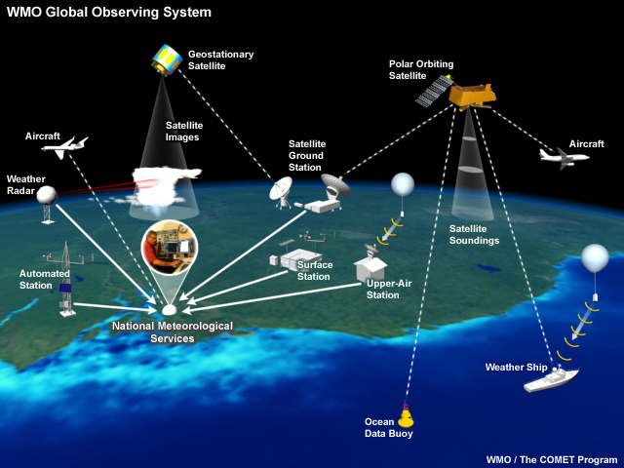
Weather Monitoring System
Notes:
Globally integrated system with many components
Acquires data, processes it, shares it with others in the network, delivers it to users

Slide 20
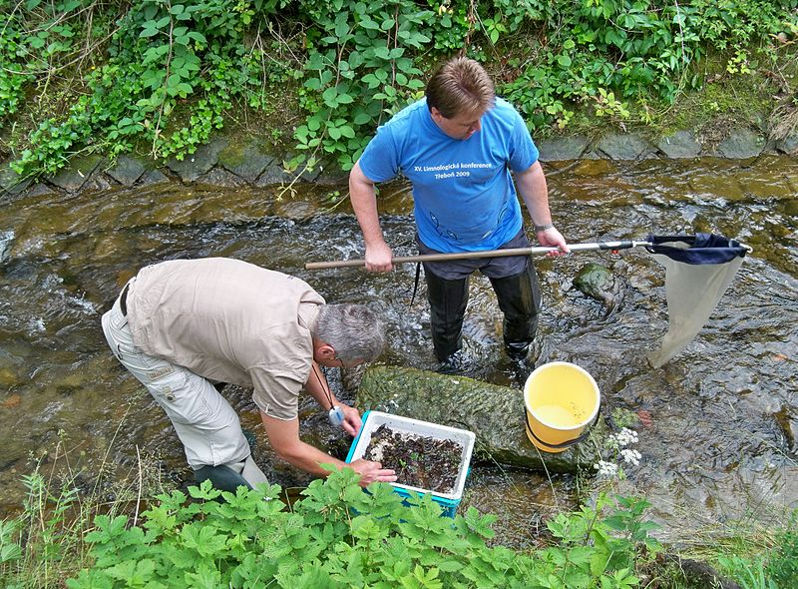
Biodiversity Monitoring System
Compared to Weather, still a lot of work to do to achieve a coordinated global monitoring system…
Panek, Wikimedia Commons
Notes:
A global biodiversity monitoring system is needed

Slide 21
Global Biodiversity Monitoring System
CBD & IPBES have indicated this is needed
Strong ties to GEO & GEO BON
  GEO sponsored workshop (Feb 2020)
Planned workshop: World Biodiversity Forum, 2022
EO is essential: Global, periodic, perfect for monitoring…
  CEOS could play a key role
  Observations and products

Slide 22
Global Biodiversity Monitoring System
Not a “project”: too big to just “build”
  Long-term activity
  Guided by shared vision among many stakeholders
  Approach: Grow a System of Systems for monitoring, largely from existing components
Roles for both CEOS and biodiversity community
Key stakeholders include
  CBD, SDGs, other IEAs, NGOs, national governments, private sector…
  Data product producers and distributors

Slide 23
Federated Approach?
Wikipedia: A federation often emerges from an initial agreement between several separate states.
A federated system could utilize the varied capabilities of its collaborators (EO, in situ, providers, distributors…), yet provide enough autonomy that each can still focus on its core mission. (Simplified autonomy continuum below…)
Single big,
highly integrated
system
Federated,
loosely coupled
system of systems
Level of collaborator autonomy
One developer
Guided by sponsor(s) requirements
Design & build
Internal interfaces
Manage the system
High complexity
More control over outcome
Many organization develop
Guided by shared vision
Grow rather than build
Externally exposed interfaces
Manage the interfaces (standards)
Low complexity
Somewhat less control
Notes:
The bullet points are highly simplified. Since the complexity of a system is largely dependent on the number and types of interfaces between components, as a system gets large its complexity can increase non-linearly. Dividing the system into fewer major and somewhat autonomous components can result in a hierarchy of interfaces so that at the top level there is a manageable number. Basically, this “hides” much of the complexity and delegates its management to the major components. Importantly, this also provides for component autonomy, allowing relatively independent development of each component. This is important for a system of systems where each component can come from a different organization with its own mission and constraints.

Slide 24
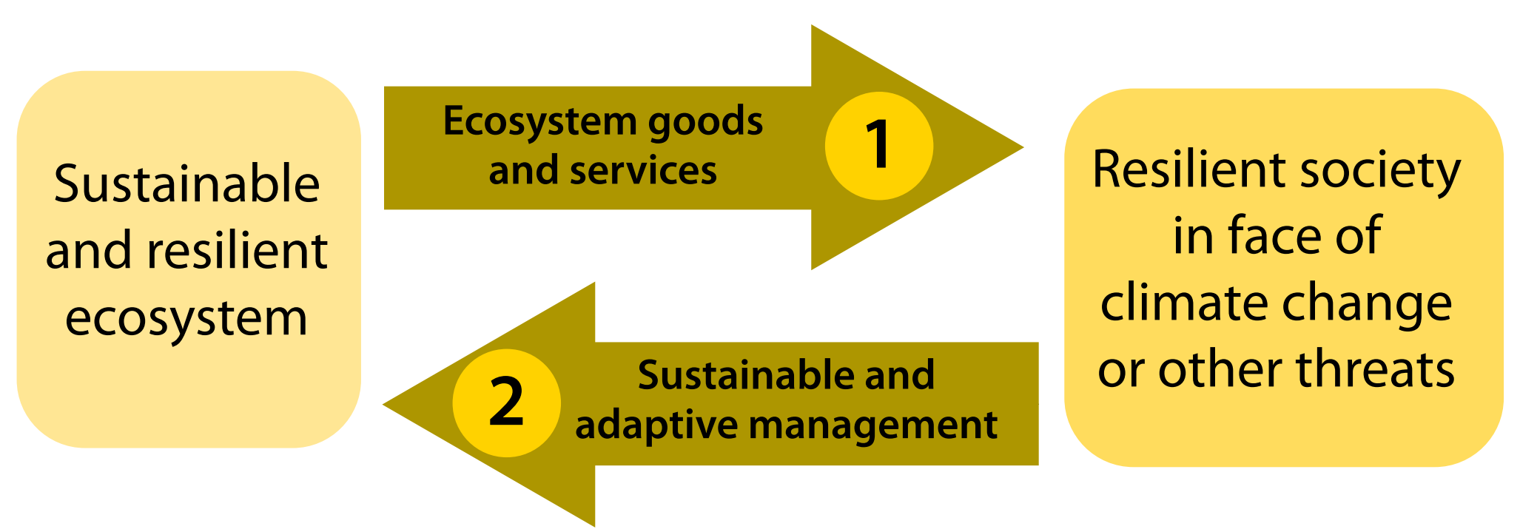
Climate Change Adaptation
Adaptation for biodiversity…or biodiversity for societal adaptation?
Locatelli et al 2010

