Slide 1
CEOS Contribution on Oceans
SIT Chair Team
SIT Vice-Chair Team
Agenda Item #2.26
2021 CEOS Plenary
Virtual Meeting
1-4 November 2021

Slide 2
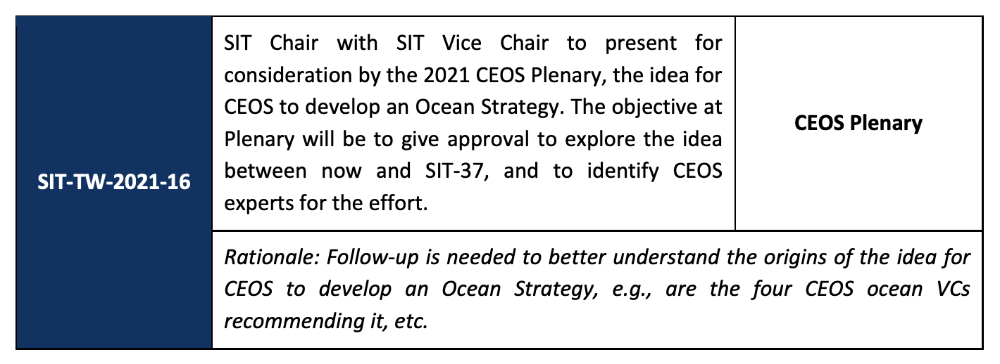
Context
SIT-TW 2021 discussion on CEOS ocean activities and coordination:
“..Mark Dowell (COM/JRC) added that the idea of the CEOS ocean and coastal strategy should be given serious consideration, it is perfect timing and there are new opportunities.
  - investigate the need for “an overarching CEOS Ocean Strategy for 2022”…support the creation of cross-cutting activities for CEOS.
- suggested focus on the UN Decade of Ocean Science for Sustainable Development.”

Slide 3
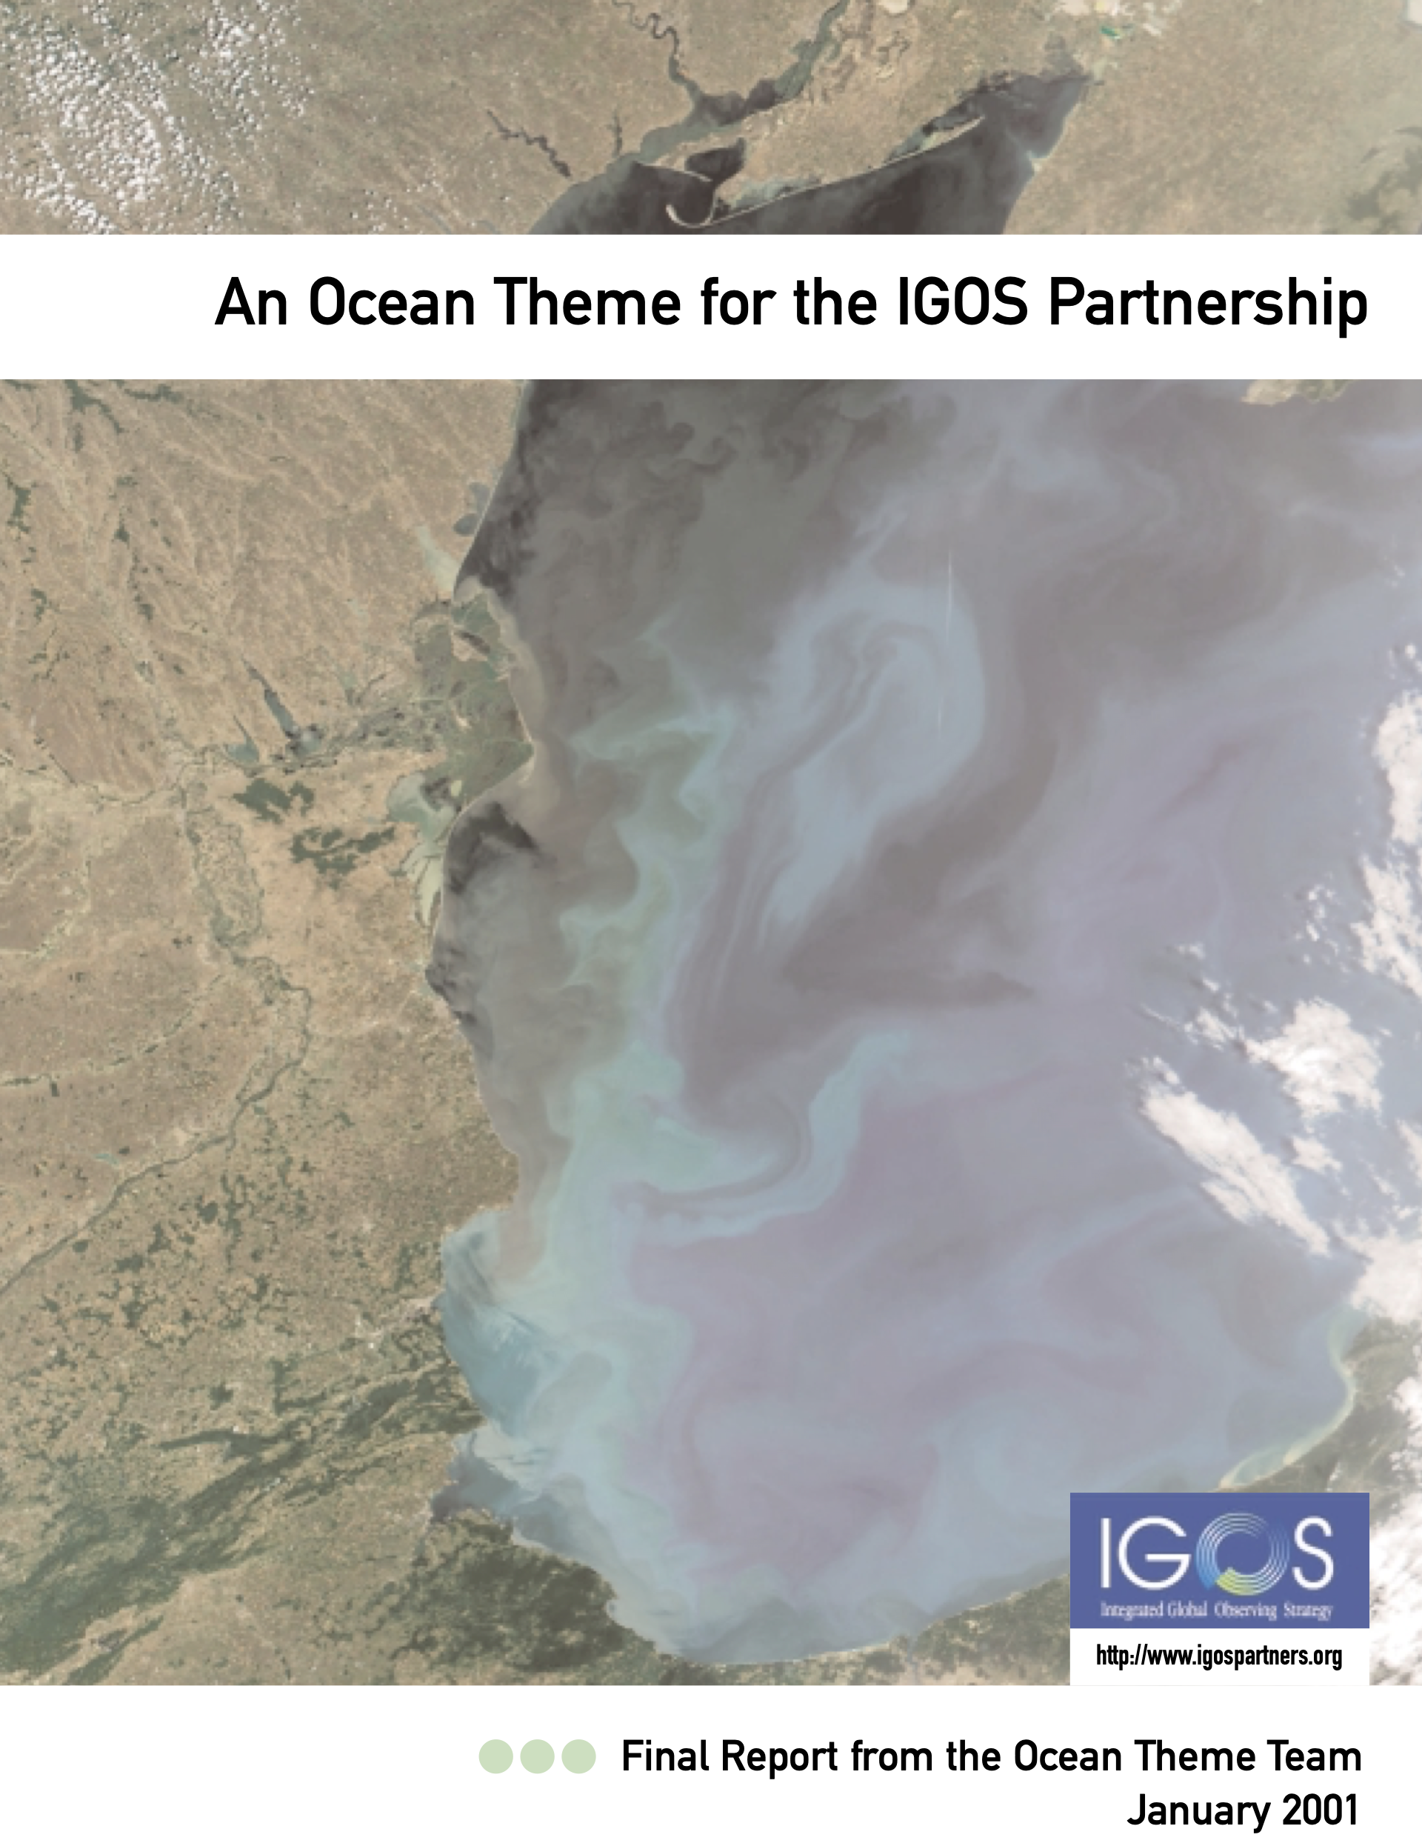
Context
IGOS demonstrated a holistic approach for thematic requirements setting and observation coordination
Crucial lesson was for the key user bodies to engage and coordinate the definition of requirements
Key stakeholders and activities include:
  GOOS/IOC
  UN Decade of Ocean Science
  SDG Stakeholders
  GEO BluePlanet
  Thematic groups: GHRSST, IOCCG, IOVWST, OSTST
Key internal groups include (but not limited to):
  Ocean VCs: OCR, SST, OST, OSVW
  COVERAGE & COAST
  WGCV

Slide 4
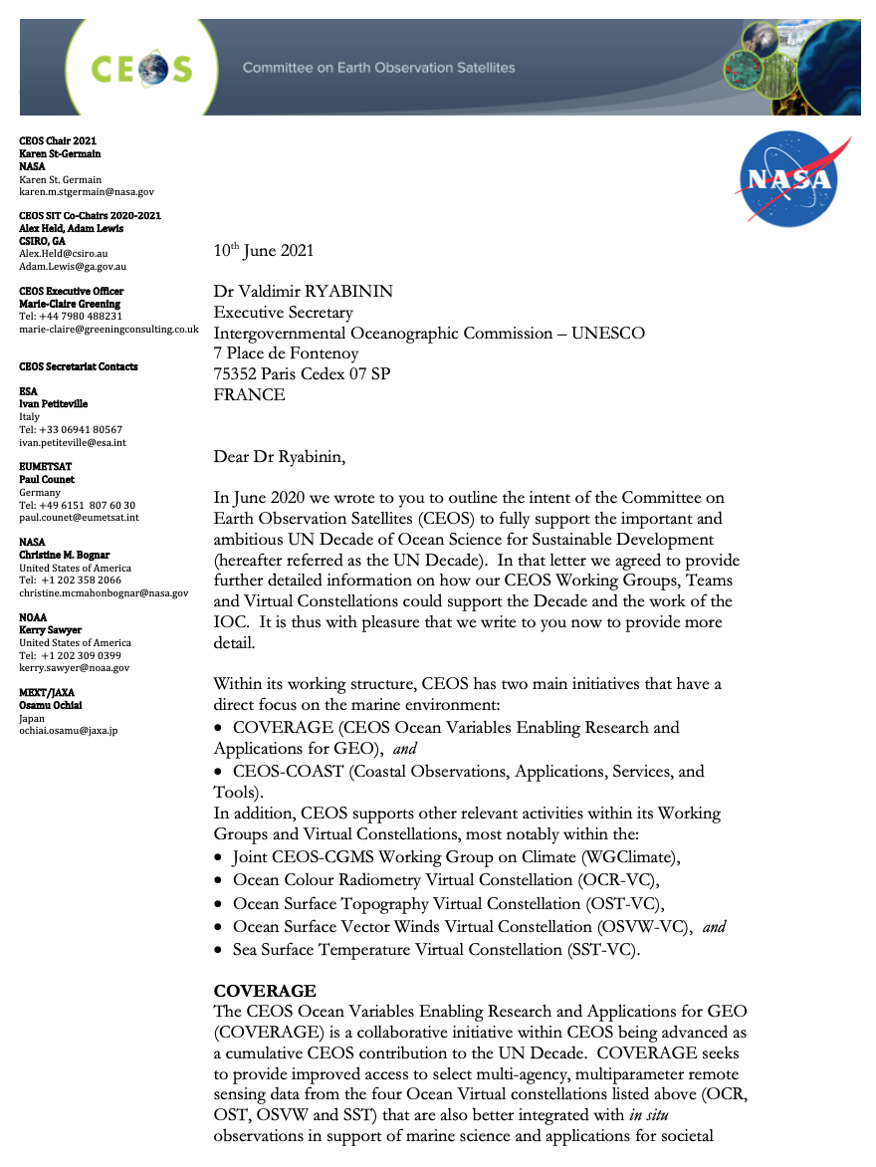
A way forward?
Options moving forward include:
  Improved communication of our ocean ‘offer’?
  Better coordination and linking of existing activities?
  Identifying new opportunities?
Prerequisite is clear user need and counterpart(s)?
  As a response to the IOC Decade of the Oceans?
  Aligned to SDGs and statistical office needs?
  Other reference points?
Multiple CEOS groups would need to be involved – SIT Chair to provide oversight
Propose preparation of SIT-37 discussion by our relevant technical experts on the need for and optimal form of further CEOS coordination on ocean observations

