Slide 1
CEOS Ad Hoc Team on the Sustainable Development Goals (SDG-AHT)
A. Held, (CSIRO)
& M. Paganini (ESA)
Conference Agenda Item #23
2021 CEOS Plenary
Virtual Meeting
1-4 November 2021

Slide 2
The CEOS SDG Ad hoc team
Progress report: summary
Proposed federated approach to Sustainable Development Goals (SDGs)
CEOS Sustainable Development Goals (SDG) Strategy Implementation
see Background information for more info

Slide 3
1. Progress Report: Deliverables in the Work Plan
Number | Objective / Deliverable | Completion | Responsible Entity
SDG-19-02 | Open Data Cube algorithms for the SDGs | 2022 Q4 | SEO
SDG-20-01 | GEO Federated Approach on SDGs | 2020 Q1 | SDG AHT
SDG-20-02 | SDG EO Toolkit Specification | 2020 Q1 | SDG AHT
SDG-20-03 | Satellite data requirements for SDG Indicator 6.6.1 (Water-related ecosystems) | 2021 Q4 | SDG AHT (Water Sub-team)
SDG-20-04 | Satellite data requirements for SDG Indicator 11.3.1 (Sustainable urbanization) | 2021 Q4 | SDG AHT (Urban Sub-team)
SDG-20-05 | Satellite data requirements for SDG Indicator 14.1.1 (Marine Pollution) | 2021 Q4 | COAST (with the support of SDG AHT)
SDG-20-06 | Satellite data requirements for SDG Indicator 15.3.1 (Land Degradation) | 2021 Q4 | SDG AHT (Land Degradation Sub-team)
SDG-20-07 | EO Enabling Infrastructures for SDGs (for SDG EO Toolkits) | 2022 Q4 | SDG AHT| (with support of WGISS, SEO)
SDG-20-08 | EO Good Practice Guidance (for SDG EO Toolkits) | 2022 Q4 | SDG AHT
SDG-20-09 | EO Demonstration Cases for SDGs (for SDG EO Toolkits) | 2022 Q4 | SDG AHT, SEO
SDG-20-10 | Data Supply Analysis and Strategy Document | 2020 Q2 | SDG AHT, SIT Chair

Slide 4
1. Progress Report: SDG AHT Overview
3 sub-teams + 14.1.1 indicator undertaken by COAST
All have made progress on EO requirements and improved their connections with GEO relevant activities
Deliverables: EO Requirements reports are all in progress and likely not finalised before next year (except 11.3.1) – external engagement, and constantly evolving environment (e.g. on Land degradation: Global Practice Guidance review to be released soon… EO requirements to be updated)
SIT-TW outcomes:
  Decision on the Future governance: Federated approach presented and discussed
  Action (COMPLETED) to develop an SDG Strategy implementation Plan by Plenary, and thus to update the WP (based on available resources)
Decisions to be taken today:
SDG AHT to be dismantled
Approval of the Federated Approach to continue SDG work using existing resources

Slide 5


SDG Sub-teams summary (1/2)
 | WATER (6.6.1) | URBAN (11.3.1)
Team’s organisation | 14 members + experts from GEO Aquawatch, Wetlands and GLOWS Stakeholders: UNEP, Ramsar and Countries | 13 members + experts from GEO and more Stakeholders: UN Habitat Countries and Cities
2021 Highlights | Review of the UNEP 6.6.1 monitoring methodology and Freshwater Ecosystems Explorer Analysis for 2 SDG pathways: production of global datasets (top down from UNEP) and development of national capacities (bottom up from Ramsar). See Background info slides | Contributed to the launch of the EO Toolkit for Sustainable Cities and Human Settlements, eotoolkit.unhabitat.org Summary inventory of EO data, tools, and use case See Background info slides
Deliverables | “Satellite data for SDG 6.6.1” Technical Report with outreach to custodian agencies (UNEP and Ramsar). In progress – to be finalised in Q2 2022 | “Satellite data for SDG 11.3.1” Technical Report to be included in ‘EO Toolkit for Sustainable Cities and Human Settlements’ ‘Learn Path’ hosted by UN Habitat (eotoolkit.unhabitat.org) In progress – To be finalised by end of 2021
Future & aspirations | Willing to continue its work in 2022 in collaboration with LSI-VC experts (e.g. in water leaving radiance ARDs) and others | More collaborations with Esri and UN Habitat to develop 11.3.1 Learn Path (Toolkit); WGCapD in multi-part Toolkit training; LSI-VC (e.g., development of new CARD4L data pipelines like VIIRS Nightlights, Landsat-Sentinel Harmonized dataset)

Slide 6


SDG Sub-teams summary (2/2)
 | Marine Pollution (14.1.1) via COAST | Land Degradation 15.3.1
Team’s organisation | Led by CEOS COAST team -> GEO Blue Planet WG that collaborates with CEOS on space data needs for specific projects - See background info slides | ~10 members + GEO LDN experts Close collaboration with UNCCD See background info slides
2021 Highlights | Satellite chlorophyll sub-indic data included in 2020 SDG report Working with regional UN Environment leads to bring together the national statistical offices, scientists and CEOS agencies to improve the utility of indicators and develop useful tools | Decision trees and updating of Good Practice Guidance Reference to ARD, CEOS
Deliverables | Satellite data requirements for 14.1.1 (marine pollution) Iterative document, regular updates based on end-user needs | Satellite data requirements for 15.3.1 : technical report In progress – to be completed in 2022 + Revised GPG for 15.3.1 due for release imminently (Updated dataset recommendations Data quality decision trees for Indicator and sub-indicators)
Future & aspirations | GEO Blue Planet & AquaWatch Initiatives will continue to work with CEOS on pilots; More merged/gap-free coastal ocean colour products (chlorophyll-a et al.) at highest possible spatial resolutions; CEOS-COAST & Blue Planet/AquaWatch to pursue AI/ML approaches | Reviewing data needs after SDG reporting period Data collated by UNCCD Connecting GEO LDN activities to CEOS Potential elevation of GEO LDN

Slide 7
2. Proposed federated approach to SDGs
Main points:
  Multiple options explored since 34th Plenary, in consultation with other CEOS entities, Agencies, and GEO
  a ‘Federated approach’ was found to be the most realistic, efficient and responsive
  Doesn’t close the door to a future WG if the need arises
  This option would allow CEOS to continue play an active role in the 2030 Agenda on Sustainable Development facilitating the access and use of satellite data by all countries, leaving no one behind, while taking account current CEOS resources

Slide 8
3.Strategy Implementation
A recommendation detailing the approach and its planned implementation was distributed to CEOS community late October, and is available on the CEOS website (35th Plenary Meeting)
Key points:
  Two layers of roles & responsibilities: a small core SDG Coordination group (=>Strategy), ensuring SDG deliverables are completed by Experts (from an SDG Experts pool, other CEOS bodies, GEO) (=> Implementation)
    Strategy, led by the SIT Chair
    Implementation, led by the SEO
  Annual review of SDG needs & requests in terms of satellite data and analysis
Decisions needed: CEOS Principals to approve this Recommendation

Slide 9
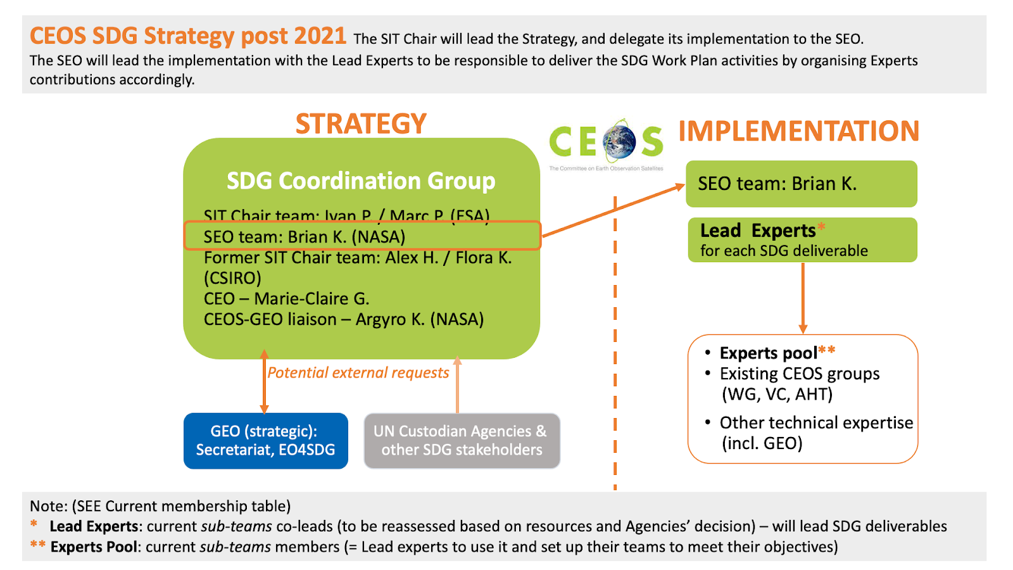
Strategy Implementation overview

Slide 10
Discussion & conclusion
The CEOS SDG AHT is seeking CEOS Principals’ endorsement of the Federated approach which is described in the CEOS SDG Strategy Implementation. The CEOS SDG AHT will thus be dismantled this year.
All current activities & deliverables will be transferred to the new SDG Coordination group – available resources will be reassessed after Plenary
The last 5-years activities & related documentations will remain available on the CEOS website (new section)
Discussion:
  on the proposed federated approach
  Comments & suggestions welcome on the Strategy Implementation

Slide 11
BACKGROUND INFORMATION

Slide 12
SDG AHT Work Plan 2020-2021
Objectives
Coordinate the efforts of the CEOS agencies
to facilitate the use of satellite data in the implementation of
the 2030 Agenda on sustainable development.
Support GEO efforts to advance the uptake of EO in the implementation of the 2030 Agenda on Sustainable Development, acting as a “Space Enabler” to facilitate access and use of satellite data.
Participate to the GEO federated approach on SDGs that aims at harnessing all expertise inside and outside GEO Work Programme (including CEOS) in order to maximize impact.
Contribute to the development of the GEO Toolkits on SDGs coordinated by GEO EO4SDG, which will package all available EO assets in practical guidelines for easy appropriation by countries.
Analyse, in cooperation with GEO, the “satellite data needs” for four selected SDG indicators: 6.6.1 on water-related ecosystems; 11.3.1 on urban land consumption, 14.1.1 on coastal eutrophication, and 15.3.1 on land degradation.
Liaise with other CEOS entities (VCs, WGs, SEO) to harness CEOS collective expertise and maximize benefits.

Slide 13
34th CEOS Plenary Outcome
Decision 34-15 | Plenary agreed to extend the SDG-AHT for one year, with direction for the SDG-AHT to plan a transition of SDG activities to internal (within CEOS) and/or external entities by the 2021 CEOS Plenary.
CEOS-34-16 | CEOS Sustainable Development Goals Ad Hoc Team (SDG-AHT) to prepare inputs (according to the Roadmap proposed) to the 2021 CEOS Plenary outlining the proposed new permanent mechanism. | CEOS Plenary 2021

Slide 14
Transition Roadmap from Plenary to Plenary
SDG AHT Future Workshop
(1/2 day)
Review and discuss the future options, reduce to 2 scenarios (including variants if needed)
Extended discussions in CEOS and GEO
Develop the 2 scenarios in the synthesis paper, identifying resources
34th Plenary
Approval of
SDG AHT extension until end 2021
(with Transition Roadmap)
by CEOS Principals
35th Plenary
Seek CEOS Principals endorsement of the recommended permanent mechanism
Transfer Documentation V1
Draft the documentation
for the transfer to the permanent structure
(ToRs, work plan and strategy outline)
Final round for comments + consolidation of the V2 documentation
OCT
NOV
DEC
JAN
FEB
MAR
APR
MAY
JUN
JUL
AUG
SEP
OCT
NOV
Synthesis Paper V1 substantive analysis of the pros and cons of the different future options (at least 4 options), recalling the results of the AHT survey (Sept. 2020)
Synthesis Paper V2
incl. compelling justifications for the selection of the 2 best scenarios
SIT-36
SDG AHT side meeting
Present conclusions of the extended discussions and choose the best scenario to be recommended to SIT-36
Liaise with relevant CEOS/GEO entities to finalize arrangements for
the recommended option
Transfer Documentation V2
Develop a V2 documentation on the future permanent structure
SIT TW
Present and review details of the recommended option and relevant documentation
SIT-36 SDG session
seek CEOS Principals recommendation to Plenary

Slide 15
Options explored
# | Future Options | Description | Coordination | Work
OPTION 1 | Full-scale option | Create a new CEOS Working Group on SDGs. | The Working Group would perform the full coordination function for CEOS support to GEO on SDGs, including the supervision of the CEOS Work Plan Deliverables and the detailed work plans of the new Working Group | The new Working Group would have its own capacity and resources to perform SDG tasks, in coordination with other CEOS bodies when specific competencies are required and available.
OPTION 2 | Federated option | Transfer the CEOS work on SDGs into existing CEOS entities under an internal CEOS coordination mechanism. | There would be an identified SDG Coordinator or Coordination Team (single individual or group of persons) to which the CEOS coordination role on SDGs would be delegated. | CEOS work in support of the SDGs would be fully decentralised and performed across existing CEOS working teams and entities.
OPTION 3 | On-demand option | Reduce the scope of CEOS support to GEO on SDGs to a responsive model, in line with CEOS External Request process. | The response coordination will be provided by CEOS, in accordance with the CEOS External Request Process Paper. | CEOS would only take action if requested by GEO or by the SDG community (e.g. UN agencies) and essentially for activities in line with the work plans of existing CEOS entities.

Slide 16
Water sub-team
Water-related ecosystems (6.6.1): M. Paganini/ESA, A. Carbonniere/CNES
Sub-Team members:
M. Paganini/ESA, A. Carbonnière/CNES,
Alice Andral/CNES, A. Kavvada/NASA, Nima Pahlevan/NASA, B. Killough/NASA,
Luca De Felice/COM JRC, C. Ishida/JAXA, K. Hamamoto/ JAXA,
Norman Muller/GA, F. Kerblat/CSIRO, E. Smail/NOAA, H. Kim/WMO, D. Cripe/GEO,
in partnership with GEO Wetlands, GEO AquaWatch and GEO GLOWS and collaboration with SDG 6.6.1 co-custodian agencies: UNEP and Ramsar; Countries (NSOs and line ministries and support agencies in charge of water-related ecosystems)
Deliverable Status
“Satellite data for SDG 6.6.1” Technical Report with outreach to custodian agencies (UNEP and Ramsar).
In progress – Ongoing analysis, and Report to be finalised in 2022
2021 Highlights
Review of the UNEP 6.6.1 monitoring methodology and Freshwater Ecosystems
Explorer and associated methodologies, as a basis to identify areas of use and
better uptake of satellite observations within current methodologies.
Discussions with Ramsar on EO approaches to wetland inventories and EO inclusion in the Ramsar Toolkit for National Wetlands Inventories.
Notes:
(1 expert_

Slide 17
Water sub-team
Water-related ecosystems (6.6.1): M. Paganini/ESA, A. Carbonniere/CNES
2021 Highlights (to be continued)
Analysis done for 2 SDG pathways: production of global datasets (top down from UNEP) and development of national capacities (bottom up from Ramsar).
CEOS Agencies are producing global EO datasets for many 6.6.1 sub-indicators and associated variables (GSWE, GMW, CLMS). Identification of areas of dataset improvements.
Multi-sensor approaches needed for all sub-indicators (e.g. water, wetlands, mangroves, WQ) to address limitation of single sensor approaches and better capture temporal dynamics.
Round Robin intercomparison of Surface Water Detection algorithms at 10m based on Sentinel 1 and Sentinel 2, organised by the ESA WordWater project.
Analysis of advances in WSE from RA to infer changes in lake volumes and river discharge.
Initiate a stronger collaboration with GEO GLOWS (e.g. HydroSpace-GEOGloWS WS 2021).
Post 2021 aspiration
Willing to continue the work in 2022 with the support of LSI-VC experts (e.g. in water leaving radiance ARDs). No objection to an integration of the sub-team in a “water” subgroup of LSI.
Notes:
(1 expert_

Slide 18
Urban sub-team
  Sustainable Urbanization (11.3.1): A. Kavvada/NASA, N. Mudau/SANSA
Sub-Team members:
A. Kavvada/NASA, N. Mudau/SANSA
Brian Killough/NASA & CEOS SEO, Garik Gutman/NASA, Bob Chen/CIESIN and GEO Human Planet, Greg Yetman/CIESIN , Peter Caccetta/CSIRO, Flora Kerblat/CSIRO, Alexander Baklanov/ WMO,Thomas Kemper/JRC and GEO Human Planet, Yifang Ban/KHT and GUOI, Mattia Marconcini/DLR, Marc Paganini/ESA
Stakeholders
SDG 11.3.1 co-custodian agency: UN Habitat
Countries and Cities (NSOs, line ministries, city authorities and support agencies in charge of SDG 11)
in partnership with GEO HPI, GEO GUOI
Deliverable Status
SDG-20-07 “Satellite data for SDG 11.3.1” Technical Report to be included in ‘EO Toolkit for Sustainable Cities and Human Settlements’ ‘Learn Path’ hosted by UN Habitat (eotoolkit.unhabitat.org) In progress – Report to be finalised by end of Q4/ 2021.

Slide 19
  Sustainable Urbanization (11.3.1): A. Kavvada/NASA, N. Mudau/SANSA
2021 Highlights
Contributed to the launch of the Earth Observations Toolkit for Sustainable Cities and Human Settlements, eotoolkit.unhabitat.org (UN Statistical Commission side event, 25 February 2021).
Strong collaboration with EO4SDG, UN Habitat, GEO Human Planet, GUOI and over 30 organizations (national statistical offices, mapping agencies, city authorities, academia, research institutions, non-governmental organizations, space agencies, and the private sector).
Summary inventory of EO data, tools, and use cases (e.g., derived urban extent products based on EO and open source processing tools, such as GHSL, Trends.Earth Urban Mapper, U-TEP, ODC from CEOS agencies) included in the Toolkit.
Degree of Urbanization as method to delineate cities, urban and rural areas (approved by the UN Statistical Commission for international comparison): need for more rigorous validation or inter-comparison to evaluate the usefulness of global public datasets and tools for national and sub-national reporting (SDGs, NUA)
Contributing to development of 11.3.1 one-pager as well as ‘ease of use’, ‘FAIRness’, and ‘authoritative data’ frameworks to be integrated into the Toolkit.
Q4 2021 & Post-2021 aspiration
•Collaboration with Esri and UN Habitat to develop 11.3.1 Learn Path as part of the Toolkit
•Collaboration with WGCapD in multi-part training on the Toolkit
•Collaboration with LSI VC (e.g., development of new CARD4L data pipelines (e.g., VIIRS Nightlights), Landsat-Sentinel Harmonized dataset)

Slide 20
Marine pollution
Coastal eutrophication (14.1.1), via COAST: E. Smail (NOAA, Blue Planet)
Team’s organisation Led by CEOS COAST team -> GEO Blue Planet working group that collaborates with CEOS on space data needs for specific projects.
In partnership with GEO Blue Planet & GEO AquaWatch
Deliverable Status: SDG-20-05 Satellite data requirements for 14.1.1 (marine pollution)
Iterative document to be completed as per users requirements (inputs to be refined in 2022)
2021 Highlights
Satellite chlorophyll sub-indicator data included in 2020 SDG report
Working with regional UN Environment leads to bring together the national statistical offices and the national scientists and CEOS agencies to improve the utility of indicators and develop useful tools for member countries
Post 2021 aspiration:
GEO Blue Planet & AquaWatch Initiatives will continue to work with CEOS-COAST on pilots to develop new and improved national/regional indicator approaches for eutrophication implemented using fit for purpose OCR products (existing & emerging) from CEOS agencies;
Further development is needed of merged/gap-free coastal ocean colour products (chlorophyll-a et al.) at highest possible spatial resolutions; CEOS-COAST & Blue Planet/AquaWatch interested in working with OCR-VC on emerging approaches/solutions for global & regional/national needs;
CEOS-COAST & Blue Planet/AquaWatch to pursue AI/ML approaches that provide an integrated, trans-boundary approach for an improved coastal eutrophication indicator using both land/sea data.

Slide 21
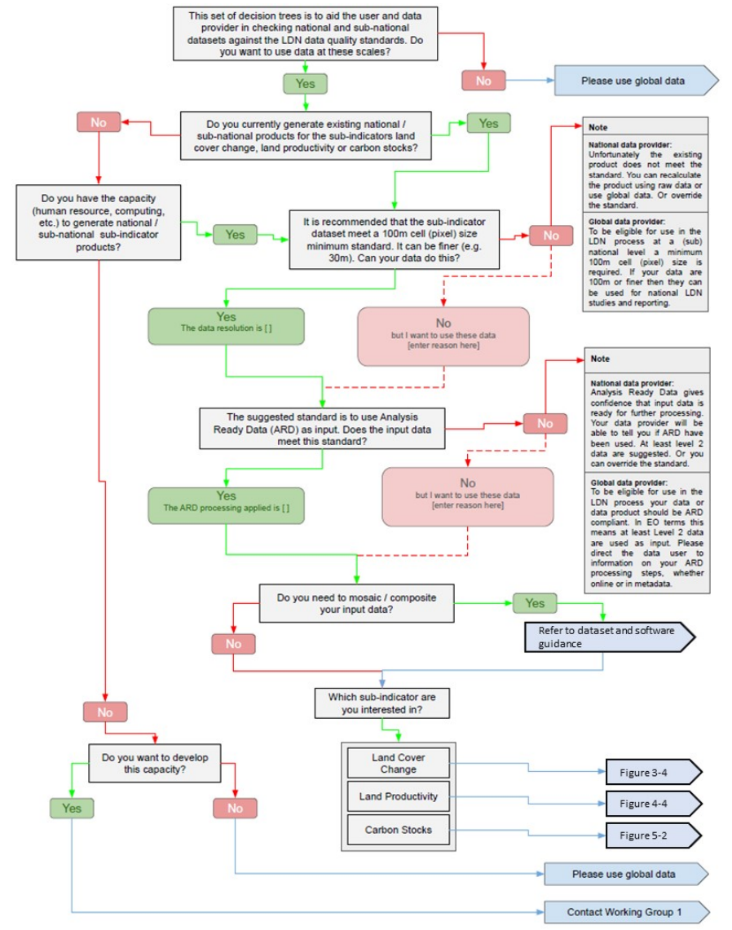

Land degradation
Land degradation (15.3.1): N. Sims/CSIRO, U. Heiden/DLR
    Sub-team members
    N. Sims/CSIRO, U. Heiden/DLR, F. Kerblat/CSIRO,
    B. Killough (NASA), N. Mueller (GA), M. Paganini (ESA), C. Ishida (JAXA),
    K. Hamamoto (JAXA)
    Deliverable
    SDG-20-06: Satellite data requirements for SDG Indicator 15.3.1.
    Ongoing analysis - In progress - to be completed in 2022
    Revised GPG for 15.3.1 released in Oct 21
    Updated dataset recommendations
    Data quality decision trees for Indicator and sub-indicators
    2021 Highlights
  Decision trees and updating of GPG
    Reference ARD, CEOS
    Post 2021: visions and aspirations
  Reviewing data needs after SDG reporting period
    Data collated by UNCCD
  Connecting GEO LDN activities to CEOS
    Potential elevation of GEO LDN

