Slide 1
CEOS GST Portal
Stephen Ward
For the Australian SIT Chair and NASA CEOS Chair Team
Agenda Item 19
2021 CEOS Plenary
Virtual Meeting
1-4 November 2021

Slide 2
Heritage & approach
SIT Chair Team had action from SIT-36 to prepare a dedicated area on ceos.org for our dataset contributions to the GST
Consolidated presentation of the various GHG and AFOLU datasets and associated guidance
A thin layer of introductory information to help users find relevant CEOS contributions in one place
Progressed as a SIT Chair - CEOS Chair cooperation and 2021 outcome
Slide ‹#›

Slide 3
Contributions
CEOS GST Data Portal (ceos.org/gst) is the culmination of significant work by dozens of dataset teams across CEOS agencies and working teams
Big thanks to the GHG and AFOLU teams in particular for development of the template and provision of consistent information to explain and characterise the different entries
Slide ‹#›

Slide 4
ceos.org/gst
Organised by:
CO₂ & CH₄
Above Ground Biomass
Forests
Mangroves
Agriculture
Land Cover
Slide ‹#›

Slide 5
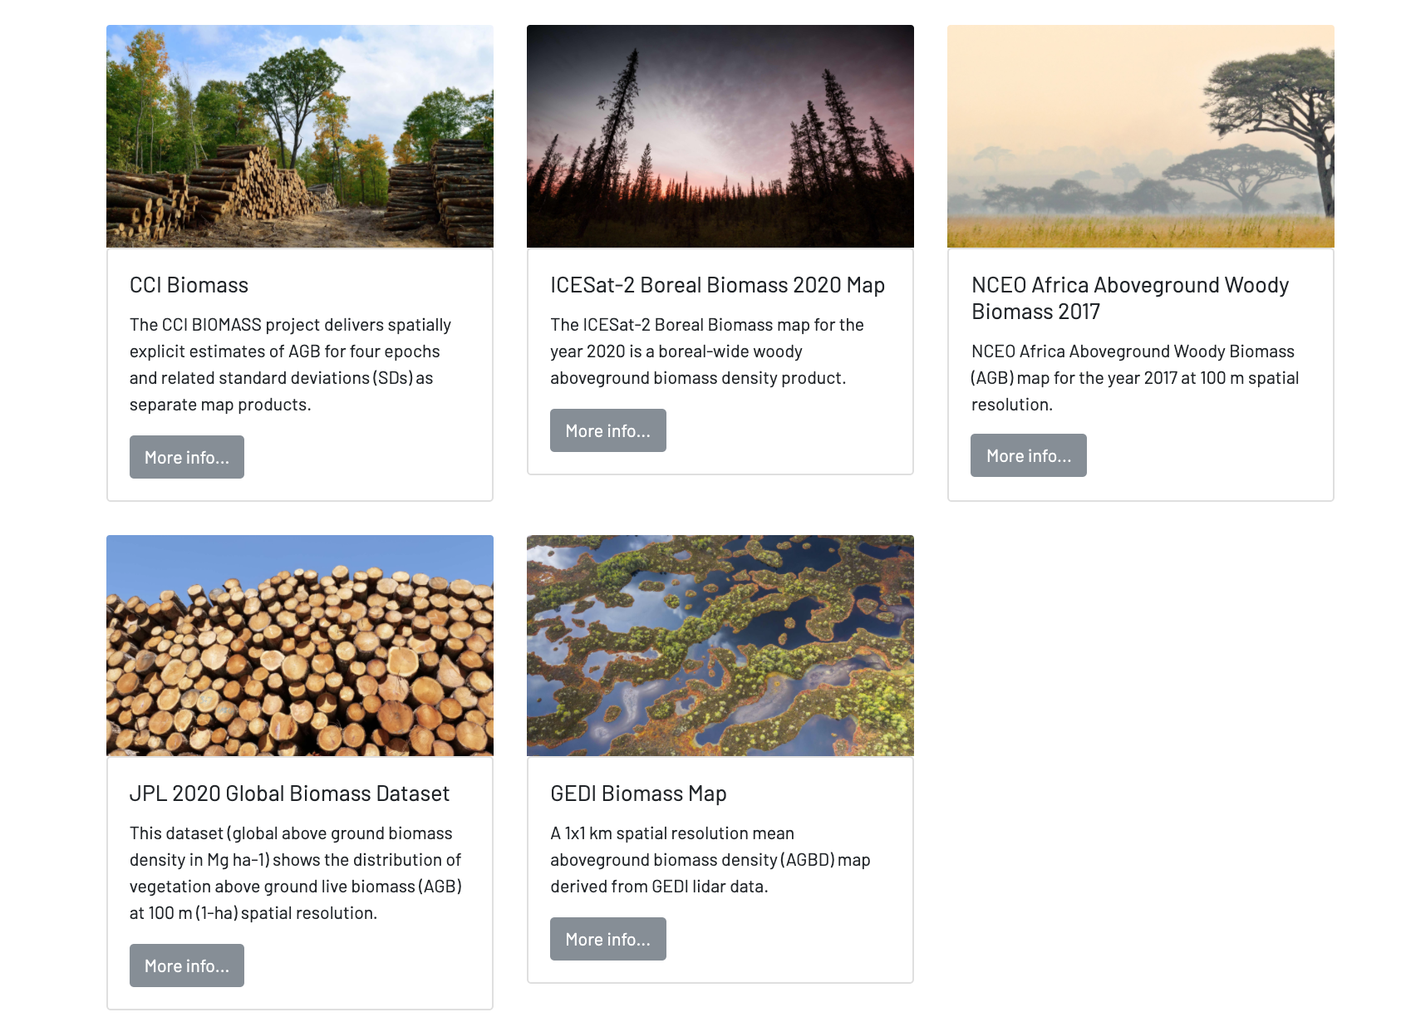
Dataset descriptions
Dataset description
Pointers on usage
Methodology
Uncertainty & Accuracy
Sustainment
Associated Guidance
User Manual
Point of Contact for help
All in English, French and Spanish
Slide ‹#›

Slide 6
Deployment and future
Please advertise this new resource, at COP and beyond
V1 was expedited for COP-26 as a milestone in the GST Process
SIT Chair Team will continue to evolve the resource consistent with
the GST Schedule and CEOS GST Strategy
developments in the supporting CEOS datasets
feedback from agencies and users
will integrate links to other CEOS info systems including MIM
Slide ‹#›

Slide 7
Thank you...visit ceos.org/gst !
To the numerous teams tolerating our deadlines for the Portal
To CEOS and SIT Chair Teams for effective cooperation
Slide ‹#›

