Slide 1
CEOS AFOLU Roadmap
2021 Progress and Next Steps
Osamu Ochiai (JAXA)
Frank Martin Seifert (ESA)
Sylvia Wilson (USGS)
Mark Dowell (EC-JRC)
Ben Poulter (NASA)
Agenda Item 18
2021 CEOS Plenary
Virtual Meeting
1-4 November 2021

Slide 2
Agenda item
2021 progress
Osamu Ochiai, JAXA & Frank Martin Seifert, ESA
National user engagement
Sylvia Wilson, USGS
GHG-AFOLU cooperation
Mark Dowell, EC-JRC
2022 plans and agency support
Ben Poulter, NASA
5 mins
5 mins
5 mins
5 mins
Slide ‹#›

Slide 3
Desired Outcomes from Agenda Item
Principals’ understanding of the opportunity presented to space agencies by the UNFCCC Global Stocktake process and the importance of the land sector within it
Including … the new dimension to our national user engagement
the necessary linkages with GHG
Clarity on the way forward and approach required
Key agencies commit representatives and resources
Slide ‹#›

Slide 4
Global Stocktake
Space agencies (CEOS & CGMS) have emphasised ECVs and Physical Climate via the GCOS framework very effectively for the past decade
The importance of NDCs to Paris Agreement, and specifically the Global StockTake (GST), raises new challenges around country needs and implications for using EO data with greater emphasis on mitigation and adaptation, and national-level datasets
A whole new dimension to our climate coordination - both a huge opportunity and a significant challenge
“...if Land Use, Land Use Change and Forestry targets involved in the initial NDCs were implemented in full, this would represent approximately a quarter of pledged mitigation efforts up to 2030“
SIT-35 action: JAXA and ESA explore the development of a CEOS AFOLU (Agriculture, Forestry and Other Land Uses) Roadmap. The aim of the Roadmap is to assess the will, direction and capability of the relevant CEOS Agencies, with the SIT Chair team supporting communications with Principals and identifying team nominees.
Slide ‹#›

Slide 5
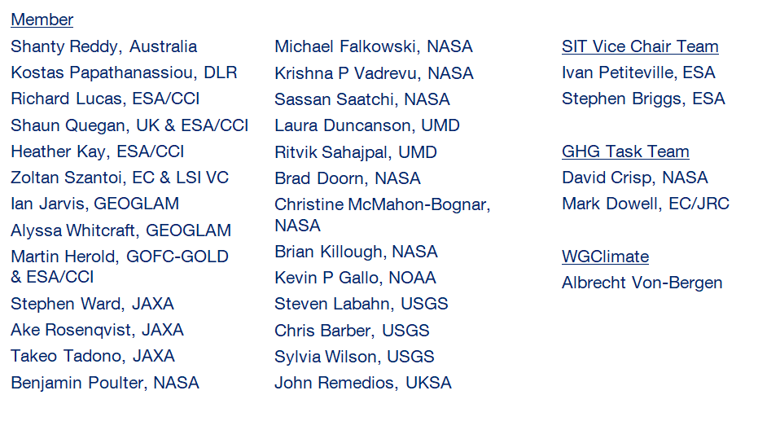
AFOLU Team Participation
LSI Forest & Biomass SG
Co-Lead: Osamu Ochiai, JAXA & GFOI Co-Lead
Co-Lead: Frank Martin Seifert, ESA & GFOI Co-Lead
Slide ‹#›

Slide 6
Heritage
SIT-35 action in March 2020
Discussion Paper prepared for October 2020 Plenary
A CEOS AFOLU Initiative for the UNFCCC Global Stocktake Process:
A Discussion Paper for CEOS Plenary to explore the development of a CEOS AFOLU Roadmap
In consultation with GHG team, agreed a laser focus during 2021 on having preliminary AFOLU products ready for COP-26 in support of GST-1
In parallel: new engagement axis with national inventory users, building on our GFOI experience and in the spirit of the ambition cycle of the Paris agreement to learn together and grow together
Also supporting CEOS input to the SO Synthesis Report
Slide ‹#›

Slide 7
Heritage & 2021 Approach
SIT-35 action in March 2020
Discussion Paper prepared for October 2020 Plenary
A CEOS AFOLU Initiative for the UNFCCC Global Stocktake Process:
A Discussion Paper for CEOS Plenary to explore the development of a CEOS AFOLU Roadmap
2021 approach
  Assessment of latest AFOLU products that could be readied for COP-26
  Engagement of relevant product teams and identification of team leads for our purposes
  Coordination with SIT Chair Team and GHG Team to establish a working template for each dataset and its inclusion on the new CEOS GST Portal – as a unified point of entry to explain and offer our data
  New engagement axis with national inventory users, building on our GFOI experience and in the spirit of the ambition cycle of the Paris agreement to learn together and grow together
Slide ‹#›

Slide 8
AFOLU Dataset Summary
 | COP-26 (Nov 2021) | GST1 (2021-23?) | Beyond (2024+) | Notes
Forest - Above Ground Biomass | Fall back is individual existing datasets (originally aimed at synthesised biomass product providing estimates at a jurisdictional level globally) | Synthesized, jurisdictional level biomass, emission factors (and prototype biomass change) | Synthesized spatially explicit, annual biomass, emission factors and biomass change | Work plan and schedule provided
Land Cover & Forest (Area) | - Copernicus annual global land cover - C3S/CCI Land Cover - WorldCover, HILDA+ - Global Forest Watch tree cover loss and forest fluxes | Synthesised map products and estimates of land cover and change at regional, and global levels Global tree cover and forest emissions and removals | Statistically robust activity data estimates (6 IPCC classes) at national and global levels Global annual forest emissions and removals at 30-100 m resolution. | GOFC-GOLD coordination proposed
OLU - Mangroves & Wetlands | - Global Mangrove Watch cover and change (1996-2016) - Global Mangrove biomass (2000) | Global mangrove cover and change at 25 m (2019+) Global mangrove biomass at 12 m (2015) | Global annual mangrove emissions and removals at 10-25 m resolution. | In coordination with GMW
Agriculture | Demonstration WorldCereal products for at least 5 countries (Argentina, Spain, France, Ukraine and Tanzania) | Initial WorldCereal map and analytical system. On-going seasonal analysis products | Continual system improvement and production of seasonal state and change products | In coordination with GEOGLAM
Slide ‹#›

Slide 9












Our AFOLU offering for the GST Portal
Above Ground Biomass
Land Cover
Future - synthesised biomass product providing estimates at a jurisdictional level globally
Global Land Cover
HILDA+
Forests
Mangroves
Agriculture
Refer to ceos.org/gst for further details on individual datasets & their application

Slide 10
Roadmap signposts
Ben on next steps
Pragmatic focus for delivery to GST1 and GST2 like GHG Roadmap
Simplify the offering to users – too many datasets = too much choice. Harmonised & recommended products per the biomass ambition
Engage with countries and stakeholders in case studies to improve understanding and uptake of EO data by countries
Take actions to assure the policy relevance of new capabilities (eg, through measures such as the CEOS Biomass Protocol)
Improve EO capabilities to better meet the needs of the Convention and Parties, globally and on national level
Providing new measurements that do not currently form part of CEOS agency capabilities
Continue to engage in policy process and increase efficiency and effectiveness by which climate data requirements are set and to which CEOS and CGMS space agencies respond
Ensure integration with GHG roadmap and products
Sylvia on user engagement
Steve on GST
Mark on GHG-AFOLU
Slide ‹#›

Slide 11
National User Engagement
Sylvia Wilson, USGS & SilvaCarbon
Slide ‹#›

Slide 12

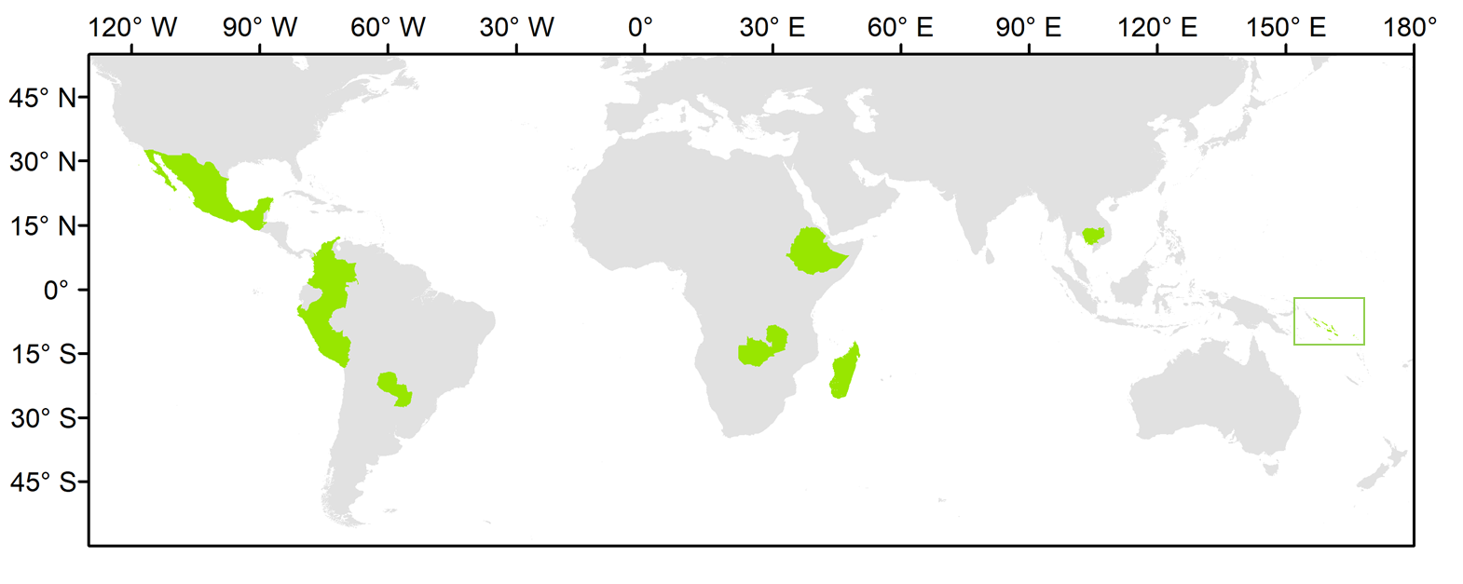
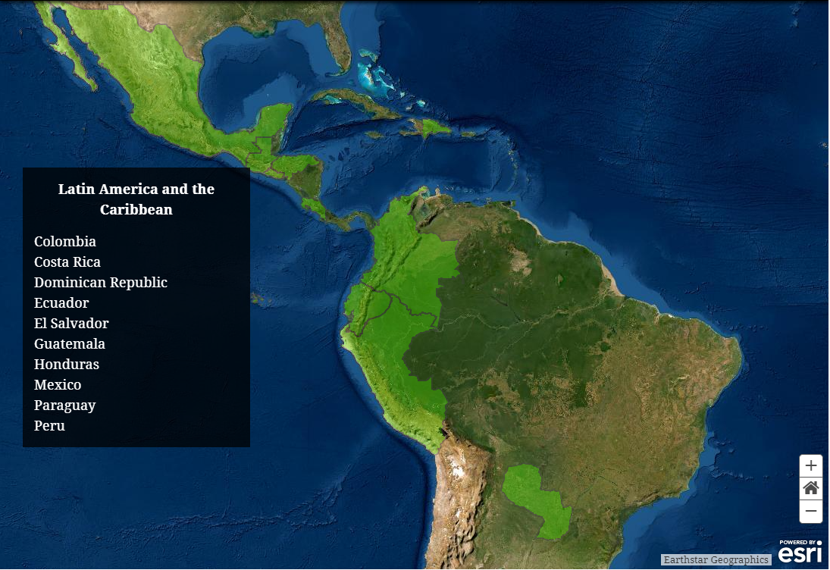
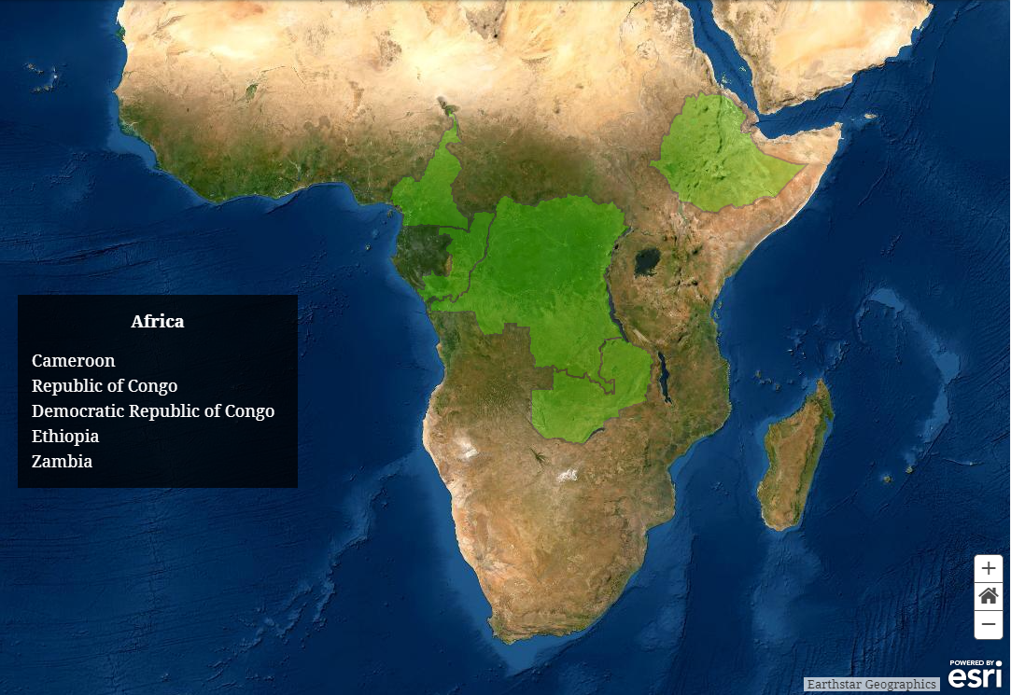
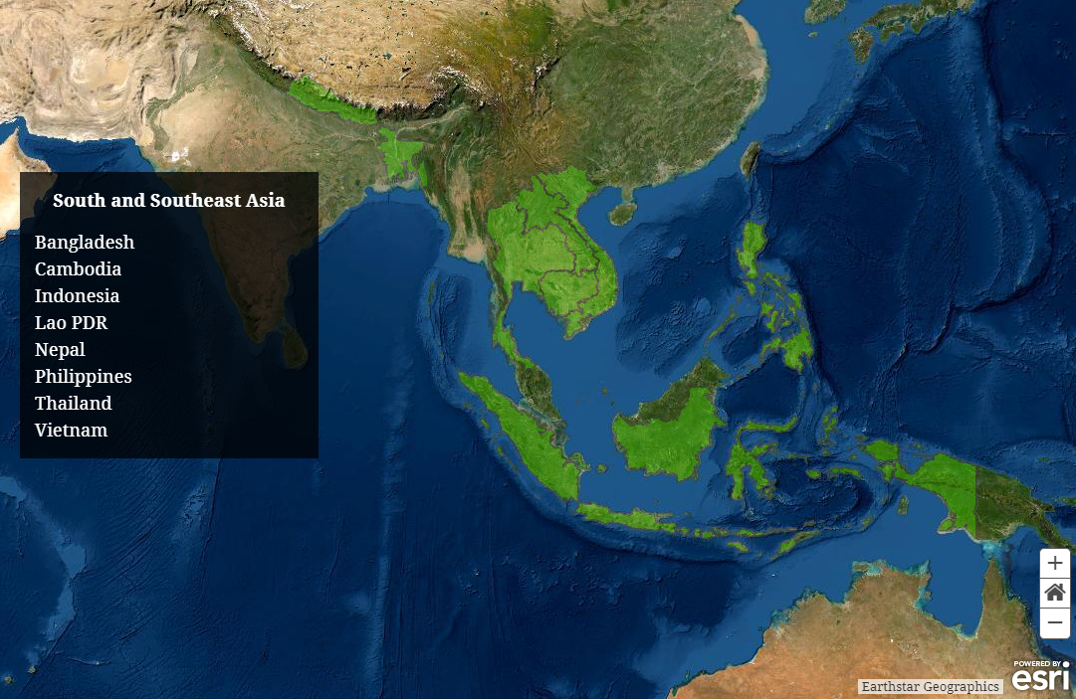
National User Engagement
Demonstration of uptake of satellite-based data and derived products in country reporting to the UNFCCC
 |  |  | indicators of MRV capacity
Country | Region | Status | FREL | BUR REDD+ Annex | BUR | NIR | NFI
Cambodia | Asia | LDC | 2017; 2021 | 2020 | 2020 | 2020 | No
Colombia | Latin American | n.a. | 2015; 2020 | 2016, 2019 | 2015, 2018 | 2019 | Yes
Ethiopia | Africa | n.a. | 2016 | n.a. | n.a. | n.a. | ?
Guatemala | Latin American | n.a. | n.a. | n.a. | n.a. | n.a. | Yes
Madagascar | Africa | LDC | 2017; 2018 | n.a. | n.a. | n.a. | Yes
Mexico | Latin America | n.a. | 2015; 2020 | n.a. | 2015, 2019 | 2019 | Yes
Paraguay | Latin America | n.a. | 2016 | 2019 | 2015, 2018 | n.a. | Yes
Peru | Latin America | n.a. | 2016; 2021 | n.a. | 2014, 2019 | 2019 | Yes
Solomon Islands | Asia | LDC | 2019 | n.a. | n.a. | n.a. | No
Zambia | Africa | LDC | 2016; 2021 | n.a. | 2020 | n.a. | Yes
validation of the harmonized biomass map (additional NFI data)
Solomon Islands

Slide 13
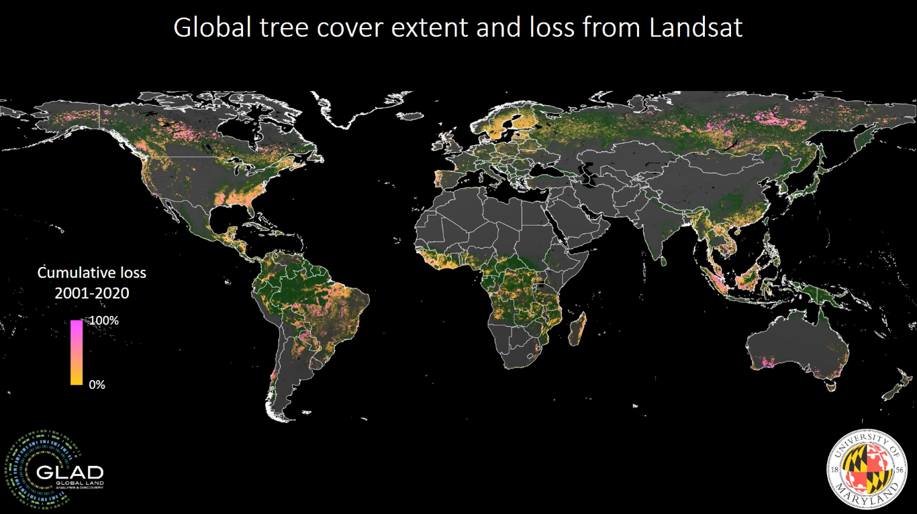
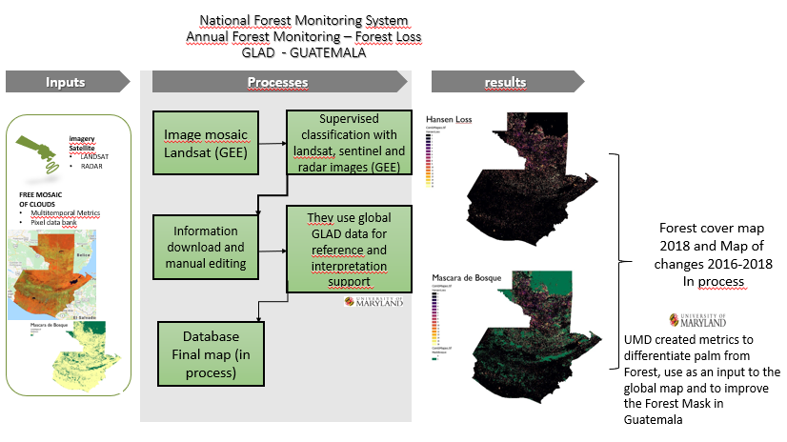
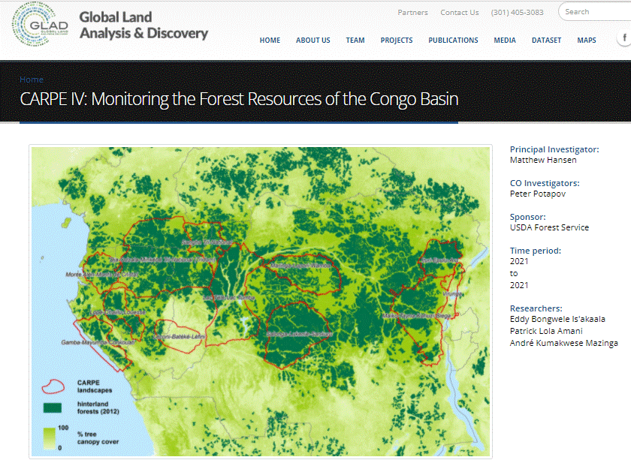
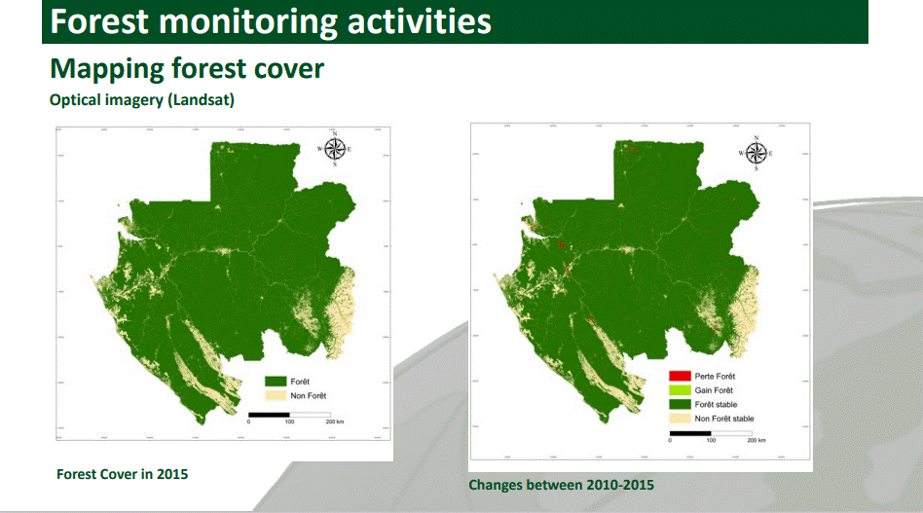
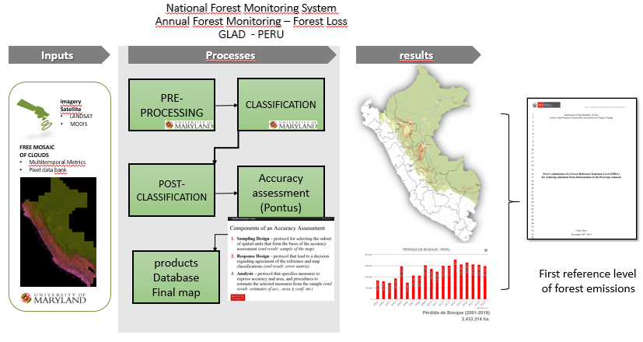
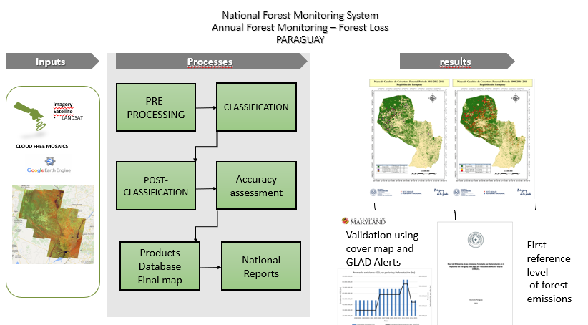

Slide 14
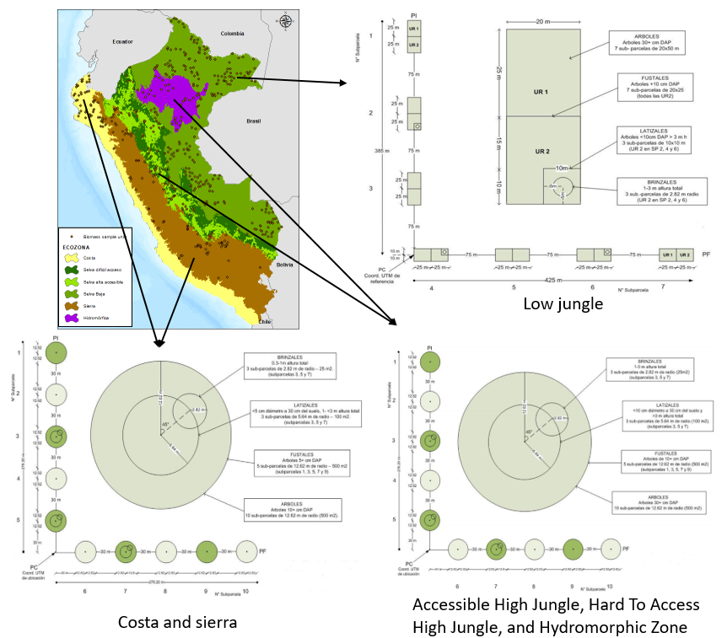
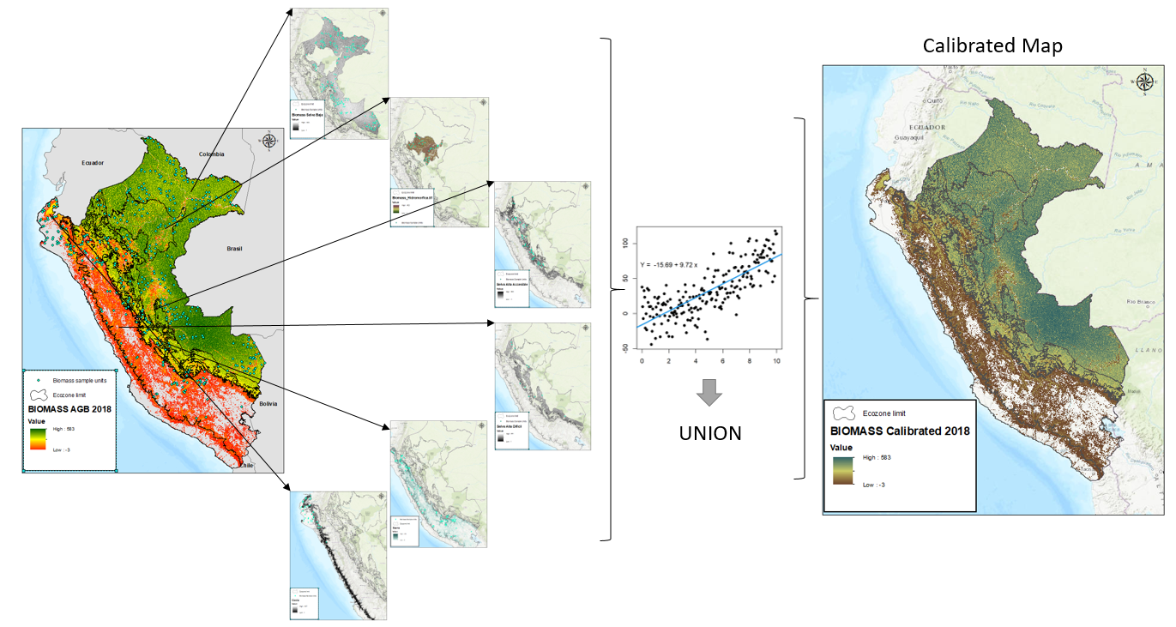
Biomass – Calibration of Global CCI Biomass Map in Peru
Current work:
1. Peru is using the CCI biomass map (AGB) to update ecozone emission factors in the Peruvian Amazon.
2. calibrating these maps using parcel field data to obtain a spatially explicit biomass map for all ecozones in Peru.
The carbon stored in the forests of Peru is measured from NFI Data by ecozones:
Coast,
Highlands
Accessible High Forest
High Forest of Difficult Access
Low Forest

Slide 15
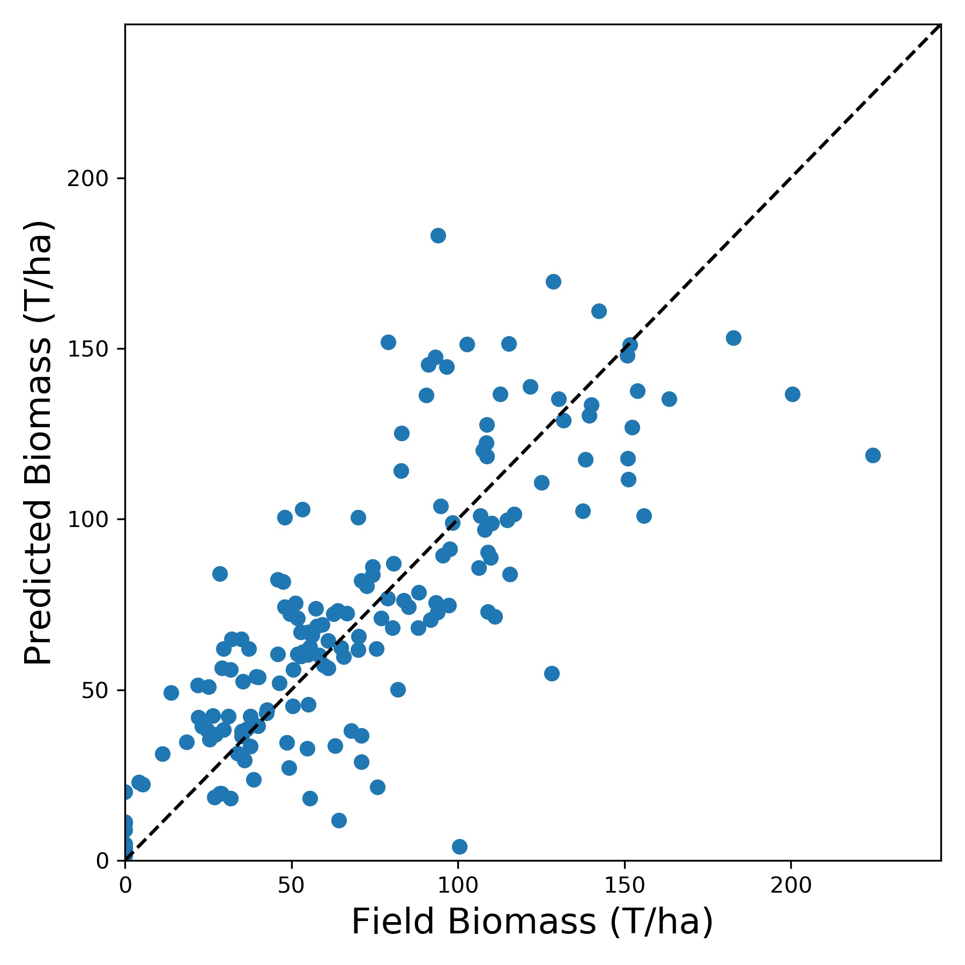
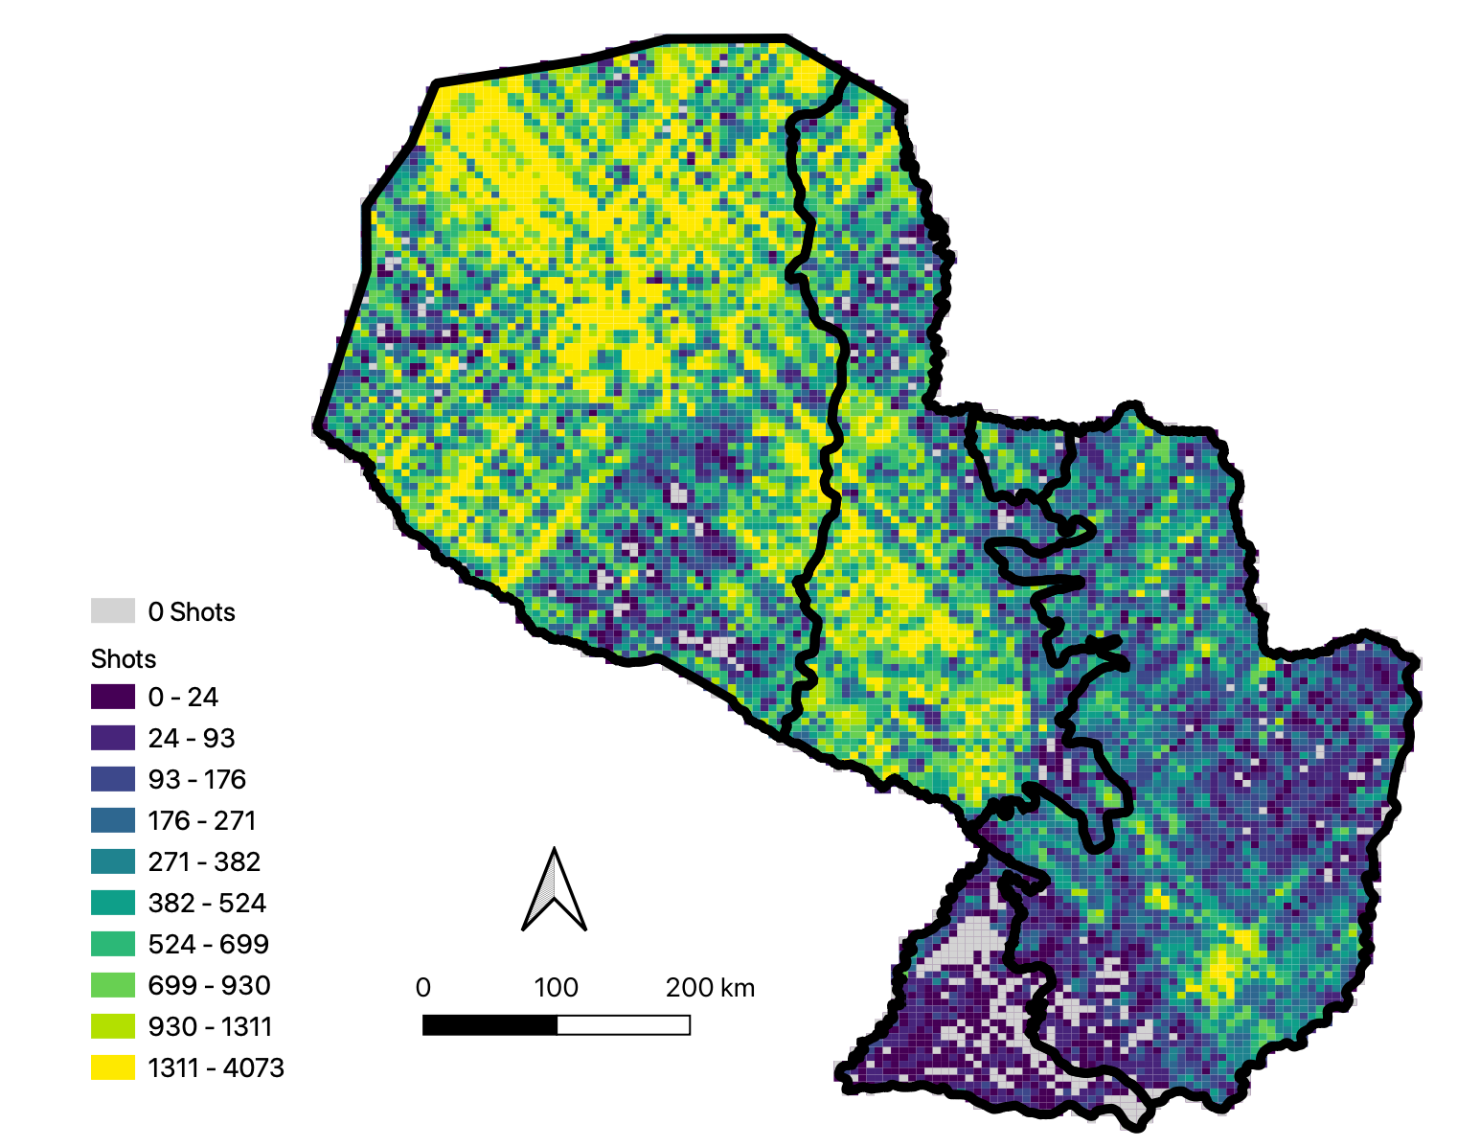
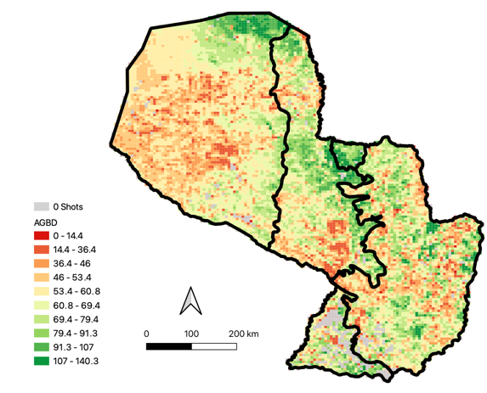
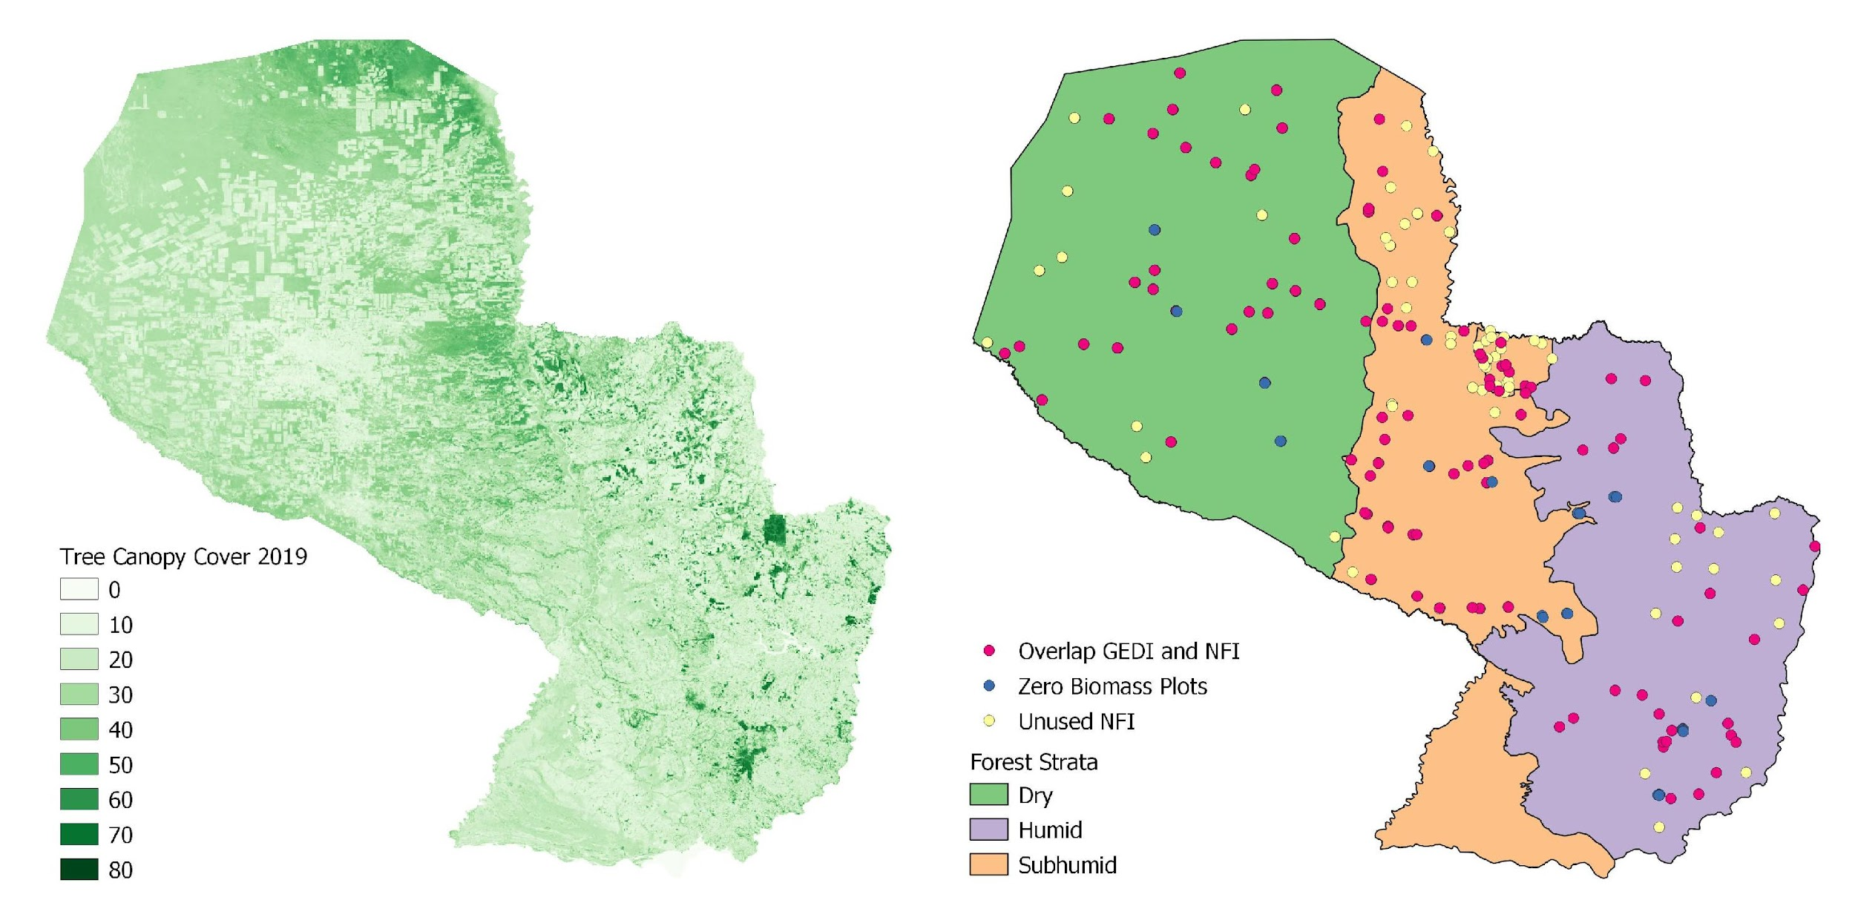
Model Overview
Paraguay GEDI inclusion on Emission Factors
Two primary outputs:
  Map of biomass at 6 km pixel resolution
  Statistical estimate of mean biomass and margin of error
Updates biomass estimates from inventory to 2020
Estimate can be made at national, regional, local, or forest scale
Applicable in remote and inaccessible forests and in countries without a well-established forest inventory
Statistical estimation of mean biomass and margin of error
Remote sensing datasets calibrated with forest inventory data
Inputs: Field measurements of biomass, GEDI data, canopy cover, and forest strata
Predicted Versus Observed Biomass
GEDI
Tree Canopy Cover
Forest Strata and Field Plots
Notes:
We are piloting a methodology in Paraguay that integrates remote sensing and forest inventory data into a model to estimate aboveground forest biomass.
The model uses LiDAR measurements from the GEDI mission, a Landsat tree canopy cover dataset, and forest type information to predict biomass at our field plots. These datasets are spatially explicit and therefore cover the entirety of Paraguay’s vast and often inaccessible forests.

Slide 16
Moving Ahead….
Request of NFI or ground based data for calibration and validation of pantropical and global biomass datasets (ABG) – 27 countries
Include case studies of Biomass in NASA Biomass Dashboard
Validation of other CEOS datasets (World Cover, Hilda+ and Copernicus)
Engagement with other partners (GFOI and FAO)
Thanks!
Sylvia Wilson
snwilson@usgs.gov

Slide 17
GHG-AFOLU Cooperation
Mark Dowell, EC-JRC
Slide ‹#›

Slide 18


GHG-AFOLU Workshop (... finally)
Workshop on Systematic Observation contributions and synergies for GHG & AFOLU in support of UNFCCC
Start dialogue between the different Earth Observation communities addressing the needs of UNFCCC
In particular, atmospheric GHG monitoring and those addressing aspects of the AFOLU sector
15th, 18th,19th November
Involving many relevant International coordination mechanisms
Address the "soft" coordination and stakeholder engagement aspects i.e. interface with the Convention, the UNFCCC Secretariat and Party user groups, but also more technical aspects of reporting, outputs datasets, formats, avoiding "double - accounting" and the longer-term ambition of using diverse earth observation datasets in the modelling and MVSs being developed
Topic => Questions => Discussion => Recommendations (report)

Slide 19
Agenda and Guiding Questions
15 November | 18 November | 19 November
Intro Session | Overview 2 (15min) | Overview 4 (15min)
Intro Session | Question 2 (60min) | Question 4 (60min)
Overview 1 (15min) | Overview 3 (15min) | Overview 5 (15min)
Question 1 (60min) | Question 3 (60min) | Question 5 (60min)
Overview/Question 1: User need/requirements
Overview/Question 2: Datasets & Standards
Overview/Question 3: Links to Carbon Cycle Community
Overview/Question 4: Research Needs
Overview/Question 5: Towards a Common MVS System

Slide 20
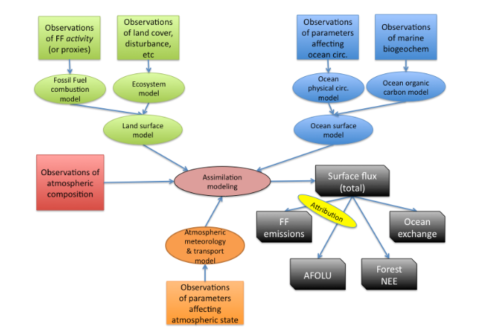
Question 3 (& 2)
from Ciais et al. 2014
Recommendation 1: WGClimate GHG Task Team should consult with the relevant elements of CEOS, including Associates such as ISC, WCRP and GCOS, together with modelers, to check the GHG Implementation roadmap on completeness concerning requirements for terrestrial observation (SIF; NPP, landcover, biomass, etc.) for supporting mitigation actions through the development of MVS. The actions in Annex C of the roadmap shall be complemented as needed.
From (propose) CEOS GST Strategy. Also addresses Recommendations 2 & 4 as well
Link to CEOS Carbon Strategy - See progress on certain topics in additional material [Link]
Also follow-on plan for target ECV Gap Analysis workshop (Feb 2022) - incl. Oceans
Notes:
Question(s): How can the EO community addressing GHG and AFOLU establish closer links to the Carbon Cycle Community? To better address issues on: differences in the timescale of products; possible issues of double "accounting"; and other internal inconsistencies. Are the current biosphere models fit-for-purpose - for the longer term MVS needs? Are there missing coordination mechanisms to assist in this dialogue?

Slide 21


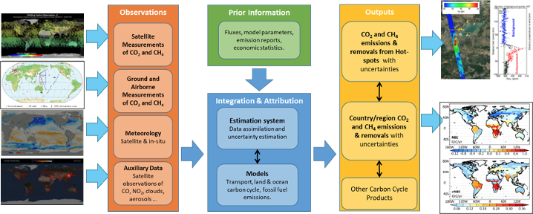
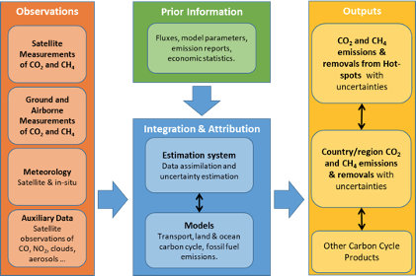
Question 5: Towards a common MVS
Should we be thinking of a common MVS for both GHG and AFOLU sector users? if so - how do we get there, joint Roadmap? To start can we agree on a common GHG-AFOLU System overview?
?
AFOLU
?
GHG

Slide 22
2022 Plans & Agency Support
Ben Poulter, NASA
Slide ‹#›

Slide 23
2022 Plans
2020-21 efforts took stock of relevant capabilities and focused on ensuring relevant datasets were on the table for COP-26 and GST1
We now have more time to develop a considered strategy for an evolution of our GST AFOLU engagement that is in step with the timetable and process of the GST, the ambition cycle of the Paris agreement and the reporting needs of countries
Signposts from the road so far:
  We must simplify the offering to users. Fewer options means harmonised and recommended datasets
  Country engagement will be key
  We must ensure integration with GHG roadmap and products
Slide ‹#›

Slide 24
2022 Plans
A full roadmap should provide a long-term framework, including:
  Engagement in the policy process
  Engagement with countries and stakeholders
  Active participation of the major land surface observing programmes of CEOS agencies and of the respective dataset teams
  Internal coordination within CEOS, including with the GHG Task Team, LSI-VC, our GFOI reps etc (oversight of the CEOS GST Strategy will be provided by SIT Chair)
  Feedback to the agency mission and product planning processes
Slide ‹#›

Slide 25
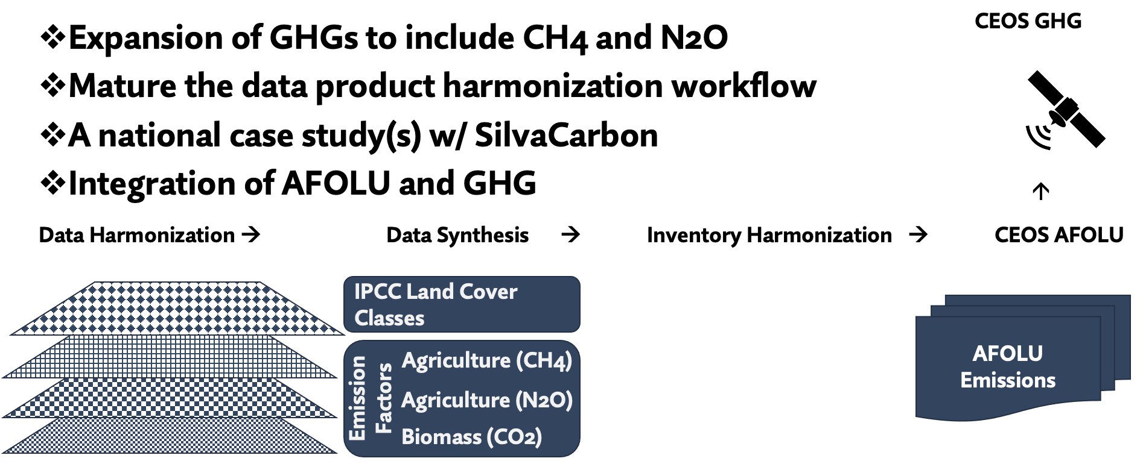
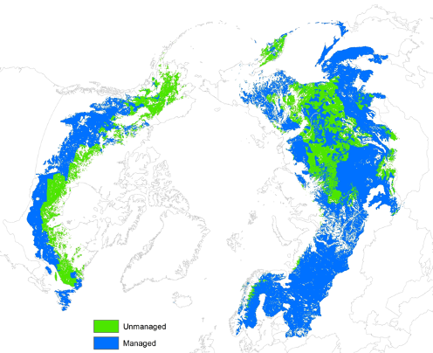
AFOLU Roadmap 2022 Plans & Agency Support
Slide ‹#›

Slide 26
Agency Support
NASA (Ben Poulter) will step up to join JAXA (Osamu Ochiai) and ESA (Frank Martin Seifert) as co-lead of the AFOLU Roadmap Team
Principals of all major land observing programmes are encouraged to confirm support for this major initiative
  A step change in capacity is needed
  Confirmation of new representatives welcome
  Re-confirmation and support of existing representatives also welcome
Key agency programmes include those of : ESA, EC, NASA, USGS, JAXA, CNES, DLR, CSA, amongst others
Slide ‹#›

