Slide 1
CEOS / CGMS Working Group on Climate Plenary Report 2021
A. von Bargen, DLR
J. Privette, NOAA
Conference Agenda Item # 1.14
2021 CEOS Plenary
Virtual Meeting
1-4 November 2021

Slide 2
Updated ECV Inventory
ECV Inventory updated (v4) and released online on 29 October
Metadata on ~1,300 climate data records (current & planned)
Key ECV gaps filled with new CDRs
Additional agencies contributed
Gap Analysis 3.0 close to finalization (late 2021)
Gap Analysis 4.0 via February 2022 workshop. Focus: Carbon Cycle variables
Request to agencies
Accepting new CDR entries throughout year – no limited “Open Seasons”
Support Gap Analysis 4.0 with Subject Matter Experts (invitations forthcoming)
http://climatemonitoring.info

Slide 3
CDR Use Cases Going Online
https://climatemonitoring.info/use-cases/
Use Cases for CDRs in ECV Inventory
Showcases CDR value in climate monitoring, modeling, applications, services
18 received covering wide range of applications
Independent review by Subject Matter Experts
NOAA Communications Team transforms to publication quality
5 now online (rolling publication dates)
Request to agencies
Continue submitting new Use Cases – no limited “Open Seasons”
Advertise through your partners, user communities and organizations
Benefit: Web presence and WMO-sponsored publication (forthcoming)

Slide 4
Greenhouse Gas Task Team
See also under http://climatemonitoring.info
Guided by AC/VC White Paper & GHG Roadmap
New representatives appointed for each CGMS major Working Group
In-situ community is now represented
Presentation of Agriculture, Forests and Other Land Use (AFOLU) Roadmap at WGClimate meeting
Reporting in Session 2

Slide 5
Coordination with GCOS
See also under http://climatemonitoring.info
“Space element” in GCOS: WGClimate contributes to GCOS Status Report and supports Implementation Plan
GCOS requirements: Regular dialogue with GCOS on new application-oriented requirements
Advocating space observations in GEO Climate Change Working Group

Slide 6
Coordination with UNFCCC/SBSTA
See also under http://climatemonitoring.info
WGClimate provides single official CEOS conduit to UNFCCC
Coordinated CEOS contributions
Joint CEOS/CGMS Statement to UNFCCC
SBSTA/RSO Earth Information Day (1 presentation and 5 posters)
UNFCCC Structured Expert Dialogue Session (1 poster)
Representing CEOS (& CGMS) in authorship of synthesis paper on the coordinated contribution of the systematic observation community to the first Global Stocktake

Slide 7
Endorsement of Statement for COP-26
Subject of endorsement: Statement Reporting on Progress by the Committee on Earth Observation Satellites (CEOS) and the Coordination Group for Meteorological Satellites (CGMS) on Coordinated Response to UNFCCC Needs for Global Observations
Statement given by the Party delegation (U.S.) of the CEOS chair (NASA) during the SBSTA opening session of the UNFCCC/COP
Drafted by Working Group on Climate with review and approval in CEOS and CGMS
Final version approved by the U.S. State Department
Final version recommended for endorsement

Slide 8
Joint CEOS/CGMS Working Group on Climate
Back-Up Slides

Slide 9
Gap analysis workshop
Focus of gap analysis is with Carbon Cycle
Shall allow a way forward wrt rec.1 & 2 of the Global Stocktake Strategy
Mid November: JRC workshop on AFOLU bringing together communities as of GHG and AFOLU
Small team prepares in advance priorities in ECVs and variables not covered by the ECV list of GCOS
Primary goals
Find gaps in the CDRs and formulate recommendations
Allow GHG task team members, AFOLU team members and additional experts figuring out concrete way forward with respect GST strategy recommendation 1
Set-up for recommendation 2
Addressed experts: space agencies, scientists, CEOS VCs & WGs and others

Slide 10
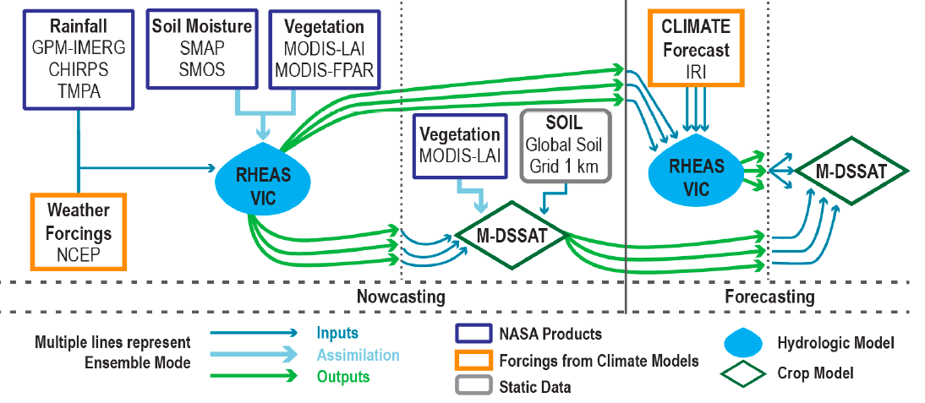
Use cases
18 Use Cases are received, covering a wide range of application areas (i.e., food security, wildfire monitoring, climate extremes, coastal environment, insurance, global stocktake …). Additional use cases are announced
These cases are reviewed by subject matter expert and 5 cases are now published on https://climatemonitoring.info/use-cases/
Marine climate change and the impact on coastal regions
Impact of wildfires on air quality in Sub-Saharan African (SSA)
Use of Seasonal Forecasts for Food Security Analysis in Kenya
Soil moisture estimation over agriculture fields using synthetic aperture radar
Developing a top-down carbon dioxide and methane inventory to aid the global stocktake
Use case is a continuous activity for the Working Group on Climate and your continued support (contributing and reviewing cases) is greatly appreciated
Climate data records from satellite observations are used as inputs to hydrologic model (VIC) and crop model (DSSAT) to provide food security analysis for advance planning.

Slide 11
Working Group meeting schedule
Schedule | High-level | WG meeting | Participation
November 2020 | CEOS plenary
December 2020 | UNFCCC / Earth Information Day
January 2021
February 2021
March 2021 | CEOS SIT | WG meeting
April 2021 |  | WG meeting
May 2021 | CGMS plenary
June 2021 |  | GHG Task Team
July 2021
August 2021
September 2021 | CEOS SIT TW
October 2021 |  | WG meeting & GHG Task Team
November 2021 | COP-26 / Earth Information Day

