Slide 1
WGDisasters
David Green, NASA
Session 1.13: CEOS Core Business
2021 CEOS Plenary
Virtual Meeting
1-4 November 2021

Slide 2
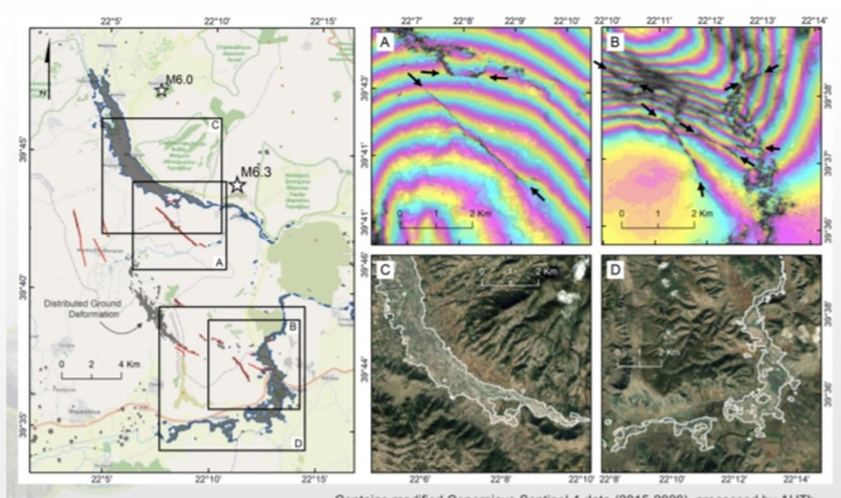
WGDisasters Progress
Advancing CEOS Chair Theme: “EO Data for Open Science and Decision Support”
Promoting Access, Use and Utility of Space Data for Disaster Risk Management
WGDisasters Strategy Paper endorsed SIT 2021 continues to guide WG direction
International Charter Space and Major Disasters (Response Support)
“Observer Status” confirmed and Value-Added Product sharing process refined
Free and Fast Satellite Imagery for Emergency Response

Slide 3
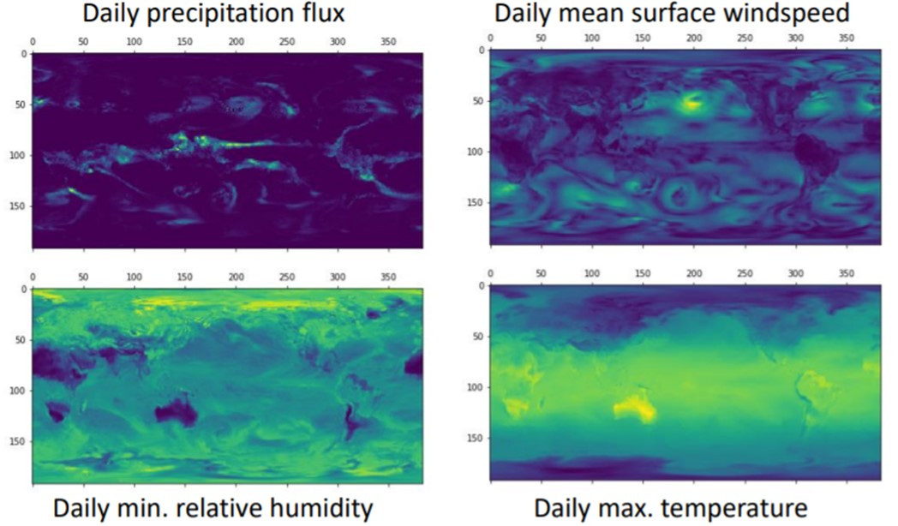
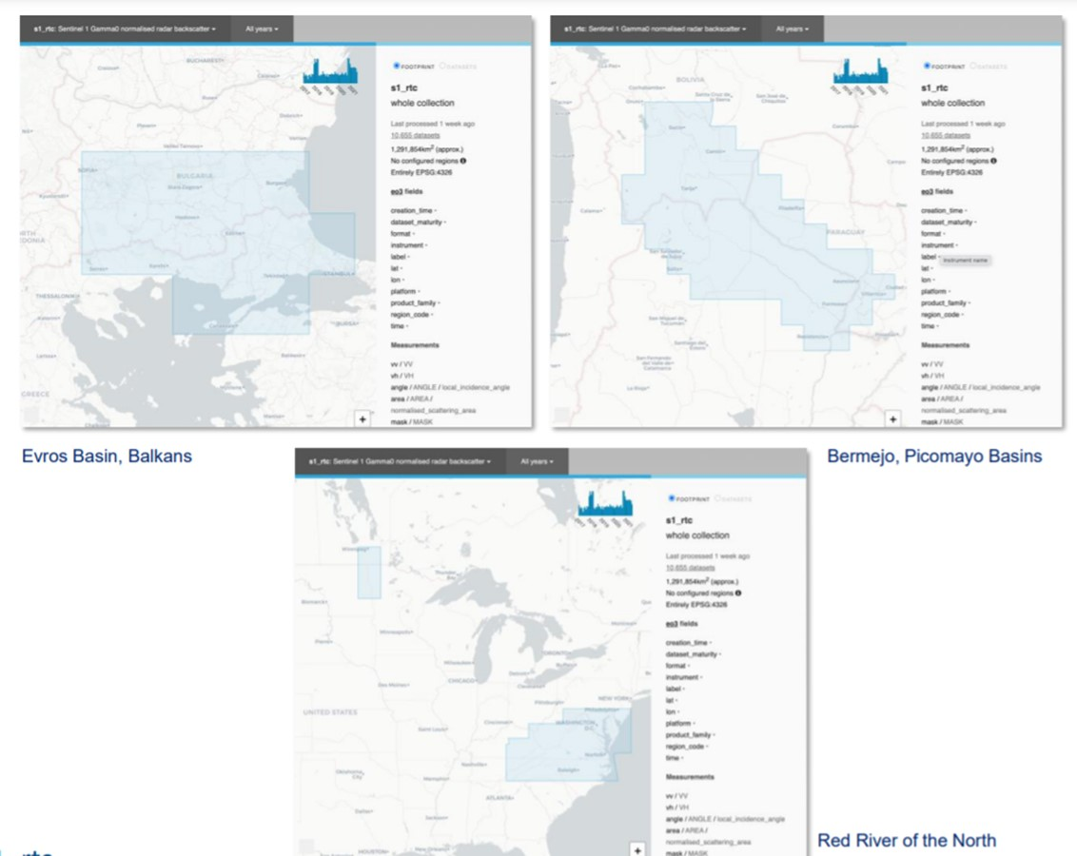
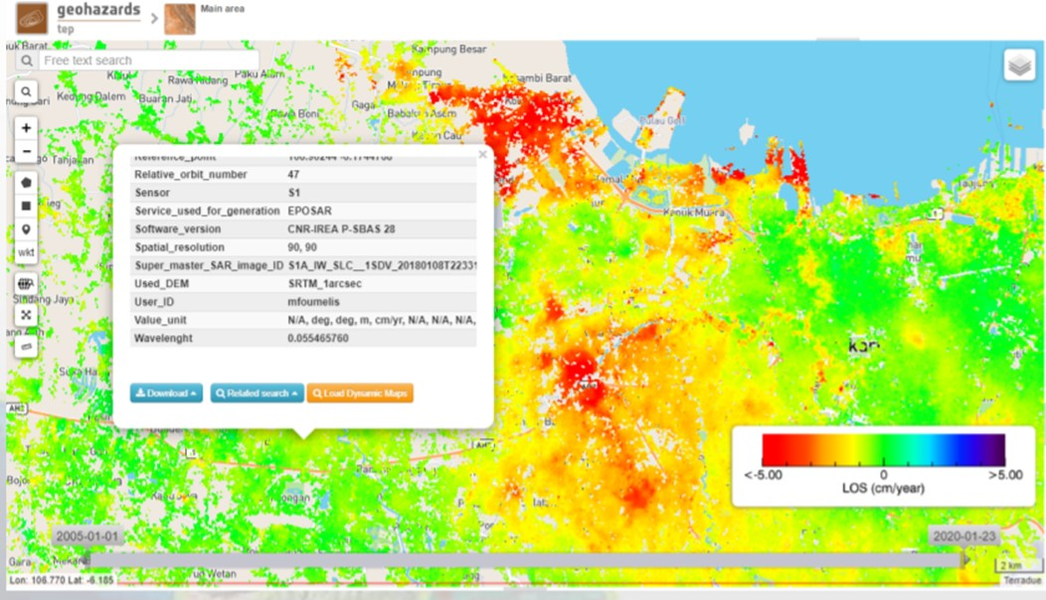
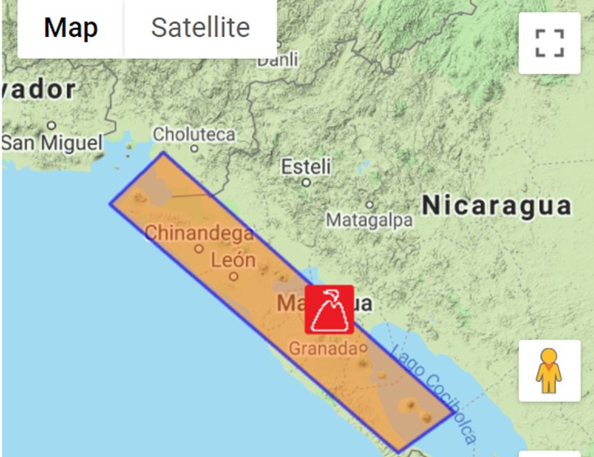
WGDisasters Progress
Wildfire Pilot (Feasibility of integrated EO for global wildfire regime monitoring)
Global active-fire monitoring inventory & gap analysis under development
Flood Pilot (Feasibility of integrating GEO-LEO-SAR for flood risk monitoring)
Improved flood mapping through data fusion with WGISS/SEO Earth Analytics Interoperability Lab (EAIL)
Geohazard Lab (Platform with federated resources)
GEO Supersites and Natural Laboratories GSNL (Expanded coverage)
New Nicaragua Supersite launched

Slide 4
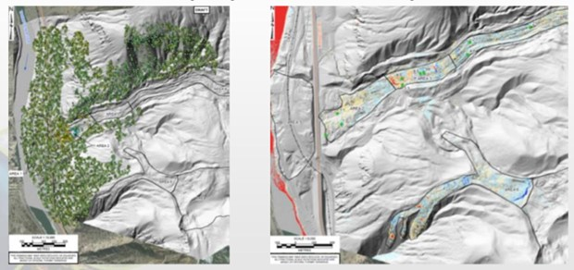
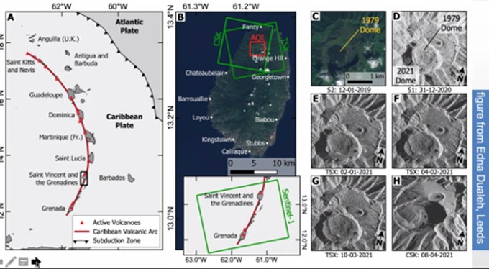
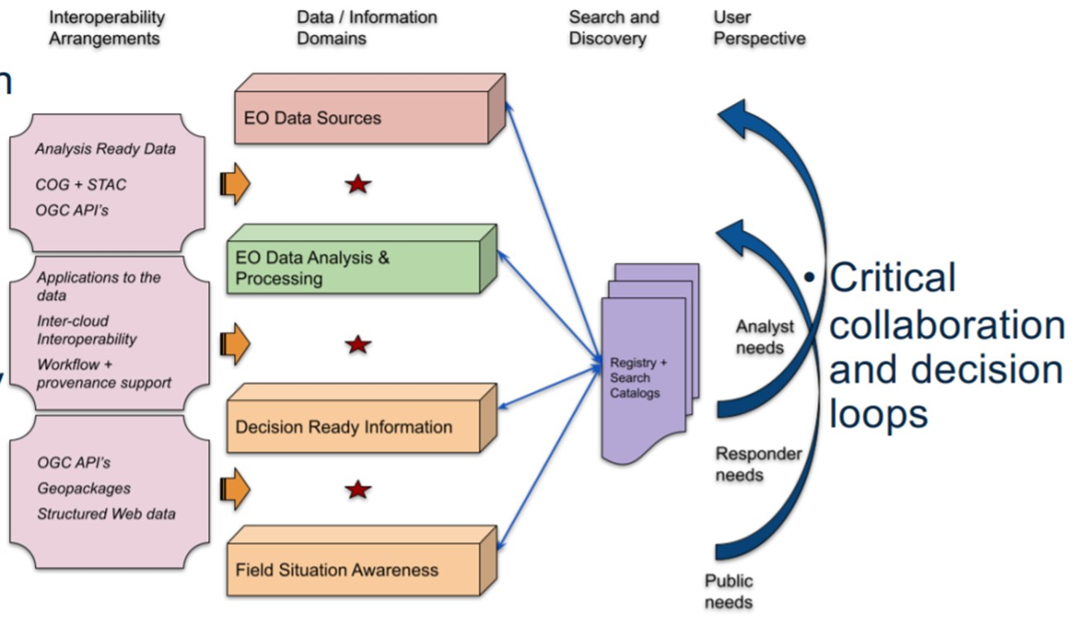
WGDisasters Progress, cont.
Landslide Demonstrator (Value to sectors impacted)
Application demonstration underway for landslide disaster assessment and mitigation along transportation and pipeline critical infrastructure corridors
Volcano Demonstrator (Value of timely global coverage)
Ongoing demonstration of necessity and viability of international coordination of satellite tasking for volcano monitoring
CEOS CARD4L (Value of interoperability with users)
Investigating applications and use case examples highlighting benefit of ARD to the disaster risk reduction and management end user community (OGC Disaster Pilot 2021)

Slide 5
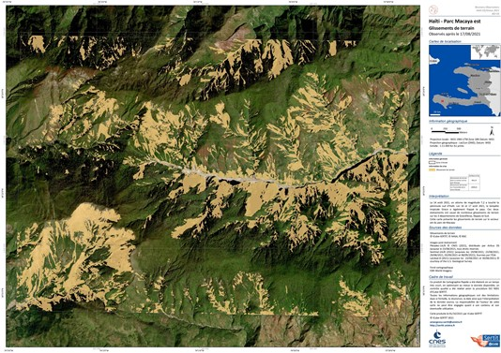
Recovery Observatory Demonstrator
Value of EO to timely development and recovery financing
Successful fostering of use of existing EO-based services
E.g., Copernicus R&R activations in Lebanon, Nicaragua, and Guatemala
Significant deepening of institutional relationships
Regional institutions
E.g., CEPREDENAC in Central America
Successful uptake of EO-based products
Developed by partners in Post Disaster Needs Assessment
E.g., Haiti EQ PDNA Oct 2021 used Sentinel and Pleiades-products for agricultural damages and environmental impact
Value added product tailored to specific, identified needs and delivered within weeks of activation according to UN/WB/EU priorities – example of exhaustive landslide inventory in support to PDNA.
Slide 5

Slide 6
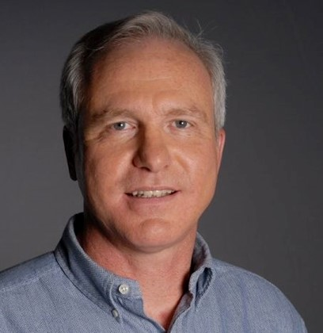
WGDisasters Chair Handover
Welcome New WGDisasters Chairs!
Secretary
Andrew Eddy
Nov 2021 – May 2022
Pierric Ferrier
Programme Manager – Space and risks, CNES
May 2022 – Fall 2023
Hélène de Boissezon
Competivity & Development – Disasters, Crisis, CC impact, CNES

Slide 7
WGDis Incoming Chair Priorities
Focus on global challenges
Relating disaster-focused UN mandates (UNFCC, SDGs, DRR Sendai), GEO support (incl. Urban Agenda/Resilient Cities), and exploiting satellite EO for high benefit contributions
Bringing satellite EO to national/local actors engaged in DRM, especially Climate related DRM
Explore how CEOS WGDis can employ ‘new geometries’
Working with industry, new missions, and new data and analysis techniques (AI) for maximum impact and continued relevance in a changing sector
Continue to develop model partnerships
Contribute to Disaster Risk Management (DRM) objectives through Demonstrators and RO

Slide 8
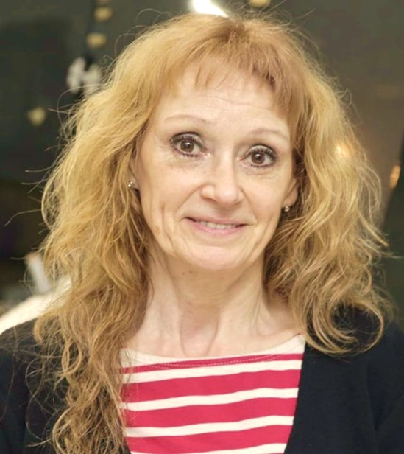
Vice Chair Nomination
WGDisasters Vice Chair Nomination received from CONAE - Ms. Laura Frulla
CEOS Endorsement Requested

Slide 9
Thank you
Sincerest appreciation to David Borges, WGDisasters Secretary – best wishes in your new role as a member of the CEOS SEO
Thank you to all WG members who have helped us achieve substantive advances together over the last two years
David

