Slide 1
Working Group on Capacity Building and Data Democracy (WGCapD)
Nancy D. Searby, PhD, NASA
Conference Agenda Item #12
2021 CEOS Plenary
Virtual Meeting
1-4 November 2021

Slide 2
An Active WGCapD Community
WGCapD members are working on executing the 2021-2023 work plan that includes 32 deliverables: 21 to be implemented in 2021 calendar year, 10 – in 2022, 1 – in 2023.
Some recently completed deliverables:
The Land Cover and Land Use Change MOOC has been launched on the EO College site.
Webinar Series on Image Restoration and Processing of SAR Data was completed by 1,569 participants with 195 participants completing Image and Processing training.
The Phase II Geospatial Applications for Disaster Risk Management MOOC launched as a joint effort by UNOOSA, Centre for Space Science and Technology Education in Asia Pacific, and ISRO.
Slide 2

Slide 3
EOTEC DevNet Phase 1 Completed
Following the endorsement of the EOTEC DevNet Initiation Plan at SIT-36, the EOTEC DevNet Task Team was formed and has completed eight of ten Phase 1 initiation phase tasks to initiate the operations of the network, including:
Refining the concept of operations, developing a theory of change to model how the network will make an impact, defining resource requirements, securing broader network leadership endorsement, and holding regional and leadership meetings.
Two tasks continue into the Phase 2 pilot phase, which will focus on expanding the network and identifying opportunities to connect:
Move beyond disaster risk reduction in our information collection “trackers” to include climate adaptation, mitigation, and human vulnerability
Extend focus beyond training to education and more fully address gaps/overlaps, use cases, and evidence
EOTEC DevNet regional exchanges on June 14 and on September 21 developed new tracking tools for flood- and drought-related capacity building opportunities.
EOTEC DevNet focuses on:
Disaster Risk Reduction
Climate Adaptation and Mitigation
Vulnerability Assessments
WGCapD requests endorsement of EOTEC DevNet Initiation Plan Phase 1 report and recommends proceeding to Phase 2 through the end of the 2-year pilot, March 2023.
Slide 3

Slide 4
Supporting 2021 CEOS Chair Theme
The Jupyter Notebook Webinar (a joint deliverable with WGISS) focused on Earth Observation (EO) applications that will allow more users to connect to open satellite datasets and was attended by 288 participants across two sessions.
The CEOS Webinar Toolkit, developed by WGCapD, was used in preparations for the abovementioned Jupyter Notebook Webinar and EO-focused webinar series by VNSC. The toolkit can be of use by other WGs and AHTs within CEOS.
Working on strengthening capacity building resources for open science and decision support for flood research and applications via EOTEC DevNet and in collaboration with WGDisasters.

Slide 5
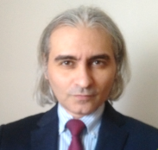
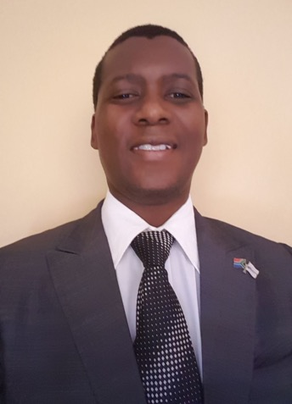
Leadership Transition
UNOOSA nominated Jorge Del Rio Vera, Scientific Affairs Officer, as WGCapD Chair
“Mr. Del Rio Vera is currently providing technical and scientific leadership to the flagship “Access to Space for All” initiative of the Office, which provides research opportunities in orbital experiments, small satellites and in space exploration. In 2021, he is also responsible for key capacity building events, including the UN/International Astronautical Federation Workshop to be held in Dubai just prior to the International Astronautical Congress. Mr. Del Rio Vera also provides the Office with specialist advice on subjects, among others, such as global navigations satellite systems, Earth observations and space asset operations. I copiously trust Mr. Del Rio Vera for the position of Chair, and he will have my full support during his tenure.” - Simonetta di Pippo, UNOOSA Director
SANSA nominated Dan Matsapola, Science Engagement Manager, as WGCapD Vice-Chair
Dan currently drives the strategic objective “to support the development of a critical mass of skills and expertise needed to give effect to regional space initiatives” in the SANSA 2020 – 2025 Strategic Plan.
“SANSA uses this strategic objective to drive capacity development initiatives, with partners at national and regional level. It is against this strategic alignment and SANSA’s historic participation in CEOS and in particular WGCapD, that SANSA raises its hand for the WGCapD vice-chair role.” - Andiswa Mlisa, SANSA Managing Director Earth Observations
Both nominations supported unanimously by WGCapD. Endorsement by CEOS Plenary is requested.
Slide 5

Slide 6
Thank You!
Nancy D. Searby, Ph.D & Pham Thi Mai Thy, Ph.D
nancy.d.searby@nasa.gov & ptmthy@vnsc.org.vn

