Slide 1
Information Systems & Services (WGISS)
Dr Rob Woodcock, CSIRO
Conference Agenda Item 11
2021 CEOS Plenary
Virtual Meeting
1-4 November 2021

Slide 2
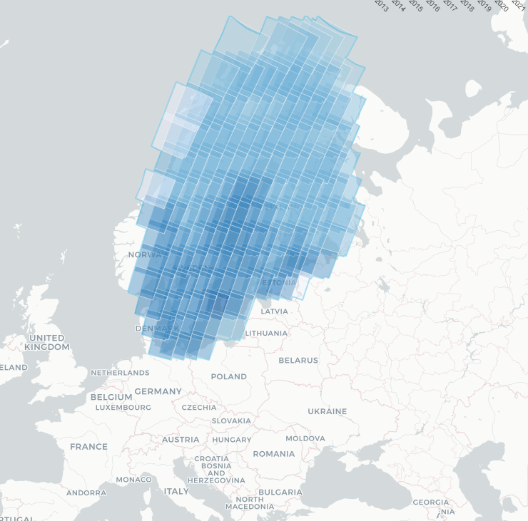
Achievements: Future Data Architectures
Overall maturity and use of FDA and ARD is markedly increased across CEOS agencies
Data in the Cloud
Significant increase
Plans to continue to grow
Transition to Business-as-Usual
In use in CEOS EAIL, CEOS Open Data Cube, …
Use of FDA terminology will be deprecated – it is no longer Future.

Slide 3
Achievements
Data Discovery, Access, Preservation
Continue to embrace both opportunities and challenges presented by Cloud
Quality standards
Integrity assurance
Replicas
Services discovery
STAC metadata for Cloud EO data
Updated Open Search Guidelines
Persistent Identifier Best Practice
Interoperability and Use
CEOS EAIL
46 registered CEOS project users
Training in Jupyter Notebook and Open Data Cube
CEOS Cloud hosted ARD (or nearest equivalent) and STAC metadata
Open Source Software and Tools Catalogue
ISO/OGC including Cal/Val Standard
Carbon Portal: ARD Services for ECV

Slide 4
Achievements
Technology Exploration
Jupyter Notebooks for EO with WGCapD
Webinar: 536 registrations
Survey results indicate strong desire for more and volunteers to assist
Blockchain KSI for EO data integrity & provenance
AI and ML in EO

Slide 5
WGISS Next Actions
Support Open Science Theme
Will continue at WGISS 53 building off the
special session at WGISS 52
CEOS EAIL
We will soon seek endorsement for 2-year continuation
Invite support (operating costs and effort) to sustain and grow support WG/VC projects
Jupyter for EO
Best Practice development
EO training with WGCapD
Discovery and Use of CEOS data in Cloud
ARD, Quality and Integrity
Operational Best Practices
Service discovery

Slide 6
WGISS Chair and Vice Chair
WGISS Chair
Dr Makoto Natsuisaka, JAXA
WGISS Vice Chair
Mr Tom Sohre, USGS

