Slide 1
WGCV
Akihiko KUZE and Philippe GORYL
Conference Agenda Item 1-10
2021 CEOS Plenary
Virtual Meeting
1-4 November 2021

Slide 2
Report from WGCV
<Meetings>
(1) WGCV-49 virtual meeting between June 29- July 1
Revisited the WGCV CARD4L review process to improve timeliness and efficiency.
Odele Codington presented “TSIS solar reference spectra”
David Crisp presented “WGCV Support to the CEOS Strategy for the Global Stocktake of the UNFCCC Paris Agreement”
Intercomparisons: BRIX-2 and DEMIX, Organization: of ACIX3 (with focus on Hyperspectral) and CMIX2
(2) WGCV members joined the ISO 19124 meeting on Aug 30.
Discussed topics: Maturity Matrix (MM) stage, Data Product Level Definitions
Draft technical standard deadline is end of December 2021.
(3) WGCV-50
Proposing a hybrid and joint meeting with WGISS between March 21-24, 2022 in Tokyo.
Joint session: Data quality self-assessment and indicators, Maturity matrix, terminology

Slide 3
TSIS Solar Irradiance dataset for GHG SWIR spectrometers
<TSIS Objective>
The accurate measurement of total and spectral solar irradiance to improve understanding of solar variability and Earth’s climate response to solar variability.
<TSIS-HSRS>
TSIS-1 HSRS high-accuracy (0.3-1.3%), high-resolution (0.01 nm or better), solar reference spectrum
Uncertainty in SWIR irradiance (8-10%) was much reduced
User friendly data base with various spectral resolutions from radiometers to high resolution spectrometers.
<CEOS WGCV Action>
To recommend TSIS-1 HSRS as the new CEOS solar irradiance reference spectrum (one year).
To assess consistency between GHG sensors; OCO, TROPOMI, GOSAT, extending 2.3 micron for CH₄ and CO.

Slide 4
Publications, Documents, and Actions
SI-Traceable Space-based Climate Observing System was hosted by the National Physical Laboratory, UK, 9-11 September 2019 SITCOS report
http://calvalportal.ceos.org/report-and-actions
DEMIX Team published a reference paper on "Digital Elevation Models: Terminology and Definitions” Remote Sens. 2021, 13(18), 3581; https://doi.org/10.3390/rs13183581
Update on RadCalNet Guidance document describing new site acceptance process
To consider nominations for the WGCV Vice Chair (October 2022 to October 2024).

Slide 5
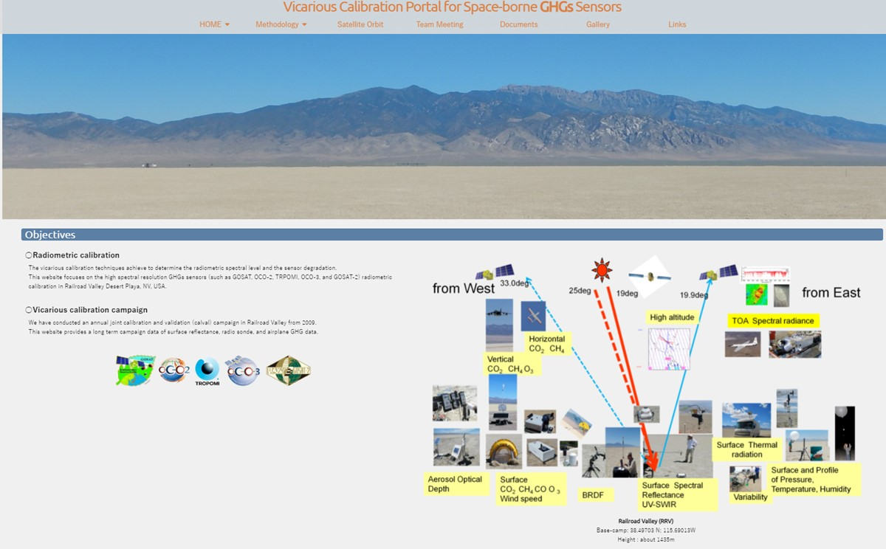
VCAL portal for GHG sensors
GHG sensors have wide swath with larger footprints and SWIR channels at CO₂ and CH₄ bands.
Radiometric calibration is required to estimate the light path modification by aerosol and clouds, which is one of the largest error sources in GHG column density retrieval.
https://www.eorc.jaxa.jp/GOSAT/GHGs_Vical/index.html
The VCAL Portal site provides
Methodology of vicarious calibration for various size footprint and off-nadir data.
13-year annual joint campaign data for CAL-VAL
Dataset for analysis
Analytical results from various type of spectrometers: GOSAT FTS, OCO, S5P TROPOMI

Slide 6
CEOS Common Terminology
Multi-disciplinary collaboration across Earth Observation and geoscience domains becomes more frequent and requires a common understanding of terms and definitions
Collaboration initiated between CEOS WGCV, IVOS, and WGISS to “advance the idea of a CEOS common online dictionary, with a view to eventually reaching out to launch a broader community effort (…)” (WGCV Action Item 49-06, June 2021)
Status and way forward
CEOS Common Terminology group established
Workplan drafted
Merging WGISS Data Stewardship Glossary into CEOS WGCV ‘Terms and Definitions’ Wiki - ongoing
Reach out to promote initiative - ongoing
Dicsuss target infrastructure - upcoming
EO-DataStewardshipGlossary_v1.3.doc
http://calvalportal.ceos.org/ca/t-d_wiki

Slide 7
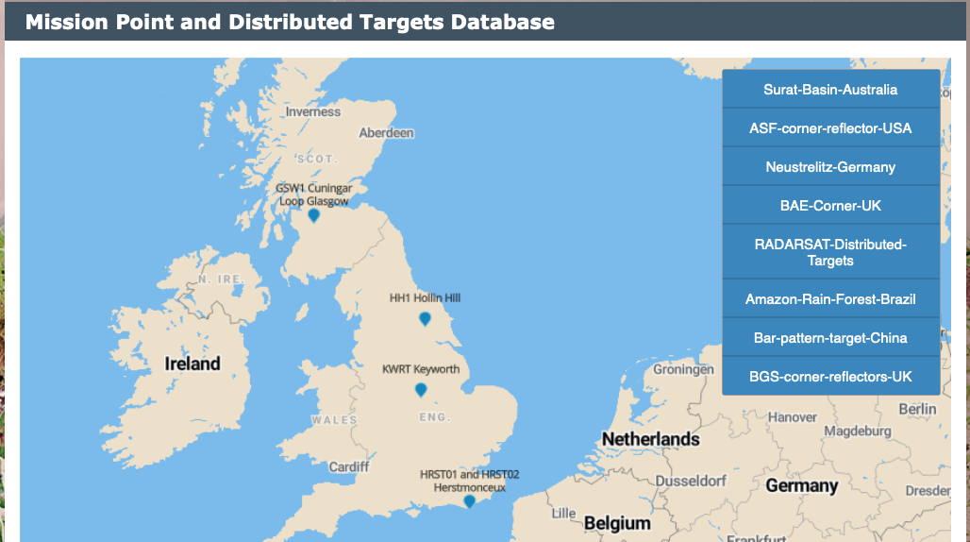
CEOS Cal/Val Portal
The CEOS Cal/Val portal has been re-shaped and is now operational
The portal will host new pages including: planning, methods, reports and results for ACIX-II-Land, ACIX-II-Aqua, CMIX, and DEMIX (work in progress).
the context of the CEOS SAR Subgroup: the Virtual Workshop Announcement
CEOS SAR Workshop 2-4 November-> new entry page and repository for
the presentations; Target DB → BGS Corner Reflectors updates.
SISTSCOS WS – webpage is available including Report, Agenda
and all the presentations.
The link to the Vicarious Calibration Portal for Space-borne GHGs
Sensors has been included.
In the context of Terms and Definitions the Wiki page has recently
been growing thanks to an enrichment of the dedicated
“Terms and Definitions” group.
A dedicated page embedded in the portal for demo and exercises
with Jupiter Notebooks (work in progress).

