Slide 1
CEOS Communications
Kim Holloway, SEO
Agenda Item #9
2021 CEOS Plenary
Virtual Meeting
1-4 November 2021

Slide 2

What’s Ahead
Earth Observation Data for Open Science and Decision Support:
Strategic and effective CEOS Communications are absolutely critical for raising awareness about and expanding the impact of the data accessibility, transparency, and reproducibility made possible by CEOS and its Agencies.
This Presentation:
  Background
  Annual Analytics
  New CEOS Branding Guidelines
  New CEOS Communications Strategy
  New and Ongoing Improvements
Slide 2

Slide 3
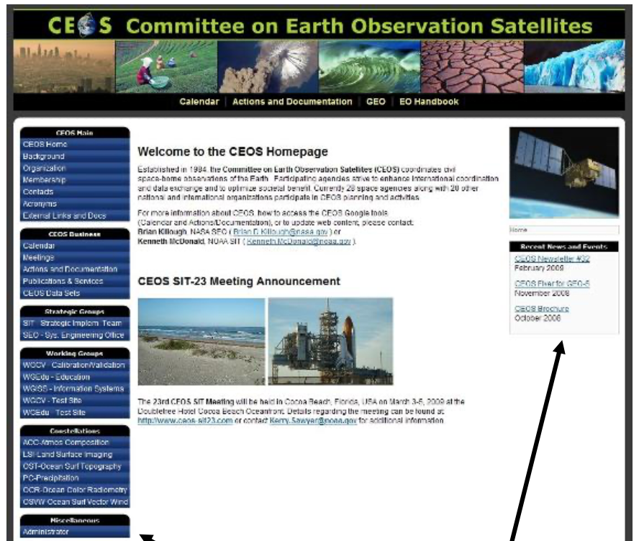
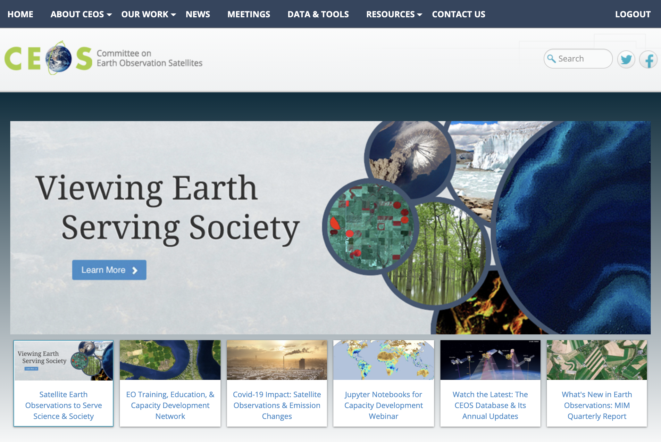

Background
2009 CEOS Website
2013 CEOS Joined Social
2014 Website Redesign
2015 Developed a Social Media Strategy
2021 Here We Are!
Slide 3

Slide 4
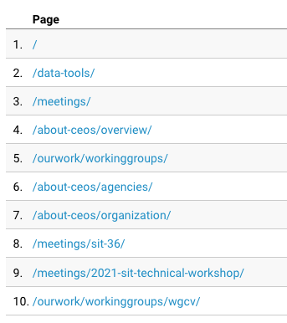
October 2020-2021 Analytics
31,218 CEOS website visitors (88% first time)
3,633 Twitter Followers (~1K new over the last year)
1,817 Facebook Followers (~200 new over the last year)
104 LinkedIn Group Members
145 Subscribers on our YouTube Channel
Still no in-person outreach, but we are still attending events virtually, e.g. IGARSS, GEO Symposium, AGU
Slide 4

Slide 5

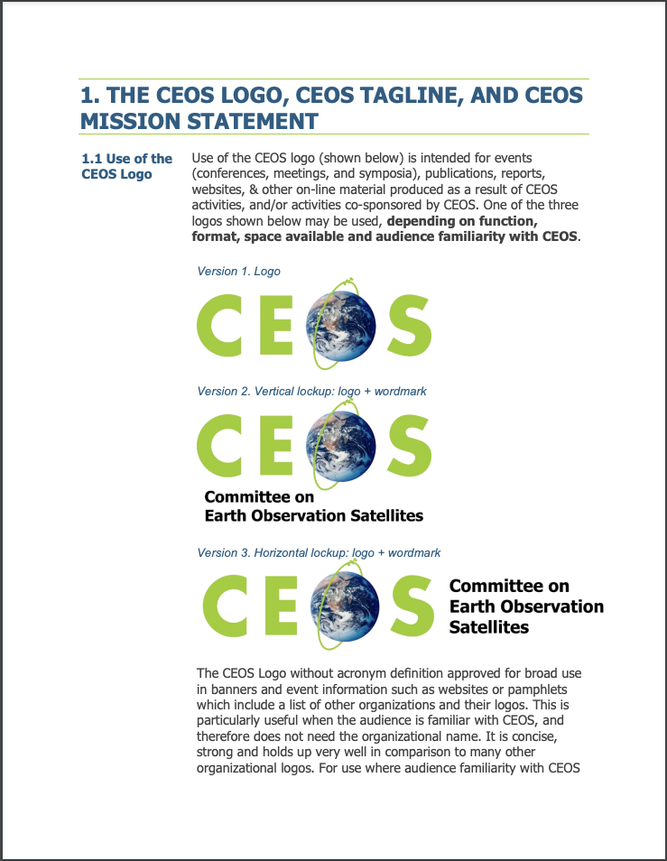
Document For Endorsement
CEOS Branding Guidelines for:
The CEOS Logo, CEOS Mission Statement
New logos incorporating CEOS brand elements
Leveraging the CEOS Brand by CEOS Working Groups, Virtual Constellations, Ad Hoc Teams, and other CEOS activities (and other organizations)
Slide 5

Slide 6
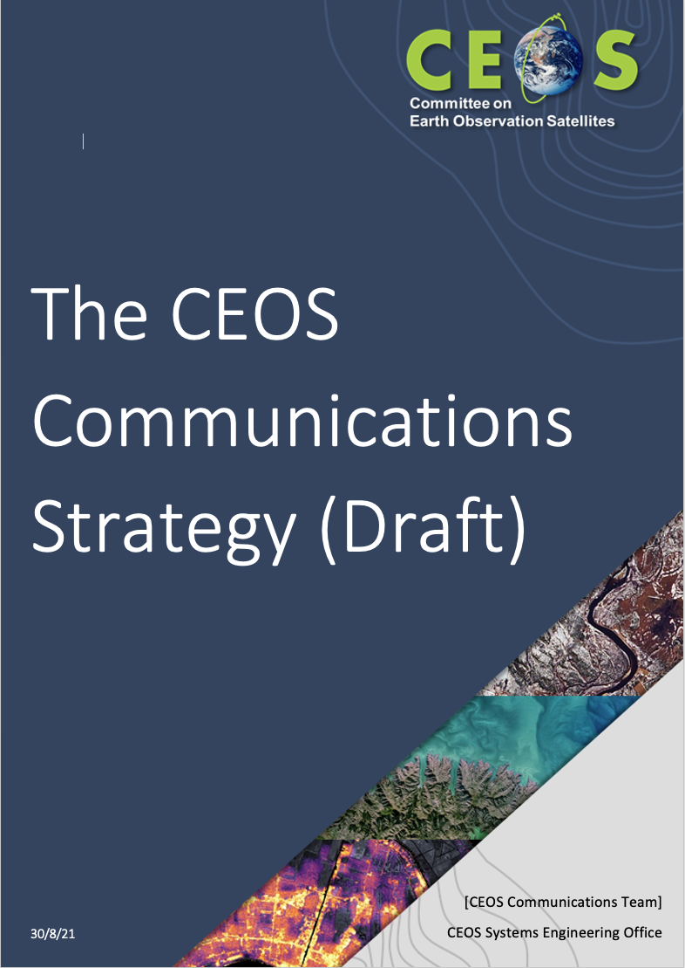
Document For Endorsement
Goal: Help people and organizations more easily discover and benefit from CEOS work.
CEOS Communications Strategy Includes:
  CEOS Communications Objectives
  Target Audience Definitions
  Goals & Outcomes for each Audience
  Types of Content and on What Channels
  Content Creation and Publication Work Flow
  Ideas for the Future
Kudos to Libby Rose (Symbios) for our new CEOS Templates!
Slide 6

Slide 7

Website Upgrades In Progress
Increased CEOS activity/achievement feature story publication on improved homepage news slider
Designed new, searchable CEOS News page to showcase and archive all CEOS feature stories
Elevated access to all WG / VC / AHT / Other Activity pages via homepage links and modified main menu structure
Improved Data and Tools page (website traffic hot spot)
Implemented new “Key Publications” page for easy access to major CEOS publications and documents
Centralized CEOS web presence and improved branding consistency across the organization
Quarterly, open CEOS Communications Strategy Meetings to plan content for the upcoming quarter, measure success, and offer support
Designing a set of thematic icons and content “tags” to help users easily identify relevant CEOS content
Slide 7

Slide 8
Thank You!
Get Involved:
kim.e.holloway@nasa.gov
Slide 8

