Slide 1
CEOS Missions, Instruments and Measurements (MIM) Database Annual Report
Ivan Petiteville, ESA
Agenda Item #8
2021 CEOS Plenary
Virtual Meeting
1-4 November 2021

Slide 2
Summary
The CEOS MIM (Missions, Instruments, Measurements) remains a key ‘connective tissue’ across the CEOS community – CEOS Work Plan ‘Core Service # 7’
2021 update survey completed with 30 new missions and 34 new instruments
Web audience continues in the 1000’s/month, adding CEOS Internal, Twitter, and YouTube content
Initiated quarterly reports in order to increase information flow and currency
Produced a video series → Watch the CEOS Database Year in Review Video during the break!
Slide 2

Slide 3
2021 Survey – Response
Annual effort of at least 15 weeks FTE for contacts from 30+ CEOS Agencies - thanks for your support!
25 agencies responded to the survey this year
Initial outreach to new CEOS Associate from 2020 POLSA
Ongoing challenge to secure quality inputs from CAST, CRESDA, NRSCC, NSMC-CMA
CGMS Plenary, OSCAR/Satellite, and launch activity reports help augment information
30 new mission records, almost 250 mission records updated
34 new instrument records, more than 200 inst. records updated
113 new instrument-measurement mappings added
database.eohandbook.com > missions > activity
database.eohandbook.com > about
Slide 3

Slide 4
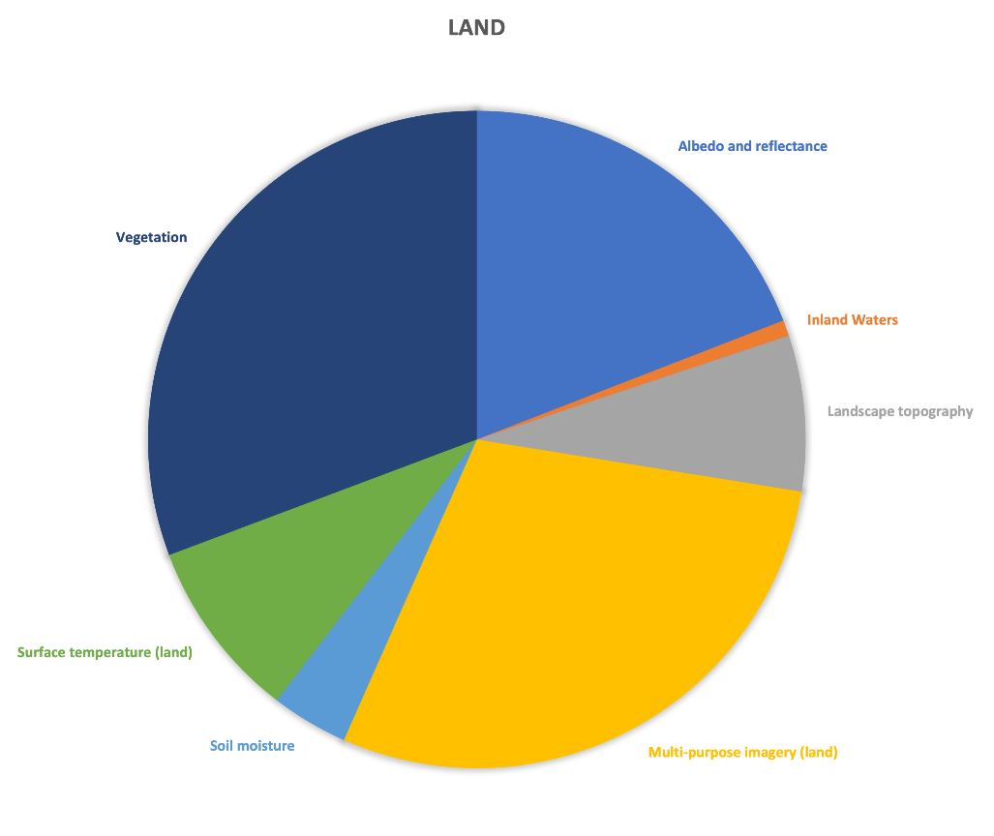
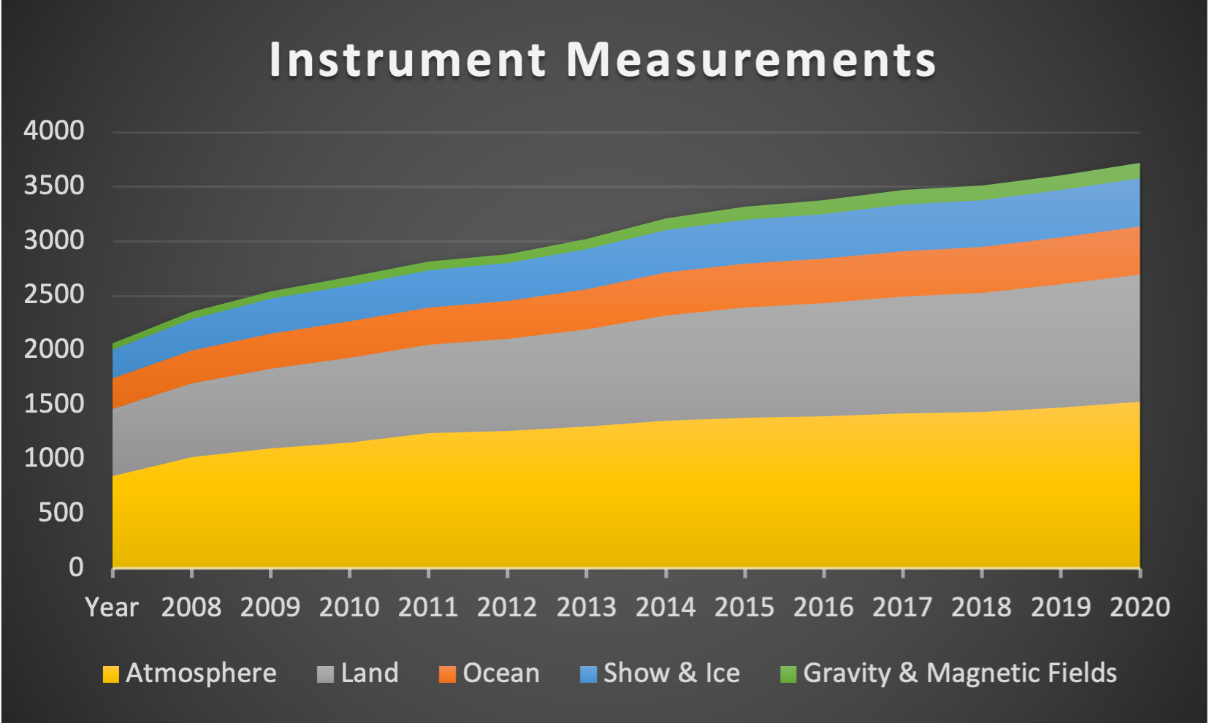
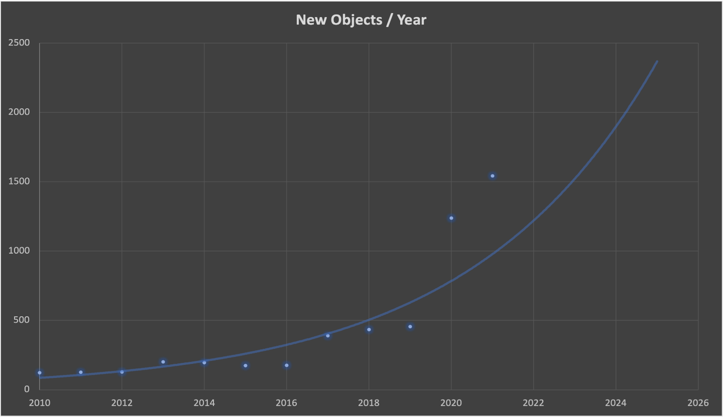
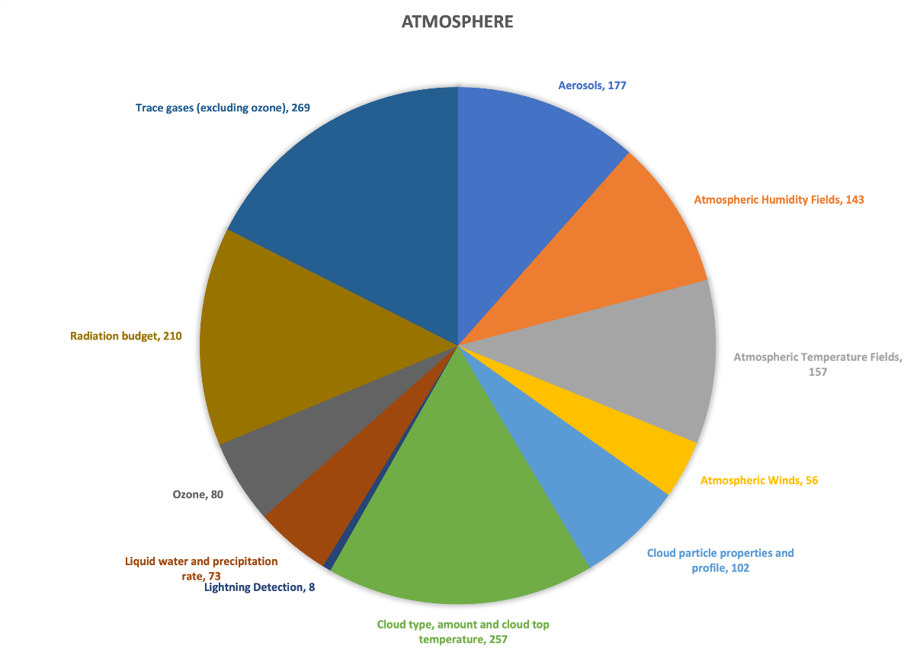
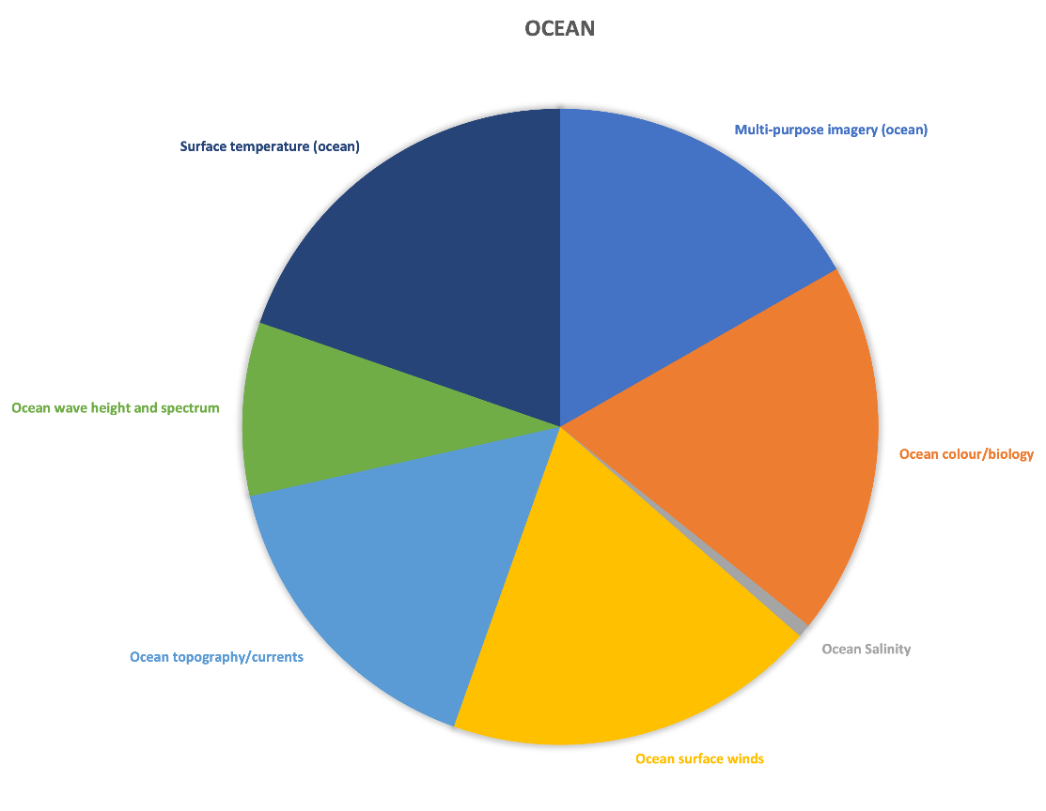
2021 Survey - Activity
1674 SATCAT tracked objects launched to 16-Oct-2021
+ 917 for a comparable period in 2020
Commercial Small Satellites !
+836 new Starlink and +248 new OneWeb launches 2021 YTD
Imaging: +6 ICEYE, +48 Planet Flock/Doves, +4 NuSat/Satellogic, …
RO: +16 Lemur
GHG: +1 GHTSat, +1 Aurora/Orbital Sidekick
What are CEOS Agency instruments measuring?
New non-debris SATCAT Objects by Year
2010 - 122
2011 - 127
2012 - 128
2013 - 202
2014 - 196
2015 - 175
2016 - 177
2017 - 389
2018 - 434
2019 - 456
2020 - 1238
2021 - 1542

Slide 5
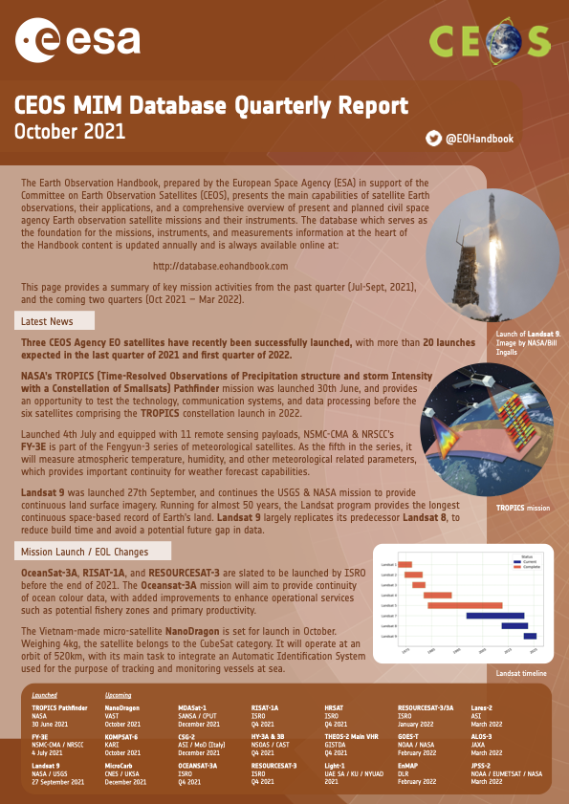
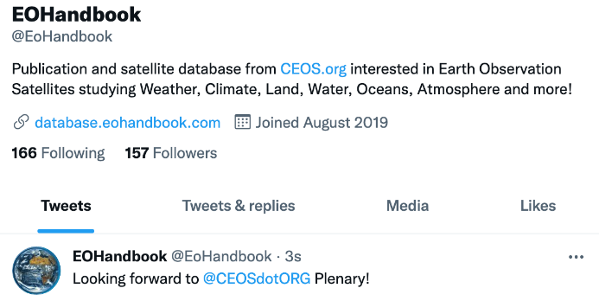
Audience and Outreach
Quarterly reports initiated this year
Small effort, more frequent updates
Currently PDF → discussing CEOS Newsletter contribution
Collaborated with the World Geospatial Industry Council on their report for COP-26 on “GHG Monitoring from Space: A mapping of capabilities across public, private, and hybrid missions”
Building Twitter Following @EOHandbook
Monthly website traffic
Slide 5

Slide 6
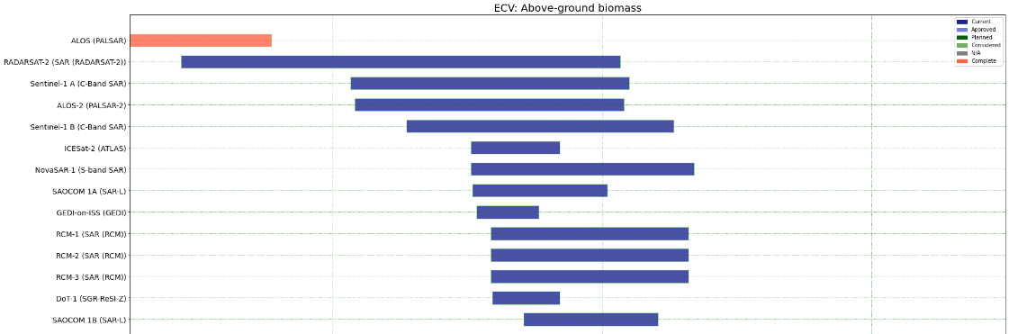
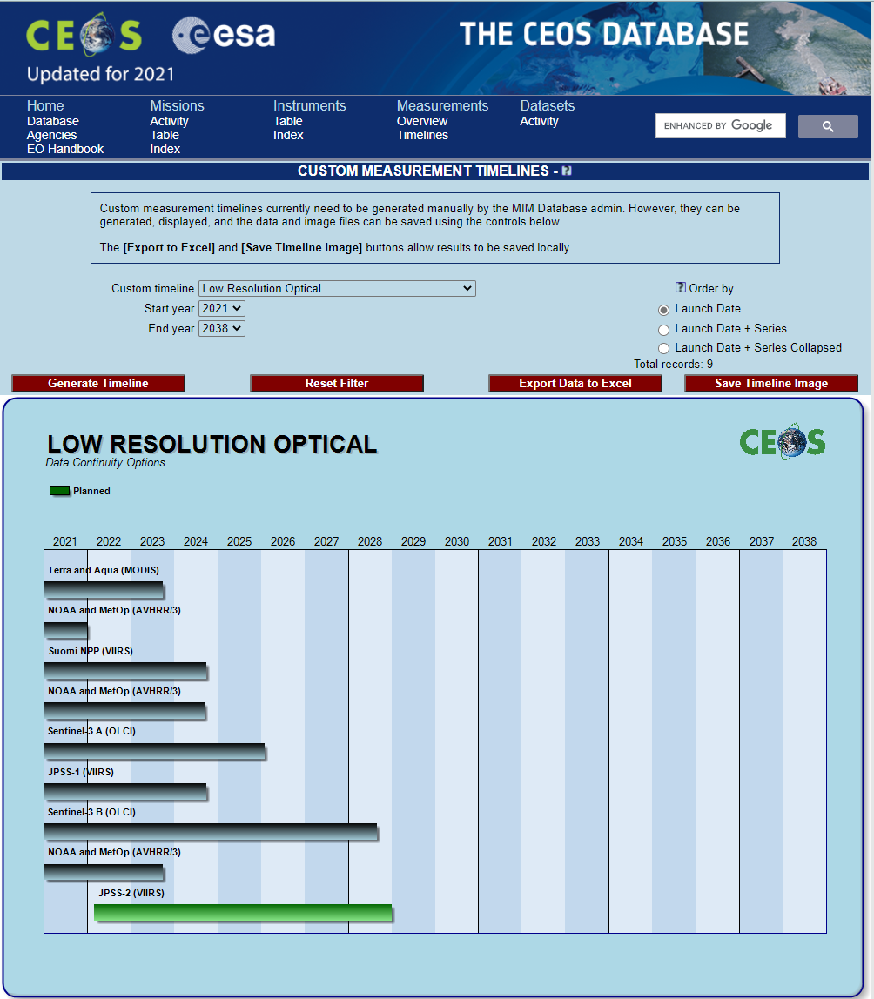
Support to CEOS Activities
CEOS Chair – series of 11 videos about CEOS MIM uses
Highlighting “Open Science and Decision Support” aspects of the Database
Release and production coordinated with broader CEOS Communications efforts
YouTube: https://www.youtube.com/channel/UCAVzS51yWyBKZwvBX5pVM3g
Pilot development of toolkit in response to deliverable VC-18-07 (‘Gap Analysis Tools’)
Presentation to WGDisasters-16 on possible CEOS Database content related to disasters themes
FLOODS
Slide 6

Slide 7
Thanks!
We look forward to continuing to support the CEOS and broader Earth observations communities in 2022
Invitation to enjoy the CEOS Database Year in Review video during the break – link to be posted in the chat
Slide 7

