Slide 1
CEOS Executive Officer Report
Marie-Claire Greening
CEOS Executive Officer
Conference Agenda Item 7
2021 CEOS Plenary, Virtual Meeting
1-4 November 2021

Slide 2
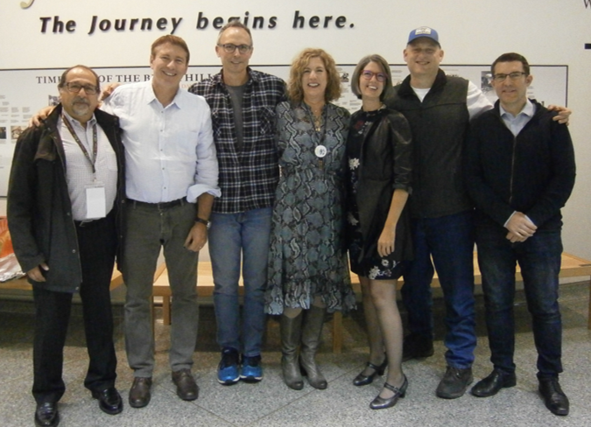
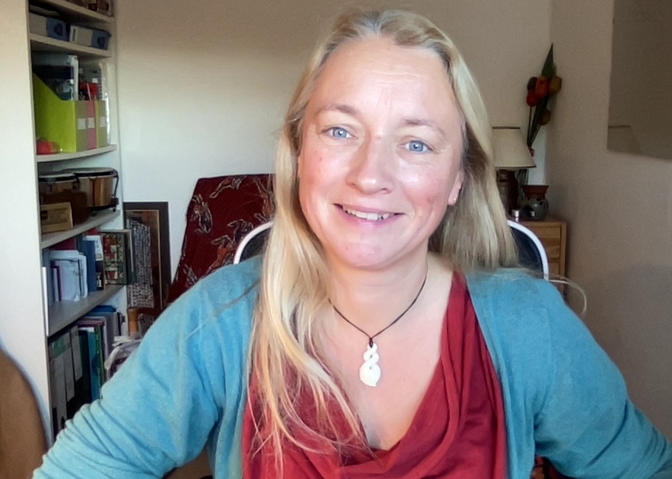
The CEOS Executive Officer
The role of the CEOS Executive Officer (CEO) was established in 2006 as a mechanism to primarily support the interactions of CEOS with the then emerging Group on Earth Observations (GEO). Since its inception, the remit of the CEO has greatly expanded and in 2011 a Deputy CEO role was added.

Slide 3
CEO Roles and Responsibilities
Serves the entire CEOS organisation and acts with neutrality
Internal Stakeholders
Focal point on governance, resourcing and processes
Custodian of CEOS Governing Documents, including CEOS Work Plan
Ensures information flow across all CEOS entities and advises CEOS leadership
Handles membership and works with the SEO on comms and outreach
Contact point for all enquiries, responsible for CEOS membership, listservs, website and events calendar … and general housekeeping!
External Stakeholders
Point of Contact for all external stakeholders, both existing and new
CEOS interface to the Group on Earth Observations (GEO); supports bilateral meetings and sits on the GEO Programme Board
External interface to all CEOS contacts and represents CEOS at relevant partner and stakeholder meetings

Slide 4
Governance & Work Planning
Four key governing documents primarily guide the work of CEOS:
CEOS Terms of Reference defines the mission and scope of CEOS activities
CEOS Strategic Guidance document articulates the overarching long-term (7-10 years) purpose and goals of CEOS
CEOS Governance and Processes document provides guidelines on the structure, operations, and processes CEOS employs to achieve its goals
CEOS Work Plan (3-year rolling) sets forth near-term actions to achieve the goals outlined in the CEOS Strategic Guidance document
The CEO is the custodian of all CEOS Governing Documents, including the annual update of the 3-year CEOS Work Plan and the definition and monitoring of the deliverables it informs

Slide 5
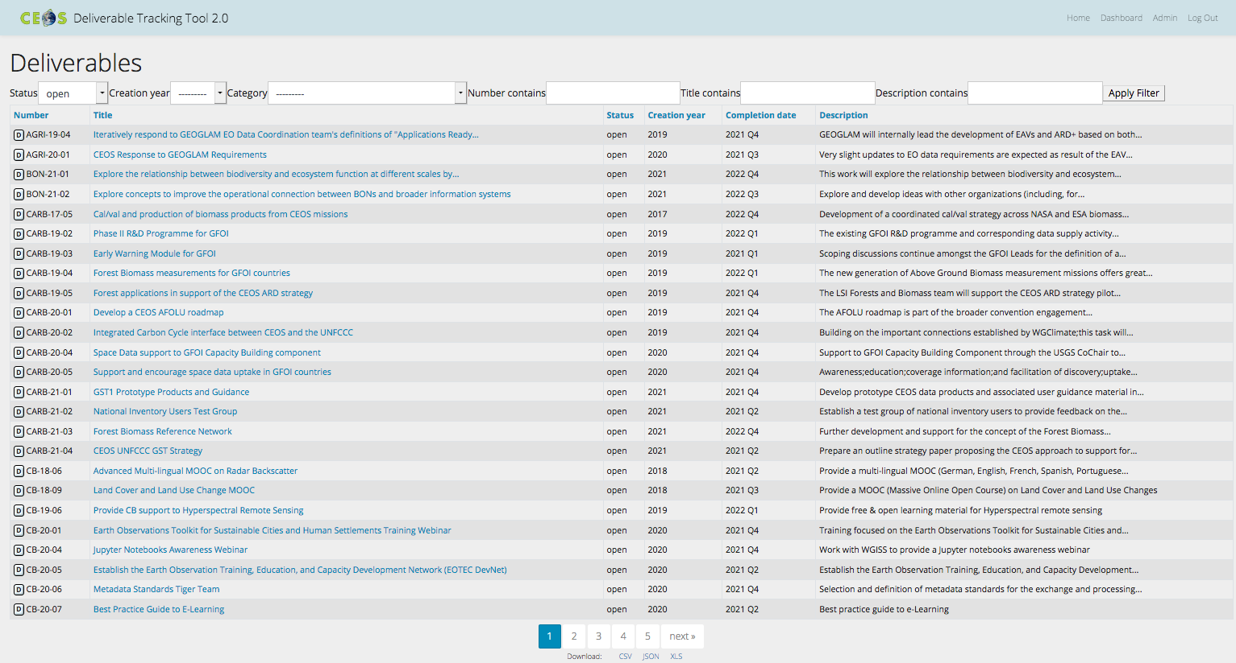
CEOS Work Plan 2021-23
3-year plan updated by all CEOS entities every year and put forward for formal endorsement at SIT in March. Rigorous work planning, execution and monitoring is critical to CEOS’s credibility.
Plenary
SIT
Jan
Feb
Mar
May
Apr
Jun
Jul
Aug
Dec
Sep
Oct
Nov
SIT TW
Detailed work defined as deliverables: outlined in the WP, reconciled and tracked in CEOS deliverable tracking tool

Slide 6
2020-22 vs 2021-23
 | Closed from 2020-22 WP | Carried over from 2020-22 WP | New for 2021-23 WP
Climate Monitoring, Research, and Services |  | 5
Carbon Observations in Support of Climate Science and Policy | 2 | 9 | 4
Observations for Agriculture |  | 2
Observations for Disasters | 1 | 12
Observations for Water | 1
Data Quality |  | 11
Capacity Building and Data Democracy | 10 | 20 | 10
Data Discovery, Access, Preservation, Usability and Exploitation: approaches, systems, tools and technologies | 2 | 6
Advancement of the CEOS Virtual Constellations | 8 | 31
Support to Other Key Stakeholder Initiatives | 4 | 11 (1 from Obs for Water) | 2
Totals | 28 | 107 | 16

Slide 7
As of today…
 | Closed | 2021 | 2022 | 2023 & beyond
Climate Monitoring, Research, and Services |  | 3 (3 overdue) | 1 | 1
Carbon Observations in Support of Climate Science and Policy | 1 | 6 (1 overdue) | 6
Observations for Agriculture |  | 2 (1 overdue)
Observations for Disasters | 1 | 3 | 4 | 4
Data Quality | 1 | 8 | 2
Capacity Building and Data Democracy | 10 | 6 | 13 | 1
Data Discovery, Access, Preservation, Usability and Exploitation: approaches, systems, tools and technologies | 2 | 4
Advancement of the CEOS Virtual Constellations | 3 | 8 | 15 | 5
Support to Other Key Stakeholder Initiatives |  | 5 | 7 | 1
Totals | 18 | 45 | 48 | 12

Slide 8
Internal Information Flow
Past Chair
CEOS Chair
Future Chair
The CEO:
is the internal liaison between CEOS leadership roles (CEOS Chair, SIT Chair, SEC and SEO) and across all CEOS entities (Working Groups, Virtual Constellations, ad hoc Teams and other CEOS Initiatives)
attends all major Principal-level CEOS meetings, is a standing member of the CEOS SEC and contributes to many meetings hosted by CEOS entities
provides guidance on internal and external collaboration to ensure cross-flow of information, priority and objective goal-setting, and resource and scheduling implications
NASA/USA
ISRO/India
CNES/France
Troika (all 3 chairs) 1-year terms
SEO
SIT Chair
CEO
Secretariat
NASA
CSIRO/GA
Chair Agency,
SIT Vice-Chair
DCEO
ESA, EUMETSAT,
MEXT/JAXA,
ESA
Vacant
NASA, NOAA
2-year term
2-year term
Permanent
Virtual Constellations
Working Groups
Ad Hoc Teams
AC-VC
OST-VC
WGCV
Sustainable Development
∙ NASA
∙ CNES
∙ Chair: JAXA
Goals
∙ ESA
∙ EUMETSAT
∙ Vice-Chair: ESA
∙ ESA
∙ JAXA
P-VC
WGCapD
∙ CSIRO
LSI-VC
∙ NASA
∙ Chair: NASA
Coastal Observations
∙ EC
∙ JAXA
∙ Vice-Chair: VNSC
Applications Services
∙ GA
SST-VC
WGClimate
and Tools (COAST)
∙ EUMETSAT
∙ Chair: DLR
∙ NOAA
OCR-VC
∙ NASA
∙ Vice-Chair: NOAA
∙ ISRO
∙ ESA
∙ EUMETSAT
WGDisasters
OSVW-VC
∙ Chair: NASA
∙ NOAA
∙ Vice-Chair: CNES
∙ EUMETSAT
WGISS
∙ ISRO
∙ Chair: CSIRO
∙ Vice-Chair: JAXA
Primary Reporting Path
Secondary Reporting Path

Slide 9
2021 Key Meetings
 | Jan | Feb | Mar | Apr | May | Jun | Jul | Aug | Sep | Oct | Nov | Dec
CEOS Leadership | SEC¹ | SEC | SIT²-36 SEC | Troika SEC | SEC | SEC | SEC |  | SIT TW³ SEC | SEC | CEOS-35 SEC | SEC
Working Groups |  |  | WGCapD⁴-10 WGDisasters⁵-15 WGClimate⁶-14#1 | WGISS⁷-51 WGClimate-14#2 |  | WGCV⁸-49 |  |  | WGDisasters-16 SIT TW side meetings | WGClimate-15 WGISS-52
Virtual Constellations |  |  |  |  | LSI-VC⁹-10 All Hands calls | AC-VC¹⁰-17 All Hands calls |  |  | SIT TW side meetings
ad hoc Teams |  | SDG¹¹ Future Workshop |  |  |  |  |  |  | SIT TW side meetings | COAST¹² Product Showcase
GEO | PB¹³-19 | CEOS-GEO Bilateral | ExComm¹⁴-54 |  | PB-20 | GEO Symposium | EXComm-55 |  | PB-21 |  | GEO-17
Other External |  |  |  |  | CGMS¹⁴ |  | IGARSS¹⁵ |  |  | IAC¹⁶-72 COP¹⁷-26
¹ CEOS Secretariat
² CEOS Strategic Implementation Team
³ Technical Workshop
⁴ CEOS Working Group on Capacity Building and Data Democracy
⁵ CEOS Working Group on Disasters
⁶ Joint CEOS/CGMS Working Group on Climate
⁷ CEOS Working Group on Information Systems and Services
⁸ CEOS Working Group on Calibration and Validation
⁹ CEOS Land Surface Imaging Virtual Constellation
¹⁰ CEOS Atmospheric Composition Virtual Constellation
¹¹ CEOS Sustainable Development Goals ad hoc Team
¹² CEOS Coastal Observations, Applications, Services and Tools ad hoc Team
¹³ GEO Programme Board
¹⁴ GEO Executive Committee
¹⁴ Coordination Group for Meteorological Satellites
¹⁵ International Geoscience and Remote Sensing Symposium
¹⁶ International Aeronautical Congress
¹⁷ Conference of the Parties

Slide 10
Documents for Endorsement
CEOS Governance and Processes v1.2 (September 2021)
Fairly small but meaningful editorial changes to the text related to the CEOS Executive Officer on page 6
A new updated organisation chart in Fig 2-1
A fully up-to-date Annex B in Pages 20-23, which lists all CEOS agency members and associates.
CEOS Statement for GEO Week 2021

