Slide 1
CEOS Systems Engineering Office (SEO) Report
Brian Killough, PhD
NASA, CEOS-SEO
Agenda Item #6
2021 CEOS Plenary
Virtual Meeting
1-4 November 2021

Slide 2
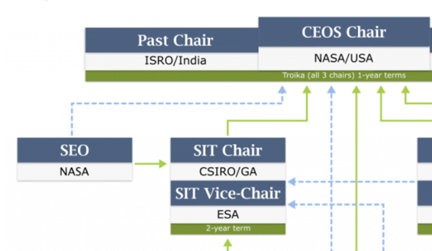
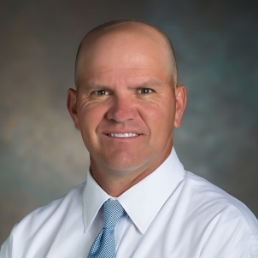
SEO Reminder ... What We Do
The CEOS Systems Engineering Office (SEO) was established in April 2007 (sponsored by NASA HQ) to support the CEOS organization and facilitate global space agency initiatives. 14+ years of support to CEOS!
The SEO technical functions include: systems engineering tools and solutions for CEOS, requirements and gap assessments, data acquisition planning, and special projects (e.g. Open Data Cube)
The SEO management functions include: improving communications through web-based tools, managing CEOS social media, meeting logistics, and developing education and outreach products.
Slide 2

Slide 3
Accomplishments in 2021
Technical Team:
Open Data Cube (ODC) ... detailed charts to follow
Analysis Ready Data (ARD) ... advanced a Sentinel-1 Data Cube processing pipeline via Sinergise, developed Nighttime Lights ARD specification
Support to SDG AHT ... development and testing of ODC algorithms focused on SDG 6.6.1 (water) and SDG 11.3.1 (urbanization)
Earth Analytics Interoperability Lab (EAIL) ... Worked with CSIRO to implement/test the EAIL and coordinate with CEOS initiatives (e.g., COAST, Flood Disasters, DEM evaluation).
COVE Tool ... migrated to the AWS cloud, updated detailed (63-page) User’s Guide, improved performance and enhanced output products
WGCapD and WGISS Databases ... released new WGCapD Training Calendar, initiated work on a new EOTEC DevNet Floods Tracker tool, developed WGISS Open Source Software Inventory and Future Data Architectures Inventory.
Management Team:
Updated CEOS website and social media content including addressing numerous IT security issues
Provided meeting logistics support across many CEOS groups
Led a team to develop a new CEOS Branding Guidelines and a new CEOS Communications Strategy (see Agenda Item #9)
Continued updates to the numerous CEOS mailing lists
Slide 3

Slide 4
Open Data Cube
Open Earth Alliance (OEA) ... a new GEO Community Activity created by the ODC Founding Partners to expand the impact of ODC, support the concept of regional data cubes, and explore new open source data solutions and technologies. Currently working on a cloud comparison (AWS, Google, Microsoft), gathering training materials from various ODC sources, and testing radar applications.
Digital Earth Africa ... transitioned all prior work to DE-Africa team, member of Technical Advisory Committee
Digital Earth Americas ... several workshops, sponsored by CSIRO-Chile and INEGI, were held to demonstrate various levels of complexity using data cubes and satellite data.
Digital Earth Pacific ... managed by the South Pacific Consortium (SPC), the SEO is a member of the Interim Steering Group and has helped guide needs assessment and demonstrate application products.
Continue to support ODC outreach via invited presentations to international meetings: FOSS4G (open source software), UNGGIM (Americas Geospatial), GEO Symposium, Earth Archive Congress, CEOS WGCapD Jupyter Notebook Webinar, IGARSS (remote sensing conference) and hosting two NASA DEVELOP summer students.
ODC Website: www.opendatacube.org
Slide 4

Slide 5
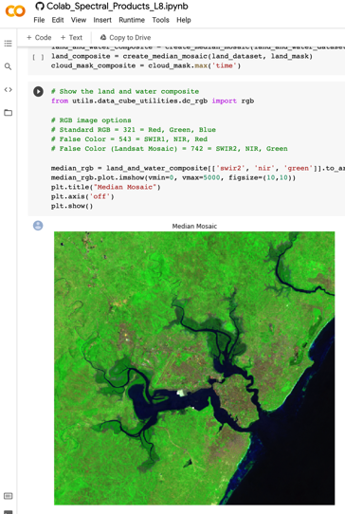
Open Data Cube Sandbox
The SEO developed a new Open Data Cube (ODC) Sandbox that runs on Google Colab.
This tool is a free and open Jupyter notebook interface connected to Google Earth Engine datasets that can create sample application products anywhere in the world without the need to download data.
Access to Sentinel datasets (1 and 2), Landsat, and VIIRS Nightlights are available.
Applications include: cloud statistics, spectral products, cloud-filtered mosaics, vegetation change, water extent, vegetation phenology, nighttime lights, mission coincidences, and flooding using S1 radar.
This tool is ideal for supporting Open Science and has generated significant interest as an educational tool (e.g. Jupyter Notebook Webinars, AmericaView).
+
+
openearthalliance.org/sandbox
Slide 5

Slide 6
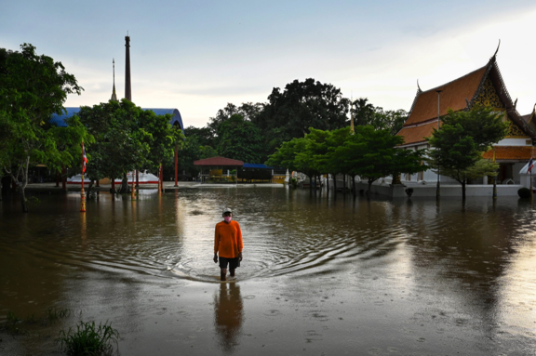
ODC Sandbox – Thailand Flooding
The International Charter was activated on September 28, 2021 for Thailand due to flooding from Tropical Storm Dianmu.
Heavy rainfall flooded over 70,000 homes.
As of late October, the flooding was not completely receded and flooded areas still persisted in the region.
The SEO is working with the WG-Disasters to explore how this tool could be available through the Disasters Charter website for users to track flood recovery.
Ayutthaya, Thailand on September 28, 2021
after Tropical Storm Dianmu
Reference: Licas News
Slide 6

Slide 7
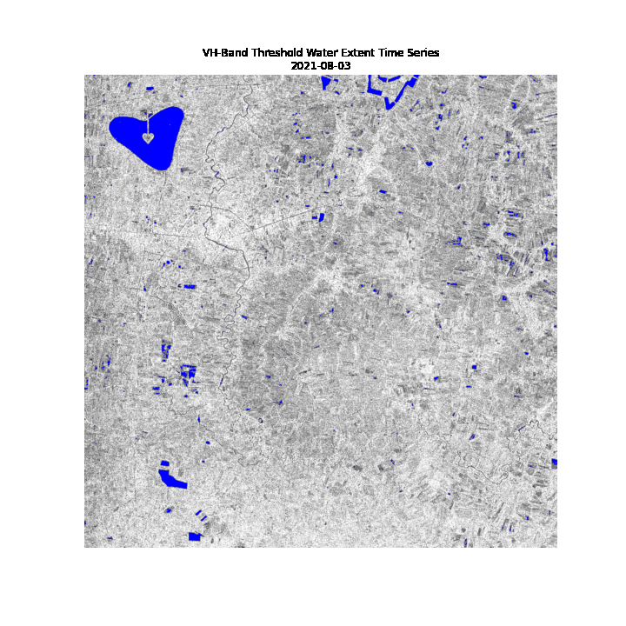
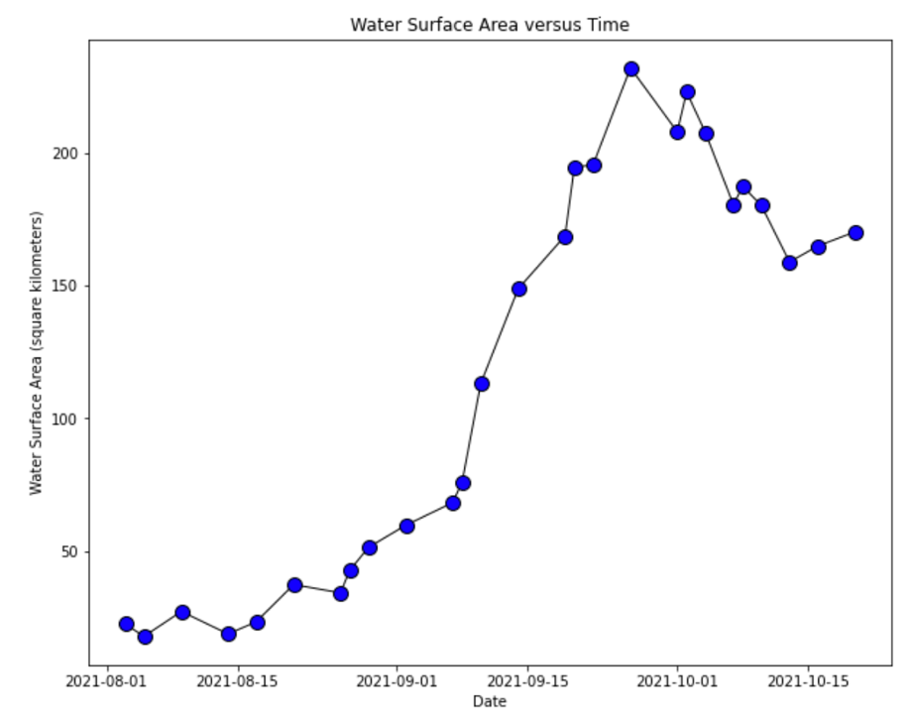
Time Series Water Extent
Sukhothai, Thailand > August 1 to October 20, 2021
Charter Activation
Time Series Animation
Slide 7

Slide 8
Plans for 2022
SDG Coordination Group ... SEO implementation lead, continue development of ODC tools and case studies for specific SDGs
DE-Americas ... continue working with INEGI, CSIRO-Chile and AmeriGEO to explore opportunities in the region
DE-Pacific ... continue as a member of the Interim Steering Group to develop strategic plans and explore data options
Earth Analytics Interoperability Lab (EAIL) ... work with CSIRO to implement the EAIL and support data and algorithm testing for CEOS initiatives (COAST, Disasters, Rice Monitoring, DEM evaluation).
Open Data Cube (ODC) ... advance country/region prototypes, advance tools (sandboxes), advance algorithms (Jupyter notebooks), develop a new user forum, and investigate new datasets.
Analysis Ready Data (ARD) ... continue testing datasets and supporting development of product specifications (e.g. Nighttime Lights, NASA Black Marble), promote and demonstrate ARD value thru ODC prototypes, improve production and access to Sentinel-1 products
Continue CEOS outreach at major meetings ... IGARSS, GEO, AGU
CEOS Communications ... improvements on website and social media
Let us know how the SEO can better serve CEOS!
Slide 8

