Slide 1
Agency Nomination for 2023 CEOS Chair
2021 CEOS Plenary Virtual Meeting
1-4 November 2021
Pakorn Apaphant, Ph.D.
Executive Director
Geo-Informatics and Space Technology Development Agency (GISTDA)

Slide 2
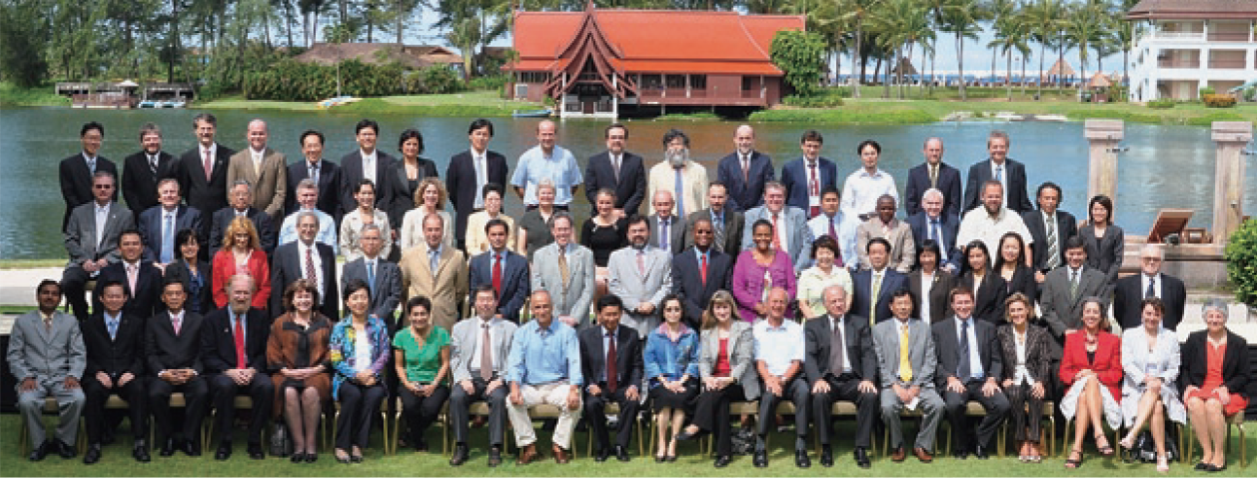
GISTDA and CEOS
2001
GISTDA join CEOS
2003
WGISS 16 Co-Host with NASDA, Thailand
2006
WGCV meeting at Chiang Mai, Thailand
2011 CEOS WGISS Chair
2008 GISTDA Capacity Building on data democracy
2009 CEOS Chair
<<< Participants of the 23rd Plenary in Phuket, Thailand 2009
<<< Participants of the WGISS-31 meeting in Sioux falls 2011

Slide 3
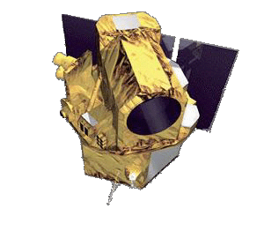
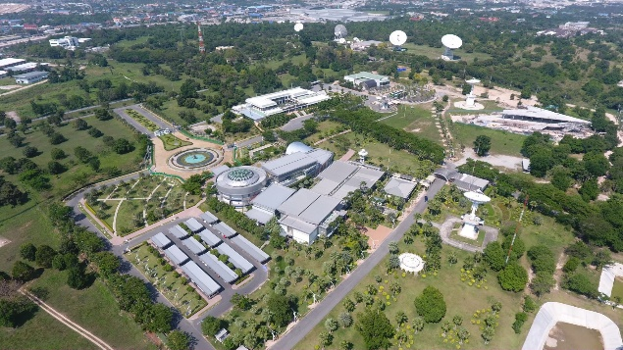
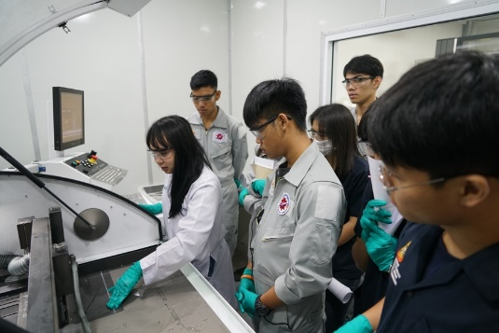
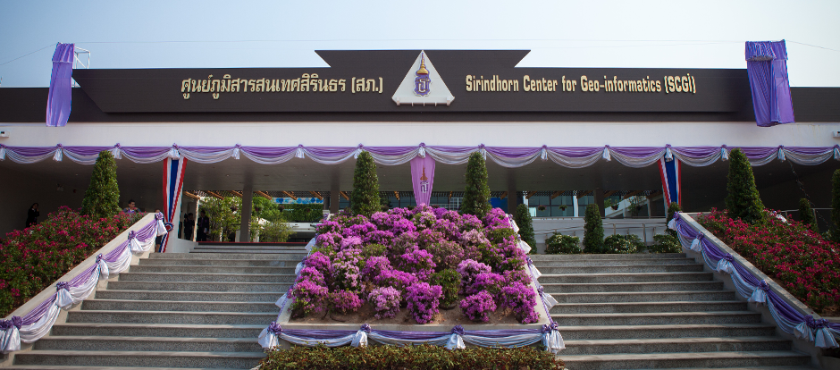
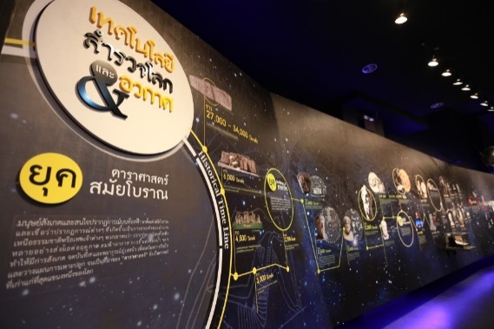
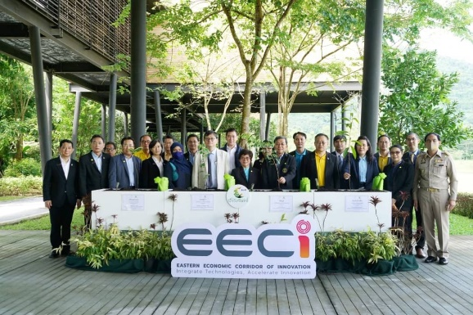
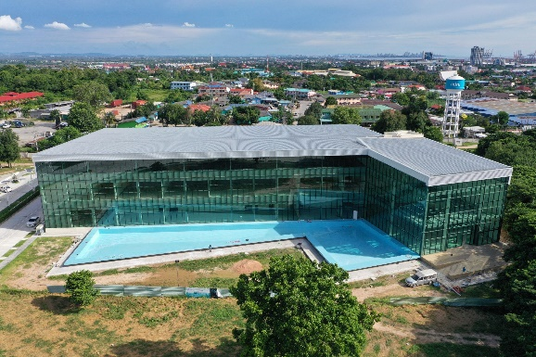
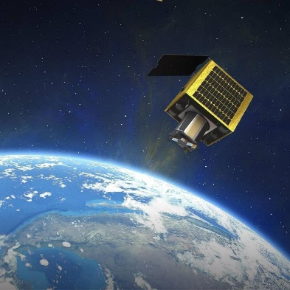
GISTDA Info : Our Growth
Sat. Ground Station
THOES Launch
SKP Established
Aerospace Promotion
SCGI Opening
2006
2008
2012
2013
2015
Space Inspirium
EECI Kick-off
THEOS-2 / AIT
THEOS-2
2016
2017
2018
2022
2025
Open Innovation Center Application & Solution Platform@ Space Krenovapolis

Slide 4
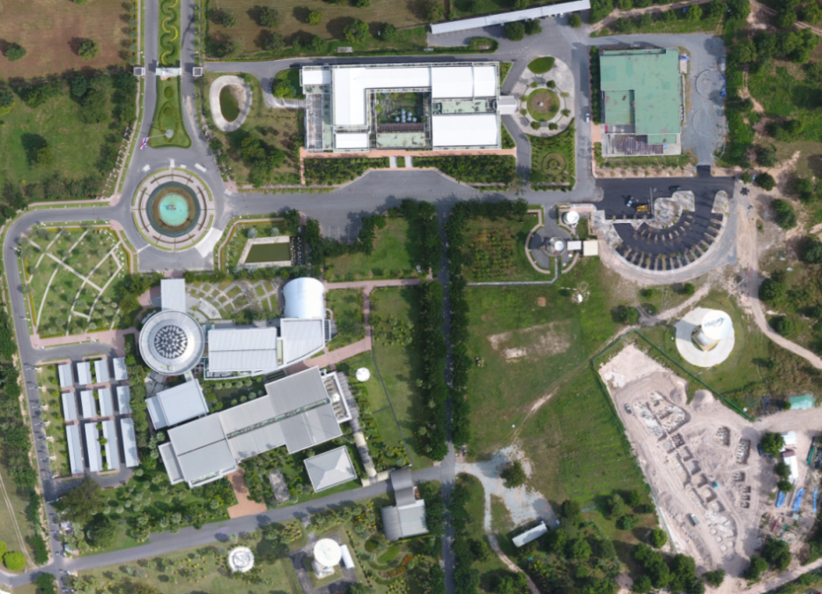
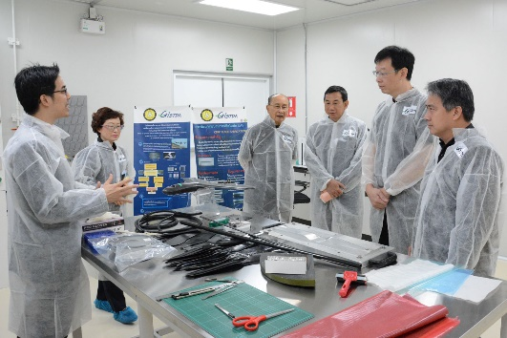
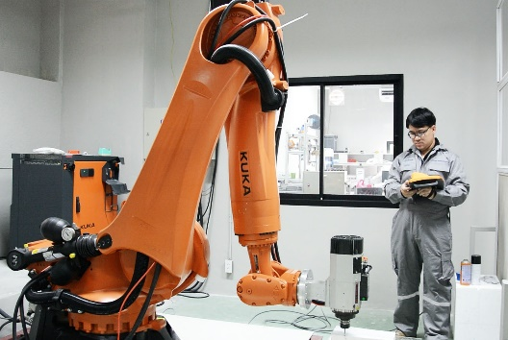
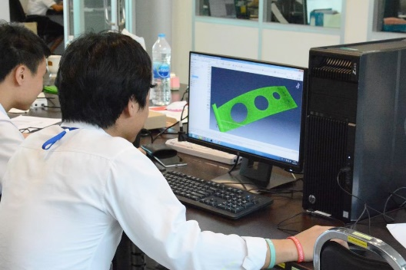
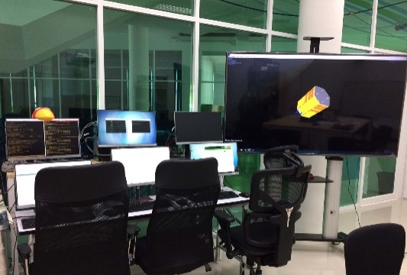
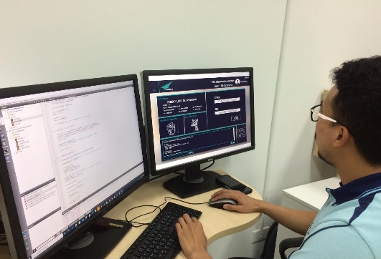
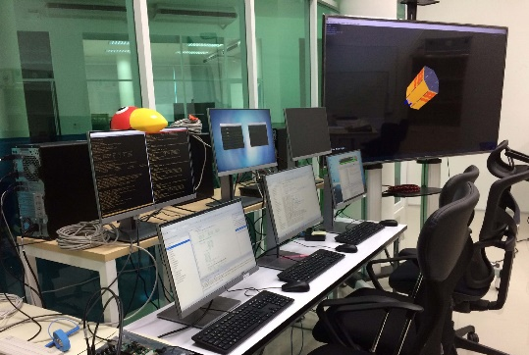
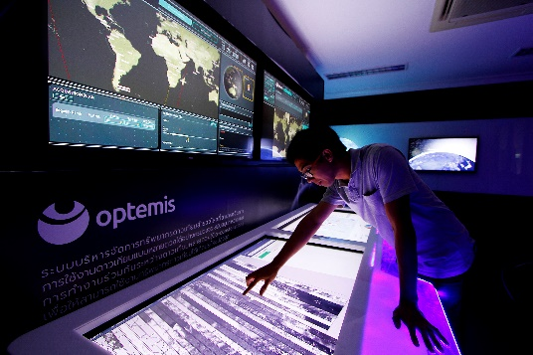
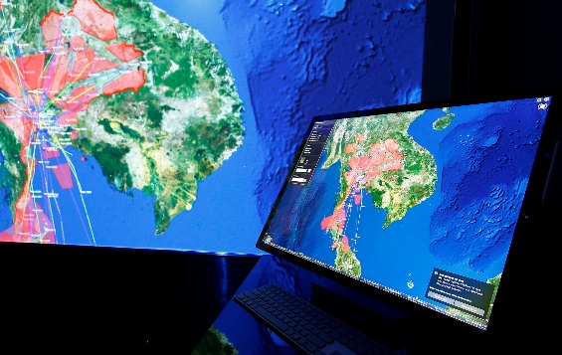
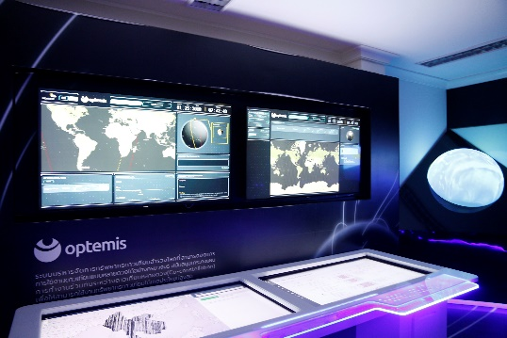
GISTDA Info : Infrastructure for Space Industry and Innovation
“Space Krenovation Park” has been endorsed by BOI as Science and Technology Park and Eastern Economic Corridor Digital Innovation Zone (EECd)
Satellite AIT

Slide 5
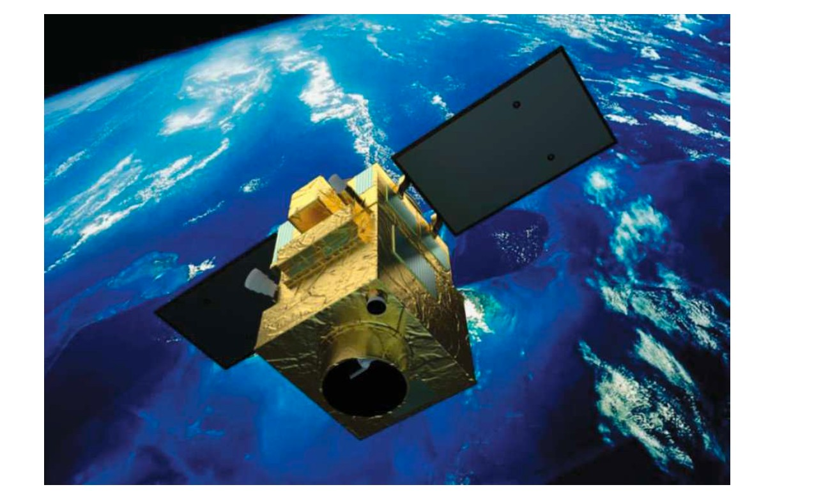
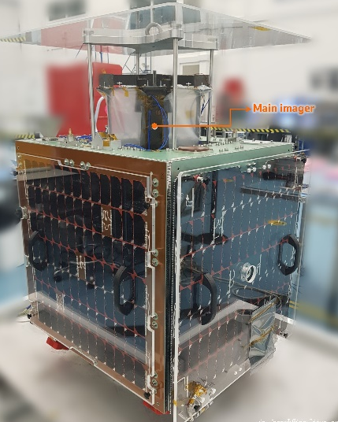
GISTDA Info : Space Technology Development
THEOS-1
THEOS-2
THEOS2 MainSAT
Altitude : 621 Km Spectra Bands , Pan, Blue, Green, Red, Near Infrared Mission Lifetime 10 years
GSD Panchromatic 0.5m, Multispectral 2m
THEOS2 SmallSAT
Altitude 590 km
camera GSD 1.18 m
spectra band: Red green blue
life time 3 years

Slide 6
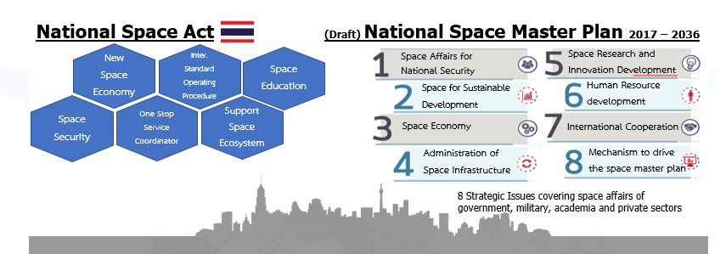
GISTDA Info : National Space Policy
Space Economy lifting off
National Space Master Plan

Slide 7
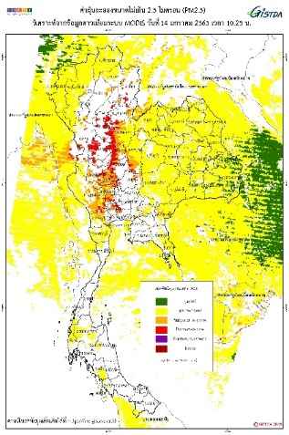
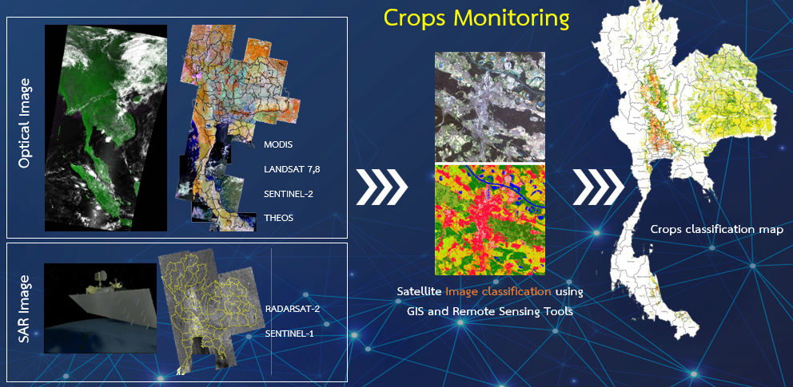
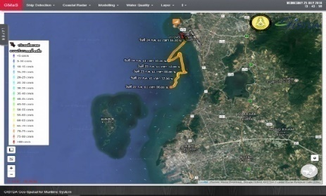
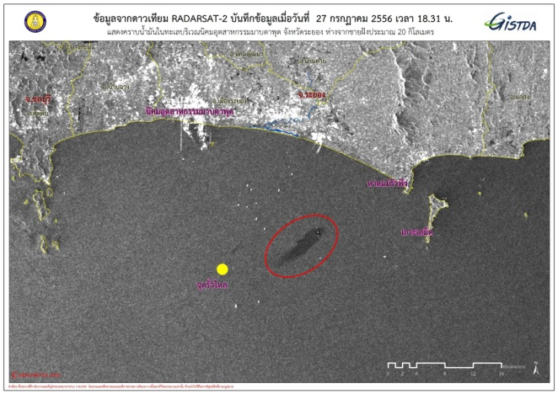
GISTDA Info : CEOS WG and GISTDA’s products and services
Climate Change
CEOS- Key Issue
Essential Climate Variable (ECV)
GISTDA Mission
Atmosphere
Air quality : PM2.5, PM10 , pollution , hotspot, forest fire risk monitoring
Land
Agriculture : Near real time monitoring of Economic crop
Forrest : Detecting and warning
Floods and droughts : Monitoring and support
Ocean
Marine debris Coastal radar station
Oil spills and marine pollution
PM 2.5, 10
Ocean
Slide 7

Slide 8
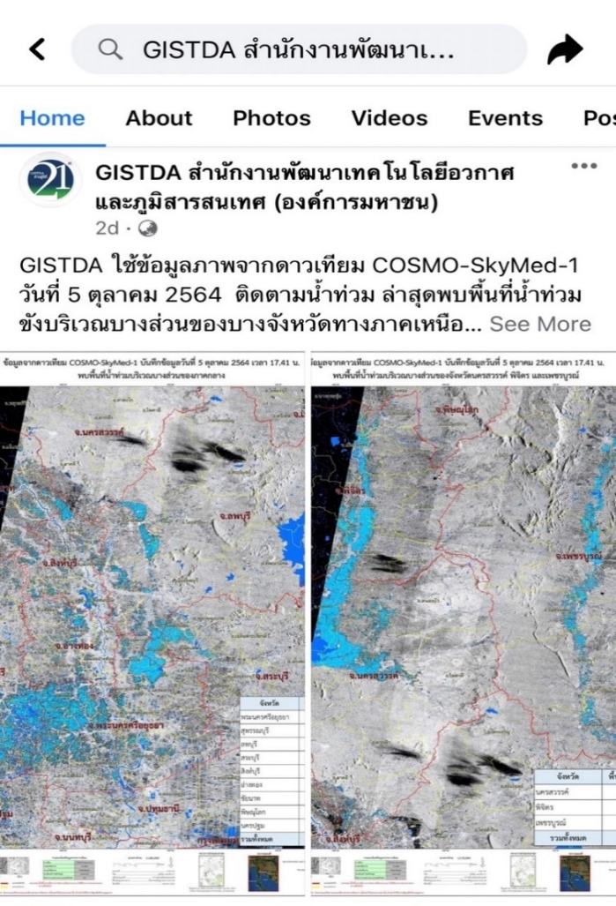
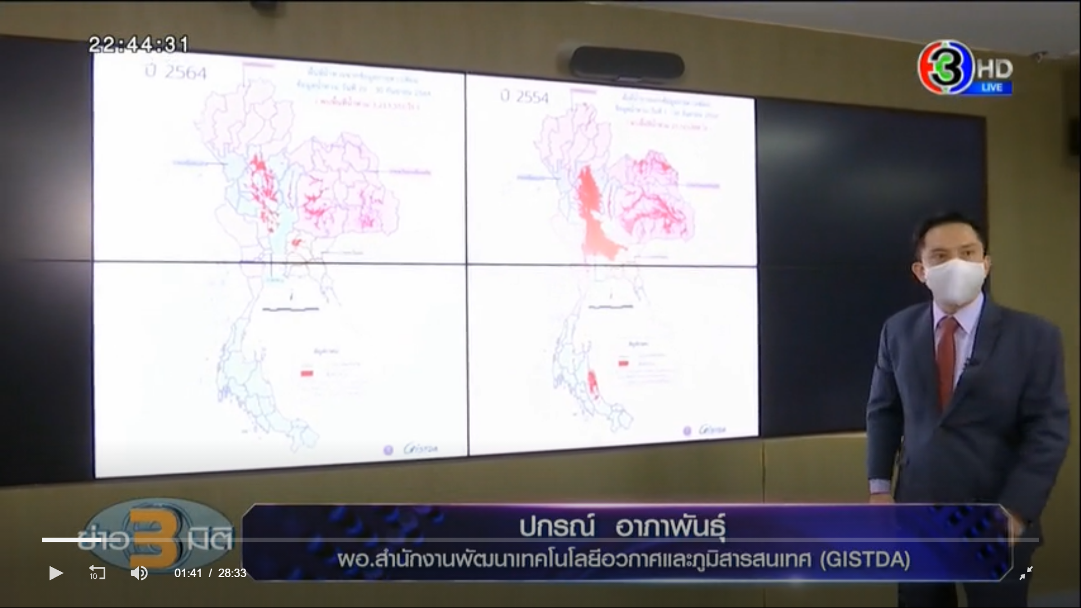
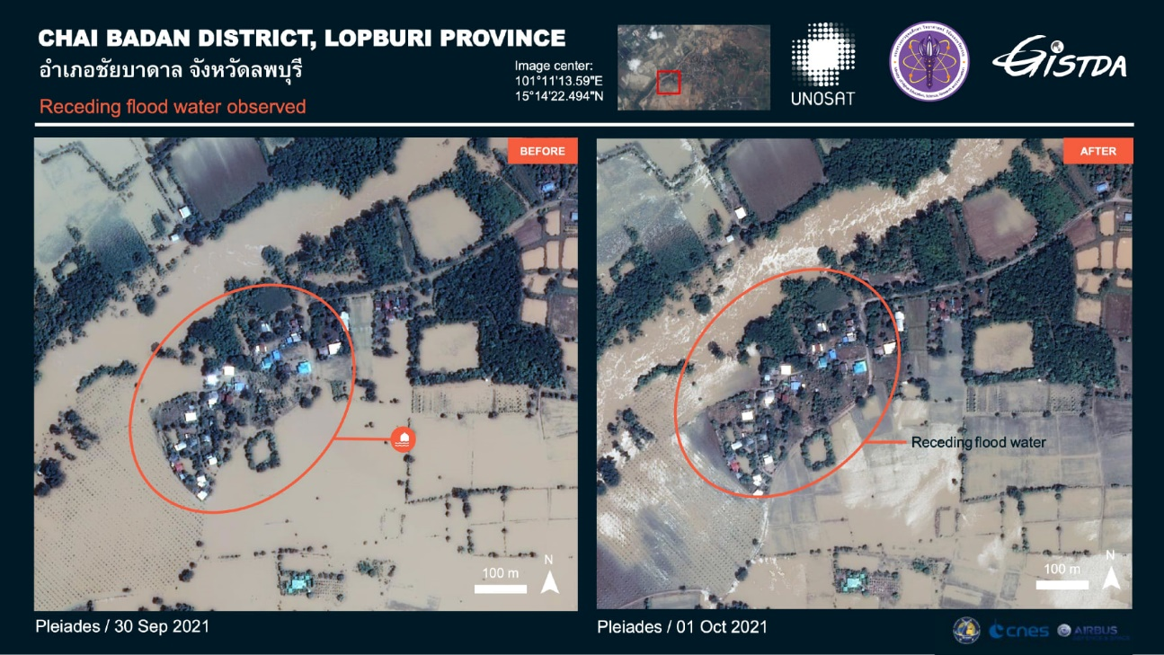
GISTDA Info : CEOS WG and GISTDA’s products and services
Disasters
CEOS- Key Issue
Disaster Risk Management(DRM)
GISTDA Mission
Current situating in Thailand: Flooding
Slide 8

Slide 9
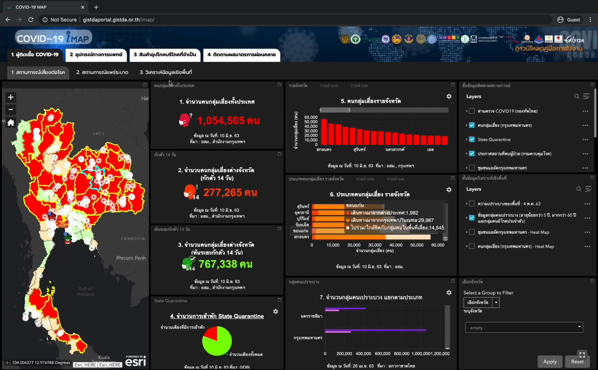
GISTDA Info : CEOS WG and GISTDA’s products and services
Global pandemic and situation in Thailand
Slide 9

Slide 10
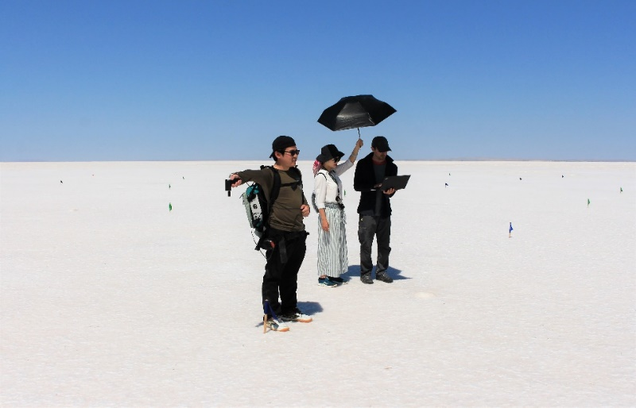
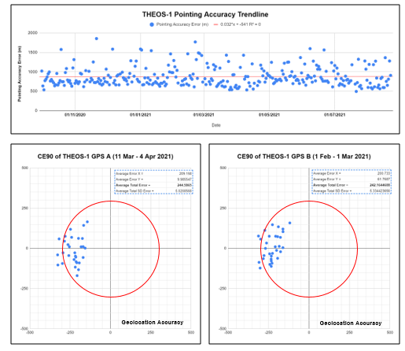
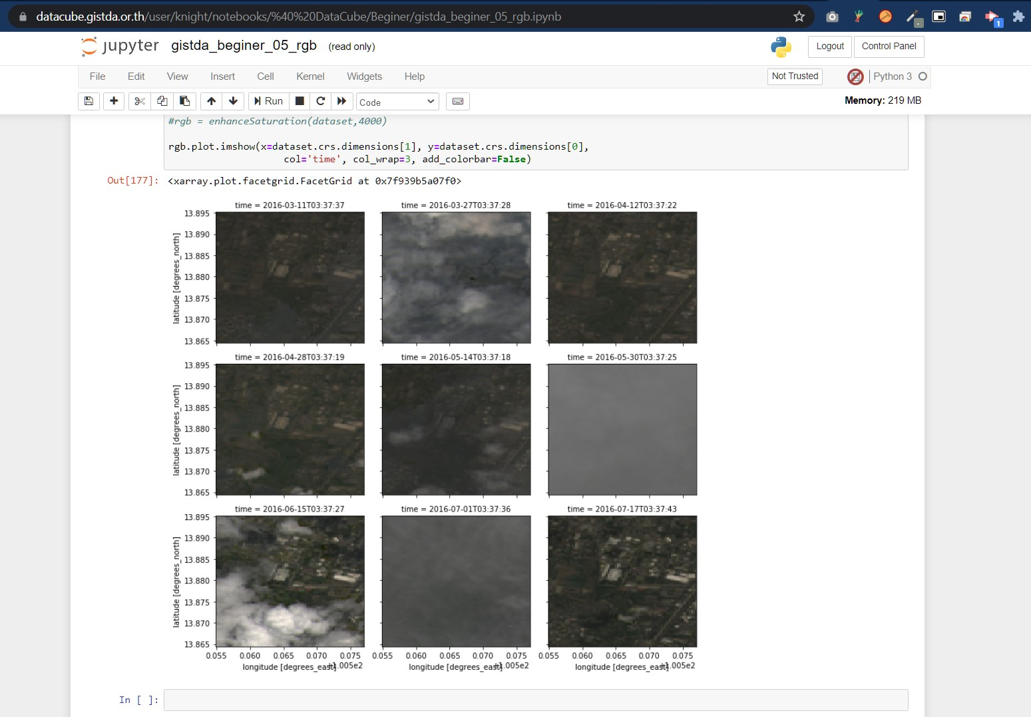
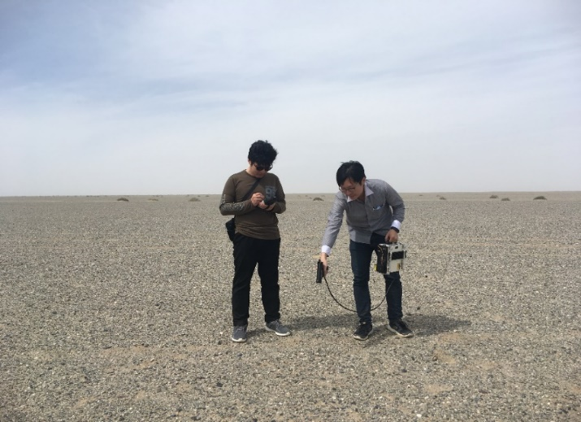
GISTDA Info : CEOS WG and GISTDA’s products and services
Information Systems & Services
CEOS- Key Issue
CEOS Analysis Ready Data
The Open Data Cube,
ESA openEO Platform
GISTDA Mission
Data Cube
Calibration & Validation
CEOS- Key Issue
To ensure long-term confidence in the accuracy and quality of Earth Observation data
GISTDA Mission In-house Cal/Val software development
https://datacube.gistda.or.th/
Dunhuang, China
August 2017
In-house Cal/Val software development
Tuz Golu, Turkey
August 2018
Slide 10

Slide 11
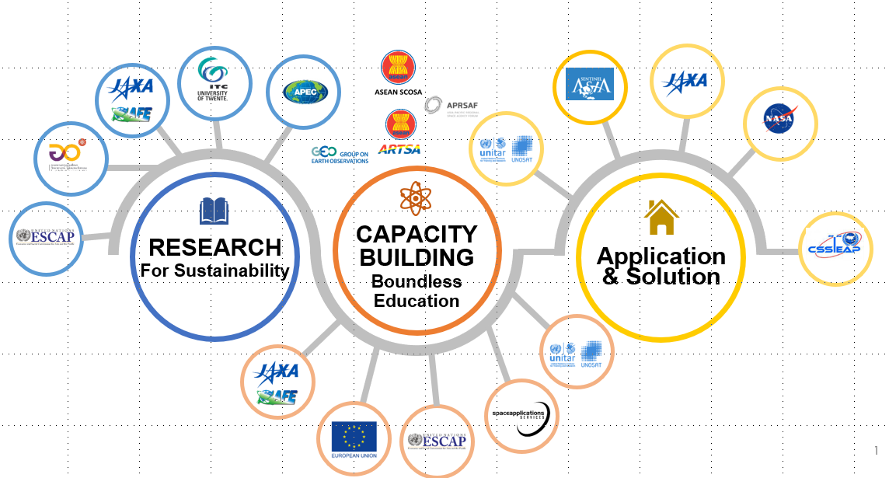
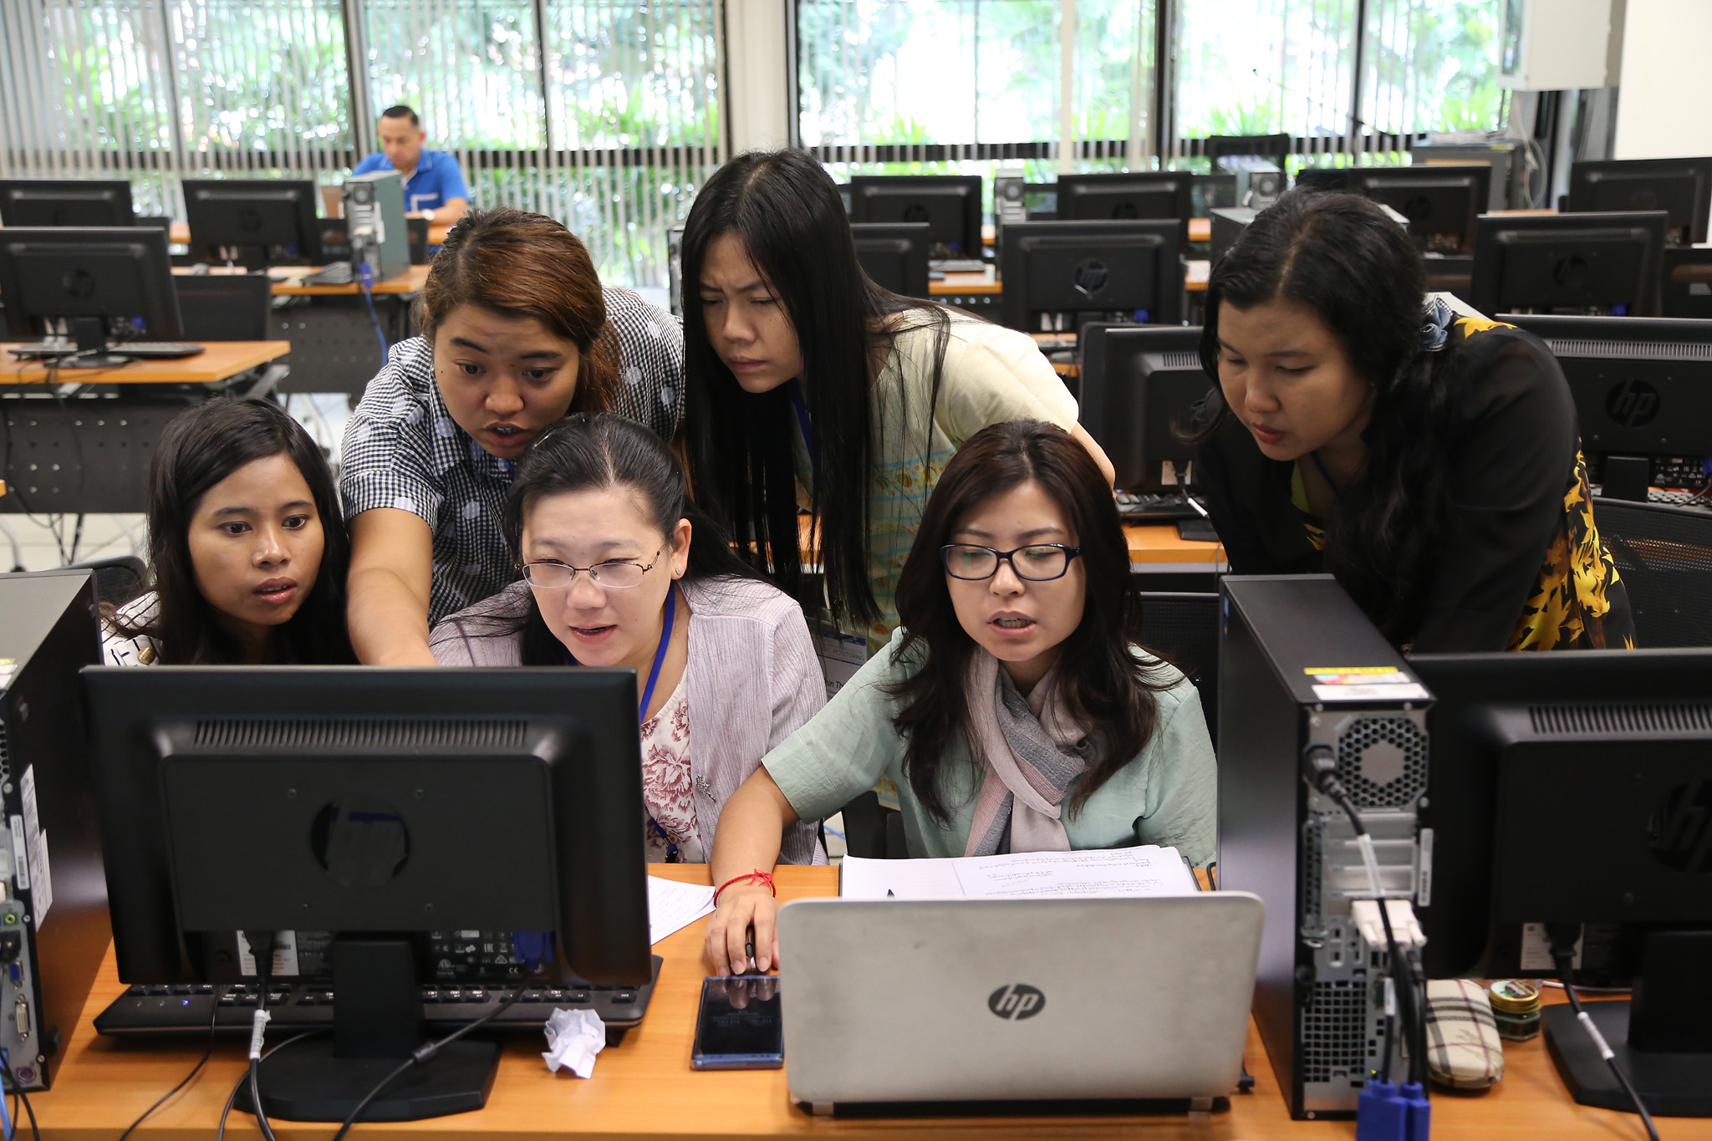
GISTDA Info : CEOS WG and GISTDA’s products and services
Capacity Building
CEOS- Key Issue
Providing the Training and generate excitement program
GISTDA Mission
The Hub of Southeast Asia for Research and Capacity Building
Coordinator for CEOS and UNESCAP for Space Technology Applications
International Networks

Slide 12
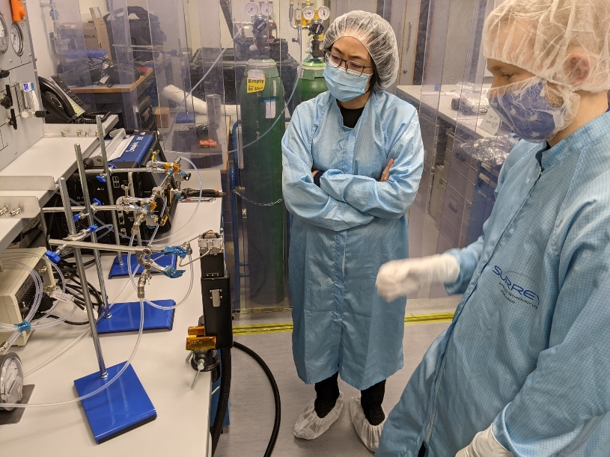
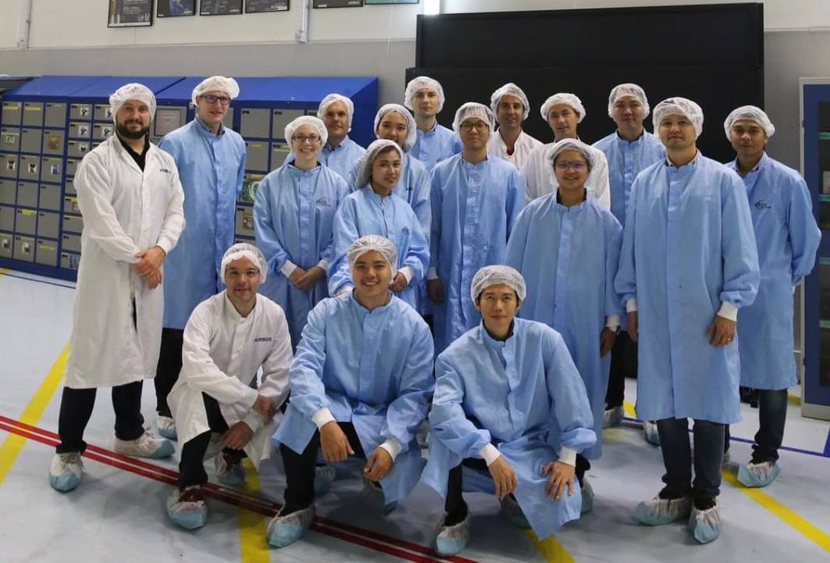
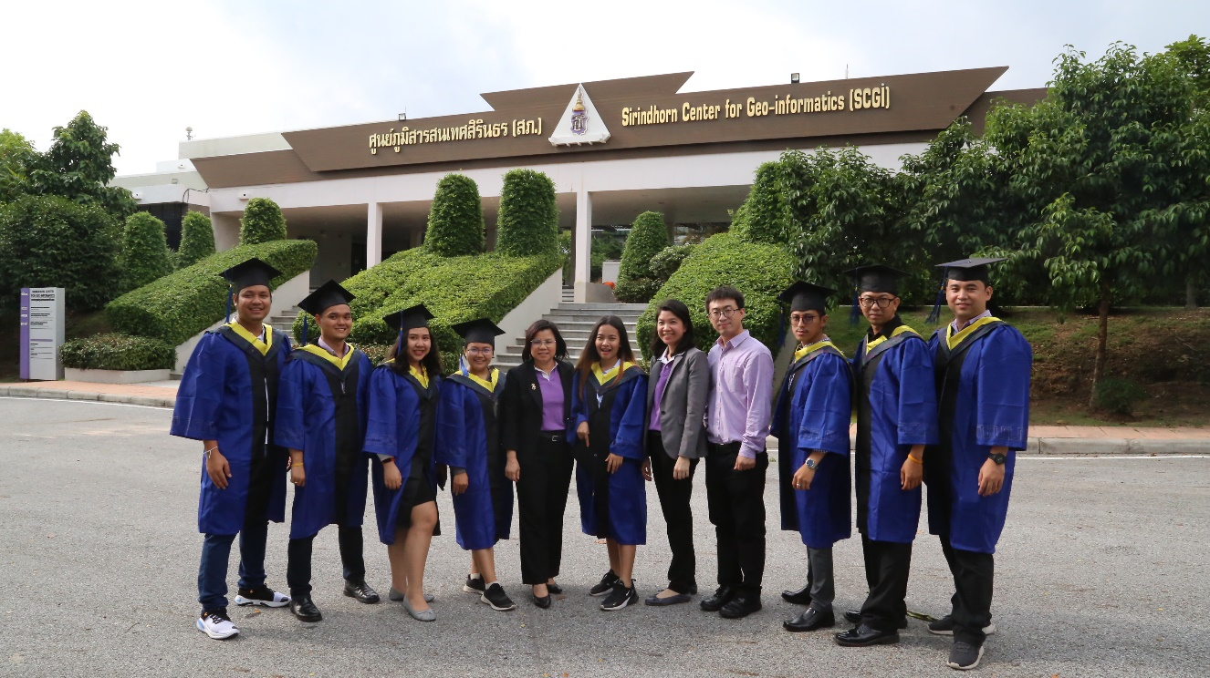
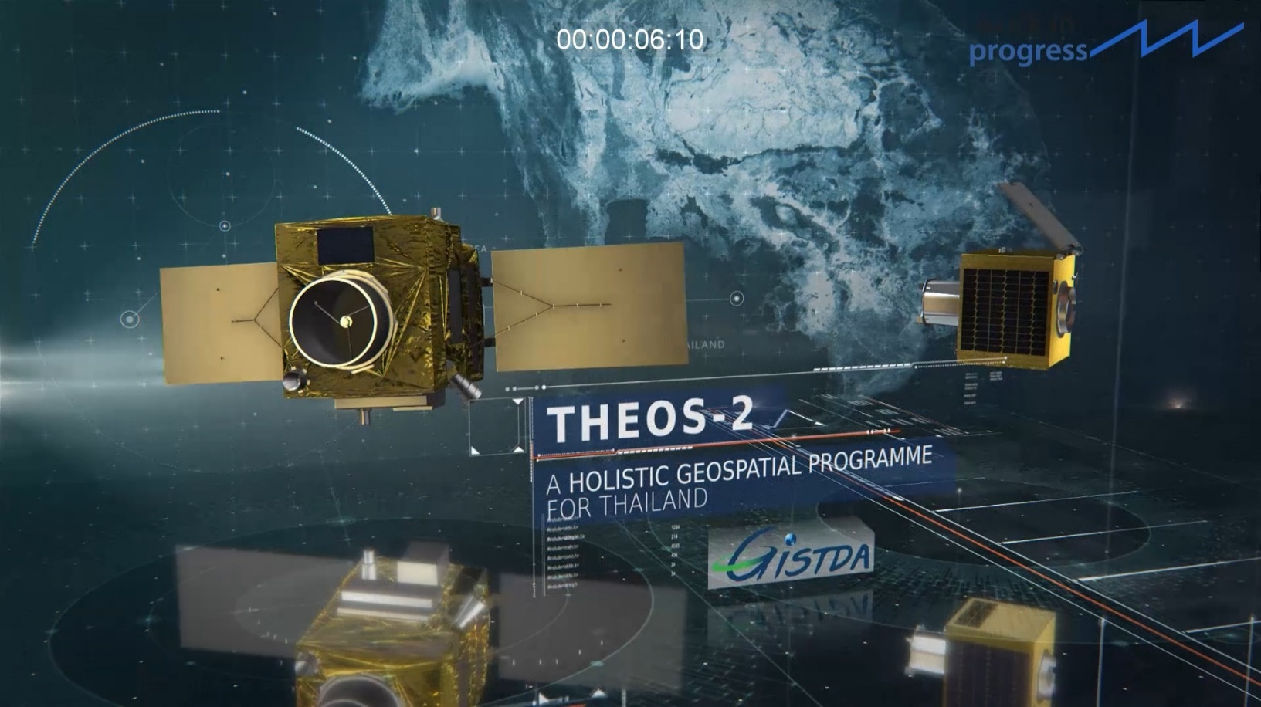
GISTDA Info : CEOS WG and GISTDA’s products and services
THOES-2 : GISTDA Engineers team

Slide 13
2023 CEOS Direction
Future vision : Accelerate Climate Action : Go Net-Zero
Support the current and future missions of CEOS
Core Business of all Working Group
CEOS Strategy to Support the Global Stocktake
Greenhouse Gas , Agriculture, Forestry ,land use, Carbon Biomass,
Coastal research and application, Biodiversity activity, etc.
Partnering with Purpose for Open Science and Decision Support
CEOS Analysis Ready Data (ARD) Strategy
Slide 13

Slide 14
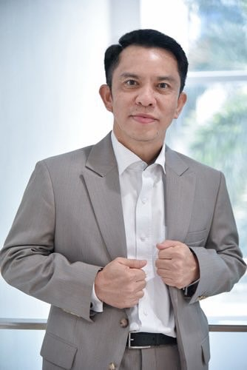
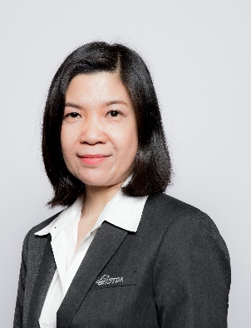
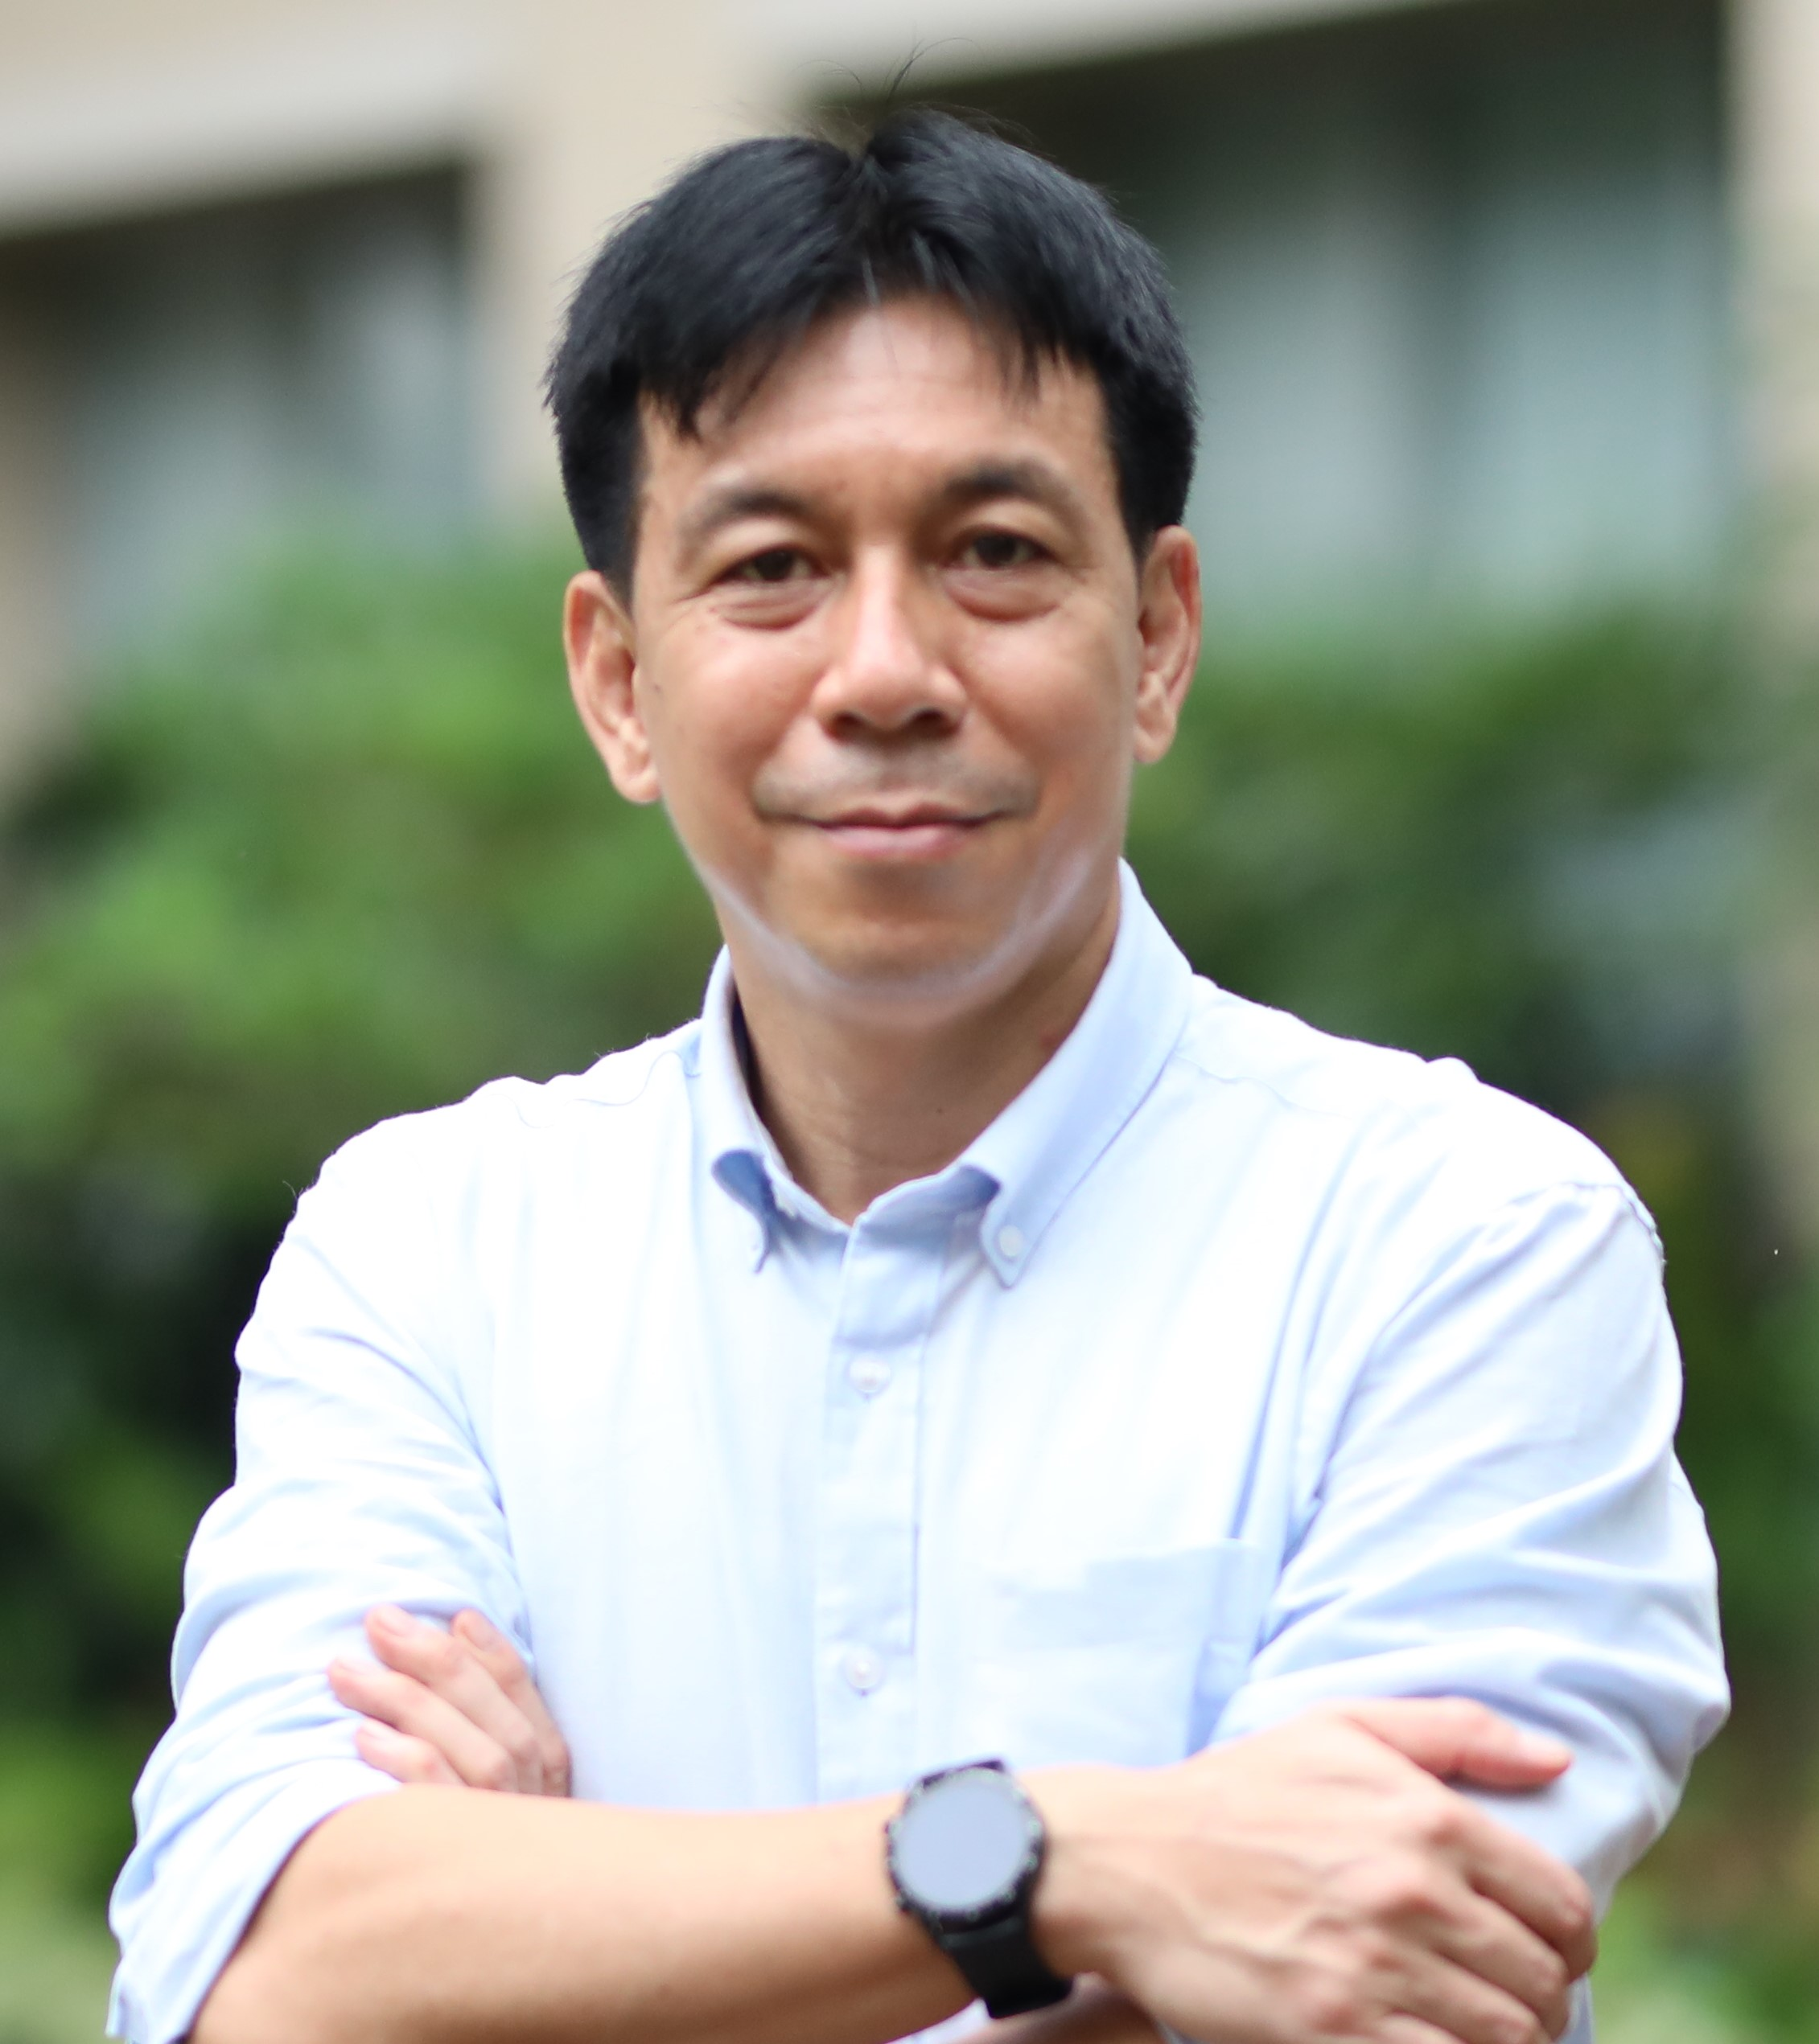
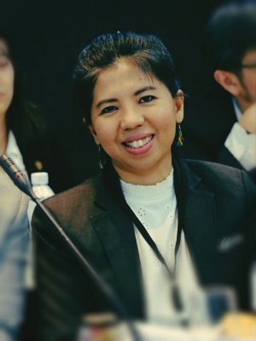
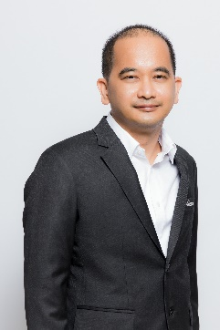
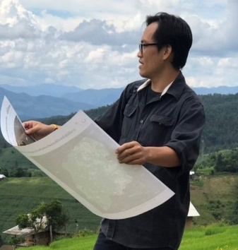
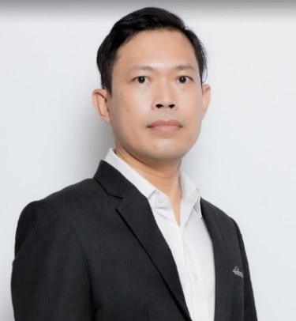
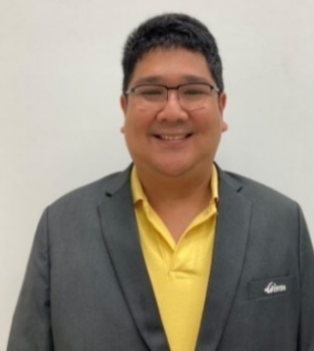
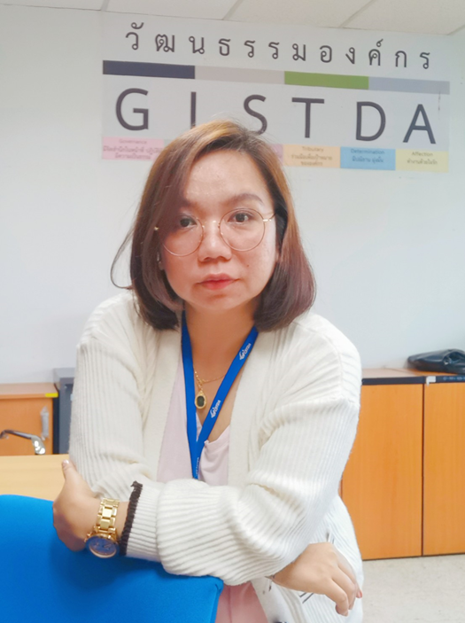
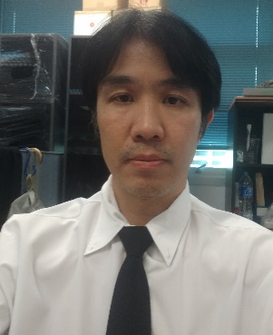
2023 CEOS New direction : CEOS–GISTDA Team
Principal
Advisor
tatiya@gistda.or.th
Advisor
tanita@gistda.or.th
Dr.Pakorn Apaphant
ceo@gistda.or.th
Mr.Tatiya Chuentragun
Dr.Tanita Suepa
POC
Team
Technical
Team
Ms.Raksina Lekthanoo
raksina@gistda.or.th
Dr. Watanyoo Suksa-ngia
watanyoo.suk@gistda.or.th
Dr. Sitthisak Moukomla
sitthisak@gistda.or.th
Dr.Pisut Nakmuenwai
pisut@gistda.or.th
Dr.Warinthorn Evans
warinthorn@gistda.or.th
Dr. Suwat Sreesawet
suwat@gistda.or.th
Mr. Peerapat Akarakupt
peerapat@gistda.or.th
Mrs.Kanjana Koedkurang
kanjana@gistda.or.th
Mr.Yossavin Sombutpanich
yossavin@gistda.or.th
Dr.Khruewan Champangern
khruewan@gistda.or.th
Dr. Surassawadee Phoompanich
surassa@gistda.or.th

Slide 15
Thank you
For more information, please visit us at >>>

