Slide 1
34th CEOS Plenary Closing Session
Committee on Earth Observation Satellites
CEOS Chair Team
CEOS Plenary 2020
Agenda Item # 5.2
22 October 2020

Slide 2
Session Objectives
Objectives:
Confirm key messages and outcomes
Finalise any outstanding points that weren’t resolved or addressed during the other sessions
Review and confirm the formal actions and decisions of CEOS Plenary

Slide 3
1.2: 2020 CEOS Chair Priorities
Key points raised
BIMSTEC ARD activities are appreciable, tools developed
Possibility of involvement of other agencies in BIMSTEC SDG activities
Collaboration with JAXA on Bangladesh AMAN Rice
Team formed for Scatterometry inter-calibration and metrics
Solar and wind energy potential development (Web and Mobile App)
Meeting with GEO-VENER
Disaster application with EO data and on-line tool development
Closer interactions with WGDisaster on proposed activities
WGDisaster will look into Online tools with a demonstration planned
WMO emphasised their involvement particularly for forest fire, floods
Actions recorded / proposed
ISRO 2020 CEOS Chair Team to explore with OSVW-VC the establishment of a joint CEOS-CGMS Task Team to assess user requirements and mission feasibility for the Scatterometry Virtual Constellation (VC) priority
ISRO to identify a representative for the SDG Ad Hoc Team

Slide 4
1.3: CEOS Membership Matters
Key points raised
Application for CEOS Associate membership by the Polska Agencja Kosmiczna (POLSA)
Actions recorded
CEOS-34-01: CEO to confirm both the POLSA Principal and Point of Contact, and to have the CEOS website and mailing lists updated to reflect POLSA’s Associate membership. ASAP
Decisions recorded
The application for CEOS Associate membership by the Polska Agencja Kosmiczna (POLSA) was endorsed.

Slide 5
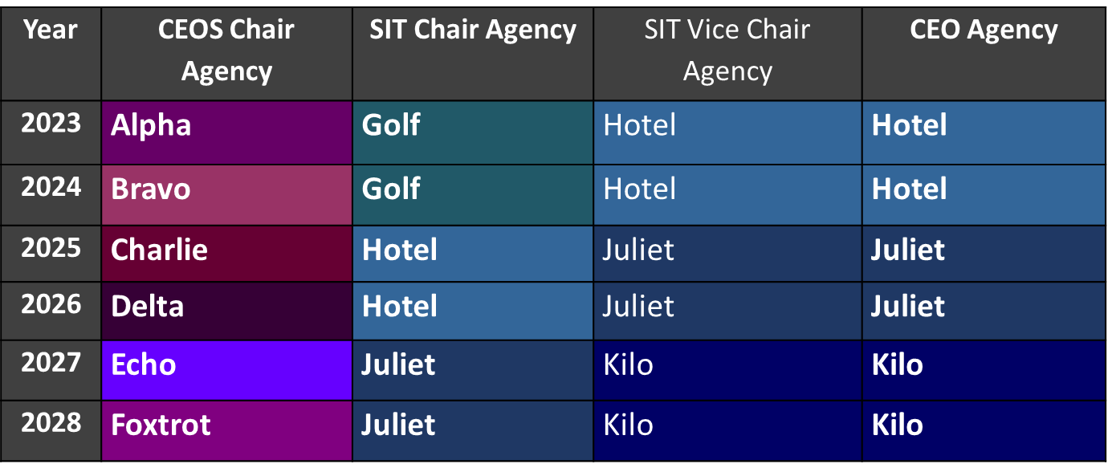
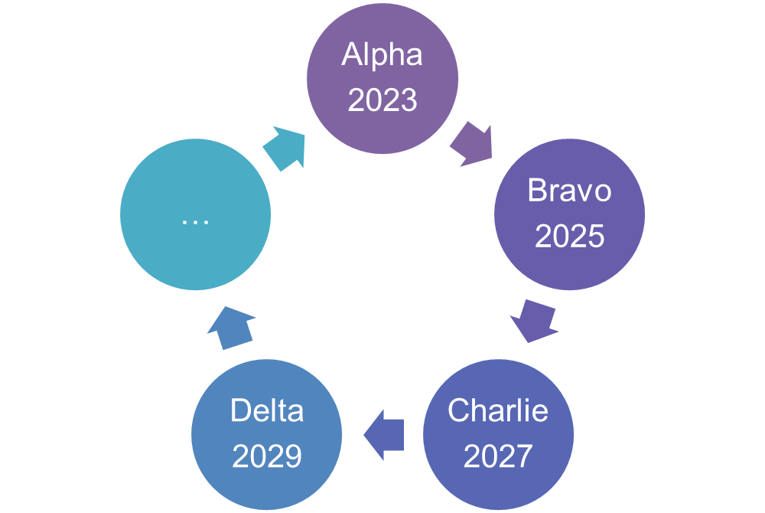
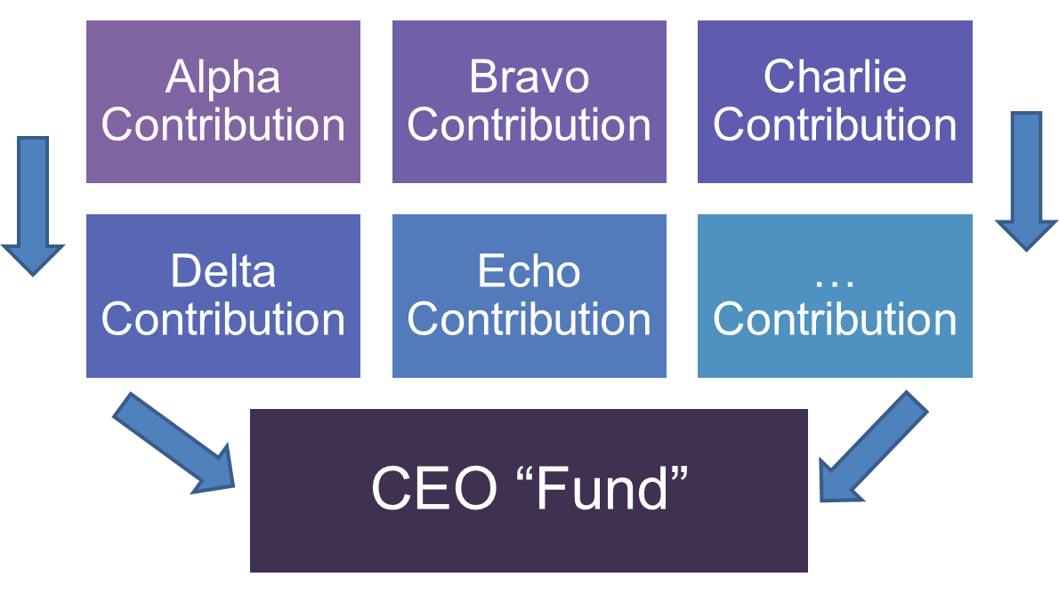
1.4: CEOS Executive Officer Continuity (CEO, CEOS Chair)
There is need to identify a mechanism to ensure consistency and sustainability in the securing of a CEOS Executive Officer
Three Proposals presented by CEO to stimulate discussion on CEO continuity
Option 1: Tie the two-year term for CEO to the SIT Vice Chair Agency and the Vice Chair two-year term
Option 2: Geographical rotation of CEO and DCEO with announcement of each Agency’s commitment two years in advance
Option 3: CEOS Agencies to contribute funds to a centrally managed account to cover costs for a CEO
Support for Option 1 noted from UKSA, NOAA, CNES, EUM
Support for Option 3 noted from NASA
Action recorded
CEOS Chair to work with CEOS Secretariat to explore the CEO continuity options for the long term with the pros and cons of different approaches

Slide 6
1.5: 2022 CEOS Chair
Key points raised
CNES has expressed willingness and interest to become CEOS Chair for 2022, but at this stage is still investigating the possibility internally.
Proposed to set a deadline for returning to CEOS with a decision by the end of November.
Action recorded
CEOS-34-02: CNES to confirm their ability to serve as CEOS Chair 2022 via the CEO and CEOS Secretariat. By end November 2020

Slide 7
1.6: CEOS-GEO Coordination
(SIT Chair Team)
Key points raised
Report reflected that the CEOS-GEO relationship remains strong and deep
This was recognised by the GEO Secretariat Director
CEOS sits on the Programme Board and participates in the GEO Executive Committee as one of three Participating Organization (PO) Observers
PB participation makes CEOS eligible; elected by other POs on the PB
Planning is underway for the 2021 CEOS/GEO bi-lateral
Analysis Ready Data in Cloud Object Stores is a key enabler/priority for GEO
Brian (SEO) gave an update on the Open Earth Alliance (OEA) which has been approved as a GEO Community Activity this year
Decisions recorded / proposed
Decision 34-02: The CEOS Statement to GEO Week 2020 was endorsed, subject to the outcomes and decisions of the CEOS Plenary, as the statement includes some references of topics that still need to be endorsed at CEOS Plenary.

Slide 8
2.1: CEOS Virtual Constellations
(SIT Chair Team)
(SIT Chair Team)
Key points raised
ESA responded to call for P-VC representation, nominating Tobias Wehr (EarthCARE)
CEOS ARD strategy (LSI-VC + ) remains vibrant and with broad support
SST-VC White Paper completed
OST-VC: Copernicus Next Gen. Topography Constellation (NG-TC) Expert Team addressing continuity; Sentinel-6 Michael Freilich launches in Nov!
OSVW-VC notes open and near real-time data access remains challenging
OCR-VC addressing the Aquatic Carbon aspects of the GHG Roadmap

Slide 9
2.1: CEOS Virtual Constellations
(SIT Chair Team)
(SIT Chair Team)
New Thematic Observing Strategies page for website visitors
ceos.org/observations

Slide 10
2.2 : WGDisasters
Key points raised
Wildfire Pilot Implementation Plan expected to be submitted for review before, and endorsement at, SIT-36.
All CEOS Members are encouraged to join these new and existing WGDisasters activities.
Decisions recorded / proposed
WGDisasters Strategy Document endorsed.
Recovery Observatory Demonstrator Implementation Plan endorsed.
GEO/LEO/SAR Flood Pilot Implementation Plan endorsed.

Slide 11
2.3: WGISS/SEO: Earth Analytics Interoperability Lab (EAIL)
Key points raised
CEOS activities seeking advice on implementation, and on validating interoperability between multiple CEOS organizations and groups, and the EAIL will help navigate some of the complexity involved
Activities include CEOS-COAST, WGCV DEMIX, the WGDisasters Flood Pilot, and the CEOS Rice Monitoring Community.
The first Lab node is hosted by CSIRO, and jointly operated by WGISS and SEO, and seeks to validate and demonstrate interoperability approaches
Could assess accomplishments, targets and sustainment options in the SIT-36 timeframe

Slide 12
2.4: CEOS Working Group (WG) Vice-Chair Decisions
Decisions recorded:
WGCV
Plenary endorsed Philippe Goryl of ESA as the WGCV Vice Chair for 2021-2022 and WGCV Chair for 2023-2024.
WGClimate
Plenary endorsed Jeff Privette of NOAA as the WGClimate Vice Chair for 2021-2022 and WGClimate Chair for 2023-2024.

Slide 13
2.5: COVERAGE & UN Decade of the Oceans
(COVERAGE Team)
(SIT Chair Team)
Key points raised
Presented background on COVERAGE, status of its Phase B activity, and an overview of the UN Decade of the Oceans for Sustainable Development. Outlined possible next steps in terms of COVERAGE and CEOS involvement.
Discussed: Issue of coordination and a central CEOS point of contact to IOC/Decade, possible synergies between COVERAGE and other relevant CEOS efforts (e.g., COAST)
COVERAGE indicated interest in being involved and partnering with other relevant CEOS entities in any Decade efforts. Consideration of COVERAGE as a cumulative CEOS contribution is also of interest.
COVERAGE is considering submitting an expression of interest to the current “Ocean Shot” solicitation for concepts by the US Decade committee (due Dec.1)
Actions recorded / proposed
COVERAGE and the SIT-Chair Team to confer on how this desired coordination within CEOS on the matter of Decade involvement could occur.
Decisions recorded / proposed
None.

Slide 14
2.6: Annual Report: CEOS Systems Engineering Office
Key points raised
Significant accomplishments and activities of SEO in 2020 presented
SEO plans for 2021 include: the Earth Analytics Interoperability Lab (EAIL); Open Data Cube (ODC); Analysis Ready Data (ARD); support to SDGs; COVE and CEOS Mission Database (MIM); continued CEOS outreach at major meetings (IGARSS, GEO, AGU)
How CEOS Agencies can support efforts of the SEO:
biggest contribution CEOS Agencies can make to ODC is to push CEOS Analysis Ready Data to accessible locations (e.g., cloud) – greatly increase the pace of development.
Agencies to review and revise the CEOS website content - keep it up to date for our 30,000 unique visitors!

Slide 15
2.7: CEOS External Request and New Initiatives Process Papers
Key points raised
The ERPP supplements the NIPP and provides a detailed process to address requests that originate outside of the CEOS organization and do not currently have CEOS sponsorship.
Decisions recorded / proposed
Plenary endorsed the External Request Process Paper.
Plenary endorsement of the updates to the New Initiatives Process Paper (NIPP).

Slide 16
2.8: Annual Report: CEOS MIM Database
Key points raised
The number of users of The EO Handbook and database continuously increases every year: over 15,000 users last year.
Responses received from 32 of 38 agencies surveyed.
Annual collective effort from the database team + agency contacts, is ~15 weeks FTE, guaranteeing an accurate information.
Significant update of the Measurements list this year – enabled links to GCOS ECVs and the ECV Inventory v3 and harmonisation of the variables names with those used by OSCAR, GCOS,etc.. Possible future linkages to activities such as the SDGs.
Upcoming work includes a possible integration with the COVE API + demonstrations of analysis using the database in Jupyter Notebooks.
Efforts have been made to have the MIM database interoperate with OSCAR/Satellite, SATCAT (NORAD tracking), COSPAR (identifiers), and the Union of Concerned Scientists database.
Mission datasets are also linked via OpenSearch APIs from NASA and ESA.

Slide 17
3.2: CEOS Webinar Toolkit
(WGCapD)
Key points raised
CEOS can strengthen its effort to provide effective webinars through the creation of a webinar toolkit and review framework that taps into the collective knowledge of the WGCapD
Actions recorded / proposed
Create the webinar toolkit and review framework
Test the toolkit and framework with the WGISS-SEO Jupyter notebook webinar
Promote the toolkit - potentially create a webinar for an internal CEOS audience about the toolkit, using the toolkit
Decisions recorded / proposed
Agreement to proceed with preparing CEOS Branded Webinar Toolkit

Slide 18
3.3: WGCV
Key points raised
RadCalNet: number of users nearly 500 today. A new site was recently welcomed to the network: a sandy desert site in Baotou, China. Cindy thanked Marc Bouvet (ESA) for his dedication and leadership.
CARD4L Peer Review: Recently approved Landsat Collection 2 Surface Reflectance and Surface Temperature products as the first CARD4L products (at CARD4L Threshold level). The self-assessment and peer review of Sentinel-2 Level-2A products is in process. Cindy thanked Medhavy Thankappan (GA) for his effort leading this process.
CEOS WGCV LPV Biomass Validation Protocol: The document is now open for feedback until 15 December 2020 and will seek endorsement at the SIT-36 meeting in March 2021.
Akihiko Kuze (JAXA) taking over the Chair position following Plenary.

Slide 19
3.4: Greenhouse Gas (GHG) Roadmap
Key points raised
Expected Outcomes of the Roadmap Activities are: delivery of pilot datasets of CO2 and CH4 fluxes in support of the Global Stocktake 2023; delivery of an operational system for producing future atmospheric CO2 and CH4 flux products to support the Global Stocktake 2028; and, refinement of user requirements in preparation of the implementation of the operational system.
3 broad categories of resources requested for consideration by CEOS Agencies: dedicated human resources (via the WGClimate Task Team and consistent with the requested skillsets); support for travel and hosting of workshops, internal funding mechanisms to support research, development and infrastructure
Decision recorded
Decision 34-08: CEOS Plenary endorsed the GHG Roadmap document (v2.4), describing an approach and resource needs for the implementation of the GHG Constellation Strategy. This is to be considered a living document and the Actions in Annex C provide a current snapshot of the work plan definition which will be updated over time. CEOS Agencies will strive to provide the identified resources for the specific activities and entities.
Action recorded
CEOS-34-05: CEOS agencies are asked to consider and provide the identified resources for the specific activities and entities within the endorsed GHG Roadmap by CEOS Plenary 2021

Slide 20
3.5: CEOS AFOLU Roadmap
(JAXA, ESA, AFOLU Team)
(SIT Chair Team)
Key points raised
CEOS Plenary asked to recognise the magnitude of the opportunity for satellite Earth observations in support of the Global Stocktake (GST) process.
CEOS agencies asked to support GST1 AFOLU inputs in 2021
Key agencies encouraged to provide representation and resources going forward to support the development of a full CEOS AFOLU Roadmap, including long-term vision
AFOLU Roadmap and GHG Roadmap deliverables will require coordination and collaboration (planned GHG-AFOLU Workshops should help)
CEOS focal points to the UNFCCC SEC GST process to keep CEOS updated: Osamu Ochiai (for AFOLU issues), David Crisp (GHG issues), Jörg Schulz (general issues).
Actions recorded
The AFOLU Roadmap team to follow up with key CEOS agencies to establish their contribution and availability of the necessary resources to proceed with the Roadmap and to produce the GST1 deliverables (Nov 2020)
WGClimate, GHG Roadmap Team and AFOLU Roadmap team to coordinate and ensure the necessary collaboration for GST1 deliverables and to ensure a unified interface to UNFCCC SEC and long-term vision
Decisions recorded
It was agreed that it is important for a CEOS AFOLU Roadmap to proceed, noting the need for a long-term vision, but also the urgency of clearly understanding stakeholder requirements and defining targets for the first Global Stocktake. Coordination of the AFOLU Roadmap with the ongoing GHG Roadmap was recognised as essential.

Slide 21
3.6 & 3.7: Forest Biomass Protocol and Reference Network
(WGCV LPV)
(SIT Chair Team)
Key points raised
Biomass protocol draft is complete and provides guidance for collection of reference data and validation of satellite biomass products
A Global Forest Biomass Reference Network is proposed as a concept and is seeking support (including field and airborne data collection and coordination)
Actions recorded
CEOS Agencies to provide feedback on the current draft Biomass Validation Protocol document with a view to seeking endorsement at SIT-36. CEOS agencies are encouraged to follow Protocol guidance in biomass relevant activities.
CEOS Agencies invited to provide feedback on how to achieve the proposed creation of a Global Forest Biomass Reference System, including possible national contributions
CEOS agencies encouraged to communicate existing and potential new activities that could contribute to collection and curation of new biomass reference data
WGCV LPV Biomass team will seek to establish a site prioritisation for the Forest Biomass Reference Network

Slide 22
3.9: WGClimate
(SIT Chair Team)
Key points raised
The delivery of the Cycle 3 Gap Analysis and Coordinated Action Plan has moved to autumn 2020, and the group is aiming for virtual endorsement by the end of 2020
CEOS Plenary to endorse way forward for interaction with GCOS for the work on the requirements framework
CEOS Agencies are asked to facilitate the submission of climate data record use cases: http://climatemonitoring.info/use-cases/
Decisions recorded / proposed
Decision 34-10: It was agreed that virtual endorsement of gap analysis and updated coordinated action plan before the end of 2020 is acceptable
Decision 34-11: The way forward on the interaction with GCOS on the work on the requirements framework was endorsed
Decision 34-12: It was agreed that Plenary Action CEOS-32-02 is kept open and that WGClimate Chair advices on implementation via CEOS SEC

Slide 23
3.10: UNFCCC Global Stocktake Process & Space Agency Engagement
(SIT Chair Team)
Key points raised
The pilot atmospheric greenhouse gas (GHG) products described in the GHG Roadmap are on schedule to support the 2023 Global Stocktake
CEOS will continue conversation with the relevant stakeholders (UNFCCC, IPCC, GCOS) and customers in the national inventory community to demonstrate the capabilities of atmospheric GHG measurements and to refine requirements for future Global Stocktakes
WCapD could support with Webinars addressing EO capabilities for SBSTA parties
The endorsement of the GHG Roadmap maintains the focus on this effort
Fostering closer coordination between the CEOS GHG and AFOLU efforts is a high priority for 2021

Slide 24
4.2: CEOS Analysis Ready Data (ARD) Strategy
(SIT Chair Team)
Key points raised
The Industry Engagement report, previously viewed at SIT, and SIT-WS, which lays out the proposed engagement with industry on Analysis Ready Data.
The Interoperability Terminology report, developed by WGISS, which clarifies a number of important concepts and terms.
Extension of CEOS ARD Beyond Land, led by Ed Armstrong, which proposes that more work is needed to understand how the current framework can be adjusted to be applicable in other realms, including ocean and atmosphere.
Actions recorded
CEOS will form a small team to review the CEOS ARD Framework (Definition, specifications and processes around ARD) for completeness and suitability.
Decisions recorded
The CEOS Industry Engagement Report was endorsed
The CEOS Interoperability Terminology report was endorsed

Slide 25
4.3: CEOS Coastal Observations and Applications Study Team (COAST)
(SIT Chair Team)
Key points raised
Welcome Raj Kumar (ISRO) as COAST Co-Chair
Phase 1 of the study has been completed, including a draft Implementation Plan for Phase 2 (now in draft, to be delivered by December 2020).
Actions recorded /
CEOS-34-14: CEOS COAST ad hoc Team to provide Final Terms of Reference (per usual process) and a Phase 2 Implementation Plan. To be delivered by December 2020, with a report at January’s CEOS Secretariat meeting
CEOS-34-15: CEOS COAST ad hoc Team to coordinate with CEOS Secretariat on the submission of COAST as a submission to the U.N. Ocean Decade.
Decisions recorded /
Plenary agreed on the continuation of COAST activities through September 2022 as a CEOS ad hoc Team with Final Terms of Reference and a Phase 2 Implementation Plan to be delivered by December 2020.

Slide 26
4.4: Sustainable Development Goals Ad Hoc Team (SDG-AHT)
(SDG AHT Co-Leads)
(SIT Chair Team)
Key points raised
SDG AHT Progress report of 2020 activities, including sub-teams creation & initial work, CEOS contributions to GEO Federated Approach on SDGs (including GEO SDG Toolkits) and ODC SDG algorithms development
A 2021 transition roadmap for a smooth transfer of AHT activities into an permanent operating structure was presented as required after SIT TW
2 future options (and their justification) were proposed for discussion and Principals’ decision
Actions recorded / proposed
Prepare inputs (according to the proposed Roadmap) to Plenary 2021 summarising how the SDG-AHT activities have been transferred to, and outlining the new permanent mechanism
Decisions recorded / proposed
SDG AHT extended for another year, with the objective to transfer all SDG AHT activities into a permanent structure, inside or outside of CEOS, by the end of 2021.

Slide 27
4.5: COVID-19 and Earth Observation from Space
Key points raised
See the slides!
Actions recorded / proposed
A
B
Decisions recorded / proposed
A
B

Slide 28
4.6: Report: SIT Chair Term Accomplishments
(SIT Chair Team)
(SIT Chair Team)
Key points raised
Substantial progress on ARD, SDG and Carbon and Biomass themes - outstanding effort by all the supporting teams (refer to those agenda items)
New Working Teams Processes for 2020:
All-Hands calls with WGs, VCs and AHTs - agenda set by Teams
Continuity of individual calls with VC Leads - informal & frank
CEOS SEC telcon slots for VCs to report
Substantial increase in VC representation in CEOS WP deliverables - via informal calls with Leads (39 VC-xx deliverables in Work Plan, 30 created in 2020)
Leadership and representation support provided to: AC-VC (thanks JAXA/NIES!), P-VC (thanks ESA!)
SIT-36, week 22nd March 2021: Sydney, Australia => default assumption GTM
SIT-TW-2021, Sep 2021: TBA

Slide 29
34th CEOS Plenary Closing Session
Committee on Earth Observation Satellites
CEOS Chair Team
CEOS Plenary 2020
Agenda Item # 5.3
22 October 2020

Slide 30
